Slide 1
Strong-Style Pairing
Llewellyn Falco & Maaret Pyhäjärvi

Slide 2
In the beginning (stories of pairing with Llewellyn)

Slide 3
What is Strong Style?

Slide 4
“For an idea to go from your head to the computer it must go through someone else’s hands”

Slide 5
In the beginning (stories of Maaret watching other people work)

Slide 6
Lines

Slide 7
Being a good driver/navigator

Slide 8
Highest level of abstraction Intent Location Details

Slide 9
Language (demo) normal strong strong

Slide 10
Rules of Improv Agree Yes, and… Statements there are no mistakes

Slide 11
Rules of Pairing Try it Yes, and… Do first, explain later Look for wins

Slide 12
Language (Exercise)

Slide 13
Navigation
If you are working on a task or doing test-first development, it is very useful to have an example written on a whiteboard. The examples should be very simple, and only show one path at a time. This means you can not use conditional words like "or", "if", "depending", or "maybe". If there is an example, it might take many turns before its finished, and having it on the board will give guidance for the whole team on what they need to do as each new navigator takes over and continues on the task. Examples should make you feel like the person telling the example actually did the thing yesterday.

Slide 14
How to start pairing.

Slide 15
Trust is built on Many small successes

Slide 16
Coding exercise

Slide 17
Fizz Buzz 1, 2, Fizz, 4, Buzz, Fizz, 7, 8, Fizz, Buzz, 11, Fizz, 13, 14, FizzBuzz, 16, 17, Fizz, 19, Buzz

Slide 18
Mobbing exercise

Slide 19
Reese’s

Slide 20
Switching on time on task on idea

Slide 21
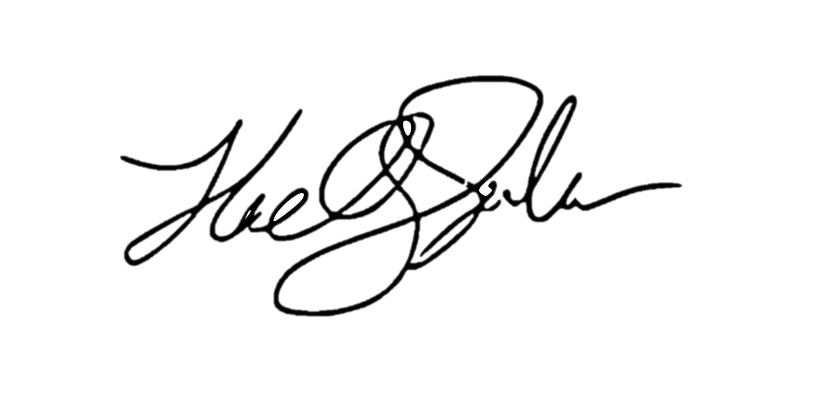
ROI of spending 1 hour a day
learning for a 1% increase
5x (1 year)
4x (10 months)
Output
2x (6 months)
3x (8.5 months)
28 days
Llewellyn Falco

Slide 22
Homework Assignment

Slide 23
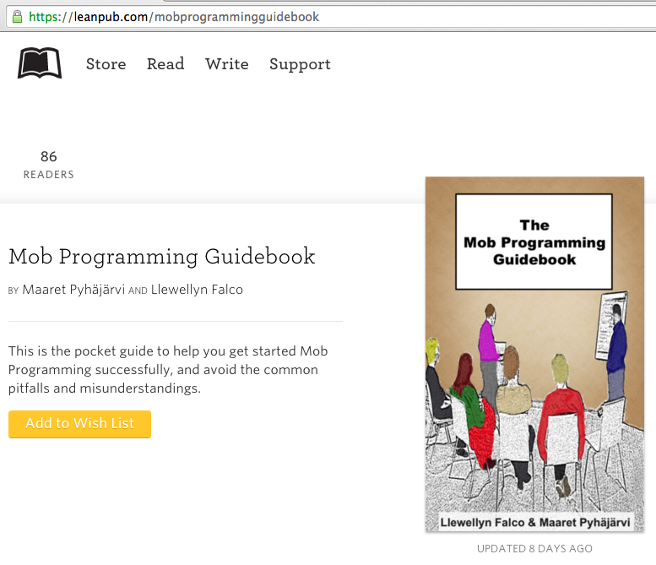
#MobProgrammingGuidebook

Slide 24
Thank you.
@maaretp
@LlewellynFalco
(please connect with us through Twitter or LinkedIn)

