Slide 1
Strong-Style Pairing
Maaret Pyhäjärvi & Llewellyn Falco

Slide 2
Except…

Slide 3
Benefits of working together

Slide 4
Wasted Effort effort building wrong thing effort testing effort fixing
@maaretp

Slide 5
Time to deliver
@LlewellynFalco

Slide 6
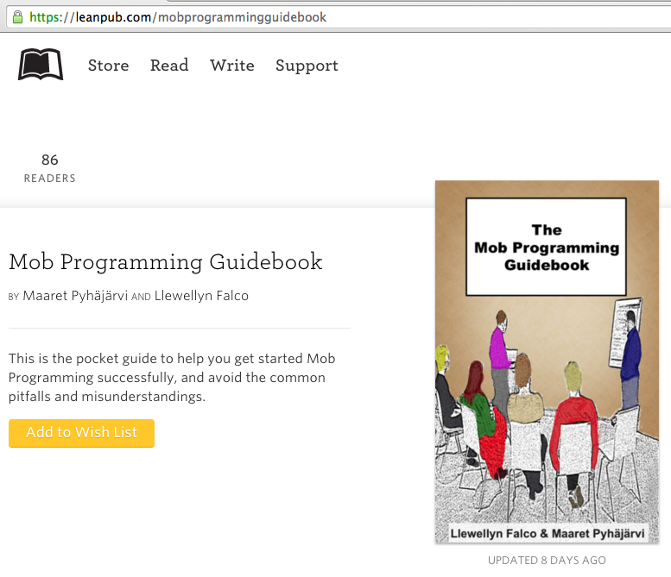
#MobProgrammingGuidebook

Slide 7
Thank you.
@maaretp
@LlewellynFalco
(please connect with us through Twitter or LinkedIn)

