Slide 1
Strong-Style Pairing
Maaret Pyhäjärvi & Llewellyn Falco

Slide 2
In the beginning (stories of pairing with Llewellyn)

Slide 3
What is Strong Style?

Slide 4
“For an idea to go from your head to the computer it must go through someone else’s hands”

Slide 5
In the beginning (stories of Maaret watching other people work)

Slide 6
Lines
@maaretp

Slide 7
Being a good driver/navigator

Slide 8
Highest level of abstraction Intent Location Details

Slide 9
Language (demo) normal strong strong
@LlewellynFalco

Slide 10
Rules of Improv Agree Yes, and… Statements there are no mistakes

Slide 11
Rules of Pairing Try it Yes, and… Do first, explain later Look for wins

Slide 12
Language (Exercise)
@maaretp

Slide 13
How to start pairing.

Slide 14
Trust is built on Many small successes

Slide 15
Coding exercise
@LlewellynFalco

Slide 16
Fizz Buzz 1, 2, Fizz, 4, Buzz, Fizz, 7, 8, Fizz, Buzz, 11, Fizz, 13, 14, FizzBuzz, 16, 17, Fizz, 19, Buzz
@LlewellynFalco

Slide 17
Mobbing exercise
@maaretp

Slide 18
Reese’s exercise
@LlewellynFalco

Slide 19
Switching on time on task on idea

Slide 20
Homework Assignment
@LlewellynFalco

Slide 21
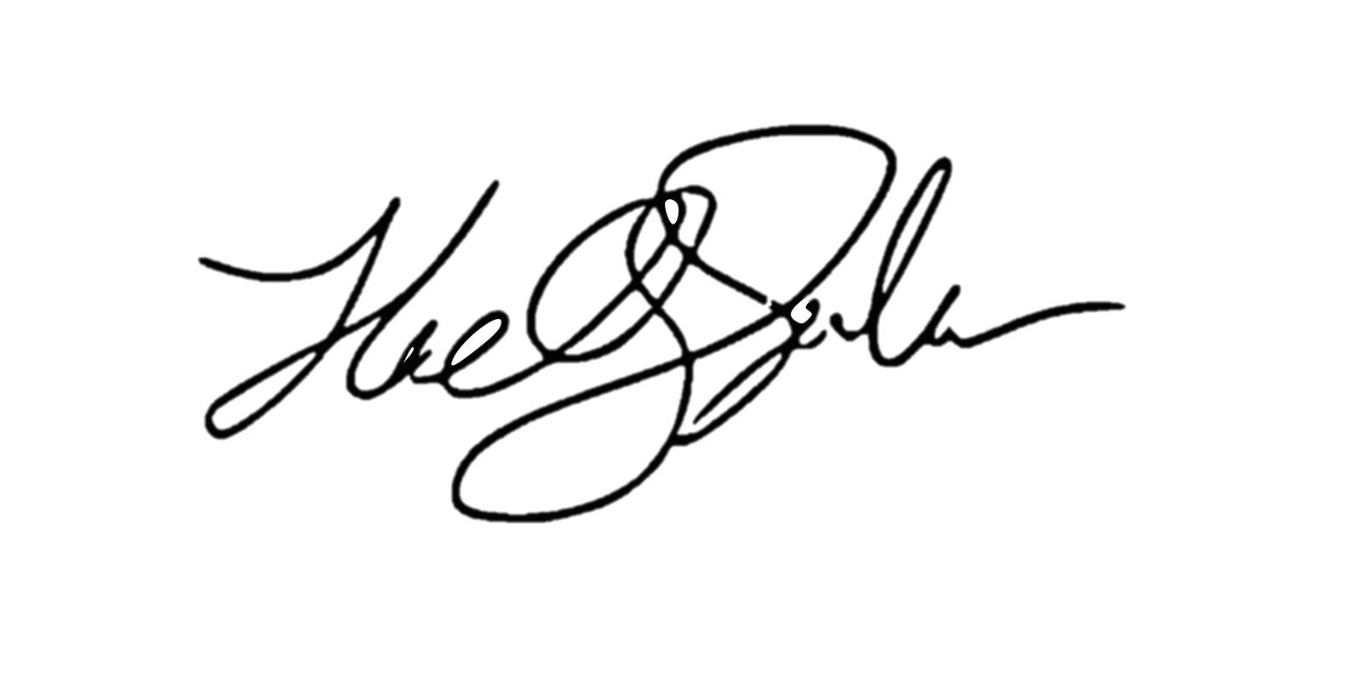
ROI of spending 1 hour a day
learning for a 1% increase
5x (1 year)
4x (10 months)
Output
2x (6 months)
3x (8.5 months)
28 days
Llewellyn Falco

Slide 22
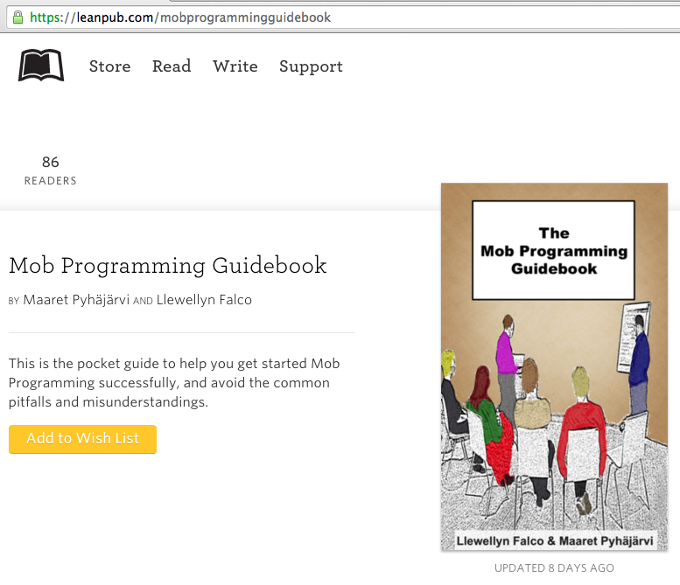
#MobProgrammingGuidebook

Slide 23
Thank you.
@maaretp
@LlewellynFalco
(please connect with us through Twitter or LinkedIn)

