Slide 1
Analyzers in .NET
An overview of .NET analyzers, and how to create a custom one

Slide 2
Types of knowledge
PROFICIENCY
FLUENCY
AWARENESS

Slide 3
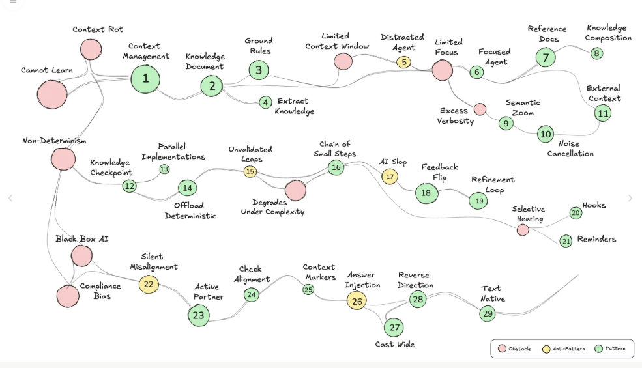

Lada Kesseler

Slide 4
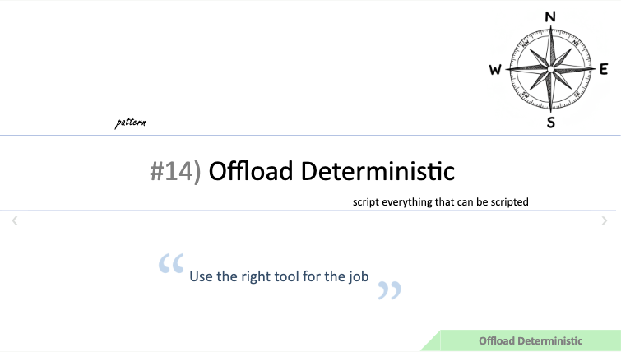
https://talks.ai-coding-patterns.dev/socrates-2026/slides/#offload-deterministic/1

Slide 5
How analyzers plug into a .csproj
MyApp.csproj
<ItemGroup>
<PackageReference
Include="StyleCop.Analyzers"
Version="1.1.118"
PrivateAssets="all" />
</ItemGroup>
Add the NuGet package
Roslyn loads it at compile time
.editorconfig
dotnet_diagnostic.SA1503.severity
= error
Squiggles in the IDE, warnings or errors in the build

Slide 6
ECOSYSTEM · AZURE_FUNCTIONS_0001
AzureFunctionAnalyzers
Fixes: class names that drift from function names
Wrong
public class Orders
{
[Function("GetOrder")]
public Task Run(...) { ... }
}
Right
public class GetOrder
{
[Function("GetOrder")]
public Task Run(...) { ... }
}

Slide 7
STYLE · SA1503
StyleCop.Analyzers
Fixes: omitted braces
Wrong
if (x) return;
Right
if (x) { return; }

Slide 8
CORRECTNESS · [Id] attribute
StrongIdAnalyzer
Fixes: IDs crossed between domain types
Wrong
void Ship([Id("Order")] Guid orderId) { }
[Id("Customer")] Guid customerId = Guid.NewGuid();
Ship(customerId); // Customer ID passed as Order ID
Right
[Id("Order")] Guid orderId = Guid.NewGuid();
Ship(orderId);

Slide 9
CORRECTNESS · [Id] attribute
StrongIdAnalyzer
Fixes: IDs crossed between domain types
Wrong
void Ship(Guid orderId) { }
Guid customerId = Guid.NewGuid();
Ship(customerId); // Customer ID passed as Order ID
Right
Guid orderId = Guid.NewGuid();
Ship(orderId);

Slide 10
CORRECTNESS · [StringSyntax] attribute
StringSyntaxAttributeAnalyzer
Fixes: strings passed to the wrong syntax
Wrong
void Match(
[StringSyntax(StringSyntaxAttribute.Regex)] string pattern) { }
[StringSyntax(StringSyntaxAttribute.Json)] string json = "{}";
Match(json); // Json passed where Regex expected
Right
[StringSyntax(StringSyntaxAttribute.Regex)] string pattern = @"^\d+$";
Match(pattern);

Slide 11
GENERAL · RCS1118
Roslynator
Fixes: locals that should be const
Wrong
int max = 5;
Right
const int max = 5;

Slide 12
GENERAL · MA0006
Meziantou.Analyzer
Fixes: ambiguous string comparison
Wrong
if (a == b) { }
Right
if (string.Equals(a, b, StringComparison.Ordinal)) { }

Slide 13
CORRECTNESS · ERP022
ErrorProne.NET
Fixes: swallowed exceptions
Wrong
try { Save(); } catch { }
Right
try { Save(); }
catch (Exception e)
{
logger.LogError(e, "Save failed");
throw;
}

Slide 14
GENERAL · GU0011
Gu.Analyzers
Fixes: ignored return values
Wrong
name.Trim();
Right
name = name.Trim();

Slide 15
GENERAL
Wintellect.Analyzers
Fixes: opaque objects in the debugger
Wrong
public class Order { public int Id; public string Name; }
Right
[DebuggerDisplay("{Id}: {Name}")]
public class Order { public int Id; public string Name; }

Slide 16
GENERAL · CA1822
Microsoft.CodeAnalysis.NetAnalyzers
Fixes: instance members that should be static
Wrong
public int Add(int a, int b) => a + b;
Right
public static int Add(int a, int b) => a + b;

Slide 17
CONCURRENCY · AsyncFixer02
AsyncFixer
Fixes: blocking calls in async code
Wrong
async Task Run() { Thread.Sleep(1000); }
Right
async Task Run() { await Task.Delay(1000); }

Slide 18
CONCURRENCY · IDISP001
IDisposableAnalyzers
Fixes: leaked disposables
Wrong
var stream = File.OpenRead(path);
Right
using var stream = File.OpenRead(path);

Slide 19
SECURITY · S2068
SonarAnalyzer for C#
Fixes: hard-coded credentials
Wrong
var password = "hunter2";
Right
var password = config["Db:Password"];

Slide 20
SECURITY · SCS0002
Security Code Scan
Fixes: SQL injection
Wrong
new SqlCommand("SELECT * FROM Users WHERE Id=" + id, conn);
Right
var cmd = new SqlCommand("SELECT * FROM Users WHERE Id=@id", conn);
cmd.Parameters.AddWithValue("@id", id);

Slide 21
SECURITY · DS126858
Microsoft DevSkim
Fixes: weak hash algorithms
Wrong
var hash = MD5.Create();
Right
var hash = SHA256.Create();

Slide 22
SECURITY · cs/sql-injection
CodeQL
Fixes: SQL injection across methods
Wrong
var id = Request.Query["id"];
var sql = Build(id); // returns "... WHERE Id=" + id
db.ExecuteSqlRaw(sql);
Right
db.Users.FromSqlInterpolated($"SELECT * FROM Users WHERE Id={id}");

Slide 23
SECURITY
Snyk Code
Fixes: tainted input that crosses files
Wrong
var sql = "SELECT * FROM Users WHERE Name='"
+ Request.Query["name"] + "'";
Right
var cmd = new SqlCommand("SELECT * FROM Users WHERE Name=@name", conn);
cmd.Parameters.AddWithValue("@name", (string)Request.Query["name"]);

Slide 24
TESTING · xUnit2013
xUnit.net Analyzers
Fixes: unclear collection-size asserts
Wrong
Assert.Equal(0, items.Count);
Right
Assert.Empty(items);

Slide 25
TESTING · NS1000
NSubstitute.Analyzers.CSharp
Fixes: mock setups that silently do nothing
Wrong
class Repo { public int Count() => 0; }
sub.Count().Returns(5); // non-virtual, setup does nothing
Right
class Repo { public virtual int Count() => 0; }
sub.Count().Returns(5);

Slide 26
ECOSYSTEM · Serilog006
SerilogAnalyzer
Fixes: inconsistent log property names
Wrong
log.Information("Got {userId}", id);
Right
log.Information("Got {UserId}", id);

Slide 27
ECOSYSTEM · API1000
Microsoft.AspNetCore.Mvc.Api.Analyzers
Fixes: undocumented response codes
Wrong
[ProducesResponseType(200)]
public IActionResult Get(int id) => NotFound();
Right
[ProducesResponseType(200)]
[ProducesResponseType(404)]
public IActionResult Get(int id) => NotFound();

Slide 28
ARCHITECTURE · Loop can be converted to LINQ
ReSharper
Fixes: hand-written loops LINQ can replace
Wrong
var result = new List<int>();
foreach (var n in nums) if (n > 0) result.Add(n);
Right
var result = nums.Where(n => n > 0).ToList();

Slide 29
ARCHITECTURE · CQLinq: namespaces mutually dependent
NDepend
Fixes: circular namespace dependencies
Wrong
namespace Orders { class Order { Billing.Invoice I; } }
namespace Billing { class Invoice { Orders.Order O; } }
Right
namespace Contracts { interface IOrder { } interface IInvoice { } }
namespace Orders { class Order : IOrder { IInvoice I; } }
namespace Billing { class Invoice : IInvoice { IOrder O; } }

Slide 30
Example
A small rant…

Slide 31
# Project
This is a .net analyzer that flags the use of the greater than sign (>) in code.
It should also have a auto fixer that replaces the greater than sign with a less than sign (<) and flips values so it's a pure refactoring.
this also includes <=
if multiple numbers are involved it should also order from smaller to larger.
So
5 > x && x > 2
should become
2 < x && x < 5
# Project Structure
Scripts: build_and_test.sh
Unit tests: use xunit
CI: Github actions
build and test (uses the script) on push
publish, on github deploy, version from tag (example tag: v1.2.3)
Nuget: publishes the

Slide 32
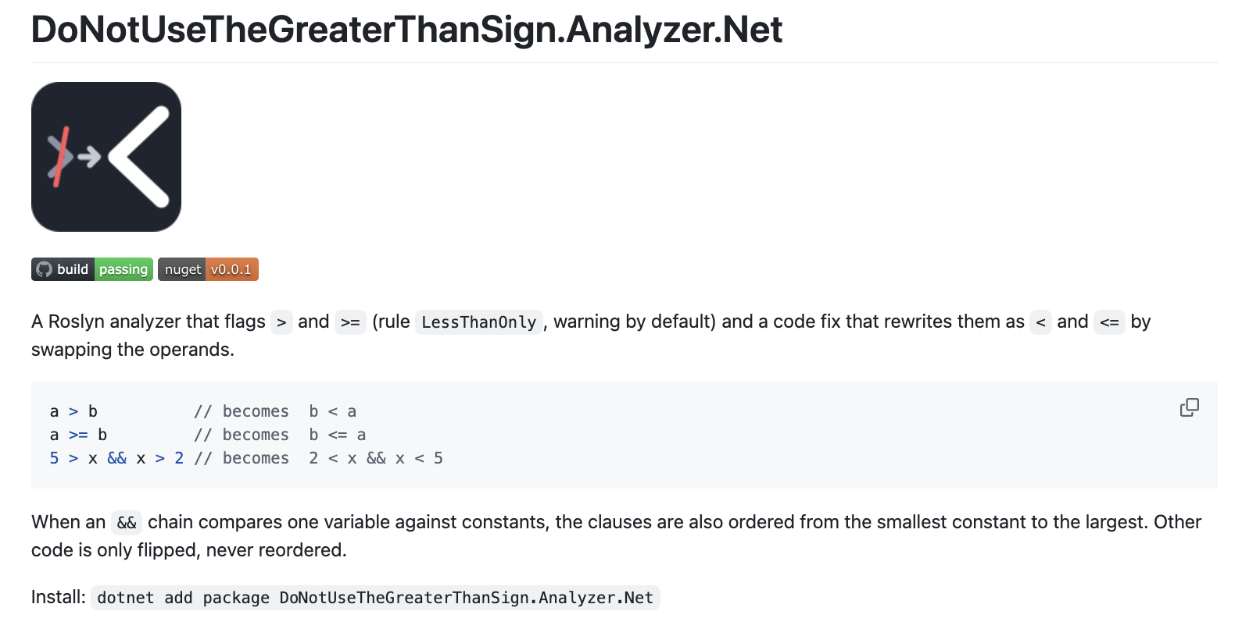
https://github.com/LearnWithLlew/DoNotUseTheGreaterThanSign.Analyzer.Net

Slide 33

Thank you
Llewellyn Falco
github.com/isidore/Talks/blob/master/Analyzers.Net.md

Slide 34
Style Guide
Color Palette
#1F3A5F
#415A77
#5A7D5A
#A14B4B
#6B7280
#DCE3EC
Navy
Primary
Slate
Secondary
Green
Accent
Rust
Alert
Gray
Neutral
Light
Text/BG
Typography
Components
Title — 32pt Bold
Card Title
Supporting body text with an accent highlight
Step
Card Header — 18pt Bold
Body Text — 14pt Regular

Slide 35
Design Philosophy
Every choice in this system serves one goal: making complex ideas clear, easy to visualize, and easy to follow
01
Clarity over decoration
Structure carries the meaning.
Color and shape signal hierarchy and state
Never ornament for its own sake.
02
Calm, confident palette
Navy and slate set a steady tone.
Green and rust appear sparingly.
Color marks safe and risk — nothing more.
03
Consistent components
Rounded cards and arrows repeat.
One visual grammar across slides.
Every new slide fits the system.
04
Scannable by design
Lead with the takeaway.
Short lines over dense paragraphs.
Limited attention is a constraint, not an afterthought.

