Slide 1
Working with AI
My first 4 weeks at a new company

Slide 2
github.com/isidore/Talks/blob/master/WorkingWithAI.md

Slide 3


Slide 4

Jonathan

Slide 5
VUE.JS • ASP.NET • EF
SQL
50K Lines

Slide 6
Knowledge
+
Tools
+
Feedback
Small Steps + Focus

Slide 7

Database
Tests
Nullables

Slide 8
Database
150 MB
Backups
none → 1600 MB → 150 MB
94 → 65
Tables
25
Schema Updates
54
Dead Columns Removed

Slide 9
How did we get there?

Slide 10
The check list
[ ] AI can’t see the Database
[ ] Country abbreviations have extra space
[ ] …

Slide 11
./query_staging.sh
Tools
Exploring Data
query_staging "select * from dbo.company" # inline query
query_staging -f query.sql # from file
type query.sql | query_staging # piped stdin

Slide 12
./query_staging.sh
Tools
> ./query_staging.sh "select * from MetaInformation"
| Id | Key | Value |
| -- | -------------- | ----- |
| 1 | schema_version | 25 |
Knowledge
> ./query_staging.sh "select schem from MetaInformation"
Exception: Invalid column name 'schem'.
Feedback
Knowledge
> ./query_staging.sh "drop table MetaInformation"
Exception: Read-Only Queries Only
+
Feedback
=
Guidance

Slide 13
The check list
[X] AI can’t see the Database
[ ] Country abbreviations have extra space
[ ] …
"US "
"CA "

Slide 14
Knowledge
What schema version is the Database?
How do I update it?

Slide 15
What version is the Database?
dbo.MetaInformation
Id | Key | Value
1 | schema_version | 1
Knowledge
Tools
Schema_Update.1.sql
Schema_Update.2.sql
Schema_Update.3.sql
Schema_Update.4.sql
Schema_Update.5.sql
Schema_Update.6.sql
Schema_Update.7.sql
Schema_Update.8.sql

Slide 16
update-database-schema.process.md
Knowledge
Updating the Database Schema
This describes the process for updating the database schema and how it is done.
Schema Aware Database
The database has a table called MetaInformation that contains a single row with the current schema version.
Updates
The directory Schema_Updates contains all the SQL scripts that are used to update the database schema. Each script is named with the version number it updates to, for example: Schema_Update.1.sql These files are deployed to the backend server. The biggest number is the latest version. Each Schema Update:
Validates it is on the previous Schema.
Updates the database schema and any data cleanliness issues.
Updates the MetaInformation table with the new schema version.
Mechanism
When the backend server starts it checks the MetaInformation table for the current schema version. If the current schema version is less than the latest schema version, it will run all the Schema Update scripts in order until it reaches the latest version.
Step 0
Schema Version 1 involves checking that the meta version does not exist and creating the MetaInformation table with the initial schema version.
Skill: Adding a New Schema Update
Follow these steps when you need to make a schema/data change:
Find the current latest version by looking at the highest-numbered file in backend/MemberPortal/Backend/Schema_Updates/ (e.g. Schema_Update.1.sql means the latest version is 1).
Create a new file named Schema_Update.<next_version>.sql in that same directory, where <next_version> is the latest version + 1.
Write the script so it:
Validates the database is on the expected previous version (e.g. check MetaInformation for schema_version = <previous_version>, and abort/raise an error if not).
Makes the schema and/or data changes for this update.
Updates the MetaInformation row to set Value = '<next_version>' where Key = 'schema_version'.
Prefer plain, explicit statements (e.g. one ALTER TABLE ... DROP COLUMN per line) over loops/cursors/dynamic SQL, even if more verbose — readability over cleverness.
Do not modify any existing Schema_Update.*.sql files — each one is an immutable step in history. If you got something wrong, add a new script to fix it forward.
No backend code changes are needed for a normal update — SchemaUpdateService (backend/MemberPortal/Backend/Services/Impl/SchemaUpdateService.cs) automatically discovers and runs any pending scripts in order at startup.
The .csproj already copies everything in Schema_Updates\**\* to the output directory, so a new script is deployed automatically — no project file changes needed.
Before committing, test the script against staging with test-database-update.cmd <version> (see below) to confirm it applies cleanly. Never modify the script afterward to fix a failure it reveals — fix forward with a new script per rule 4.
Testing a Schema Update
test-database-update.cmd <version> runs a single Schema_Update.<version>.sql script against staging inside a transaction that is always rolled back, then reports success or failure.

Slide 17
Schema_Update.1.sql
IF EXISTS (SELECT 1 FROM INFORMATION_SCHEMA.TABLES WHERE TABLE_NAME = 'MetaInformation')
BEGIN
RAISERROR('Schema_Update.1.sql: MetaInformation already exists; expected no prior schema.', 16, 1);
RETURN;
END
CREATE TABLE dbo.MetaInformation (
Id INT NOT NULL IDENTITY(1,1) PRIMARY KEY,
[Key] NVARCHAR(100) NOT NULL,
[Value] NVARCHAR(MAX) NOT NULL
);
INSERT INTO dbo.MetaInformation ([Key], [Value])
VALUES ('schema_version', '1');
Check Version
Change Schema
Update Version

Slide 18
Schema_Update.2.sql
IF NOT EXISTS (SELECT 1 FROM dbo.MetaInformation WHERE [Key] = 'schema_version' AND [Value] = '1')
BEGIN
RAISERROR('Schema_Update.2.sql: expected schema_version 1.', 16, 1);
RETURN;
END
ALTER TABLE dbo.Country
ALTER COLUMN Abbreviation NVARCHAR(3) NULL;
UPDATE dbo.Country
SET Abbreviation = RTRIM(Abbreviation);
UPDATE dbo.MetaInformation
SET [Value] = '2'
WHERE [Key] = 'schema_version';
Check
Change
Schema Version

Slide 19
prompt:
Please read @update-database-schema.process.md
The country table returns spaces in the Abbreviation. Please fix this

Slide 20
Testing Schema Updates
BEGIN TRANSACTION;
IF NOT EXISTS (SELECT 1 FROM dbo.MetaInformation WHERE [Key] = 'schema_version' AND [Value] = '1')
BEGIN
RAISERROR('Schema_Update.2.sql: expected schema_version 1.', 16, 1);
RETURN;
END
ALTER TABLE dbo.Country
ALTER COLUMN Abbreviation NVARCHAR(3) NULL;
UPDATE dbo.Country
SET Abbreviation = RTRIM(Abbreviation);
UPDATE dbo.MetaInformation
SET [Value] = '2'
WHERE [Key] = 'schema_version';
ROLLBACK TRANSACTION;

Slide 21
Tools
Testing Schema Updates
Feedback
> test-database-update.cmd 22
SUCCESS

Slide 22
The check list
[X] AI can’t see the Database
[X] Country abbreviations have extra space
[ ] Make a backup of production

Slide 23
Tools
backup-production.cmd
create-schedule-task.cmd
restore-local.cmd
restore-staging.cmd

Slide 24
Tools
backup-production.cmd
create-schedule-task.cmd
restore-local.cmd
restore-staging.cmd
90 mins → 1.6 GB
2 mins
90 mins

Slide 25
- __MigrationHistory
- AccreditationStatus
- Addresses
- aspnet_Applications
- aspnet_Membership
- aspnet_Paths
- aspnet_PersonalizationAllUsers
- aspnet_PersonalizationPerUser
- aspnet_Profile
- aspnet_Roles
- aspnet_SchemaVersions
- aspnet_Users
- aspnet_UsersInRoles
- aspnet_WebEvent_Events
- AuditLog
- Authorizations
- Authorizations_backup
- Authorizations_Backup07242020
- Authorizations_Backup10282020_1055
- Authorizations_Backup10302020_1000
- Authorizations_Backup10302020_1410
- Authorizations_Backup_05132022
- Certification
- Certification_Course
- Certification_PrerequisiteCertification
- Certification_Theme
- CertificationEarnedMethods
- CertificationsEarned
- CertificationType
- Class
- Class_Backup20201021_1522
- Class_Instructor
- ClassAddress
- ClassInstructor
- ClassSchedule
- ClassSchedule_Backup092820201606
- ClassSchedule_Backup20201021_1522
- ClassSurveyResponses
- ClassSurveys
- ClassType
- Company
- Company_UserProfile_Role
- CompanyLanguage
- CompanyRegion
- CompanyType
- Country
- Course
- CourseAccreditations
- CourseInstructor
- CourseOfferedBy
- DomainCompetencies
- ELMAH_Error
- ELMAH_Error20191023
- EmailChangeRequest
- Event
- Event_Company
- Event_LearningObjective
- EventAttendees
- ExpertCertification_User_Details
- ICPEquivWaiver
- Instructors
- Language
- LearningObjective
- MicroCredentialUnitConversionLog
- PartnerRecognitionProgram
- PasswordLinkToken
- PaymentErrors
- PaymentHistories
- PaymentHistories_042122_Backup
- PaymentLog
- PreRoster
- QBMapping
- QuickbooksTokens
- Region
- Roster
- SessionTypes
- ShowTrackForPublic
- ShowTrackForUser
- StaticRedirects
- Subject
- Subject_Theme
- Survey
- SurveyAnswers
- SurveyAvailableAnswers
- SurveyQuestions
- SurveyQuestionTypes
- Theme
- Theme_LearningObjective
- Track
- Track_Subject
- TrackDesigners
- UserInterestCertifications
- UserProfile
- UserProfile_Class_Details

Slide 26
prompt:
Focus
Please inspect the database and the code and make a list of all the tables that are no longer used. Place it in @abandoned-tables.md
/clear
Interface
Please read @update-database-schema.process.md and @abandoned-tables.md Please remove these tables

Slide 27
backup-production.cmd
90 mins
1600 MB
→
→
2 mins
150 MB

Slide 28
- __MigrationHistory
- AccreditationStatus
- Addresses
- aspnet_Applications
- aspnet_Membership
- aspnet_Paths
- aspnet_PersonalizationAllUsers
- aspnet_PersonalizationPerUser
- aspnet_Profile
- aspnet_Roles
- aspnet_SchemaVersions
- aspnet_Users
- aspnet_UsersInRoles
- aspnet_WebEvent_Events
- AuditLog
- Authorizations
- Authorizations_backup
- Authorizations_Backup07242020
- Authorizations_Backup10282020_1055
- Authorizations_Backup10302020_1000
- Authorizations_Backup10302020_1410
- Authorizations_Backup_05132022
- Certification
- Certification_Course
- Certification_PrerequisiteCertification
- Certification_Theme
- CertificationEarnedMethods
- CertificationsEarned
- CertificationType
- Class
- Class_Backup20201021_1522
- Class_Instructor
- ClassAddress
- ClassInstructor
- ClassSchedule
- ClassSchedule_Backup092820201606
- ClassSchedule_Backup20201021_1522
- ClassSurveyResponses
- ClassSurveys
- ClassType
- Company
- Company_UserProfile_Role
- CompanyLanguage
- CompanyRegion
- CompanyType
- Country
- Course
- CourseAccreditations
- CourseInstructor
- CourseOfferedBy
- DomainCompetencies
- ELMAH_Error
- ELMAH_Error20191023
- EmailChangeRequest
- Event
- Event_Company
- Event_LearningObjective
- EventAttendees
- ExpertCertification_User_Details
- ICPEquivWaiver
- Instructors
- Language
- LearningObjective
- MicroCredentialUnitConversionLog
- PartnerRecognitionProgram
- PasswordLinkToken
- PaymentErrors
- PaymentHistories
- PaymentHistories_042122_Backup
- PaymentLog
- PreRoster
- QBMapping
- QuickbooksTokens
- Region
- Roster
- SessionTypes
- ShowTrackForPublic
- ShowTrackForUser
- StaticRedirects
- Subject
- Subject_Theme
- Survey
- SurveyAnswers
- SurveyAvailableAnswers
- SurveyQuestions
- SurveyQuestionTypes
- Theme
- Theme_LearningObjective
- Track
- Track_Subject
- TrackDesigners
- UserInterestCertifications
- UserProfile
- UserProfile_Class_Details

Slide 29
- __MigrationHistory
- AccreditationStatus
- Addresses
- aspnet_Applications
- aspnet_Membership
- aspnet_Paths
- aspnet_PersonalizationAllUsers
- aspnet_PersonalizationPerUser
- aspnet_Profile
- aspnet_Roles
- aspnet_SchemaVersions
- aspnet_Users
- aspnet_UsersInRoles
- aspnet_WebEvent_Events
- AuditLog
- Authorizations
- Authorizations_backup
- Authorizations_Backup07242020
- Authorizations_Backup10282020_1055
- Authorizations_Backup10302020_1000
- Authorizations_Backup10302020_1410
- Authorizations_Backup_05132022
- Certification
- Certification_Course
- Certification_PrerequisiteCertification
- Certification_Theme
- CertificationEarnedMethods
- CertificationsEarned
- CertificationType
- Class
- Class_Backup20201021_1522
- Class_Instructor
- ClassAddress
- ClassInstructor
- ClassSchedule
- ClassSchedule_Backup092820201606
- ClassSchedule_Backup20201021_1522
- ClassSurveyResponses
- ClassSurveys
- ClassType
- Company
- Company_UserProfile_Role
- CompanyLanguage
- CompanyRegion
- CompanyType
- Country
- Course
- CourseAccreditations
- CourseInstructor
- CourseOfferedBy
- DomainCompetencies
- ELMAH_Error
- ELMAH_Error20191023
- EmailChangeRequest
- Event
- Event_Company
- Event_LearningObjective
- EventAttendees
- ExpertCertification_User_Details
- ICPEquivWaiver
- Instructors
- Language
- LearningObjective
- MicroCredentialUnitConversionLog
- PartnerRecognitionProgram
- PasswordLinkToken
- PaymentErrors
- PaymentHistories
- PaymentHistories_042122_Backup
- PaymentLog
- PreRoster
- QBMapping
- QuickbooksTokens
- Region
- Roster
- SessionTypes
- ShowTrackForPublic
- ShowTrackForUser
- StaticRedirects
- Subject
- Subject_Theme
- Survey
- SurveyAnswers
- SurveyAvailableAnswers
- SurveyQuestions
- SurveyQuestionTypes
- Theme
- Theme_LearningObjective
- Track
- Track_Subject
- TrackDesigners
- UserInterestCertifications
- UserProfile
- UserProfile_Class_Details

Slide 30
- __MigrationHistory
- AccreditationStatus
- Addresses
- aspnet_Applications
- aspnet_Membership
- aspnet_Roles
- aspnet_Users
- aspnet_UsersInRoles
- Authorizations
- Certification
- Certification_Course
- Certification_PrerequisiteCertification
- CertificationEarnedMethods
- CertificationsEarned
- CertificationType
- Class
- ClassAddress
- ClassInstructor
- ClassSchedule
- ClassSurveyResponses
- ClassSurveys
- ClassType
- Company
- Company_UserProfile_Role
- CompanyLanguage
- CompanyRegion
- CompanyType
- Country
- Course
- CourseInstructor
- CourseOfferedBy
- EmailChangeRequest
- EventAttendees
- ExpertCertification_User_Details
- ICPEquivWaiver
- Instructors
- Language
- MetaInformation
- PaymentHistories
- PaymentLog
- PreRoster
- QuickbooksTokens
- Region
- Roster
- SessionTypes
- ShowTrackForPublic
- ShowTrackForUser
- StaticRedirects
- Survey
- SurveyAnswers
- SurveyAvailableAnswers
- SurveyQuestions
- SurveyQuestionTypes
- Track
- Track_Subject
- UserProfile
- UserProfile_Class_Details

Slide 31
prompt:
Focus
Please inspect the database and the code and make a list indexes that would be most helpful based on the queries we run. Also, query the usage logs. Place it in @suggested-indexes.md
/clear
Interface
Please read @update-database-schema.process.md and @suggested-indexes.md Implement the top-suggested and next-suggested

Slide 32
UserProfile
Before
Schema update 22
After
42 columns
Removed 15 dead columns
27 columns
InstructorDiscount
DisplayCertSection
DisplayOtherCertSection
DisplayLearnTransSection
UsePrintedSig
isTranscriptSupressedinInstProfile
Region
isDefaultPassword
isInterestID
isInterestBuisness
isInterestLeadership
Salutation
HideICPEPLPanel
PasswordChangePending
Title

Slide 33
Knowledge
Tools
Feedback
15 markdown files
6 CLI Tools + Update Process
Can see and test
almost everything

Slide 34
Database
Tests
Nullables

Slide 35
Tests
Unit &
Full Stack
Tests
Reproduce
Production
Bugs
Test in CI
65% Coverage

Slide 36
How did we get there?

Slide 37
The check list
[ ] Run the server
[ ] Run the tests
[ ] …

Slide 38
./run.sh
Tools
> Terminal
> ./run.sh
Claude 1
Claude 2

Slide 39
./run.sh
Tools
> Terminal
> ./run.sh
> back_end
> front_end
Claude 1
Claude 2

Slide 40
./run.sh
Tools
Terminal
back_end
front_end
> ./run.sh
Claude 1
Claude 2

Slide 41
The check list
[ ] Run the server
[ ] Run the tests
[ ] …

Slide 42
Tools
build-and-test.sh
Feedback
> ./build-and-test.sh
Test summary: total: 1, failed: 0, succeeded: 1

Slide 43
Tools
./build-and-test.sh
Feedback
> ./build-and-test.sh
Warning ...
Warning ...
Warning ...
Warning ...
Warning ...
Warning ...
Warning ...
Warning ...
Warning ...
Warning ...
Warning ...
Warning ...
54 warnings
Test summary: total: 1, failed: 0, succeeded: 1

Slide 44
fix-warnings.process.md
Knowledge
Run build-and-test
Tools
Fix all warnings
of type X
Focus
Pick a warning
Repeat till done
2. build-and-test
F eedback
3. commit `! r fixed warning <type>

Slide 45
Feedback
Validate?
Let’s look at the commit…

Slide 46
Bug - Quickbooks

Slide 47
Knowledge
[Fact]
public async Task Test_QuickbooksCustomerSave()
{
var company = new Company
{
Id = 1,
Name = "Test Company",
BillingAddress = Address.CreateNull("old"),
QuickBooksId = "newQuickbooksId"
};
var logger = ConsoleLogger.CreateNull<QuickBooksService>();
var service = MemberOrganizationController.CreateNull(
QuickBooksService.CreateNull(logger));
var memberOrganization = MemberOrganizationDTO.CreateNull("new");
await service.SaveToQuickbooks("1", memberOrganization, company);
Approvals.Verify(logger.GetLog());
}
Tools
Arrange
Act

Slide 48
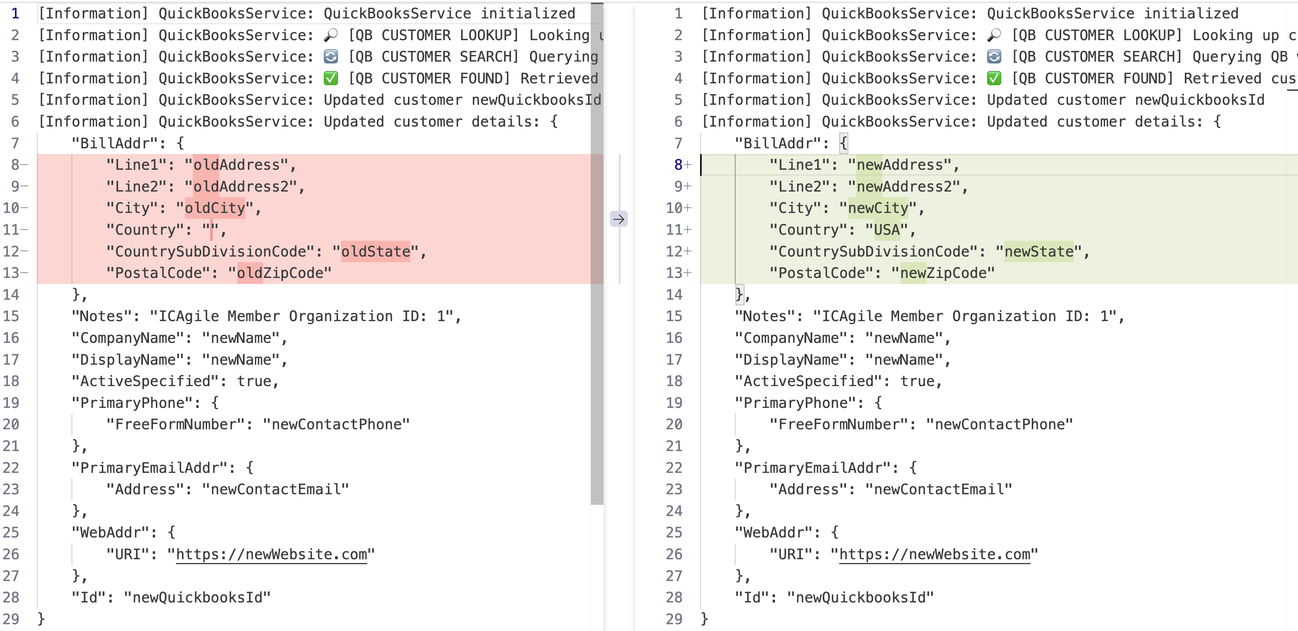
Feedback

Slide 49
prompt:
Run the test, they highlight a bug. Please fix it
Knowledge
+
Tools
+
Feedback
Focus
+
Small Step

Slide 50
Static Analysis

Slide 51
Tools
create-code-analysis.sh
Feedback
> ./create-code-analysis.sh
Cyclomatic complexity report written to .reports/cyclomatic-complexity.txt

Slide 52
prompt:
Read @reduce-complexity.process.md apply it to @cyclomatic-complexity.txt
Feedback
?

Slide 53
Coverage

Slide 54
Tools
create-code-coverage.sh
> ./create-code-coverage.sh
Coverage report generated at ...

Slide 55
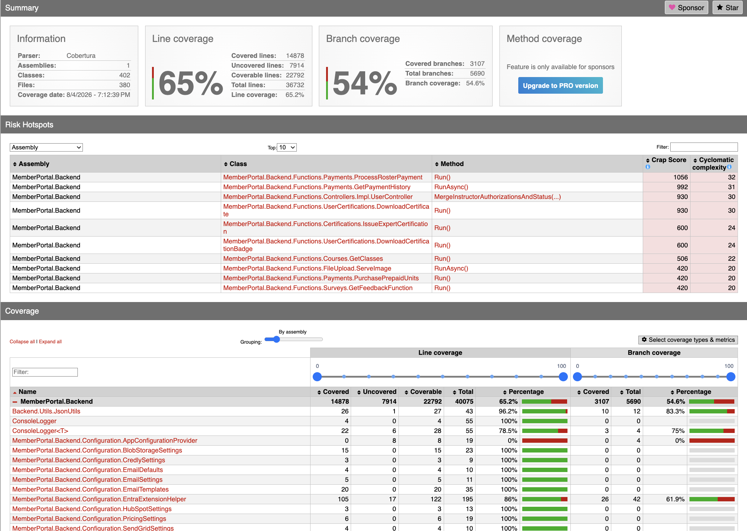
Feedback

Slide 56
prompt:
Run create-code-coverage.sh and create a list of the top classes that need
Tests. Place it in @InternalDocuments/increase_test_coverage.md

Slide 57
Side Note:
Knowledge
Property based test

Slide 58
Steve's coverage
kuoman/skills/pinning-test-builder

Slide 59
prompt:
Tools
/pinning-test-builder CourseController.cs

Slide 60
Static Analysis

Slide 61
prompt:
Read @reduce-complexity.process.md apply it to @cyclomatic-complexity.txt
Feedback

Slide 62
Database
Tests
Nullables

Slide 63
[Fact]
public async Task Test_QuickbooksCustomerSave()
{
var company = new Company
{
Id = 1,
Name = "Test Company",
BillingAddress = Address.CreateNull("old"),
QuickBooksId = "newQuickbooksId"
};
var logger = ConsoleLogger.CreateNull<QuickBooksService>();
var service = MemberOrganizationController.CreateNull(
QuickBooksService.CreateNull(logger));
var memberOrganization = MemberOrganizationDTO.CreateNull("new");
await service.SaveToQuickbooks("1", memberOrganization, company);
Approvals.Verify(logger.GetLog());
}

Slide 64
var service = MemberOrganizationController.CreateNull(
QuickBooksService.CreateNull(logger));
var service = new MemberOrganizationController();
var service = MemberOrganizationController.CreateNull();

Slide 65
Constructors

Slide 66
var service = MemberOrganizationController.CreateNull();
public static MemberOrganizationController CreateNull()
{
return new MemberOrganizationController(
null,
null,
null,
null,
null,
null,
null,
null,
null
);
}

Slide 67
var service = MemberOrganizationController.CreateNull();
public static MemberOrganizationController CreateNull()
{
return new MemberOrganizationController(
CompanyManager.CreateNull(),
LanguageManager.CreateNull(),
SurveyManager.CreateNull(),
BlobStorageService.CreateNull(),
HubSpotService.CreateNull(),
QuickBooksService.CreateNull(),
NullOptions.Create<QuickBooksSettings>(),
PaymentAuditService.CreateNull(),
ConsoleLogger.CreateNull<MemberOrganizationController>()
);
}

Slide 68
17 Create Nulls
MemberOrganizationController.CreateNull
├── CompanyManager.CreateNull
│ └── ICAgileDBContext.CreateNull
├── LanguageManager.CreateNull
│ └── ICAgileDBContext.CreateNull
├── SurveyManager.CreateNull
│ └── ICAgileDBContext.CreateNull
├── BlobStorageService.CreateNull
├── HubSpotService.CreateNull
│ └── ConsoleLogger.CreateNull<HubSpotService>
├── QuickBooksService.CreateNull
│ ├── QuickBooksTokenService.CreateNull
│ │ ├── QuickBooksTokenManager.CreateNull
│ │ │ ├── ICAgileDBContext.CreateNull
│ │ │ └── QuickbooksTokenValue.CreateNull
│ │ ├── ConsoleLogger.CreateNull<QuickBooksTokenService>
│ │ ├── QuickbooksApi.CreateNull
│ │ └── Clock.CreateNull
│ ├── ConsoleLogger.CreateNull<QuickBooksService>
│ └── QuickbooksHelperWrapper.CreateNull
├── PaymentAuditService.CreateNull
│ ├── PaymentHistoryManager.CreateNull
│ │ └── ICAgileDBContext.CreateNull
│ └── ConsoleLogger.CreateNull<PaymentAuditService>
└── ConsoleLogger.CreateNull<MemberOrganizationController>

Slide 69
CreateNull
Constructor Pattern
Call new() with a CreateNull for every parameter

Slide 70
Interfaces

Slide 71
public class ConsoleLogger<T> : ILogger<T>
{
public IDisposable BeginScope<TState>(TState _) => null!;
public bool IsEnabled(LogLevel logLevel) => true;
public void Log<TState>(
LogLevel logLevel, EventId eventId, TState state,
Exception? exception, Func<TState, Exception?, string> formatter) {}
}
public class ConsoleLogger
{
public static ConsoleLogger<TYPE> CreateNull<TYPE>()
{
return new ConsoleLogger<TYPE>();
}
}

Slide 72
CreateNull
Interface Pattern
Make NullInterface that returns reasonable defaults

Slide 73
Splitting

Slide 74
Database Calls: scattered → encapsulated → extracted
DataManager
1 Scattered calls
2 Encapsulated in methods
3 Extracted to a manager
red = database access

Slide 75
Database calls: scattered → encapsulated → extracted
DataManager
red = database access

Slide 76
Feedback
Validate?
Let’s look at the commit…

Slide 77
var service = MemberOrganizationController.CreateNull();

Slide 78
So what?!?

Slide 79
[Fact]
public async Task Test_QuickbooksCustomerSave()
{
var company = new Company
{
Id = 1,
Name = "Test Company",
BillingAddress = Address.CreateNull("old"),
QuickBooksId = "newQuickbooksId"
};
var logger = ConsoleLogger.CreateNull<QuickBooksService>();
var service = MemberOrganizationController.CreateNull(
QuickBooksService.CreateNull(logger));
var memberOrganization = MemberOrganizationDTO.CreateNull("new");
await service.SaveToQuickbooks("1", memberOrganization, company);
Approvals.Verify(logger.GetLog());
}

Slide 80
Feedback

Slide 81
[Fact]
public async Task Test_QuickbooksCustomerSave()
{
var company = new Company
{
Id = 1,
Name = "Test Company",
BillingAddress = Address.CreateNull("old"),
QuickBooksId = "newQuickbooksId"
};
var logger = ConsoleLogger.CreateNull<QuickBooksService>();
var service = MemberOrganizationController.CreateNull(
QuickBooksService.CreateNull(logger));
var memberOrganization = MemberOrganizationDTO.CreateNull("new");
await service.SaveToQuickbooks("1", memberOrganization, company);
Approvals.Verify(logger.GetLog());
}

Slide 82
MemberOrganizationController
QuickBooksService
var logger = ConsoleLogger.CreateNull<QuickBooksService>();
var service = MemberOrganizationController.CreateNull(
QuickBooksService.CreateNull(logger));
Logger

Slide 83
public static MemberOrganizationController CreateNull(
QuickBooksService? quickBooksService = null,
CompanyManager? companyManager = null,
LanguageManager? languageManager = null,
SurveyManager? surveyManager = null,
ILogger<MemberOrganizationController>? logger = null,
IBlobStorageService? blobStorageService = null,
HubSpotService? hubSpotService = null,
IOptions<QuickBooksSettings>? quickBooksSettings = null,
PaymentAuditService? paymentAuditService = null)
{
return new MemberOrganizationController(
companyManager ?? CompanyManager.CreateNull(),
languageManager ?? LanguageManager.CreateNull(),
surveyManager ?? SurveyManager.CreateNull(),
blobStorageService ?? BlobStorageService.CreateNull(),
hubSpotService ?? HubSpotService.CreateNull(),
quickBooksService ?? QuickBooksService.CreateNull(),
quickBooksSettings ?? NullOptions.Create<QuickBooksSettings>(),
paymentAuditService ?? PaymentAuditService.CreateNull(),
logger ?? ConsoleLogger.CreateNull<MemberOrganizationController>()
);
}

Slide 84
CreateNull
Dependence Injection Pattern
All Parameters Present but Optional

Slide 85
Side Note:
Knowledge
Property based test

Slide 86
Test_CreateNull_HasOptionalParameterForEachConstructorParameterType()
Tools
Feedback
CreateNull() params
Knowledge
Classes
Has CreateNull()
Every constructor type has an optional param
filter
Constructor params

Slide 87
In Summary
Database – Tools – Internal Documents – Code – Tests – Response Times - Deployments

Slide 88

Thank you
Llewellyn Falco
github.com/isidore/Talks/blob/master/WorkingWithAI.md

Slide 89
The Meta of the Talk
This page is not presented. It is notes for arch and message of the talk for the designers. Notes below.
Notes:
Always alter slides by making a copy directly after the slides and editing the copy I can see the differences. This also mean you can take bigger risks.
STYLE GUIDE (slides 13–14 ARE the spec — never edit them; match them):
• Palette: Navy #1F3A5F (primary), Slate #415A77 (secondary), Green #5A7D5A (safe/pass), Rust #A14B4B (risk/violation), Gray #6B7280 (neutral), Light #DCE3EC.
• Use green/rust ONLY to mark safe vs risk; navy/slate carry everything else.
• Type scale: Title 32pt Bold · Card Header 18pt Bold · Body 14pt. Cover hero larger.
• Fonts: Calibri for prose; Consolas for code, syntax-highlighted (keyword #93B8E6, string #BCE3BC, number/func #E6C77A, comment #9AA7B5, punctuation #C2CCD6, base #E8EDF3, JSON key #93B8E6).
• Components: rounded cards, ovals, arrow connectors — one visual grammar repeated on every slide.
• Philosophy: clarity over decoration; structure carries meaning; lead with the takeaway; short lines; scannable.
RULES FOR FUTURE EDITS: never touch the style-guide slides (13–14) or this Meta slide unless asked; keep one visual grammar; prefer more slides over dense ones; concrete examples win.

Slide 90
Style Guide
Color Palette
#1F3A5F
#415A77
#5A7D5A
#A14B4B
#6B7280
#DCE3EC
Navy
Primary
Slate
Secondary
Green
Accent
Rust
Alert
Gray
Neutral
Light
Text/BG
Typography
Components
Title — 32pt Bold
Card Title
Supporting body text with an accent highlight
Step
Card Header — 18pt Bold
Body Text — 14pt Regular

Slide 91
Design Philosophy
Every choice in this system serves one goal: making complex ideas clear, easy to visualize, and easy to follow
01
Clarity over decoration
Structure carries the meaning.
Color and shape signal hierarchy and state
Never ornament for its own sake.
02
Calm, confident palette
Navy and slate set a steady tone.
Green and rust appear sparingly.
Color marks safe and risk — nothing more.
03
Consistent components
Rounded cards and arrows repeat.
One visual grammar across slides.
Every new slide fits the system.
04
Scannable by design
Lead with the takeaway.
Short lines over dense paragraphs.
Limited attention is a constraint, not an afterthought.

