Slide 1
Collaborative Exploratory and Unit Testing Harnessing Insights to Protect Your Code
Maaret Pyhäjärvi & Llewellyn Falco
@maaretp & @llewellynfalco

Slide 2


Course Vision
Exploratory Tester
Extreme Programmer
PAIRING

Slide 3
THINGS TO LEARN TODAY
What is Unit Testing (Llewellyn way)
Collaboration of two different skill sets
What is Exploratory Testing (Maaret way)
Types of Insights
Doing Exploratory Testing
Doing Unit Testing
Tools: Mindmup & Approvals

Slide 4
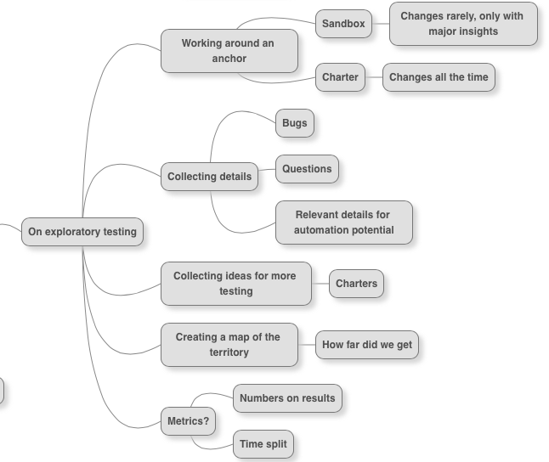
The Specifics of Exploratory Testing

Slide 5
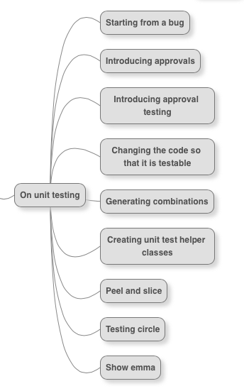
The Specifics of Unit Testing

Slide 6
How the Day Will Run
Getting to know you
Tools for today
“Bug database” as sticky notes
Mindmup
Eclipse & Approvals
Introducing the software to test
Sessions with observations
Exploratory testing in sessions
Unit testing in sessions
Wrap-up

Slide 7
Getting the Software to Test
http://darkfunction.com/editor/
➔ Download the jar
http://lfal.co/DfExamples
➔ Download as zip

Slide 8
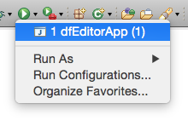
The App: Dark Function Editor
Eclipse:
Open dfEditorApp (Ctrl+Shift+T)
Run (Ctrl+F11)
A 2D sprite and animation tool for game developer
Two main uses:
Sprite sheet creator: Create sprite sheets by adding coordinates or by putting together individual sprites (New / Sprite sheet)
Image animator: Create animations from sprite sheets (New / Animation set)
Test data to start from:
In darkFunction-Editor/TestingResources/StarWarsImages/SWAll.sprites

Slide 9
Get in Touch
Maaret Pyhäjärvi
Email: maaret@iki.fi
Twitter: @maaretp
Blog: visible-quality.blogspot.fi
Llewellyn Falco
Email: isidore@setgame.com
Twitter: @llewellynfalco
Blog: llewellynfalco.blogspot.com

Slide 10
Charter 1: Mindmap of Features for Image Animator
Explore the product using mindmup.org to create an outline of functionalities to test in the application
Sharing notes to learn to identify functionalities as an exploratory tester
Test data to start from:
In darkFunction-Editor/TestingResources/StarWarsImages/SWAll.sprites

Slide 11
Charter 1I: Find Bugs in a Feature
Explore a feature of choice to identify bugs as in “anything that might bug a user”
Report issues in “Bug database” on the wall

Slide 12
Charter III: Exploring Code
Explore a the code to find something that
seems “unit-test-worthy” or
gives you ideas on what to test on the application that you recognize easier by seeing how it is implemented
Identify tasks for the whiteboard to consider

Slide 13
Exploratory Testing Concepts
Concept: Working around an anchor point
Sandbox
Charter
Concept: Continuous Plan
Concept: Details
Charters
Bugs
Functionality outline
Questions
What am I learning?
Automation ideas

