Slide 1
Collaborative Exploratory and Unit Testing Harnessing Insights to Protect Your Code
Maaret Pyhäjärvi & Llewellyn Falco
@maaretp & @llewellynfalco

Slide 2
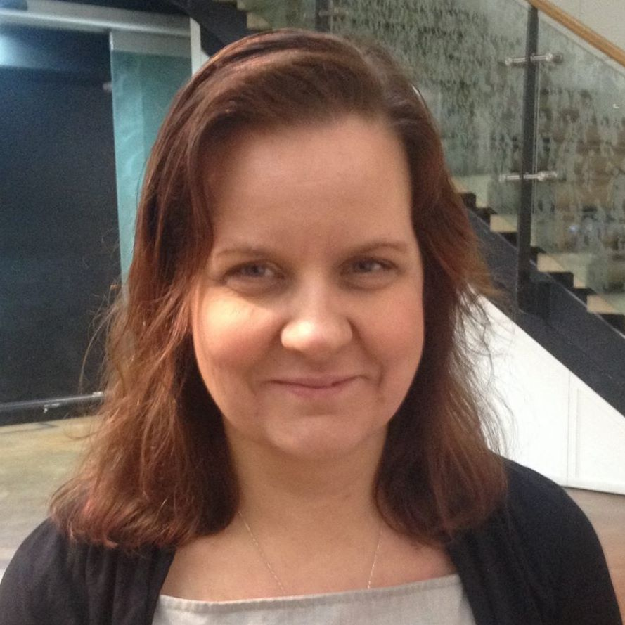

Course Vision
Exploratory Tester
Extreme Programmer

Slide 3
THINGS TO LEARN TODAY
What is Unit Testing (Llewellyn way)
Collaboration of two different skill sets
What is Exploratory Testing (Maaret way)

Slide 4
HOW THE DAY WILL RUN

Slide 5
DfEditor Intro

Slide 6
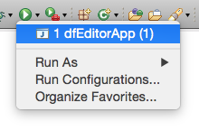
Running the app
Open dfEditorApp (Ctrl+Shift+T)
Run (Ctrl+F11)

Slide 7
SETTING ThiNGS UP WITH INTRODUCTION

