Slide 1
Collaborative Exploratory and Unit Testing
Maaret Pyhäjärvi & Llewellyn Falco
@maaretp & @LlewellynFalco

Slide 2
Today’s Outline
Course Principles
We go where they go
We shepherd if they go crazy
Intro
Lines (height, distance, name, testing, programming, , exploratory testing, automated testing, unit testing, Android & iPhone)
Strong Style Pairing Exercise Phone
How to obverse Patterns
Intro Mobbing
Exploratory Testing :
Explore Space – Build Map (very little guidance)
Basic use case (add guide)
Retro
Test Specific Area (animations)
(possible retro)
Report a bug
Retro
Unit Testing
Seams (Guided mob)
Retro
White board and multi-cases
Retro
Close
Palette Cleansing
Overall Retro
Closing Summary

Slide 3


Course Vision
Exploratory Tester
Extreme Programmer
MOB PROGRAMMING

Slide 4

Strong Style Pairing
“For an idea to go from your head to the computer it must go though someone else’s hands”
*http://llewellynfalco.blogspot.fi/2014/06/llewellyns-strong-style-pairing.html

Slide 5
THINGS TO LEARN TODAY
What is Unit Testing (Llewellyn way)
Collaboration of two different skill sets
What is Exploratory Testing (Maaret way)
Types of Insights
Doing Exploratory Testing
Doing Unit Testing
Tools: Mindmup & Approvals

Slide 6
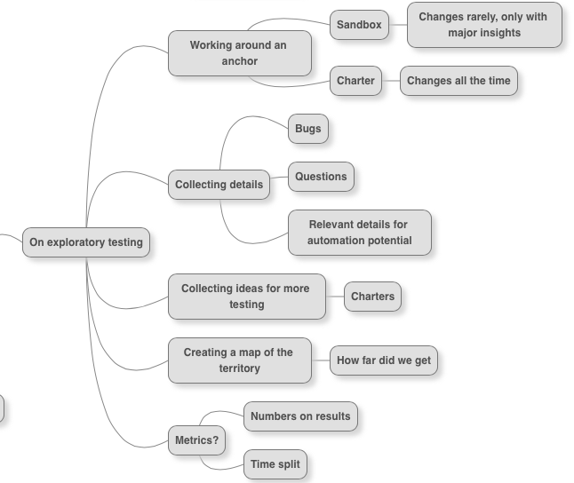
The Specifics of Exploratory Testing

Slide 7
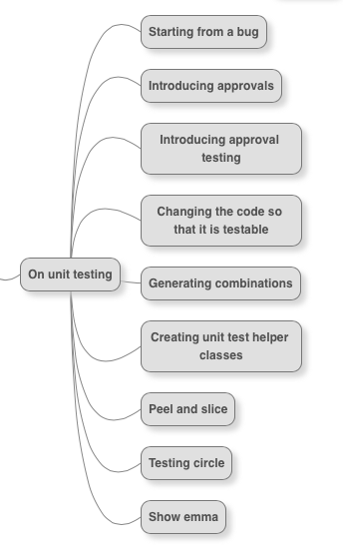
The Specifics of Unit Testing

Slide 8
Power of Collaboration
Quality

Slide 9
Power of Collaboration
Quality
“It’s about getting the best (not the most) out of everyone”

Slide 10
Mob Programming Rules for Exploratory Testing Activity
No thinking as the driver
Yes, and…
Kindness, consideration and respect

Slide 11
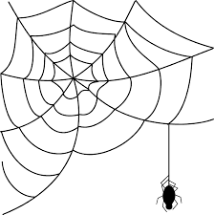
Testing as Performance (Exploring) vs. Testing as Artifact Creation

Slide 12
Explore with Intent
Mission
Charter
INTENT
Other Charters
Details
LEARNINGS

Slide 13
Structure Function Data Platform Operations Time

Slide 15
Looking at World from Different Angles
Certainty “I know what I know” Exploit
Caution “I know what I don’t know” Explore
Amnesia “I don’t know what I know” Expose
Ignorance “I don’t know what I don’t know” Experiment
Tester view
Unit Testing
Builder view
Exploratory Testing
Notes:
Unit testing focuses on what we know should exist.

Slide 16
What Testing Gives Us
Testing as performance
SPEC
FEEDBACK
REGRESSION
GRANULARITY
Unit Testing
GUIDANCE
UNDERSTANDING
MODELS
SERENDIPITY
Exploratory Testing
Testing as artifact creation
Notes:
“there’s a process of knowing” – learning
Does not give as regression; serendipity (safety against things happening randomly) / unwanted serendipity events.
This is what it is and what it could be. There’s a direction to it, not just statement of what it is.
Coaching is not just feedback, it’s pointing them to the right way.
Safety.
EXPERIENCE (the verb) rather than facts ; emotions over facts. REACTIONS.
HISTORY, Lessons learned, checklists. Modeling.
UNDERSTANDING – where you start (knowing the thing (code & environment), knowing the user, knowing the problems, knowing the developers (how to help them and what they do so that you can efficiently test), knowing the hackers (weird use cases outside common ‘have you tried reading it upside down’) , knowing all stakeholders, knowing the business priorities)
Uncovering things I cannot know, giving the application a change to reveal information for me.
This allows you to know things.

Slide 17
Exploration Skills Source: Adapted from James Bach, Jon Bach, Michael Bolton. Exploratory Testing Dynamics. v.2.2. 2009
Self-management
Developing ideas
Examining product
Done
To Do
Issues
Coverage
All sources available
Best use of time – effective and efficient work
Making models
Tool support – creative solutions
Risk-based testing – scientific approach
Keeping one’s eyes open

Slide 18
Exploratory Testing: Frame of Management
Coaching
Debriefing
Perception of quality and coverage
Quality Report
Past
Results
Obstacles
Outlook
Feelings
”A day’s work”
Test Manager
Vision (“Sandbox”)
Current Charter
Metrics summary
Tester
Other Charters
Details
#
Session sheets of the past testing
?
Charter backlog of the future testing
x
#, ?, x, +
Next in importance!
20:20:60
Idea of exploration
Bug Reports
Playbooks
Coverage outlines
Out of budget

Slide 19
Functional
All inputs in
Deterministic
All results out

Slide 20
NON-Functional
Get inputs as needed (global state, file, database…)
Result vary (dates, random, environment)
Store results (global, disk, database, transient)

Slide 21
Why functional is easier for tests
Unit Test
Production Code
Do
Verify

Slide 22
Why functional is easier for tests
Unit Test
Functional Harness
Production Code
Do
Verify

Slide 23
public static Output function(inputs)

Slide 24
Separating functional Pieces
List
Non-Functional
Functional

Slide 25
Separating functional Pieces
List
Non-Functional
List2
Functional

Slide 26
Peel
*http://lfal.co/PeelAndSlice

Slide 27
return sample
SLICE
*http://lfal.co/PeelAndSlice

Slide 28
Why is Testing Hard?
XPath
Finding Elements
Global state
Dates
Failure cases
Wait Times
Mobile
Setup
Lot’s of paths
Environment
Uncontrollable Variables
UI
Money
Dates
Database
Integration
Finding Elements
Timing

Slide 29
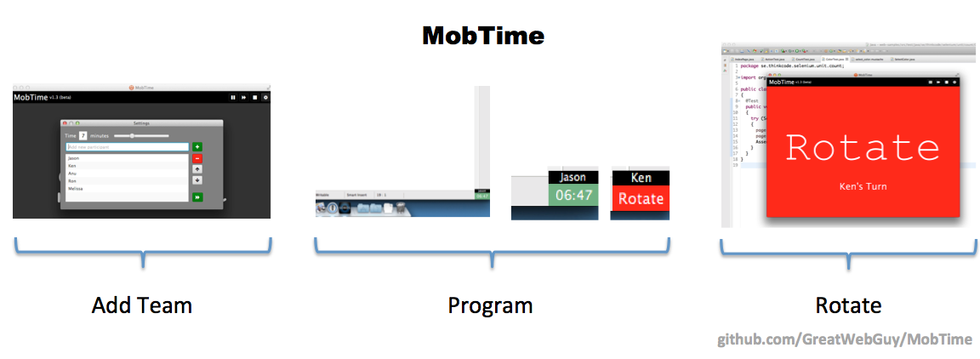
MobTimer

Slide 30
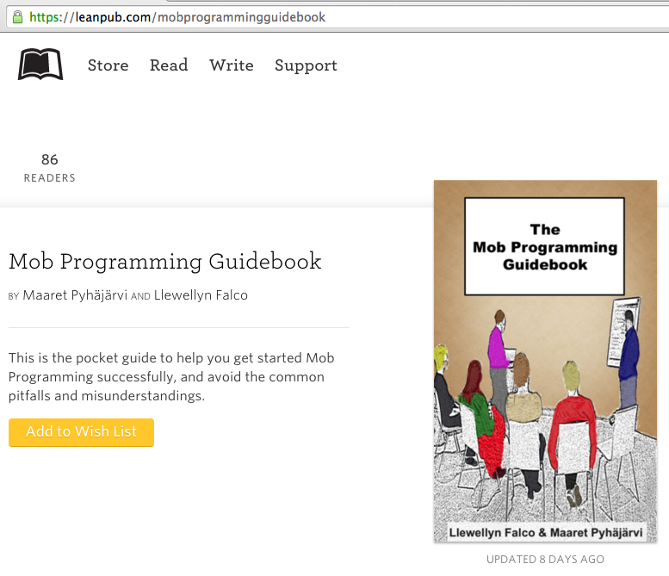
#MobProgrammingGuidebook

Slide 31
Get in Touch
Maaret Pyhäjärvi
Email: maaret@iki.fi
Twitter: @maaretp
Blog: visible-quality.blogspot.fi
Llewellyn Falco
Email: isidore@setgame.com
Twitter: @LlewellynFalco
Blog: llewellynfalco.blogspot.com

Slide 32
Question, Thoughts? Feedback?

Slide 33
Getting the Software to Test
http://darkfunction.com/editor/
➔ Download the jar
http://lfal.co/DfExamples
➔ Download as zip

Slide 34
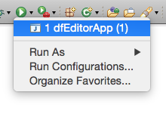
The App: Dark Function Editor
Eclipse:
Open dfEditorApp (Ctrl+Shift+T)
Run (Ctrl+F11)
A 2D sprite and animation tool for game developer
Two main uses:
Sprite sheet creator: Create sprite sheets by adding coordinates or by putting together individual sprites (New / Sprite sheet)
Image animator: Create animations from sprite sheets (New / Animation set)
Test data to start from:
In darkFunction-Editor/TestingResources/StarWarsImages/SWAll.sprites

