Slide 1
Brainy: Effective Selection of Data Structures
Notes:
Hello everyone, today my presentation’s topic is

Slide 2
Why data structure selection is important
How to choose the best data structure for a specific application
Related work
Brainy
Evaluation
Future work
Summary
Notes:
The paper focuses on how to choose the most effective data structures from a set of alternative choices.
Maybe you will ask why data structure selection is important to application performance.

Slide 3

Algorithms + Data Structures
= Programs
Algorithms + Data Structures
= Programs
Niklaus Wirth
Notes:
Niklaus Wirth (Niklaus Emil Wirth (born February 15, 1934) is a Swiss computer scientist, best known for designing several programming languages, including Pascal, and for pioneering several classic topics in software engineering. In 1984 he won the Turing Award for developing a sequence of innovative computer languages.) has said programs are algorithms plus data structures.

Slide 4
Alternative Data Structures
Vector (Store ith item in A[i])
Singly or Double linked list
Find the ith item
O(1)
O(n)
Insert or delete an element
O(n)
O(1)
less cache misses,
but may move all elements when dynamic adjust size
Memory
accessing
more cache misses
Notes:
We know that for such specific application, there will be several kinds of candidate data structure. As the example shows Vector and List are two most common data structures, and they can replace each other in most cases. However, there performances are totally different in different situations. As the slide shows, the vector may not be efficient for dynamic membership: adding deleting elements; while linked list is not effective for finding ith item. And they also have different performance on accessing memory.

Slide 5
Why data structure selection is important
How to choose the best data structure for a specific application
Related work
Brainy
Evaluation
Future work
Summary
Notes:
So the problem is how to make a good decision from these candidate data structures?

Slide 6
Developer depend on
Data structure library
Asymptotic analysis
DSLs are designed for common case,
not consider application-specific situation
Asymptotic analysis is not accurate to data structures. Better asymptotic behavior may perform worse (for example, Fibonacci heap); Same asymptotic behaviors with different performances (splay tree often perform better than other balanced binary search trees).
Notes:
Nowadays, developers most often do not select data structure implementations at not. They trust a data structure library to make a good choice for them. However, the data structure library just faces common case to make choice, and they cannot take all specific application properties into considerations. When developers do manually selection, they will use asymptotic analysis to guide their decision. However, asymptotic analysis always make incorrect choice in data structure selection. For example, although the Fibonacci heap has better asymptotic performance on inserting and decreasing key than binary heap, it always has worse performance in the real applications even there are hundreds of elements. And although Red-black tree has the same asymptotic behaviors with splay tree, it always performs worse than splay tree in real cases.
(Find-minimum is O(1) amortized time. Operations insert, decrease key, and merge (union) work in constant amortized time. Operations delete and delete minimum work in O(log n) amortized time.) Splay&RB(Average&worst) SpaceO(n) Search/Insert/Delete O(log n)O(n) RB(worst O(logn))

Slide 7
What we need take into account?
Which interface functions are invoked, (how often the functions are used…)
What is the input for the data structure (data elements size, the number of elements…)
Which kind of underlying architecture the program running (cache size…)
Notes:
Now before proposing an useful method, we need know what will influence the performance of data structures under a specific application. The first two points are easy to understand. The most interesting thing is the last point. We often separately optimize the hardware and the data structure or algorithm, forgetting the connection between them.

Slide 8
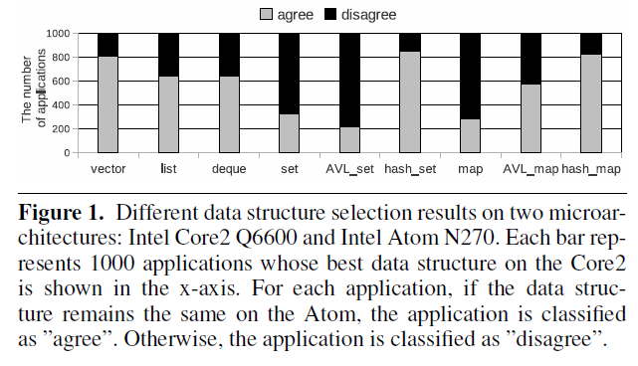
The paper shows, between two different architectures Intel Core Q6600 and Intel Atom N270, 43% of the randomly generated application have different optimal data structures.
Notes:
I am surprised on 43% of the randomly generated applications have different optimal data structures on these two different architectures. I think it is mainly because they have different cache size and the Core2 is 64-bit machine, while the Atom is 32-bit.

Slide 9
Related Work
L.Liu and S.Rus Perflint: A Context Sensitive Performance Advisor for C++ Program
O.Shacham, M.Vechev, and E.Yahav. Chameleon: adaptive selection of collections
Notes:
Compared with the other works in the area, Brainy got much more accurate prediction on data structure selection. That is mainly because two sides innovation. First, it uses machine learning to automatically construct more accurate models instead of hand-construction. On the other hand, Brainy take hardware performance into account, thus providing greater accuracy.

Slide 10
Why data structure selection is important
How to choose the best data structure for a specific application
Related work
Brainy
Evaluation
Future work
Summary
Notes:
Due to there are so many aspects we need consider on, it is very difficult to hand-construct accurate data structure cost models. Facing such complex problem, machine learning is a quite popular method.

Slide 11
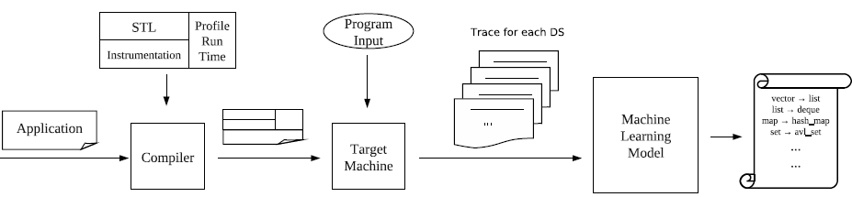
How to get the training examples?
Notes:
So the paper proposes the Brainy, using machine learning to automatically select the best data structure for a given program on a specific input and microarchitecture. Mentioned machine learning, the first thing is how to get training examples.

Slide 12
How to get the training examples?
Condition:
In order to avoid over fitting, every portion of the design space (input/ interface function) must be fully represented.
Is using real applications to train the machine learning algorithm a good suggestion?
Application Generator: creating a variety of applications that test different parts of the overall space.
Notes:
We need clear understand that it need a huge number of training examples, otherwise when a new application comes, it cannot find fully similar training example features from set files. Such over fitting will mislead the predictions.
And it’s the same reason why real applications are unacceptable for training examples. Real applications are too small to cover the so many cases.
In Brainy, they designed an application generator to cover the design space sufficiently with synthetic application. In these applications all data structure behaviors are determined randomly, such as total number of invocations for all interface functions, size of data element, maximum value of data to be inserted/ removed/ searched.
And the number of applications is around several thousands for each data structure. It is decided by the specific application, balancing between the cost of time and the accuracy.

Slide 13
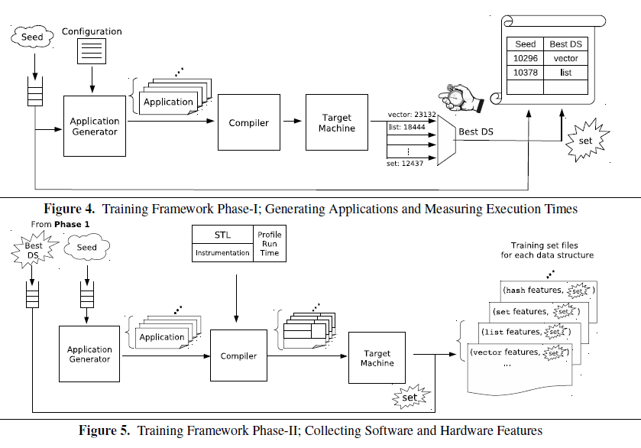
Notes:
In Brainy, the training consists two phases. In first phase, after the application generating, there are a set of synthetic applications with the same behavior but different data structures. And it will compile the set of applications and execute on the target machine. After comparing the various executing time, it can get the best data structure for the specific application. In the end of first phase, in seed_de_pairs, it records all seeds which correspond a specific application and its best data structure.
In phase2, it regenerates the applications using the seeds from seed_de_pairs, and compiles them with addition instrumentation, which can collects all software and hardware features during program execution. After that in training set file, there will save the best DS and its corresponding application features.

Slide 14
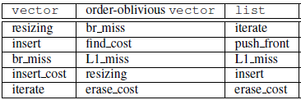
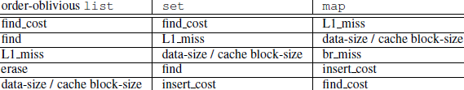
Artificial Neural Network
Feature Selection (Using genetic algorithm)
Take a given subset of features as a chromosome, and get the global optimum by mutation.
Notes:
In Brainy, it chooses Artificial Neural Network from several machine learning techniques, since it is robust to noise as well as effective for linear and non-linear statistical data modeling. By the way, the features are collected in the phases2 are both linear and non-linear.
Selecting the most relevant features, is an important way to make accurate result with a low overhead. In Brainy, it uses genetic algorithm in feature selection…

Slide 15
Why data structure selection is important
How to choose the best data structure for a specific application
Related work
Brainy
Evaluation
Future work
Summary
Notes:
The next section is evaluation

Slide 16
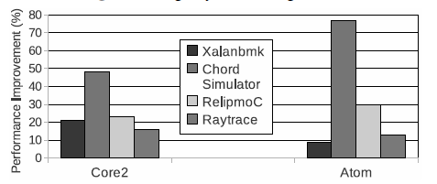
Evaluation
Performance improvement Brainy achieved
27% on Core2 and 33% on Atom
Notes:
In order to evaluate the effectiveness of Brainy, the authors implemented it as part of C++ Standard Template Library for GCC 4.5. And they implemented Brainy on four cases from various area. It seems having around 30% improvement on two different machines, Core2 and Atom. However, I think there is a problem from they summarize their experiment results. On the page 93, the last sentence of the left side, said … I am not sure if I understand this sentence in a right way. Does this mean they just show the best performance result across all kinds of input?

Slide 17
Why data structure selection is important
How to choose the best data structure for a specific application
Related work
Brainy
Evaluation
Future work
Summary

Slide 18
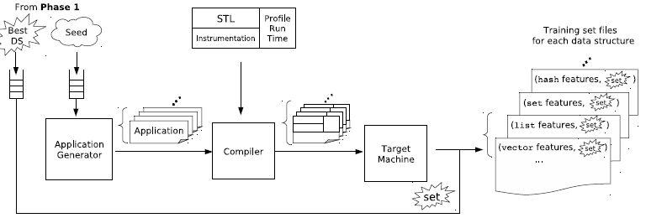
Future Work
Exclude the interference from intervening instructions
Notes:
Nowadays, when the modified standard template library collects the software and hardware features by profiling, it cannot exclude the impart from intervening instructions. So the modeling isn’t 100% accurate. In the future, it may take these intervening impact into consideration and modeling more accurate.

Slide 19
Why data structure selection is important
How to choose the best data structure for a specific application
Brainy
Evaluation
Future work
Summary

Slide 20
Summary
Selection of Data Structures is important
Using machine learning in data structure selection
Hardware features
Reduced overhead

