Slide 1
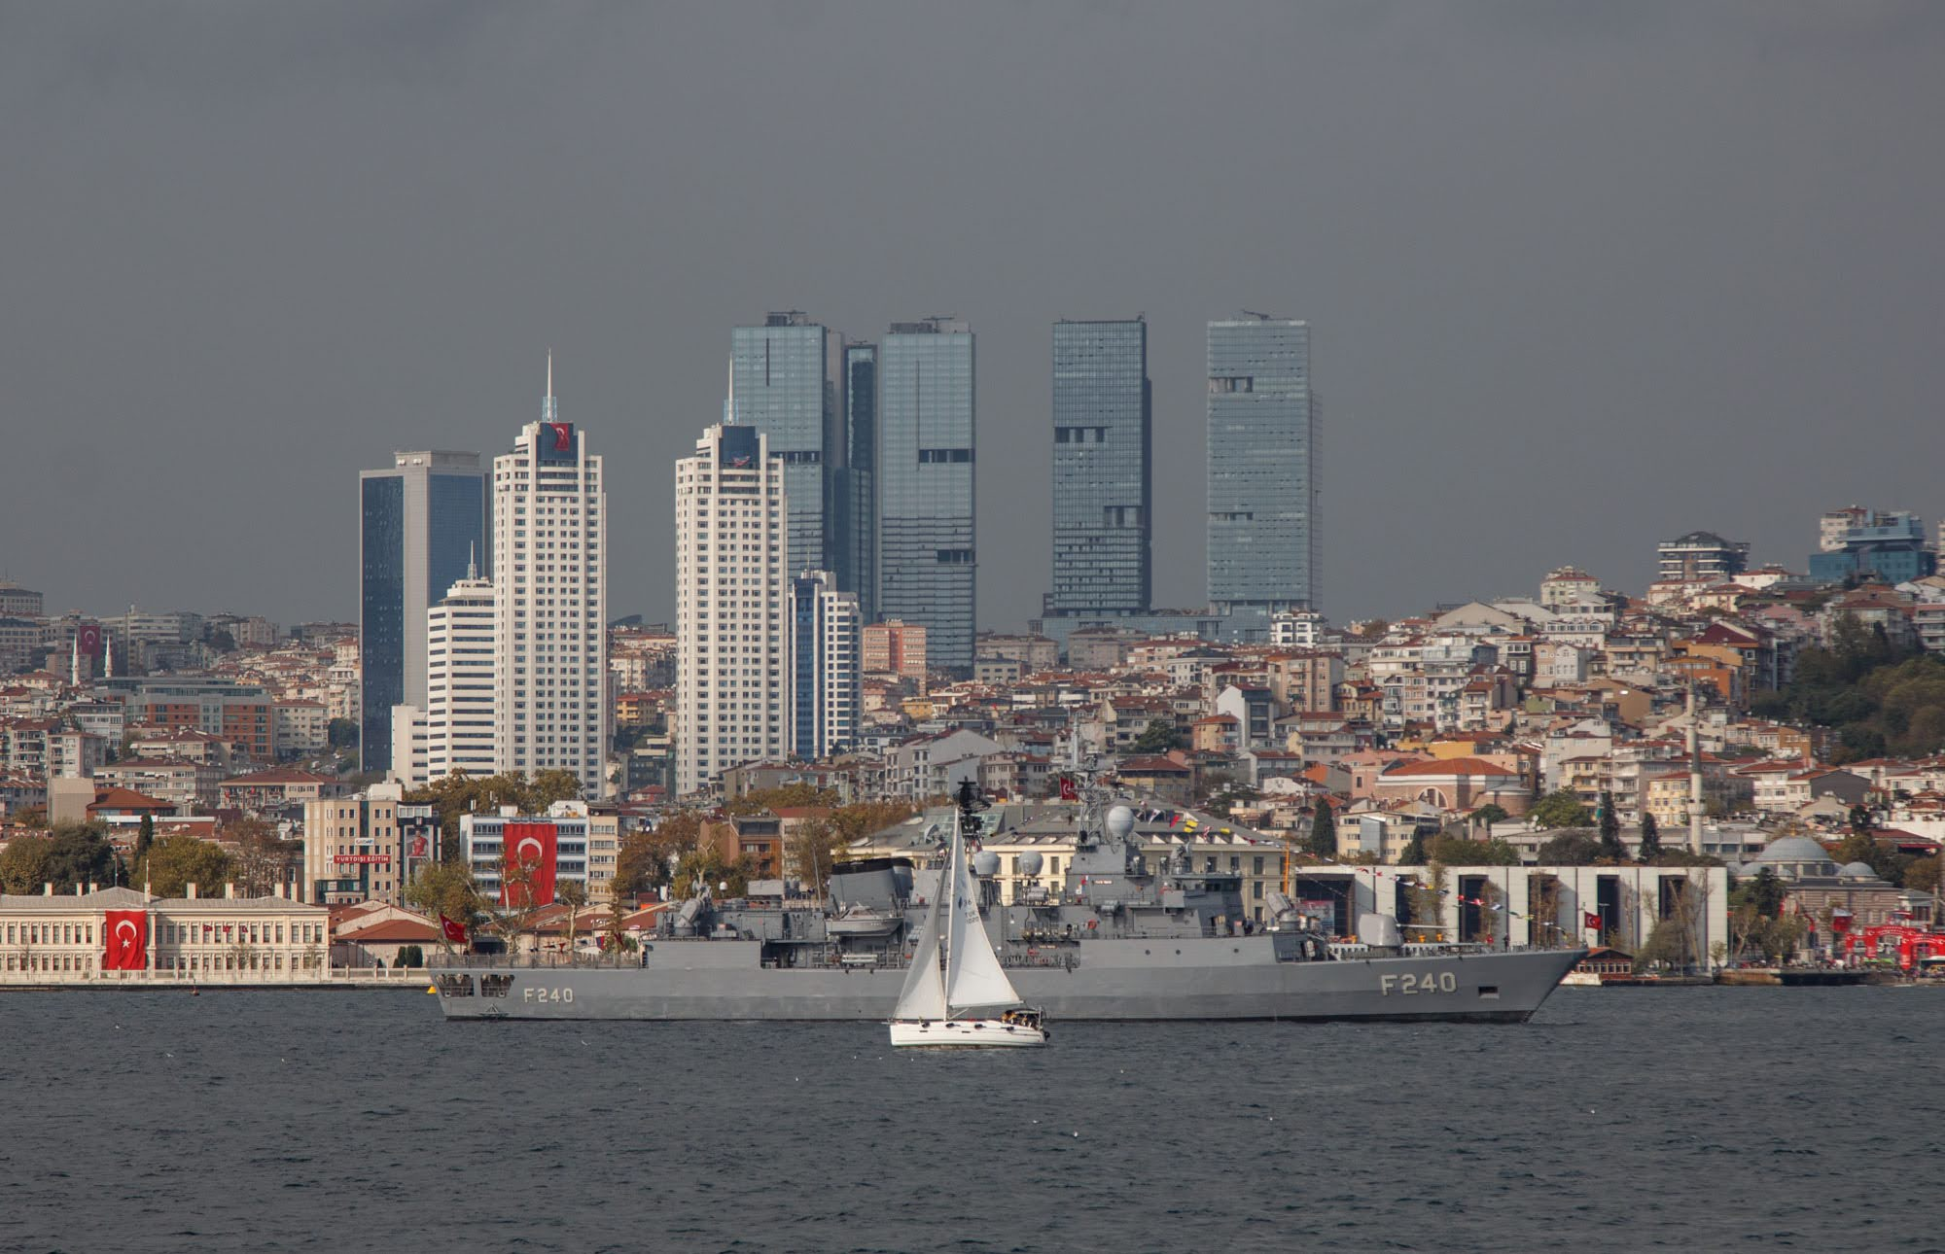
DSA 210 TERM PROJECT
Food Price Inflation in Turkey (2019-2024)
Isik Giray Onal | 34088

Slide 2
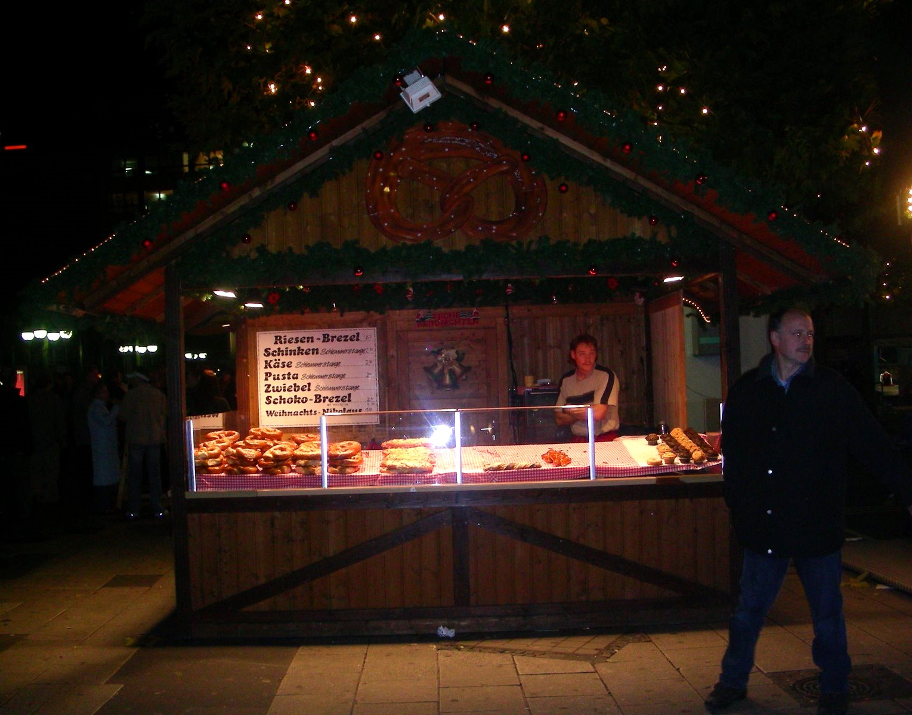
Introduction
DSA 210
Analyze monthly food price indices (bread, milk, meat) and USD/TRY from 2019-2024.
Construct a composite Food Price Index to summarize food inflation dynamics.
Use EDA and correlation tests to quantify the currency-food link.
Evaluate basic time-series regression models for short-term prediction.

Slide 3

Motivation
DSA 210
Food inflation directly affects household purchasing power.
USD/TRY depreciation raises import and input costs for food producers.
Understanding co-movement helps explain macro-level inflation pressures.

Slide 4
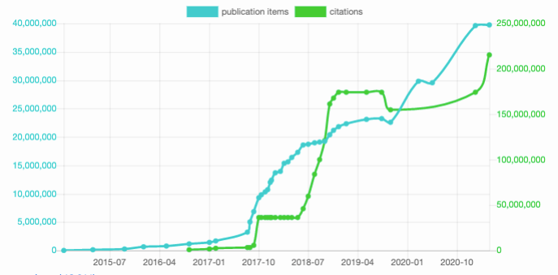
Research Questions
DSA 210
How strongly do food price indices co-move with USD/TRY?
Which food group (bread, milk, meat) shows the fastest growth?
Do lag and rolling features improve short-term prediction?

Slide 5
Data Collection and Preparation
DSA 210
USD/TRY: TCMB EVDS monthly series (TP.DK.USD.A.YTL).
Food indices: Eurostat HICP via FRED (2015=100).
Align monthly dates, compute composite Food Price Index.
Engineer lag and rolling features for modeling.

Slide 6
DSA 210
Exploratory Data Analysis

Slide 7
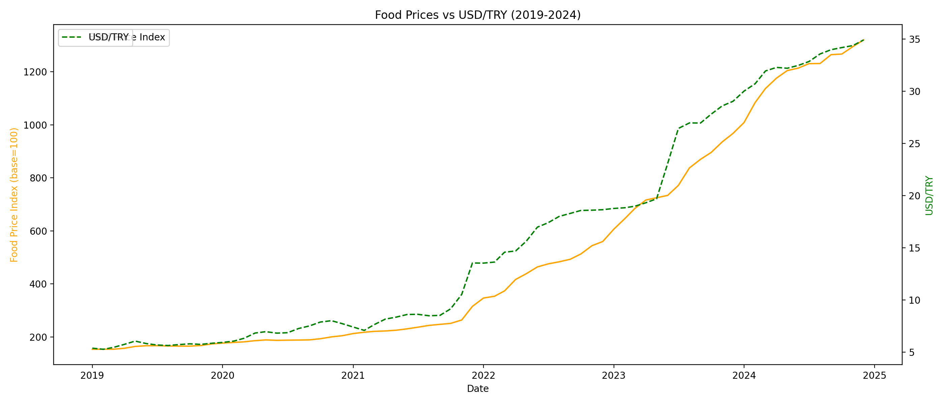
Analysis
DSA 210
Both series trend upward over 2019-2024.
Strong co-movement suggests currency pass-through.
Composite index smooths item-level noise.

Slide 8
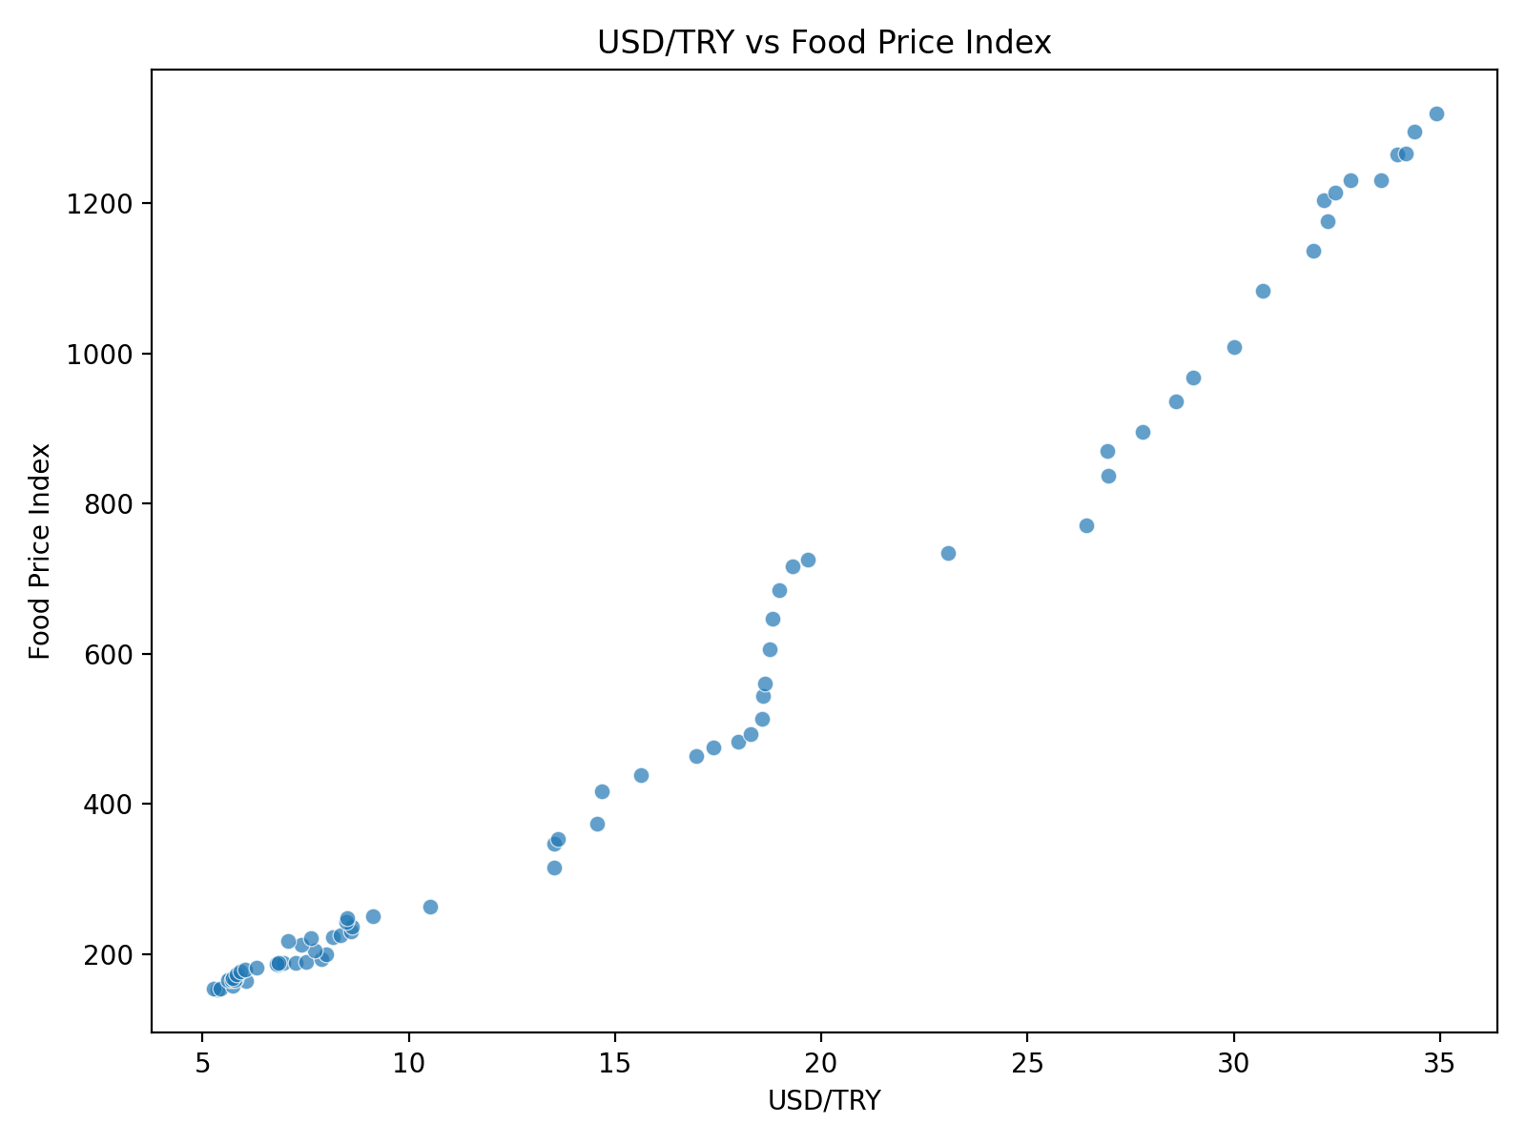
Analysis (cont.)
DSA 210
Pearson r = 0.9891 (p = 5.26e-60).
Relationship is strongly positive and significant.
Supports H1: currency and food inflation co-move.

Slide 9
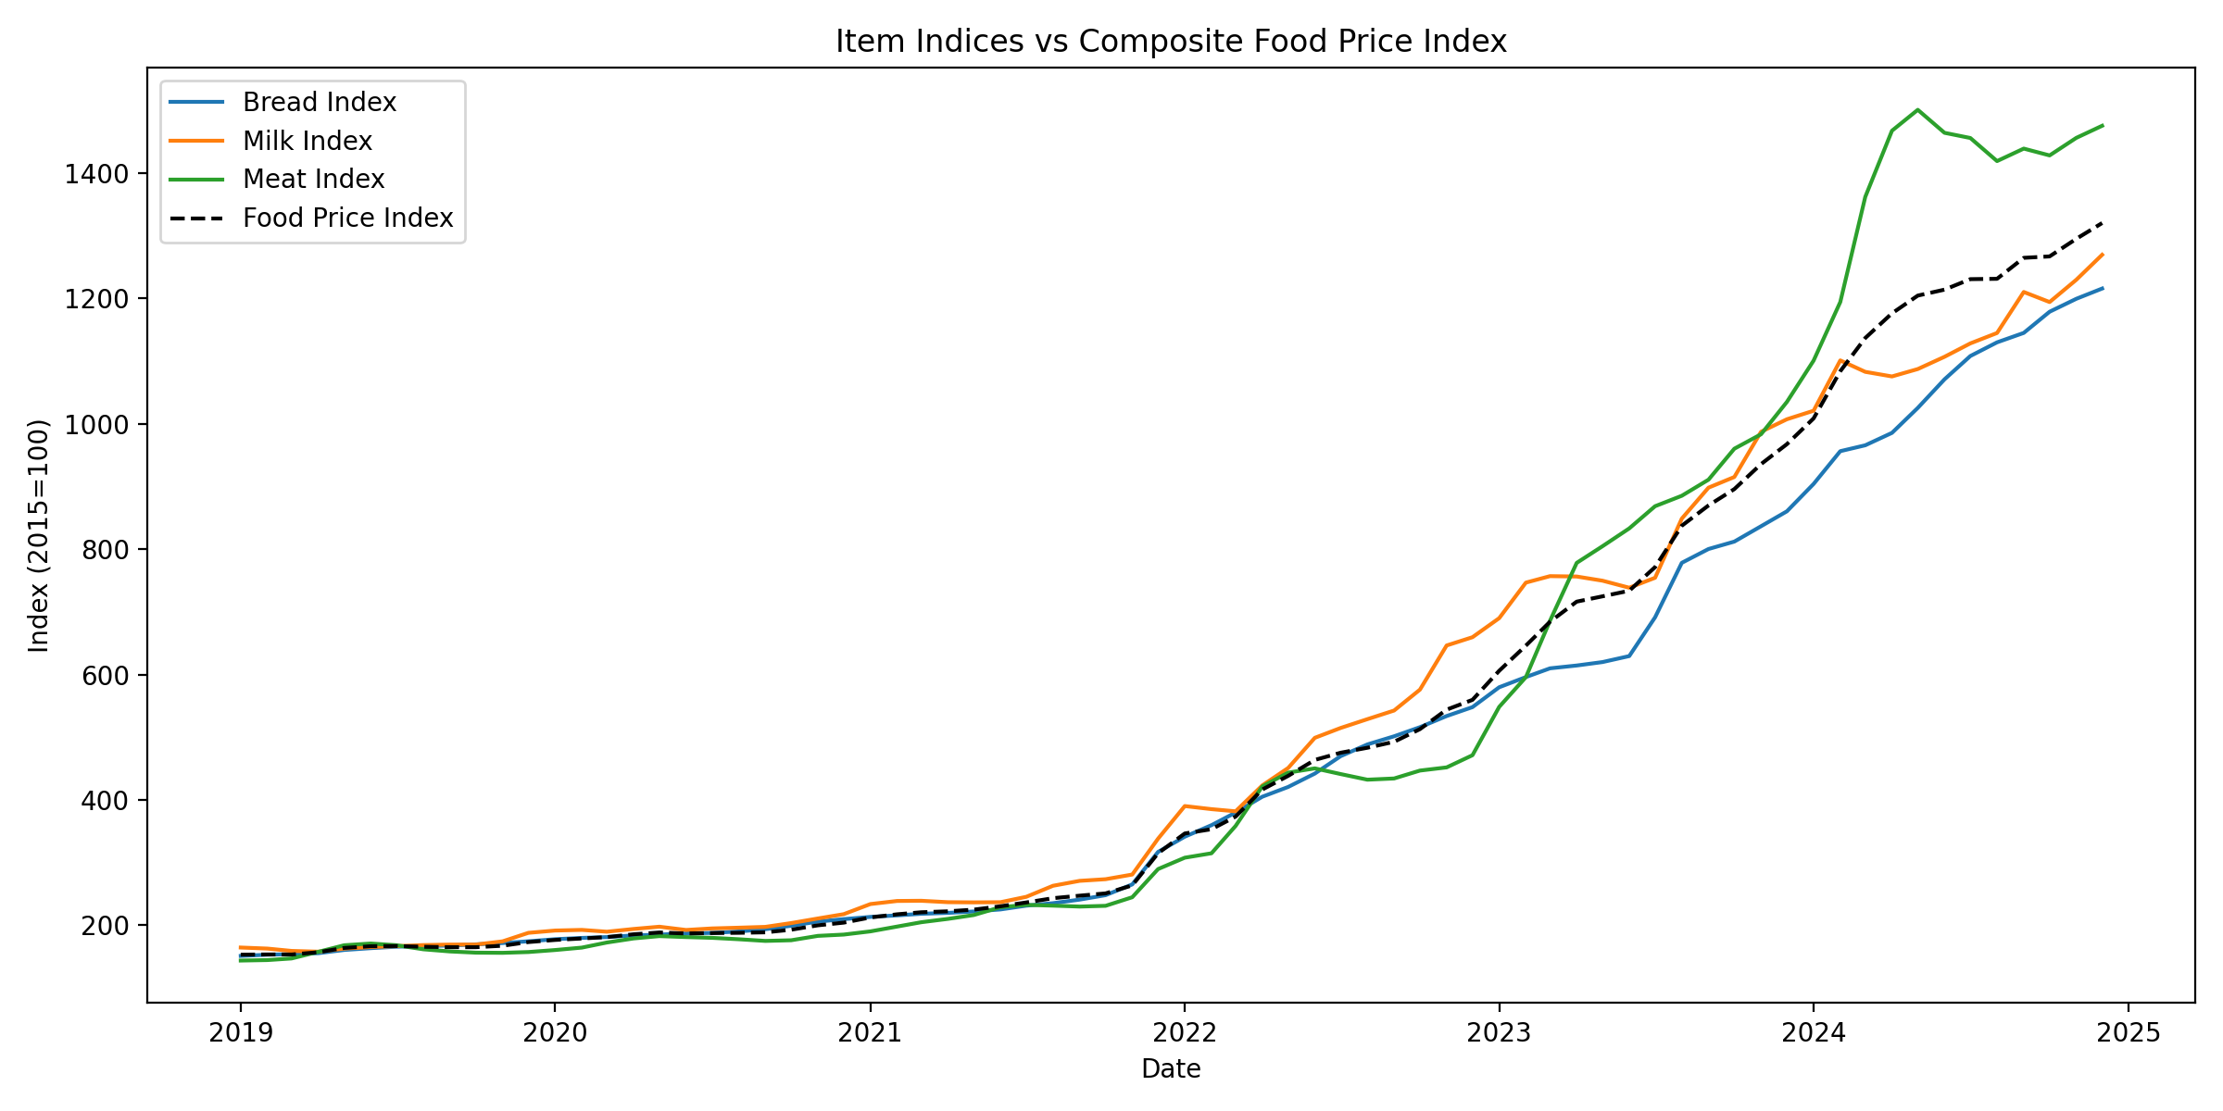
Analysis (cont.)
DSA 210
Meat index grows fastest (~10.3x).
Bread (~8.0x) and milk (~7.7x) rise steadily.
Composite tracks the shared upward trend.

Slide 10
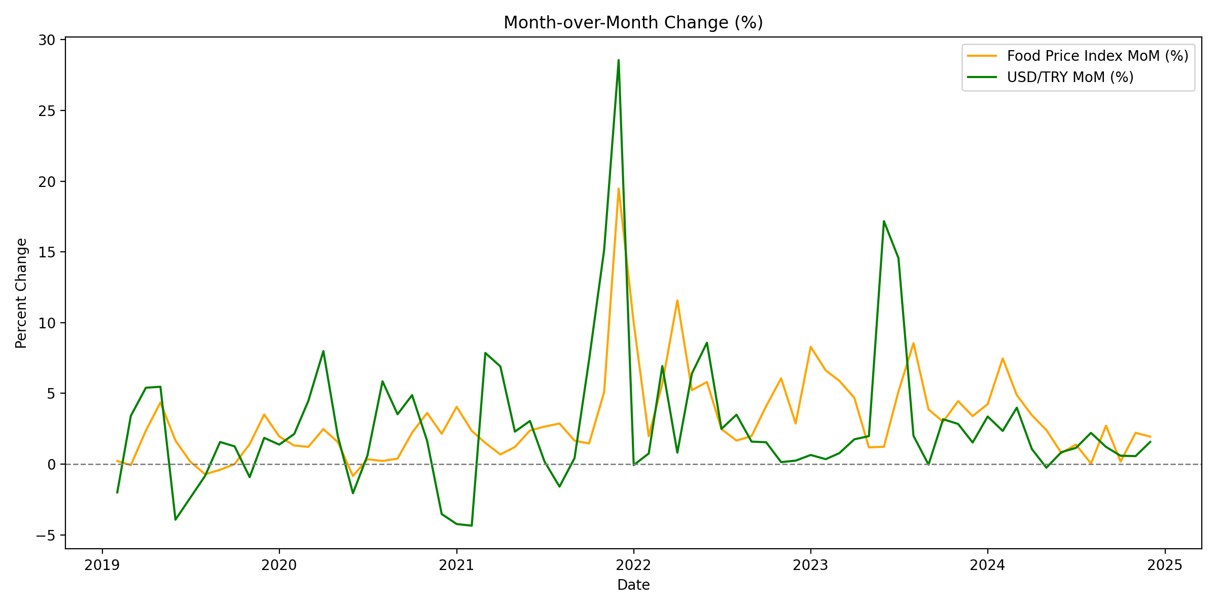
Analysis (cont.)
DSA 210
MoM changes show clustered volatility.
Currency shocks align with larger food jumps.
Volatility increases in later years.

Slide 11
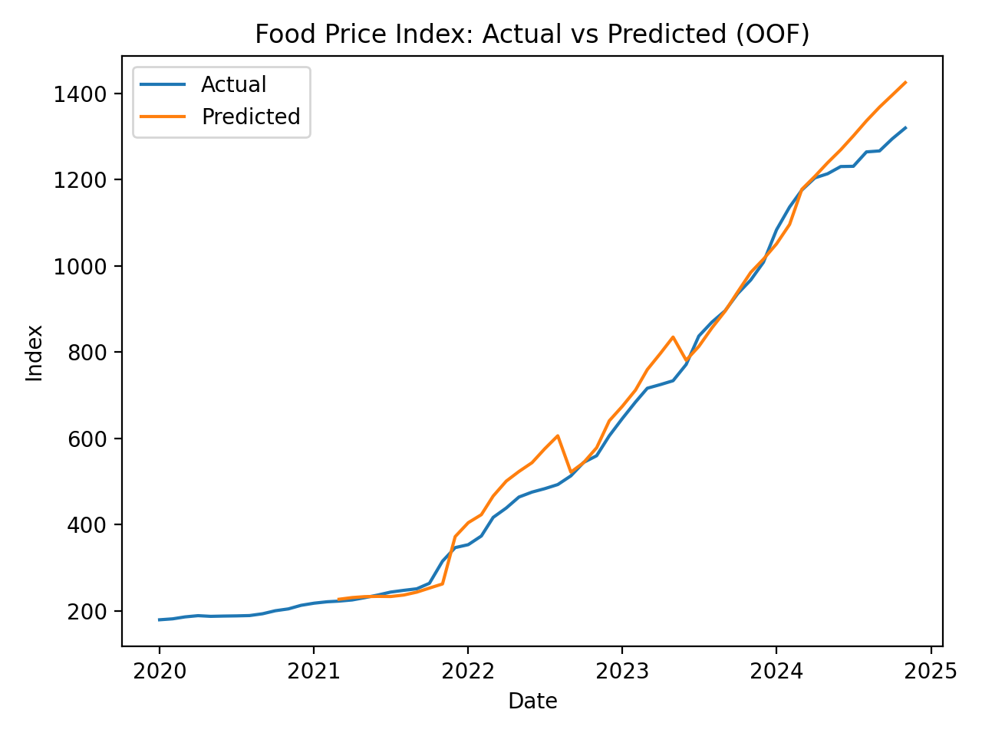
Machine Learning Applications
DSA 210
Time-aware CV with lag and rolling features.
Best model: Ridge (RMSE 45.15, R2 -0.025).
Linear models underfit; richer features needed.

Slide 12
Conclusion
DSA 210
Food prices and USD/TRY move closely together.
Meat prices show the fastest index growth.
Short-term regression remains challenging without richer signals.

Slide 13
Sources
DSA 210
TCMB EVDS: https://evds2.tcmb.gov.tr
FRED (Eurostat HICP): https://fred.stlouisfed.org
Series: CP0111TRM086NEST, CP0112TRM086NEST, CP0114TRM086NEST
Stock images: Wikimedia Commons (Istanbul skyline 02, Food stall at Christmas market, MICEX, Wikidata statistics)

Slide 14
Thank you

