Slide 1

G2M Case Study Virtual Internship 30-May-2021
Asena Işık Gürhan

Slide 2
Background And Information About Data
XYZ is a private firm in US. Due to remarkable growth in the Cab Industry in last few years and multiple key players in the market, it is planning for an investment in Cab industry and they want to understand the market before taking final decision. Time period of data is from 31/01/2016 to 31/12/2018.
Each data set represents different aspects of the customer profile.
Cab Data – this file includes details of transaction for 2 cab companies
Customer ID – this is a mapping table that contains a unique identifier which links the customer’s demographic details
Transaction ID – this is a mapping table that contains transaction to customer mapping and payment mode
City – this file contains list of US cities, their population and number of cab users
XYZ is interested in using your actionable insights to help them identify the right company to make their investment.

Slide 3
HYPOTHESIS
Which company has more profit per KM in three years period?
Does income levels cause differences in profit among two cab companies?
Does age groups cause differences in profit among two cab companies?
Does payment method cause differences in profit among two cab companies?
Which seasons has most demand in cabs?
Is there a difference in demand throughout the days of a month? (1-31)
Does the customer retention same for both companies?
Which company has higher profit rates amongst cities?

Slide 4
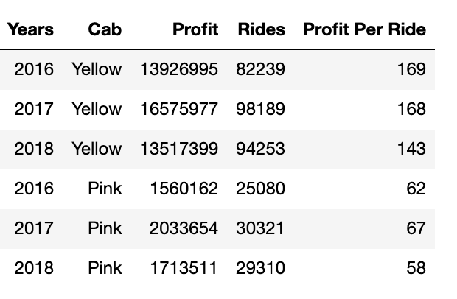
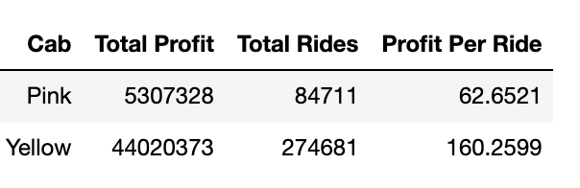
Total profit, rides and profit per ride for pink and yellow cab through the years (2016, 2017 and 2018):
Total profit, total rides and profit per ride for pink and yellow cab accordingly:

Slide 5
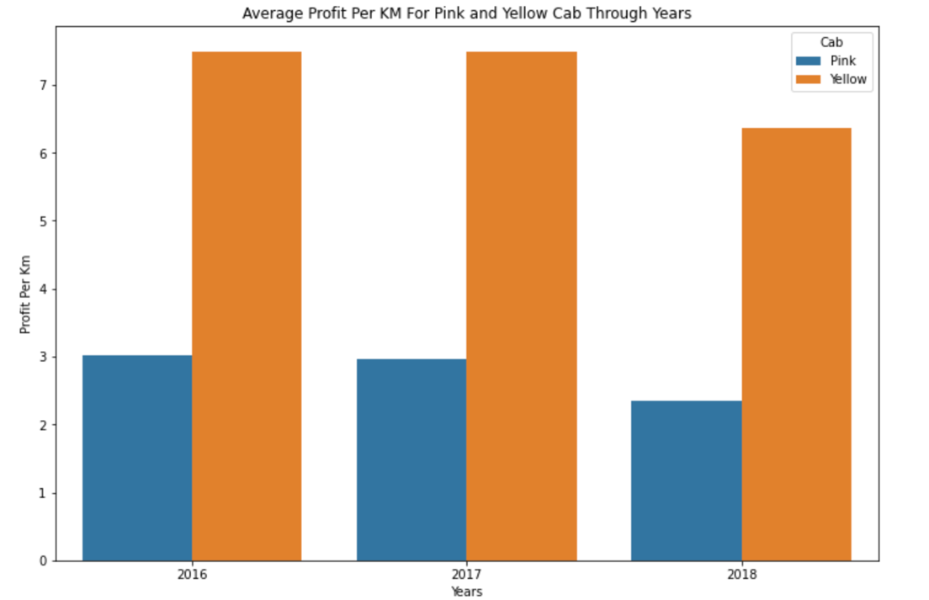
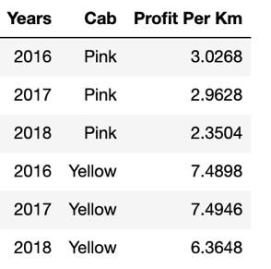
Average Profit Per Km Amongs Pink And Yellow Cab Throughout Years
The data and the graph suggest that average profit per KM almost doubles within the yellow cab company.

Slide 6
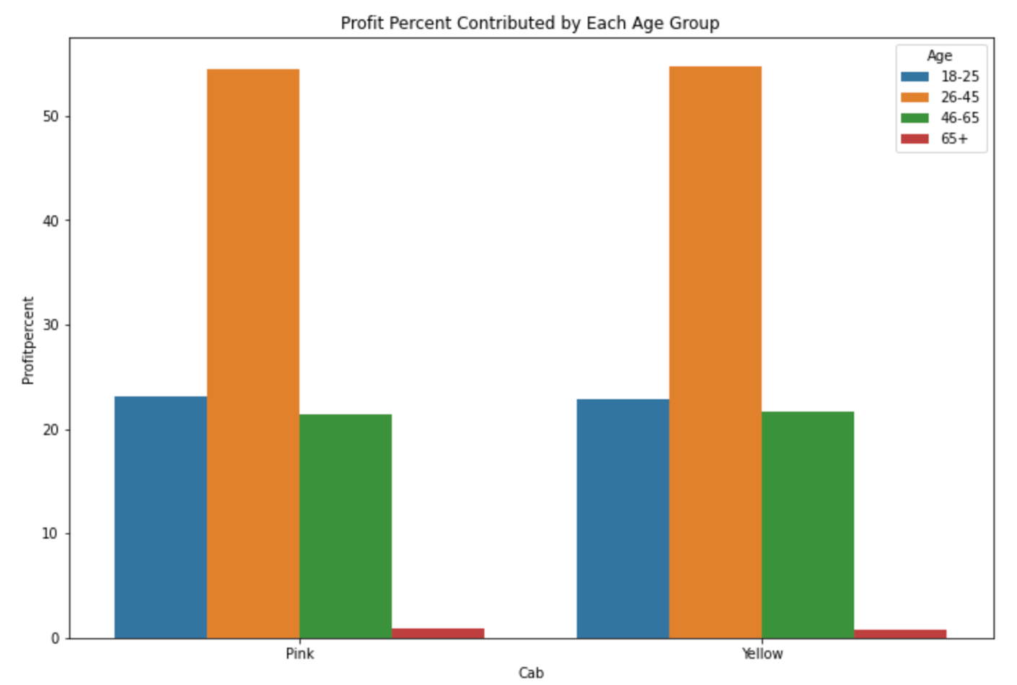
Profit Contributed By Age Groups (%)
There are 4 age groups which includes:
18-25
26-45
46-65
65+
Graph shows that amongst 4 different age groups there are no significant difference in contribution to profit within two companies.
Lowest contribution comes from 65+ age group and highest comes from 26-45 age group.

Slide 7
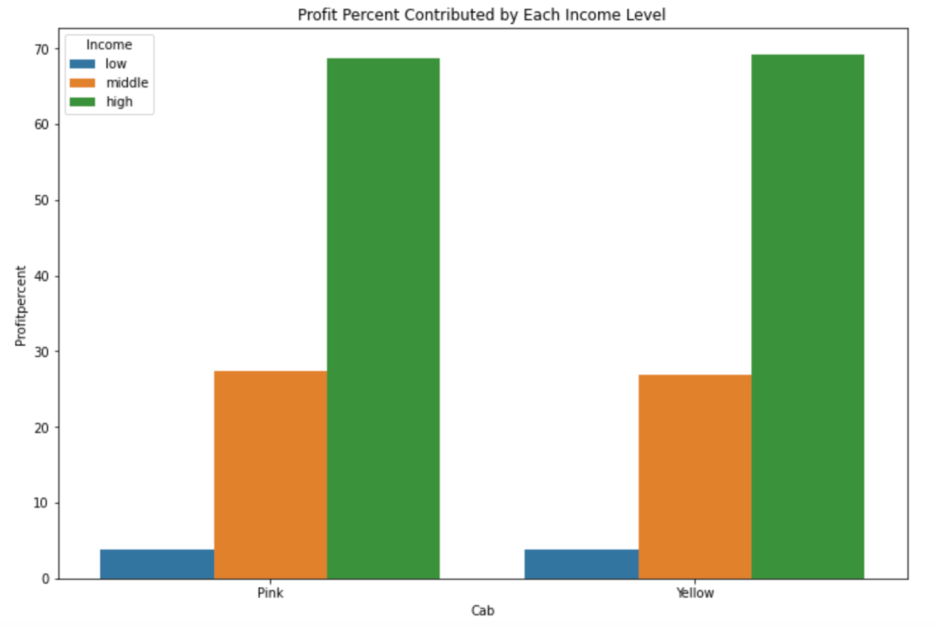
Profit Contributed By Income Levels (%)
There are 3 income levels which include:
Low ( <3000 USD /month)
Middle (>3000, <10000 USD/month)
High (>10000 USD / month)
Graph shows that amongst 3 different income levels there are no significant difference in contribution to profit within two companies.
Lowest contribution comes from low income level and more then 90% profit comes from middle and high income levels.

Slide 8
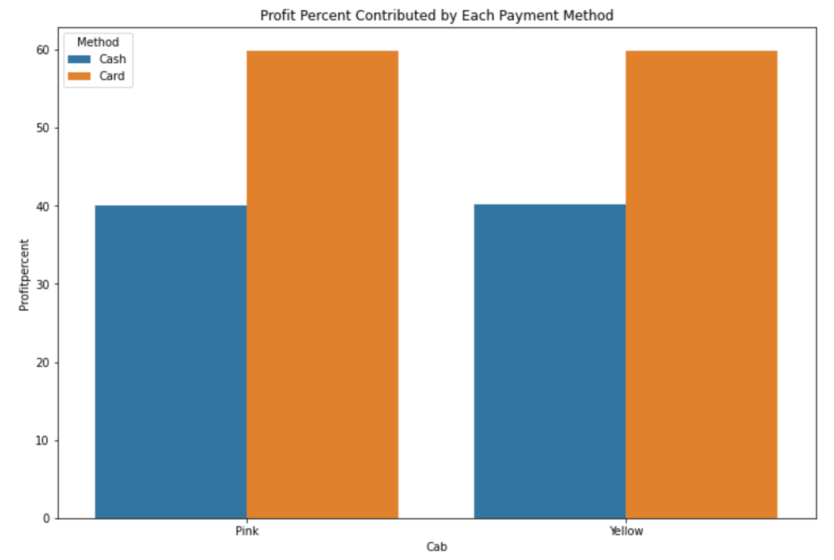
Profit Contributed By Payment Method (%)
There are 2 different payment methods which includes:
Card
Cash
Graph shows that amongst 2 different payment methods there are no significant difference in contribution to profit within two companies.
Almost 60% percent of income comes from Card payment and 40% comes from cash payment in both companies.

Slide 9
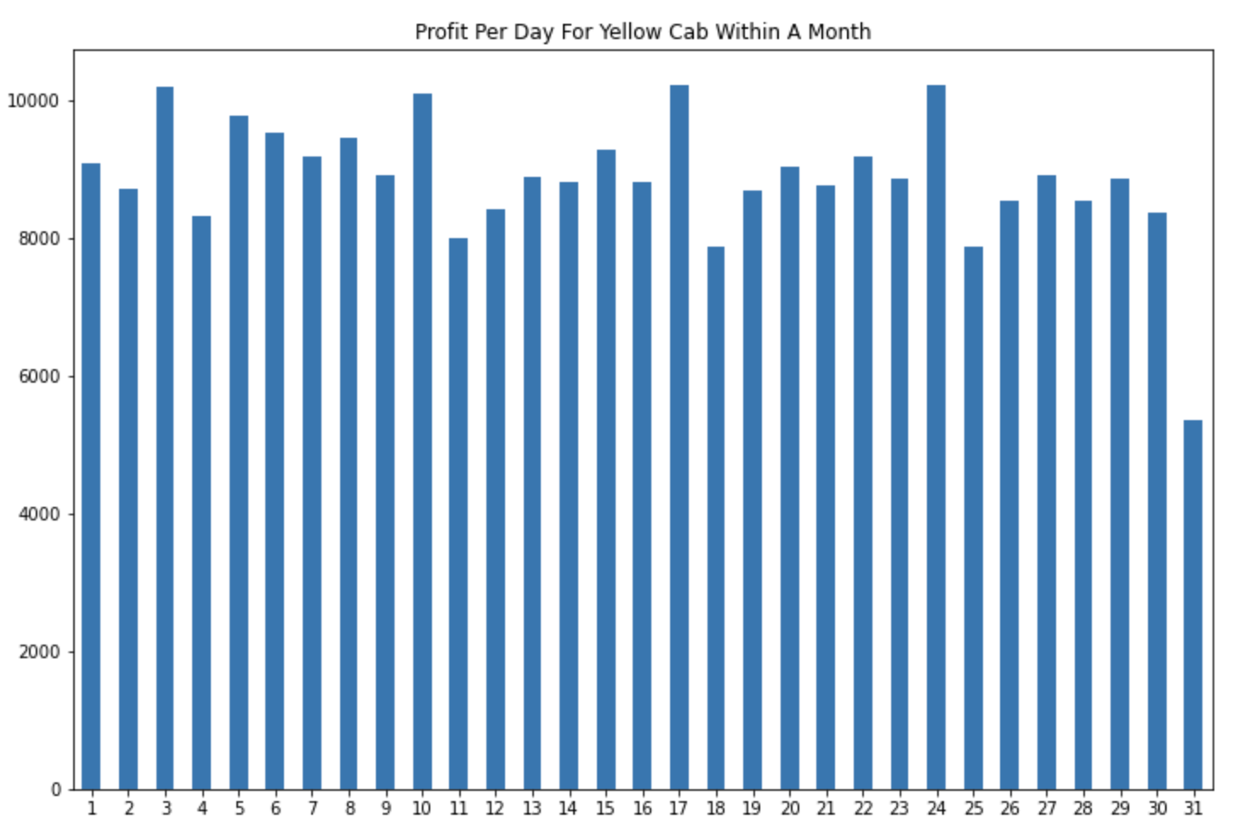
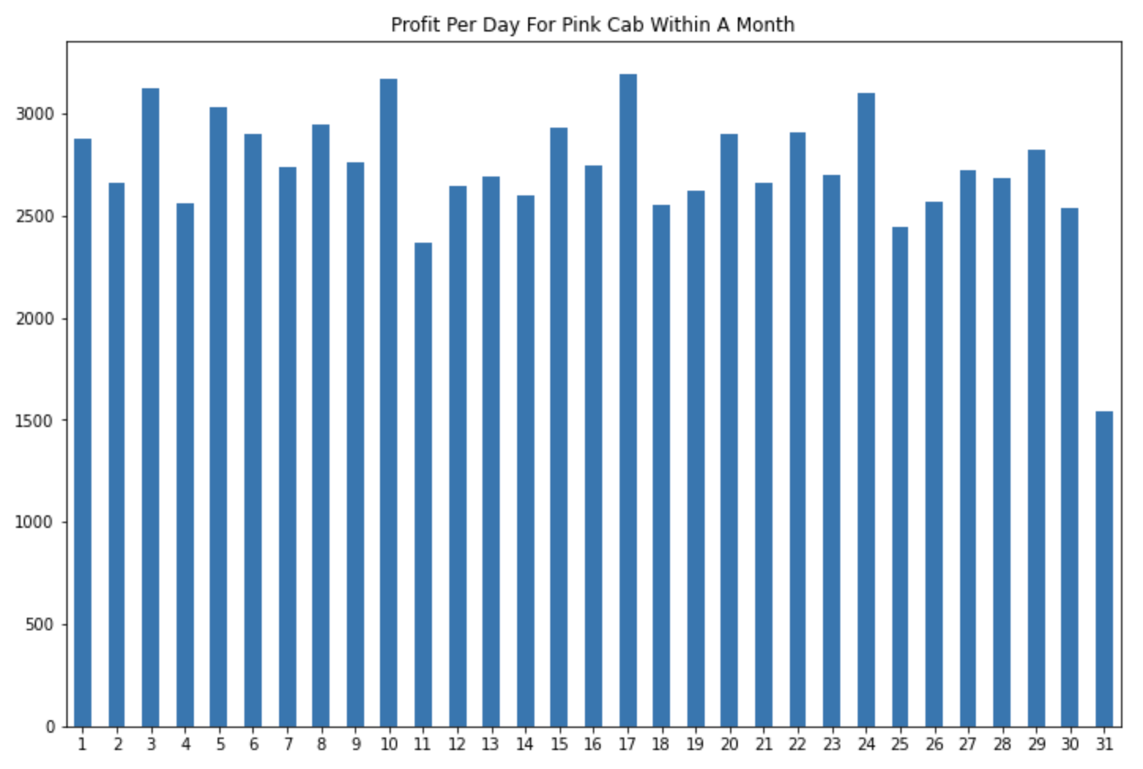
Profit Per Day (1-31)
Both graphs suggest that there is an increase in demand at 3rd day of the month and it repeats 7 day cycle which means there is an also increase in demand at 10th, 17th and 24th of the month.
There are no significant difference in contribution to profit within two companies.

Slide 10
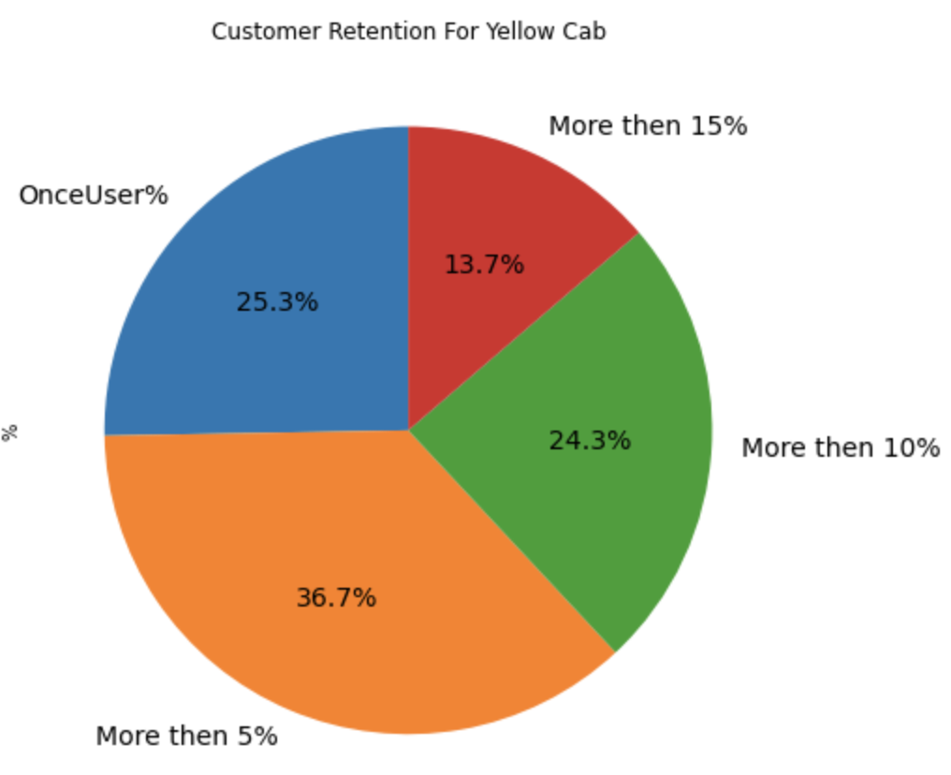
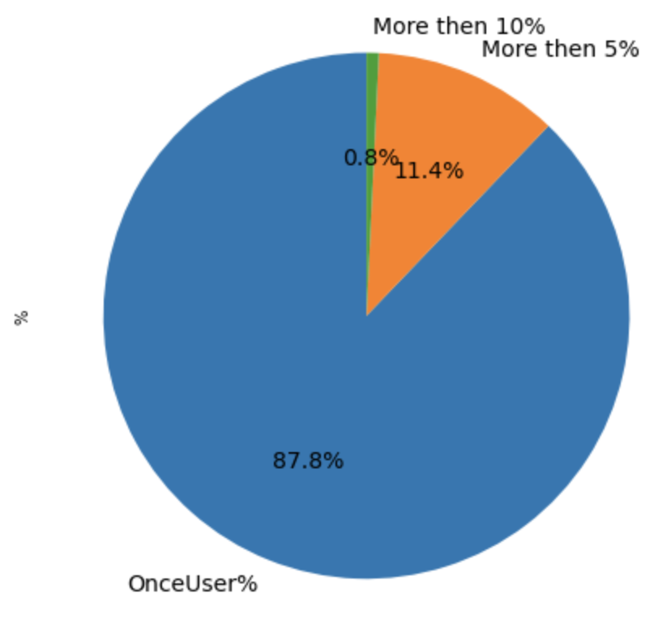
Customer Retention
Percentage of customers who have taken at least 5 rides differs from yellow cab company to pink cab company.
Yellow cab is better to retain their customers more then pink cab.

Slide 11
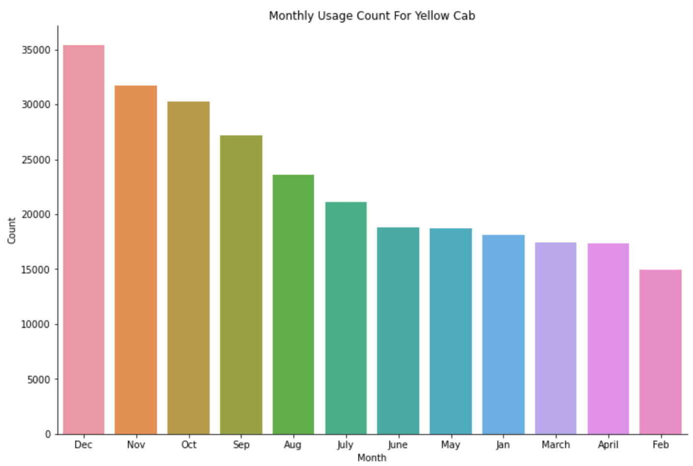
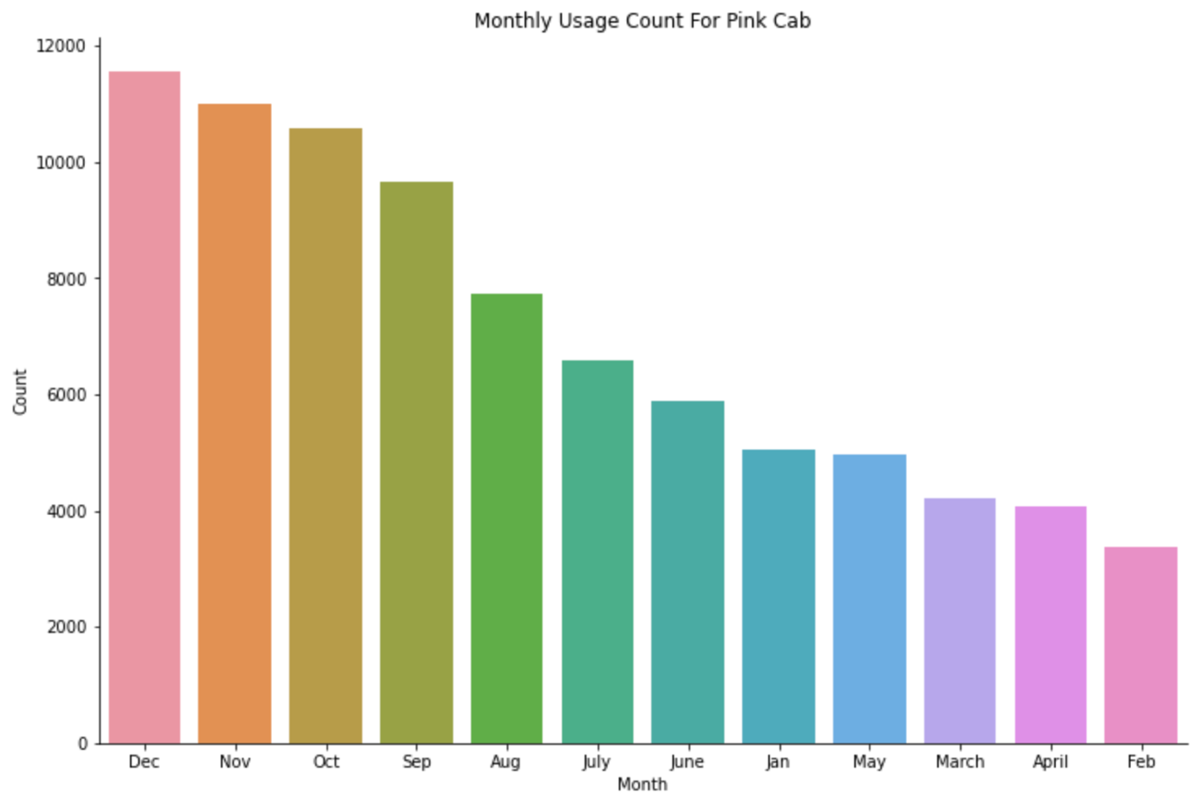
Monthly Cab Usage
Most demanding months for cabs are December, October, November and September for two companies.
Graphs shows that there are no significant difference in contribution to profit within two companies throughout the year.

Slide 12
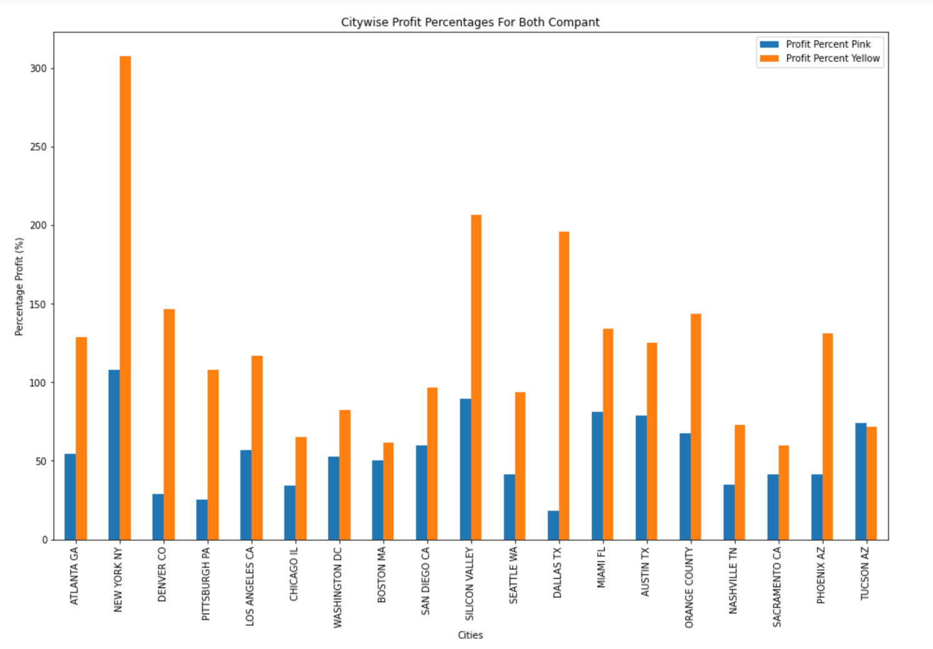
Citywise Profit
Pink cab have only higher profit margin in Tucson amongst 19 cities.
Yellow cab generally doubles the profit percentage per ride.
For both companies best profit and best reach comes from New York.

Slide 13
Recommendations
Profit Per KM: Average profit per KM and profit per ride almost doubles within the yellow cab company.
Customer Retention: I have analyzed this in three segments : at least 5 drive,at least 10 drive and at least 15 drive with the same cab company and Yellow Cab is doing far better than Pink cab. There is more then %50 difference.
Citywise: Pink cab have only higher profit margin in Tucson amongst 19 cities. Yellow cab generally doubles the profit percentage per ride.
Incomewise: Yellow cab is performing betterthan Pink cab in all the three income class groups.
Overall Yellow cab has better profit margin and better retention also it is more popular almost in all cities. I recommend Yellow cab for investment.

