Slide 1



YZV-202
Optimization for Data Science
Ömer Atmaca 150220335
Emre Aydoğmuş 150220323
Işıl Altınışık 150220308

Slide 2
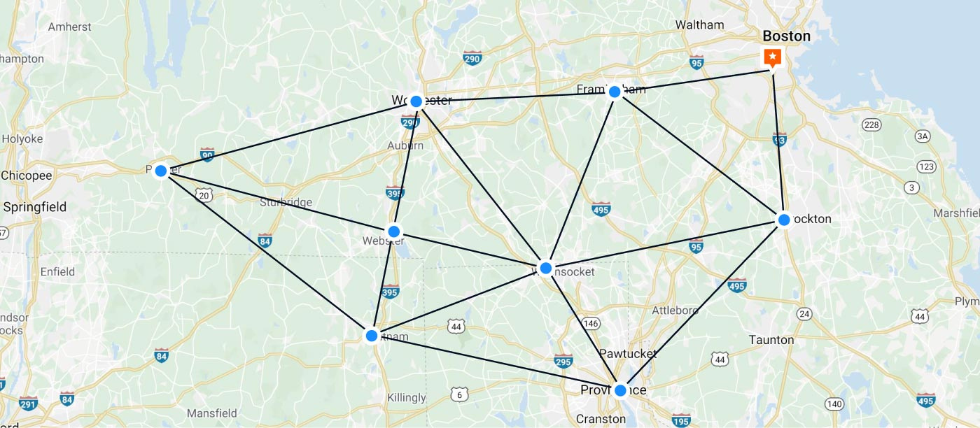
Travelling Salesman Problem:
Given a list of cities and the distances between each pair of cities, what is the shortest possible route that visits each city exactly once.

Slide 3
The Aim of the Project
Our goal is to apply this concept to the drilling pcb problem which is finding the shortest and cheapest path with different gradient-free algorithms.
Also, we will monitor how these algorithms worked on this problem seperatly.

Slide 4
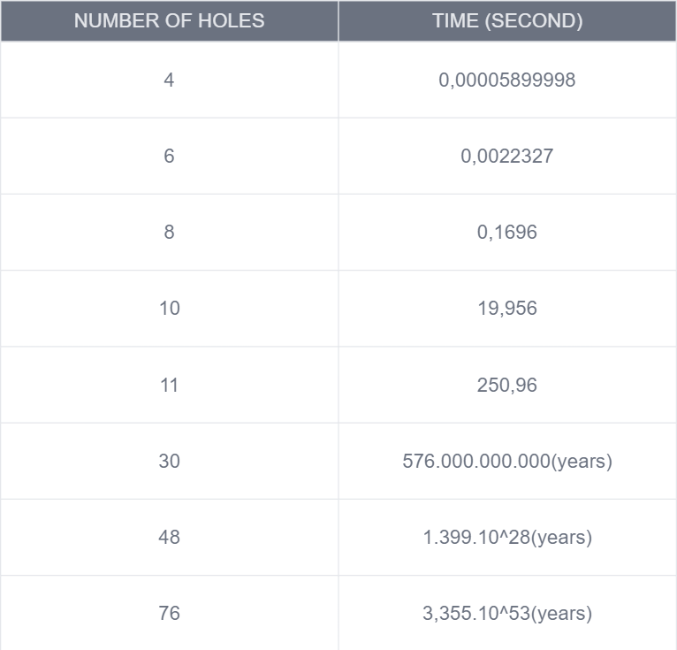
Why do we need various algorithms to solve this problem
Can’t we just try all the different combinations and try to find the best solution?
It can work with very small datasets but it is impossible to find the best way with this way for bigger datasets.
Note that even with the 30 holes the time needed is more than the age of universe !

Slide 5
Algorithms Used
Genetic Algorithm
Genetic algorithms are based on the ideas of natural selection and genetics.
Simulated Annealing
The method models the physical process of heating a material and then slowly lowering the temperature to decrease defects, thus minimizing the system energy.
Particle Swarm
The PSO algorithm is a population-based optimization method inspired by the social behavior of bird and fish flocks searching for food, which means that individuals in a group move to good regions based on their adaptation to the environment

Slide 6
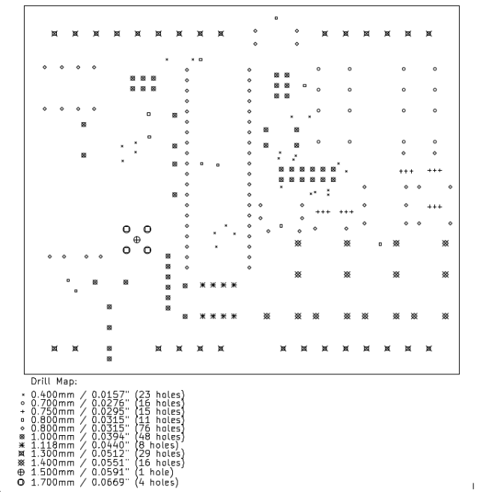
The Dataset
We have created a dataset from this circuit board as their x , y coordiantes and the radius of that hole.

Slide 7
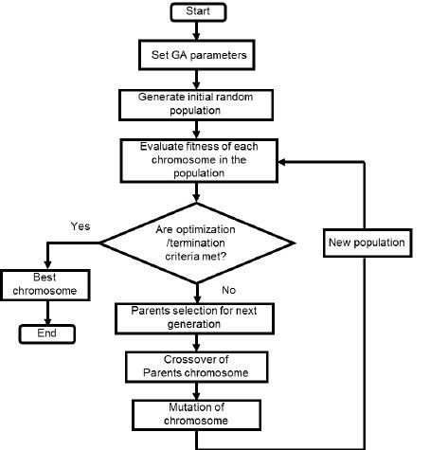
Genetic Algorithm
In this algorithm, we have created a 2D list whose elements are like :
[index, x_coordinate, y_coordinate, size_of_hole] with the help of pandas library.
Then we created a population list with random selected paths and their total distances as a 2d array. Finally we implemented the crossover and mutation operations to this population.

Slide 8
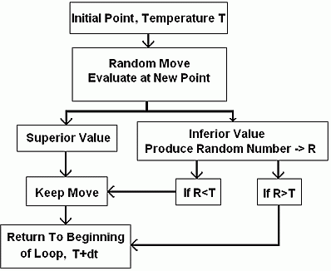
Simulated Annaeling
We started this algorithm with an initial temperature and cooling rate and also the list of holes that we have created earlier. In addition, we make system cooler at every iteration with the cooling rate. While doing that we swap two hole randomly in the list and then calculate the total sum. If that total sum is smaller than our current total sum we kept that randomly selected holes.

Slide 9
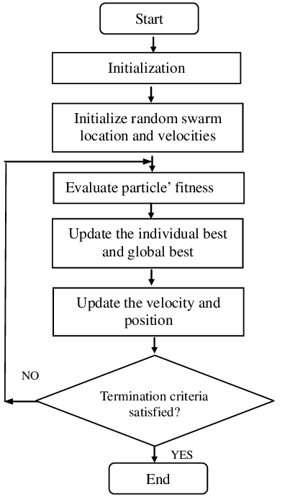
Particle Swarm
With this algorithm, we crated a class that represents each hole in the circuit with an initial velocity and position and also we have an update method that updates the velocities based on the velocity of the particle, the best velocity in the swamp. In addition we update the position of each particle’s position based on it’s velocity.

Slide 10
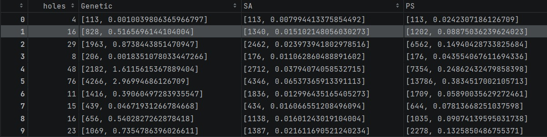
Results(Algorithm,best distance and total time)
GA is better than SA and PS for finding the minimal distance most of the time.In addition, GA seems faster than others when the dataset is relatively small. Thus using GA is the best idea when working with small datasets. However, as the number of holes increases, the amount of time that needed to run the algorithm also increases significantly. Therefore using the GA for very big datasets might be a bad idea.

Slide 11
Results(Algorithm,best distance and total time)
The ability of finding the minimum distance of SA is worse than GA and better than PS however it is faster than GA especially when the dataset becomes larger. Thus if you aim to find a relatively minimum distance and also you care about the time and your dataset is significantly larger then the best algorithm to use is SA.

Slide 12
Results(Algorithm,best distance and total time)
Using PS is the worst option at least for this problem considering it got beaten by SA in finding the minimal distance and the time consumption. Its minimum distance is significantly longer than other algorithms.

Slide 13
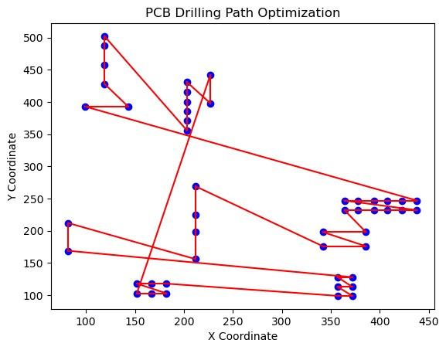
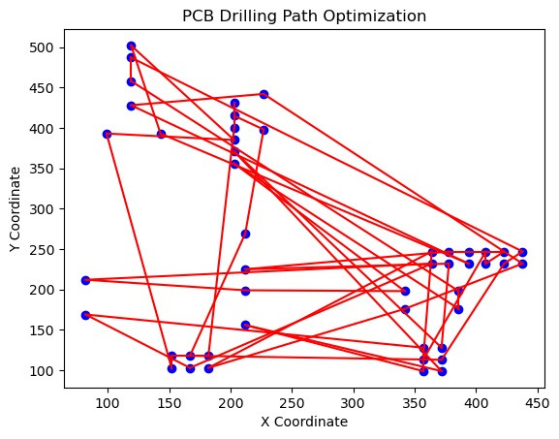
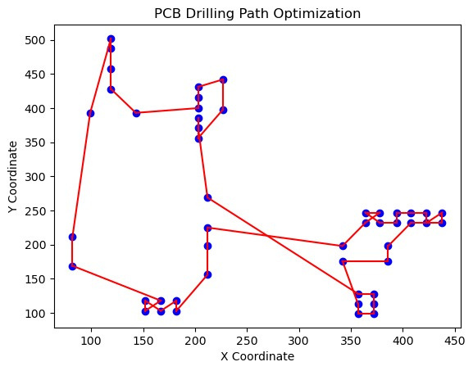
48 holes with SA
48 holes with PS
48 holes with GA

Slide 14
THANK YOU FOR LISTENING!

