Slide 1

MACHINE LEARNING COURSE PROJECT
Models Python Notebook
https://colab.research.google.com/drive/1OHVrrp4Mu4lYOimp6bpSo9kH5JsezEyY?usp=sharing
Visualization Python Notebook
https://colab.research.google.com/drive/1sFvHRP-FQY_pF0KGfxb7ZUxsv6OUxBBQ?usp=sharing
Işıl Sefünç - 26698
Yusufhan Kırçova - 26678
Faik Şahin - 21784

Slide 2
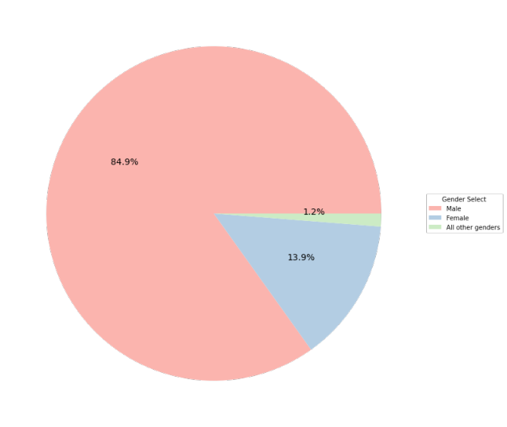
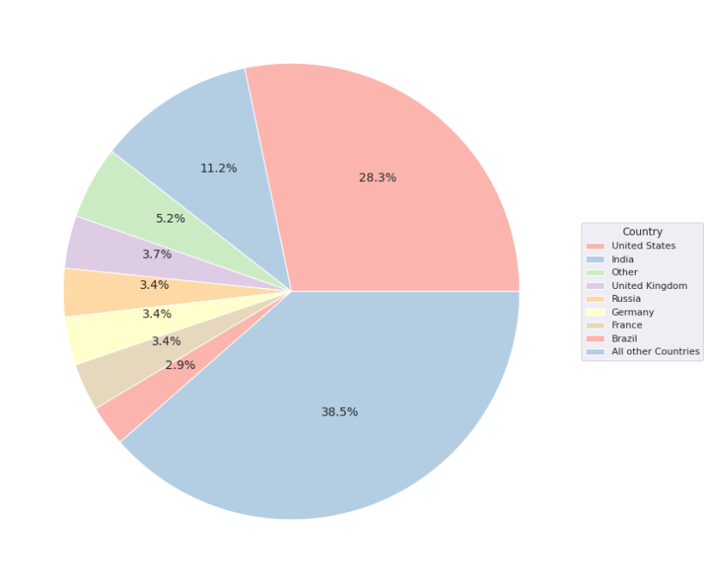
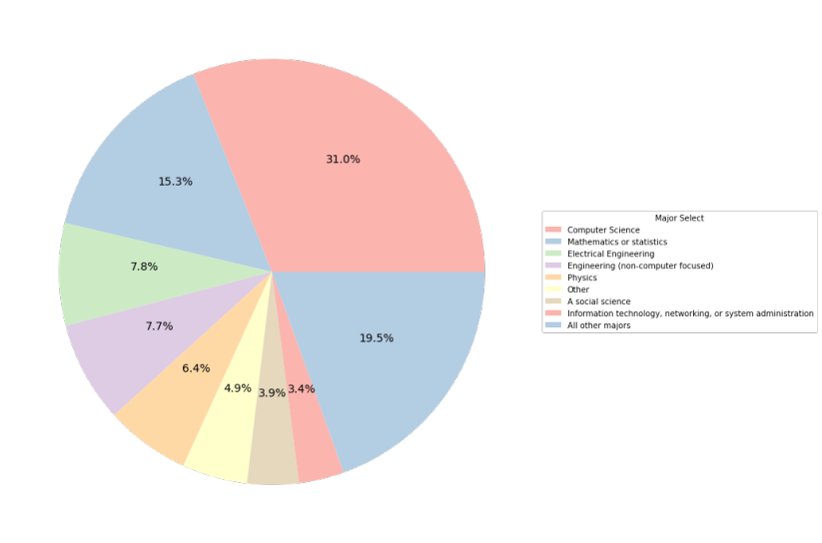
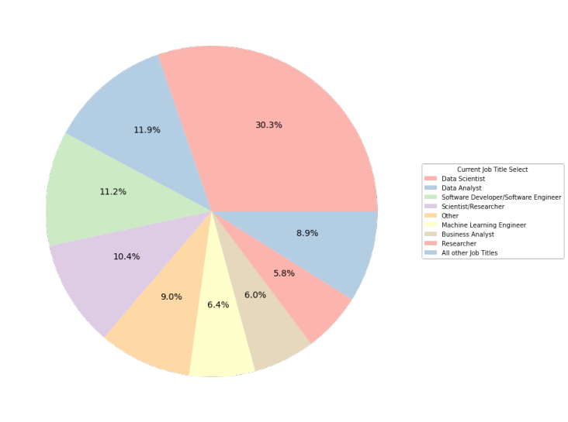
EXPLORING THE DATASET
The dataset contains 54 columns and 5530 observations
There are 42 categorical and 4 numerical variables including the target variable which is job satisfaction

Slide 3
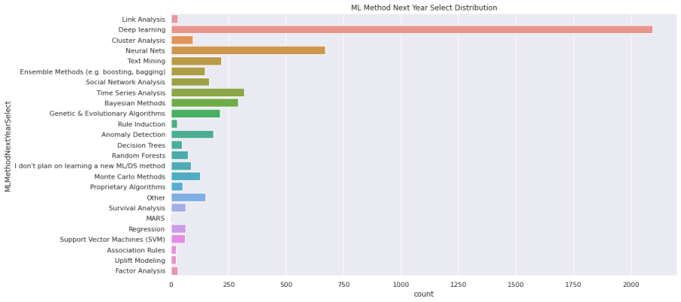
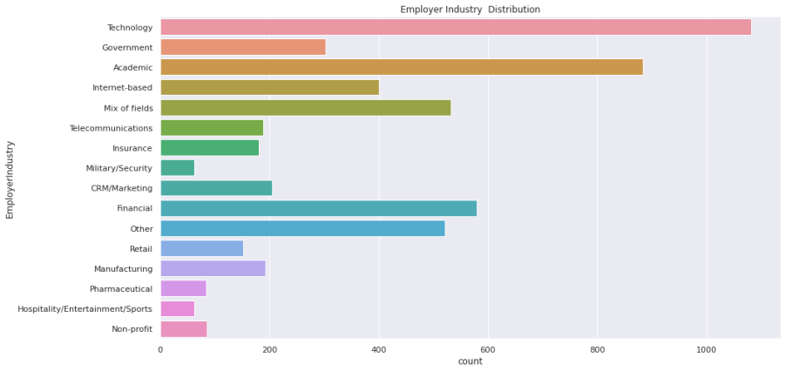

Slide 4
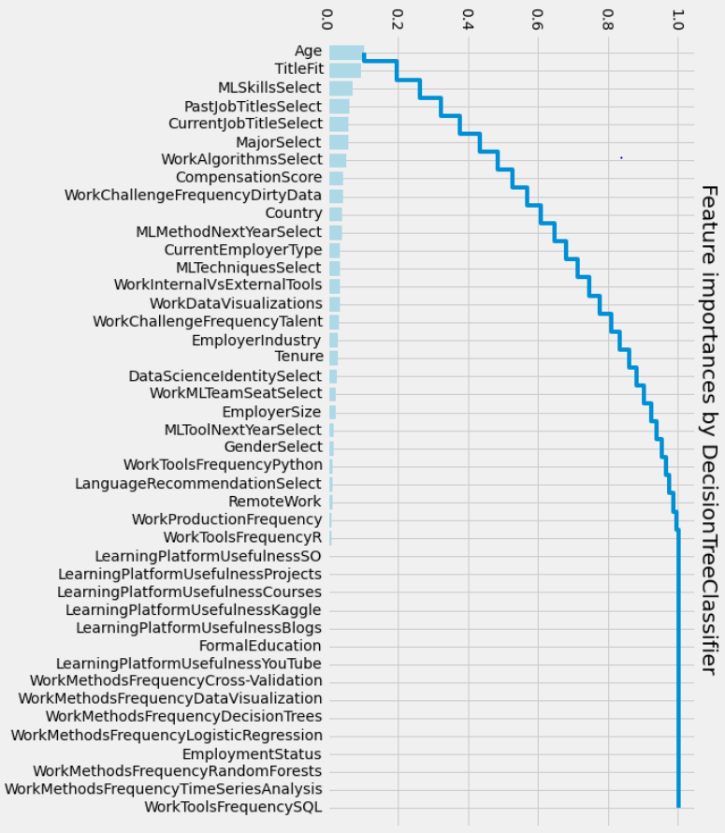
FEATURE IMPORTANCES
Age
Title Fit
How well do you feel your title suits you
ML Skills Select
Past Job Title Select
Last 10 years past job titles
Current Job Title Select
Major Select
University Major
Work Algorithm Select
What algorithms do you use in your job?
Compensation Score
Work Challenge Frequency Dirty Data
Country

Slide 5
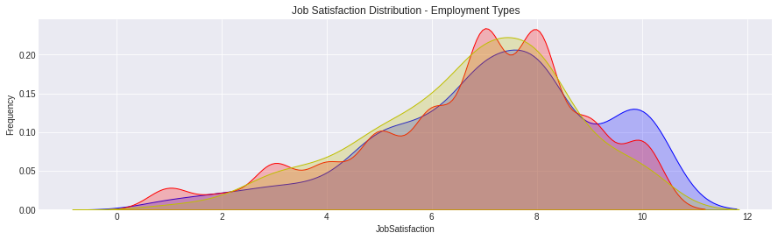
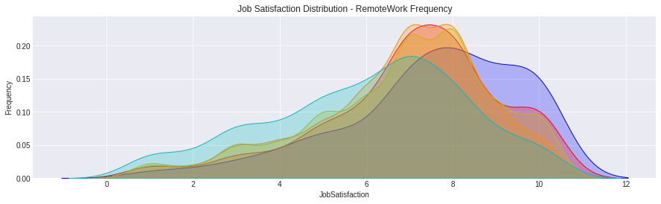
Freelancer
Employed part-time
Employed full-time
Always
Most of the time
Sometimes
Rarely
Never

Slide 6
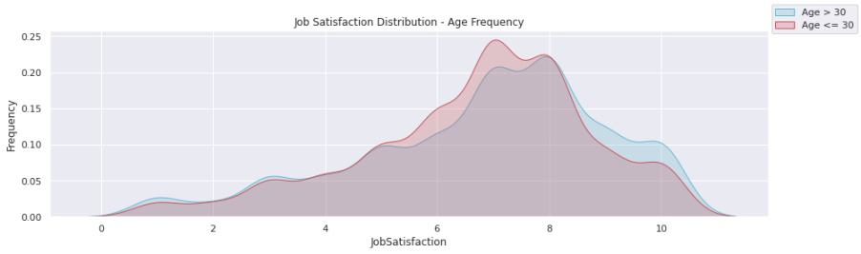
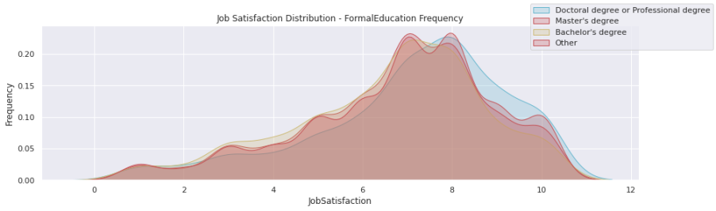

Slide 7
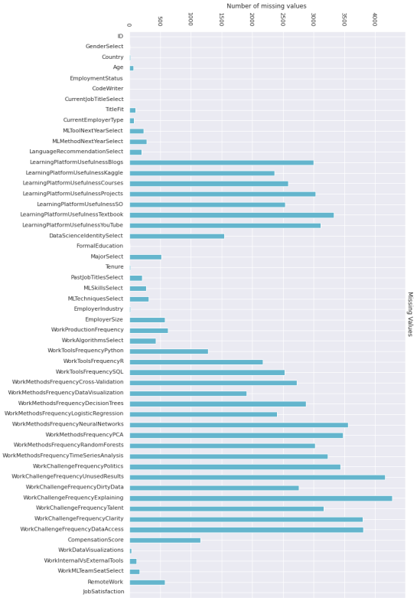
Dropped ID Column
Dropped columns which had more than 60% of empty rows
(NaN Value)
Dropped columns regarding their unique label count (Dropped columns which had 1 unique label or more than 1000 unique labels)
Mapped attributes which have hierarchical relationship
(Ordinal Categories)
Created new columns out of the attributes which consisted of lists
Target variable was determined as Job Satisfaction
Performed one hot encoding of categorical features
Calculated correlation scores and dropped columns which had lower correlation score than -0.009 or 0.009 correlation with target variable
‘Past Job Titles Select’ , ‘ML Skills Select
Replaced remaining NaN values with mode of the columns
PREPROCESSING

Slide 8
Machine Learning Models Utilized
ML Models
Gradient Boost Regressor
RMSE is 2.0131283795394395
Random Forest Regression
RMSE is 2.029846419720492
K-Neighbors Regressor
RMSE is 2.0644345761356817
SVC (Support Vector Classifier)
RMSE is 2.2453504943475955
Even though the problem we are facing is a regression problem we wanted to try SVC to test its performance

Slide 9
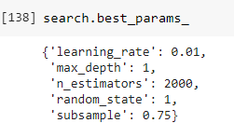
Gradient Boosting Regressor
ML Models
Hyperparameter Tuning
Hyperparameter tuning is used to set the value of parameters that the algorithm cannot learn on its own.
There are multiple hyperparameters we need to arrange
-Number of Estimators; Number of estimators is the number of boosting stages to be performed by the model. -Maximum Depth; The maximum depth is the depth of the decision tree estimator in the gradient boosting regressor. -Learning Rate; The learning rate is a hyper-parameter in gradient boosting regressor algorithm that determines the step size at each iteration while moving toward a minimum of a loss function. -Subsample; Subsample is fraction of samples used for fitting the individual tree learners.
Made an instance of the GradientBoostingRegressor and created our grid with the various values for the hyperparameters
Determined the best combination of hyperparameters.

Slide 10
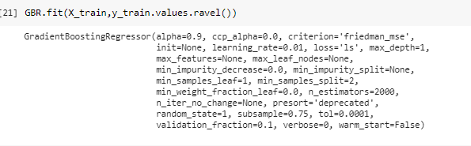
Gradient Boosting Regressor
ML Models
Training the GBR model
Made an instance of the GradientBoostingRegressor with using the best hyperparameters we found
Created an instance, GBR, of the class GradientBoostingRegressor, by passing the best hyperparameters, to the constructor.
Fit method was called on the model instance and it predicted y values

Slide 11
ML Models
Gradient Boosting Regressor
Model Evaluation
Root Mean Square Error(RMSE) on test data is 1.96966
Root Mean Square Error (RMSE) of mean of the cross-validation score is 2.0060102251564653
Gradient boosting is used to improve a regression tree by creating multiple models.
Gradient Boost Regressor will have a better performance than other methods which we have used in our project.
Advantages of Gradient Boosting
Higher flexibility: Gradient Boosting Regression can be used with many hyper-parameter and loss functions. This made the model highly flexible and it can be used to solve a wide variety of problems.
Better accuracy: Gradient Boosting Regression provided us better accuracy. When we compare the accuracy of GBR with other models we tried

Slide 12
Gradient Boost Regressor
ML Models
Root Mean Square Error (RMSE) is 1.96966
Root Mean Square Error (RMSE) of mean of the cross-validation score is 2.0131283795394395
In gradient boosting, each predictor corrects its predecessor’s error. The weights of the training instances are not tweaked, instead, each predictor is trained using the remaining errors of predecessor as labels.
Made an instance of the GradientBoostingRegressor and created our grid with the various values for the hyperparameters
Determined the best combination of hyperparameters.
search_grid={'n_estimators':[500,1000,2000],
'learning_rate':[.001,0.01,.1],
'max_depth':[1,2,4],
'subsample':[.5,.75,1],
'random_state':[1]}

Slide 13
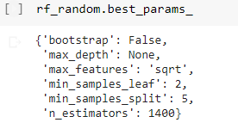
Random Forest Regression
ML Models
Root Mean Square Error (RMSE) is 1.98727
Root Mean Square Error (RMSE) of mean of the cross-validation score is 2.029846419720492
Random Forest has multiple decision trees as base learning models. Randomly performed row sampling and feature sampling from the dataset forming sample datasets for every mode
Improving the performance
Each hyperparameter’s range was narrowed down using RandomizedSearchCV
3-fold cross validation is used to search across 100 different combinations, found the best hyperparameter combination.
Using the best hyperparameters, a prediction was made regarding job satisfaction score.

Slide 14
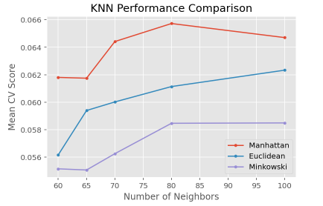

K-Neighbors Regressor
ML Models
Root Mean Square Error (RMSE) of mean of the cross-validation score is 2.0644345761356817
The KNN algorithm assumes that similar job satisfactions exist in closer proximity. KNN captures the idea of similarity with calculating the distance between points on a graph
First, we define a dictionary of KNN parameters for the grid search. Here, we will consider K values between 60 and 100 and p values of 1 (Manhattan), 2 (Euclidean), and 5 (Minkowiski)
Then we pass KNeighborsRegressor() and KNN_params as the model and the parameter dictionary.
After repeating 5-fold cross-validation three times, we observe that the optimal parameters are :
Visualizing the hyperparameter tuning from the cross-validation:

