Slide 1
AWS Auto Scaling
Application scaling to
optimize performance and costs
Team or presenters name:
Date

Slide 2
Table of contents
Amazon EC2 Auto Scaling
Scaling Strategies
Edge Case Scenarios
Lifecycle Hooks
Best Practices
New Features
CloudFormation Support for Autoscaling

Slide 3
Amazon EC2 Auto Scaling

Slide 4
Scaling Strategies
Simple Scaling
Active cooldown period suspends all scaling activities
Aggregates metrics for new instances
Step Scaling
Only suspends new instance launches in same step
Doesn’t aggregate metrics of new instances.
No effect of warmup period on scale down
Target Tracking
Select metric to scale against
Specify Target value for metric
Disable Scale-in to scale down aggressively

Slide 5
Edge Case Scenarios
Scaling Issues: Why didn't my Auto Scaling Group scale up/down
Possible Causes:
Desired already at Min or Max capacity
Alarm was not breached
Suspended processes
Overlapping scaling policies
In cooldown/ warmup period
Lifecycle hook incomplete
Instance Limits (EC2 or EBS limits)

Slide 6
More Edge Case Scenarios
Race Condition: Scheduled scaling policy did not get triggered.
Issue:
If dynamic scaling and scheduled scaling happens at approximately same time .
Cause :
Two consecutive scaling policy are triggered at same time
autoscaling picks the latest policy update

Slide 7
Additional Edge Case Scenarios
Health Check Issues: Auto Scaling did not terminate the instance failing health checks.
Possible Causes:
Health check type
Advanced health checks
Suspended processes
Instance recovered it’s health before autoscaling checks
Health check throttling

Slide 8
One More Edge Case Scenario
Rebalancing: Auto Scaling group exceeded max capacity.
Possible Cause:
If at your max group size, rebalancing can cause max to be exceeded by a 10 percent margin (or by a 1-instance margin, whichever is greater) during a rebalancing activity. This only lasts whilst rebalancing.
NOTE: Auto Scaling only rebalances once it reaches desired capacity

Slide 9
Lifecycle Hooks

Slide 10
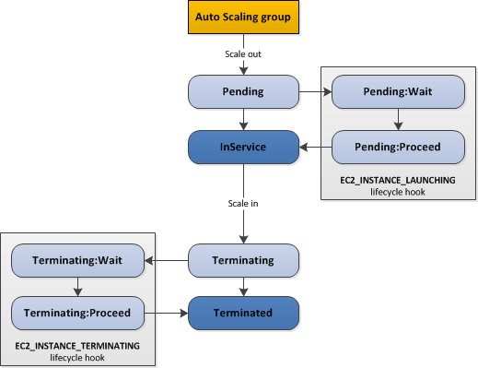
Lifecycle Hooks
Lifecycle hooks enable you to perform custom actions by pausing instances as an Auto Scaling group launches or terminates them.

Slide 11

Best Practices
“Everything fails all the time”
Werner Vogels, VP & CTO at Amazon.com
DESIGN FOR FAILURE
Failures should be expected and planned for
Use Route 53 failover with health checks

Slide 12
New Features

Slide 13
Mixed Instance Group (MIG)
What is Mixed Instance Group?
Create ASG that spans across purchase options (On-demand, Spot, RI)
“Prioritized” On-Demand strategy
“Flexible” On-Demand strategy (***internal customers only)
“Lowest price ‘n’ pools” Spot strategy

Slide 14
MIG Configuration Example
Mixed On-demand and Spot Instances: Scaling out on on-demand instances for the first 12 instance and maintain a 50:50 ratio between on-demand and spot instances beyond that
{ "MixedInstancesPolicy": {
"LaunchTemplate": {
"LaunchTemplateSpecification": {
"LaunchTemplateName": "LaunchTemplateA",
"Version": "$latest" },
"Overrides": [
{"InstanceType": "c5.large"},
{"InstanceType": "c4.large"},
{"InstanceType": "c3.large"}]},
"InstancesDistribution": {
"OnDemandAllocationStrategy": "prioritized",
"OnDemandBaseCapacity": 12,
"OnDemandPercentageAboveBaseCapacity": 50,
"SpotAllocationStrategy": "lowest-price", "SpotInstacePools": 2
} }}

Slide 15
Predictive Scaling
Predictive Scaling
This helps predicts future traffic based on daily and weekly trends, including regularly-occurring spikes, and provisions the right number of EC2 instances in advance of anticipated changes, machine learning algorithms detect changes in daily and weekly patterns, automatically adjusting their forecasts and provisions the right amount of instances.

Slide 16
Instance Weighing
Specify capacity units for each instance type in ASG
Specify instance weight that maps to application performance
Addresses Security and Compliance requirements

Slide 17
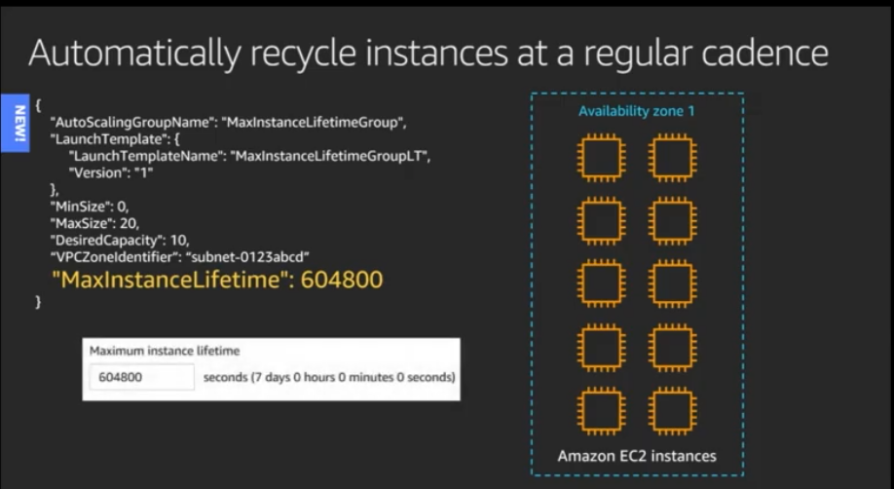
Time based lifetime
Set Max Instance Lifetime parameter
Automatically recycle instances
Addresses Security and Compliance requirements
Notes:
To maximize visibility, when placing a logo on Squid Ink we recommend getting a white version of the logo with a transparent background. If this is not possible you should use the slide for logos with the white background.

Slide 18
CloudFormation support for Autoscaling
Amazon EC2 Autoscaling supports CloudFormation ,see a simple sample script below :
{
"Type" : "AWS::AutoScaling::AutoScalingGroup",
"Properties" : {
"AutoScalingGroupName" : String,
"AvailabilityZones" : [ String, ... ],
"Cooldown" : String,
"DesiredCapacity" : String,
"HealthCheckGracePeriod" : Integer,
"HealthCheckType" : String,
"LaunchConfigurationName" : String, "LaunchTemplate" : LaunchTemplateSpecification,
"LifecycleHookSpecificationList" :[LifecycleHookSpecification, ... ],
"MaxSize" : String,
"MinSize" : String,
"VPCZoneIdentifier" : [ String, ... ]
}
}

Slide 19
Q&A
Name of presenter

Slide 20
Thank you

