Slide 1
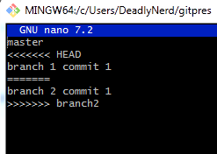
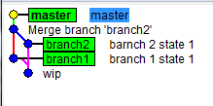
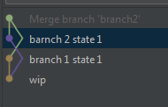
Merge 2 branch u master
git checkout master
git merge branch1
git merge branch2
# resolve conflict
git add .
git merge –continue

Slide 2
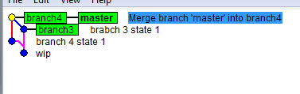
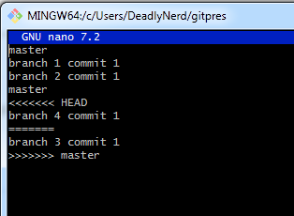
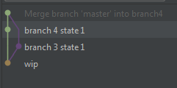
merge master into branch, merge branch into master
git checkout master
git merge branch3
git checkout branch4
# resolve conflict
git add .
git merge –continue
git merge master
git checkout master
git merge branch4

Slide 3

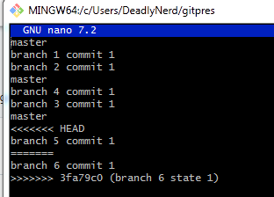

merge branch into master, rebase drugi branch, merge into master
git checkout master
git merge branch5
git checkout branch6
git rebase master
# resolve conflict
git add .
git rebase –continue
git checkout master
git merge branch6

Slide 4
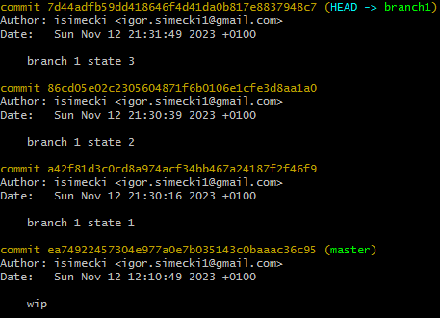
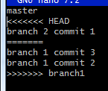
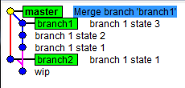
više commitova? squash
git checkout master
git merge branch2
git merge branch1
# next page

Slide 5
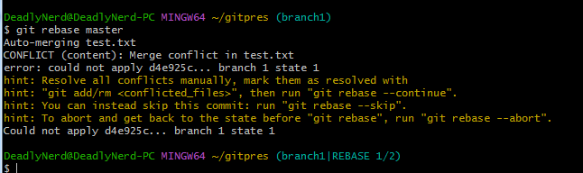
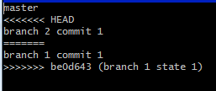
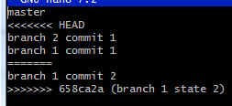
git checkout master
git merge branch2
git checkout branch1
git rebase master
# REBASE 1/2

Slide 6
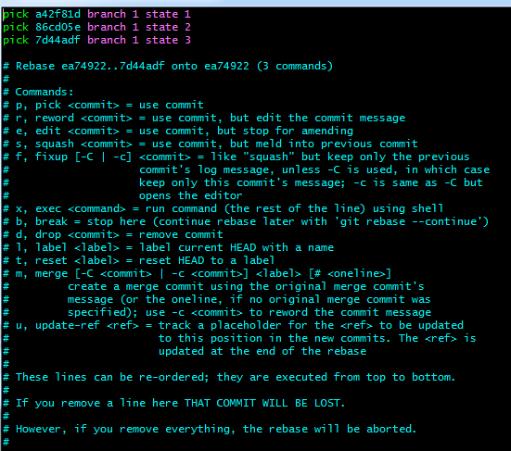

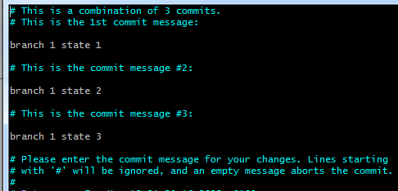
squash - interactive rebase
git checkout master
git reset –hard origin/head
git checkout branch1
git rebase -i head~3
# ovo je vim pa esc -> :wq -> enter

Slide 7
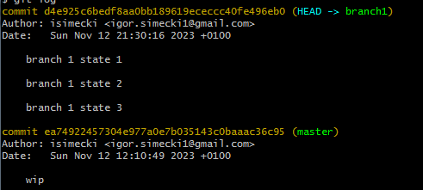
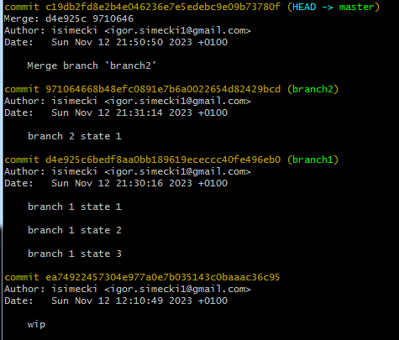
novi history
novi hash commita

Slide 8
git reset –soft
git reset –soft head~3
git add .
git commit -m ‘novi message’
git reset –soft hash-prvog-commita-prije-tvojih
git add .
git commit -m ‘novi message’

Slide 9
rebase troubleshooting
git rebase –continue
# nastavi s rebaseom, svi conflictovi moraju biti trackani s git add
git rebase –skip
# preskoči commit, ali se nastavlja rebase
git rebase –abort
# zaustavi rebase proces i vrati se na zadnji commit brancha

