Slide 1
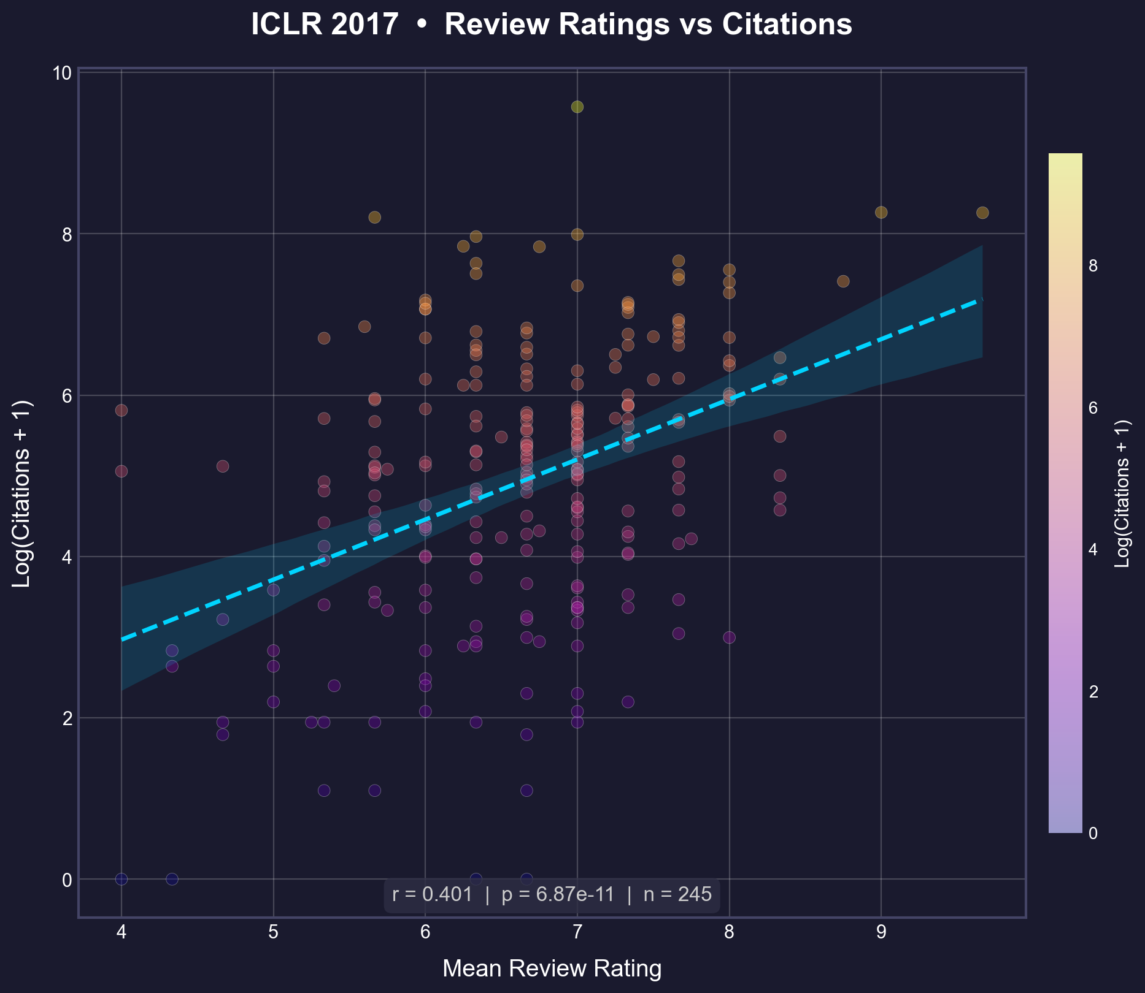
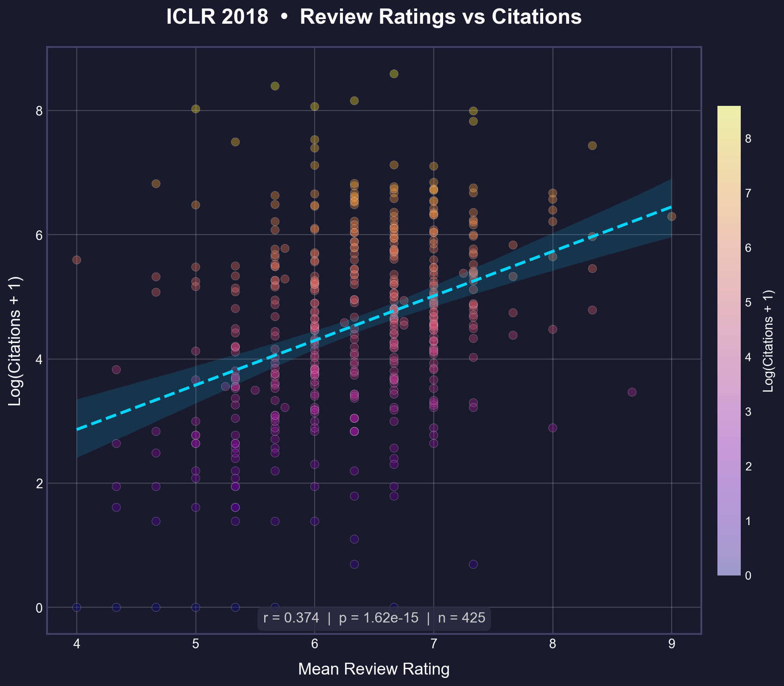
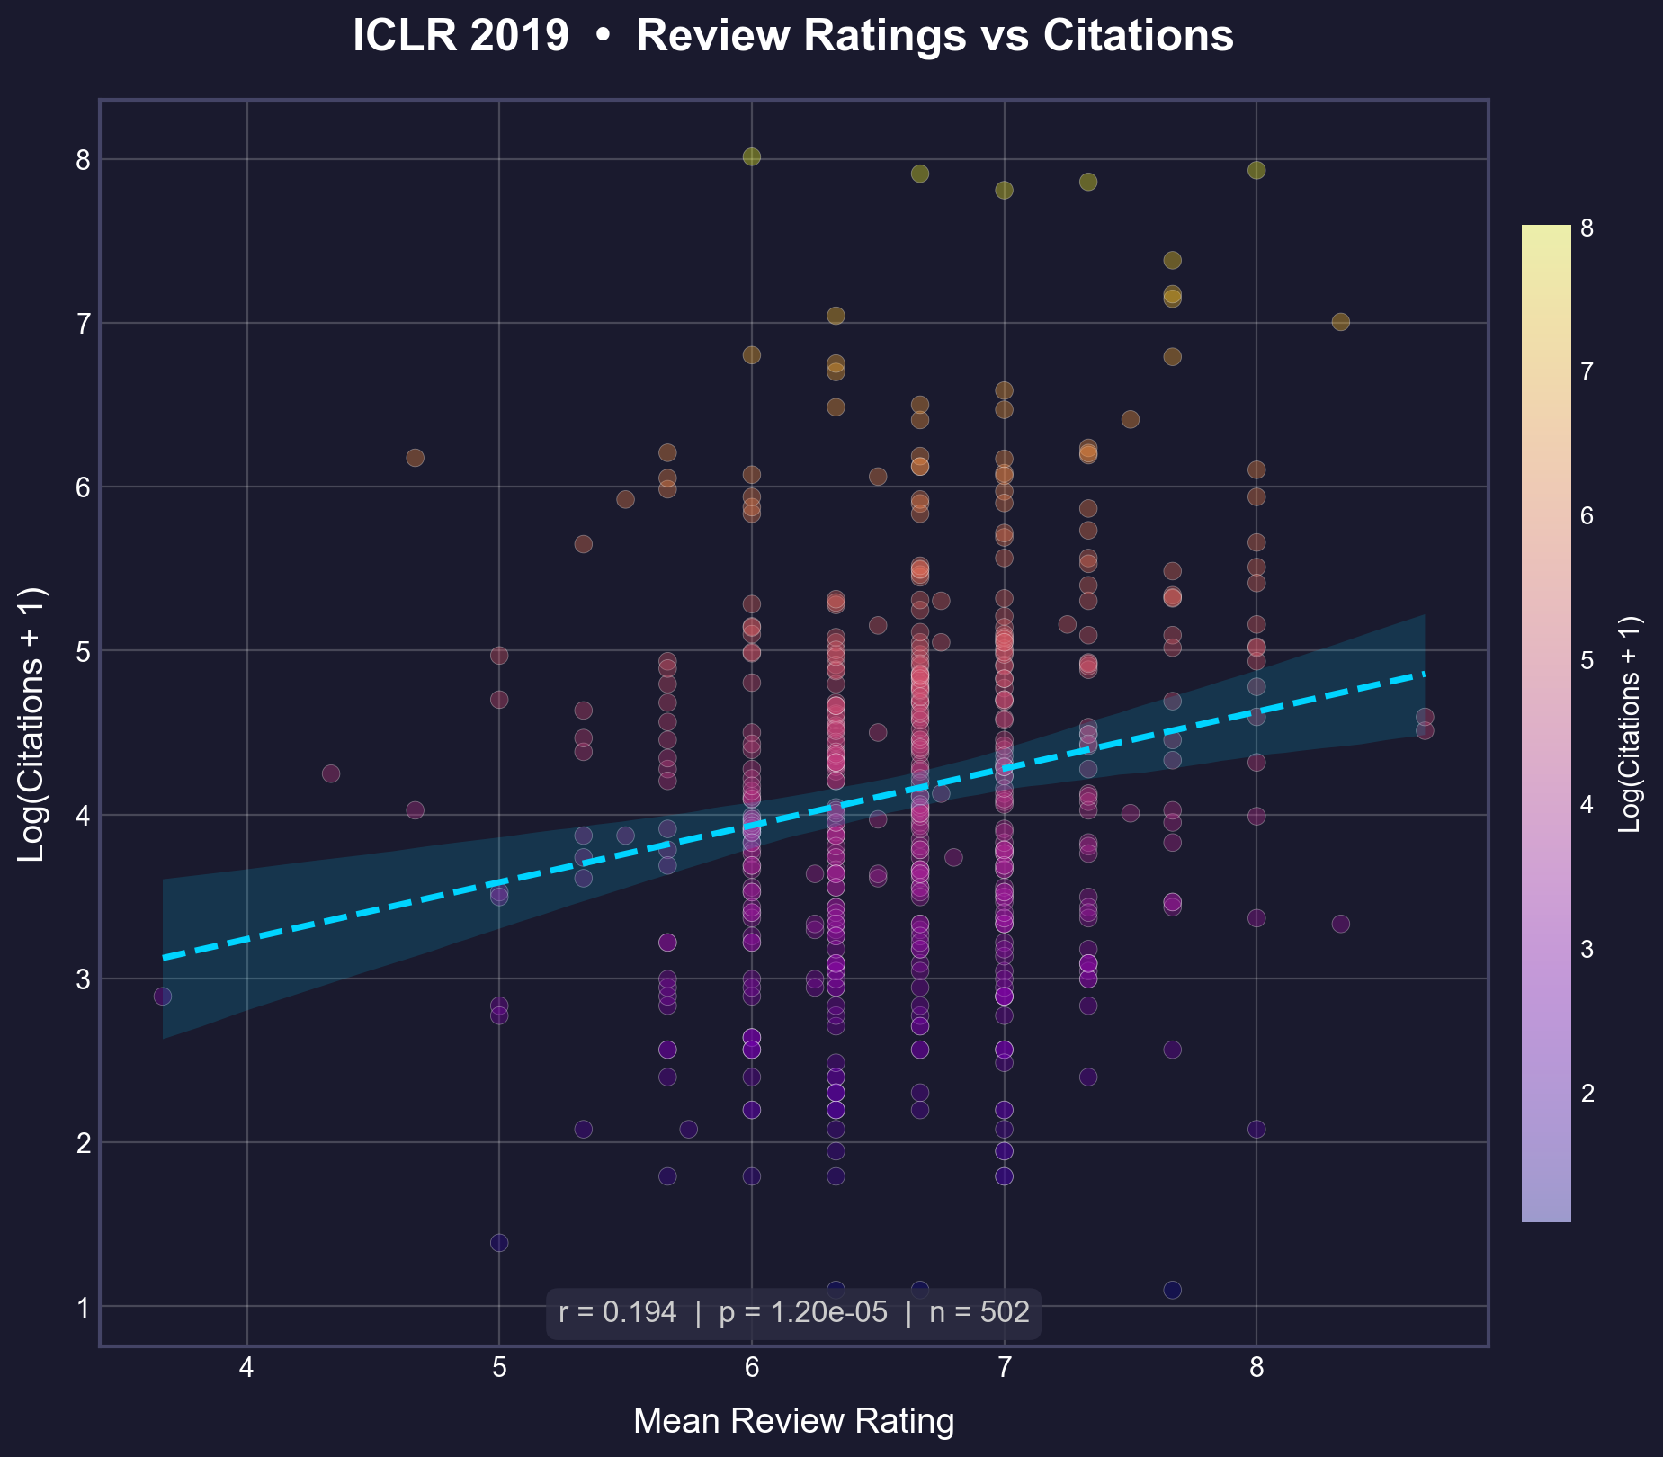
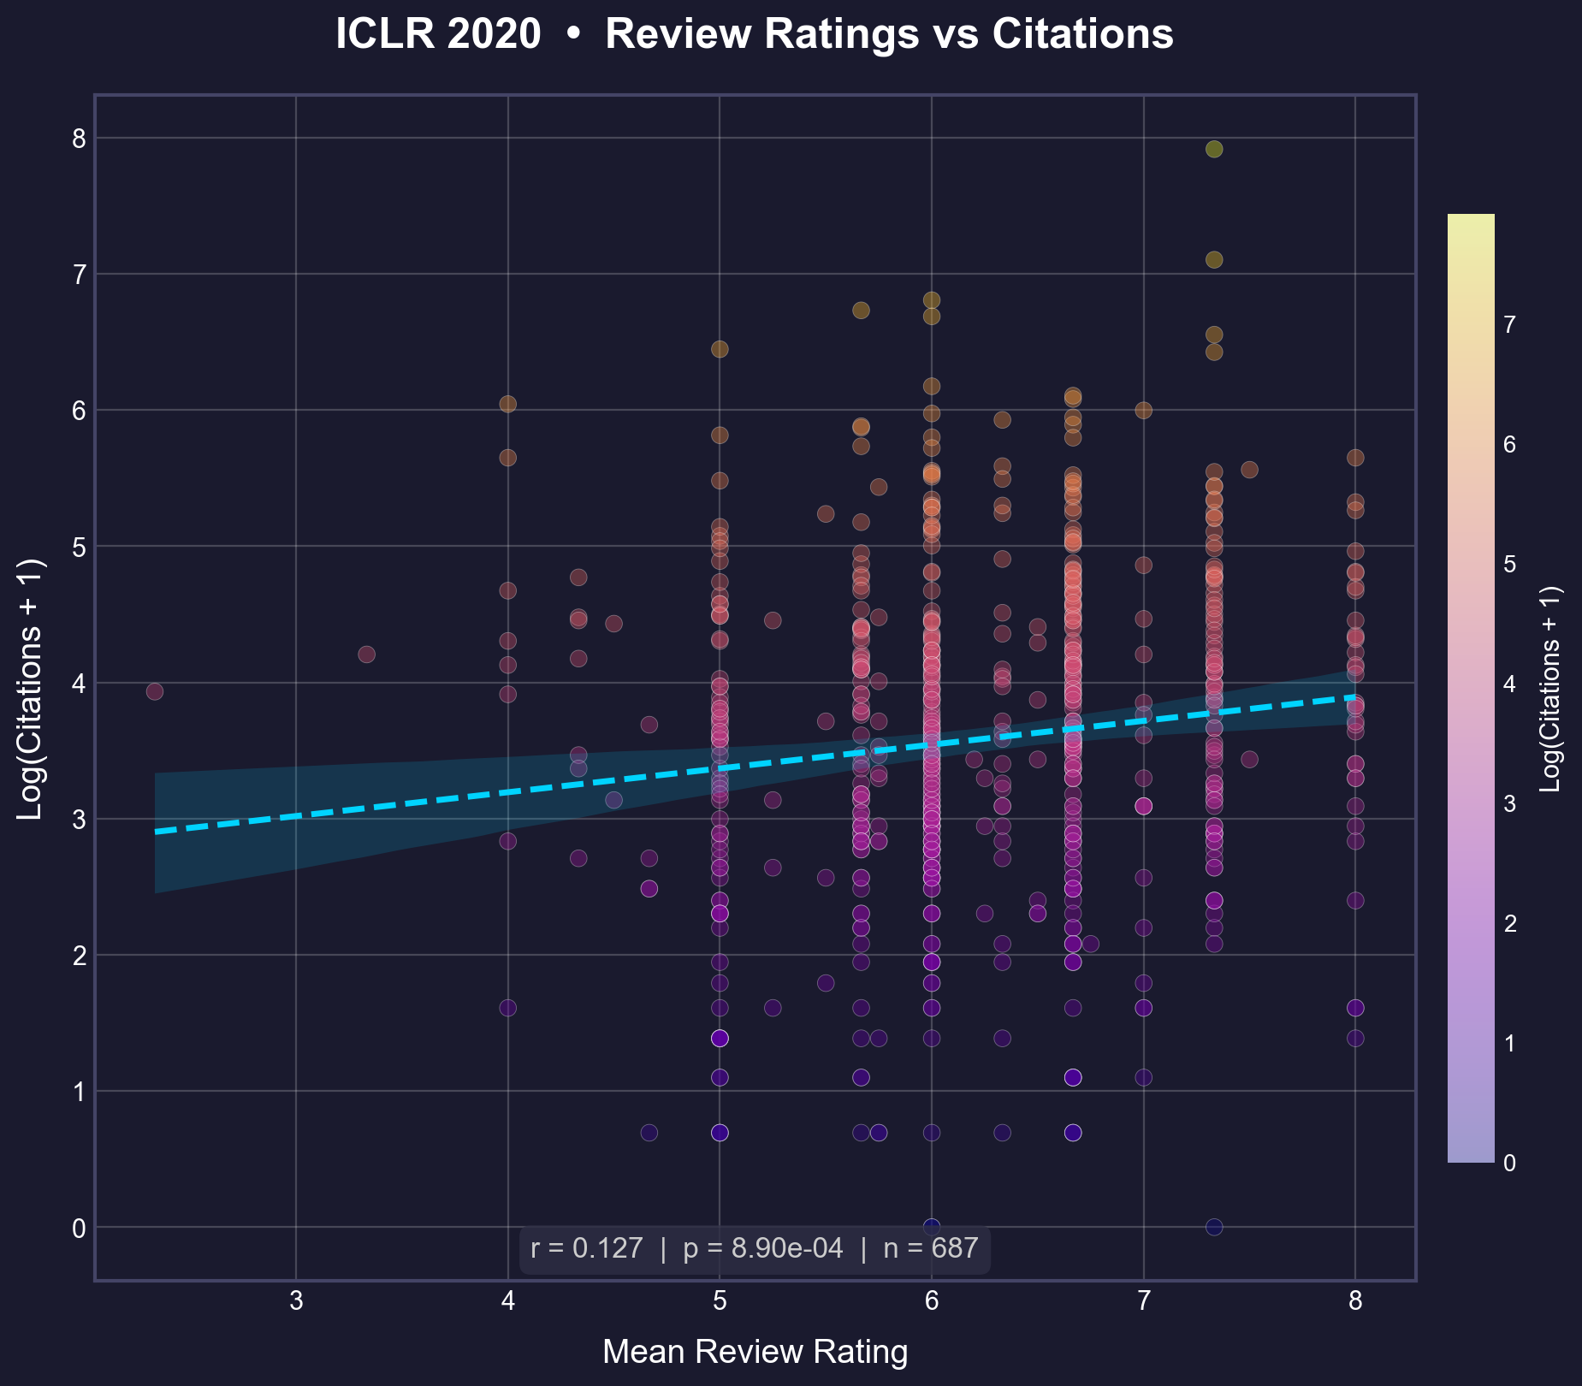
📊 Do Peer Review Scores Predict Scientific Impact?
Empirical Analysis of ICLR Papers (2017-2020) • PyCon Korea 2022
🔍 Key Finding
Correlation between ratings and citations is declining over time (r: 0.40 → 0.13)
Year | Papers | r | p-value
2017 | 245 | 0.40 | 6.9e-11
2018 | 425 | 0.37 | 1.6e-15
2019 | 502 | 0.19 | 1.2e-05
2020 | 687 | 0.13 | 8.9e-04
📐 Methodology: Pearson correlation on log(citations+1)
Log transform reduces outlier dominance in heavy-tailed citation distributions
github.com/isingmodel/openreview_ratings_vs_citations

