Slide 1
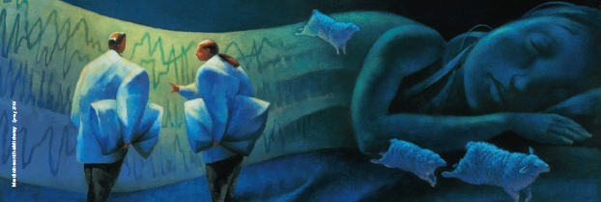
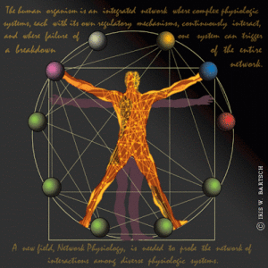

Interacting networks of sleep and wake-promoting neurons and their role in triggering arousals from sleep
ISINP 1.8.19
Ronny Bartsch

Slide 2
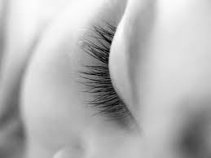

Acknowledgements
Collaborators:
Hila Dvir, Shlomo Havlin – Physics Department, Bar-Ilan University
Lior Appelbaum – Faculty of Life Sciences, Bar-Ilan Univ.
Plamen Ch. Ivanov – Keck Laboratory for Network Physiology, Boston University
Grants:
Marie Curie Fellowship (IIF), German-Israeli Foundation (GIF)

Slide 3
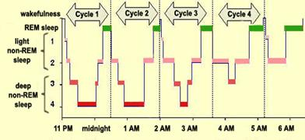
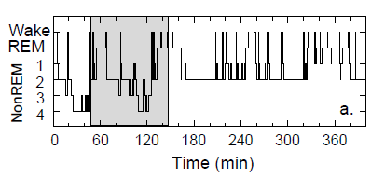
Sleep dynamics – Conventional view and Observations
Sleep dynamics exhibit ultradian rhythms with ~ 90 min period comprised of light sleep, deep sleep and REM sleep → “Sleep Cycle”
Textbook:
Reality:
Brief awakenings from sleep (arousals) on scales of sec to min appear random in time and occur throughout the sleep period

Slide 4
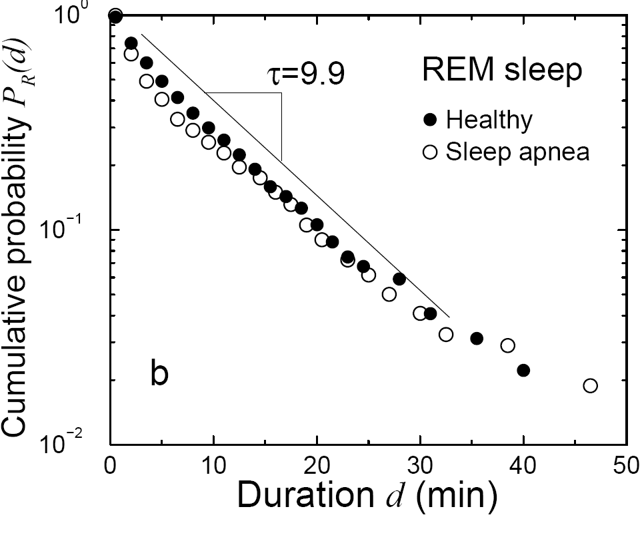
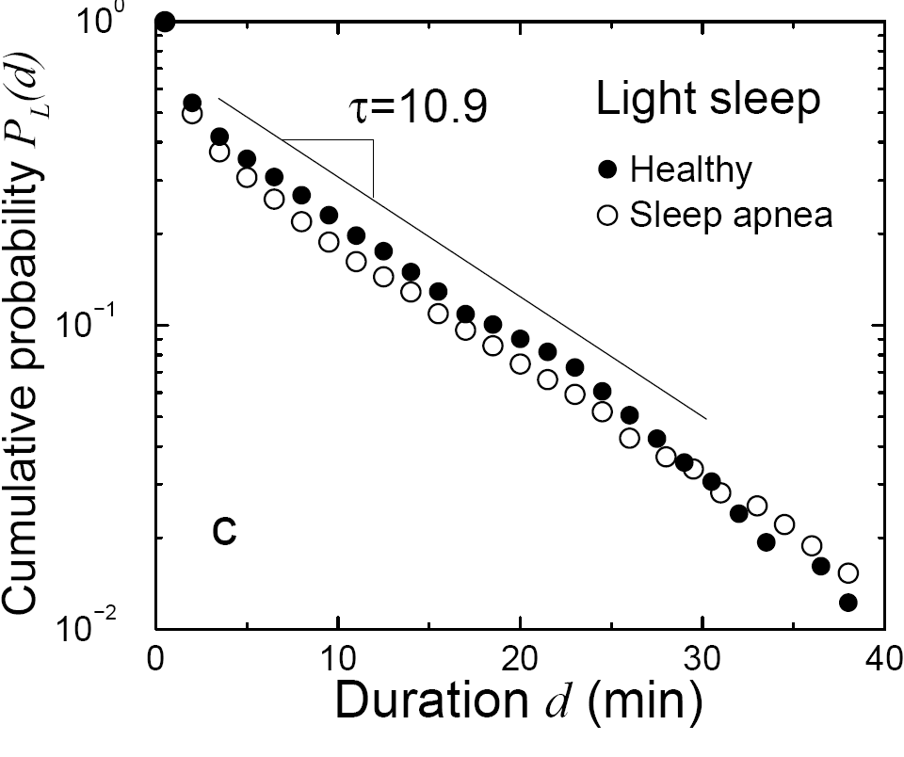
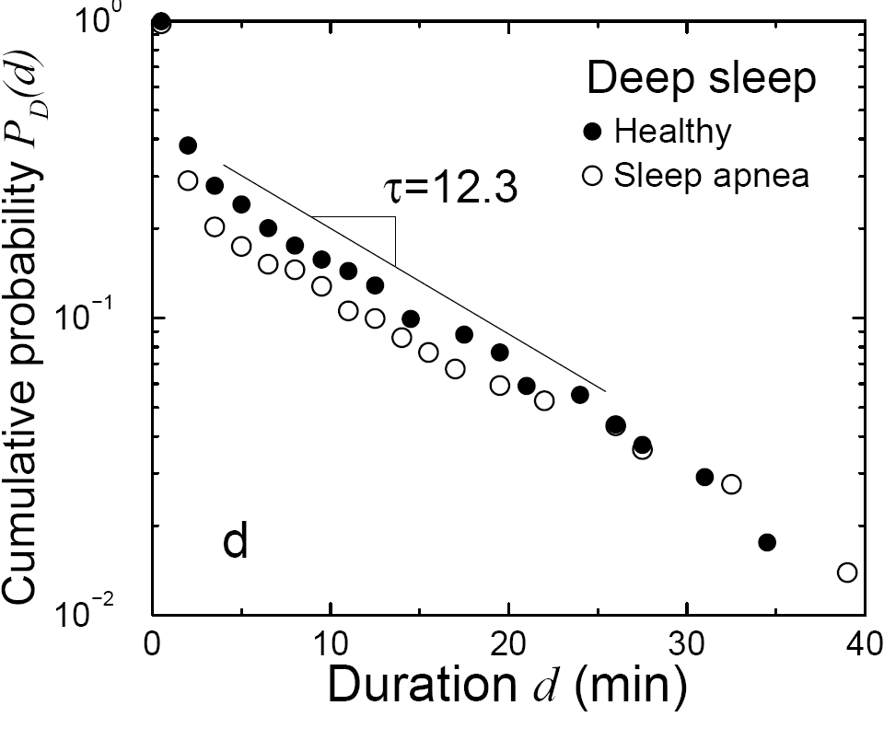
Probability distributions of arousal and sleep-stage durations
… cumulative probability distribution
… probability density function to find sleep stage k with duration d
Lo, Bartsch, Ivanov, EPL 102, 10008 (2013)

Slide 5
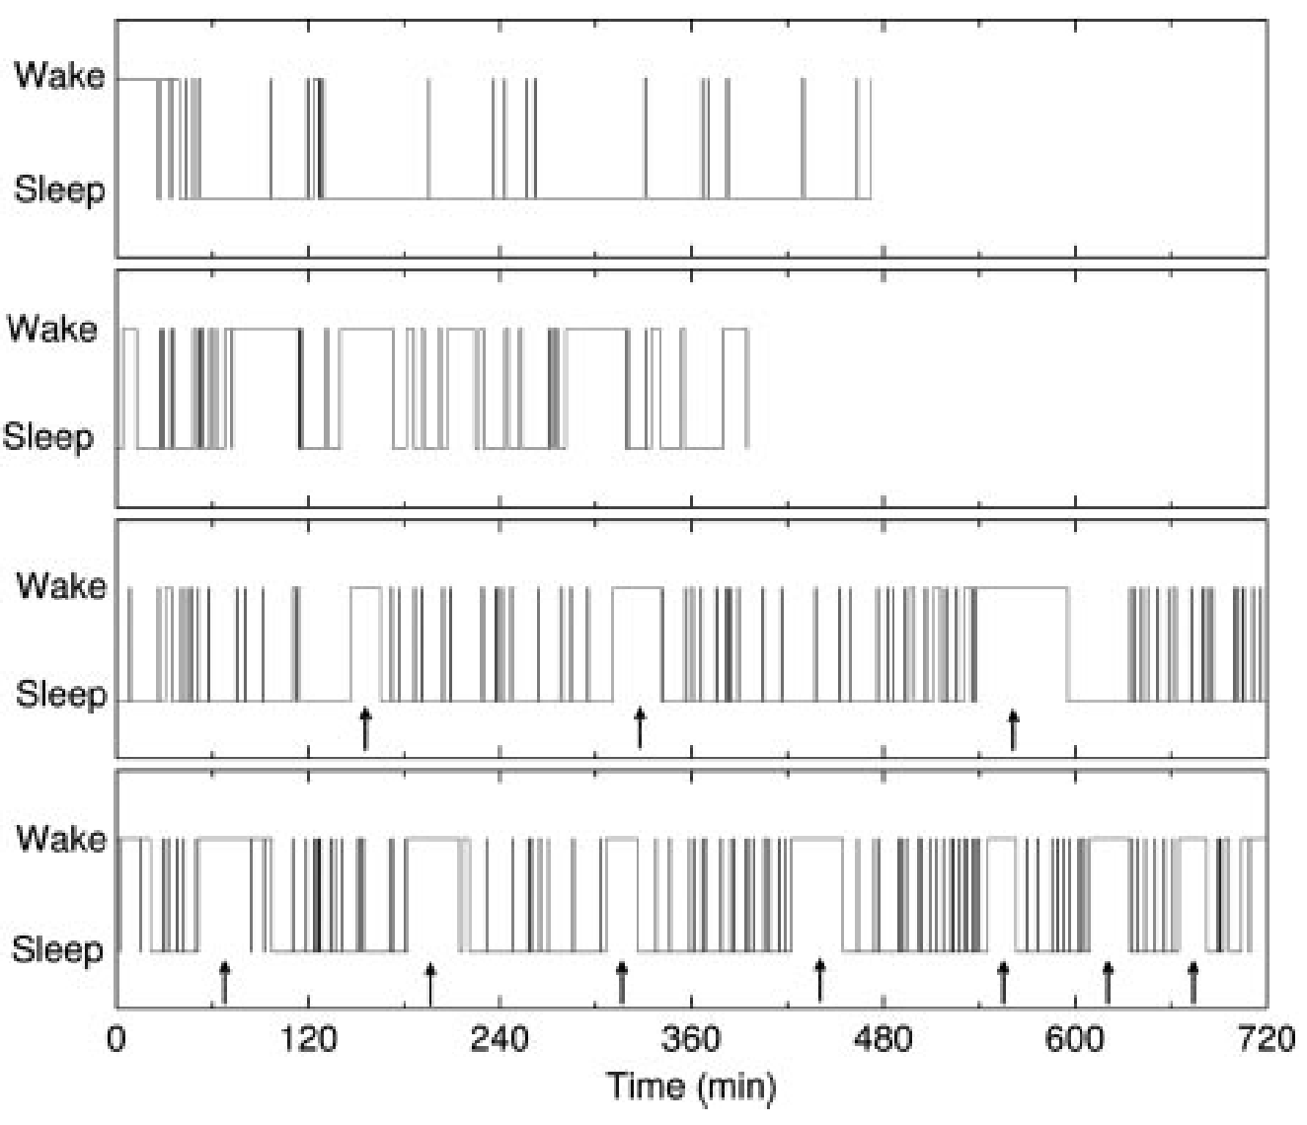
Probability distributions of arousal/sleep durations across species
Human
Cat
Rat
Mouse
Lo, Ivanov et al., PNAS 101, 17545 (2004)

Slide 6
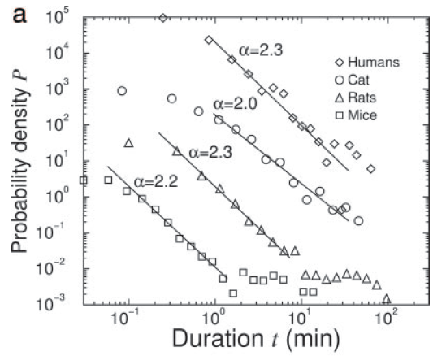
Probability distributions of arousal/sleep durations across species
→ Co-existence of both scale-invariant (power-law) and exponential (with a characteristic time scale) processes as an output of a single sleep regulatory mechanism across various mammalian species
→ Has not been observed in other integrated physiological systems under neural regulation
Lo, Ivanov et al., PNAS 101, 17545 (2004)

Slide 7
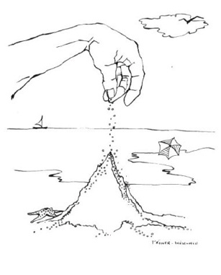
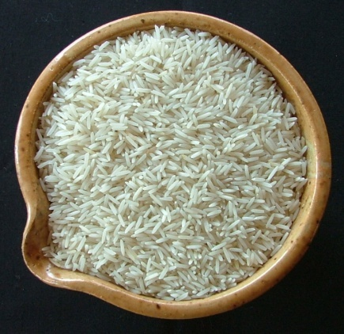

Relation to self-organized criticality (SOC)
Sandpile Metaphor
Bak-Tang-Wiesenfeld model
slowly driven
non-equilibrium steady state
avalanche of any size
power law statistics of avalanche size
waiting times between avalanches are exponentially distributed
Bak: “self-organized criticality”
Jens Feder et. al (1995): SOC found in rice piles
Basmati Rice!

Slide 8
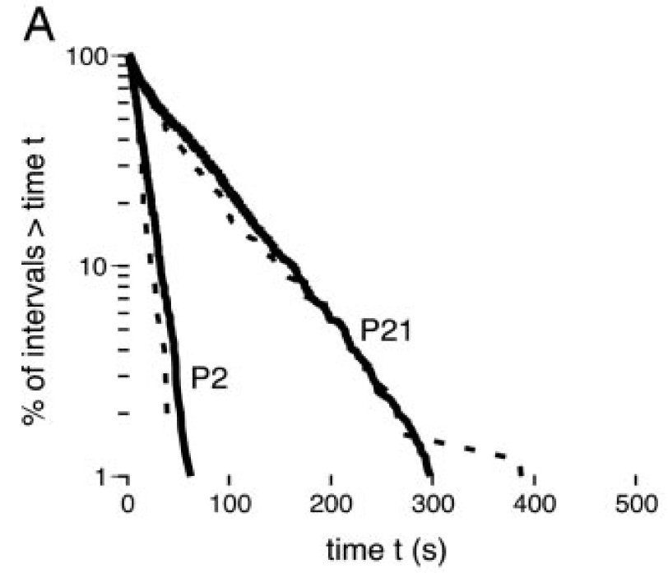
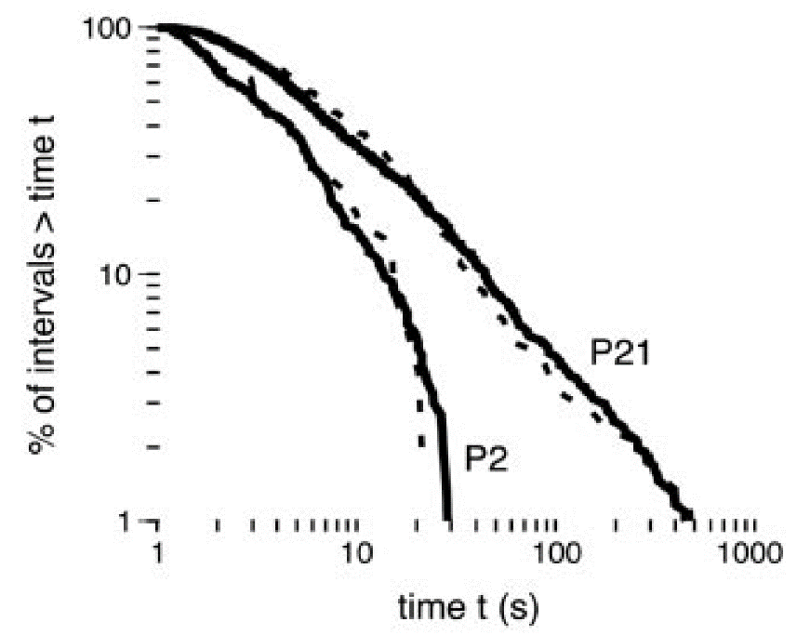
Dynamic characteristics of sleep/wake transitions –
Scaling changes with maturation in rats
Sleep
Wake
Power-law during wake gradually emerges with maturation.
M.S. Blumberg, A.M.H. Seelke, S.B. Lowen, K.A.E. Karlsson, “Dynamics of sleep-wake cyclicity in developing rats”, PNAS 102: 14860 (2005).
Notes:
8

Slide 9
Modeling arousal dynamics
Question: Can we come up with a simple model including a network of sleep- and wake-promoting neurons to reproduce the observed arousal/sleep dynamics?
Previous work by Lo, Ivanov et al., EPL 57, 625 (2002):
biased diffusion model

Slide 10
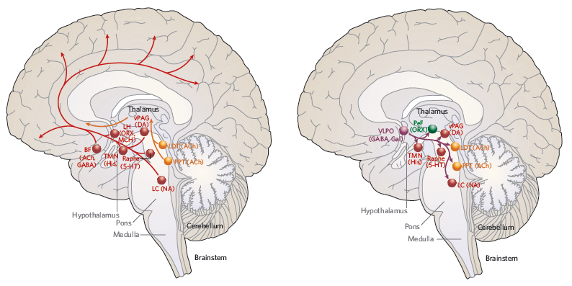
Neuronal groups and pathways involved in sleep/wake generation
Wake promoting
Sleep promoting
Cholinergic
neuronal pathway
Monoaminergic
neuronal pathway

Slide 11
Neuronal groups and pathways involved in sleep/wake generation
During Sleep
Wake promoting neurons are
suppressed by VLPO but still
have intrinsic noise
“neuronal noise”

Slide 12
Neuronal noise – origin and characteristics
“neuronal noise” = subthreshold voltage fluctuations
Two main sources (Manwani and Koch, Neural Comput. 11, 1831 (1999)):
stochastic openings and closings of voltage gated membrane channels
random background synaptic activity
subthreshold voltage fluctuations are temperature dependent and decrease with increasing temperature
(Steinmetz et al., J. Comput. Neurosci. 9, 133 (2000))

Slide 13
Modeling arousal dynamics: integrated neuronal noise of WPN can trigger arousal
Network of
wake-promoting
neurons (WPN)
Dvir et al., Science Advances 4, eaar6277 (2018)
Notes:
13

Slide 14
Modeling arousal dynamics: integrated neuronal noise of WPN can trigger arousal
during sleep
during arousal
Sleep restoring current
Notes:
14

Slide 15
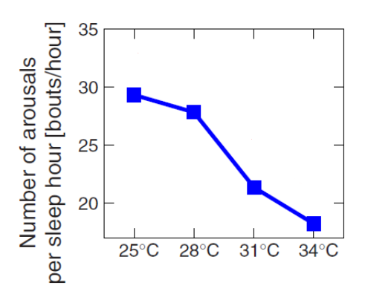
Modeling arousal dynamics: lower temperature yields more arousals?
during sleep
during arousal
Sleep restoring current
Notes:
15

Slide 16
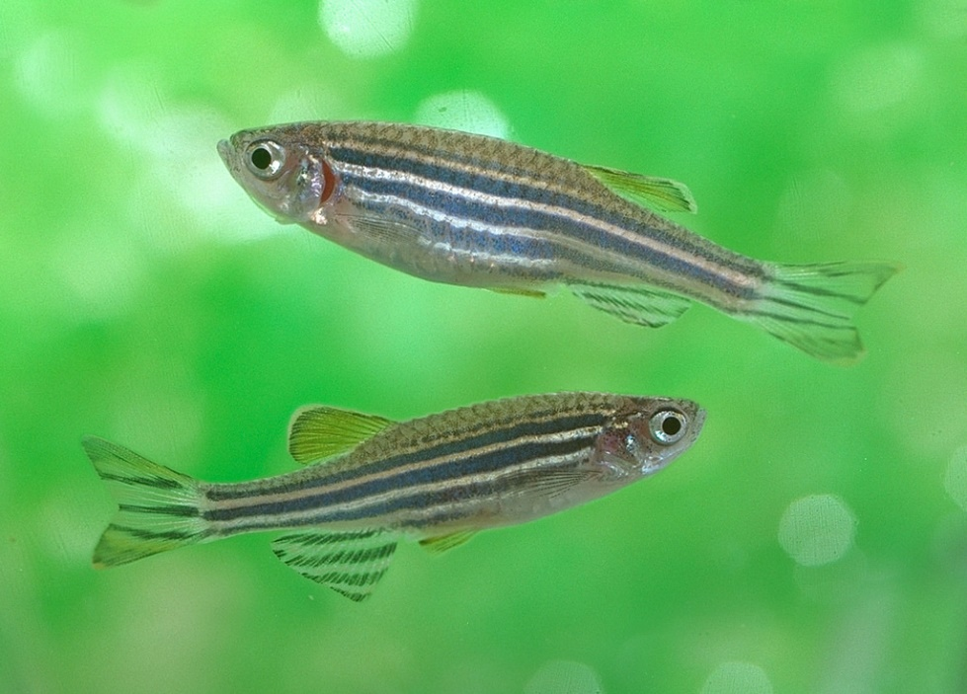
How to test model prediction experimentally?
Experiment on fish!
Study sleep/wake behavior of zebra fish at different water temperatures
(Lior Appelbaum, BIU Life Sciences)
zebrafish exhibit similar diurnal sleep/wake cycles as humans
Notes:
16

Slide 17
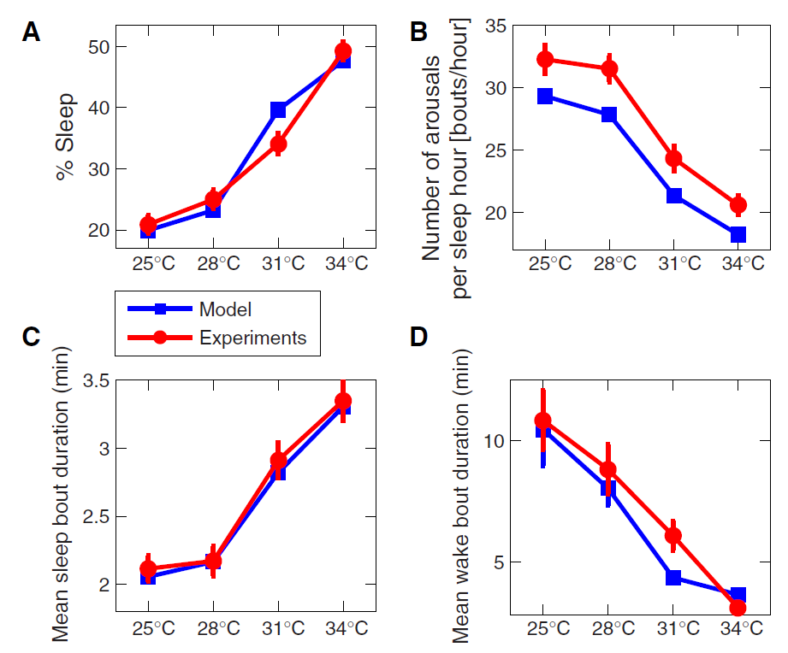
Modeling dynamics of sleep/wake transitions
Model agrees with data for both wake and sleep intervals
Dvir et al., Science Advances 4, eaar6277 (2018)
Notes:
17

Slide 18
Modeling arousal dynamics: distribution of wake and sleep bout durations
τ (characteristic time of sleep bout
duration) increases with Temp
α (power law exponent for wake bout
durations) increases with Temp
Notes:
18

Slide 19
Summary
brief arousals are an integral part of healthy sleep regulation, and are found in mammalian and non-mammalian species
arousal durations show power-law distribution (scale-invariant), sleep stage durations show exponential distribution (scale-specific)
accumulated neuronal subthreshold voltage fluctuations in wake-promoting neurons can possibly be an origin of spontaneous brief arousals during sleep
arousal statistics changes with temperature (more arousals at lower temp) at least for ectothermic animals
Notes:
19

Slide 20

Why do we care?

Slide 21
Significance
Sudden Infant Death Syndrome (SIDS)
Thermoregulation in very young infants not fully developed (show ectothermic traits similar to fish); more susceptible to higher ambient temperature and in higher risk for SIDS
Notes:
21

Slide 22
Sudden Infant Death Syndrome (SIDS)
Dvir et al., Science Advances 4, eaar6277 (2018)
Notes:
22

