Slide 1
Neurosurgery and Medicine: Testing Ground for Network Physiological Methods?
James Holsapple MD
Chief of Neurological Surgery
Boston University School of Medicine and Boston Medical Center

Slide 2
Problems in Neurosurgery
Determining (pre op, intra op) effects of resection and brain manipulation
Real time and expected long term effects of stimulation (blockade, synchronization)
Accurate (physiologic) targeting of CNS structures
Classification and management of unconscious (COMA) states
Classification and management of traumatic brain injures (severe to mild – concussion)
Optimized management of patients with severe CNS pathology and altered physiology (trauma, SAH)
Optimized integration-manipulation of systemic elements (cardiopulmonary, renal, metabolic, endocrine) in setting of CNS pathology

Slide 3
Limitations
Absent “ground truth” regarding brain anatomy and function
Manipulation (surgical) is poorly tolerated
Biological material (soft, easily injured) that must be moved to operate
Scales: m (tracts), cm (cortex, nuclei), mm (functional), micro m (cellular), nano m (membranes, channels, synapses, molecular)
Data: limited largely to “outside the box” measurements
Data: limited to averages, intermittent sampling, low resolution time series, aggregate

Slide 4
Functional Neurosurgery
Neurosurgery
nm
µm
mm
cm
m
Cell/Axon
Nuclei
Cortical Fxnl Zones
Tracts
Brain
Microelectrode
Operating Microscope
Retractor, Knife
DBS
SCS, Cortical Stimulator

Slide 5
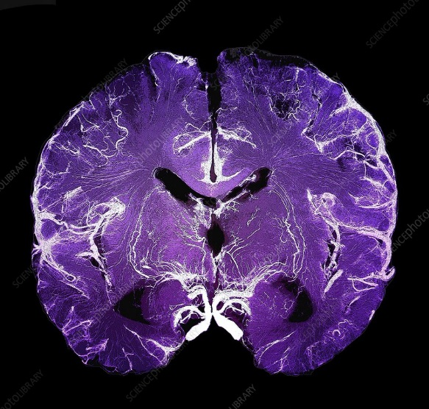
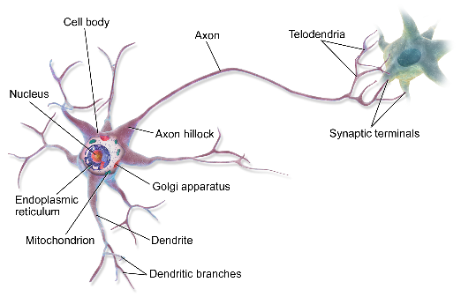
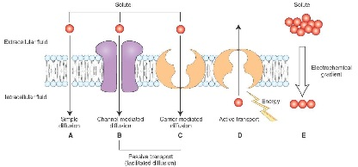
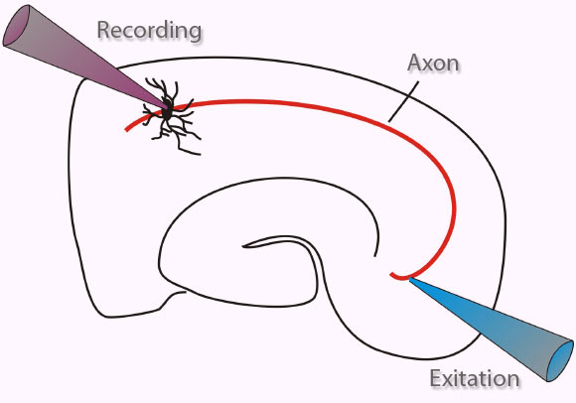
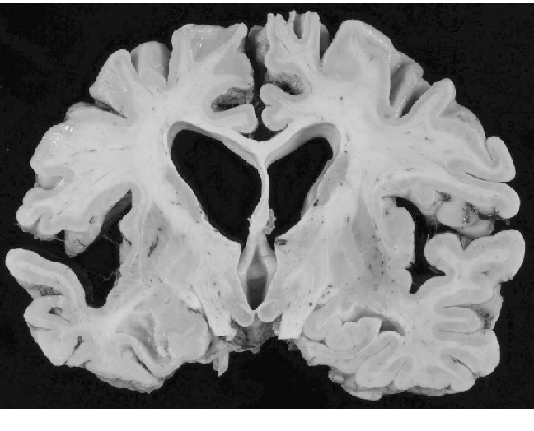
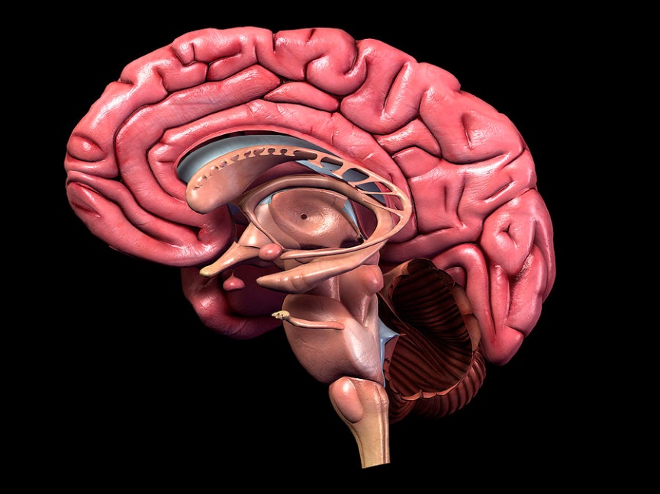

Slide 6
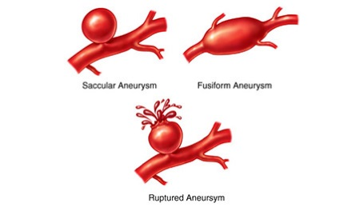
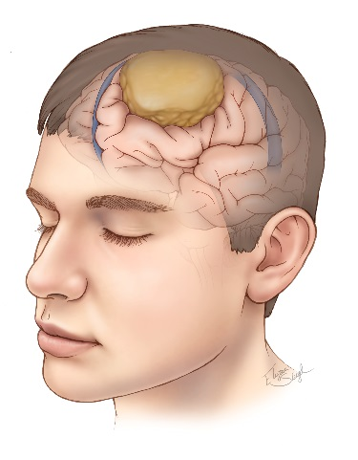
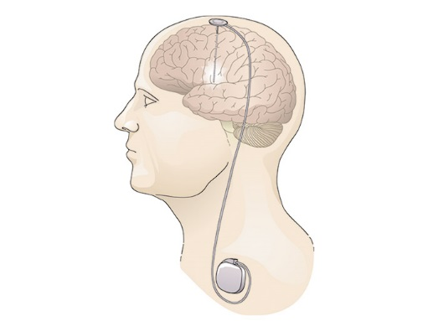
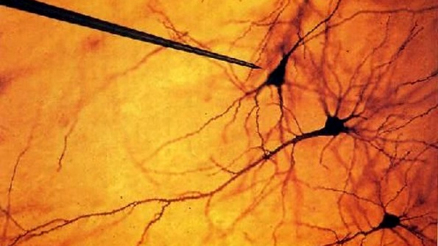
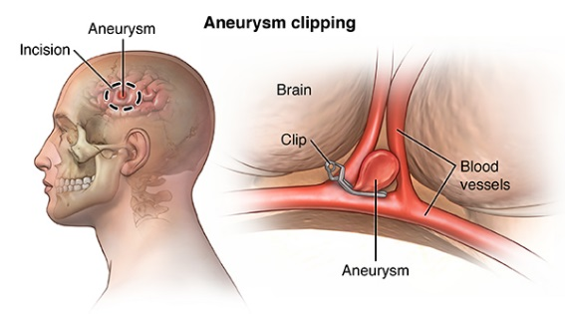
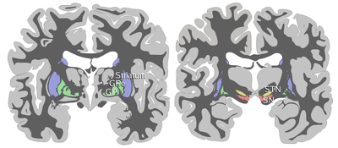
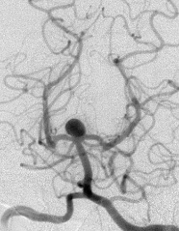
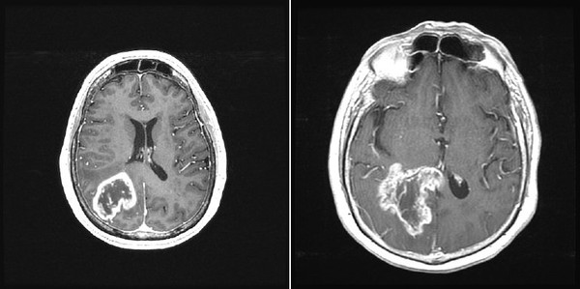

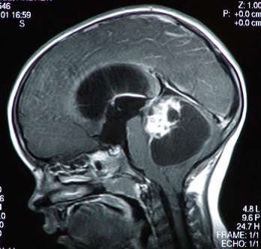
Microelectrode Recording
Angiography
MRI, fMRI, CT, PET
Doppler Velocity
MRI*
EEG
30 cc

Slide 7
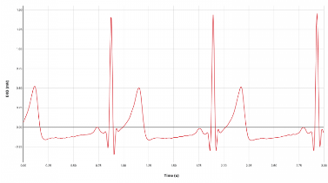
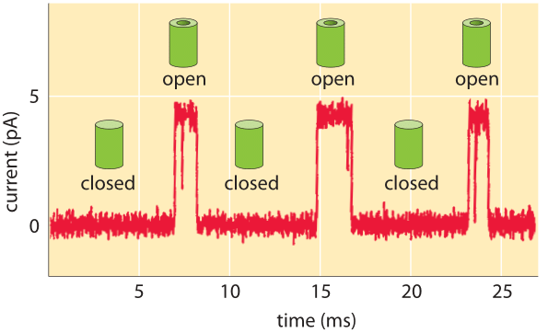
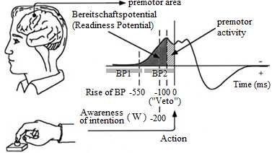
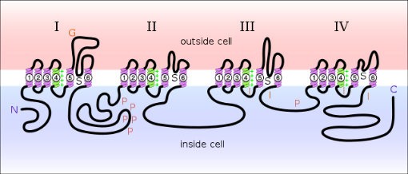
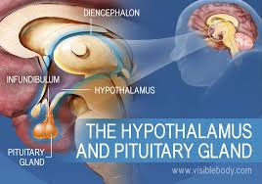

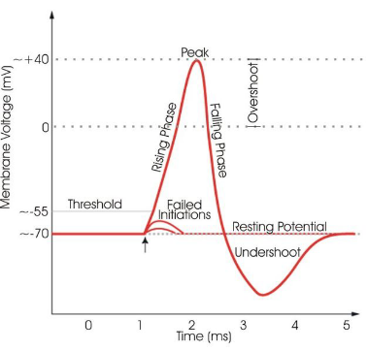
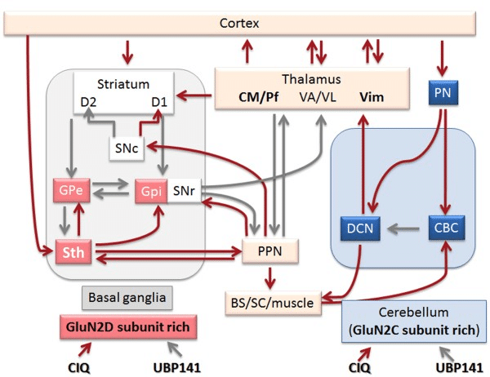
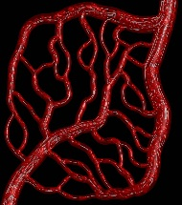
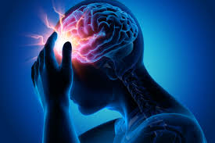
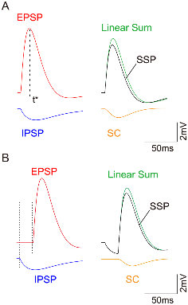
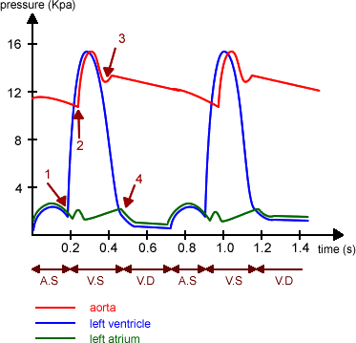
10⁻⁹
10⁻⁸
10⁻⁷
10⁻⁶
10⁻⁵
10⁻⁴
10⁻³
10⁻²
10⁻¹
1
10
10²
s
10³
10-15 min
Warm ischemia time

Slide 8
10⁻⁹
10⁻⁸
10⁻⁷
10⁻⁶
10⁻⁵
10⁻⁴
10⁻³
10⁻²
10⁻¹
1
10
10²
s
10³
ECG
Cardiac Output
Chemistry (blood, urine)
Arterial Pressure
Temperature
Thermogram
Respiratory Rate, Volumes
End Tidal CO2
O2 Sat (pulse oximeter)
Pulmonary Artery Pressure
Central Venous Pressure
Systemic
Urine Output
CNS, Brain
EEG (scalp)
EEG (depth electrode)
EEG (surface grid)
Single and multi-unit recording
ICP
CBF velocity
Brain pO2 (local)

Slide 9
Hypothalamus/ANS
Temperature control, metabolic homeostasis, water/Na control
Hypothalamus-Pit/Endocrine
BMR, thyroid, adrenal, water elimination-retention, reproduction
Medullary, RVL, X
Heart rate, respiratory control, BP control
Skeletal Motor System, Cortical Motor, Cerebellum
Tone, movement, tremor suppression
Brainstem, BG, reticular thalamus
Consciousness
Sleep
CNS
SYSTEM

Slide 10
Network and Configuration
The language of “state, configuration, network, and coupling of elements” has already found its way deeply into our notions of brain function (isolated), systemic function, and brain-system interaction.
We lack – however – clinically applicable tools that convincingly identify states defined by coupling of elements that can be used to guide bedside decision-making.
Q1: are physiological and pathophysiological (in setting of clinical neurology and neurosurgery) configurations real and meaningful?
Q2: are there any real-life neurosurgical problems that could be approached or investigated using these perspectives, methods, and tools?

Slide 11
We don’t know --- but I think there are good reasons to explore these possibilities further, especially in the care of patients with neurological disorders.

Slide 12
Clinical Problem-Opportunity 1: COMA
Many clinical circumstances characterized by loss of consciousness (and normal sleep).
Causes are variable (trauma, SAH, hypoxic brain injury, toxic encephalopathy)
On the surface, patients look very similar although the underlying pathophysiology is different and outcomes vary drastically.
Tools to differentiate cases are crude and descriptive (GCS)
Prognostication is at best approximate and can be catastrophically inaccurate (good or bad)
No tools that can reliably define, detect, or identify subgroups.

Slide 13
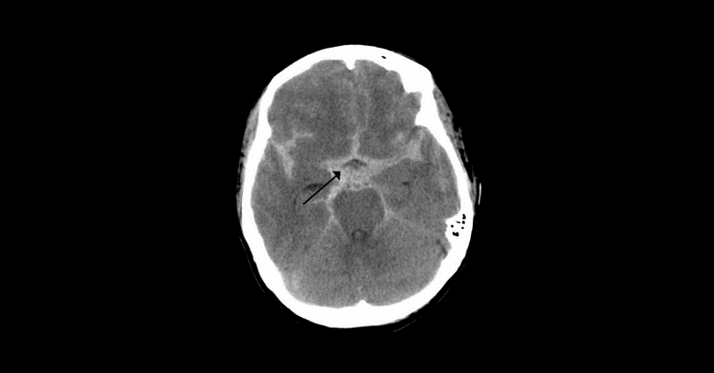
Cases
Case 1: 50 yo male with diffuse grade IV SAH. Angiography reveals a ruptured anterior circulation aneurysm which is coil occluded to avoid repeat rupture. Patient remains unresponsive for 4 weeks on ventilator support. Vital signs are largely normal throughout hospital course. Eventually, a tracheostomy is placed and patient is transferred to a nursing facility where he never regains consciousness despite imaging that discloses no brain tissue loss. Patient expires 2 years post SAH of complications (infection, pulmonary embolism, malnutrition).

Slide 14
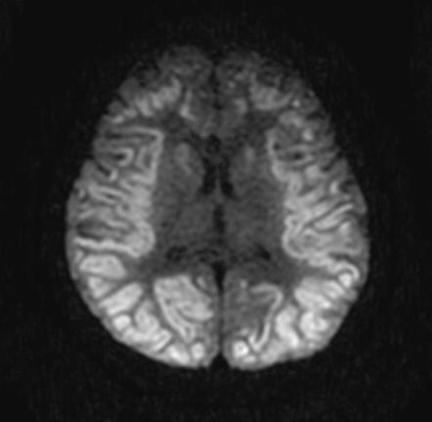
Cases
Case 2: 55 yo female with family history of coronary artery disease is found unconscious and pulseless at home. EMT arrive, intubate and resuscitate the patient. She is admitted to the neurointensive care unit where she remains unresponsive for several weeks. Diagnostic studies reveal the patient has suffered a cardiac arrest from a inferior wall MI. Vital signs are essentially normal and stable throughout the hospitalization. Imaging suggests a diffuse hypoxic brain injury. Hospital day 30 the patient opens her eyes and beings to follow commands. She is extubated and makes a slow but dramatic recovery eventually returning to home and work.

Slide 15
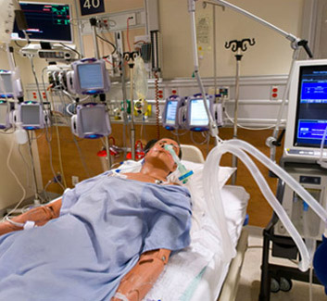
Prognosis and Management
Some prognostic factors are known in both instances (SAH vs anoxia)
Hunt and Hess Grade of SAH (how neurologically impaired at outset)
Fisher Grade of SAH (how much blood)
Occurrence and severity of vasospasm
Exposure time to low or zero perfusion
Age of patient
Signs of brainstem injury or malfunction
OVERALL CARE IS LARGELY SUPPORTIVE

Slide 16
Hints
Although systemic factors (BP, etc.) are normalized, the absolute value of vital signs may not be as helpful a guide as system reactivity (ANS function and brain-system coupling). Points to brain-system coupling.
Attempts are made to normalize CBF and ICP but best strategy (target values) may depend on state of autoregulation (CPPop). Points to brain-vasculature coupling.
Metabolic factors probably contribute to outcome (baseline glucose, ph, pCO2). Points to brain-metabolism coupling.
Neuro suppression (barbiturates, etc.) may be helpful.
Neuro suppression (hypothermia) may be helpful or harmful.

Slide 17
Issues and Questions
Can pathophysiologic states (brain) of unconsciousness be defined and detected beyond those characterized by etiology and crude grading scales of apparent severity?
Can pathophysiologic states (brain + system) of unconsciousness be defined and detected?
If so, how might this be done? (using clinically available data)
If so, how might this be useful? (influence on management, path from COMA to wakefulness --- available? Which path?)

Slide 18




Present Model
Normalize Every Salient Physiologic Factor
Wait
COMA

Slide 19

Provisional Concept
c1
c2
c3
c4

Slide 20
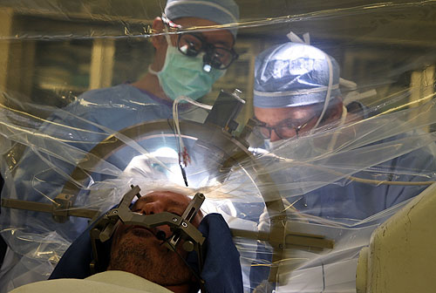
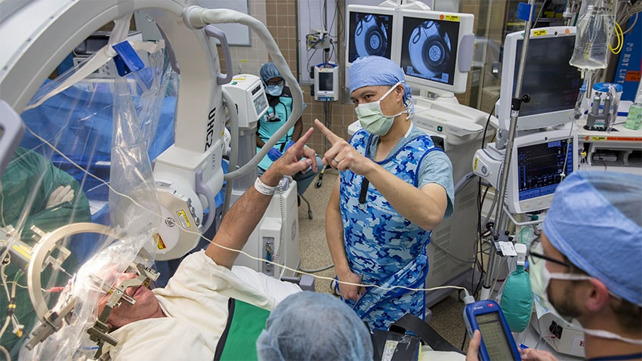
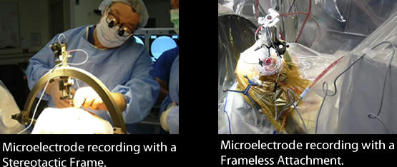
Clinical Problem-Opportunity 2: Functional Neurosurgery

Slide 21
Tool: Functional Neurosurgery
Ablate saliently overactive regions
Stimulate target
Stimulation: a) depolarization block (ablate output), b) synchronize neurons
Utilize micro electrode recording to identify targets
Place large permanent stimulating electrodes to achieve block or synchronization
Notion is to achieve some “normalization” of network function to restore ability to move, eliminate involuntary movements, reduce pain, alter mood, control compulsions, alter hunger

Slide 22
Limits of Functional Neurosurgery
Incomplete picture of “ground truth” that depicts healthy and pathological network activity
Incomplete knowledge of possible targets
Incomplete knowledge of combination effects
Limited repertoire of effects with stimulation (block regional output, synchronize regional output)
Limited ability to measure effect (live) of stimulation (no interrogation of network beyond large scale effects on patient in OR)
Do not collect additional date during stimulation and device placement that may guide target selection (EEG, EMG, multi-target unit activity)
Individual variation in severity of disease and effects DBS

Slide 23
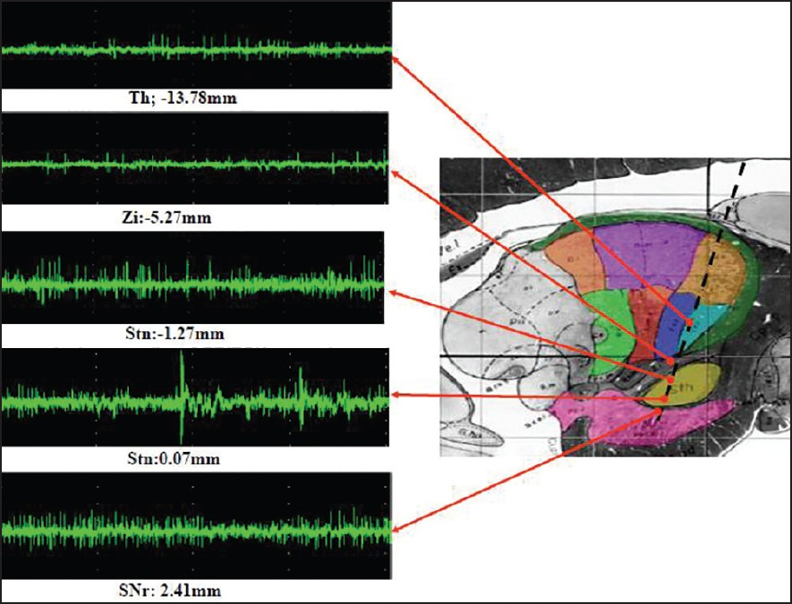
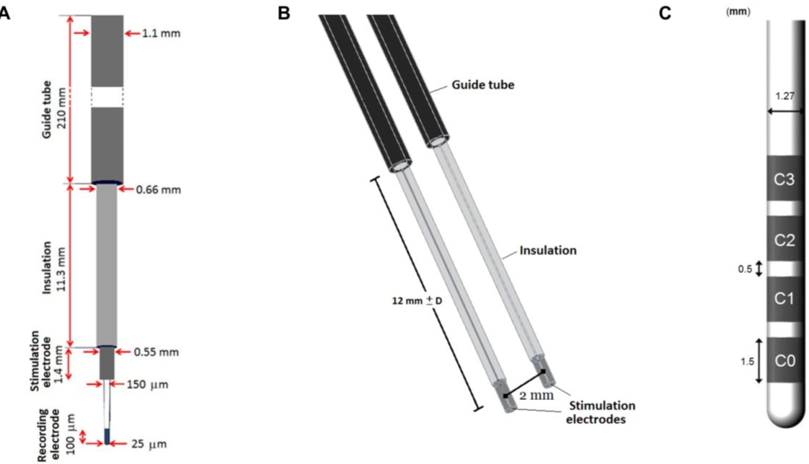

Slide 24
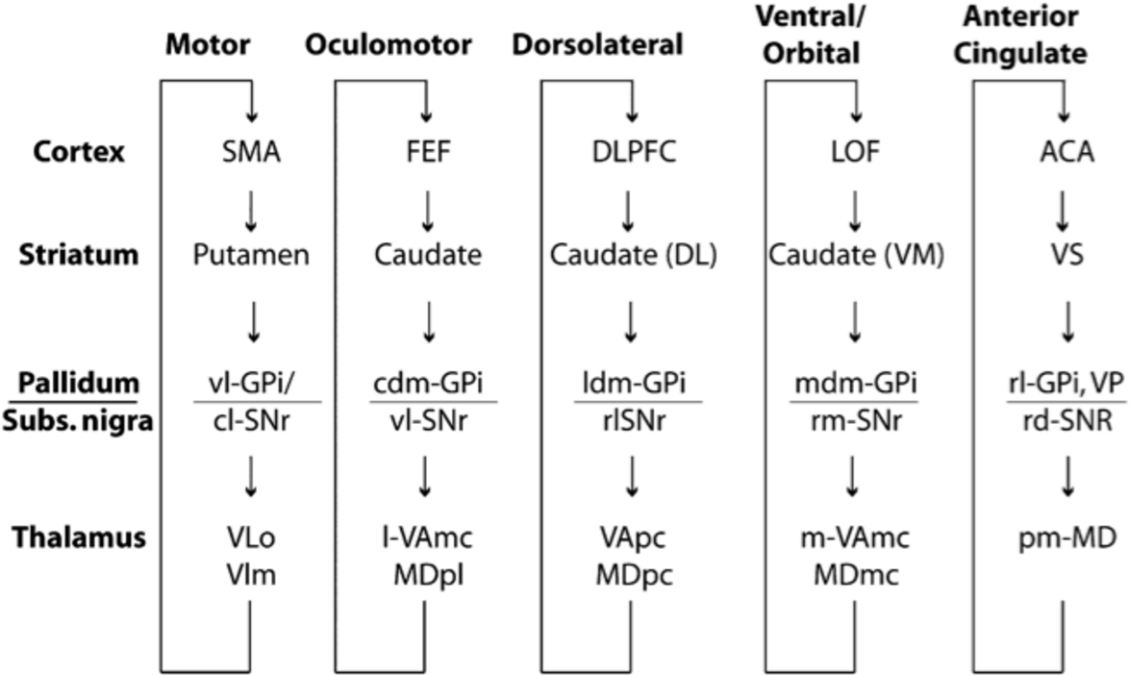

Slide 25
Pathologic
Normalized Output
synch
block

Slide 26
Functional Neurosurgery
Probably the greatest opportunity to study and improve brain function in pathological circumstances.
Methods are crude and guided by incomplete knowledge or guesses from primate models.
Frontiers are real: movement disorders and other neurodegenerative diseases, psychiatry-behavior, obesity, X.
Only setting in which human neuronal activity can be obtained in an ethically acceptable manner.
Desperately need TOOLS to identify and define pathologic “state(s)” pre operatively (class of patients and individuals).

Slide 27
Is there a place for network physiological methods in neurosurgery?
Abundant data – not clear how best to use it.
Can we do better than normalization of bedside physiologic parameters we can measure and wait?
Can we use the perspective of configurations and element coupling to define and visualize real and clinically relevant states of brain and brain-system? Can we create a more granular catalog of disease states?
Can we use identified states to study clinical paths from COMA to recovery?
Can we use a catalog definable states to select and alter anatomical targets in the human brain to treat disease or ameliorate its effects?

