Slide 1


Quantifying Stability Complex Networks and its Application to Neuroscience
Jürgen Kurths
Potsdam Institute for Climate Impact Research
&
Institute of Physics, Humboldt-Universität zu Berlin
juergen.kurths@pik-potsdam.de
http://www.pik-potsdam.de/members/kurths/

Slide 2
Main Collaborators:
Sabine Auer, Jobst Heitzig, Frank Hellmann, Peter Menck, Paul Schultz PIK Potsdam & Humboldt Uni Berlin
Jinqiao Duan, Meng Zhan, Yayun Zheng HUST, Wuhan
Siyang Leng, Wei Lin, Peng Ji Fudan Uni
Piotr Brzeski, Tomasz Kapitaniak, Przem Perlikowski, Lodz Univ Technol, Poland
Vladimir Klinchuk, IAP, Nizhny Novgorod

Slide 3
Contents
Introduction
Stability concepts
Basin stability for complex networks
Extensions
Stochastic Basin Stability
Conclusions

Slide 4
Complex Networks

Slide 5
Network of Networks
Interconnected Networks
Interdependent Networks
Multiplex Networks
Multilayer Networks…

Slide 6
Power Grids

Slide 7
Intended Solution: stable synchronized behaviour along the whole network of networks

Slide 8
How to control such networks?
Pinning Control (which nodes?)
Highly Non-trivial Task
Monster blackouts
Failing of Control!!!

Slide 9
Stability

Slide 10
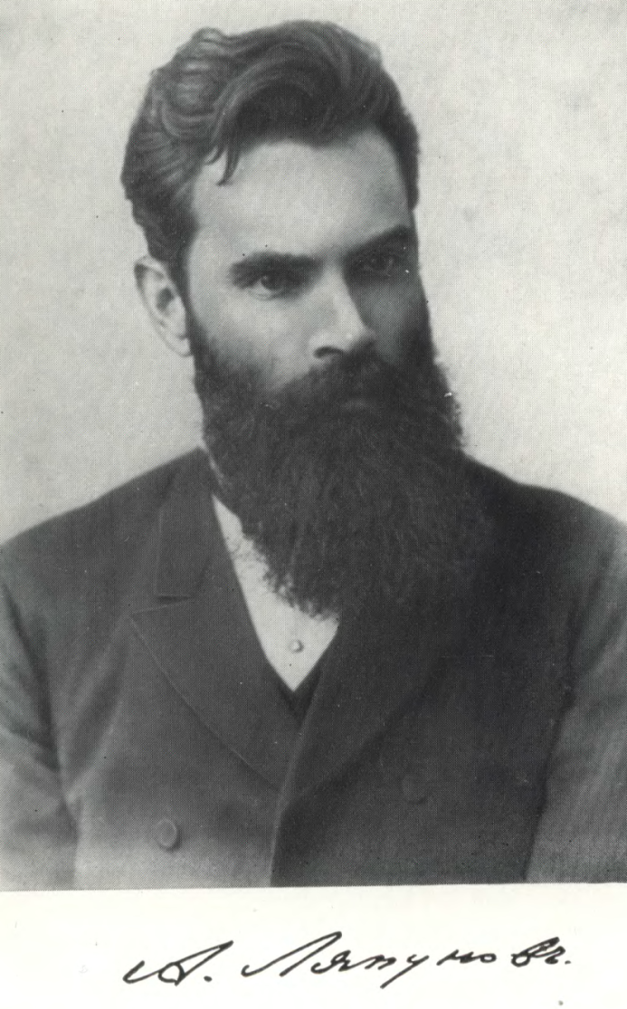
Stability of Dynamical Systems
Alexandr Mikhailovich Lyapunov (1857 – 1918)
Student of P. L. Chebyshev and friend of A. A. Markov
Master: On the stability of ellipsoidal forms of equilibrium of rotating fluids (1884) – french translation (1904)
PhD: The general problem of the stability of motion (1892)
1893 – full Prof. Kharkiv Univ
1902 – St. Petersburg (followed Chebyshev)

Slide 11
Alexandr Mikhailovich Lyapunov
Lyapunov was the first to consider modifications necessary in nonlinear systems to the linear theory of stability based on linearizing near a point of equilibrium
The equilibrium x_{Ɛ} of the system is said to be Lyapunov stable, if for every (∀ Ɛ > 0) and (∀ t₀), there exists a δ = δ(t₀, Ɛ) > 0 such that,
if |x(t₀)-x_{Ɛ}|< δ, then |x(t)-x_{Ɛ}|< Ɛ, for every t ≥ 0.
Extension to asymptotical and exponential stability

Slide 12
Stability of Complex Networks
(Synchronized Dynamics)

Slide 13
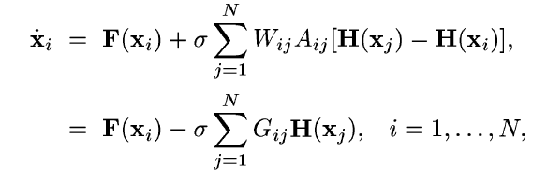



Weighted Network of N Identical Oscillators
F – dynamics of each oscillator
H – output function
G – coupling matrix combining adjacency A and weight W
- intensity of node i (includes topology and weights)

Slide 14





General Condition for Synchronizability
Stability of synchronized state
N eigenmodes of
ith eigenvalue of G

Slide 15



Main results
Synchronizability universally determined by:
- mean degree K and
- heterogeneity of the intensities
or
minimum/ maximum intensities
(Motter, Zhou, Kurths, PRL 2006)

Slide 16
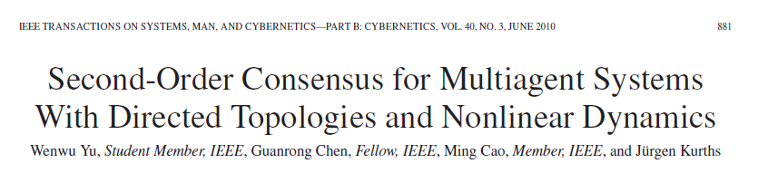
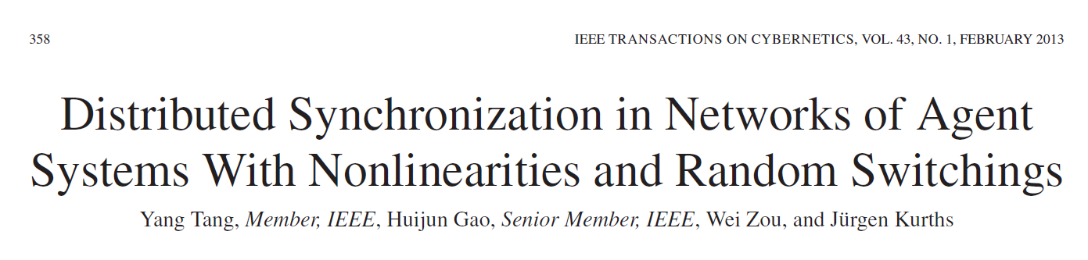
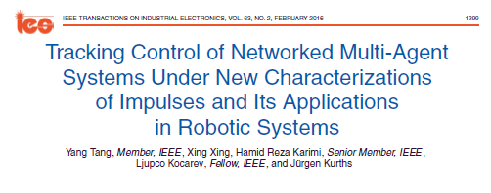

Slide 17
Stability of Networks
Synchronizability –
Master Stability Formalism
Pecora&Carrol (1998) –
based on local stability

Slide 18



Synchronizability – Master Stability Formalism (Pecora&Carrol (1998)
Synchronizability Ratio
Stability Interval for coupling strength K
Synchronizability condition

Slide 19
Stability/synchronizability in small-world (SW) networks
Small-world (SW) networks
(Watts, Strogatz, 1998 – WS-networks)
F. Karinthy hungarian writer –
SW hypothesis (1929)

Slide 20
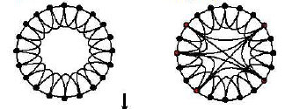
Small-world Networks
Nearest neighbour and a few long-range connections
k nearest neighbour
connections
Regular ➔ Complex Topology

Slide 21

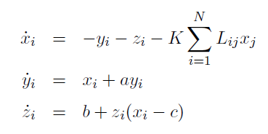
Chosen: a = b = 0.2, c = 7.0 ➔ R < 37.88
Chaotic Rössler oscillators, N = 100

Slide 22
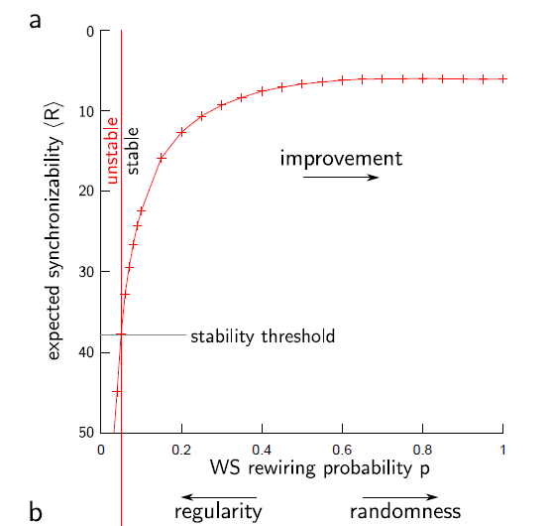
Main Result: SW-Network best synchronizable for most random SW-networks
Puzzle!

Slide 23
MSF – local stability (Lyapunov stability)
How to go beyond (not only small perturbations)?
Lyapunov Functions?

Slide 24
Network´s Basin Stability
basin volume of a state (regime)
measures likelihood of return to this state (regime)
Nature Physics 9, 89 (2013)

Slide 25
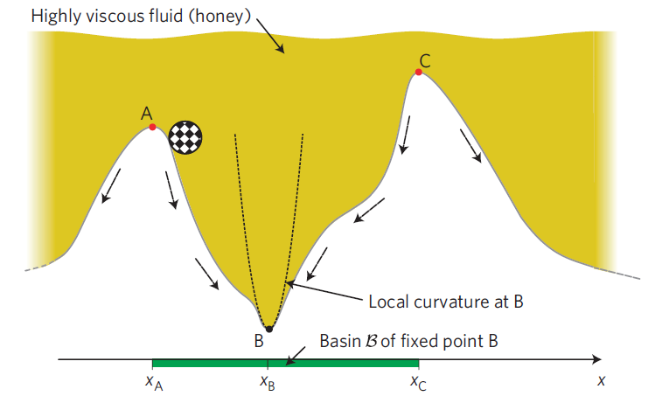
Figure 1 Thought experiment: marble on a marble track. The track is immersed in a highly viscous fluid to make the system’s state space one-dimensional. Dashed arrows indicate where the marble would roll from each position. A, B and C label fixed points. Only B is stable. The green bar indicates B’s basin of attraction B. If the marble is perturbed from B to a state within the basin, it will return to B. Such perturbations are
permissible. Perturbations to states outside the basin are impermissible. The dashed parabola shows the local curvature around B, fitting the true marble track poorly in most of the basin.

Slide 26
Network´s Basin Stability
basin volume of a state (regime) measures the likelihood of
- arrival at this state (regime)
quantifies its relevance (M. Girvan, 2006)
- return to this state after a random perturbation quantifies its stability
( Menck, Heitzig, Marwan, Kurths:
Nat. Phys., 2013)

Slide 27




Normalized Network´s Basin Stability
- Synchronous state´s basin of attraction
- Subset of state space S covering the system´s (weak) attractor
Normalized Basin Stability

Slide 28

- T experiments (different initial conditions – randomly distributed)
- M states converge to
- Estimate M / T
➔ standard error
- T=500 ➔ error < 0.023
Bernoulli-like experiment

Slide 29
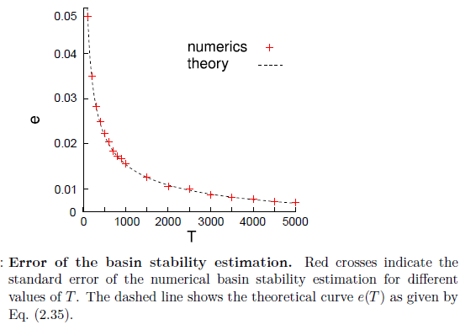
Basin Stability for the Rössler System
Q := q**N with q = [−15, 15] × [−15, 15] × [−5, 35]

Slide 30
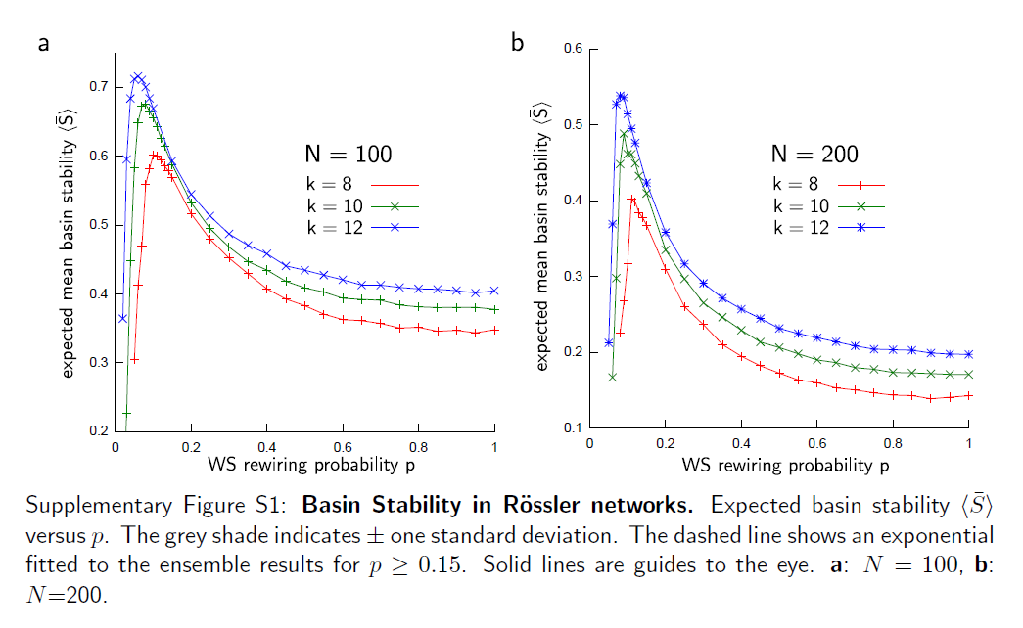

averaged over coupling strengths K

Slide 31
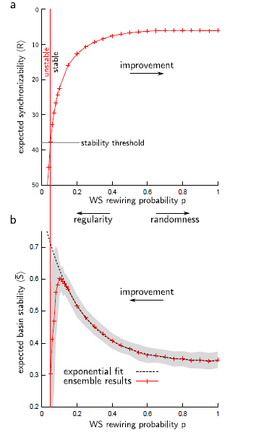
Synchronizability and basin stability inWatts-Strogatz (WS) networks
of chaotic oscillators.
a: Expected synchronizability R versus the WS model's parameter p.
The scale of the y-axis was reversed to indicate improvement upon increase in p.
b: Expected basin stability S versus p. The grey shade indicates one standard deviation.
The dashed line shows an exponential fitted to the ensemble results for p > 0.15. Solid lines are guides to the eye. The plots shown were obtained for N = 100 oscillators of Roessler type, each having on average k = 8 neighbours. Choices of larger N and different k produce results that are qualitatively the same.

Slide 32
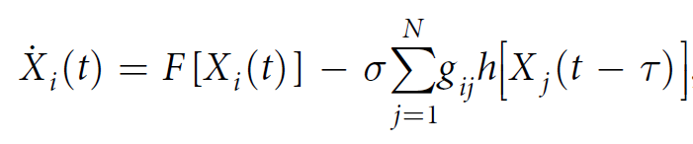
Extension to delay-coupled systems
Scient. Rep., 2016

Slide 33
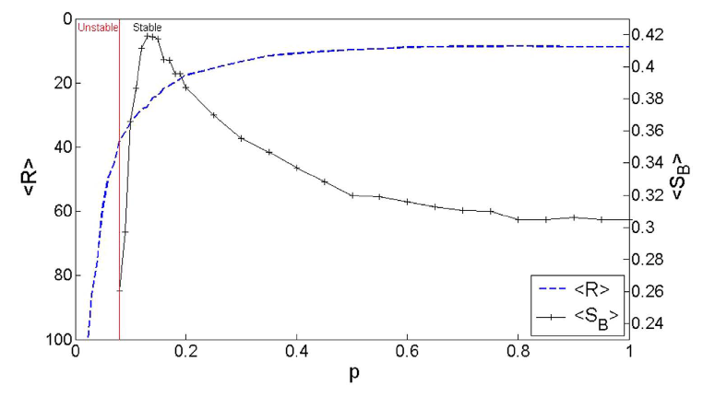
SW network, N = 100, chaotic Roessler oscillators, 6 neighbours each (in average)

Slide 34
Other Approaches
Basin stability refers to asymptotic behaviour and requires multistability
In many applications (cybersystems, power grids, brain…) transient behaviour more important
Apply concept of survivability
Basin of Survival
Scient. Rep. 2016

Slide 35
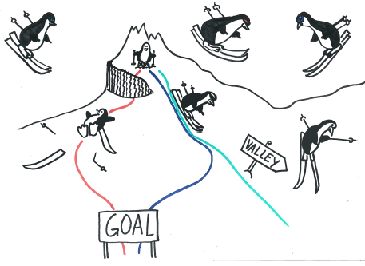
Penguin reaches goal in two way, but one via an undesirable state (due to cliff)
Basin of survival: all routes starting on top reaching the goal savely

Slide 36

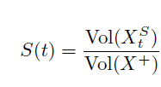
Desirable region
Survivability S(t):
Fraction of trajectories starting at and staying within the whole time [0 , t]
t-time basin of survival

Slide 37
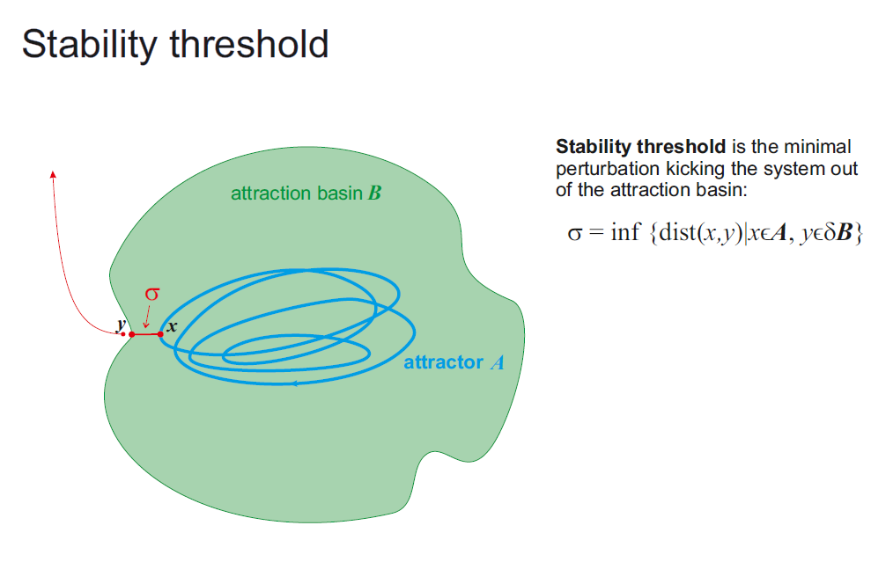
New J. Physics, 2016

Slide 38
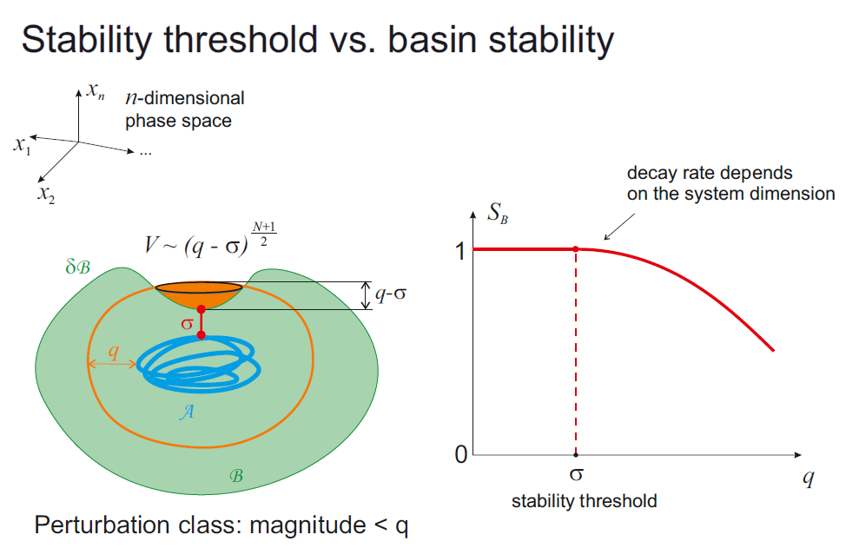

Slide 39
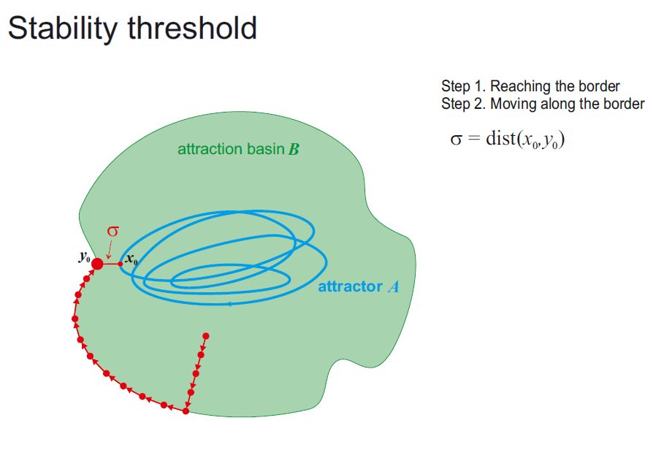

Slide 40
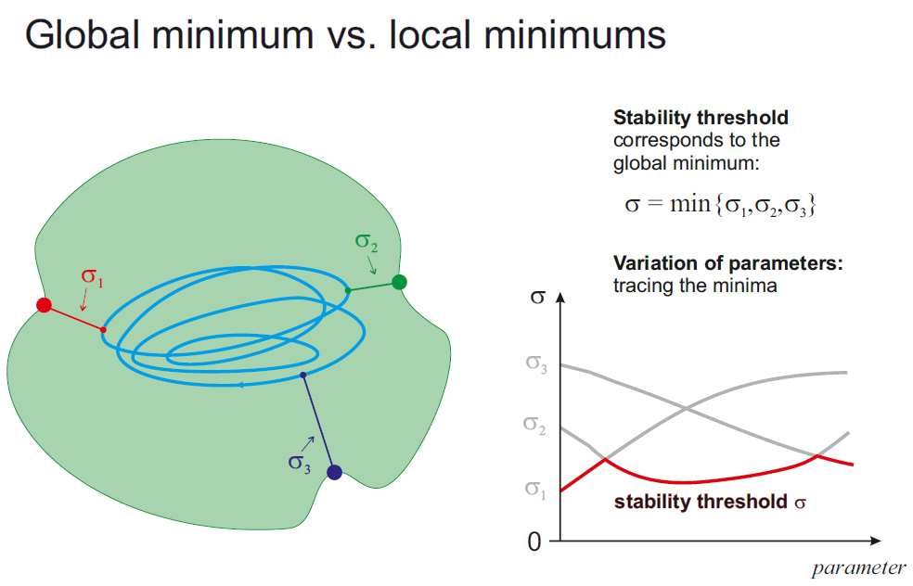

Slide 41
Stochastic Basin of attraction (SBA) for metastable states
SBA – set of initial conditions where solutions have a small probability of exits from the neighbourhood of an attractor and high probability of returns to it
Calculation of these probabilities via elliptic partial differential eq. with Dirichlet boundary conditions
CHAOS 26, 073117 (2016)

Slide 42
Basic examples
Three-well potential
Genetic toggle system (Scient. Rep. 2016)
Discontinuous systems (application: Amazonian vegetation) (Scient. Rep. 2017)
Transport of particles in rough ratchets
CO oxidation on Ir (111) surfaces

Slide 43
Finding special behaviour
Le´vy noise with larger jumps and lower jump frequencies (ɑ ≤ 0.5) enhances metastability (symmetric and asymmetric)
Thermal noise stabilizes metastability in asymmetric potentials but reduces it in symmetric ones

Slide 44
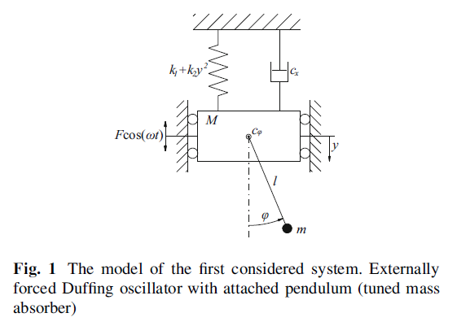
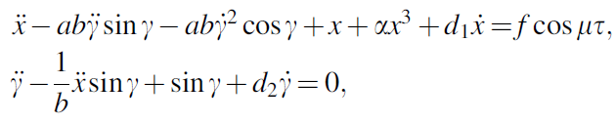
Multistable mechanical systems

Slide 45
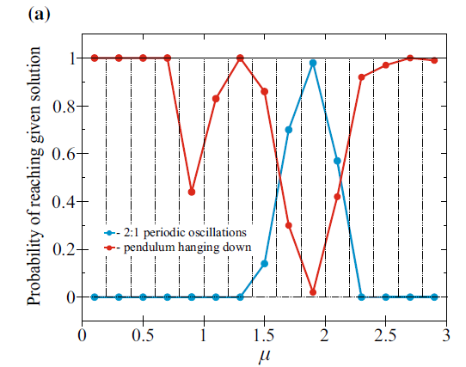
Basin stability analysis

Slide 46
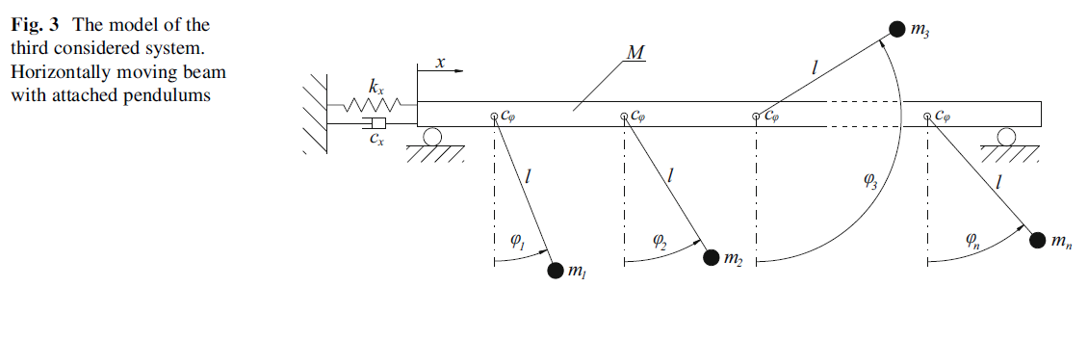
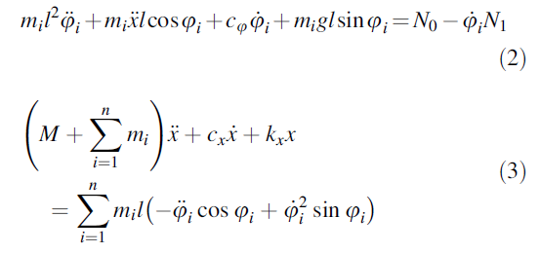

Slide 47
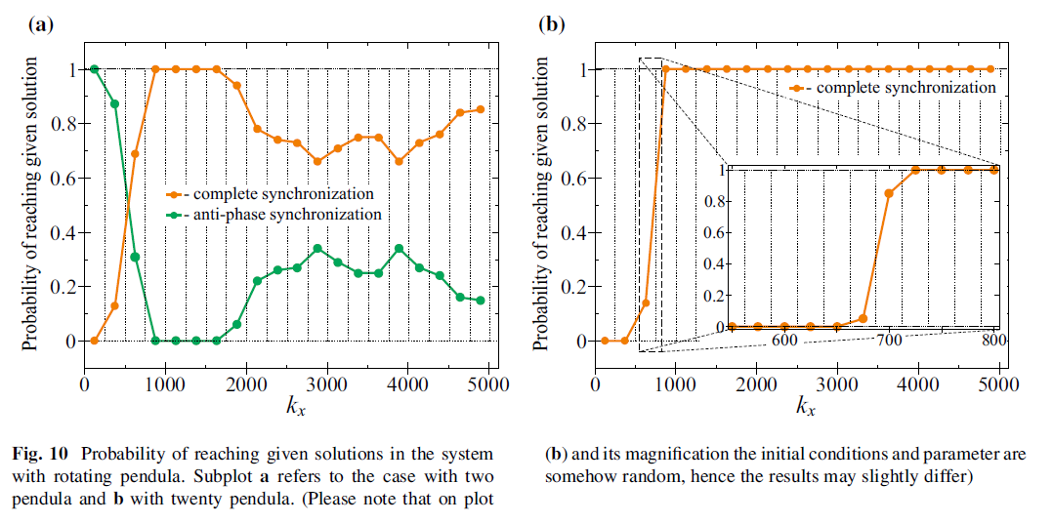
BS Analysis

Slide 48
Multistable mechanical systems
Generalized method for stability analysis
identification of parameter regions leading to a certain regime of basin stability
Meccanica 2016

