Slide 1
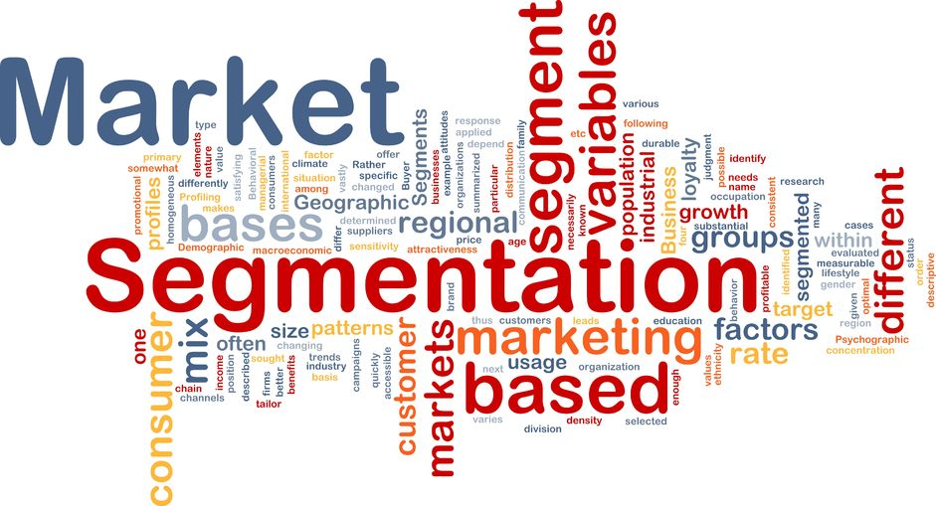

Unsupervised Learning
Gamboa, Juliana
Mancini, Andrés

Slide 2
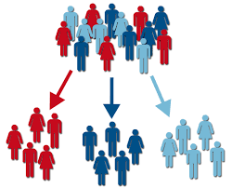

Objetive
Classify customers into segments with similar characteristics to generate specific actions for marketing campaigns.
Identify customer base with the greatest potential for product’s sale.

Slide 3
Steps
Exploratory Data Analysis
Variable selection
Model Selection, Evaluation & Tuning
(KMeans, DBSCAN, Agglomerative)
Cluster description
Business recommendations

Slide 4
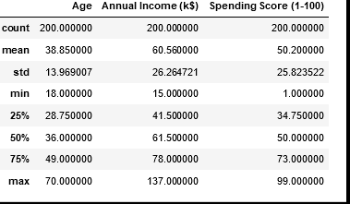
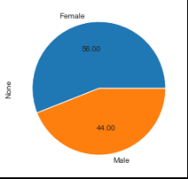
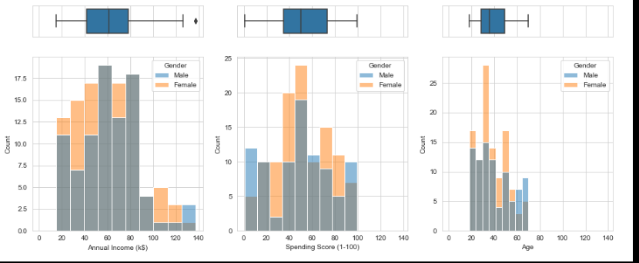

Exploratory Data Analysis
Original dataset : 200 entries and 5 columns
Column | Data type
CustomerID | int64
Gender | object
Age | int64
Annual Income (k$) | int64
Spending Score (1-100) | int64
Dataset size after outlier treatment: (198, 5)
Not nulls detected.

Slide 5
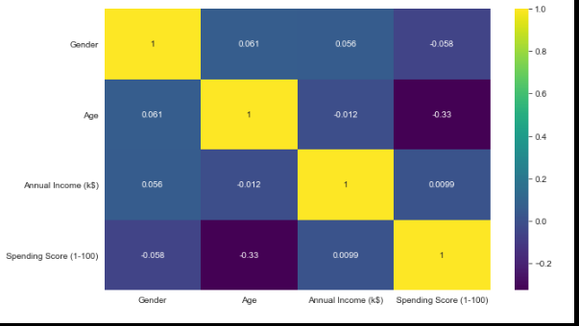
Exploratory Data Analysis
Age is negatively correlated with Spending Score.
Annual Income is very less correlated with Age.
Annual Income and Spending Score is also very less correlated.
Gender is very less correlated with Spending Score but more correlated, when compared to Annual Income.

Slide 6
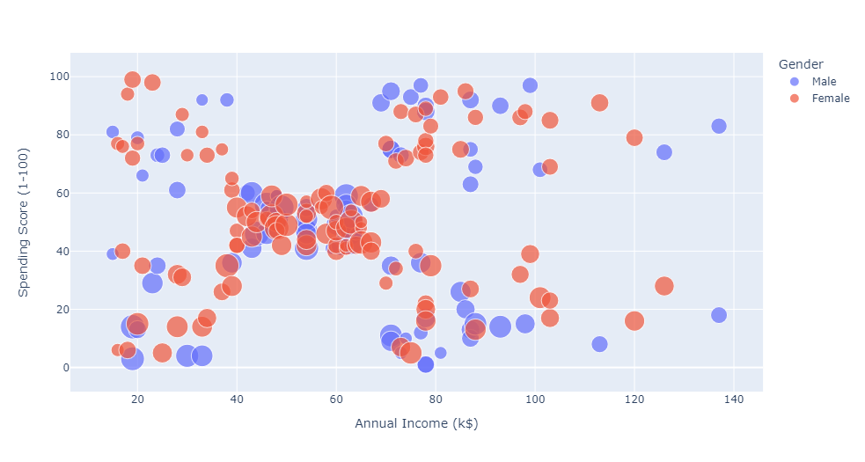
Variable Selection
For clustering:
Gender and Age are not used to avoid bias.
CustomerID was removed cause it’s an unique identifier.
We use Annual Income and Spending Score to segmentate customer profiles.

Slide 7
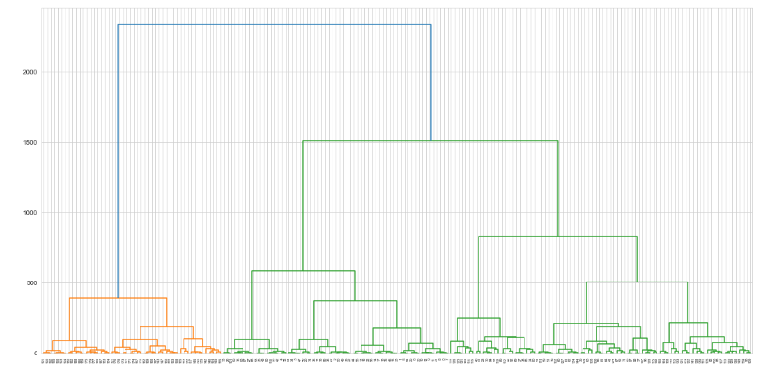
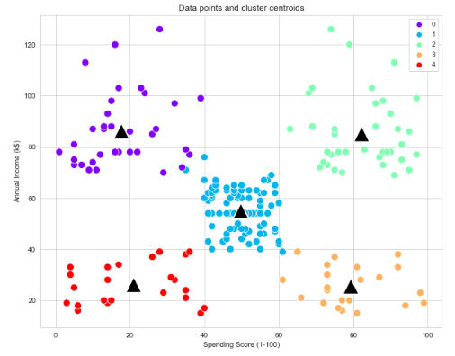
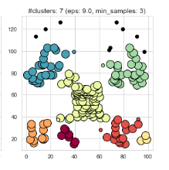
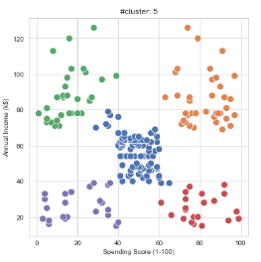
Model Selection, Evaluation & Tuning
3 unsupervised clustering algorithms were evaluated and tuning:
KMeans
DBSCAN.
Hierarchical clustering.
KMeans
DBSCAN
KMeans had the best performance in order to segmentate customer so we focus on it.
Hierarchical clustering

Slide 8
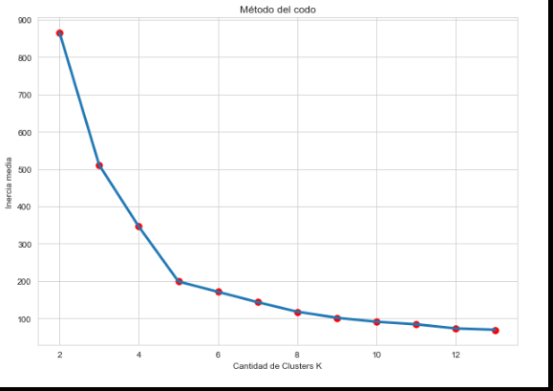
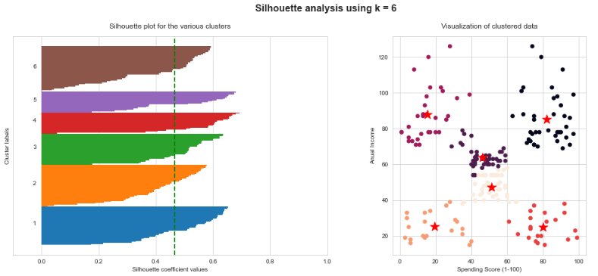
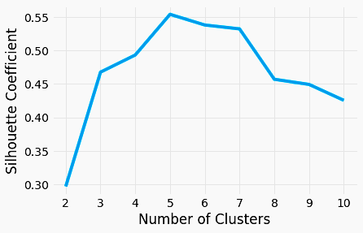
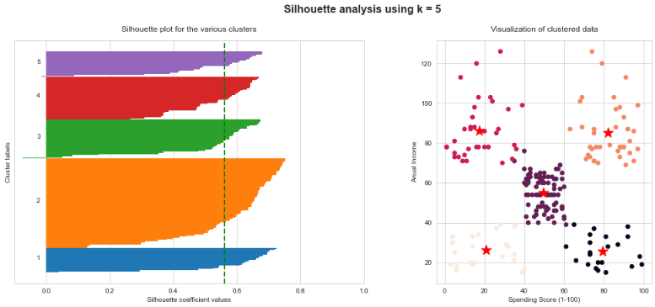
Cluster Number (Kmeans)
It’s possible to combine the two central clusters and get a better customer segmentation for marketing campaigns.

Slide 9
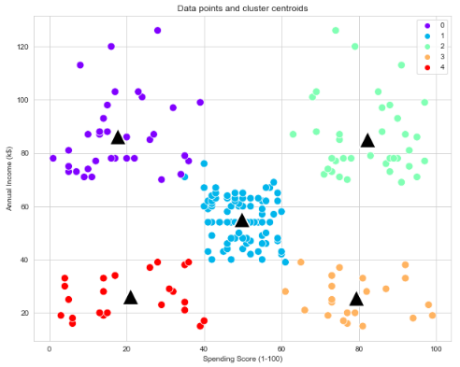
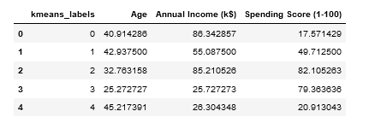
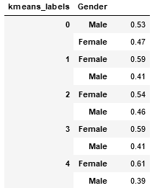
Cluster Description (Kmeans)
Inactive Customers
Red (4): low annual income, low spending score
The average age is 45 years; predominantly male; Average Annual Income is 26k in dollars; Average Spending Score is 20.
Orange (3) : low annual income, high spending score
The average age is 25 years; predominantly female; Average Annual Income is 26k in dollars; Average Spending Score is 80.
Blue(1): intermediate annual income, intermediate spending score.
The average age is 43 years; predominantly female; Average Annual Income is 55k in dollars; Average Spending Score is 49.
Green(2): high annual income, high spending score
The average age is 32 years; predominantly female; Average Annual Income is 85k in dollars; Average Spending Score is 82.
Violet (0): high annual income, low spending score
The average age is 41 years; predominantly male; Average Annual Income is 86k in dollars; Average Spending Score is 17.
Impetuous buyers
Middle-class
Top customers
cautious spenders

Slide 10
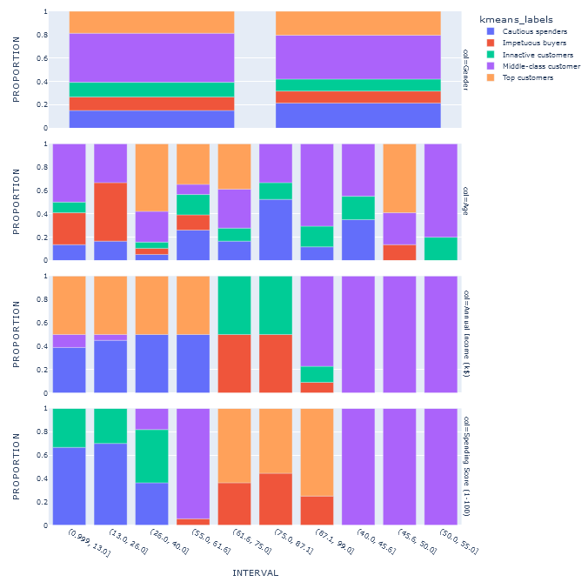
Cluster explainability (Kmeans)

Slide 11



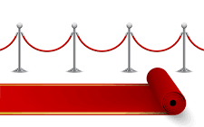

Customer profile
Customer profile | General characteristics | Description | Business suggestion
Inactive Customers | Low annual income, low spending score. The average age is 45 years; predominantly male; Average Annual Income is 26k in dollars; Average Spending Score is 20. | This segment consists of the older population who earn and spend less. They might be saving up for retirement. | Healthcare-related products can be promoted amongst this cluster. Usage of adequate discount coupons, promo codes, etc might also help.
Impetuous buyers | Low annual income, high spending score. The average age is 25 years; predominantly female; Average Annual Income is 26k in dollars; Average Spending Score is 80. | This segment consists of youngsters who are careless with their spending habits. This group is likely to be comprised of first jobbers who tend to spend above their means in the pursuit of a good lifestyle. | Since a lot of youngsters love the idea of vacationing, providing this segment with adequate hotel coupons, flight offers might be a good idea. This group is also deemed to spend the maximum on clothing and related accessories when compared to other clusters. Providing adequate discounts for such goods might also be a useful strategy
Middle-class | Intermediate annual income, intermediate spending score. The average age is 43 years; predominantly female; Average Annual Income is 55k in dollars; Average Spending Score is 49 | This cluster consists of middle-aged customers who spent and earn money on an intermediate level. They are careful with their spending scale as their income levels are not excessive. These people might also be the ones with higher financial responsibilities. For instance, higher education of their children | Discounts offers, Promo codes, loyalty cards, etc
Top customers | High annual income, high spending score. The average age is 32 years; predominantly female; Average Annual Income is 85k in dollars; Average Spending Score is 82 | This segment consists of middle-aged individuals who worked up a significant amount of wealth in their initial years. They also have a large spending scale and hence lead a very affluent lifestyle. | The majority of the people in this age group might be in their initial phase of building up a family. Hence, promoting real estate, properties, car deals, etc is most likely to catch their attention. These people are presumed to make serious financial commitments out of all clusters due to their high spending capacity
Caution spenders | High annual income, low spending score The average age is 41 years; predominantly male; Average Annual Income is 86k in dollars; Average Spending Score is 17 | This cluster consists of middle-aged people who are frugal about their spending habits. Although the income levels are high, they spend very little. This might be an indicator of their financial responsibilities. | Membership cards, discount coupons, offers, etc could have a drastic impact on this cluster

Slide 12
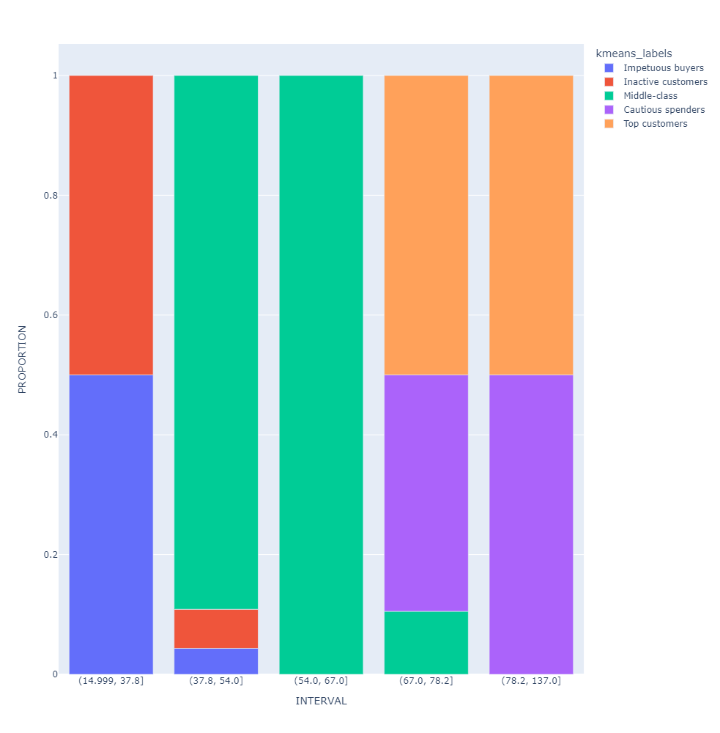
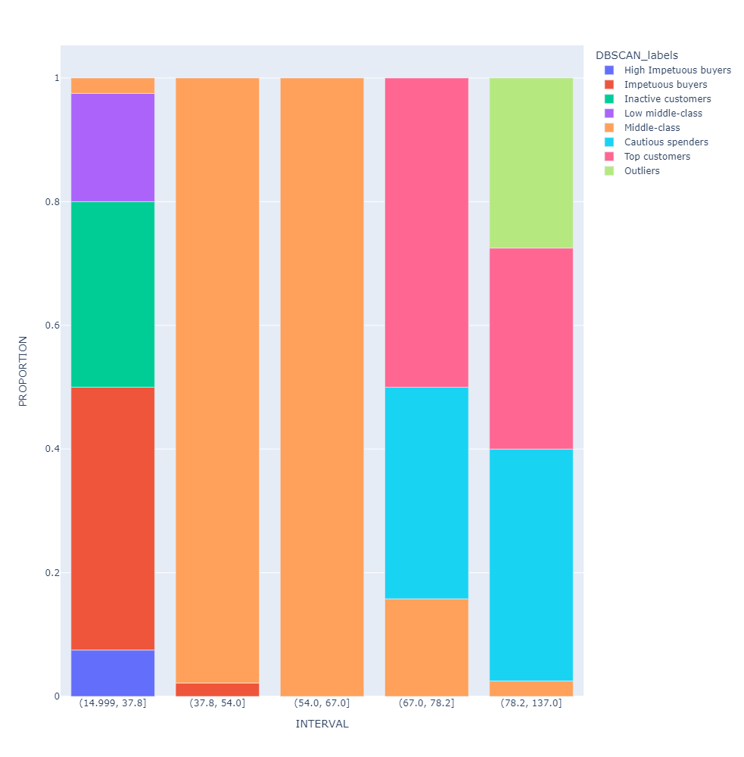
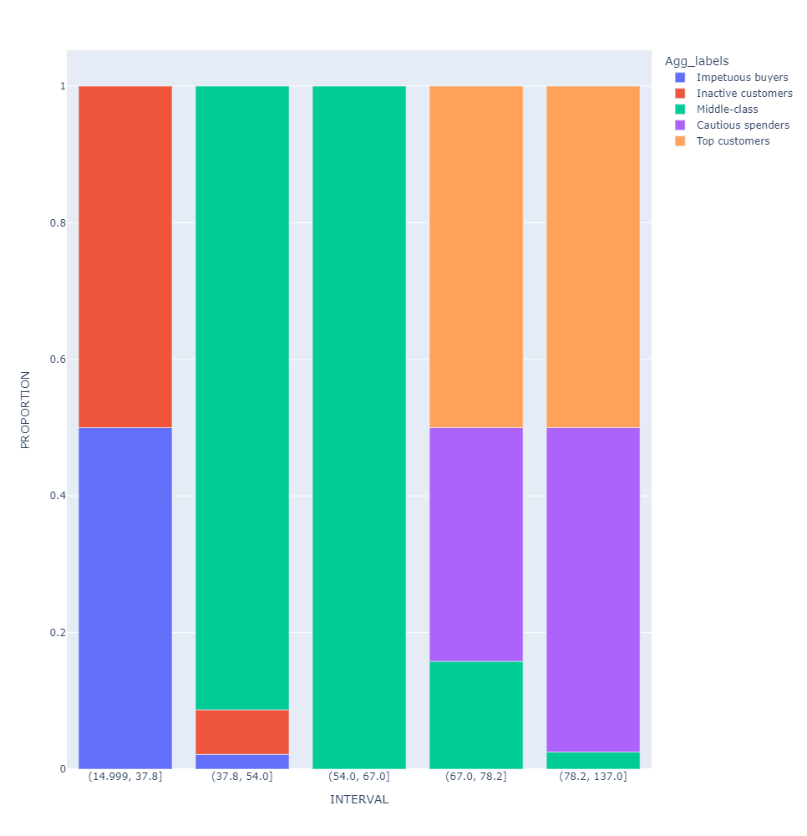

Cluster COMPARISON
KMEANS
DBSCAN
AGGLOM
Annual Income (k$)

Slide 13
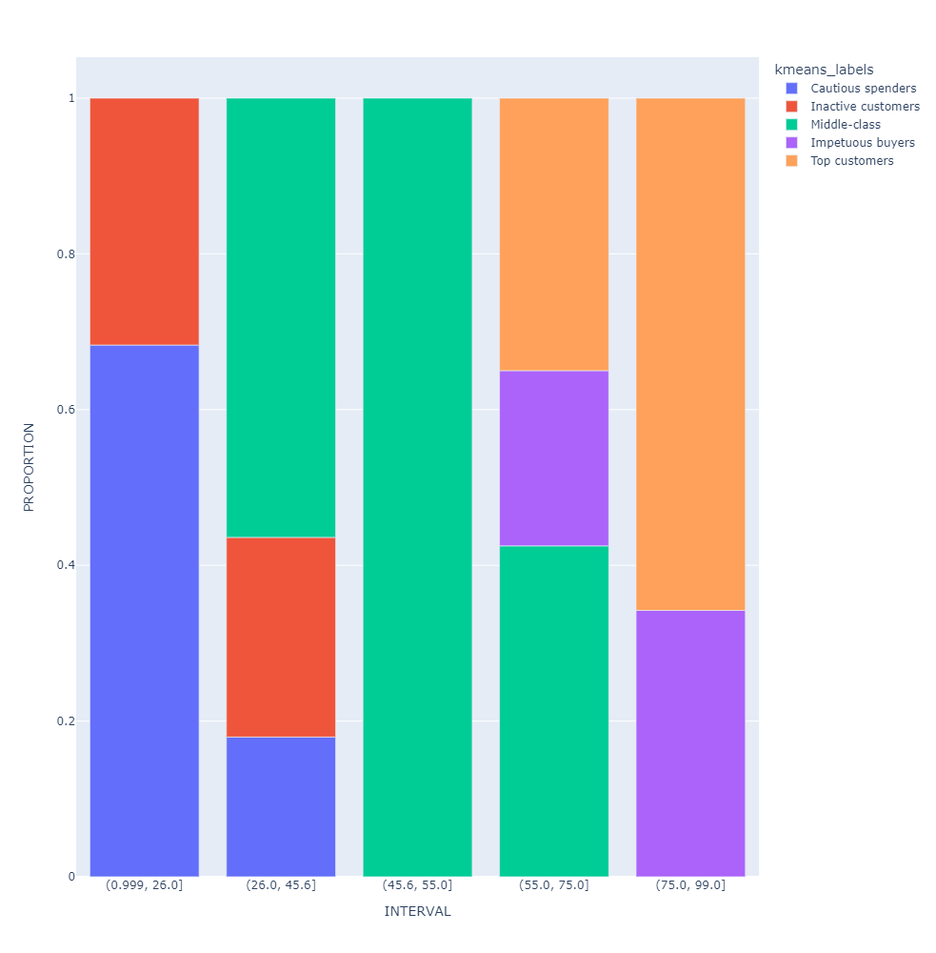
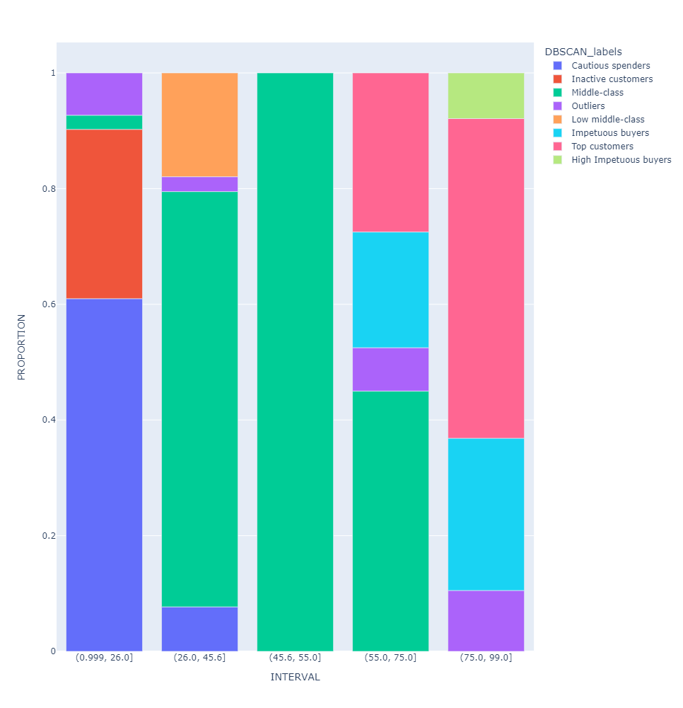
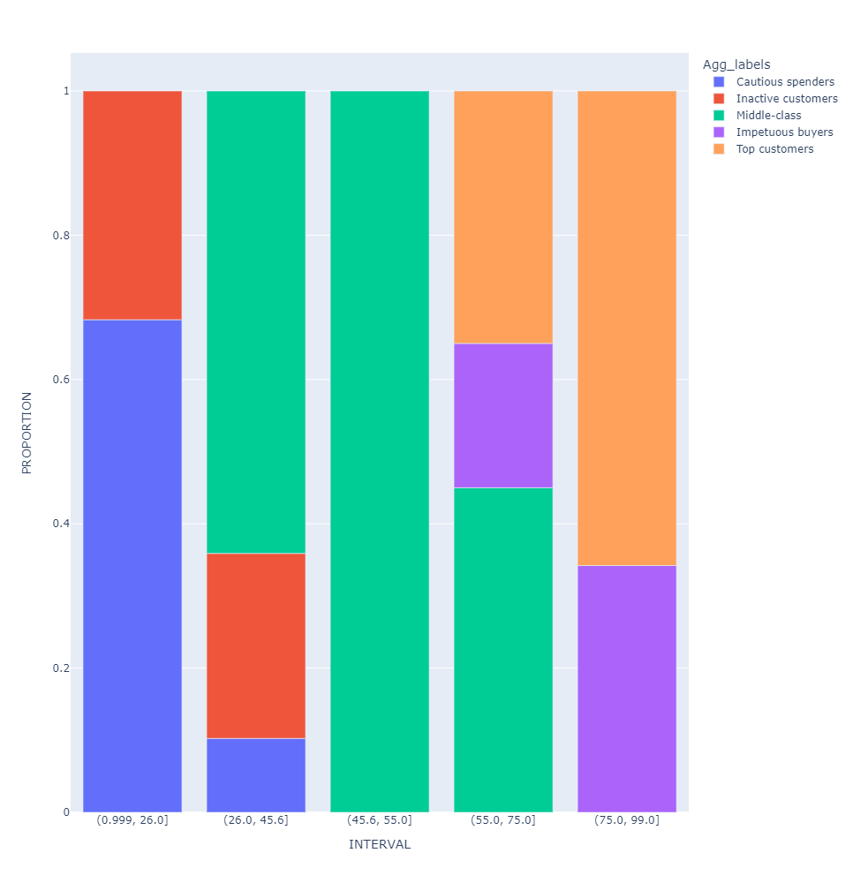
Cluster COMPARISON
KMEANS
DBSCAN
AGGLOM
Spending Score (1-100)

Slide 14
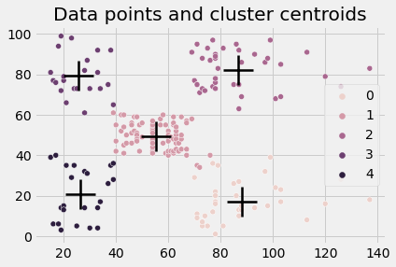
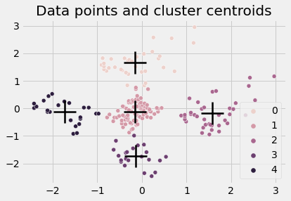
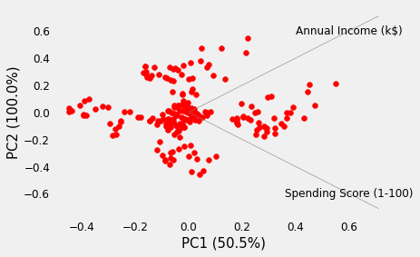
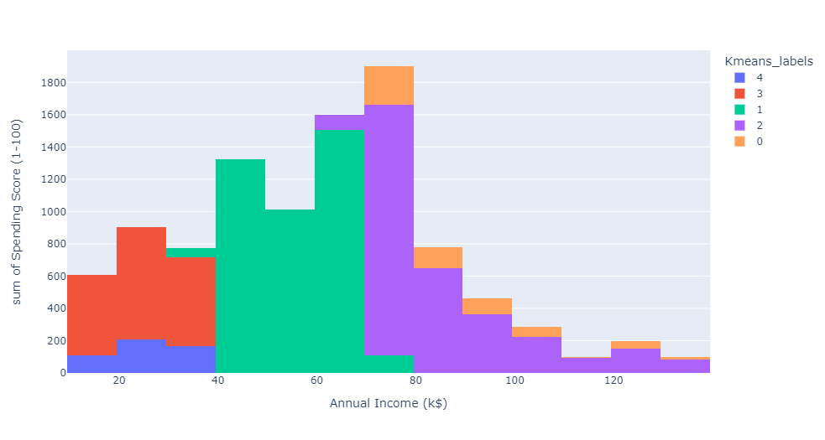
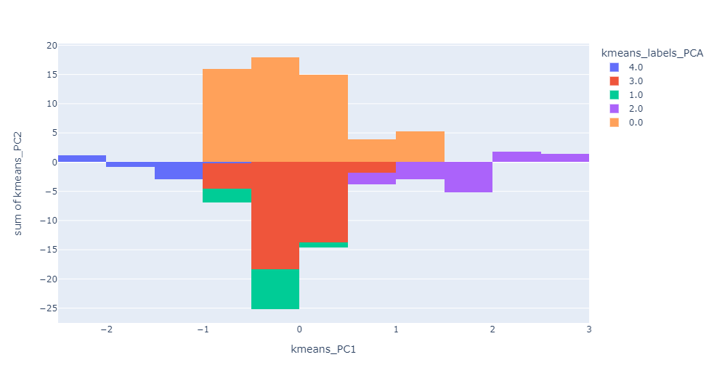
Kmeans+PCA
Kmeans
Spending Score (1-100)
Annual Income (k$)
No differences in kmeans cluster
assignment after applying PCA.

Slide 15
Conclusions
We performed exploratory data analysis on the dataset, and after pre-processing stages we built 3 models (K means, DBSCAN, Agglomerative clustering).
DBSCAN clustering method was discarded since it did not improve the K means clustering results.
Since Agglomerative clustering method led to identical results compared to K means method, we selected K means due to it simplicity and feasibility to identify spherical clusters.
We have efficiently created a K means clustering algorithm to segment customers based on their annual income and spending habits.
Independently of the clustering method applied, Principal Component Analyses (PCA) did not improve the clustering results.
After analyzing the developed clusters, some customers insights were obtained, those were used for improving businesses strategy.
We think that “Cautious spenders” is the customer segment with greater potential to increase sales due to their low spending score and high annual income.

Slide 16
back-up slides

Slide 17


Outliers cluster assigment
The identified outliers were assigned to the following clusters

