Slide 1
EXPLORATORY DATA ANALYSIS IN R

Slide 2
CODE
# comparison of sales by Quarter
ggplot(data=book_sales_data)+
geom_bar(mapping=aes(x=Quarter,fill=Quarter))+
facet_wrap(~Quarter)+
labs(title = "Exploratory data analysis: Book sales", subtitle = "Comparison of Sales by Quarter",caption = “Data Source: Kaggle")

Slide 3
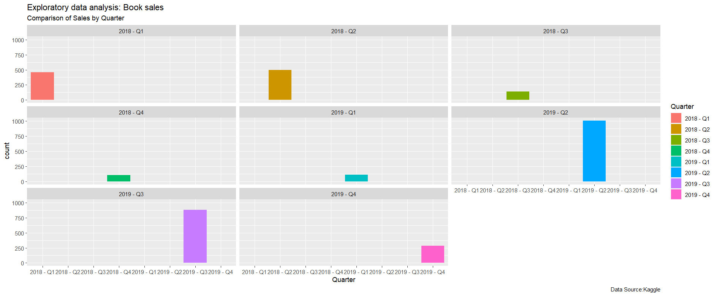

Slide 4
# Comparison of sales by year plot
ggplot(data=book_sales_data)+
geom_bar(mapping=aes(x=Year),color="purple")+
labs(title = "Exploratory data analysis: Book sales", subtitle="Comparison of Sales by year",caption="Data source: kaggle")+
annotate( "text", x = 2018.25, y = 1400, label = "Sales in 2019 are higher", color = "blue", size = 4,angle=25)

Slide 5
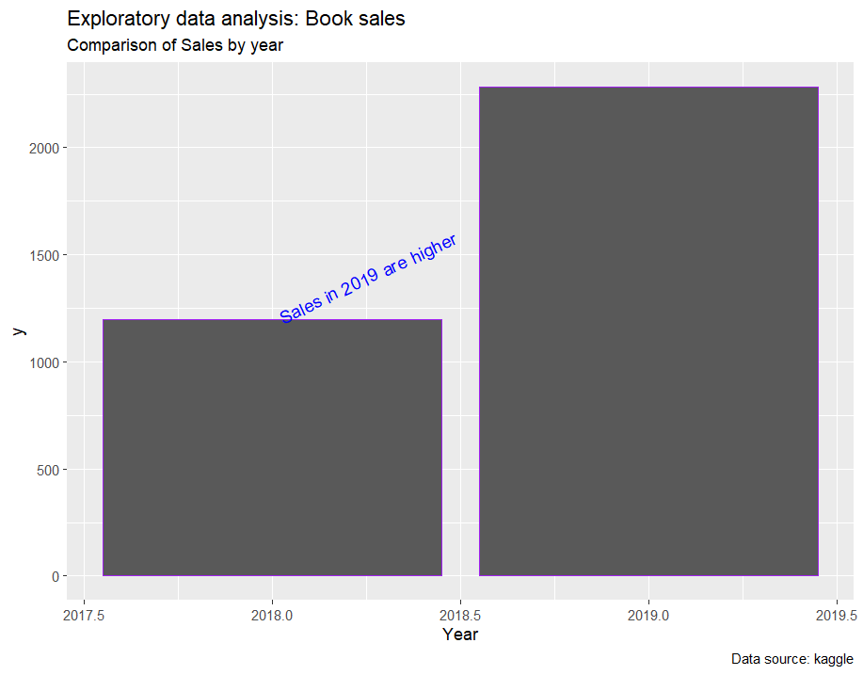

Slide 6
# Variable for 2018 sales
Data_2018<-book_sales_data %>%
filter(Year=="2018")
# Variable for 2019 sales
Data_2019<- book_sales_data %>%
filter(Year=="2019")
# Variable for Total_profit_2018
Total_profit_2018 <- Data_2018 %>%
summarise(Total_Profit_2018 = sum(`Profit (INR)`))

Slide 7
# Variable for Total_profit_2019
Total_profit_2019 <- Data_2019 %>%
summarise(Total_Profit_2019 = sum(`Profit (INR)`))
# Profit percentage increase calculation
percentage_increase <- ((Total_profit_2019 - Total_profit_2018) / Total_profit_2018) * 100
# data frame for 2018 and 2019 total profit
Total_Profit_2018_2019 <-data.frame(Yr=c(2018,2019), profit=c(99780.75,108358.4))

Slide 8
# comparison of profit by year plot
ggplot(data=Total_Profit_2018_2019)+
geom_point(mapping=aes(x=Yr,y=profit),color="red",size=8)+
labs(title="Exploratory Data Analysis",subtitle="Comparison of profit by year",caption="Data source:Kaggle")+
annotate("text",x=2018.50, y=100000, label="2019 Marked a Remarkable Milestone:A Robust 8.6% Surge in Profit Growth",fontface="bold",color="blue")

Slide 9
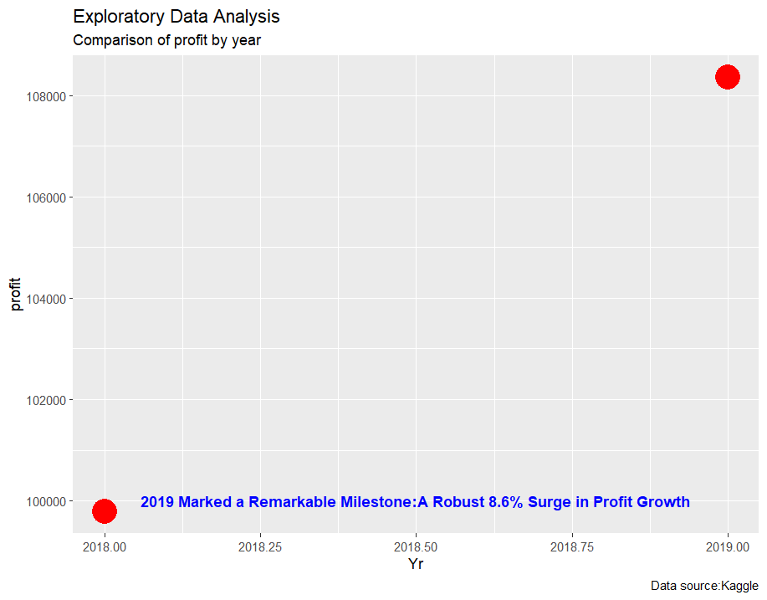

Slide 10
# Replaced "School" with school in Category column
Columncleaned_book_sale_data <- book_sales_data %>% mutate(Category = ifelse(Category == "School", "school", Category))
# Comparison of sales by book category
ggplot(data=cleaned_book_sale_data)+
geom_bar(mapping=aes(x=Category,fill="Category"))+
labs(title = "Exploratory Data Analysis:Book sales",subtitle="Comparison of sales by Category",caption = "Data Source:Kaggle")+
annotate("text",x=2,y=1000,label="The school category has the higest sales", size=4,color="purple",angle=25)

Slide 11
