Slide 1
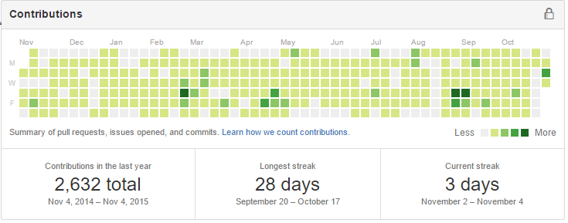
About me…
Dan Haywood
blah blah blah…

Slide 2
About you…
Frameworks, tools?
Patterns?

Slide 3
About Apache Isis…

Slide 4
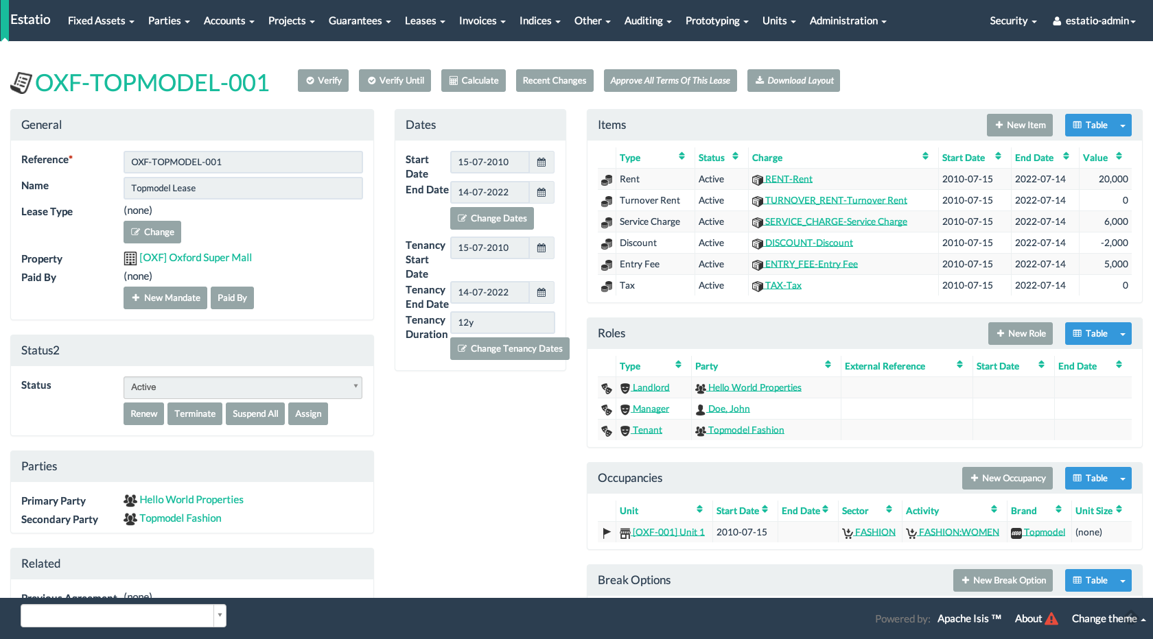
Estatio an open source estate management invoicing app, built with Apache Isis

Slide 5
There’s much more to Apache Isis
Other features
Home page
Extensible metamodel
Extensible viewer
API services, eg XML snapshots
SPI services, eg custom error reporting
Hierarchical Multi-tenancy
I18n support
User self-registration
Testing
Unit Testing
dependency injection
Integration Testing
BDD/Cucumber
Wrapper factory (subcutaneous testing)
Fixture scripts
Excel fixtures
REST
REST customizations (ContentMappingService)
Future viewers (Naked Objects.NET)
Isis Addons (cross-cutting concerns)
Command
Auditing
Publishing / PublishMQ
Excel
Docx
xdocreport (in development)
StringInterpolator
Polymorphic links
(Feature) Togglz
Incode Catalog (business functionality)
Note
Command
… more to follow (from Estatio)
Build and Dev Tools
isis-maven-plugin
Isis CLI (in development)
Asciidoc manuals

Slide 6

http://isis.apache.org
http://github.com/apache/isis
http://restfulobjects.org
http://www.isisaddons.org
http://catalog.incode.org
http://estatio.org
http://github.com/estatio/estatio
@dkhaywood
dhaywood@incode.org
dan@haywood-associates.co.uk
http://danhaywood.com
http://github.com/danhaywood

