Slide 1
Anonymous Credentials and Social Mechanisms for Censorship Circumvention
Notes:
Social rejects
Unpopular

Slide 2
What is Tor?

Slide 3
How Tor Works

Slide 4
Tor Bridges
Notes:
Secret entrances to the Tor network
Must be distributed out-of-band
DPI or an active adversary is required to identify Bridges
Distributed via a centralised system called BridgeDB

Slide 5
Tor Bridges
Secret entrances to the Tor network
Must be distributed out-of-band
DPI or an active adversary is required to identify Bridges
Distributed via a centralised system called BridgeDB

Slide 6
Arms Race
Notes:
Nothing prevents the GFW from observing all outgoing connections (particularly encrypted connections to non-standard ports), and running a Tor binary to connect to anything suspected of being a Tor bridge.
Identification by unique ciphersuite list

Slide 7
Arms Race
Since 2010: China's GFW began active probing Tor Bridges
- Observe Tor client's TCP connection to the Bridge
- For Tor<0.2.3.17-beta, identification was based upon Tor's unique ciphersuite list
- A seemingly random machine from somewhere in China (possibly using IP-spoofing) will connect to the Bridge's IP:port and attempt to complete the first couple steps of the handshake
- The Bridge is blocked by IP:port
- The GFW sometimes spoofs a RST from Bridge to the client

Slide 8
Arms Race
2012: Ethiopia began blocking all TLS by looking for the client HELLO.
Any packet with the string “TLS_DHE_RSA_WITH_AES_256_CBC_SHA” in it is dropped. If you pick “TLS_DHE_RSA_WITH_AES_128_CBC_SHA” instead, or split the ciphersuite list, it works.

Slide 9
Pluggable Transports, obfsproxy, & other unpronouceables
Notes:
The original idea was to simply make traffic look different
Protocol mimicry
There's always going to be a distinguisher somewhere

Slide 10
obfs4proxy
Tor's NTor handshake with public keys obfuscated via the Elligator 2 mapping
Link layer uses NaCl secret boxes (Poly1305, Xsalsa20)

Slide 11
Simple Formulae
Make the handshake as uniform as possible
Use some pre-shared key material for authentication of the server and encrypt starting with the client's first message
Notes:
What's the fun in “solving” a problem that starts with the assumption that our protocol starts off with already having a private, authenticated channel? What is this? Quantum Key Distribution?

Slide 12
This just sweeps the problems under the rug

Slide 13
Bridge Distribution
Bridge obfs4 106.187.37.158:62421 50182425F17DEF0B51B0790188D2E04E300314B7 cert=pKDDKPfTYDJjX2tJbm6z/CW3+dnEg1vw3YjofAw2fbDnHJ2Rc7/yTAFg/1RiyoMme5Dgcw iat-mode=0
Bridge obfs4 178.209.52.110:443 67E72FF33D7D41BF11C569646A0A7B4B188340DF cert=Z+cv8z19Qb8RxWlkagp7SxiDQN++b7D2Tntowhf+j4D15/kLuj3EoSSGvuREGPc3h60Ofw iat-mode=0
Bridge obfs4 83.212.101.3:41213 A09D536DD1752D542E1FBB3C9CE4449D51298239 cert=lPRQ/MXdD1t5SRZ9MquYQNT9m5DV757jtdXdlePmRCudUU9CFUOX1Tm7/meFSyPOsud7Cw iat-mode=0

Slide 14
Proof-of-Work doesn't work
Notes:
Unreasonable to assume that censored Tor users would have more resources than the censor to solve PoW or puzzles.
cash, computational power, bitcoin, memory
Just make them do scrypt longer
If the adversary is so omnipotent, what can we do?

Slide 15
If the adversary is so omnipotent, then what can't they do?

Slide 16
If the adversary is so omnipotent, then what can't they do?
Make friends!

Slide 17
Social Graph Leakage is
Bad News Bears

Slide 18
rBridge
Wang, Q., Lin, Z., Borisov, N., & Hopper, N. (2013, February). rBridge: User Reputation based Tor Bridge Distribution with Privacy Preservation. In NDSS.
Users are given “brownie points” for “good behaviour”
Users with enough brownie points might win the chance to invite their friends
Censors lock themselves out of the system via their own bad behaviour. Also nobody wants to be friends with those losers anyway.

Slide 19
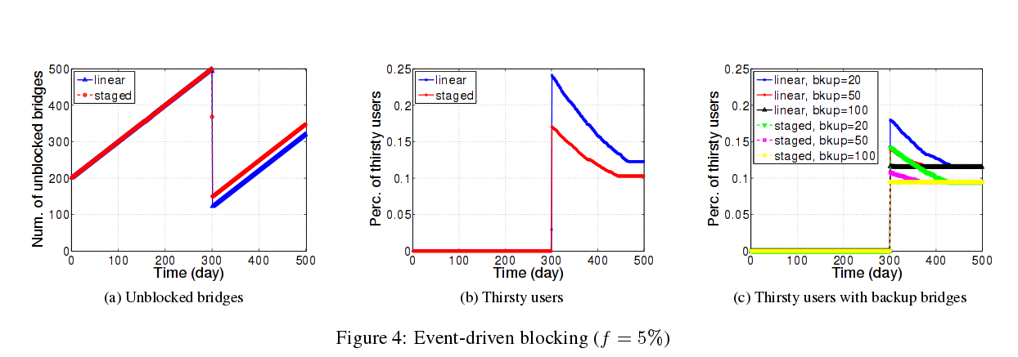
The Best Strategy for Censors

Slide 20
Some Minor Problems
Some odd crypto choices, silly mistakes, and efficiency sacrifices for very little added privacy
K-TAA signature scheme O_o'
Pedersen commitments on vectors
Oblivious Transfer
Ad-hoc anonymous credential construction from k-TAA signatures and Camenisch-Stadler NIZK proof of discrete logarithm.

Slide 21
Redesign
CL Anonymous Credentials
Belenkiy, M., Camenisch, J., Chase, M., Kohlweiss, M., Lysyanskaya, A., & Shacham, H. (2009). Randomizable proofs and delegatable anonymous credentials. In Advances in Cryptology-CRYPTO 2009 (pp. 108-125). Springer Berlin Heidelberg.
Uses Boneh-Boyen signatures and rerandomised Groth-Sahai NIZK proofs of satisfiability of a pairing-product equation to construct delegatable authentication tokens with attributes.

Slide 22
Redesign
CL Anonymous Credentials
Removes the need for k-TAA signatures, fixes the issues with making Pedersen commitments on vectors of independent variables, and provides a slightly less insane alternative to the credential constructions.

Slide 23
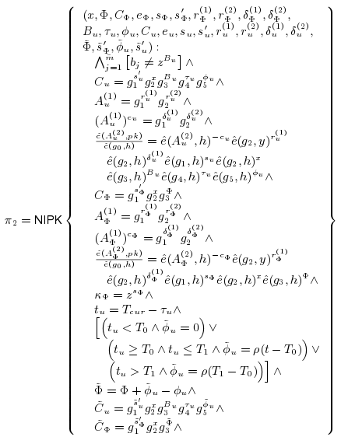
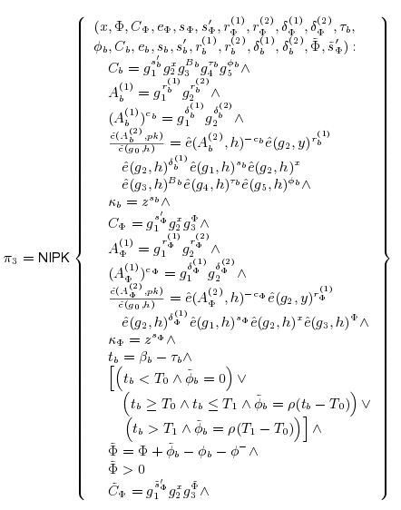
Redesign

Slide 24
Remove Oblivious Transfer
rBridge uses n-out-of-m OT to hide which Bridges are distributed to a client at the time of distribution.
Another messy construction for an additional proof of inequality of openings to commitments to chosen Bridge and some previous Bridge to avoid duplicates.
In the end, the client tells the server which Bridge it has when it reports the Bridge was blocked.

Slide 25
Open Questions
What do we mean when we say “A Bridge is blocked”? Does “blocked in China” mean “blocked in Iran”? What if China sells data on Tor Bridges to Iran?
Simpler anonymous credential constructions which don't require pairings? E.g. based upon algebraic MACs or Diffie-Hellman. Apparently pairings aren't cool enough or something and cryptographers keep needing to invent cool stuff to one-up each other.

