Slide 1
Tor Bridges: Hiding Public Resources from Nation-State Adversaries
Isis Agora Lovecruft
The Tor Project
Notes:
Social rejects
Unpopular

Slide 2
What is Tor?

Slide 3
How Tor Works

Slide 4
Tor Bridges
Notes:
Secret entrances to the Tor network
Must be distributed out-of-band
DPI or an active adversary is required to identify Bridges
Distributed via a centralised system called BridgeDB

Slide 5
Tor Bridges
Secret entrances to the Tor network
Must be distributed out-of-band
DPI or an active adversary is required to identify Bridges
Distributed via a centralised Bridge distribution system called BridgeDB

Slide 6
Arms Race
Notes:
Nothing prevents the GFW from observing all outgoing connections (particularly encrypted connections to non-standard ports), and running a Tor binary to connect to anything suspected of being a Tor bridge.
Identification by unique ciphersuite list

Slide 7
Arms Race
Since 2010: China's GFW began active probing Tor Bridges
- Observe Tor client's TCP connection to the Bridge
- For Tor<0.2.3.17-beta, identification was based upon Tor's unique TLS ciphersuite list
- A seemingly random machine from somewhere in China (possibly using IP-spoofing) will connect to the Bridge's IP:port and attempt to complete the first couple steps of the handshake
- The Bridge is usually blocked by IP:port
- The GFW sometimes spoofs a RST from Bridge to the client

Slide 8
Arms Race
2012: Ethiopia began blocking all TLS by looking for the client HELLO.
Any packet with the string TLS_DHE_RSA_WITH_AES_256_CBC_SHA in it is dropped…
…but when you specify a preference for TLS_DHE_RSA_WITH_AES_128_CBC_SHA instead (or split the ciphersuite list) it works just fine.

Slide 9
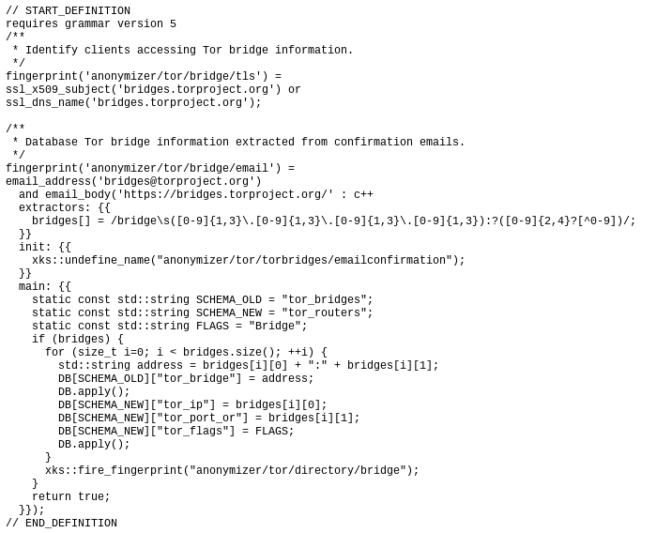
Arms Race
2014: Das Erste releases several NSA XKEYSCORE selectors. These are the XKEYSCORE selectors for Bridge IPs handed out from the current bridge distribution systems.
http://daserste.ndr.de/panorama/xkeyscorerules100.txt

Slide 10
Pluggable Transports, obfsproxy, & other completely unpronouceable things
Notes:
The original idea was to simply make traffic look different
Protocol mimicry
There's always going to be a distinguisher somewhere

Slide 11
obfs4proxy
Tor's NTor handshake with public keys obfuscated via the Elligator 2 mapping
Link layer uses NaCl secret boxes (Poly1305, Xsalsa20)

Slide 12
Simple Formulae
Make the handshake as uniform as possible
Use some pre-shared key material for authentication of the server and encrypt starting with the client's first message
Notes:
What's the fun in “solving” a problem that starts with the assumption that our protocol starts off with already having a private, authenticated channel? What is this? Quantum Key Distribution?

Slide 13
This just sweeps the problems under the rug

Slide 14
Bridge Distribution
Bridge obfs4 106.187.37.158:62421 50182425F17DEF0B51B0790188D2E04E300314B7 cert=pKDDKPfTYDJjX2tJbm6z/CW3+dnEg1vw3YjofAw2fbDnHJ2Rc7/yTAFg/1RiyoMme5Dgcw iat-mode=0
Bridge obfs4 178.209.52.110:443 67E72FF33D7D41BF11C569646A0A7B4B188340DF cert=Z+cv8z19Qb8RxWlkagp7SxiDQN++b7D2Tntowhf+j4D15/kLuj3EoSSGvuREGPc3h60Ofw iat-mode=0
Bridge obfs4 83.212.101.3:41213 A09D536DD1752D542E1FBB3C9CE4449D51298239 cert=lPRQ/MXdD1t5SRZ9MquYQNT9m5DV757jtdXdlePmRCudUU9CFUOX1Tm7/meFSyPOsud7Cw iat-mode=0
We need some manner of getting these Bridge connection details and pre-shared key material to Tor clients, and only to Tor clients.

Slide 15
Proof-of-Work Schemes Won't Work
The adversary is always going to have access to significantly more resources than the Tor users we're trying to help.
This applies to anything:
  Resource-based (CPU and/or memory)
  Monetary (Yes, even Bitcoin…)
  CAPTCHA-solving capabilities
  The thirty other PoW schemes proposed to me over the years.

Slide 16
If the adversary is so powerful, then what can't they do?

Slide 17
If the adversary is so powerful, then what can't they do?
Make friends!

Slide 18
What if we had a system where well-behaved users could invite their friends to get Bridges?
With this, we solve one problem and introduce another: the Bridge distribution system now has the complete social graph of which Tor Bridge users know each other, making it an even more attractive target for nation-state adversaries.

Slide 19
rBridge
Wang, Q., Lin, Z., Borisov, N., & Hopper, N. (2013, February). rBridge: User Reputation based Tor Bridge Distribution with Privacy Preservation. In NDSS.
Users are given “brownie points” for “good behaviour”
Users with enough brownie points might win the chance to invite their friends
Censors lock themselves out of the system via their own bad behaviour. Also nobody wants to be friends with those losers anyway.

Slide 20
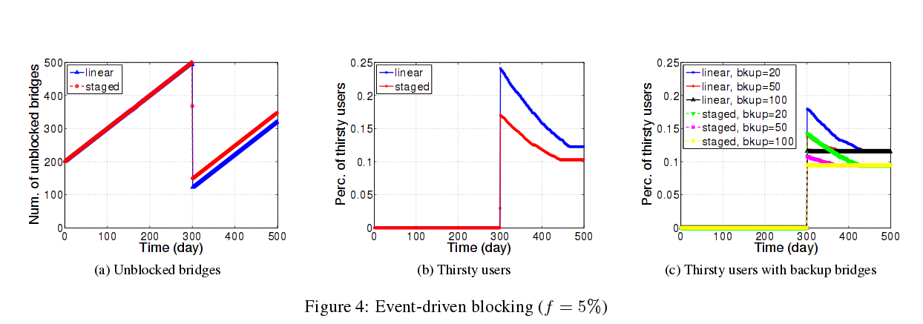
The Best Strategy for Censors

Slide 21
Some Minor Problems
Some odd crypto choices, silly mistakes, and efficiency sacrifices for very little added privacy
K-TAA signature scheme O_o'
Pedersen commitments on vectors
Oblivious Transfer
Ad-hoc anonymous credential construction from k-TAA signatures and Camenisch-Stadler NIZK proof of discrete logarithm.

Slide 22
Redesign
CL Anonymous Credentials
Belenkiy, M., Camenisch, J., Chase, M., Kohlweiss, M., Lysyanskaya, A., & Shacham, H. (2009). Randomizable proofs and delegatable anonymous credentials. In Advances in Cryptology-CRYPTO 2009 (pp. 108-125). Springer Berlin Heidelberg.
Uses Boneh-Boyen signatures and rerandomised Groth-Sahai NIZK proofs of satisfiability of a pairing-product equation to construct delegatable authentication tokens with attributes.

Slide 23
Redesign
CL Anonymous Credentials
Removes the need for k-TAA signatures, fixes the issues with making Pedersen commitments on vectors of independent variables, and provides a slightly less insane alternative to the credential constructions.

Slide 24
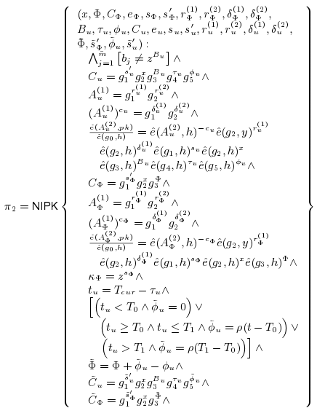
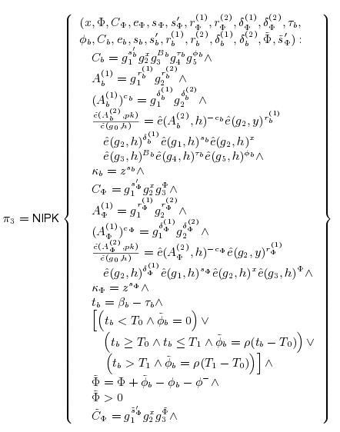
Redesign

Slide 25
Remove Oblivious Transfer
rBridge uses n-out-of-m OT to hide which Bridges are distributed to a client at the time of distribution.
Another messy construction for an additional proof of inequality of openings to commitments to chosen Bridge and some previous Bridge to avoid duplicates.
In the end, the client tells the server which Bridge it has when it reports the Bridge was blocked.

Slide 26
Open Questions
What do we mean when we say “A Bridge is blocked”? Does “blocked in China” mean “blocked in Iran”? What if China sells data on Tor Bridges to Iran?
Simpler anonymous credential constructions which don't require pairings? E.g. based upon algebraic MACs or Diffie-Hellman.

Slide 27
All these improvements only protect the Bridges from an adversary on the client side.

Slide 28
What other ways are there to discover Tor Bridges?

Slide 29

Arms Race
2015: Some researchers in China realise there's another way…

Slide 30
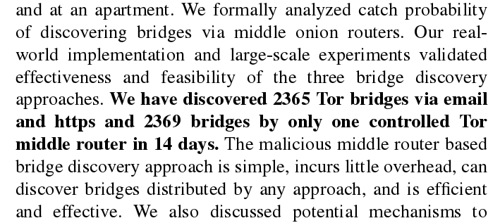
Arms Race

Slide 31

Arms Race

Slide 32
Solution
Tor Proposal #188:
https://gitweb.torproject.org/torspec.git/tree/proposals/188-bridge-guards.txt
A Tor client chooses three hops through the Tor network.
The client's traffic goes through those three hops. Well… yes. But…
Those aren't the only hops which the client's traffic can go through.

Slide 33
Solution
Nothing in Tor's circuit-level crypto prevents those three hops from adding more hops to the client's path. Tor turns out to be loose-source routed.
The client doesn't even have to know it's happening.
We can use this to have Tor Bridges choose a Bridge Guard node, and transparently inject the Bridge's Guard into the client's path.

Slide 34
Questions

