Slide 1
Matching Spirits Supply to Demand in Iowa
Decision support for the Iowa Alcoholic Beverages Division (ABD)
Group 1 · Darshita Yadav (240981) · Raghav Yadav (240598) · Rayna Manchanda (240601) · Prerit Shrivastava (240593)
Advanced Data Science · End-Term Project · November 2026
Notes:
One sentence: we help Iowa's state spirits wholesaler decide how much to buy and truck to each region next month, and we found three things about demand that the simple planning rule misses.

Slide 2
Stage 1 · Define the problem
Stakeholder · questions and hypotheses · data audit · integration plan · project plan

Slide 3
ABD must commit stock before stores order
≈2,240
Stakeholder
Iowa Alcoholic Beverages Division: sole spirits wholesaler. Buys from suppliers, holds one central warehouse, delivers to every licensed store and issues their licences.
licensed retailers supplied by ABD
Decision
4.5M
How many liters of each spirits family to buy and truck to each county next month, and how to treat border counties and new licensees.
order lines, Jan 2025 – Oct 2026
KPI and constraints
−3%
Cut planning error (WAPE, county × family) by ≥10% vs “same month last year”, bias within ±3%; translate into safety stock. Public data only · one state price · ABD is also the regulator.
statewide liters, Jan–Oct 2026 vs 2025: last year's plan over-buys
Notes:
The pre-submission said ABD sets a stocking profile per county. That was wrong: stores order what they want. ABD's real levers are procurement, delivery capacity and licensing, so the project is reframed around those.

Slide 4
Three pre-registered hypotheses, each tied to a decision
H1 · Cross-border leakage
H2 · Regional mix
H3 · Store entry
Counties where cheaper out-of-state spirits are close buy fewer liters per adult (Missouri tax $2.00/gal vs Iowa $15.14).
Decision: per-capita planning norms; state revenue.
Counties with a larger Hispanic share buy a larger tequila/mezcal share.
Decision: category mix supplied to each delivery region.
A new licence takes volume from existing stores, so the city grows by less than the newcomer sells.
Decision: how to plan and license new stores.
Written before any 2026 outcome was examined: 2025 = discovery sample, Jan–Oct 2026 = confirmation sample. This fixes the pre-submission caveat (patterns were “confirmed” on half of the same year).
Dropped from the pre-submission: income → premium share (rejected), young adults → RTD (a proxy for urbanisation), K-means (not in the course handout).
Notes:
H1 revises the pre-submission H1: we originally said bigger counties drink more. Exploring 2025 showed the lowest-buying counties all touch Missouri. Sales are recorded where the store is, so we test the mechanism. RQ3 (can ABD forecast better) is the solution part.

Slide 5
Data audit: five official sources from four publishers
Source | Publisher | Coverage | Size | Role
Iowa Liquor Sales 2025 (dataset 1262) | Iowa Data Hub (ABD / Alcohol & Tax Ops) | Jan–Dec 2025 | 2,490,620 rows | orders · discovery sample
Iowa Liquor Sales 2026 (dataset 1263) | Iowa Data Hub | Jan 1 – Oct 30 2026 | 2,029,764 rows | orders · confirmation and test
ACS 5-year 2020–24, 16 tables | US Census Bureau | 99 counties | 22 variables | demographics
County adjacency + Gazetteer 2024 | US Census Bureau | 99 counties | 15 variables | borders, area, distance
State spirits excise, Jan 2026 | Tax Foundation (cross-check: FTA) | Iowa + 6 neighbours | 7 rows | tax gap for H1
Row counts match the publisher's API exactly for both years · no Kaggle · licences and links in data/links.txt · access: open API, no constraints
Notes:
Why this data: Iowa is a control state, so this file is every spirits sale in the state, not a sample. The census and geography files are what let us explain where demand differs; the tax table gives the mechanism for H1.

Slide 6
Integration: one source of truth, 4.52M rows × 76 variables
Sales 2025 + 2026
Clean & derive
Join on county FIPS
SSOT (Parquet)
4.52M lines, 23 columns
dedupe · fix truncation · family · store type · entry type
ACS + geography + tax, many-to-one, 100% matched
4,518,330 × 76 → county, store-month and store × family × month tables
Join keys are codes, not names: 5-digit county FIPS (federal standard); store_no (stable across years, 2,078 stores in both)
Grain: one row per order line; aggregated to county (hypotheses) and store × family × month (forecast)
Units: liters recomputed from bottles × bottle size; US dollars; every step logged in data_quality_report.json
Reproducible: scripts/01_build_ssot.py rebuilds everything from raw files in about a minute
Notes:
Why FIPS and not county name: spelling varies between sources. The SSOT is one table at the most detailed grain, so every analysis aggregates from the same truth.

Slide 7
Plan: BADIR mapped to course methods
BADIR | What we do | Course methods (handout unit)
Business question | ABD's monthly supply and licensing decisions; KPI = WAPE and bias | Problem framing, KPI and metric design
Analysis plan | Pre-registered H1–H3; time-ordered split; status-quo baseline | Hypothesis testing; experimentation design
Data | ETL into an SSOT with quality gates | ETL pipelines, data warehousing
Insights | OLS + permutation + bootstrap; stacked difference-in-differences | Hypothesis testing; causal inference (DiD)
Recommendations | Gradient-boosting ensemble, calibrated intervals, newsvendor plan; API, MLflow, Docker, drift; SHAP, fairness | Feature engineering, ensembles, boosting, HPO, calibration; optimisation; MLOps; responsible AI
Not forced: Spark (data fit in memory), deep learning (tabular monthly data), RL (no sequential control), A/B test (proposed for the roll-out instead), K-means and LIME (not needed).
Notes:
The brief says not to force methods. Each method is here because a decision needs it; the bottom line lists what we deliberately did not use and why.

Slide 8
Stage 2 · Validate the evidence
Data preparation · EDA · hypothesis tests · inconclusive results · 20 more hypotheses · revised analysis

Slide 9
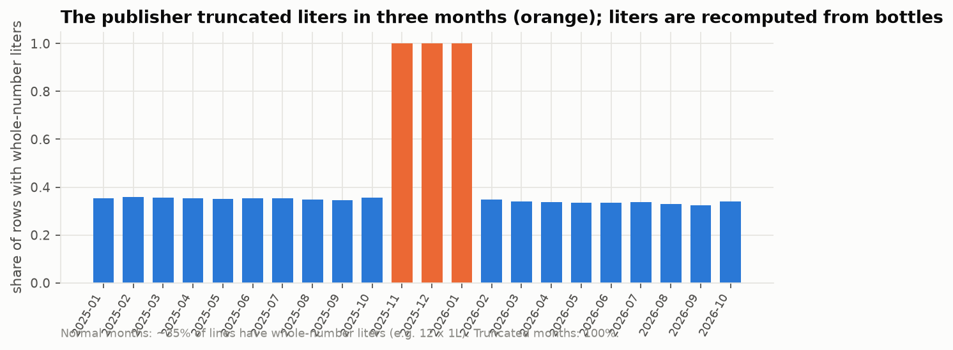
Data preparation: four defects the pre-submission missed
Truncation in three months, not two
Liters, dollars and prices are whole numbers in Nov–Dec 2025 and Jan 2026 (liters −3.4%). Liters recomputed; dollars rebuilt from item prices (validated: −0.08% error).
Multi-pack minis
313 “50 ml” items are really sleeves or buckets of minis (e.g. $81 = $1,620/L). Flagged; excluded from price metrics; ~2% of liters understated; H1 re-tested in dollars.
Also handled: 429,989-row duplicated download part · 21 exact duplicates · 4,135 blank counties (2,102 imputed from the store) · 4 renamed categories · returns kept as negative volume.
Ownership changes ≠ new stores
55 “new” licences sit at the address of a store that just closed. Separated from 281 genuinely new stores; otherwise H3 would be wrong.
Notes:
These are not cosmetic. Using the published liters would show a false holiday and January slump; treating ownership changes as entries would make H3 find competition where there is none.

Slide 10
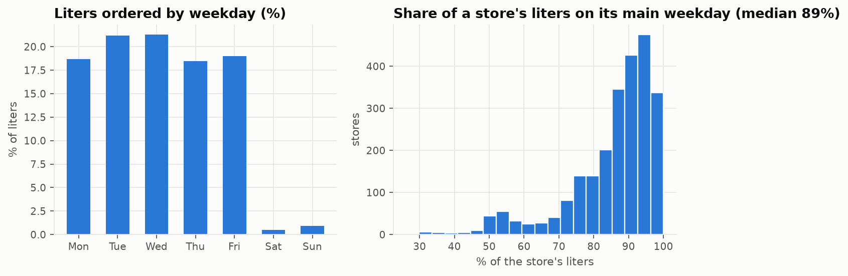
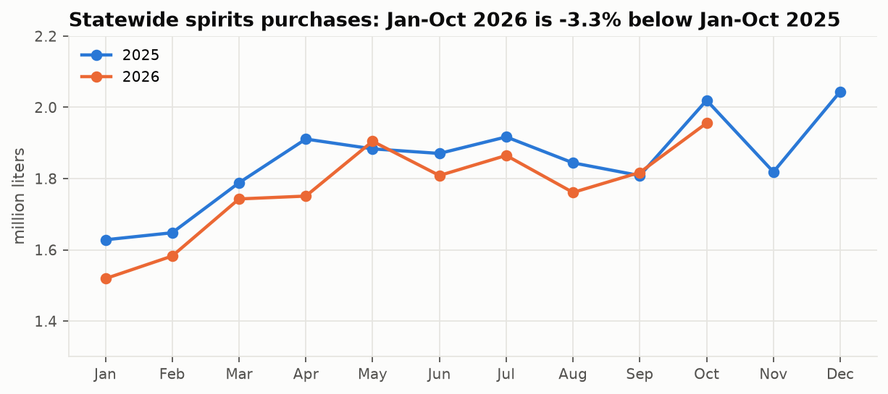
EDA: three patterns that change how ABD should plan
−3%
89%
½
2026 vs 2025, nearly every month → last year's plan systematically over-buys
of the median store's liters arrive on one weekday → 4 vs 5 order days = 25% swing
liters per adult in Missouri-border counties → per-capita norms fail there
Observation → inference → decision: drift becomes the baseline to beat; the order calendar becomes a model feature; the border becomes H1.
Notes:
The weekday finding is the kind of thing that is easy to miss: monthly totals look noisy, but much of the noise is simply how many of a store's delivery days fall in the month.

Slide 11
H1: Missouri-border counties buy 44% fewer liters per adult
−44%
liters per adult vs comparable counties, 2026 (95% CI 25–58%); 2025: −43%
Controls: population, income, median age, education
Passes all four checks: HC3, permutation, trimmed, population-weighted; also holds in dollars
Shortfall fades with distance from the border in both years
At stake: ≈$5.9M sales ≈ $2.0M ABD margin a year (upper bound; association)
Notes:
Pre-registered and confirmed on 2026 data we had not looked at. It is an association: we cannot see the Missouri side, so a confounder linked to the southern border cannot be ruled out. The revenue figure is therefore an upper bound.

Slide 12
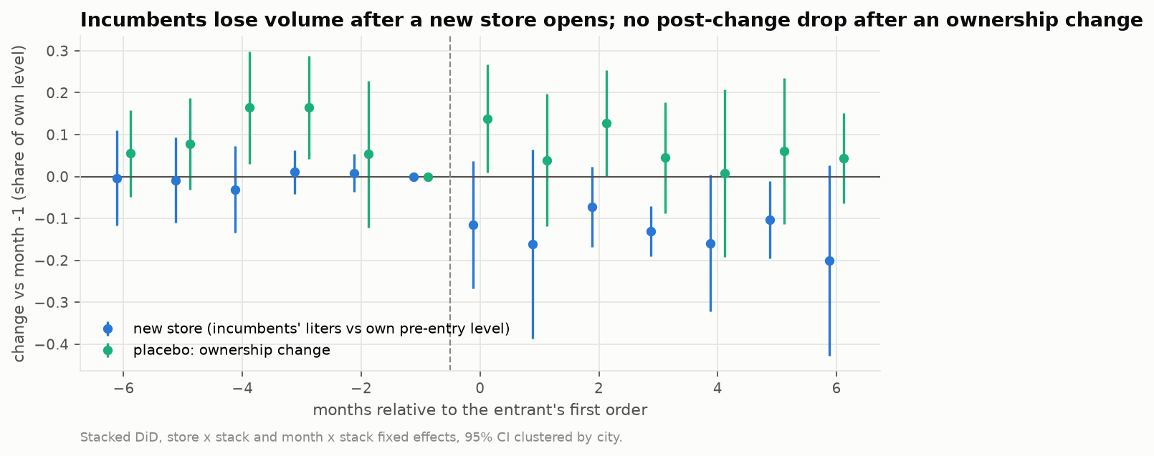
H3: a new store mostly takes sales from existing ones
−13%
incumbents' volume after a genuinely new store opens (p = 0.01, flat pre-trend)
≈60%
of the newcomer's volume diverted from incumbents (95% CI 28–129%)
Stacked difference-in-differences: 116 cities, 1,136 incumbents, 475 city clusters
Small incumbents −21% vs large −4%; ownership changes show no post-change drop
H2 also confirmed out-of-time: +0.8 pts agave share per +10 pts Hispanic population
Notes:
Causal design: incumbents in cities that get a new store vs incumbents in cities with no arrivals, store and month fixed effects. Parallel trends is supported by the flat lead coefficients. If entrants pick growing towns, the bias goes toward zero, so 60% is conservative.

Slide 13
Inconclusive and unsupported results are findings too
Result | What the evidence says | Status
H1b tax-gap dose-response | Border groups line up with the tax gap; significant in 3 of 4 checks, fails population weighting (p = 0.21) | Inconclusive
H1c fewer 1.75 L “stock-up” bottles | −7 pts at the Missouri border; fails population weighting (p = 0.23) | Inconclusive
H1d leakage to a bigger Iowa neighbour | p ≈ 0.10 once age and education are controlled | Not supported
Pre-sub H3 income → premium; H4 age → RTD | Rejected / confounded by urbanisation | Dropped, reported
H3 raw-liters outcome | Not significant: a few giant stores dominate the variance; normalised outcome used | Disclosed deviation
H3 placebo | No post-change effect, but a noisy pre-period (20 cities) | Weaker than hoped
Notes:
The guidelines treat unsupported or inconclusive results as valid outcomes. We applied our own pre-registered rule even where it cost us a 'supported' label.

Slide 14
Twenty more hypotheses: 10 supported, 3 partial, 7 rejected
Geography & culture
Cultural calendar
Prices & economics
Market & stores
H4 Brandy belt crosses the river
H8 St Patrick's lifts Irish whiskey
H13 Price cuts: stock up, then dip
H18 The long tail lives in cities
● Supported
● Supported
● Rejected · Reversed
● Supported
H5 Taste spreads to neighbours
H9 Cinco bump is Hispanic-led
H14 Tariffs raised import costs
H19 Spirits follow Zipf's law
● Supported · Whiskey, rum
● Rejected · Statewide
● Rejected
● Supported
H6 Missouri pull ends at ~30 mi
H10 College towns empty in summer
H15 Inequality builds a barbell
H20 Opening-order honeymoon
● Partial
● Supported
● Partial
● Supported
H7 Sioux County is a 'dry' outlier
H11 Holiday trade-up is for the rich
H16 50 ml nips track poverty
H21 Dying stores fade slowly
● Rejected
● Rejected · All incomes
● Partial
● Rejected · Sudden
H23 Whiskey divide is generational
H12 Palate rotates with seasons
H17 More outlets, more drinking
H22 Customers stay with the address
● Rejected · Rural, not age
● Supported · 7 of 8
● Supported · Under 1:1
● Supported
Exploratory, not pre-registered. County patterns must hold in both 2025 and 2026. Six survive a Holm correction for 20 tests: H6, H12, H18, H20, H21, H22.
Notes:
Beyond the three pre-registered hypotheses we tested twenty exploratory ones across four themes. Each states a direction before the test. County patterns only count if they hold in both Jan-Oct 2025 and Jan-Oct 2026, using the same OLS with HC3 standard errors and Freedman-Lane permutation as H1 and H2. Seven are rejected, and several of the rejections are the most interesting results. Code: scripts/05_twenty_hypotheses.py; write-up: reports/twenty_hypotheses.md.

Slide 15
Geography: tastes cross borders, and age is a red herring
H4
1.7×
Wisconsin's brandy belt crosses the Mississippi
Border counties 2.7% brandy vs 1.6% elsewhere; holds 2025 and 2026
Supported
brandy share in counties on the Wisconsin border (H4)
H5
Taste spreads to neighbouring counties
Whiskey and rum residuals cluster (Moran's I 0.14-0.17); agave and gin don't
Whiskey, rum
~30 mi
H6
Missouri's pull ends at a travel horizon
2026: +34% liters/adult per 10 mi up to ~30 mi, then flat; 2025 linear
Partial
how far Missouri's cheaper spirits pull Iowa buyers, 2026 (H6)
H7
Dutch-Reformed Sioux County is a 'dry' outlier
Ranks 40 of 99 (−7%). Real outliers: Louisa and Keokuk
Rejected
−21 pts
H23
Canadian = old Iowa, bourbon = young Iowa
Raw split looks generational; with controls the age effect flips
Canadian share of whiskey per 10× density: it's rurality, not age (H23)
Proxy
Notes:
H4: counties on the Wisconsin border put 2.7% of liters into brandy against 1.6% elsewhere, in both years. H5: Moran's I on demographic residuals; whiskey and rum cluster between neighbouring counties, agave and gin do not. H6: hinge regression; the break is about 30 miles in 2026 but the 2025 gradient is linear, so partial. H7: Sioux County ranks 40 of 99, so the religion story fails; Louisa and Keokuk are the real outliers. H23: the raw age pattern reverses once density and education are controlled. Density alone explains 48% of Canadian share, and education 45% of bourbon share. A textbook confounder.

Slide 16
The calendar: restocking runs weeks ahead of every occasion
H8
St Patrick's Day lifts Irish whiskey
+29% share in Feb-Mar (2026), +24% (2025); Scotch +4%
Supported
H9
The Cinco de Mayo bump is Hispanic-led
Bump is real (+16%) but statewide: a party, not an ethnic, occasion
Rejected
H10
College towns empty out in summer
Ames −37%, Iowa City −25% summer vs autumn: 2nd and 4th lowest of 99
Supported
H11
Holiday trade-up is a rich-county thing
Premium share 24.8% → 27.1% in Nov-Dec, equally at every income
Rejected
H12
Iowa rotates its palate with the seasons
7 of 8 as predicted. Surprise: rum is a winter spirit
7 of 8
Notes:
These are store orders, so every effect shows up 2-6 weeks before the occasion. H12 chart: store-level paired Wilcoxon of family shares, summer (Jun-Aug) vs winter (Nov-Jan). Seven of eight directions were predicted correctly; rum is the surprise, a winter spirit in Iowa. H8: Irish whiskey peaks in February, and Scotch, the placebo, barely moves. H9: the Cinco de Mayo agave bump is real (+16% in 2026, +8% in 2025) but no bigger in Hispanic counties. H10: Ames and Iowa City rank 2nd and 4th lowest of 99 for summer vs autumn. H11: holiday premium share rises equally at all incomes.

Slide 17
Prices: price cuts pay off late; new outlets add demand
H13
Price cuts: stock up now, under-order later
Reversed: flat during the cut, +49% the month after; no dip
Reversed
H14
Tariff era made imports dearer
Same-item cost moved under 1% for every origin, Jul-Oct 2026 vs 2025
Rejected
H15
Inequality builds a price barbell
High-Gini counties buy a wider price spread, but pricier on average too
Partial
H16
The 50 ml nip is a poverty index
No county effect; within a store type +3.3 pts per +10 pts poverty
Partial
H17
More outlets, but under 1:1 more drinking
Elasticity 0.39-0.52 (pop.-weighted) vs 0.40 implied by H3
Supported
Notes:
H13 chart: item and month fixed effects on 2,251 regularly stocked items, clean-price months only. We expected forward-buying (stock up during the cut, then under-order). The data shows the reverse: orders are roughly flat during the cut and jump about 49% the month after the price returns to normal (p < 1e-7). Likely mechanism: retailers pass the cut to the shelf, sell through, and restock at full price. Note: state cost is blank for Jan-Jun 2025 and truncated in Nov 2025-Jan 2026, so those months are excluded. H17: elasticity of liters per adult to outlets is 0.39-0.52 population-weighted, matching the 0.40 implied by H3's 60% diversion. Two independent methods agree.

Slide 18
Stores: a big first order, a sudden exit, and loyal addresses
H20
New stores have an opening honeymoon
Opening order 1.86× steady state, then 0.79×; steady by month 5
Supported
H21
Dying stores fade slowly before exit
Only −6% before the last order; warning AUC 0.53 (coin flip)
Sudden
H22
Customers belong to the address
New owner's mix 2× closer to predecessor's; keeps 92% of volume
Supported
H18
The long tail lives in cities
Same order lines: 547 distinct products in dense vs 322 in sparse counties
Supported
H19
Spirits follow Zipf's law
Slope −1.10; top 1% of 4,792 products = 38% of liters
Supported
Notes:
H20 chart: median ratio of a new store's monthly liters to its months 3-5 average, 191 genuinely new stores. The opening order is 1.86 times steady state, then month 1 dips to 0.79. A forecast built on the opening order overshoots month 1 by about 2.4 times. H21: exiting stores are only 6% below their seasonal norm before they stop; as a warning signal the AUC is 0.53, a coin flip. H22: 55 ownership changes; the successor's mix is half as far from its predecessor as from a random same-type store, and keeps 92% of the volume. H18: rarefaction removes the 'bigger county, more SKUs' artefact. H19: the top 1% of SKUs carry 38% of liters.

Slide 19
Five findings to take into planning
H13
H17 + H3
H22
H20
H23
+49%
~45%
92%
1.86×
−21 pts
orders the month after a price cut ends
of a new outlet's volume is new demand
of volume stays when a shop changes hands
a new store's opening order vs normal
Canadian share per 10× density
Decision
Plan promotion stock for month t+1, not t
Decision
Two methods agree; net entrants in capacity plans
Decision
Forecast from the predecessor's history
Decision
Cap entrants at month 0; use peers until month 3
Decision
Allocate whiskey by rurality and education, not age
Full tests, verdicts and caveats: reports/twenty_hypotheses.md · scripts/05_twenty_hypotheses.py
Notes:
If the audience remembers five things from the twenty: price-cut volume arrives a month late; roughly 40-50% of a new outlet's volume is new demand, confirmed by two methods; an ownership change is not a new store; a new store's opening order is a one-off; and Canadian whisky follows rurality, not age. Each maps to a planning action ABD can take with the forecast it already has.

Slide 20
Revised analysis: from explaining demand to forecasting it
Unit: store × family × month (409K rows); features only from data known the month before
Learned models under-forecast (one seasonal cycle; trees can't extrapolate giant stores); last year over-forecasts in a shrinking market
Opposite errors → ensemble: 0.55 × Tweedie XGBoost + 0.45 × calendar-adjusted seasonal naive (weight chosen on validation)
HPO (20 trials) changed little: gains come from features and design
Notes:
Why WAPE: volume-weighted, works with zeros, reads as % of liters mis-planned. Honest caveat: XGBoost alone is better at store level (36.6 vs 39.0); the ensemble is better at county and state level, which is where ABD plans.

Slide 21
Stage 3 · Inform the decision
Final findings · recommendations · impact and limits · roadmap

Slide 22
Final findings: 20–27% less error and 23 hypotheses tested
 | Finding | Status
H1 | Missouri border: −44% liters per adult | Supported
H2 | Agave share rises with % Hispanic | Supported
H3 | New licences: −13% incumbents, ~60% diversion | Supported*
H4–H23 | 20 exploratory tests: 3 partial, 7 rejected (slides 14–19) | 10 supported
Model | Bias +2% (status quo +6.5%); calibrated P10–P90 | Meets KPI
Strongest of the 20
· Price-cut orders arrive a month late: +49% (H13)
· ~45% of a new outlet's volume is new demand (H17 + H3)
· A change of owner keeps 92% of a shop's volume (H22)
* with one disclosed deviation (normalised outcome). H1b, H1c inconclusive; H1d not supported. H4–H23 are exploratory, not pre-registered.
Notes:
The forecast beats the status quo in every test month (16–26%) and in every county group in the fairness audit. Beyond the three pre-registered hypotheses, 20 exploratory tests: 10 supported, 3 partial, 7 rejected. The three that matter most for planning: price-cut volume arrives the month after the cut (H13); about 45% of a new outlet's volume is new demand, which matches H3's 60% diversion from a completely different method (H17); and an ownership change keeps 92% of the shop's volume (H22).

Slide 23
Recommendations for ABD
1
Plan procurement and capacity with the ensemble forecast; stock price-cut items for the month after
6
Forecast new licensees from peers, ownership changes from the predecessor; trim nearby incumbents
−20% / −27% error · H13: +49% a month late
H3: ~60% diverted · H20: 1.86× opening · H22: 92% kept
2
Set stock by service level, chosen per family from stock-out vs holding cost
7
In licence reviews, report the hit to small incumbents and the ~45% net-new demand
−25% safety stock
H3: −21% small · H17: elasticity ≈ 0.4–0.5
3
Plan delivery capacity by order days, not months; stock occasions and college terms weeks ahead
8
Set regional mix from local drivers (agave, NE brandy, rural Canadian); keep ethnicity out of the model
89% on one weekday · H8, H10, H12
H2, H4, H23; ablation
4
Drop per-capita norms in a ~30-mile southern band; plan those counties on their own history
9
Ask the publisher to fix truncated months, blank 2025 costs and mini pack counts
H1: −44% · H6: ~30 mi
data audit · H13
5
Brief the board and legislature on the Missouri border gap (≈$2.0M margin/yr, upper bound)
10
Roll out via a randomised regional pilot (A/B) before going statewide
H1 + tax data
causal proof of value
Notes:
Each recommendation is tied to a piece of evidence. Recommendation 10 is where the course's A/B testing belongs: randomise delivery regions to measure the operational benefit causally before full adoption. The exploratory hypotheses sharpen five of these: promotion stock goes in the month after a price cut (H13); occasions and college terms are stocked weeks ahead (H8, H10, H12); the border band is about 30 miles (H6); new stores are forecast from peers rather than their oversized opening order, and ownership changes from their predecessor (H20, H22); about 45% of a new outlet's volume is new demand, which licensing and public-health reviews should see (H17); and regional mix follows local drivers such as Wisconsin-border brandy and rural Canadian whisky, not age (H4, H23).

Slide 24
Impact, responsible AI and limitations
−25%
84K L
0
warehouse safety stock at 95% service ≈ $0.73M working capital
per month of systematic over-buying removed (≈$1.0M at cost)
personal data · ethnicity dropped from the model (no validation gain)
Responsible AI
Limitations and assumptions
SHAP: own history 78%, store 11%, demographics ~1%
Fairness: better than status quo in every group, but +7% bias in rural / border counties vs +1% urban; new stores −24%
Monitoring: PSI, monthly error, schema drift, retrain rule; one false alarm diagnosed
22 months = one seasonal cycle
Sales recorded at the store; census 2020–24; ecological data
H1 association; H3 CI wide; revenue figure an upper bound
Value assumes 1-month lead time, 20% holding cost
Notes:
Value estimates are planning estimates, not audited savings. The fairness audit is honest: no group is worse off than today, but residual bias is not equal and is monitored monthly.

Slide 25
Implementation roadmap
0–2 mo
2–5 mo
5–8 mo
3–9 mo
Ongoing
Shadow mode
Randomised pilot
Statewide roll-out
Policy use
Run & improve
Analytics team runs forecasts beside the current plan
Half of delivery regions plan with forecast + service levels
Procurement by service level; order-day capacity plan
H3 note in licence reviews; border-gap briefing (H1)
Monthly refit, drift and fairness audit, publisher data fixes
KPI: county WAPE ≤ 14%, |bias| ≤ 3%
KPI: fill rate ≥ today; inventory days −10%
KPI: safety stock −20% at equal fill rate
KPI: briefing delivered
KPI: no group |bias| > 5%
Owners: ABD supply-chain analytics (forecast, monitoring) · ABD planning and operations (pilot, roll-out) · ABD licensing and board (policy use)
Notes:
Phase 2 is the experiment: random assignment of delivery regions gives a causal estimate of the operational benefit, not just a forecast-accuracy number.

Slide 26
Demo and decision challenge
Live: FastAPI planner at localhost:8000 · county plans, service-level slider, store drivers (SHAP), model health
Reduced budget → lower service level on low-margin families · Error costs change → move the quantile · Drift → PSI + monthly refit · Fairness → group audit, bias correction · Missouri tax rises → border volume recovers (H1 bounds it) · Licensing wave → plan net of ~60% diversion
Notes:
Demo path: open Polk County, move the service level from 90 to 95%, show safety stock rise; open Davis County (Missouri border); click a Costco store to show drivers; show the model-health panel.

