Slide 1

Instructor Kick-off
Analyze A/B Test Results
© 2019 Udacity. All rights reserved.

Slide 2
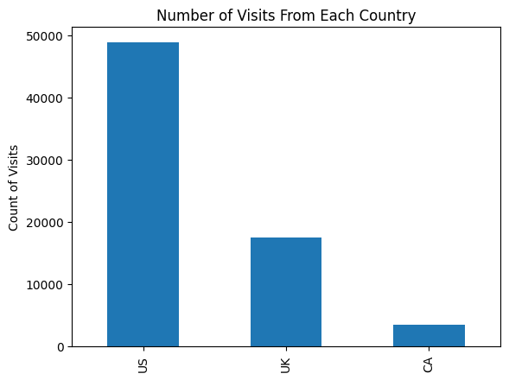
How Was The Experiment Implemented?​
Total Variant Visitors: 35211
Total Control Participants:​ 34678​
Chart of Where Users Are From

Slide 3
Conversion Rates
 | U.S. | U.K. | CA
Control | 10.7% | 10.2% | 9.4%
Treatment | 15.8% | 14.9% | 15.4%
Executive Summary: When comparing the control and treatment groups, we can see that the treatment group shows higher conversion rate compared to control group. Also, the conversion rates vary across the countries. However, there is no significant association between country of origin and conversion rates.

Slide 4
Experiment Results
Treatment Conversion Rate: 15.53%
Control Conversion Rate:​ 10.53%
Delta in Treatment vs. Control Conversion Rate:​ 0.05 (5%)
p-value:​ 0.0
Conclusion:​ The treatment group has 15.53% conversion rate compared to 10.53% for that of control group. The difference is 0.05 or 5% and the p-value is 0.0. From the results, we can see that there is statistically significant evidence that treatment has a positive effect on the conversion rates compared to the control.

Slide 5
Country Results
Conclusion:​ The p-values associated with U.S and U.K are 0.17 and 0.90 respectively. Both the p-values for U.S and U.K are greater than 0.05 and indicates that the difference in their respective conversion rates and base rates are not significant. Hence, it suggests that there is not enough evidence that being from U.S or U.K will statistically effect the conversion rates.

