Slide 1
ML Confusion Matrix
Harmeet Bhatia
March 2022

Slide 2
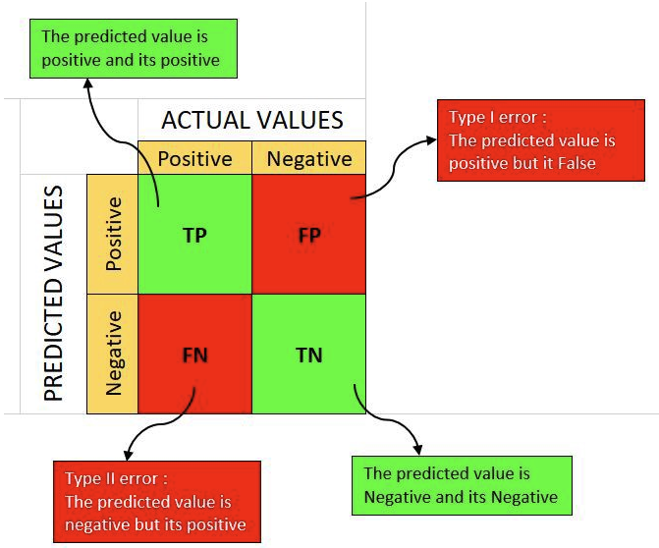
What is a Confusion Matrix in Machine Learning
Notes:
2

Slide 3
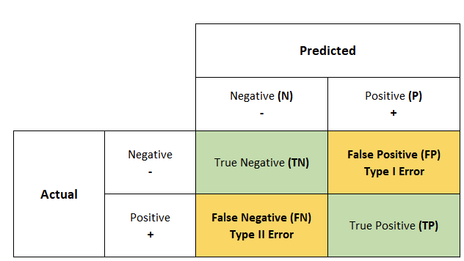
A confusion matrix is a summary of prediction results on a classification problem using N * N matrix, where N is the number of target classes. The matrix compares the actual target values with those predicted by the machine learning model.
A good model is one which has high TP and TN rates, while low FP and FN rates.
If you have an imbalanced dataset to work with, it’s always better to use confusion matrix as your evaluation criteria for your machine learning model.

Slide 4
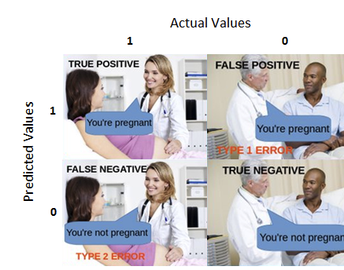
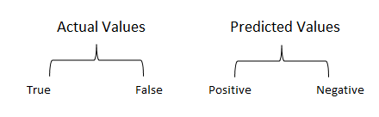
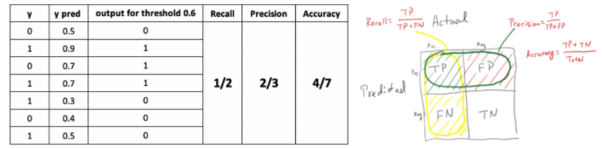
True Positive:
Interpretation: You predicted positive and it’s true.
You predicted that a woman is pregnant and she actually is.
True Negative:
Interpretation: You predicted negative and it’s true.
You predicted that a man is not pregnant and he actually is not.

Slide 5
References to learn more
https://medium.com/analytics-vidhya/what-is-a-confusion-matrix-d1c0f8feda5
https://towardsdatascience.com/understanding-confusion-matrix-a9ad42dcfd62
https://en.wikipedia.org/wiki/Confusion_matrix

