Slide 1
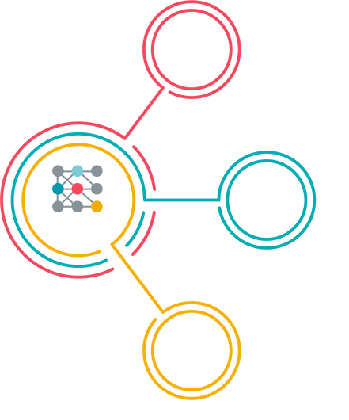
Preventative Services Audit Expansion An Overview

Slide 2
Problem Definition
Most UHC Commercial policies cover preventative services at 100% with no copay when INN provider is used. However, the preventative care policies can be complex and have multiple levels of rules (diabetes screenings are covered if these procedure codes A--D and diagnosis codes 1-4 are included but not if BCD)
An Initial POC was conducted by comparing the 'Injectable' section of the Oxford Preventative care policy document and identifying claims that did not pay according to the policy. This capability will focus on scaling the comparison of additional sections in the preventative care guides below against the paid claims.
Short term: we would like to analyze claims by comparing to the codes in the preventative services document
Long term: NLP should be leveraged to automatically read and extract rules from preventative services document. This is covered under C105571

Slide 3
Translating problem from business to technical
If we look at current issues, here is what we find
Plan benefits are recorded in plan documents for members, which are now being translated as human readable rules , populated in benefits structured table for use in claims , processing
2. Current claims system needs to implement an efficient process of
a. Applying (translating) such human readable rules to computer logic
b. Create/implement a verification system that can keep up(scale to) with number of claims being now process and for future demand
3. Translating (extracting business rules) from plan document is still manual and is error prone
Short term: we would like to analyze claims by comparing to the codes in the preventative services document
Long term: NLP should be leveraged to automatically read and extract rules from preventative services document. This is covered under C105571

Slide 4
What can be done today ?
Here is what, I would recommend as iterative solution
Let us break this problem down to 2 parts
1. Human readable business rules extraction to an efficient machine applicable system
2. Create a verification system for human readable rules
Since rules are already in place , we can start by using existing preventive rules as these exists and develop a verification system solving problem 2, 1st
Solution of this can be expanded to other business rules , beyond preventive

Slide 5
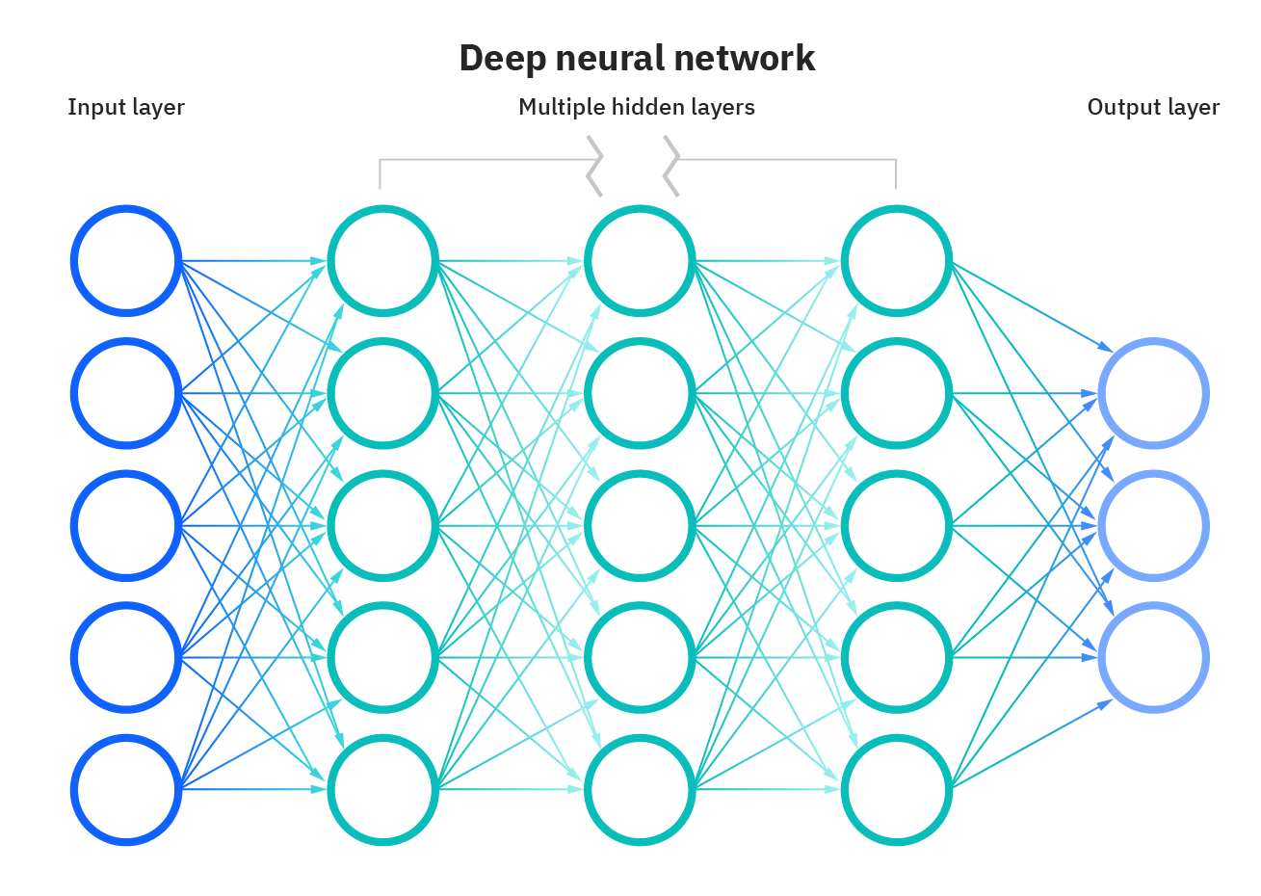
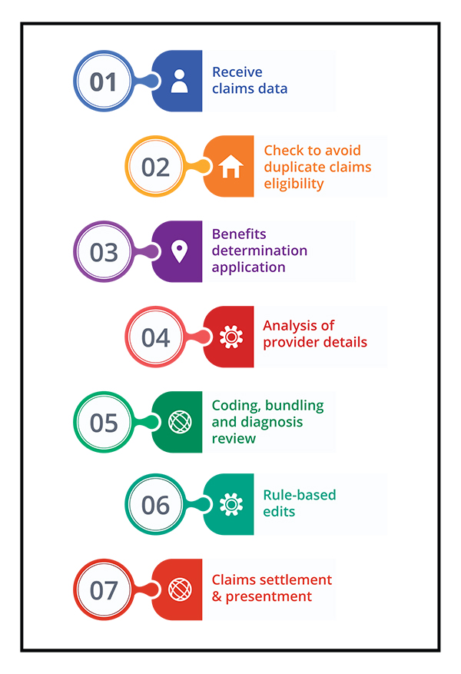


How would solution work ?
This is what we would build to translate human readable business rules to neural network based decision trees
Human readable Rules
Sample Rules from Repository
if rule_dict['proc_codes'] != '': new_dict['proc_set1'] = rule_dict['proc_codes'].upper() else: new_dict['proc_set1'] = "" if rule_dict['diag_set1'] != '' and rule_dict['diag_set1'] != []: new_dict['diag_set1'] = rule_dict['diag_set1'].upper() else: new_dict['diag_set1'] = "" if rule_dict['diag_set1'] == "pregnancy codes": new_dict['diag_set1'] = "Pregnancy Diagnosis Codes" if rule_dict['diag_set2'] != '' and rule_dict['diag_set2'] != []: new_dict['diag_set2'] = rule_dict['diag_set2'].upper() else: new_dict['diag_set2'] = "" if rule_dict['diag_set2'] == "pregnancy codes": new_dict['diag_set2'] = "Pregnancy Diagnosis Codes"
Verification Engine

Slide 6

Questions ?

Slide 7

Thank you

Slide 8
Appendix

