Slide 1
Introduction to ORM
Introduction to Object-Relational Mapping

Slide 2
Content
Introduction
What is ORM?
Why use ORM?
Core Concepts
Objects vs. Relational Data
How ORM works
Common Patterns
Benefits and Challenges
Benefits
Challenges and Limitations
Popular Frameworks
Exercises
Requirements
Setup
Explanation
Solving Time!
The End!

Slide 3

1. Introduction

Slide 4
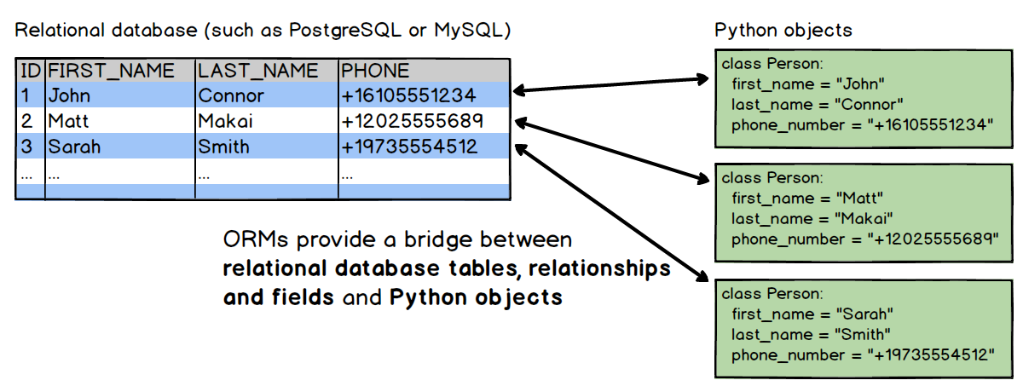
What is ORM?
Object Relational Mapping
Bridge between relational databases and objects
Think of ORM like a translator

Slide 5
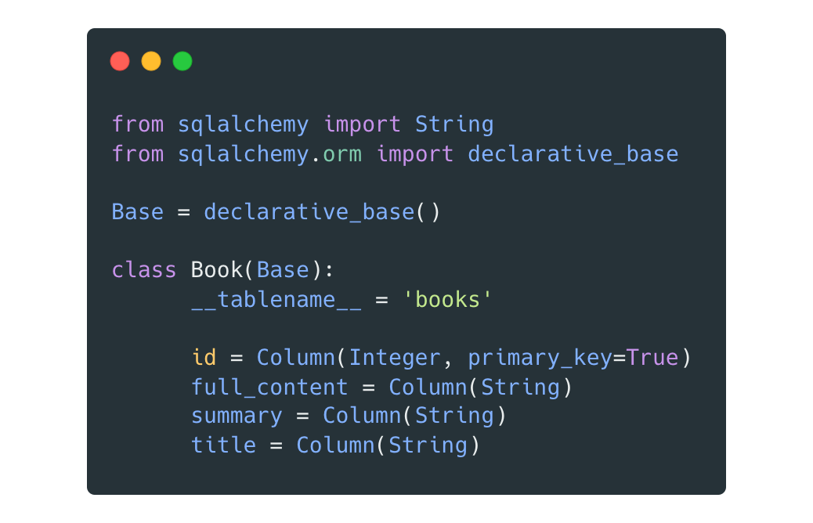
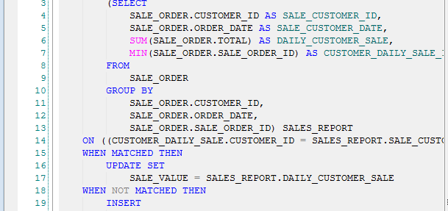
Why use ORM?
Bridge the gap
Objects and classes instead of SQL queries

Slide 6
2. Core Concepts

Slide 7
Objects vs. Relational Data
Objects
Attributes (properties)
Methods
Relational Database
Tables
Rows and Columns

Slide 8
How ORM works
Automatically generate SQL queries
Mapping Configuration / Scheme to define how objects relate to database tables

Slide 9
Common Patterns
Active Record
Simple and Easy to use
Less efficient with complex relationships
Data Mapper
More flexible
More efficient with larger applications

Slide 10

3. Benefits and Challenges

Slide 11
Benefits
Code simplicity and maintainability
Database-agnostic development
Automatic query generation and data mapping

Slide 12
Challenges and Limitations
Performance considerations
Overhead of abstraction
Complexity in handling complex queries

Slide 13
4. Popular Frameworks
Python
SQLAlchemy (Support for Active Record and Data Mapper)
Django ORM (Integrated into the Django web framework)
Java
Hibernate (Flexibility and Robustness)
.NET
Entity Framework (Wide range of features)

Slide 14

Exercises

Slide 15


Requirements
A Simple IDEA or Text Editor
Examples: Visual Studio Code, PyCharm, Sublime Text, etc..
Python 3.7 or above

Slide 16
Setup
Clone
Clone the project
Navigate
Navigate into example_project
Install
Install required packages

