Slide 1
An Introduction to ORM
Getting to know the ins and outs of Object Relational Mapping

Slide 2
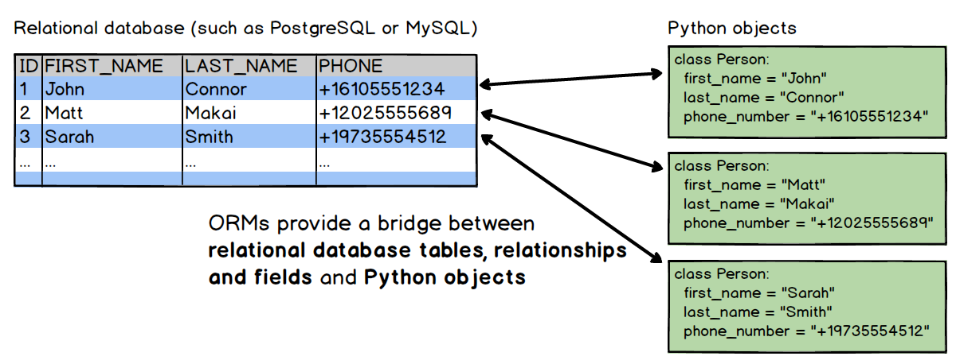
What is ORM?
Object Relational Mapping
Object Oriented Programming

Slide 3
Why use ORM?
Benefits
Abstraction
Drawbacks
Performance
Complexity
Productivity
Maintainability

Slide 4
Popular Frameworks
Python
SQLAlchemy, Django ORM
Java
Hibernate
Kotlin
Exposed
C#
Entity Framework
PHP
Doctrine ORM
JavaScript / TypeScript
PrismaJS, TypeORM

Slide 5

Let’s do some hand on exercises!

Slide 6

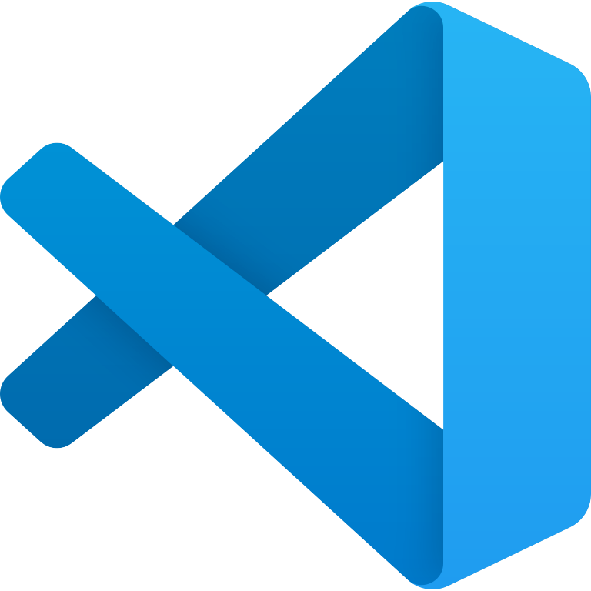
Requirements
A Simple IDEA or Text Editor
Examples: Visual Studio Code, PyCharm, Sublime Text, etc..
Python 3.7 or above

