Slide 1
PowerPointLabs Test Cases
General instructions:
DO NOT SAVE these slides after testing. Keep this file in its original form.
If your result is different from the expected output, please submit a bug report (attach slides/screenshots as necessary).

Slide 2
Auto Zoom
Additional instructions:
Select the BLUE color Rectangle shape(s).
Click “Drill Down” or “Step Back” button in the ribbon.
Compare the result with the expected output.
Also try tweaking these:
Include Slide Background
Put All Zoom Effects on Separate Slides

Slide 3
Auto Zoom:: Simple Zoom In (Drill Down)
Enable slide background in AutoZoom settings

Slide 4
HIDDEN SHAPE
Drill Down
HIDDEN SHAPE

Slide 5
HIDDEN SHAPE
Shape With Exit Animation
Shape with Animation
HIDDEN SHAPE
Blah blah
Blah blah
Blah blah
Shape with entry animation
THIS SHAPE SHOULD NOT APPEAR

Slide 6
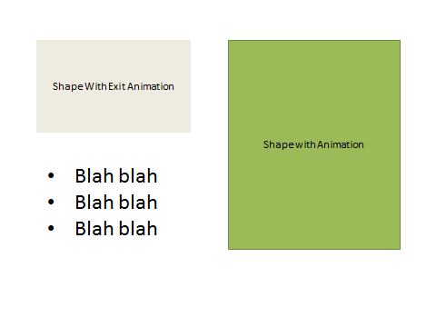
HIDDEN SHAPE
HIDDEN SHAPE

Slide 7



Slide 8
HIDDEN SHAPE
Shape With Exit Animation
Shape with Animation
HIDDEN SHAPE
Blah blah
Blah blah
Blah blah
Shape with entry animation
THIS SHAPE SHOULD NOT APPEAR

Slide 9
Auto Zoom:: Simple Zoom In (Drill Down)
Disable slide background in AutoZoom settings

Slide 10
HIDDEN SHAPE
Drill Down
HIDDEN SHAPE

Slide 11
HIDDEN SHAPE
Shape With Exit Animation
Shape with Animation
HIDDEN SHAPE
Blah blah
Blah blah
Blah blah
Shape with entry animation
THIS SHAPE SHOULD NOT APPEAR

Slide 12
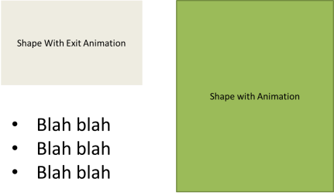
HIDDEN SHAPE
HIDDEN SHAPE

Slide 13

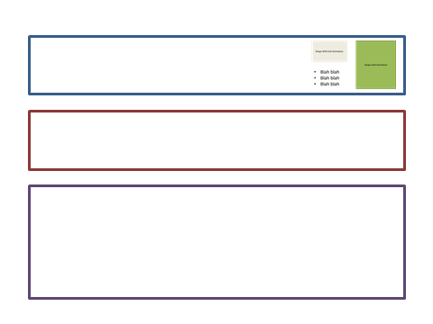

Slide 14
HIDDEN SHAPE
Shape With Exit Animation
Shape with Animation
HIDDEN SHAPE
Blah blah
Blah blah
Blah blah
Shape with entry animation
THIS SHAPE SHOULD NOT APPEAR

Slide 15
Auto Zoom:: Simple Zoom Out (Step Back)
Enable slide background in AutoZoom settings

Slide 16
HIDDEN SHAPE
Shape With Exit Animation
THIS SHAPE SHOULD NOT APPEAR
Shape with Animation
HIDDEN SHAPE
Blah blah
Blah blah
Blah blah
Shape with entry animation

Slide 17
HIDDEN SHAPE
Step Back
HIDDEN SHAPE

Slide 18
Dummy slide

Slide 19
HIDDEN SHAPE
Shape With Exit Animation
THIS SHAPE SHOULD NOT APPEAR
Shape with Animation
HIDDEN SHAPE
Blah blah
Blah blah
Blah blah
Shape with entry animation

Slide 20

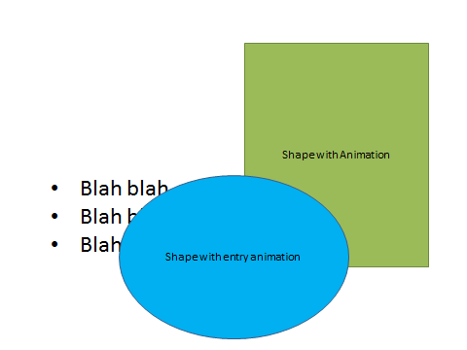

Slide 21
HIDDEN SHAPE
HIDDEN SHAPE

Slide 22
Auto Zoom:: Simple Zoom Out (Step Back)
Disable slide background in AutoZoom settings

Slide 23
HIDDEN SHAPE
Shape With Exit Animation
THIS SHAPE SHOULD NOT APPEAR
Shape with Animation
HIDDEN SHAPE
Blah blah
Blah blah
Blah blah
Shape with entry animation

Slide 24
HIDDEN SHAPE
Step Back
HIDDEN SHAPE

Slide 25
Dummy slide

Slide 26
HIDDEN SHAPE
Shape With Exit Animation
THIS SHAPE SHOULD NOT APPEAR
Shape with Animation
HIDDEN SHAPE
Blah blah
Blah blah
Blah blah
Shape with entry animation

Slide 27
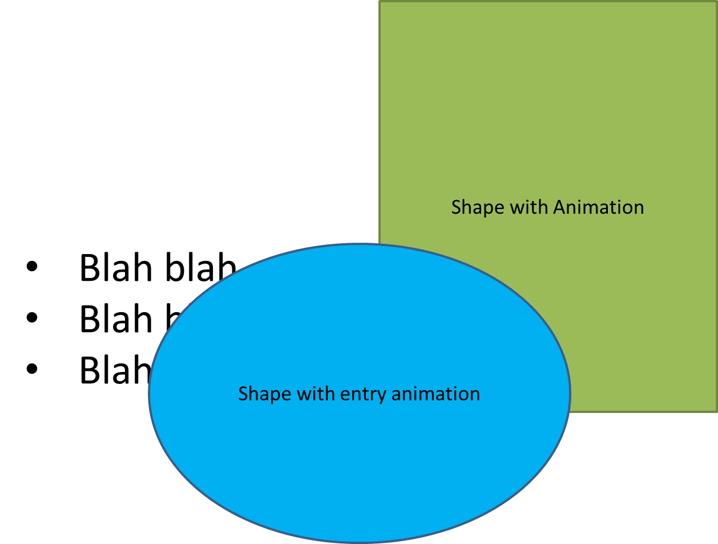

Slide 28
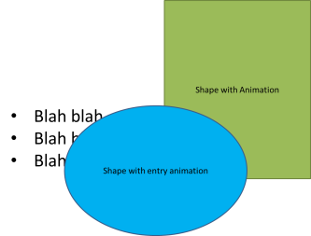
HIDDEN SHAPE
HIDDEN SHAPE

Slide 29
Auto Zoom:: Errors
1) Move slide 16 to the end of the presentation. Attempt to Drill down. This should cause an error.
2) Move the slide to the start of the presentation. Attempt to Step back. This should also cause an error.

Slide 30
HIDDEN SHAPE
Zoom Shape
HIDDEN SHAPE

Slide 31
Auto Zoom:: Clipboard Restoration
1) Copy the right shape to your clipboard
2) Attempt the stated action in the action slide
3) Verify that your clipboard has not been overridden

Slide 32

Drill Down

Slide 33
Action Slide
Drill Down

Slide 34
Drill Down
Expected Output (pasted object is the right shape )

Slide 35
Drill Down Background

Slide 36
Action Slide
Drill Down Background

Slide 37
Drill Down Background
Expected Output (pasted object is the right shape )

Slide 38
Step Back

Slide 39
Action Slide
Step Back

Slide 40
Step Back
Expected Output (pasted object is the right shape )

Slide 41
Step Back Background

Slide 42
Action Slide
Step Back Background

Slide 43
Step Back Background
Expected Output (pasted object is the right shape )

Slide 44


