Slide 1

MINAGRI CHALLENGE #14
From Fragmented Data to Trusted Decisions
AI-assisted validation and sync of agricultural commodity-price data
Cooperatives · Markets · Districts

Slide 2

THE STORY
One Number Can Change the Story
SOURCE A
SOURCE B
SOURCE C
SUSPICIOUS
Beans
Beans
Beans
1,200
1,250
12,500
RWF/kg
RWF/kg
RWF/kg
Which one should MINAGRI trust?
Sample data for illustration only.

Slide 3
THE PROBLEM
Agricultural Data Comes From Everywhere
Cooperatives
Duplicates
Conflicts
MINAGRI
Markets
Inconsistent Formats
Missing Data
District Reports
Anomalies
Manual Validation
Commodity Databases

Slide 4
THE SOLUTION
AI-Assisted Data Validation
e-biciro turns fragmented submissions into trusted agricultural data.
Multiple Data Sources
e-biciro
AI Validation
Human Verification
Clean Master Dataset
Trusted Information
Detect
Match
Standardize
Flag
Anomalies & unusual values
Duplicates & similar records
Names, units, dates & locations
Conflicts for human review

Slide 5
HOW e-biciro WORKS
AI Flags. Humans Decide.
The AI recommends. The authorized officer decides.
e-biciro · Validation Queue · Beans, Musanze
SAMPLE DATA
RECORD
Historical range
HIGH-PRIORITY REVIEW
Beans — Musanze
1,100–1,400 RWF/kg
“Reported price differs significantly from historical and cross-source observations.”
Reported
Cross-source comparison
12,500 RWF/kg
1,200–1,250 RWF/kg
VERIFY
CORRECT
REJECT
REQUEST VERIFICATION

Slide 6
VALIDATION RESULTS
Measured Accuracy, With Its Limits
1,096
96–100%
41–60%
5.6%
Rows in snapshot
All checks together
Z-score alone
Clean rows flagged
Injected error | Z-score only | Isolation Forest | All checks
Extra zero (×10) | 60% | 86.3% | 100%
Missing zero (÷10) | 53.8% | 77.5% | 100%
Price spike (+60%) | 46.3% | 56.3% | 96.3%
Ladder inversion | 41.3% | 66.3% | 100%
READ WITH CARE
Errors were injected into a real e-Soko snapshot from 2026-09-28 (8 rounds × 40 errors).
Not yet tested on real historical mistakes.
One day of data. Results may differ on other periods and markets.
SYNTHETIC ERRORS · ONE-DAY SNAPSHOT

Slide 7
THE PILOT
Start Small. Prove Value. Scale.
PROPOSED PILOT
1 COMMODITY
1 DISTRICT
MULTIPLE SOURCES
Beans
Musanze
Cooperatives + Markets + District Records
01
02
03
04
05
06
Collect
Validate
Detect
Review
Synchronize
Publish
Proposal only. No MINAGRI deployment is claimed.

Slide 8
THE ROADMAP
From One District to a National Data Ecosystem
01
PILOT
1 commodity · 1 district
02
EXPANSION
Multiple commodities · Multiple districts · More data sources
03
NATIONAL SCALE
National commodity-price data validation and synchronization infrastructure
Schematic map. Locations approximate.

Slide 9
THE TEAM
Our Team
NIYONKURU Jean De La Croix
Network engineer | software engineer
Edison UWIHANGANYE
Software Engineer
Machine learning engineer
Elisha Clever Rukundo
Business Development and Entrepreneurship Consultant
Aimee Kevine ISANGE SEBAGENI
Agrotech IT
MUSABYIMANA Jean D'amour
Mathematical skills
Data analysis skills
Machine learning skills

Slide 10
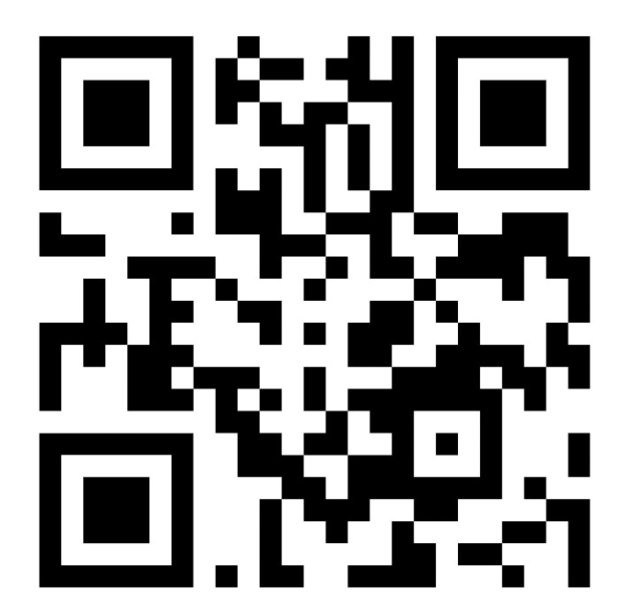
From Fragmented Data → Trusted Decisions
SOURCE
AI VALIDATION
HUMAN REVIEW
CLEAN DATA
e-biciro
TRUSTED INFORMATION
e-biciro
Turning agricultural data into trusted intelligence.
Thank You
Live Demo

