Slide 1
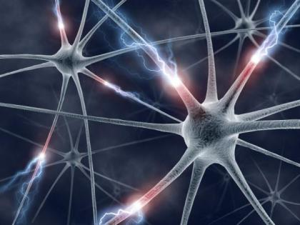
Distributed Spiking Neural Network Simulation using Message Passing Interface

Slide 2
What has this project achieved?
Creation of a distributed version of a spiking neural network simulator NeMo
Implementation of an advanced clustering algorithm that guides network separation
Full separation of the distributed version from the original NeMo implementation
Potential performance enhancement through parallelization

Slide 3
Neural Networks
(Artificial) Neural Networks - are networks composed of interconnecting artificial neurons which could be used for solving AI problems or to gain understanding of biological neural networks. The connections between neurons are called synapses.
Spiking Neural Networks incorporate not only neuronal and synaptic states, but also the concept of time into the operating model. Therefore, neurons in SNNs do not fire at each cycle, but rather when the internal membrane threshold value is exceeded.
Now let's have a better look at the compounds of neural networks.

Slide 4
Spiking Neuron Models
Here, three main neuron models for SNN simulation are presented:
Integrate and Fire (IF)
Easiest to implement and computationally efficient, does not have time-dependent memory, not biologically plausible. Leaky Integrate and Fire adds time-dependent memory, but still does not ensure plausibility.
Hodgkin-Huxley Model (HH)
One of the closest approximations of biological neurons, computationally expensive.
Izhikevich Neuron (Izh)
Model suggested by Eugene Izhikevich tries to produce biological plausibility of HH, while maintaining computational efficiency of IF. This type of neuron is the most used within the project.

Slide 5
Synapses
Synapses represent connections between different neurons. They have several properties:
Weight
Delay
Plasticity
Using last parameter, STDP plasticity can be integrated within simulator

Slide 6
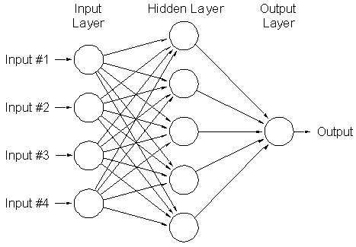
Topology
Topology of a network is essentially its layout, and it plays crucial role in the network clustering.

Slide 7
Current Solutions
NeMo – spiking neural network simulator, developed at Imperial, main project platform
SpikeNET – SNN simulator aimed at simulation of large Integrate and Fire networks
Blue Brain Project – simulator of a virtual brain, created in cooperation between IBM and EPFL.
As NeMo is the main platform, let us look at its internal architecture.

Slide 8
NeMo architecture
Main platform of this project, NeMo, has a specific set of classes that constitute the core of its simulation. Those are:
Configuration
Network
Simulation

Slide 9
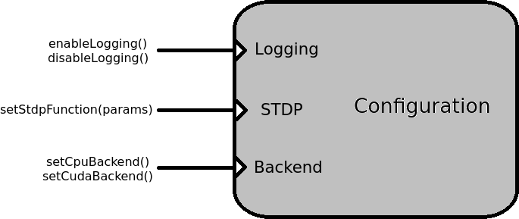
Configuration

Slide 10
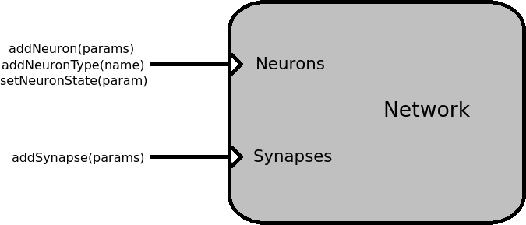
Network

Slide 11
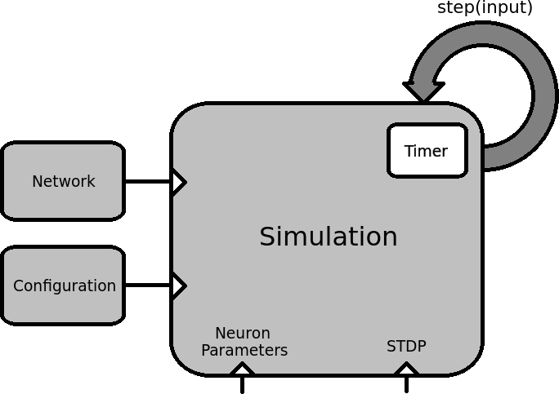
Simulation

Slide 12
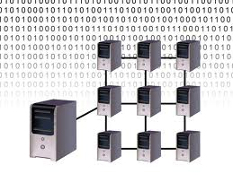
Parallel Computing
Within this project Parallel Computing is represented via:
MPI protocol
Clustering approach

Slide 13
MPI
MPI is a standardized and portable message-passing system designed for inter-process communication.
Throughout work on the project, two MPI implementations were considered:
OpenMPI – open-source project, aimed at research
MPICH2 - project by Argonne National Laboratory, aimed at high performance and extendability.

Slide 14
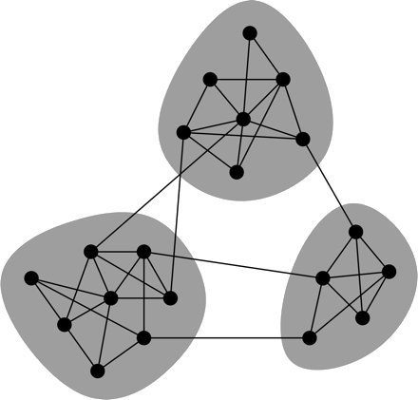
Distributed Approach (Clustering)
Clustering is a technique of graph division, depending on certain properties of the given graph. There are two approaches to this task:
Scientific – aimed at getting the optimal number of clusters that a given network could be divided into.
Engineering – aimed at splitting a given network into a set number of subnets.

Slide 15
Clustering-based solutions
Izhikevich’s large scale model for simulating mammalian thalamocortical systems (use of clustering with MPI)
IBM cortical simulator project (extremely large scale of calculations, high clusterisation)
Neuromorphic model for GPGPU cluster (layered system, clusterisation for better performance)

Slide 16
Design Objectives
Fully distributed version of NeMo
Implementation of clustering and mapping
Separation from the core of original NeMo simulation

Slide 17
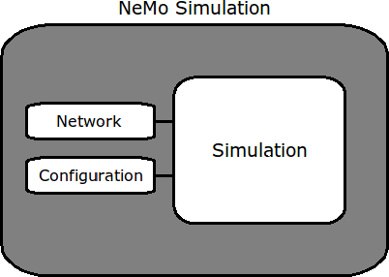
Distributed Version (1)
Original NeMo simulation is a building block of a distributed version.
Creation of a distributed version could be described in 3 steps.

Slide 18
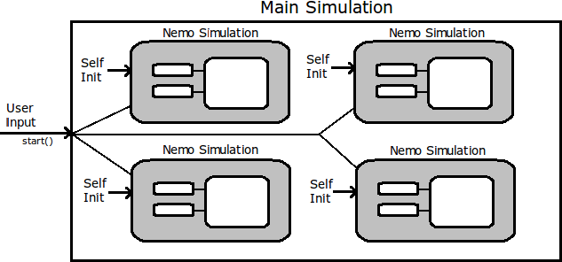
Step 1

Slide 19
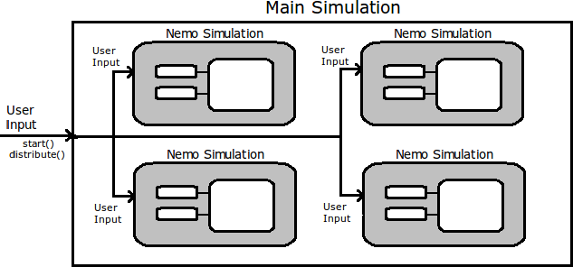
Step 2

Slide 20
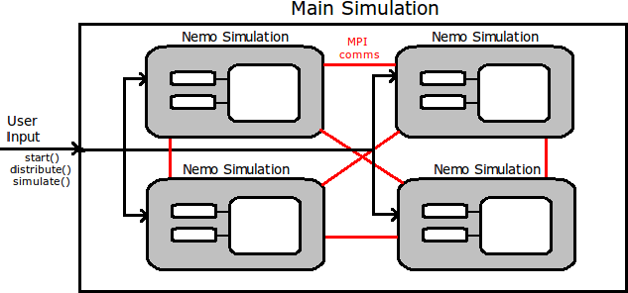
Step 3

Slide 21
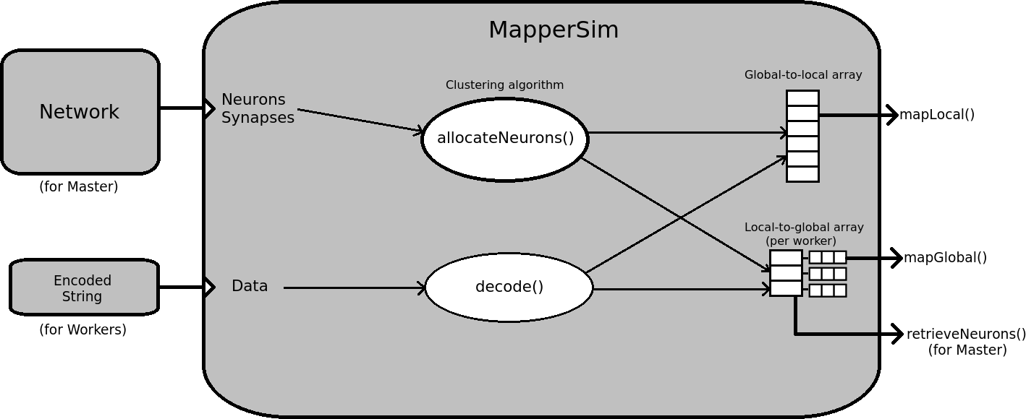
Mapper Implementation (2)
Mapper class design:

Slide 22
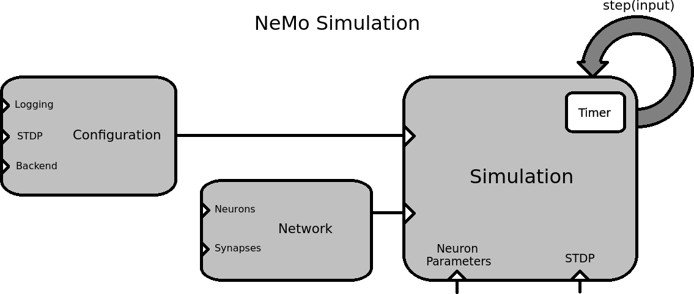
Separation from original NeMo (3)
This is the original simulation core:

Slide 23
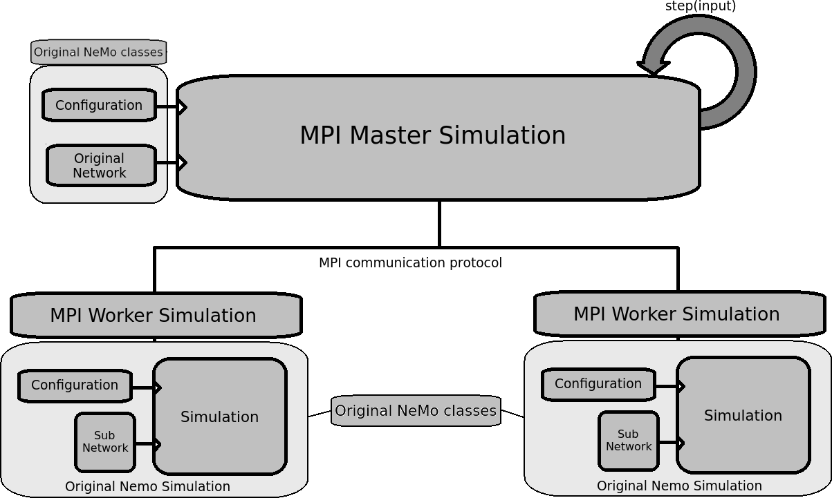
Separation from original NeMo (cont.)

Slide 24
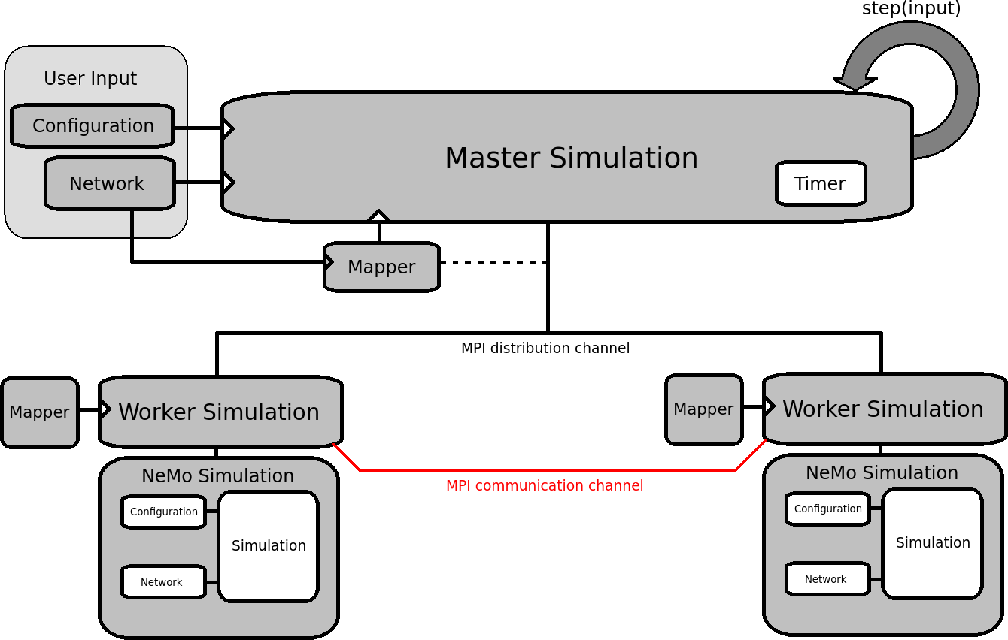
Final Design

Slide 25
Implementation
Implementation stage could also be split into several steps:
Initial parameters distribution
Spikes delivery (simulation)
Clustering algorithm implementation

Slide 26
Initial Parameters (1)
There are 4 main parts of initialization distribution:
Mapper distribution
Configuration distribution
Neuronal distribution
Synaptic distribution

Slide 27
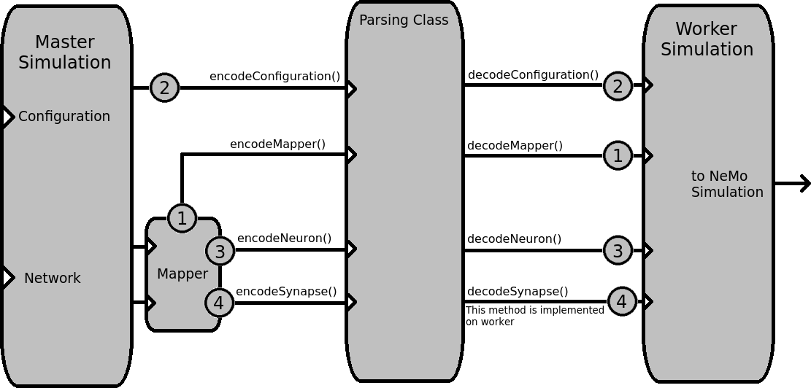
Initial Parameters (cont.)

Slide 28
Spikes Delivery (2)
The spikes delivery is the essential part of the distributed simulation. In analogy with the original simulation, the simulation step consists of 3 sub-steps:
Spikes Enqueuing (Prefire)
Original NeMo simulation step (Fire)
Spikes Distribution (Postfire)
As we do not change original simulation, the interesting parts are (1) and (3).

Slide 29
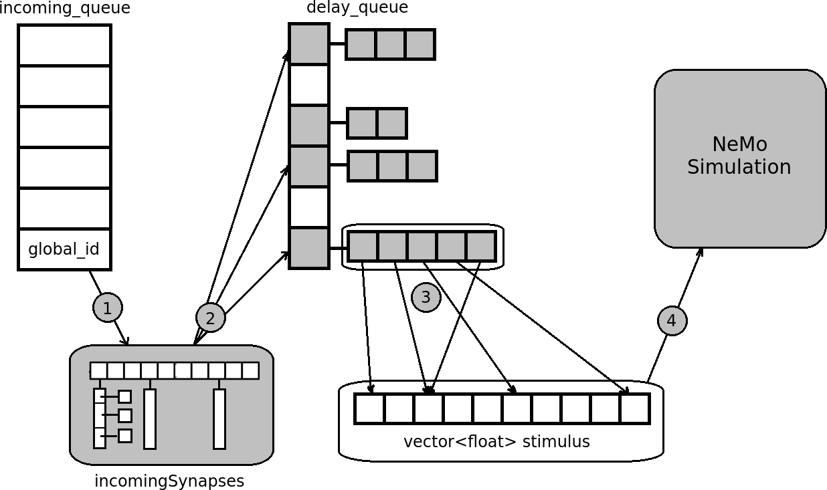
Spikes Delivery - Enqueuing

Slide 30
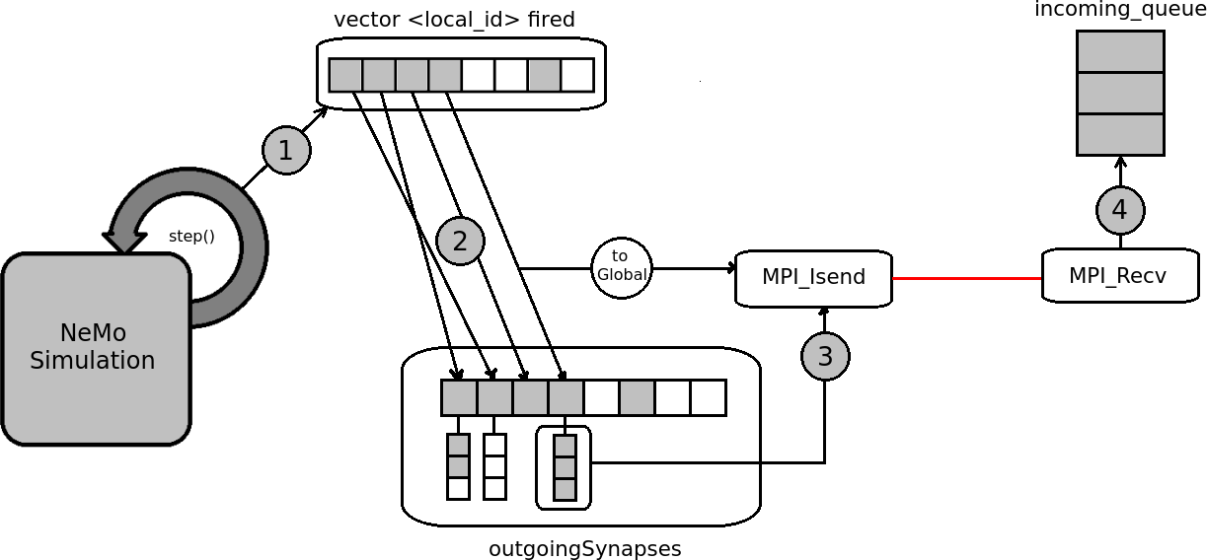
Spikes Delivery - Distribution

Slide 31
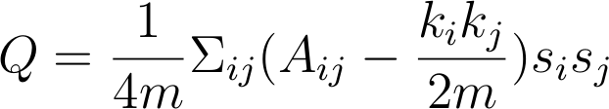
Clustering Algorithm (3)
An algorithm developed by Mark Newman, that allows to divide a graph into two sub-communities, using modularity measure. Formula for modularity is:
where A is an adjacency matrix, k is a degree of a vertex, m is a total number of edges and s is a number representing the group of a vertex (1 for group 1, -1 for group 2).

Slide 32
Clustering Algorithm (cont.)
The structure of the algorithm is as follows:
Create an adjacency matrix A for the given network
Create and populate modularity matrix Q using values from A and the formula
  Q[i][j] = A[i][j] – k(i)k(j)/2m
Generate a leading eigenvector of Q through Power-Iteration (Von Moses) method
  bk+1 = Abk / || Abk || (with a threshold value of 10)
Use eigenvector values to split the network into two parts (>0 into one partition, <=0 – into another).
If more partitions needed, repeat algorithm on the sub-partition.

Slide 33
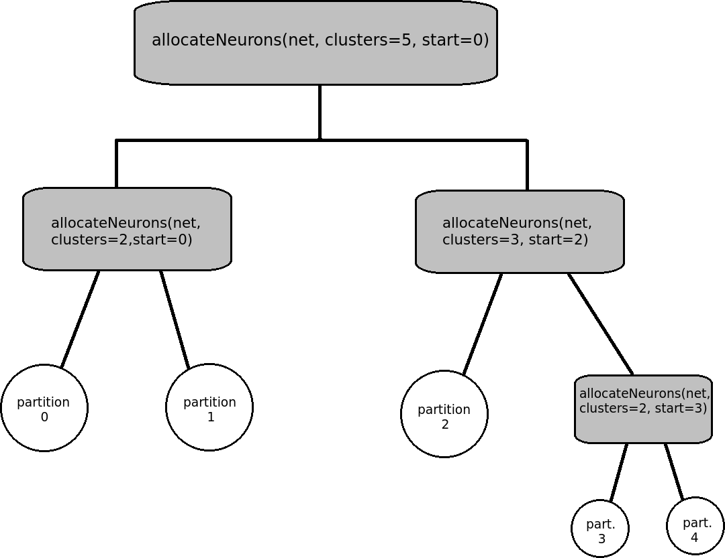
Clustering Algorithm (cont.)

Slide 34
Results Evaluation
Criteria used for evaluation:
Setup time
Simulation time
Network throughput (to a lesser extent)

Slide 35
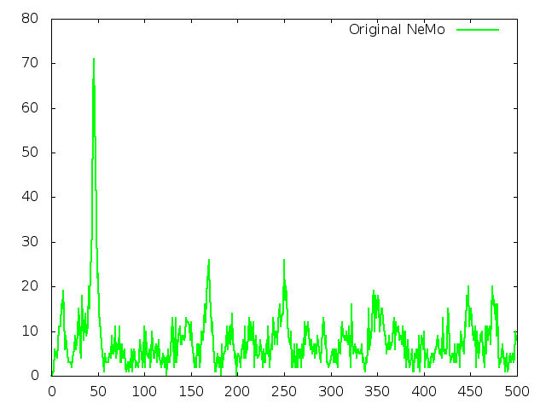
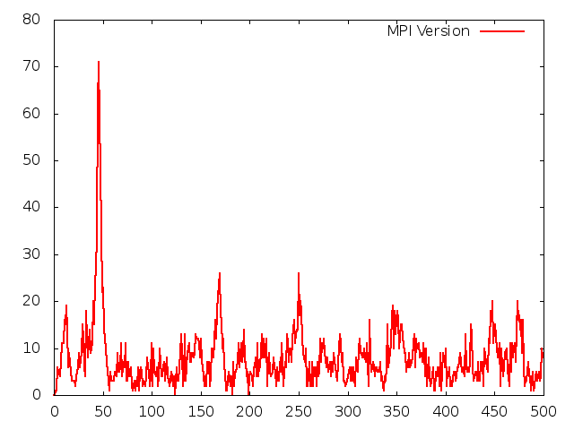
Validity

Slide 36
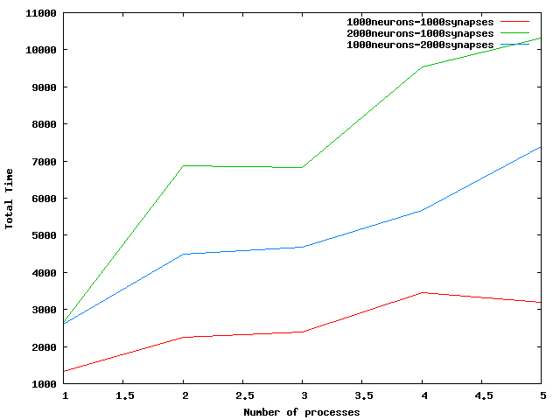
Setup Time
The setup time for an original simulation is negligible, as once Network object is constructed – it operates within simulation.
For a distributed version, however, it can be observed that a significant initialization overhead is present, mostly due to the network neural population (and smaller impact – from synaptic density).

Slide 37
Simulation Time
The main criteria that were chosen for the evaluation were:
Number of neurons
Number of synapses per neuron (synaptic density)
Number of steps (through resulting runtime)

Slide 38
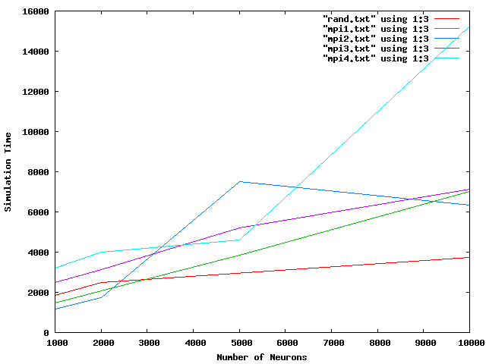
Neurons

Slide 39
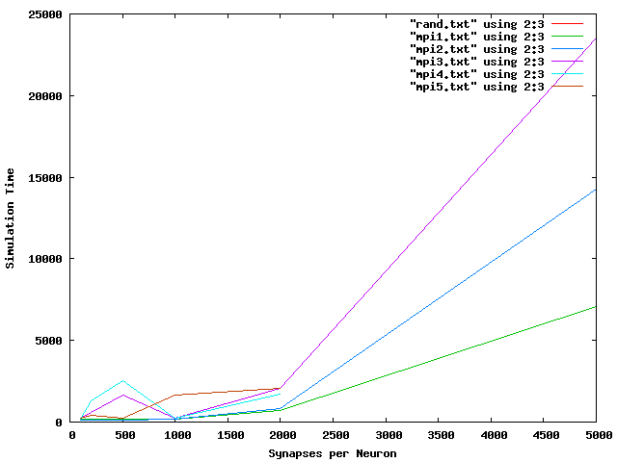
Synapses

Slide 40
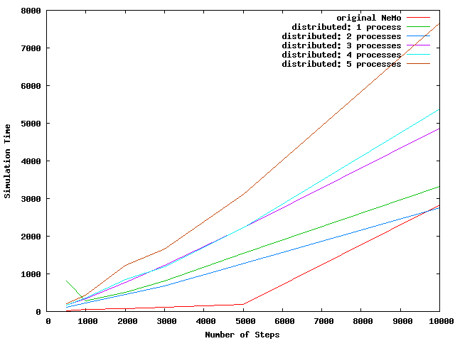
Steps

Slide 41
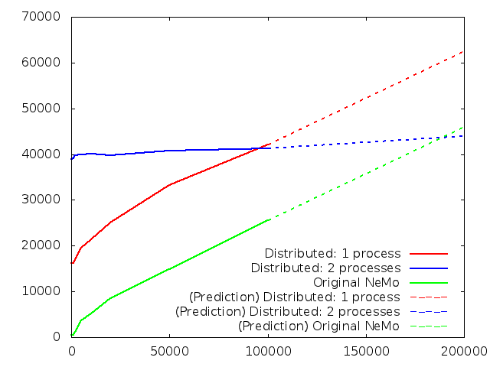
Potential Speedup
Even though the initial results did not yield significant improvements, there is room for simulations of much larger scale, which could use full potential of the distributed system.

Slide 42
DEMO

Slide 43
Further Extensions – Short Term
Optimization
The project has a strong base, but lacks optimization.
Full NeMo functionality
Even though, most of NeMo functionality is present, there are still some parts that are yet to be implemented – STDP plasticity.

Slide 44
Further Extensions – Long Term
Improve current NeMo functional base through the use of distributed version
Now, that a distributed version of NeMo is implemented, it is time to look at its potential use for internal NeMo improvement.
Implement different hierarchical systems into distributed version
More hierarchical structures could provide more space for maneuver and give advantage at use of clustering approach.

Slide 45
Conclusion
In conclusion of this project, I would like to say that I believe that this project is successful at reaching most of the goals set – creation of a distributed system, implementation of clustering and separation from NeMo codebase.
However, there is still a lot of room for further development, especially in the area of optimization and integration.

Slide 46
Questions?

