Slide 1
SAP
BTP INTEGRATION DEVELOPMENT
CAPSTONE PROJECT
EMPLOYEE DATA
SYNCHRONIZATION
SAP SuccessFactors → SAP S/4HANA → SFTP
SuccessFactors
Cloud Integration
S/4HANA
SFTP
Krishnakant Pal
PID: P2012786192
Technical Design + Test Evidence + Agile Project Artifacts

Slide 2
Project Overview & Business Requirement
02
What the solution is designed to automate
PROJECT OBJECTIVE
NOTIFICATIONS & RESILIENCE
Automate employee master-data synchronization from SAP SuccessFactors to SAP S/4HANA. The processed XML response is also converted to CSV and uploaded to an SFTP server.
Success processing sends a confirmation email. Runtime errors trigger an Exception Subprocess, which prepares and sends a failure notification.
SYSTEM LANDSCAPE
SuccessFactors
Cloud Integration
S/4HANA
SFTP
Mail
Source employee master data
iFlow orchestration & routing
Target OData service
CSV storage / transfer
Success & failure notification
BUSINESS VALUE
• Removes manual employee-data transfer.
• Provides a repeatable scheduled integration.
• Creates an auditable CSV output.
• Verifies both positive and negative scenarios.
SAP BTP Integration Development • Employee Data Synchronization
Krishnakant Pal | P2012786192

Slide 3
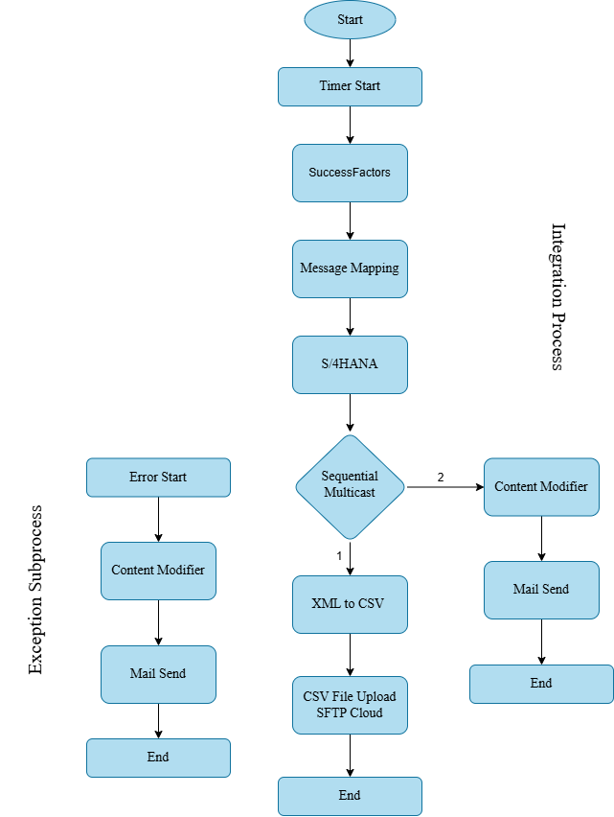
Solution Overview
03
End-to-end processing logic
FLOW IN ONE VIEW
1 Timer starts the iFlow 2 Employee data is queried from SuccessFactors 3 Message Mapping creates the S/4HANA structure 4 OData Request Reply sends the request 5 Sequential Multicast performs post-processing 6 XML is converted to CSV and uploaded to SFTP 7 Notification branch sends email 8 Exception Subprocess handles runtime failures
SOURCE
TRANSFORM
TARGET
FILE + MAIL
The architecture diagram is taken from the Technical Design & Test Documentation (page 3).
SAP BTP Integration Development • Employee Data Synchronization
Krishnakant Pal | P2012786192

Slide 4
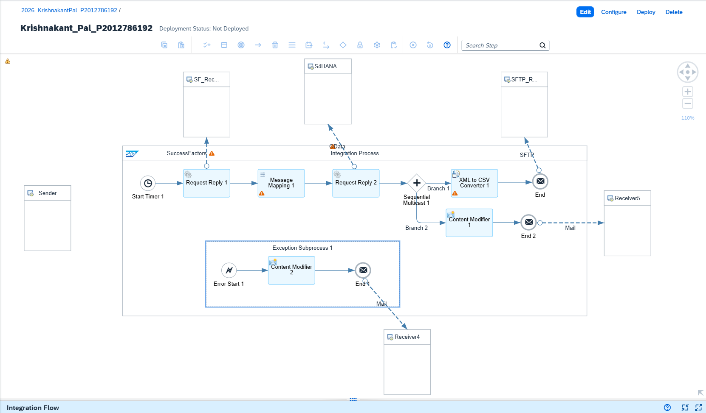
Main Integration Flow
04
Actual Cloud Integration iFlow evidence
Timer Start
Sequential Multicast
Scheduled trigger
Sequential branches
Request Reply
XML to CSV
Waits for receiver response
Format conversion
SuccessFactors
SFTP
Retrieves User data
CSV upload
Message Mapping
Mail
Transforms structure
Notification
OData V2
Exception Subprocess
S/4HANA communication
Runtime error handling
SAP BTP Integration Development • Employee Data Synchronization
Krishnakant Pal | P2012786192

Slide 5
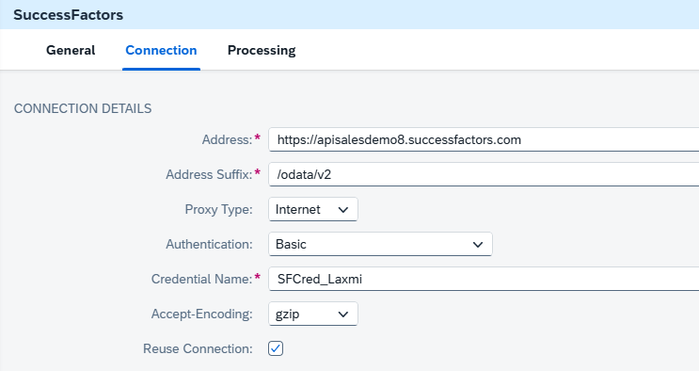
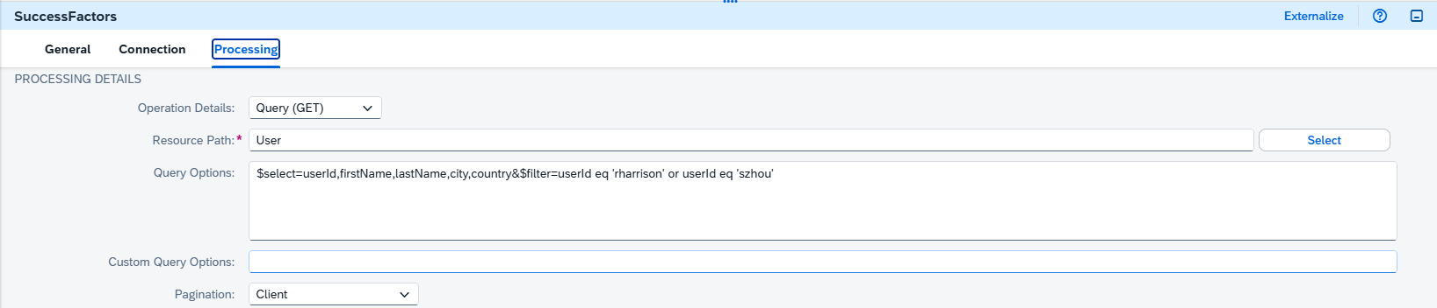
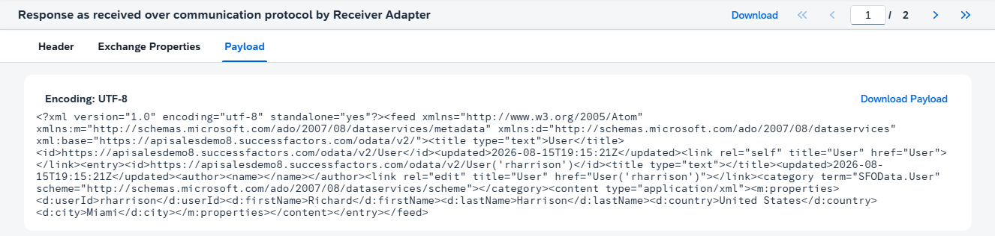
SuccessFactors Configuration
05
OData Query and retrieved employee fields
CONNECTION TAB
PROCESSING TAB
CONFIGURATION
FIELDS RETRIEVED
Operation: Query (GET) Resource Path: User Query: $select=userid,firstName,lastName,city,country Filter used for the configured employee User IDs.
userid • Employee/User identifier firstName • First name lastName • Last name city • Employee city country • Employee country
Actual retrieved payload evidence from the Technical Design & Test Documentation (page 5).
SAP BTP Integration Development • Employee Data Synchronization
Krishnakant Pal | P2012786192

Slide 6
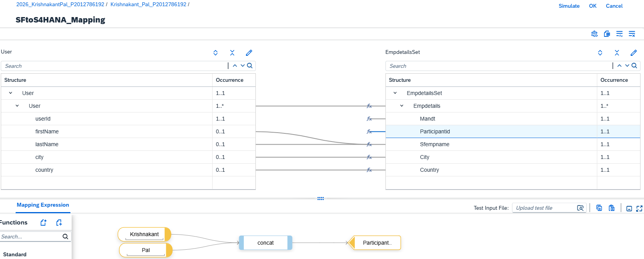
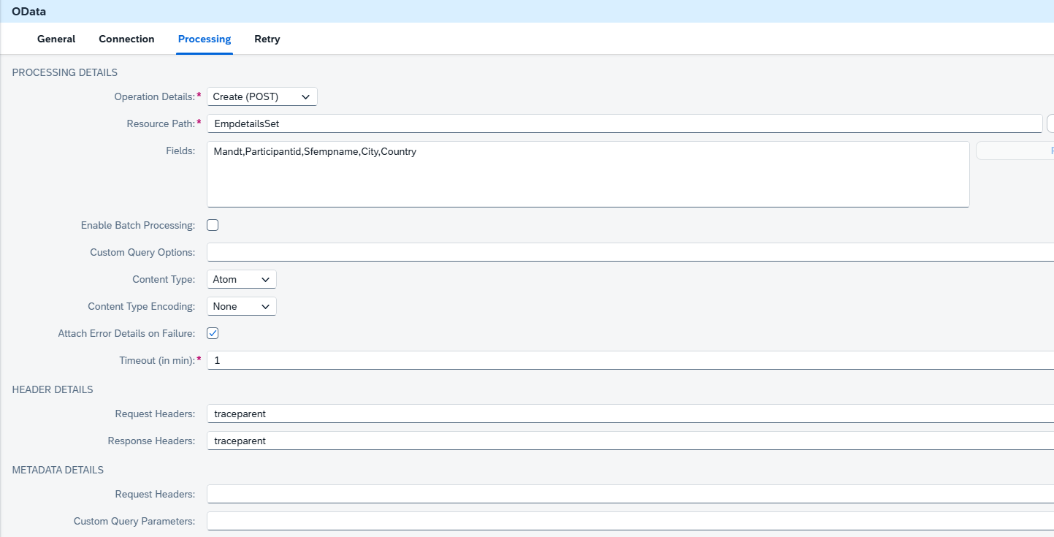
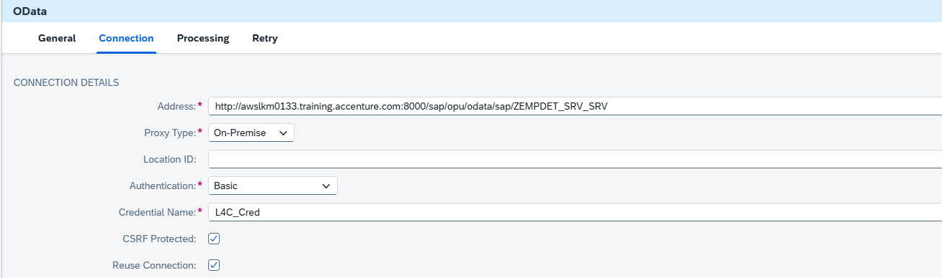
Message Mapping & S/4HANA
06
Source-to-target transformation and OData target
S/4HANA
Request Reply sends the mapped employee payload to the configured OData service. A successful response was verified in the Cloud Integration Message Monitor
MAPPING LOGIC
Mandt = hardcoded 500 Participantid = firstName + ' ' + lastName Sfempname = firstName + ' ' + lastName City = direct mapping Country = direct mapping
S/4HANA OData processing configuration
S/4HANA OData connection configuration
SAP BTP Integration Development • Employee Data Synchronization
Krishnakant Pal | P2012786192

Slide 7
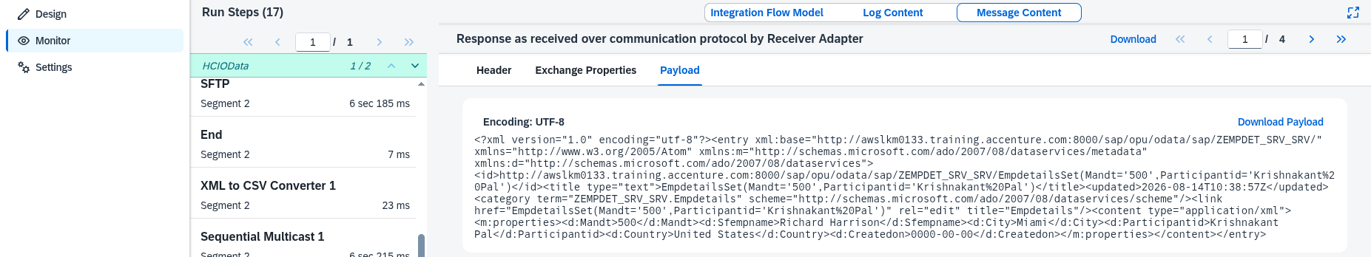
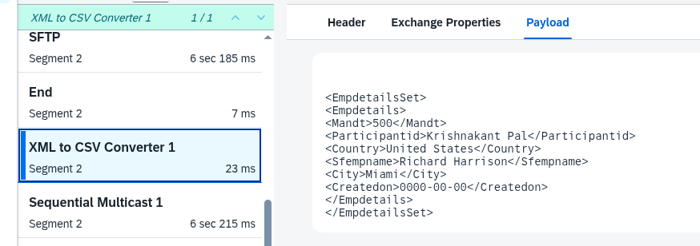
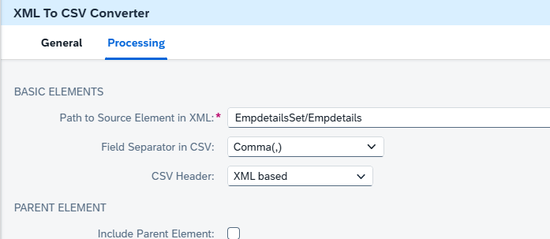
XML to CSV
07
Target response followed by file preparation
CSV OUTPUT
Generated fields include: Mandt, Participantid, Country, Sfempname, City and Createdon.
SAP BTP Integration Development • Employee Data Synchronization
Krishnakant Pal | P2012786192

Slide 8
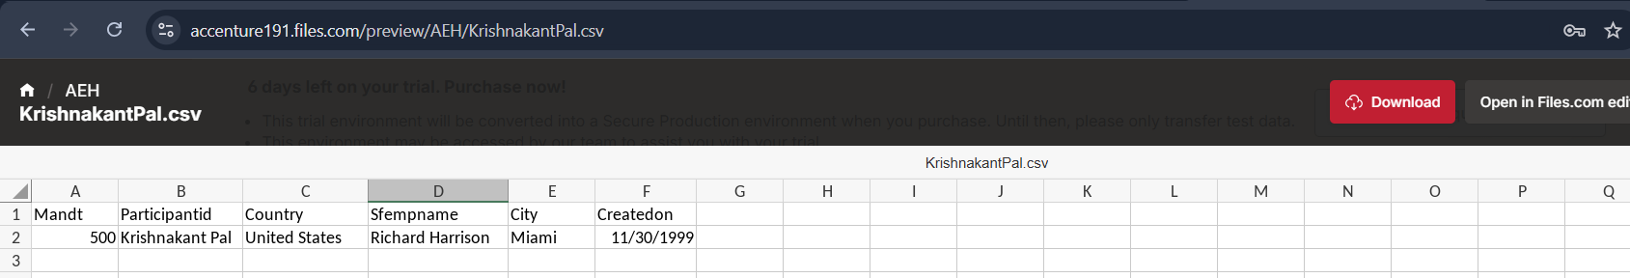
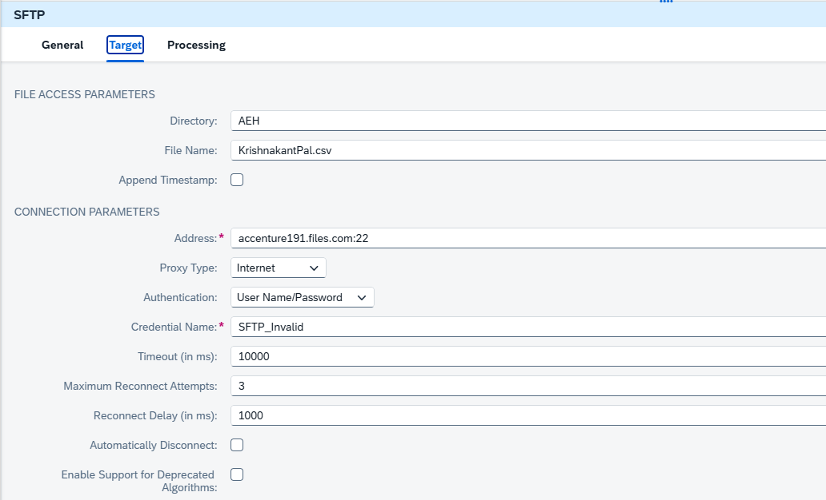
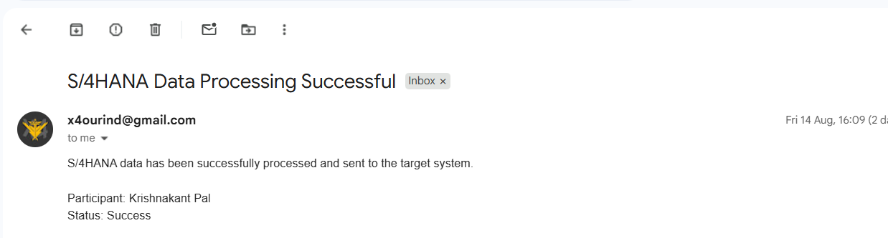
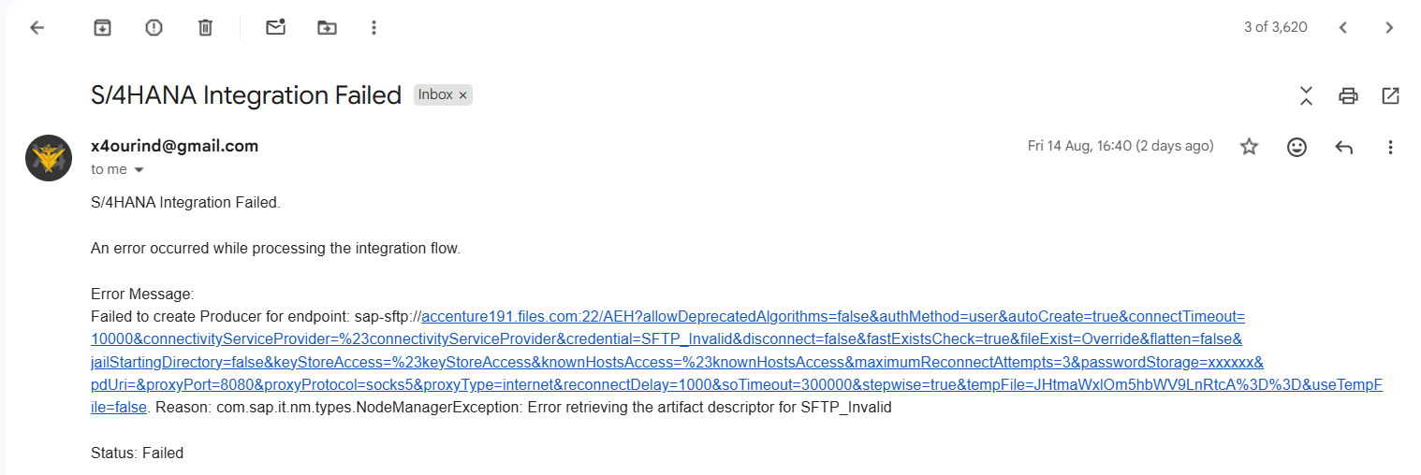
SFTP, Mail & Exception Handling
08
Output delivery plus success/failure notification paths
SFTP Configuration
EXCEPTION SUBPROCESS
The project verifies CSV upload, success email, failure email and runtime error routing.
SAP BTP Integration Development • Employee Data Synchronization
Krishnakant Pal | P2012786192

Slide 9
Testing Strategy & Results
09
Eight documented test cases — all PASS
ID | Scenario | Expected / Actual Result | Status
TC-01 | SuccessFactors data retrieval | Data retrieved successfully | PASS
TC-02 | Send data to S/4HANA | Request processed successfully | PASS
TC-03 | XML → CSV conversion | CSV generated successfully | PASS
TC-04 | CSV upload to SFTP | File uploaded successfully | PASS
TC-05 | Success notification | Email received | PASS
TC-06 | Invalid SFTP credential/config | SFTP error generated | PASS
TC-07 | Duplicate Participant ID | S/4HANA error received | PASS
TC-08 | Exception handling | Failure email received | PASS
OVERALL RESULT: PASS
Positive testing confirmed the normal flow; negative testing intentionally triggered SFTP and duplicate-ID errors to verify the Exception Subprocess and failure notification.
SAP BTP Integration Development • Employee Data Synchronization
Krishnakant Pal | P2012786192

Slide 10
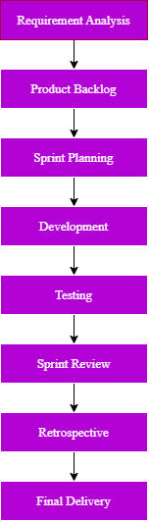
Agile Scrum Execution
10
Two sprints covering development, testing and finalization
SPRINT 1 — INTEGRATION DEVELOPMENT
SPRINT 2 — TESTING & FINALIZATION
Requirement analysis Integration architecture SuccessFactors configuration S/4HANA OData configuration Message Mapping XML to CSV SFTP + Mail configuration
Exception Subprocess Failure email Successful E2E test SFTP failure test Duplicate Participant ID test Documentation + Agile artifacts
PRODUCT BACKLOG SNAPSHOT
Area | Status
Requirements | Completed
Core iFlow | Completed
SFTP / Mail | Completed
Exception handling | Completed
Testing | Completed
Documentation | Completed
SPRINT OUTCOME
Both planned sprints were completed. The core integration was built in Sprint 1 and validated with positive/negative scenarios in Sprint 2.
SAP BTP Integration Development • Employee Data Synchronization
Krishnakant Pal | P2012786192

Slide 11
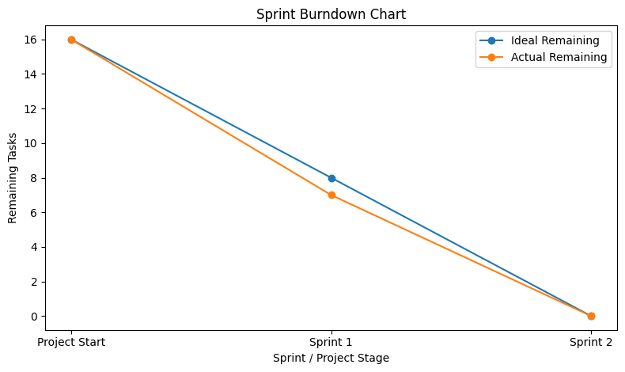
Sprint Progress, Retrospective & Burndown
11
What improved and how remaining work reduced
PROGRESS BY AREA
Requirement Analysis
100%
Architecture & Design
100%
Integration Development
100%
Testing
100%
Exception Handling
100%
Documentation
100%
Agile Artifacts
100%
WHAT WENT WELL
CHALLENGES + IMPROVEMENTS
Connectivity established • Mapping worked • CSV/SFTP verified • Exception handling tested • Success/failure emails verified
Verify target-system constraints early • Keep positive/negative tests separate • Capture monitoring evidence • Update documentation during development
SAP BTP Integration Development • Employee Data Synchronization
Krishnakant Pal | P2012786192

Slide 12
Definition of Done & Agile Metrics
12
How completion was verified
DEFINITION OF DONE
Metric | Result
Planned Sprints | 2
Completed Sprints | 2
Core Integration Flow | Completed
Positive Test Scenario | Passed
SFTP Failure Scenario | Passed
Duplicate ID Scenario | Passed
Exception Handling | Verified
Success Email | Verified
Failure Email | Verified
✓ Configuration completed ✓ Connectivity verified ✓ Integration flow validated ✓ Expected output generated ✓ Error scenario tested where applicable ✓ Evidence captured ✓ Documentation updated
PROJECT DEVELOPMENT: COMPLETED
TESTING: COMPLETED
EXCEPTION HANDLING: COMPLETED
DOCUMENTATION: COMPLETED
The Agile file defines a task as Done only after configuration, testing, verification, evidence and documentation are complete.
SAP BTP Integration Development • Employee Data Synchronization
Krishnakant Pal | P2012786192

Slide 13
Final Deliverables, GitHub & Conclusion
13
Project handover and release
GITHUB RELEASE
FINAL PROJECT PACKAGE
Repository: github.com/iskrishnakantpal/Employee-Data-Synchronization-using-SAP-Cloud-Integration Release: v1.0.0
• Technical Design & Test Documentation • Agile Project Artifacts • Integration Flow artifact ZIP • Configuration screenshots • Testing evidence • SFTP / SuccessFactors / S/4HANA evidence • Exception + email evidence • CHANGELOG + README
Open GitHub Repository
CONCLUSION
The solution successfully retrieves employee data from SuccessFactors, transforms it, sends it to S/4HANA, converts the processed data to CSV, uploads it to SFTP, and handles success/failure notifications. Positive and negative scenarios were tested successfully.
v1.0.0 • FINAL RELEASE
SAP BTP Integration Development • Employee Data Synchronization
Krishnakant Pal | P2012786192

