Slide 1
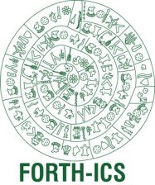

Design and Implementation of a tool for formulating
recall-oriented structured queries on semantic networks
Katerina Tzompanaki
Advisors:
Martin Doerr
Yannis Tzitzikas
Institute of Computer Science
Foundation for Research and Technology - Hellas
Computer Science Department
University of Crete
July 24, 2012
Notes:
Kalhspera sas to onoma mou einai katerina Tzompanaki kai eimai metaptuxiaki foititria
Tou tmhmatos epistimis ipologistwn tou panepistimiou Kritis. Epoptes mou stin metaptuxiaki mou ergasia
Einai o Kurios giannis tzitzikas kai o kurios Martin Nter. Titlos autis einai
Σχεδίαση και υλοποίηση ενός εργαλείου για την διατύπωση δομικών επερωτήσεων επί σημασιολογικών δικτύων για πληροφοριακές ανάγκες υψηλής ανάκλησης.
H ekponisi tis ergasias mou, ginetai se sunergasia me to Institouto pliroforikis tu Idrimatos texnologias kai ereunas.
Good afternoon, my name is Katerina Tzompanaki and I come from Crete, a beautiful island in Greece.
I work in collaboration with Dr. Martin Doerr in the Foundation of Research and Technology.
I have travelled all this way to show you today our new Framework for querying complex semantic networks.

Slide 2
Outline
Introduction
Problem
Related Work
Our proposal
Example
Implementation
Validation
Contributions
Live Demo
Notes:
H parousiasi tha ksekinisei me mia suntomi eisagwgi stis orologies kai stis anagkes tou pediou efarmogis.
Epeita tha parousiastei to problima I lisi toy opoiou apotelei kai to kinitro gia autin tin douleia kai tha
Anaferthoume stis idi iparxouses liseis.
En sunexeia tha milisoume gia tin diki mas protasi, I opoia tha epegksigithei me ena paradeigma.
Gia perissoteres texnikes leptomereies tha perigrapsoume tin ilopoiisi tis protasis
Kai tha parousiasoume ta apotelesmata aksiologisis tis proteinomenis methodou.
Ta ofeli autis tis methodou tha aparithmithoun sto telos tis parousiasis,
Enw tha kleisoume me mia epeidiksi tis xrisis tou ulopoiimenou ergaleiou
Kathws kai tis efarmogis tis methodou sto project 3D-COFORM.
After providing a few introductory information, I will expose you to the problem of querying semantic networks, the existing approach and then I will describe to you our solution. This will be accompanied by an example and finally a live demonstration of our current implementation.

Slide 3
Introduction

Slide 4
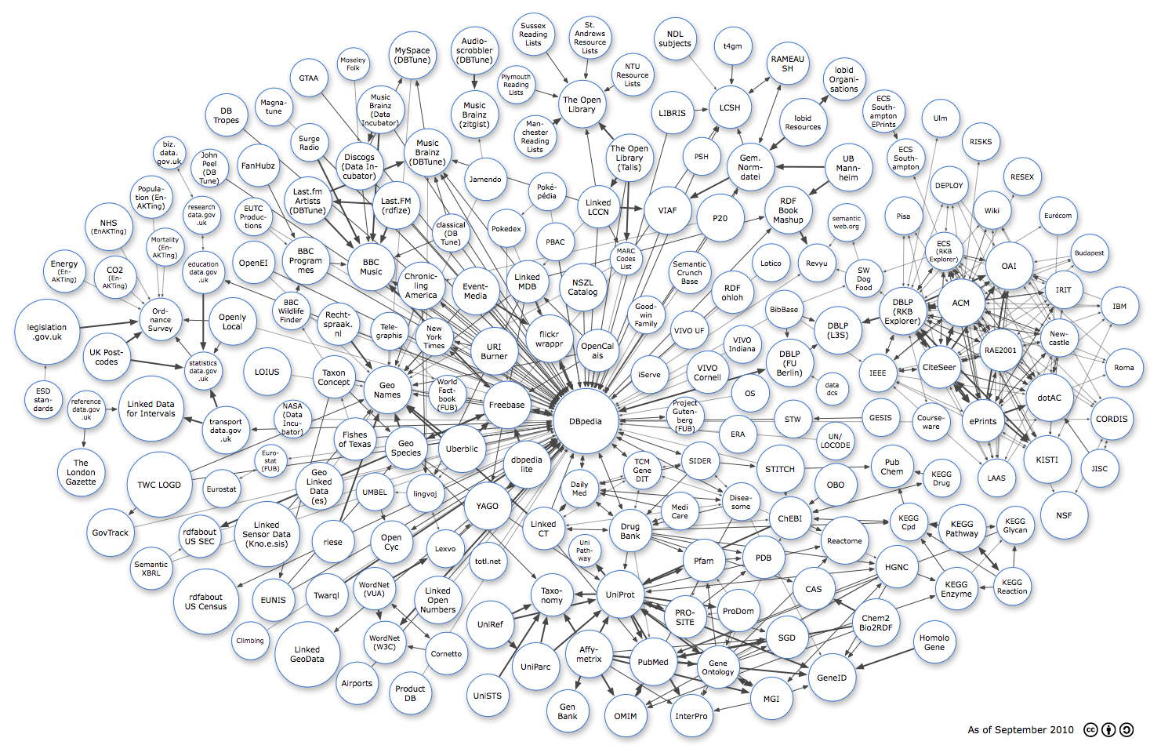
Semantic Web
Web of data
RDF/S
RDF Triple Stores
Linked Open Data (LoD): Thousands of triple stores to be accessed
Introduction
Notes:
The trend nowadays is the movement from a Web of unstructured documents to a Web of structured data.
To make this happen we use RDF/S for defining and describing data and the relations among data;
RDF triple stores to maintain the content, creating in this way hundreds of Semantic Networks;
And finally Linked Open Data to publish and interconnect the information of the various Semantic Networks into a giant
Graph comprising the Semantic Web.

Slide 5
Cultural Heritage Semantic Networks
Triple Stores of:
Heterogeneous data
social and historical events
composite structure
diverse semantics
multiple kinds of relationships
Introduction
Notes:
Sugkekrimena se autin tin ergasia asxoliomaste me simasiologika diktua politismikis pliroforias. Auta ta diktua
Sunistoun triple stores pou apothikeuoun dedomena eterogeni (diaforwn eidwn antikeimena) kai perigrafoun istorika alla kai
Koinwnika gegonota. Autou tou eidous oi plirofories sunepagontai mia syntheti domisi, poikili simasiologia (diaforetikes perigrafes) kai pollwn eidwn sxesewn metaksi ton antikeimenwn
1. Introduction
, paintings, photographs, 3D
objects, sound recordings, maps or even digital objects. FurHeterogeneity is one of the main characteristics of cultural heritage collections. Such
collections may be composed of text, written on different materialsthermore, the objects are strongly
related with the social and historical events that take place over time. Consequently, it is quite
justifiable to expose the composite structure, diverse semantics and multiple kinds of
relationships between the objects of these collections. Hence, making accessible cultural heritage
resources requires metadata schemas rich in semantics and structure able to cover the material
heterogeneity and variety of memory institutions (libraries, archives and museums).

Slide 6
Challenges
3 Major Challenges
Store: rich global schema
Query: effective and easy
Integrate: reasoning and co-reference resolution
Introduction
Notes:
Eksaitias autis tis poliplokotitas dimiourgountai extra apaitiseis oson afora tin apothikeusi, tin eperwtisi kathws kai tin oloklirwsi
Tis pliroforias se tetoia diktua. An ksexwrisoume tis apaitiseis mporoume na anaferomaste se treis prokliseis:
Firstly we need a core schema that is rich enough to represent and integrate the domain knowledge and provide extensions of any depth.
Secondly we need to provide the users with an efficient way to query large and complex networks. This is also the challenge this work is aiming at.
Last, and I won’t refer longer to this one because it is out of the presentation’s scope, we need co-reference resolution for multiple references to the same instances which is essential for the network’s consistency
1. Con: impossible – everybody has his own conceptualization
Pro: CIDOC-FRBR work empirically proves opposite
2.Con: impossible to write ad hoc rich SPARQL statements, impossible to memorize hundreds of properties
Pro: use another, simple global schema for querying

Slide 7
A Global Schema: The CIDOC CRM
Extensible core ontology
86 classes
137 properties
museum disciplines, archives and libraries,
transform, transport and merge information
Introduction
Notes:
A candidate rich schema that can cope with the needs of the complex world of cultural heritage is CIDOC-CRM.
CIDOC-CRM is the result of an extensive interdisciplinary work that results into an extensible core schema of 86 classes and 140 properties. It describes the semantics from all museum disciplines, archives and libraries based on the documentation of facts and it can easily be mapped to by other schemata. In this way huge, meaningful networks of knowledge can be created.

Slide 8
Problem

Slide 9
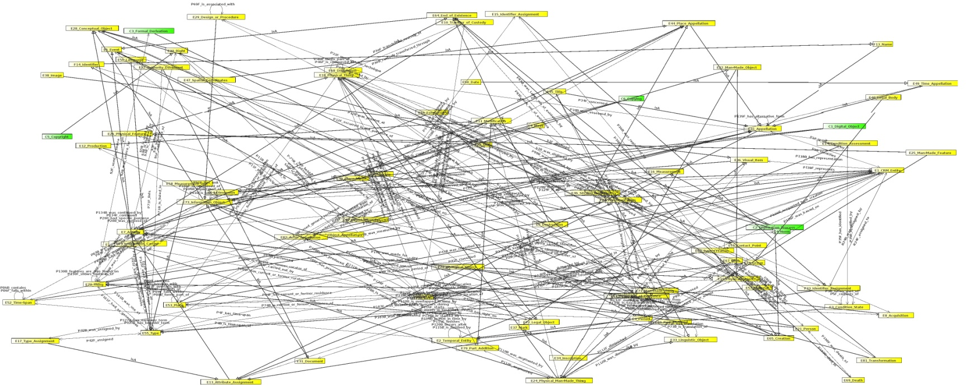

Problem
How to query rich Semantic Networks?
CIDOC-CRM Visualization by StarLion
Problem
Notes:
And here comes the second challenge: how are we to query rich semantic networks?

Slide 10
How to query rich semantic networks?
Hardships:
Incomplete information
Users’ ignorance
querying methods
Declarative (keyword search)
Structured (SPARQL)
→ insufficient
→ complicated
Problem
Notes:
This problem is not one-dimentional.
First hardship lies in the content itself: bla bla bla

Slide 11
Related Work

Slide 12
Existing Approach 1
User Interface query formulation techniques:
schema graphical representations
natural language
menu-guided interfaces with look ahead mechanisms
Drawbacks
SPARQL knowledge dependency
Schema structure knowledge dependency
Polysemy of natural language
Related Work

Slide 13
Existing Approach 2
Use of
rules
views
for queries representation (instead of SPARQL)
Drawbacks
requires technical knowledge
materialization (rules/views) → update/modification difficulties
performance issues for massive repositories
Related Work

Slide 14
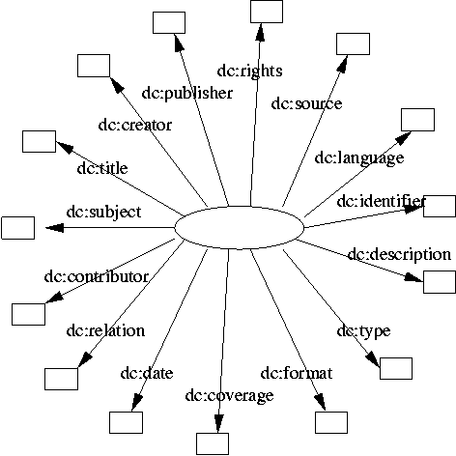
Existing Approach 3 (1/2)
Simplify the network by using “core” elements
such as in Dublin Core
The DC hedgehog model
Related Work
Notes:
The other solution proposes: why have complex structures in the first place? Let’s simplify the network from its foundation

Slide 15
Existing Approach 3 (2/2)
Advantages
Simplicity
Disadvantages
Poor scientific knowledge mapping
Low precision
Lack of expressivity
Lack of reasoning capability
Lack of integration capability
Related Work
Notes:
This proposal however cannot take us far. Cannot map complicated scientific data to small schemata with poor coverage
Does not provide adequate support for sophisticated queries or search precision across large datasets
Cannot result in good deductions and diminishes the possibility of reasoning
Cannot integrate knowledge

Slide 16
Our Proposal

Slide 17
Our proposal
Query Layer:
Simple Data model
Storage Layer:
Complex Data model
Fundamental Categories and Relationships
deductions
CIDOC-CRM
Our Proposal
Notes:
So taken as granted that we maintain the rich underlying schema, we apply the aforementioned idea about core elements, but at querying level only. Thus we have designed and implemented a new data model of Fundamental Categories and Relationships that are paths formulated as deductions from the complex CRM schema.

Slide 18
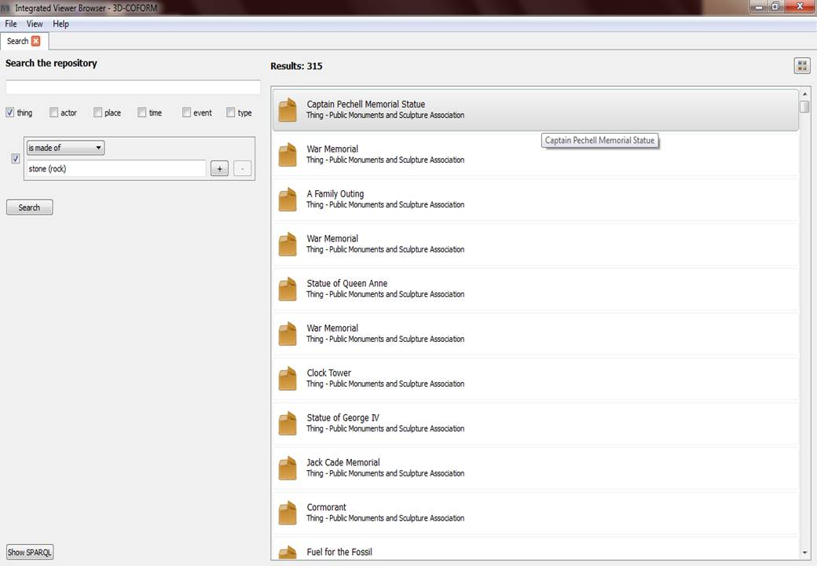
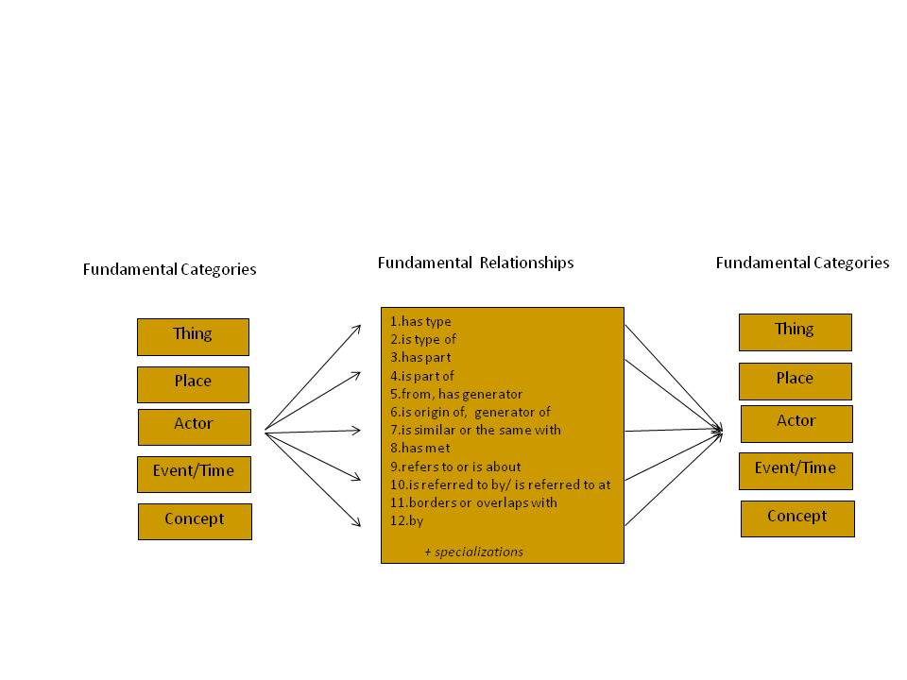
General System View
Interface
12 Fundamental Relationships!
Fundamental Categories (FCs) and Fundamental Relationships (FRs) Model
One hundred paths
Path’s expression language &
Fundamental Relationships configuration tool
Complex semantic network
Hundreds of properties
Our Proposal
Notes:
This slide shows a general view of the created system:
On the bottom there is the complex semantic network, consisting of thousands of graphs like the one I showed before.
Using the paths expression language and with the help of the Fundamental Relationships configuration tool that I have
Implemented and to which I will come back later, we build a new data model for querying, which derives from the underlying one.
On the top stands the simplified end-user querying interface.
So we have achieved to move from the handling of hundreds of properties, to the handling of one hundred of paths,
Which results to only 12 FRs in the querying interface.

Slide 19
Fundamental Relationships
Fundamental Relationships (FRs)
describe:
classification
and part-whole structure
history
subject
based on:
intuition
experience
observation
Our Proposal
Notes:
how and what an entity is (classification, part-whole structure)
what an item has undergone gone in its history
what an entity may “show”, say or refer to

Slide 20
Fundamental Categories & Relationships
Fundamental Categories:
Thing, Actor, Place, Time/Event, Concept
Fundamental Relationships:
has type /is type of
is similar to or same with
is part of (is member of) / has part (has member)
has met
from (has founder or has parent) / is origin, founder, parent, creator of
had (=owns, keeps) / were owned/kept by
refers to or is about / is referred to by - is referred to at
.. and specializations
Our Proposal
Notes:
Thing - comprising material and immaterial things, equal to “Who”
Place - geometric extents in space, on earth and on objects, often related to or even identified by some stable and prominent configuration of matter, such as a settlement, equal to “Where”
Actor - comprising persons, organisation, offices and informal groups, equal to “Who”
Time - date-time interval, a special case of “When”
Event - comprising states, historical and other periods, events and activities in the narrower sense. Can be regarded as a “When”.
Concept - comprising all kinds of universals, such as types of things, people, events, places, species etc. This is a special case of “What”.

Slide 21
Different interpretations of ‘ from’ FR
The former or current location of the thing.
The place where the Thing was created, found or acquired.
Thing from Place
The place where the owner or keeper
of the thing resides.
The place associated (birth, residence)
with the creator of the thing
The birth event of a person
Actor from Event
The formation event of a Group
Our Proposal

Slide 22
Example

Slide 23
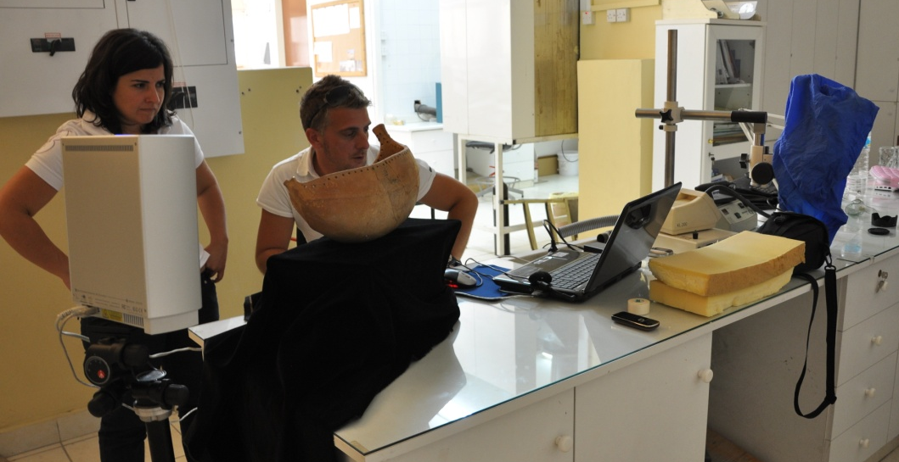
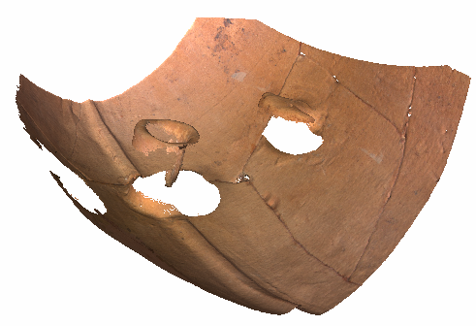
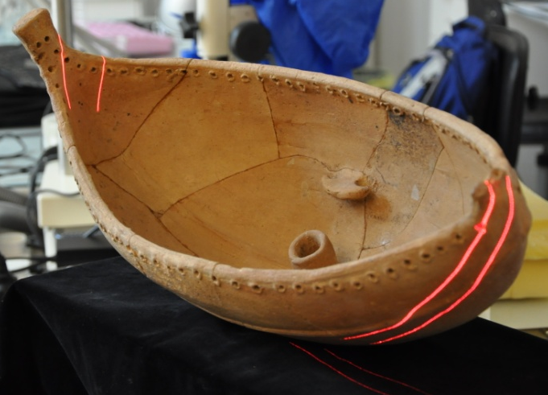
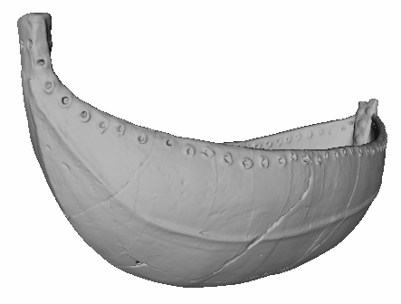
Digitization of the Kazafani Boat
Example:
The “Kazafani Boat”
Found in 1963, during a salvage excavation in the now Turkish occupied part of Cyprus (inaccessible and destroyed site).
Tomb from the 12th century B.C.
Unique object, hand made pottery
40x20.5x23 cm – canoe boat shape
Permanently exhibited at the Nicosia Museum
Workflow
3D scanning – NextEngine
3D model creation – Meshlab
Rapid prototyping
Testing glue, stabilizers, colours
Print final replica
Colour final replica
Example
23

Slide 24

Metadata tree on the Kazafani boat
Refers to
Kazafani Boat, vase
digitized by event
KAZAFANI. A Middle/Late Cypriot Tomb at Kazaphani - Ayios Andronikos
Consists of
Detailed sequence
Consists of
Documentation Event
Consists of
Object Acquisition
Consists of
Capture photo Events
Capture photo Events
1_0.ply..1_8.ply
has created
has created
DSC_0005.JPG.. DSC_0792.JPG
Has thumbnail
Was derivation source for
Has thumbnail
Meshlab processing
Was derivative created by
3D_model_boat.ply
Was derivation source for
DSC_0005_Snap.JPG.. DSC_0792_Snap.JPG
1_0Snap00.jpg.. 1_8Snap00.jpg
Thing is about the Kazafani boat ?
Was derivative created by
Meshlab processing
Time-Consuming!
boat_2500png.zip
Was derivation source for
Blender Processing
Frustrating!!
Was derivative created by
Wrong results ?
Example
boat.mp4
Has thumbnail
boatSnap.jpg
Notes:
So, from the processes a load of metadata is created, describing the obtained photos, videos etc from the kazaphani boat.
These metadata form an hierarchical tree, that is complex to follow, especially if you are not the one documenting the metadata.
So, when the archeologist or another museum employee wants to perform a query on this metadata, they will be frustrated and spend a lot of time writing a query that will most probably end in poor results.
24

Slide 25
Simplified Querying
select distinct $Thing1 $Label
{
$Thing1 rdf:type crm:E70.Thing.
optional{$Thing1 crmdig:L4F.has_preferred_label $Label.
}{optional{
$Thing1 crm:P130F.shows_features_of $Thing2.
}}UNION
{optional{
$Thing1 rdf:type crm:E24.Physical_Man-Made_Thing.
$Thing1 crm:P62F.depicts $Thing2. }}
UNION
{ $Thing1 rdf:type crm:E24.Physical_Man-Made_Thing.
$Thing1 crm:P128F.carries $Information_Object.
$Information_Object crm:P67F.refers_to $Thing2.}
UNION{$Thing1 crm:P67F.refers_to $Thing2.
}
….
UNION{
$Thing1 crm:F1F.is_derivative_of $tmpThing2.
$tmpThing2 crmdig:L11B.was_output_of $DigMachEventX2.
$DigMachEventX2 crm:P9B.forms_part_of $Z1.
$Z1 crmdig:L1F.digitized $Thing2. }}}
E70.Thing -- (F3.is_same_as)^{[0,n]}->E70.Thing:
E70.Thing--(F4F.is_composed_of) ^{[0,n]} -> E70.Thing
E24.Physical_Man-Made_Thing -- P62F.depicts-> E70.Thing
OR
E24.Physical_Man-Made_Thing -- P128F.carries -> E73.Information_Object -> P67F.refers_to -> E70.Thing
OR
D1.Digital_Object -- (F1F.is_derivative_of)^{[0,n]} -> D1.Digital_Object -- L11B.was_output_of -> D7.Digital_Machine_Event-- (P9B.forms_part_of)^{[0,n]} -> D2.Digitization_Process -- L1F.digitized -> E70.Thing -- (F4F.is_composed_of) ^{[0,n]} -> E70.Thing
Traditional way
Smaller paths
More readable and writable
Very long SPARQL queries
Very difficult to write and comprehend
Schema knowledge
Our Framework
Thing “is about or refers to”
Kazafani Boat
What the end user sees
Example
Notes:
So, the poor archeologist would normally have to build this long SPARQL query,
Which is also difficult to read and understand.
Instead of this, we propose to switch to a simpler querying method
With which the user has to build this much shorter path, which is more convenient to write and read.
Still though, it entails the complexity of having to know all the alternatives to include in the query.
So to simplify even further the process, the end user instead of the path, is only exposed to this simple relationship :
Thing is about or refers to the Kazaphani boat.
25

Slide 26
Implementation

Slide 27
Implementation
Paths’ language
Software: FR configuration Tool
Schema: CIDOC-CRM and CIDOC-CRM digital schema
Implementation
Notes:
To realize this framework I have designed and implemented the FR configuration tool, which is a Java based tool,
Including technologies like sparql, owl, rdf etc. and consisting of about 10000 lines of code.
Then I have translated the FRs for the CIDOC –CRM schema.
This framework is accepted and being implemented by the european projects 3D-COFORM in which I am also part,
And the British museum’s research space project.
Validation has been made using real archeologists queries and is practically proved to be efficient and convenientfor the user. Lastly, it can be customized to several user’s and domains’ requirements

Slide 28
Paths’ Language
Domain :
repository schema (i.e. CIDOC-CRM schema)
Constants:
classes and predicates from the schema
special symbols like ‘--’ and ‘->’
Main Variables:
predicate_expession
predicate
simple
transitive-reflexive
OR among predicates
Triple: class ‘--’ predicate_expression ‘->’ class
Path
sequences of triples (AND conjuctions)
OR among paths
E70.Thing -- (P46F.is_composed_of )[0,n]-> E70.Thing:
{
E24.Physical Man-Made_Thing--P62F.depicts -> E5.Event
OR
E70.Thing-- P12F.was_present_at -> E5.Event
}
E70.Thing -- (P46F.is_composed_of )[0,n]-> E70.Thing:
{E24.Physical Man-Made_Thing--P62F.depicts ->E5.Event}
(P46F.is_composed_of)[0,n]
{(P46F.is_composed_of)[0,n] OR (P62F.depicts)}
P62F.depicts
E24.Physical Man-Made_Thing -- P62F.depicts -> E5.Event
Implementation

Slide 29
Path Expression Example
1. shows features of
2. part-whole
E70.Thing -- (F3.is_same_as)^{[0,n]}-> E70.Thing:
{E70.Thing--(F4F.is_composed_of) ^{[0,n]} -> E70.Thing:
{E24.Physical_Man-Made_Thing -- P62F.depicts -> E70.Thing
OR
E24.Physical_Man-Made_Thing -- P128F.carries -> E73.Information_Object :
{E73.Information_Object -> P67F.refers_to-> E70.Thing }
OR
D1.Digital_Object --(F1F.is_derivative_of)^{[0,n]} -> D1.Digital_Object:
{D1.Digital_Object -- L11B.was_output_of -> D7.Digital_Machine_Event:
{D7.Digital_Machine_Event -- (P9B.forms_part_of)^{[0,n]} -> D2.Digitization_Process :
{D2.Digitization_Process --L1F.digitized -> E70.Thing :
{E70.Thing --(F4F.is_composed_of) ^{[0,n]} -> E70.Thing
} } } } } }
Rules
3. derivatives
2. part-whole
Implementation
Notes:
The paths are written in an expressive and easily readable format. This is because we need them to be understandable by the curators who are going to verify them

Slide 30
Implementation
Path’s language
Software: FR configuration Tool
Schema: CIDOC-CRM and CIDOC-CRM digital schema
Implementation
Notes:
To realize this framework I have designed and implemented the FR configuration tool, which is a Java based tool,
Including technologies like sparql, owl, rdf etc. and consisting of about 10000 lines of code.
Then I have translated the FRs for the CIDOC –CRM schema.
This framework is accepted and being implemented by the european projects 3D-COFORM in which I am also part,
And the British museum’s research space project.
Validation has been made using real archeologists queries and is practically proved to be efficient and convenientfor the user. Lastly, it can be customized to several user’s and domains’ requirements

Slide 31
FR configuration tool
Validate path
Check sub-relationship
Translate Path to SPARQL
Translate Path to IVB Template (3D-COFORM feature)
Enable-disable multiple instantiation and disjoint cases
Check schema coverage
Check for new rules
Implementation
Notes:
This is a screen shot of the interface to the FR configuration tool, providing several functionalities,
Which I skip for the sake of time

Slide 32
Implementation
Path’s language
Software: FR configuration Tool
Schema: CIDOC-CRM and CIDOC-CRM digital schema
Implementation
Notes:
To realize this framework I have designed and implemented the FR configuration tool, which is a Java based tool,
Including technologies like sparql, owl, rdf etc. and consisting of about 10000 lines of code.
Then I have translated the FRs for the CIDOC –CRM schema.
This framework is accepted and being implemented by the european projects 3D-COFORM in which I am also part,
And the British museum’s research space project.
Validation has been made using real archeologists queries and is practically proved to be efficient and convenientfor the user. Lastly, it can be customized to several user’s and domains’ requirements

Slide 33


Workflow
Write Fundamental Relationship
Validate and automatically create SPARQL
Incorporate SPARQLs in the querying tool
Query
.
.
.
PATH (text)
SPARQLs
Paths’ language
FR configuration tool
Querying component
Querying component
administrative user
end user
Implementation
Notes:
So, what is done behind the scenes in order for the end user to be able to use this simplified querying method
Is described in this slide.
Firstly a schema expert writes the paths that represent the FRs using the paths expression language.
Then they continue by validating them and automatically creating the respective SPARQLs using the FR configuration tool.
Which will be then incorporated into the querying tool.
After that the end user can easily and efficiently perform queries!

Slide 34
Workflow
Write Fundamental Relationship
Validate and automatically create SPARQL
Incorporate SPARQLs in the querying tool
Query
.
.
.
PATH (text)
SPARQLs
Paths’ language
FR configuration tool
Querying component
Querying component
administrative user
end user
Implementation
Notes:
So, what is done behind the scenes in order for the end user to be able to use this simplified querying method
Is described in this slide.
Firstly a schema expert writes the paths that represent the FRs using the paths expression language.
Then they continue by validating them and automatically creating the respective SPARQLs using the FR configuration tool.
Which will be then incorporated into the querying tool.
After that the end user can easily and efficiently perform queries!

Slide 35
Workflow
Write Fundamental Relationship
Validate and automatically create SPARQL
Incorporate SPARQLs in the querying tool
Query
.
.
.
PATH (text)
SPARQLs
Paths’ language
FR configuration tool
Querying component
Querying component
administrative user
end user
Implementation
Notes:
So, what is done behind the scenes in order for the end user to be able to use this simplified querying method
Is described in this slide.
Firstly a schema expert writes the paths that represent the FRs using the paths expression language.
Then they continue by validating them and automatically creating the respective SPARQLs using the FR configuration tool.
Which will be then incorporated into the querying tool.
After that the end user can easily and efficiently perform queries!

Slide 36
Workflow
Write Fundamental Relationship
Validate and automatically create SPARQL
Incorporate SPARQLs in the querying tool
Query
.
.
.
PATH (text)
SPARQLs
Paths’ language
FR configuration tool
Querying component
Querying component
administrative user
end user
Implementation
Notes:
So, what is done behind the scenes in order for the end user to be able to use this simplified querying method
Is described in this slide.
Firstly a schema expert writes the paths that represent the FRs using the paths expression language.
Then they continue by validating them and automatically creating the respective SPARQLs using the FR configuration tool.
Which will be then incorporated into the querying tool.
After that the end user can easily and efficiently perform queries!

Slide 37
Workflow
Write Fundamental Relationship
Validate and automatically create SPARQL
Incorporate SPARQLs in the querying tool
Query
.
.
.
PATH (text)
SPARQLs
Paths’ language
FR configuration tool
Querying component
Querying component
administrative user
end user
Implementation
Notes:
So, what is done behind the scenes in order for the end user to be able to use this simplified querying method
Is described in this slide.
Firstly a schema expert writes the paths that represent the FRs using the paths expression language.
Then they continue by validating them and automatically creating the respective SPARQLs using the FR configuration tool.
Which will be then incorporated into the querying tool.
After that the end user can easily and efficiently perform queries!

Slide 38
Validation

Slide 39
Validation
Used by
3D-COFORM Project
Research Space Project
Real archaeologist’s queries
Validation
Notes:
In order to prove the usability of the proposed model and its adequacy to create associative queries, we have used a set of real archeologists’ queries, taken from the CulTNat centre.
Validation has been made using real archeologists queries and is practically proved to be efficient and convenient for the user. Lastly, it can be customized to several user’s and domains’ requirements
The 3D-COFORM project aims at providing integrated technologies to make the large-scale production of 3D models feasible for the systematic documentation and study of material cultural heritage http://www.3d-coform.eu/
Research space: supporting collaborative internet research, information sharing and web applications for the cultural heritage scholarly community

Slide 40
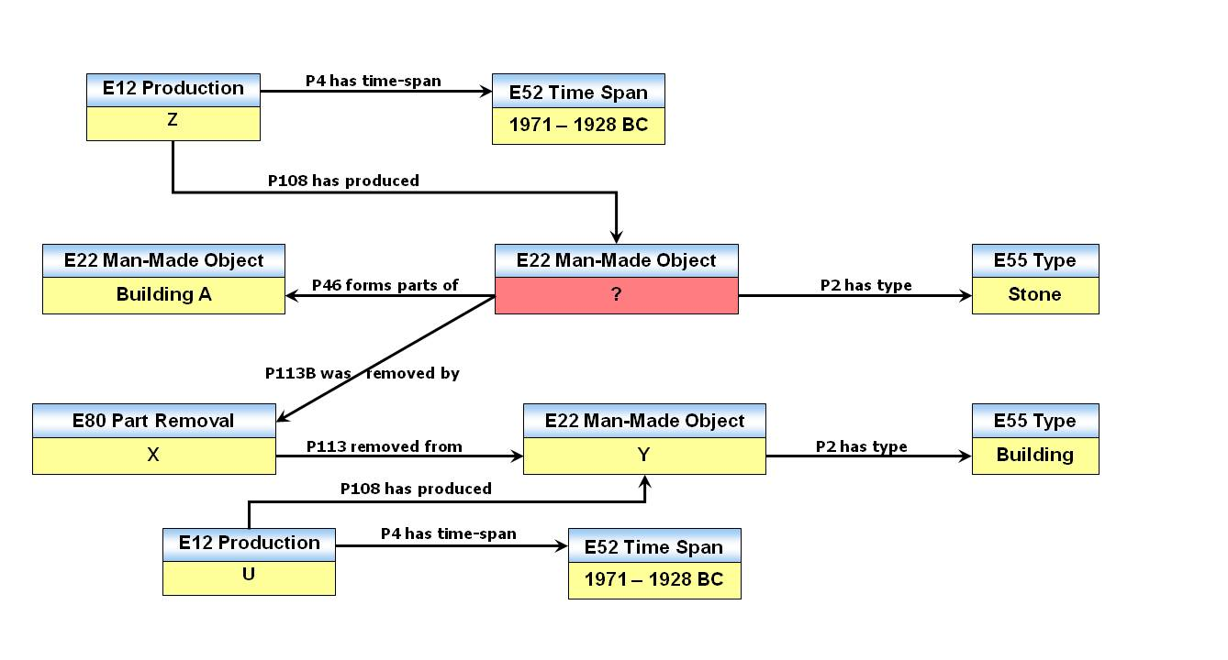
Scientific query example – CIDOC-CRM metadata (1/2)
Find all the stones from Building A that have a previous use and are dated between 1971 - 1928 BC.
Validation
Notes:
Such a query is presented in this slide. Here an archeologist wants to ask for stones from building A that once were on another building and they date from a certain period. This graph shows the respective classes and properties of the CIDOC-CRM that have to be included to create the query.

Slide 41
Scientific query example – FCs & FRs model (2/2)
Find all the stones from Building A that have a previous use and are dated between 1971 - 1928 BC.
Concept
has type
Thing
from
Time
Stone
?
1971 – 1928 BC
from
from
Thing
Thing
Intermediate class
?
Building A
has type
from
Few relationships
Concept
Time
Few categories
building
1971 – 1928 BC
Validation
Notes:
The same query in our model is mapped to this much simpler graph, that uses less properties and less classes. Moreover, in order to create the associative query, we can use intermediate classes and combine in this way more FRs in the query.

Slide 42
Validation
Used by:
3D-COFORM Project
Research Space Project
Real archaeologist’s queries
Test queries: high recall, tunable precision
Validation
Notes:
In our model we demonstrate that we target at providing high recall rates. This is achieved using property propagation
through the metadata, and even accepting the fact that a property may not necessarily be propagated in all cases. This results in precision deterioration. To face this problem, we suggest the usage of FRs specializations or the addition of extra constraints at querying time.

Slide 43
Test queries results
Query No | Query
1 | Thing from Brighton
2
3
4
Thing is located in
Brighton
Thing from Brighton and
has type sculpture (visual work)
Thing from Brighton and
has type sculpture (visual work) and
is made of stone (rock)
FR specialization
+1 constraint
+2 constraints
Validation
Notes:
To practically prove our suggestion, see for example the Thing from Brighton. There is a list of 10 expected objects to be returned. Even though, we do get all of them back, we also get a big number of redundant objects, so the precision remains low. A proposed solution would be to ask instead of Thing from Brighton, the specialization Thing is located in Brighton. This indeed improves the precision. Now, if we constrain the original query adding the has type FR, we see that the precision is improved again, and even more if we add a second constraint, the is made of stone. So, we result in the conclusion that indeed we get high recall rates and a scalable precision rate.

Slide 44
Contributions

Slide 45
Contributions
New data model → simplified querying
→ customizable
Simplified method → time saving
→ easy and efficient
Paths’ language → SPARQL avoidance
Associative querying, rules → high recall
FR specializations → precision improvement
Network’s rich schema → network integration capability
Contributions
Notes:
To sum up with, n the context of this work I have performed a background that identifies the limitations of related work.
Through the new data model I have created, there is the possibility for simplified querying.
With the paths expression language manual SPARQL generation is avoided.
High recall rates are provided using associative querying and rules like the property propagation
And improvement of precision can be achieved with the customizable FR specializations and constraints posing
At querying time.
The networks integration capability is ensured because we have kept the rich structure schema.
And lastly the querying process time has diminished to seconds from months, because of the simplicity we provide.

Slide 46
Live Demo

Slide 47

Thank you for your attention!

Slide 48
Limitations – Future Work
Limitations
Path’s Language
NOT not supported → filters in SPARQL
AND among triples and paths of the same depth
Long SPARQLs
Slow query evaluation (many joins)
Future Work
FR configuration tool
Graphical formulation of paths
filters in SPARQL
More sub-paths with owlim rules to improve query time
Further testing
E70.Thing -- (F4B.is_component_of)[0,n] -> E70.Thing:
{E70.Thing -- P12B.was_present_at-> E5.Event:
{E5.Event--(P9B.forms_part_of)[0,n]->E5.Event }
AND
E70.Thing -- P19B.was_made_for->E7.Activity:
{E7.Activity--(P9B.forms_part_of)[0,n]->E5.Event }}
E70.Thing -- (F4B.is_component_of)[0,n] -> E70.Thing:
{E70.Thing -- P12B.was_present_at-> E5.Event NOT E7.Activity:
{E5.Event--(P9B.forms_part_of)[0,n]->E5.Event }
NOT
E70.Thing – P16B.was_used_for->E7.Activity:
{E7.Activity--(P9B.forms_part_of)[0,n]->E5.Event }}
Limitations-Future Work

Slide 49
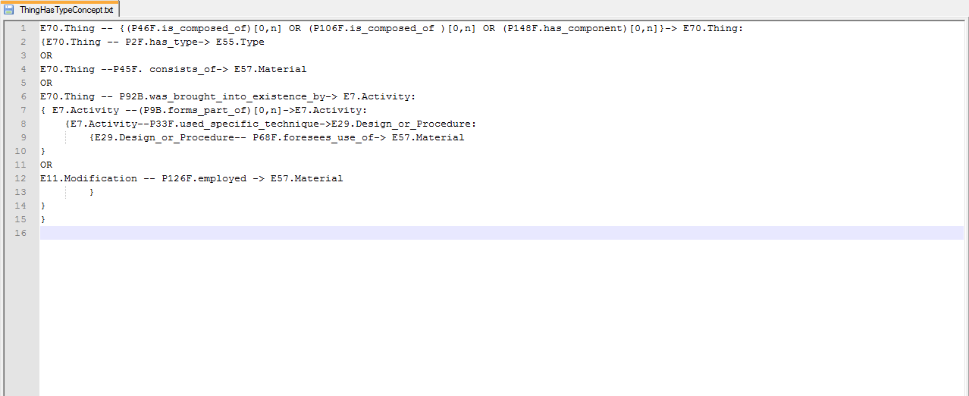

Slide 50
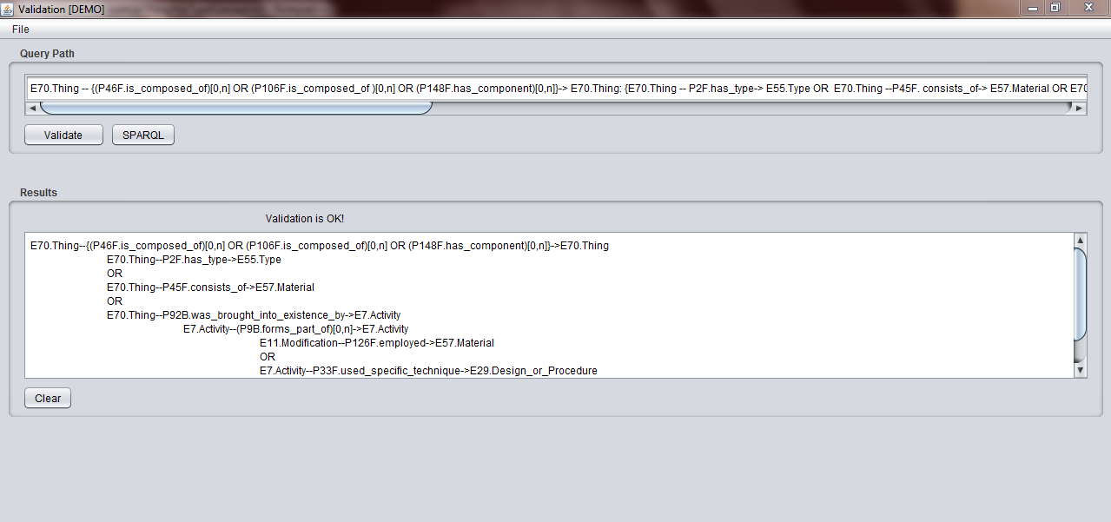
Validating a Path by using the FR customization tool

Slide 51
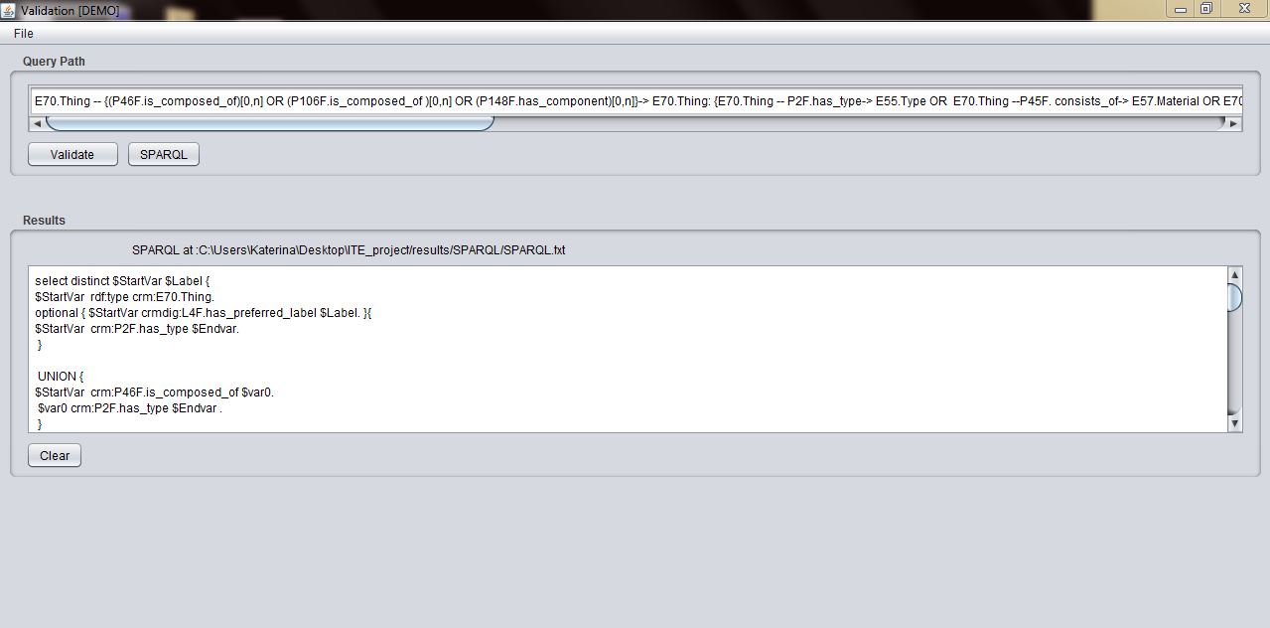
Creating the SPARQL by using the FR customization tool

Slide 52
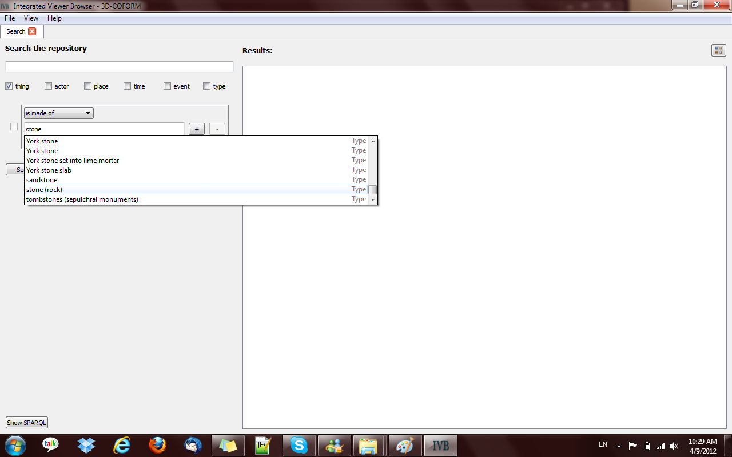
Query Thing has material stone(rock) in IVB

Slide 53
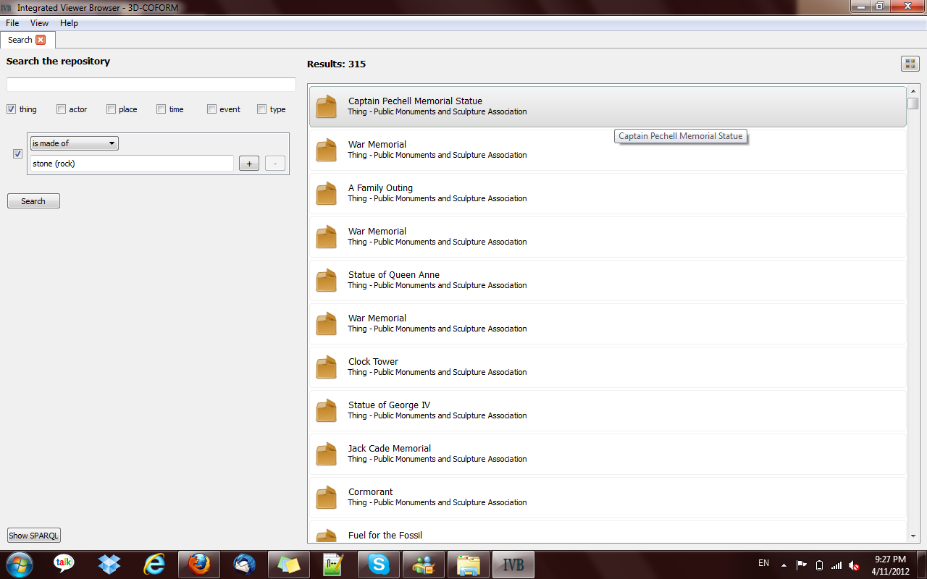
Query Thing is made of stone results in IVB

Slide 54
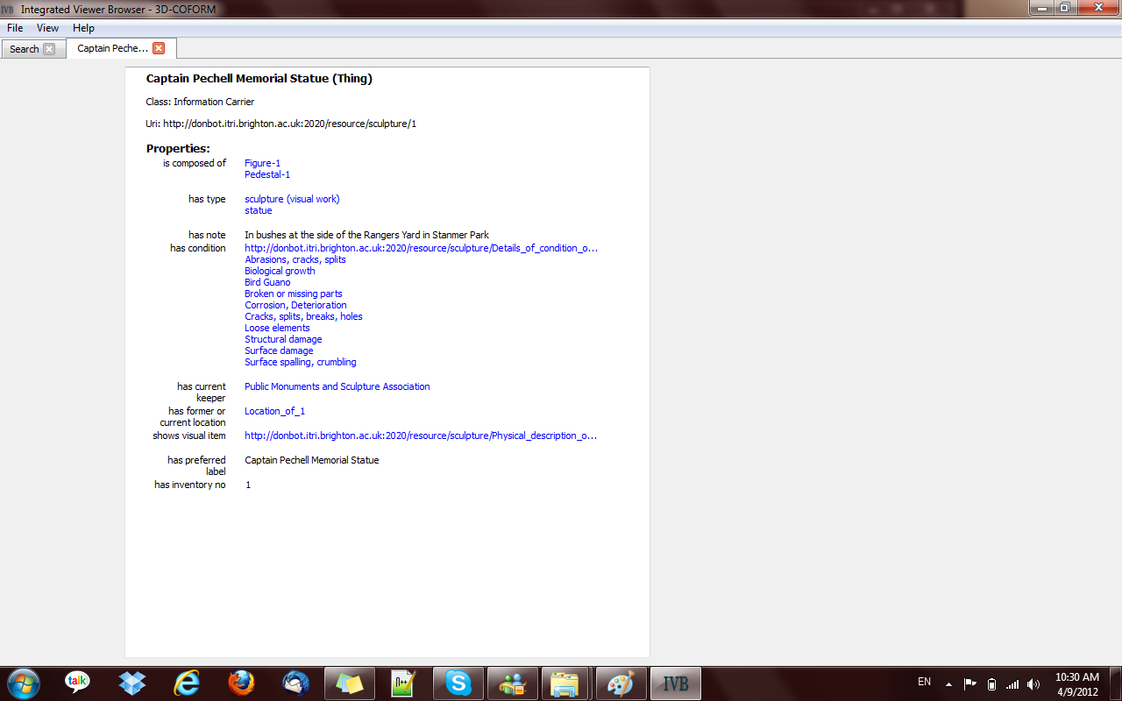

Slide 55
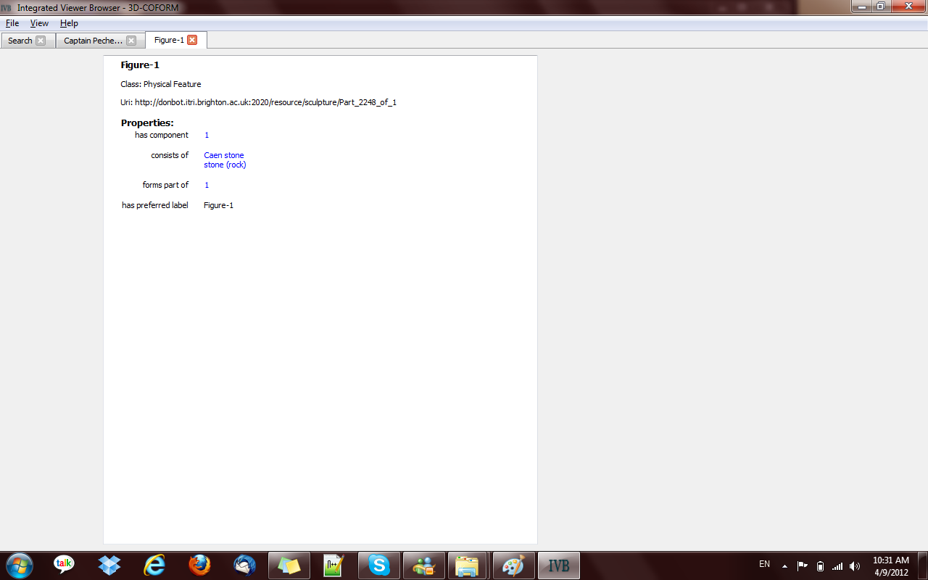

Slide 56
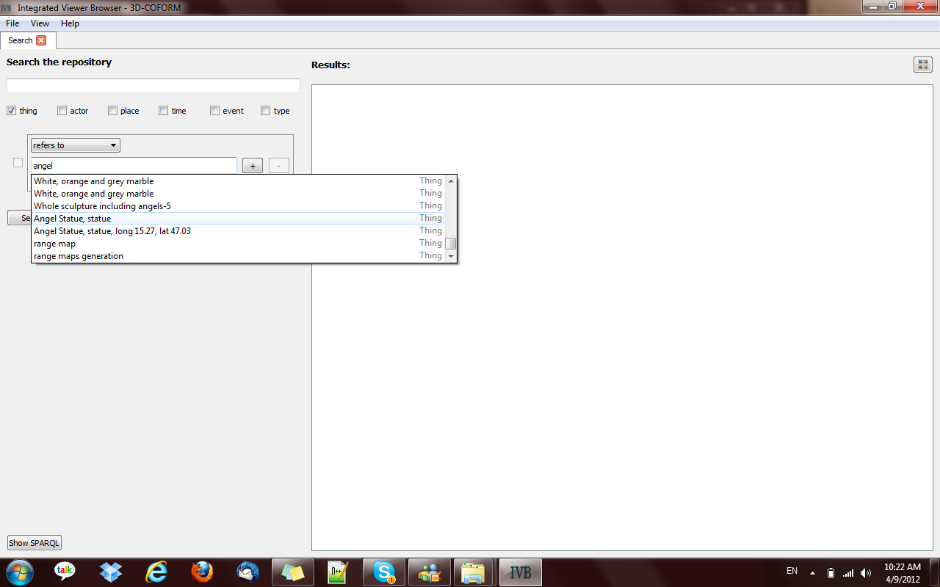

Slide 57
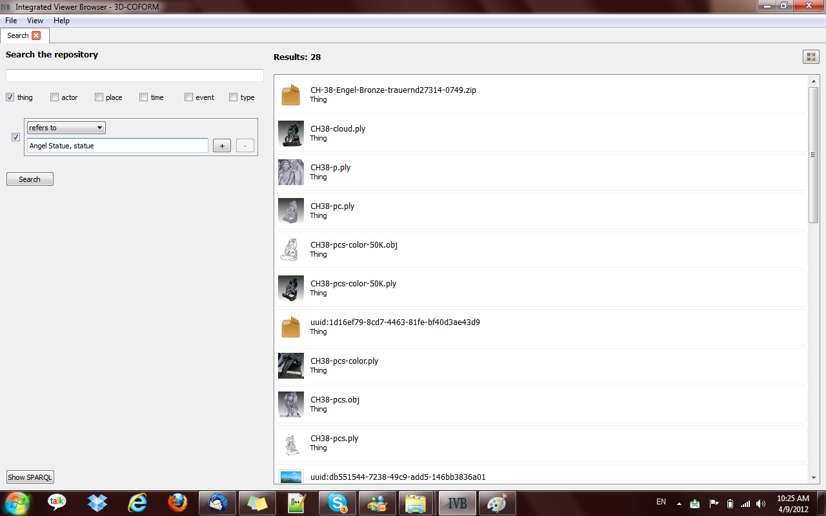

Slide 58
Key Terminology
Triple
Triple store
Schema (RDF/S)
Information search
Structured query language (e.g. SPARQL)
depicts
Guernica
Painting of Mona Lisa
Mona Lisa
refers
Part of
refers
Guernica
Mona Lisa
Painting of Mona Lisa
by
from
Precision
Picasso
Spain
by
Da Vinci
from
Itsly
Part of
Part of
Europe
Recall
Introduction
Notes:
Prin proxwrisoume se pio eksidikeumenes perigrafes, se autin tin diafaneia parathetoume mia lista apo
Basikes orologies pou tha xrisimopoioume se autin tin parousiasi.
Arxika, exoume os kurio stoixeio domisis tis pliroforias tin tripleta. Me tin tripleta domoume tin pliroforia se tria meri,
To upokeimeno thn idiotita kai to antikeimeno. Gia paradeigma, o pinakas tis mona liza deixnei tin monaliza.
Ena triple store einai mia basi gia tripletes, stin opoia I pliroforia sundeetai mesw koinwn kombwn (upokeimena I antikeimena), dimiourgwntas enan megalo grafo.
Ta upokeimena kai ta antikeimena einai stigmiotupa apo kathorismenes klaseis (katigories ontotitwn). Oi klaseis kai oi idiotites tous proerxontai apo to schema tis basis, sunithws ekfrasmeno se RDFs. To RDFs Sxima perigrafei ton tropo pou einai domimeni I pliroforia stin basi, diladi poies klasseis antistoixoun se poies idiotites kathws episis kai tin ierarxia anamesa se autes.
Sthn sugkekrimeni ergasia, asxoliomaste me tin anazitisi pliroforiwn se tetoia apothetiria. Gia na aksiologisoume tis xrisimopoioumenes methodous anazitisis xrisimopoioume deiktes opws o bathmos anaklisis (diladi se mia erwtisi pros tin basi,
posa apo ta swsta apotelesmata pu perimenw mou exoun epistrafei) kai ton dikti akribeias (diladi posa apo ta apotelesmata pou mou exoun epistrafei einai swsta). Gia tin anazitisi plliroforiwn se tetoia apothetiria, xrisimopoioume kuriws domikes glwsses eperwtisewn me kuriarxi epi autwn tin glwssa SPARQL.

Slide 59
Solution: Fundamental Categories & Fundamental Relationships Data Model
Fundamental Relationships
Fundamental Categories domain
Fundamental Categories
range
1.has type
2.is type of
3.has part
4.is part of
5.from, has generator
6.is origin of, generator of
7.is similar or the same with
8.has met
9.refers to or is about
10.is referred to by/ is referred to at
11.borders or overlaps with
12.by
Thing
Thing
Place
Place
Actor
Actor
Event/Time
Event/Time
Concept
Concept
+ specializations

Slide 60
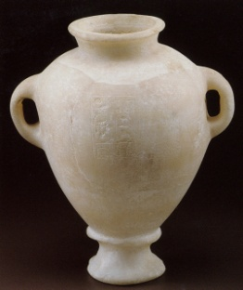
Archaeological Museum of
Heraklion Crete
record
information
Amphora placement in
Archeological Museum
time
Query:
Things from Egypt found in Crete
Stylianos Alexiou
record
information
1951
Tomb Excavation
Amphora Λ2409
Tomb
Tuthmosis III
Written on
inscription
(on amphora)
Amphora Deposition
in tomb
14th century BC
15th century BC
Tuthmosis III
reign
Amphora
Production
Papyrus
information
Egypt
Crete
space
Related Work
Notes:
To enforce this opinion take for example this case about an Egyptian Amphora and its existence in time and space declared with events.
The only direct information we know about the amphora is that it was created during the reign of Tuthmosis the third. Nevertheless through information about Tuthmosis that we know from other sources, we can infer that it was created in the 15th century in Egypt, even though the only explicitly stated place for the amphora is Crete, the place it was found. To describe all these events and the inferences that occur we definitely need a rich schema and DC elements framework is insufficient.

Slide 61
Implementation with rules
The former or current location of the thing.
Thing -- F6F.has_location -> Place
Thing -- F8F.Thing_from_Place -> Place
The place where the Thing was created,
found or acquired.
Thing -- F9F.created_in_Place -> Place
Thing from
Place
The place where the owner or keeper
of the thing resides.
Actor -- F7F.Actor_from_Place -> Place
Actor -- F7F.Actor_from_Place -> Place
The place associated (birth, residence)
with the creator of the thing
Our Proposal

