Slide 1
Querying Semantic Networks
Fundamental Categories
Fundamental Relationships
Katerina Tzompanaki - Martin Doerr
Center for Cultural Informatics,
Institute of Computer Science
Foundation for Research and Technology - Hellas
April 14, 2012
Notes:
Good afternoon, my name is Katerina Tzompanaki and I come from Crete, a beautiful island in Greece.
I work in collaboration with Dr. Martin Doerr in the Foundation of Research and Technology.
I have travelled all this way to show you today our new Framework for querying complex semantic networks.

Slide 2
Outline
Introduction - Challenges
Problem
Existing Approach
Our proposal
Example
Demonstration
Conclusions
Notes:
After providing a few introductory information, I will expose you to the problem of querying semantic networks, the existing approach and then I will describe to you our solution. This will be accompanied by an example and finally a live demonstration of our current implementation.

Slide 3
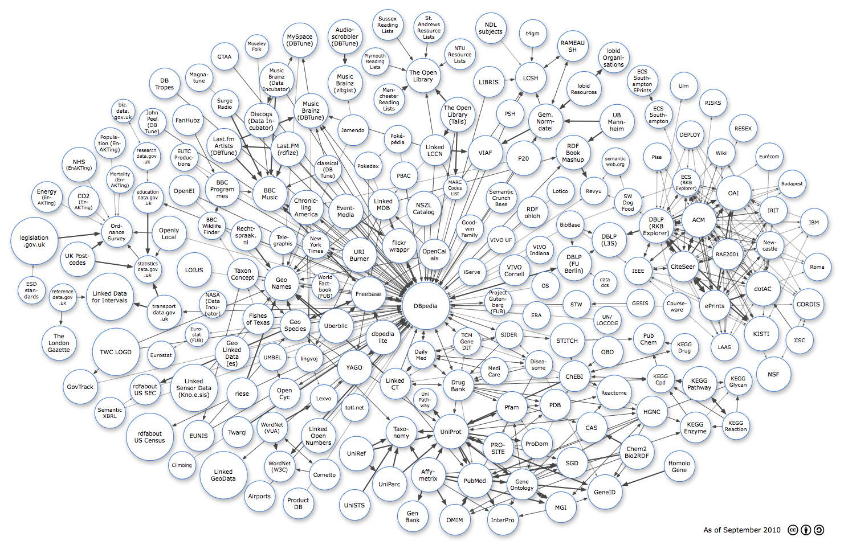
Introduction
Semantic Web
Web of data
RDF/S
RDF Triple Stores
Linked Open Data (LoD): Thousands of triple stores to be accessed
Notes:
The trend nowadays is the movement from a Web of unstructured documents to a Web of structured data.
To make this happen we use RDF/S for defining and describing data and the relations among data;
RDF triple stores to maintain the content, creating in this way hundreds of Semantic Networks;
And finally Linked Open Data to publish and interconnect the information of the various Semantic Networks into a giant
Graph comprising the Semantic Web.

Slide 4
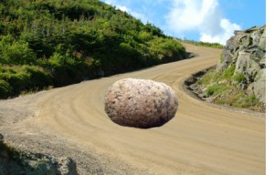
Introduction
3 Major Challenges
We need a rich, integrating global schema – a core and extensions of any depth
End-users need to query effectively large Triple Stores
Knitting” the network : without co-ref resolution facts/triples do not connect
Notes:
But in the way for the Semantic Web to succeed three major challenges must be addressed:
Firstly we need a core schema that is rich enough to represent and integrate the global knowledge and provide extensions of any depth.
Secondly we need to provide the users with an efficient way to query large and complex networks. This is also the challenge this work is aiming at.
Last, and I won’t refer longer to this one because it is out of the presentation’s scope, we need co-reference resolution for multiple references to the same instances which is essential for the network’s consistency
1. Con: impossible – everybody has his own conceptualization
Pro: CIDOC-FRBR work empirically proves opposite
2.Con: impossible to write ad hoc rich SPARQL statements, impossible to memorize hundreds of properties
Pro: use another, simple global schema for querying

Slide 5
A Global Schema: The CIDOC CRM
Is an extensible core ontology of 86 classes and 137 properties describing the underlying semantics of over a hundred database schemata and structures from all museum disciplines, archives and libraries,
It is result of 15 years interdisciplinary work and agreement.
An interlingua to transform, transport and merge information from most data structures with clear meaning.
Notes:
A candidate rich schema that can cope with the needs of the complex world of cultural heritage is CIDOC-CRM.
CIDOC-CRM is the result of an extensive interdisciplinary work that results into an extensible core schema of 86 classes and 140 properties. It describes the semantics from all museum disciplines, archives and libraries based on the documentation of facts and it can easily be mapped to by other schemata. In this way huge, meaningful networks of knowledge can be created.

Slide 6
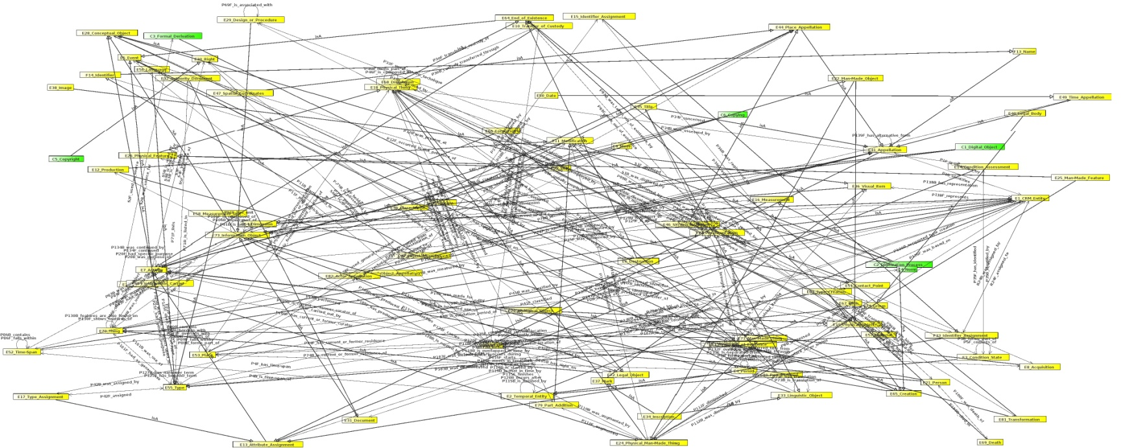

Problem: How to query rich Semantic Networks?
CIDOC-CRM Visualization by StarLion
Notes:
And here comes the second challenge: how are we to query rich semantic networks?

Slide 7
How to query rich semantic networks?
Hardships:
The nature of information in the Semantic Web
Users’ ignorance
Failure of current Information Retrieval methods (keyword search)
Notes:
This problem is not one-dimentional.
First hardship lies in the content itself: bla bla bla

Slide 8
Existing Approach 1
Facilitate the query formulation in the User Interface with
schema graphical representations
natural language
menu-guided interfaces with look ahead mechanisms
Drawbacks
Some still require SPARQL from the user
Polysemy of natural language
The user still depends on their awareness of the underlying schema

Slide 9
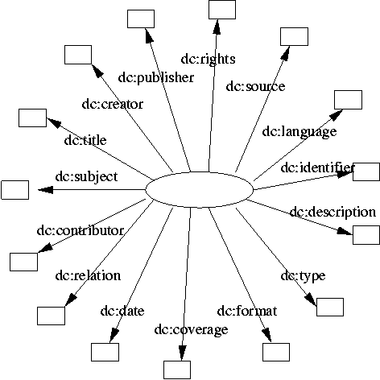
Existing Approach 2
Simplify the network by using “core” elements
such as in Dublin Core
The DC hedgehog model
Notes:
The other solution proposes: why have complex structures in the first place? Let’s simplify the network from its foundation

Slide 10
Existing Approach 2
Drawbacks
Cannot map complicated scientific data to small schemata with poor coverage
Does not provide adequate support for sophisticated queries or search precision across large datasets
Cannot result in good deductions and diminishes the possibility of reasoning
Cannot integrate knowledge
Notes:
This proposal however cannot take us far.
Humans think consciously in “compressed relations” (G.Fauconnier “The Way We Think”), in particular omitting events:
“What do we have from New Guinea?”
There are a few “Fundamental Categories” that partition our concepts (Ranganathan, “Who, When, Where, What..) and disambiguate most words
e.g., a “”museum” is a “who”, a “where” or a “what”
If we implement a simple semantic network with few compressed relationships, we cannot integrate knowledge, because the intermediates are missing, and we cannot manage the immense number of redundant relations
If we implement a CIDOC CRM network, end-users cannot write queries

Slide 11
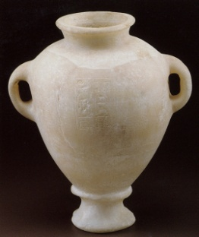
Archaeological Museum of
Heraklion Crete
record
information
Amphora placement in
Archeological Museum
time
Query:
Things from Egypt found in Crete
Stylianos Alexiou
record
information
1951
Tomb Excavation
Amphora Λ2409
Tomb
Tuthmosis III
Written on
inscription
(on amphora)
Amphora Deposition
in tomb
14th century BC
15th century BC
Tuthmosis III
reign
Amphora
Production
Papyrus
information
Egypt
Crete
space
Notes:
To enforce this opinion take for example this case about an Egyptian Amphora and its existence in time and space declared with events.
The only direct information we know about the amphora is that it was created during the reign of Tuthmosis the third. Nevertheless through information about Tuthmosis that we know from other sources, we can infer that it was created in the 15th century in Egypt, even though the only explicitly stated place for the amphora is Crete, the place it was found. To describe all these events and the inferences that occur we definitely need a rich schema and DC elements framework is insufficient.

Slide 12
Our proposal
A new “data-model” of
“Fundamental Categories” and “Fundamental Relationships”
for querying only!
… implemented as automated deductions from a CRM-based network
Notes:
So taken as granted that we maintain the rich underlying schema, we apply the aforementioned idea about core elements, but at querying level only. Thus we have designed and implemented a new data model of Fundamental Categories and Relationships that are paths formulated as deductions from the complex CRM schema.

Slide 13
Fundamental Relationships
Fundamental Relationships
describe:
how and what an entity is (classification, part-whole structure),
what an item has undergone gone in its history,
what an entity may “show”, say or refer to.
are based on:
intuition, experience and observation

Slide 14
Fundamental Categories & Relationships
Fundamental Categories:
Thing, Actor, Place,Time/Event, Concept
Fundamental Relationships:
has type /is type of
is similar to or same with
is part of (is member of) / has part (has member)
has met
from (has founder or has parent) / is origin, founder, parent, provider or creator of
had (=owns, keeps) / were owned/kept by
refers to or is about / is referred to by - is referred to at
..and specializations
Relationships change interpretation depending on category of domain and range.
Notes:
Thing - comprising material and immaterial things, equal to “Who”
Place - geometric extents in space, on earth and on objects, often related to or even identified by some stable and prominent configuration of matter, such as a settlement, equal to “Where”
Actor - comprising persons, organisation, offices and informal groups, equal to “Who”
Time - date-time interval, a special case of “When”
Event - comprising states, historical and other periods, events and activities in the narrower sense. Can be regarded as a “When”.
Concept - comprising all kinds of universals, such as types of things, people, events, places, species etc. This is a special case of “What”.

Slide 15
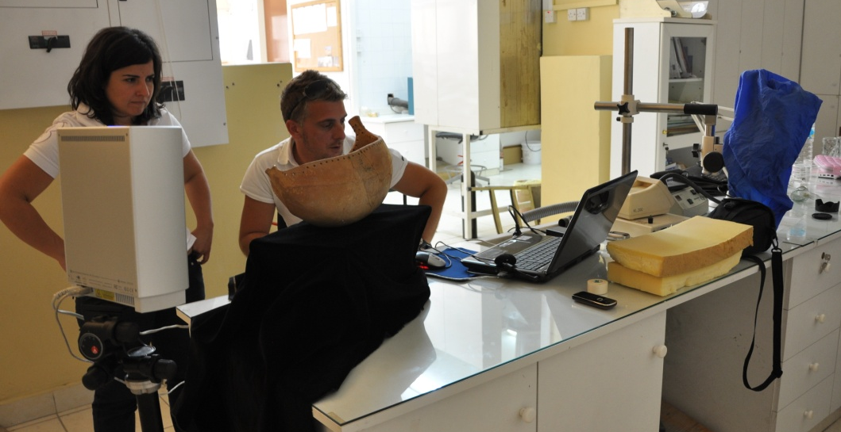
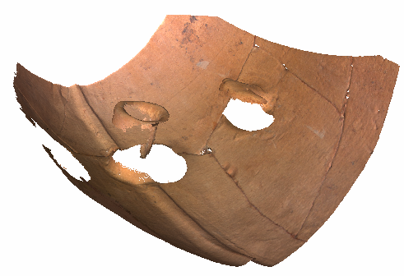
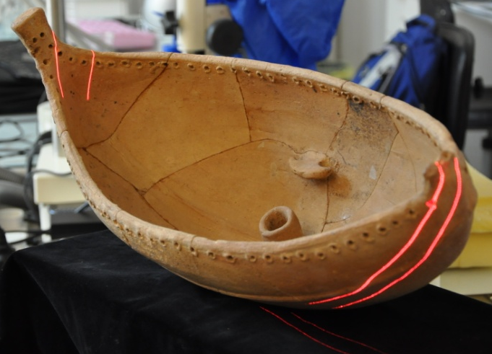
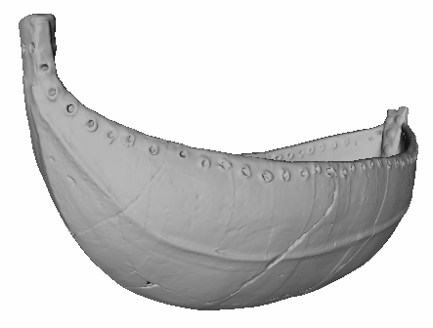
Example Query: Things about “The Kazafani Boat”
Example:
The “Kazafani Boat”
Found in 1963, during a salvage excavation in the now Turkish occupied part of Cyprus (inaccessible and destroyed site).
Tomb from the 12th century B.C.
Unique object, hand made pottery
40x20.5x23 cm – canoe boat shape
Permanently exhibited at the Nicosia Museum
Workflow
3D scanning – NextEngine
3D model creation – Meshlab
Rapid prototyping
Testing glue, stabilizers, colours
Print final replica
Colour final replica
15

Slide 16
Metadata about the digitization and documentation of
Refers to
Kazafani Boat, vase
digitized by event
KAZAPHANI. A Middle/Late Cypriot Tomb at Kazaphani - Ayios Andronikos
Consists of
Detailed sequence
Consists of
Documentation Event
Consists of
Object Acquisition
Consists of
Capture photo Events
Capture photo Events
1_0.ply..1_8.ply
has created
has created
DSC_0005.JPG.. DSC_0792.JPG
Has thumbnail
Was derivation source for
Has thumbnail
Meshlab processing
Was derivative created by
3D_model_boat.ply
Was derivation source for
DSC_0005_Snap.JPG.. DSC_0792_Snap.JPG
1_0Snap00.jpg.. 1_8Snap00.jpg
Was derivative created by
Meshlab processing
boat_2500png.zip
Was derivation source for
Blender Processing
Was derivative created by
boat.mp4
Has thumbnail
boatSnap.jpg
Notes:
Property propagation and derivation chain.
There is a load of properties that is carried down the chain, like the subject that the objects have

Slide 17
Thing is about Thing Path Expression
1. shows features of
2. part-whole
C1.Object -> (F3.is_same_as)^{[0,n]}->C1.Object:
C1.Object->(F4F.is_composed_of) ^{[0,n]} -> C1.Object
E24.Physical_Man-Made_Thing -> P62F.depicts -> C1.Object
OR
E24.Physical_Man-Made_Thing -> (P128F.carries)^{[0,1]} -> E73.Information_Object
-> P67F.refers_to-> C1.Object
OR
D1.Digital_Object -> (F1F.is_derivative_of)^{[0,n]} -> D1.Digital_Object -> L11B.was_output_of -> D7.Digital_Machine_Event-> (P9B.forms_part_of)^{[0,n]} -> D2.Digitization_Process -> L1F.digitized -> C1.Object >(F4F.is_composed_of) ^{[0,n]} ->C1.Object
Rules
3. derivatives
Notes:
The paths are written in an expressive and easily readable format. This is because we need them to be understandable by the curators who are going to verify them

Slide 18
SPARQL query statement: Thing is about Thing
#In this example $Thing1 is the queried Thing and $Thing2 is the known thing as in $Thing1 is about $Thing2
select distinct $Thing1 $Label
{
$Thing1 rdf:type crm:E70.Thing.
optional{$Thing1 crmdig:L4F.has_preferred_label $Label.
}{optional{
$Thing1 crm:P130F.shows_features_of $Thing2.
}}UNION
{optional{
$Thing1 rdf:type crm:E24.Physical_Man-Made_Thing.
$Thing1 crm:P62F.depicts $Thing2. }}
UNION
{ $Thing1 rdf:type crm:E24.Physical_Man-Made_Thing.
$Thing1 crm:P128F.carries $Information_Object.
$Information_Object crm:P67F.refers_to $Thing2.}
UNION{$Thing1 crm:P67F.refers_to $Thing2.
} ….
UNION{
$Thing1 crm:F1F.is_derivative_of $tmpThing2.
$tmpThing2 crmdig:L11B.was_output_of $DigMachEventX2.
$DigMachEventX2 crm:P9B.forms_part_of $Z1.
$Z1 crmdig:L1F.digitized $Thing2.
}}}
Notes:
This is the respective SPARQL query statement, and basically the one third of it..quite large to be presented and quite large to edit, especially when we are talking for about 100 more statements!

Slide 19
Implementation
For end users:
Query Formulation Interface (QFI) is built upon the ”Fundamental Categories and Relationships” framework
Is part of Integrated Viewer Browser Component (IVB).
Supported by the 3D-COFORM Project
By ISTI-CNR and FORTH
For administrative users:
Fundamental Relationship customization tool
guides the user to formulate the paths for the FR,
validates them against the schema and
transforms them to SPARQL queries.
Designed and implemented by FORTH
Notes:
The IVB component is not static; there is the possibility to easily adapt updates to the already existing FRs or add new ones

Slide 20


Workflow
Administrative user
validates and creates automatically SPARQL
Administrative user
formulates FR
SPARQLs incorporated in the IVB
End user
queries
.
.
.
PATH (text)
SPARQLs
FR customization tool
IVB-QFI

Slide 21
Workflow
Administrative user
validates and creates automatically SPARQL
Administrative user
formulates FR
SPARQLs incorporated in the IVB
End user
queries
.
.
.
PATH (text)
SPARQLs
FR customization tool
IVB-QFI

Slide 22
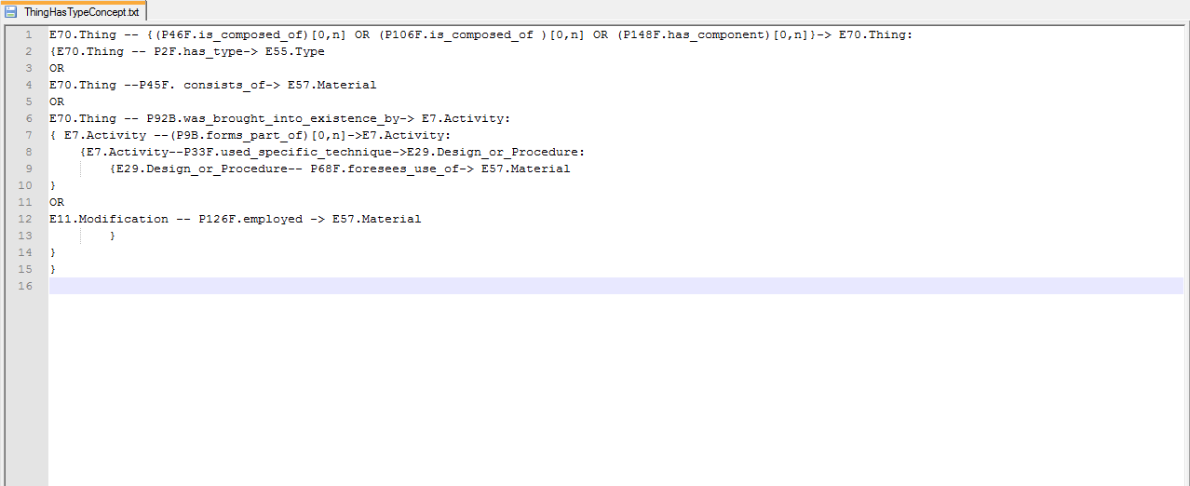

Slide 23
Workflow
Administrative user
validates and creates automatically SPARQL
Administrative user
formulates FR
SPARQLs incorporated in the IVB
End user
queries
.
.
.
PATH (text)
SPARQLs
FR customization tool
IVB-QFI

Slide 24
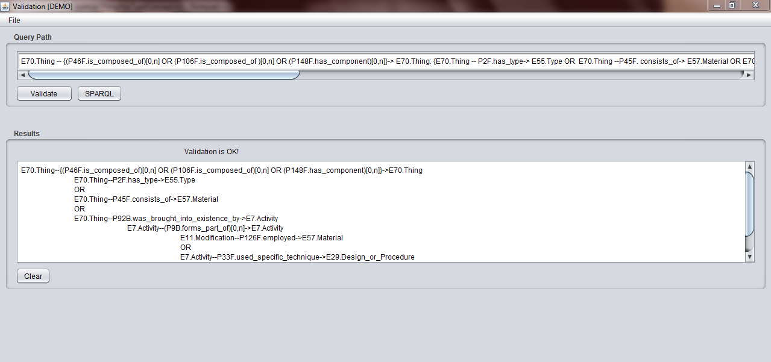
Validating a Path by using the FR customization tool

Slide 25
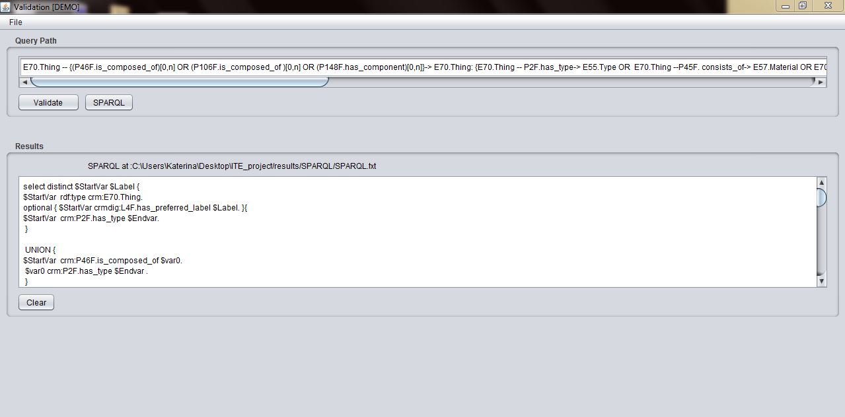
Creating the SPARQL by using the FR customization tool

Slide 26
Workflow
Administrative user
validates and creates automatically SPARQL
Administrative user
formulates FR
SPARQLs incorporated in the IVB
End user
queries
.
.
.
PATH (text)
SPARQLs
FR customization tool
IVB-QFI

Slide 27
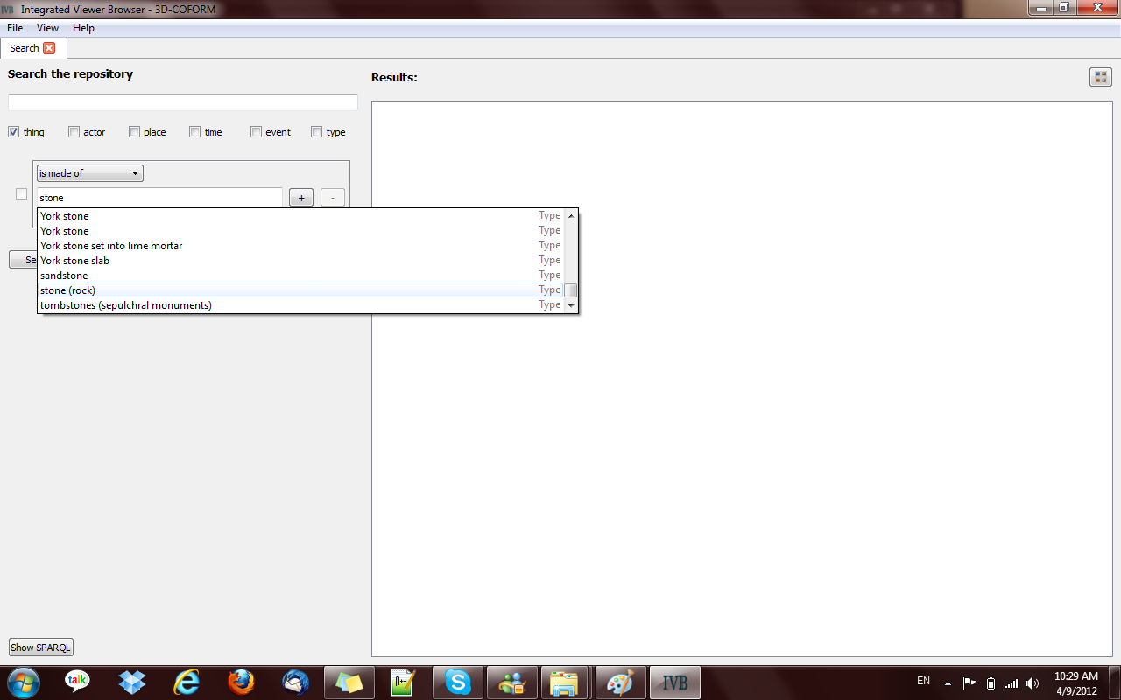
Query Thing has material stone(rock) in IVB

Slide 28
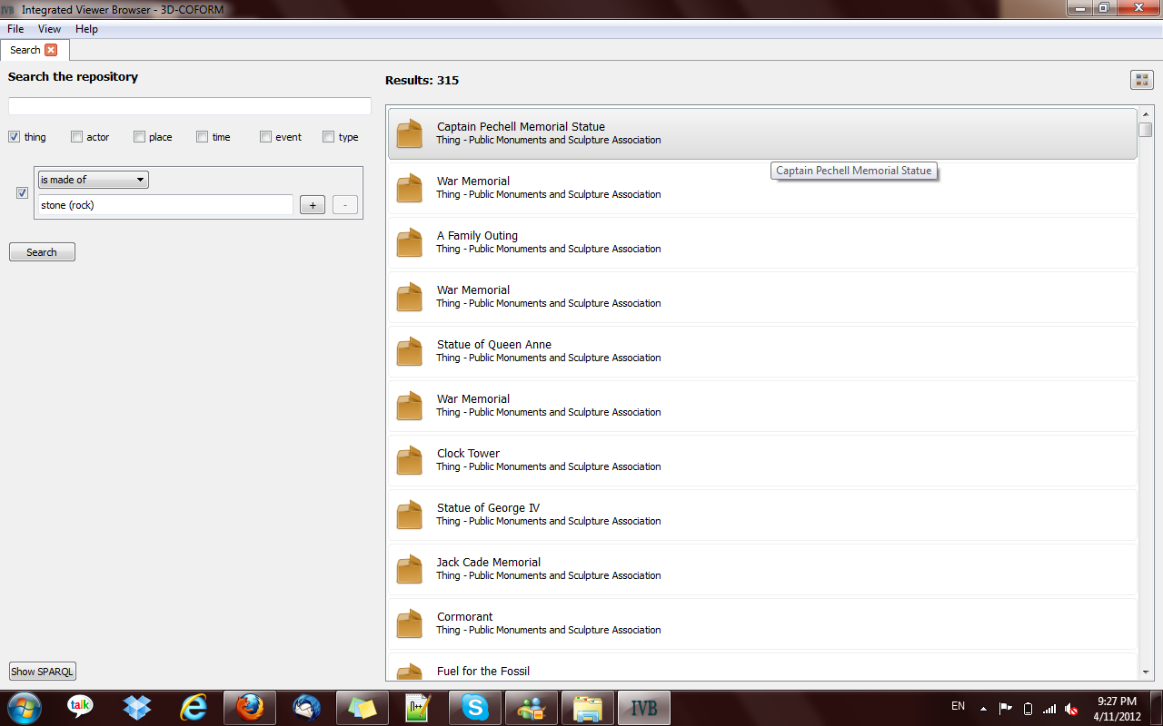
Query Thing is made of stone results in IVB

Slide 29
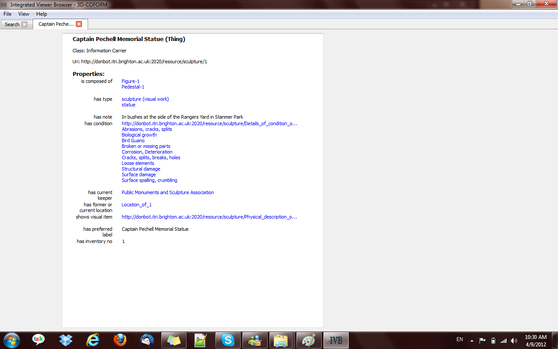

Slide 30
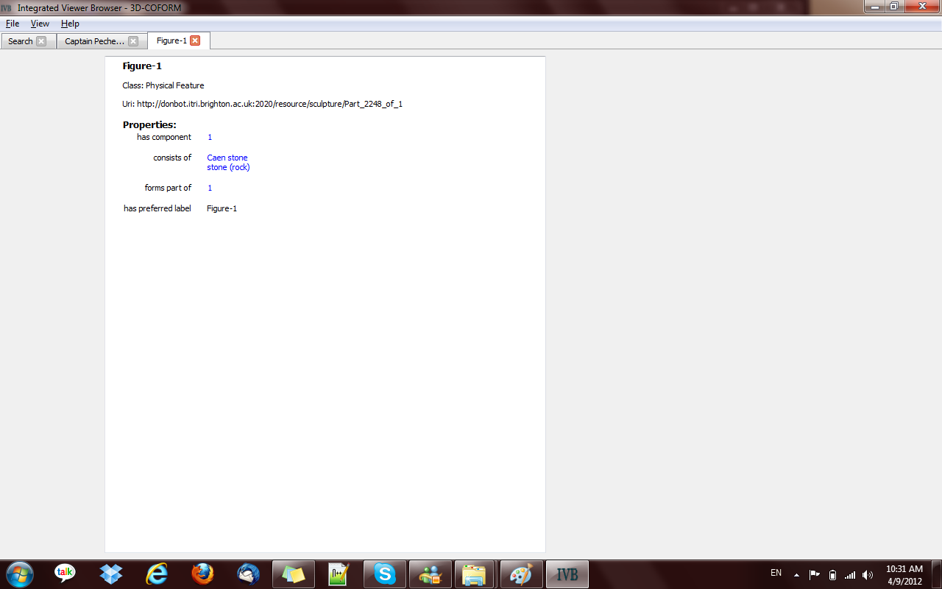

Slide 31
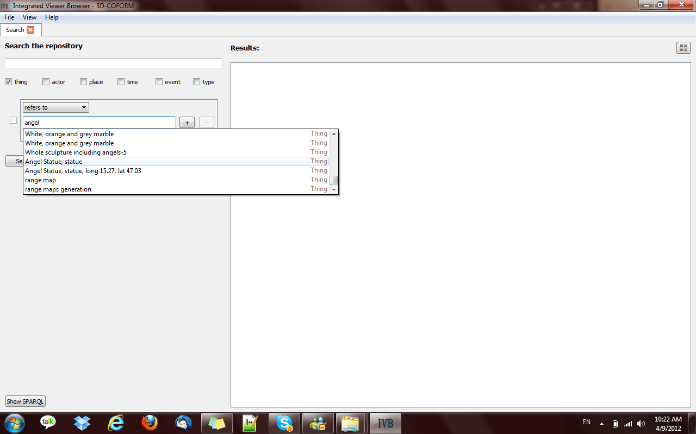

Slide 32
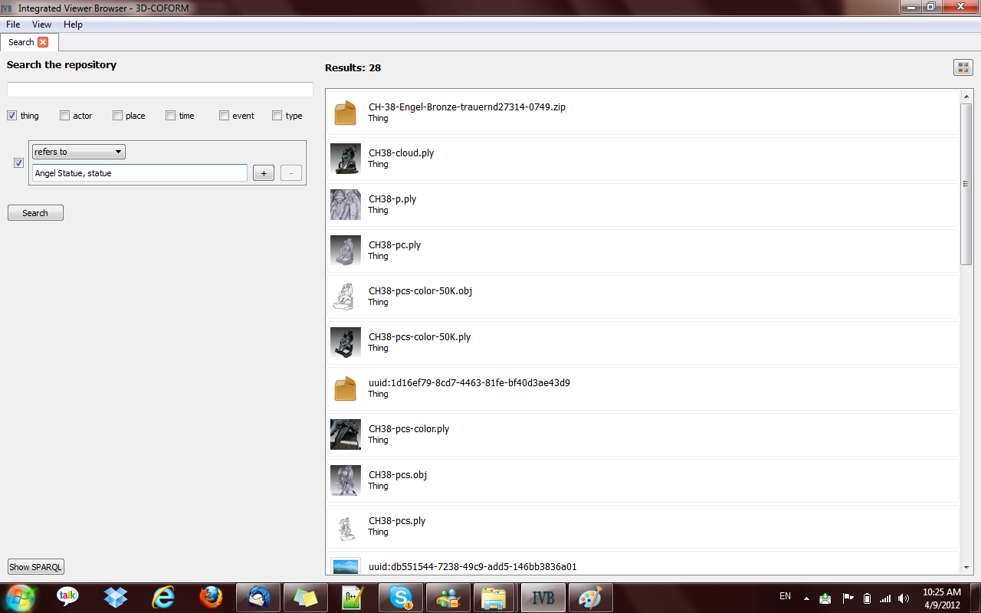

Slide 33
Conclusions
Separate the query layer from the storage layer
Maintain the information integration capability
Make use of helpful inferences and deductions
Achieve high recall rates
User-friendly querying mechanism
Customizable to different discourses

Slide 34

Thank you for your attention!

