Slide 1

< islade1-project >
CI/CD Using Terraform, AWS, Git, GitHub, Apache2. Delivery and Deploy
Made by Illia Kupchenko
1

Slide 2







Project infrastructure

Slide 3
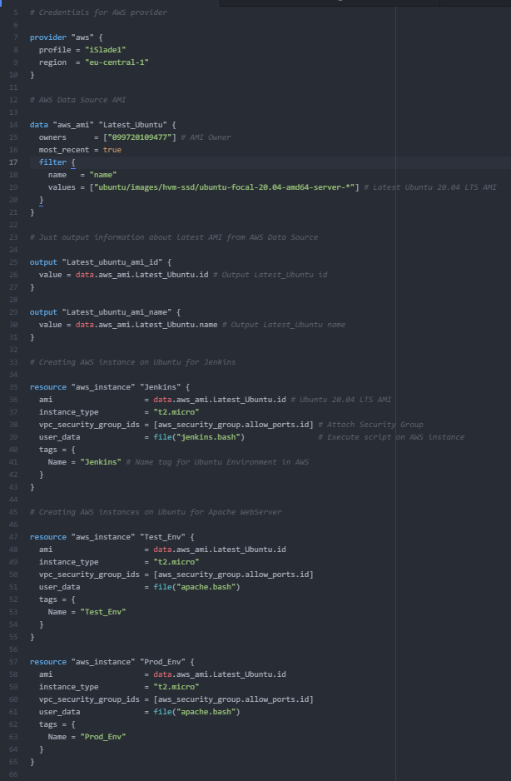
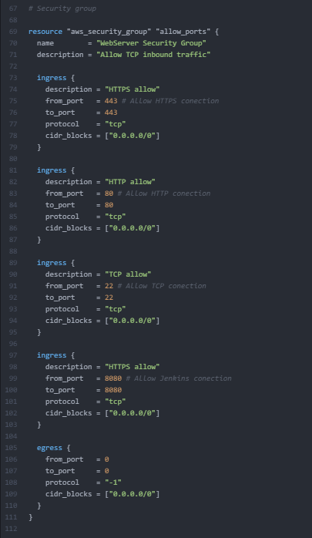
Terraform Infrastructure as a Code

Slide 4
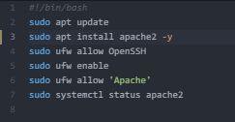
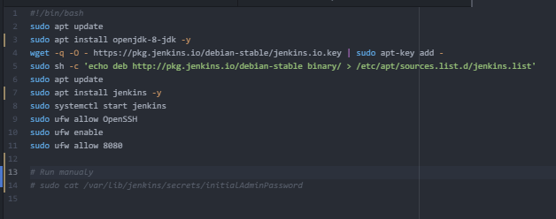
Terraform Infrastructure as a Code
Execute a simple Bash script in AWS EC2 instance via Terraform
Into Test_Env and Prod_Env
Into Jenkins Machine

Slide 5
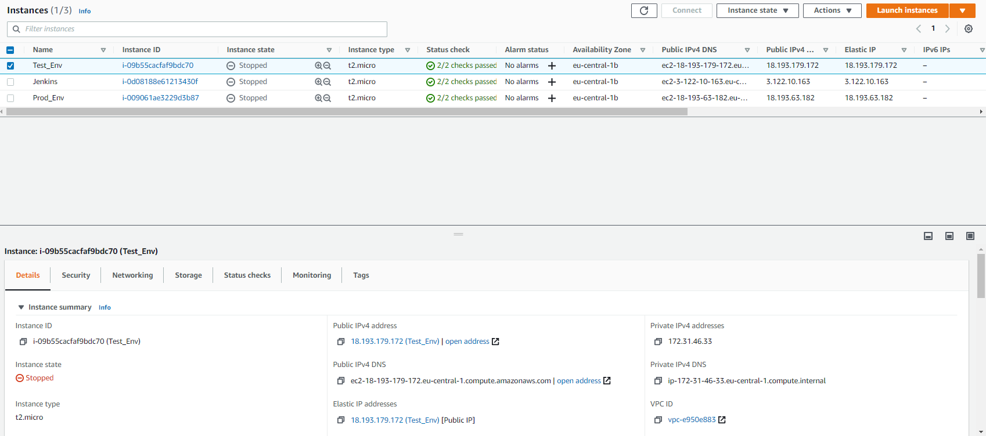
Terraform Infrastructure as a Code

Slide 6
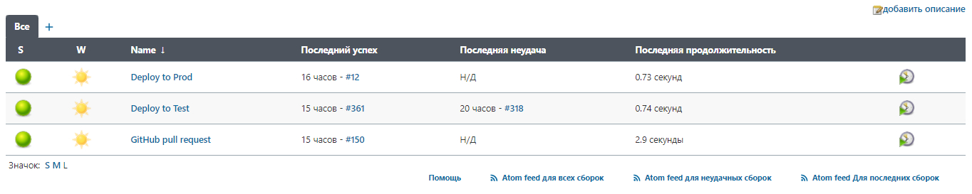
Jenkins Creating a 3 simple jobs
GitHub pull request – triggering GitHub repo by Webhook and Pull request builder
Deploy to Test – deploying index.html into Test_Env
Deploy to Prod – deploying index.html after approve into Prod_Env

Slide 7
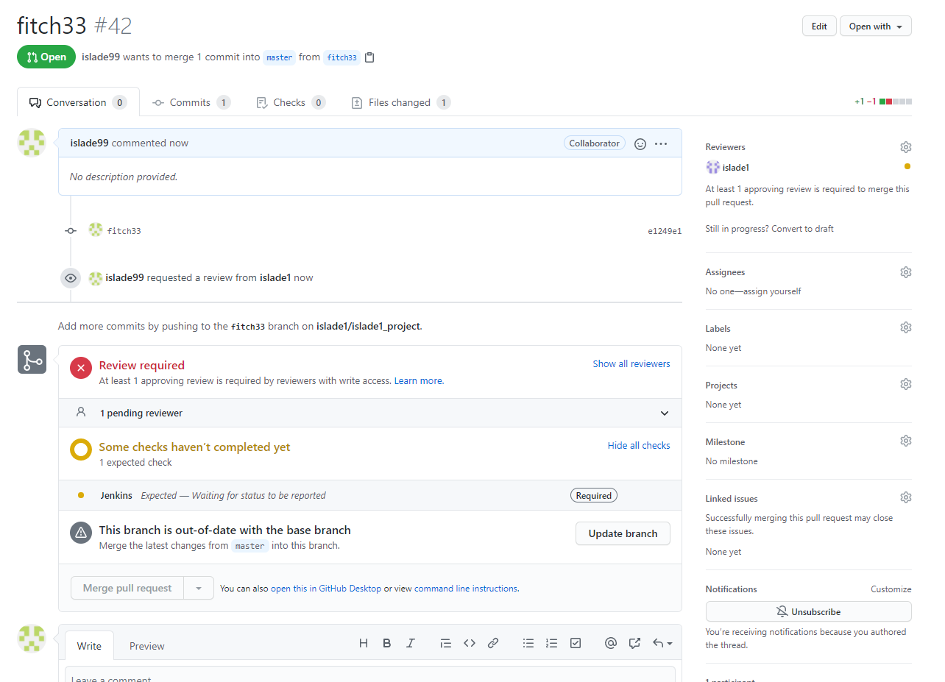
GitHub pull request

Slide 8
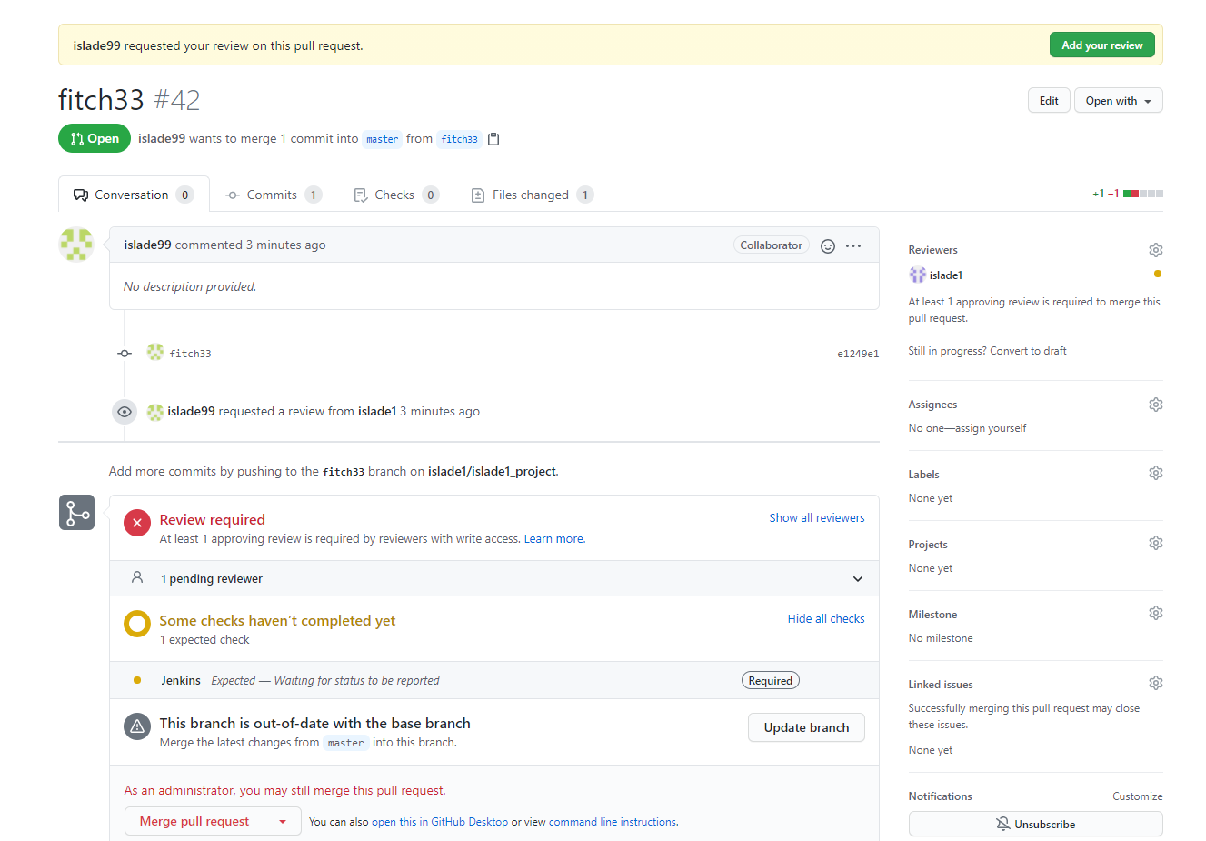
GitHub pull request

Slide 9
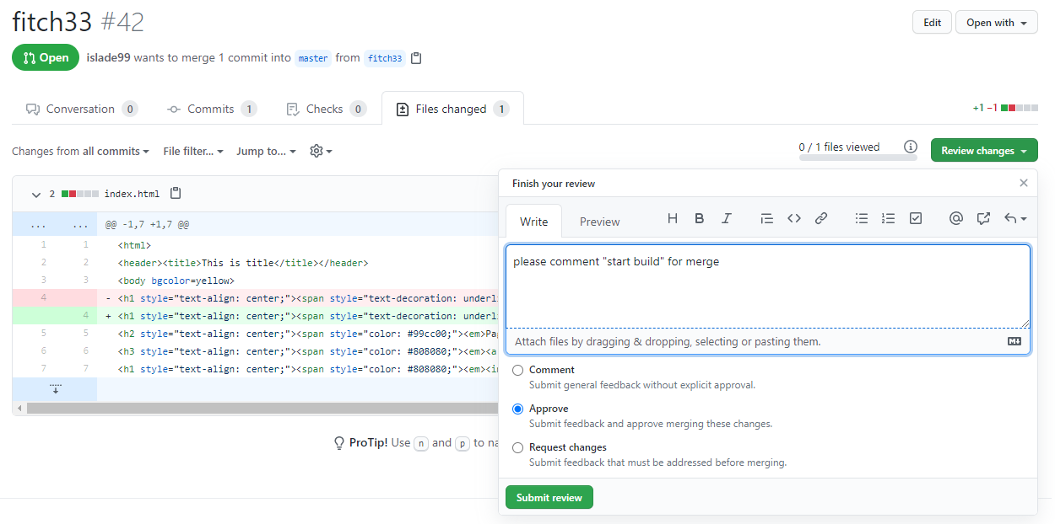
GitHub pull request

Slide 10
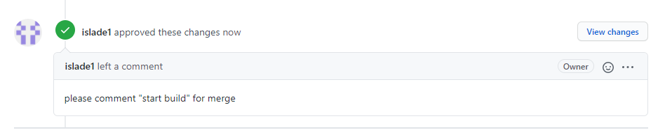
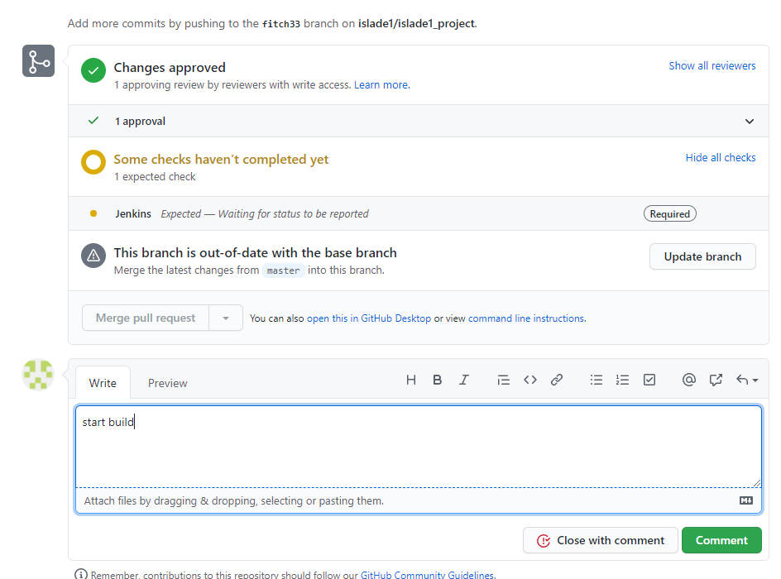
GitHub pull request

Slide 11
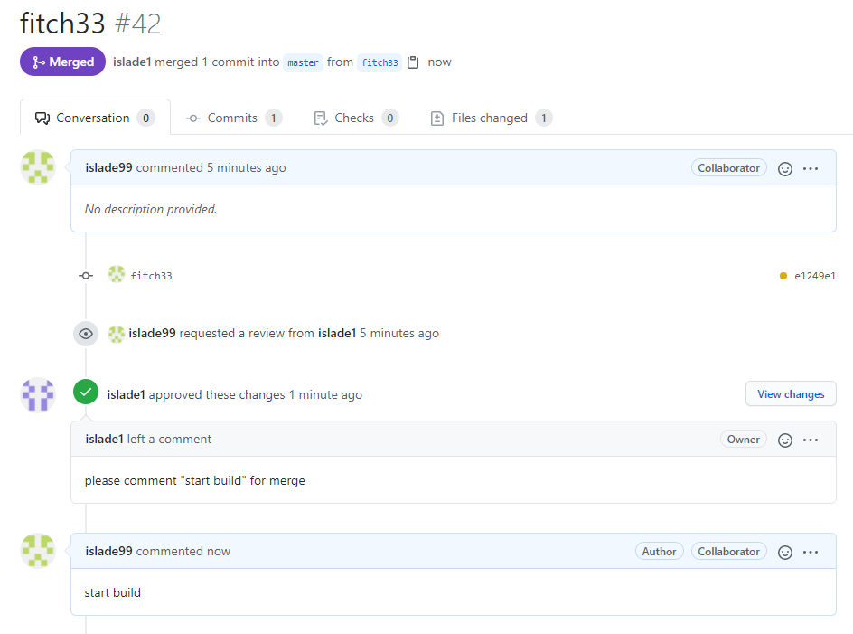
GitHub pull request

Slide 12
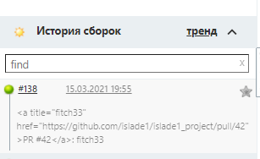
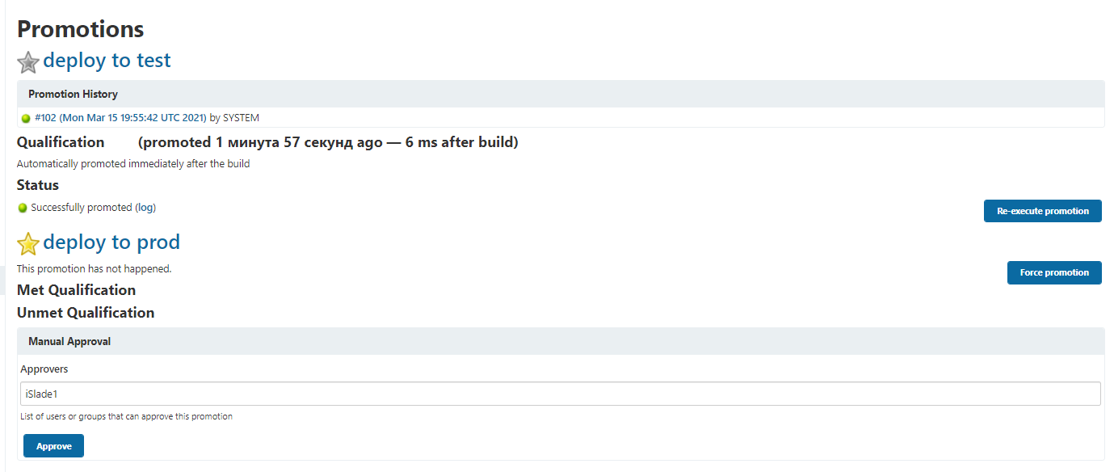
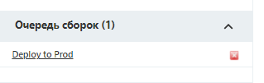
GitHub pull request

Slide 13
Thanks for attention!!! Ready to answer your questions
13

