Slide 1

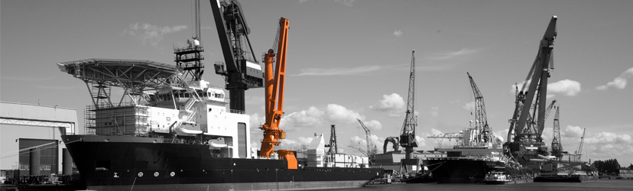
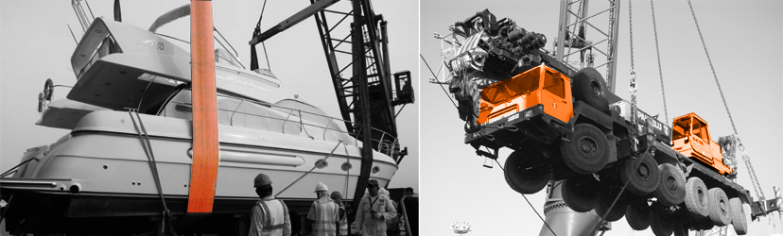

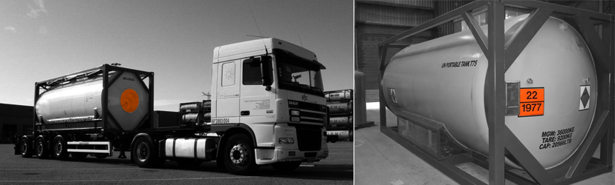
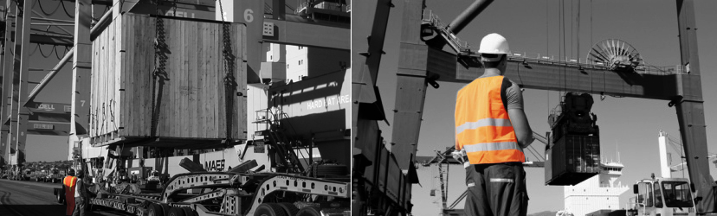

Slide 2
About us
EMT was established in 1996 by a group of well experienced shipping & logistics experts to offer customers a totally new concept for road transport and Logistic activities in Egypt.
In 2008 the decision was made to expand EMT's activities to cover the Middle East and North Africa region due to the lack of reliable freight services to Libya and Gulf countries.
EMT is now one of the leading logistics and overland trucking service providers in the MENA region operating a state of the art fleet that includes, trailers, flatbeds, dry van and reefer trucks. We provide guaranteed daily services to all major cities in the region, handling all types of manufactured goods, consumable, bulk liquids, chemicals, foodstuffs, raw materials and project cargo.
EMT's own offices within Egypt and our network of service partners and transport hubs in the Middle East Region enables us to economically move our customers products from one country to another. Our professional transport engineers and 24/7 operation supervisors monitor all movements for our shipments from origin to final place of delivery through our online tracking system.
Our constant focus on our customer's requirements and recognition of their needs is the key driver for EMT's success and our ability to safely provide the suitable transport and logistics solutions for our clients.

Slide 3
Safety & Quality Assurance
We have always regarded Quality as the foundation of success, and this has always been the prevailing culture among our staff and top management. We have always been committed to quality and this is reflected in our Strategic Management System, which is based on our belief for constant trainings for our staff, providing the best working environment for our staff and customers, constant vigilance and attention of all business aspects, steady feedback from our customers, clear and purposeful approach to health, safety, security and environment and corporate social responsibility.
Our mission, vision and basic philosophy
Our mission is to facilitate trade links in the MENA region and provide customers with a totally new concept for land transportation and logistic services in Egypt and the Middle East and North Africa region. We are one of the most efficient and reliable players in the region and with our totally devoted and self motivated team, we aim at expanding our service network beyond the MENA region. And to build on the company's vision, shared values and basic philosophy, we rely on our governing elements that strengthen our efficiency and ability to develop innovative solutions and becoming more competitive. We are determined to lead and take every opportunity to innovate and meet the ever-changing needs of our customers that drives us forward to developing services, products and solutions. But we never forget the safety and well being of people, society and the environment.

Slide 4
Land Transportation
EMT provides a wide range of trucks meeting all transport requirements within Egypt as well as North Africa & Middle East Region. Our state of the art fleet includes, trailers, flatbeds and refer trucks. We provide guaranteed daily services to all major cities in the region.
EMT has many years of experience in moving all types of manufactured goods, consumable, bulk liquids, chemicals, foodstuffs, raw materials and project cargo. Our professional services is derived from our constant recognition of the needs of our customers and our ability to offer them the suitable transport solution.
EMT's team of professional and fully dedicated trucking managers are on call 24/7 and our trucking supervisors are always present at main loading sites and boarder points overcoming any obstacles to ensure on-time deliveries.
Our Land Transportation services includes:
Container Transport.
Bulk & Break Bulk Transport.
Reefer Transport.
Liquid Transport.
Over size over weight cargo transport.
Furniture & H.H. goods Transport.

Slide 5
Project Management
Our regional connections and know-how, wide geographical knowledge and trusted partners allows EMT to professionally move heavy and oversize project cargo from origin to destination.
EMT 24-hour dedicated transport supervisors and engineers, attend all transport operation stages of heavy and oversized cargoes from place of loading till final project delivery site to guarantee safe and on time deliveries.
Our project cargo handling services include:
Comprehensive logistic solutions by our transportation engineers determining the means and most suitable transportation routes, to overcome any possible obstacles.
Disassembling and re-assembling of complex components and oversized cargoes.
Site survey / feasibility studies for tailor made solutions.
Multimodal transport services for special equipment, choosing best transport means.

Slide 6
Logistics & Supply Chain Management
Supply Chain Management:
Global supply chain management and tailor made services for manufacturers and retailers.
Freight management, Consolidation, warehousing and inventory management for raw materials.
Production and finished goods testing, sample preparation and quality control.
Value Added Services: Promotional packaging, labeling, printing and component assembly.
Cost effective handling, storage, transportation and distribution services.
Transport management and multimodal transportation for best timing and cost concerns.
International freight forwarding, import and export control and tracking system.

Slide 7
Logistics & Supply Chain Management
Sea Freight:
FCL, LCL and special equipment to/from all major ports worldwide.
General cargo – break bulk – RO/RO.
Regular consolidation services.
Specially equipped 20' Flexi-Tank containers for non hazardous liquids.
Specially equipped 20' & 40' containers for hanging garments.
Door to Door deliveries for regular and perishable cargoes.
Worldwide network of overseas partners.
Service contacts with major container lines.
Airfreight:
Efficient bookings on all major airlines at all times.
24-hour services for export traffic & handling of regular and perishable cargoes.
24-hour services for import cargo deliveries to all cities in Egypt.
Network of global partners in all five continents.
Collection at origin, customs clearing and deliveries to final destinations.
Priority with major air carriers for space allocation and special rates.
Consolidation:
Regular sea & air consolidation service to/ from U.S.A., Europe and Far East.
Export and import consolidated sea and air shipments.
Worldwide network of consolidating partners and co-loaders.
Door to Door deliveries to final destinations worldwide.

Slide 8
Logistics & Supply Chain Management
Hanging Garments:
Transporting suits, jackets, trousers,... etc. on hangers wrapped in nylon bags and installed on our locally manufactured *MICANO* installed in van trucks, 20' & 40' FCL containers and by air freight into our specially manufactured cartons.
Fairs & Exhibitions:
Swift clearing up to exhibition stand.
Professional freight handling and storage of empties.
On-time delivery and pickup of exhibitor's shipments.
Packing and Household Removals:
Special nylon wrapped palletization for commercial cargoes.
Regular cartons, corrugated sheets, tailor-made boxes for household goods.
Professional handling of all fragile items till safely placed at final destination.
Modified atmosphere palletization system for fresh produce.

Slide 9
Logistics & Supply Chain Management
Customs Clearance:
EMT is a licensed customs broker since 1996 employing 20 in-house customs brokers working in Customs points and gateways. Our professional and long years experienced customs brokers have long term relations with customs officials and can swiftly clear all types of cargoes to avoiding any delays.
Our Customs Clearance services include:
24-hour service for clearing all export shipments.
pre-clearance approvals, drawback, temporary import, free zone and transit customs clearance for import shipments.
Accompanying customs delegates by EMT customs brokers, and escorting them to factories, farms and other working sites for inspection of goods and finalizing customs formalities at boarder points.
Customs consulting , tariff and commodity interpretation.

Slide 10
Fresh Produce & Reefer cargo Transport
EMT is one of the leading companies in Egypt and the MENA region specialized in the field of fresh produce and reefer cargo handling. Our professional team have many years experience in the handling of citrus, onions, potatoes, frozen vegetables, dairy products, ... etc.
EMT provides all types of required trucks and trailers according to the nature of the transported goods starting from regular flat bed trucks, Side walls and 13.6 m Thermo king reefer trailer units. Our good reputation in this field was derived from our long years experience and our constant focus on our customer's needs for swift and on-time deliveries for such sensitive products with a limited shelf life.
EMT overland reefer trailer services is not only limited to Egypt, North Africa and Arabian Gulf Countries but also extends all the way to Europe and UK through our network of specialized and reliable overseas partners and our long term relations with Ro-Ro vessel owners operating at both Red Sea and Mediterranean region.
Our Perishable cargo services include:
Modern Fleet of flat bed, side walls and 13.6 m Thermo King reefer trailers.
Professional handling of frozen products, fresh vegetables & highly sensitive fruits.
24/7 presence by our customs brokers and supervisors at all Egyptian gateways and boarder points.
Employed customs brokers and supervisors escorting customs delegations to farms, pack-houses and loading stations and immediate issuance of certificate of origins and phyto-sanitary certificates.
PTI for all reefer trailers and constant monitoring by our professional drivers.
Door to Door Sea / Land reefer trailer services to Gulf Countries, UK and European destinations.
Voyage and time charters for ro-ro, ventilated and reefer vessels.

Slide 11
Contact us
Alexandria:
17 Al Farana St., El Sultan Hussein, Alexandria, Egypt.
Tel: +203 4878171 / Fax: +203 4837054
info@emtegypt.com
Cairo:
2 El Bostan St., Behind Fairmont Heliopolis, Cairo, Egypt.
Tel: +202 22684781 / Fax: +202 22667886
Port Said:
Farama Building A, Mohamed Aly St., Port Said, Egypt.
Tel: +2066 3252979 / Fax: +2066 3252979
Damietta:
Damietta Terminal Road, Damietta, Egypt.
Tel: +2057 292027 / Fax: +2057 292027

