Slide 1
MPI practice
Aleksey Doludenko

Slide 2
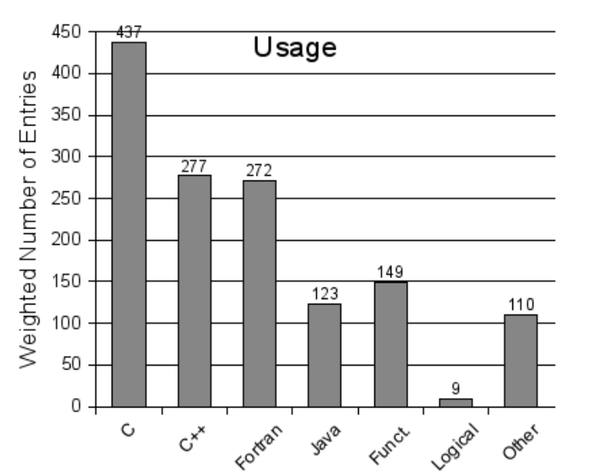
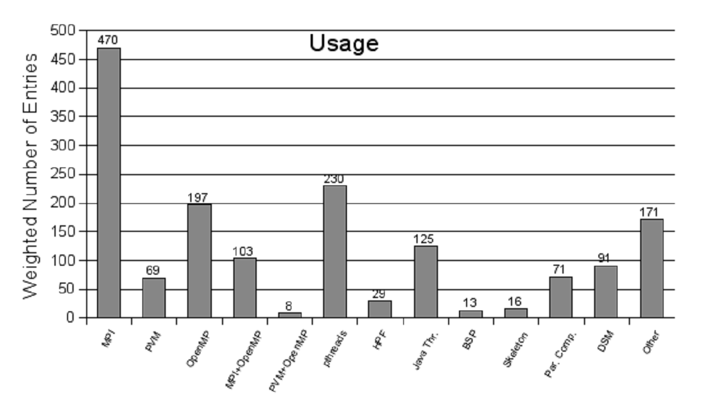
Role and place of parallel languages and libraries
* - по данным опроса
Suess M, Leopold C. Observations on the Publicity and Usage of Paral-
lel Programming Systems and Languages: A Survey Approach. (2007)
The most popular parallel programming languages *
The most popular parallel programming libraries *

Slide 3
History and overview
The message passing interface effort began in the summer of 1991. The draft MPI standard was presented at the Supercomputing '93 conference in November 1993. After a period of public comments, which resulted in some changes in MPI, version 1.0 of MPI was released in June 1994.
MPI is a language-independent communications protocol used to program parallel computers.
MPI is not sanctioned by any major standards body; nevertheless, it has become a de facto standard for communication among processes that model a parallel program running on a distributed memory system.

Slide 4
Concepts
A process is an instance of a computer program that is being executed. A computer program is a passive collection of instructions; a process is the actual execution of those instructions.
Preamble
Preamble
One process
work
Work
process
Work
process
Work
process
Post-processing
Post-processing

Slide 5
Cluster. Host and logins
Login:
pd891XY,
XY is the number
Password:
…
Host
calc.cod.phystech.edu

Slide 6
Some Linux commands
ls - view files in the current directory
pwd - view the path to the current directory
mkdir directory_name - make a new directory
rmdir directory_name - remove the directory
cd directory_name - go to the directory
cd / - go to the root directory
cd .. - go to a higher level
chmod 755 filename - set file execution permissions
ssh –p port login @ remote_machine_name - logging into a remote machine via ssh (Secure Shell), default port equals to 22

Slide 7
Some vi editor commands
vi myfile.c – create a new or open the old file
i – command after which you can enter some text
press Esc, :wq, press Enter – write to the file and exit editor
:q! – press to exit without saving

Slide 8
1st program, part 1
#include<stdio.h>
#include<stdlib.h>
#include<mpi.h> // mpi header file
int main(int argc, char *argv[]){
int i;
int array[10];
int myrank, size;
MPI_Status Status; // mpi data type

Slide 9
1st program, part 2
/* MPI programs start with MPI_Init; all 'N' processes exist thereafter */
MPI_Init(&argc, &argv);
/* find out how big the world of processes is */
MPI_Comm_size(MPI_COMM_WORLD, &size);
/* and this processes' rank is */
MPI_Comm_rank(MPI_COMM_WORLD, &myrank);

Slide 10
Первая программа, часть 3
/* At this point, all proсesses are running equivalently, the rank
distinguishes the roles of the processes in the program, with rank 0 often used specially... */
printf("I am %d of %d\n", myrank, size);
/* MPI programs end with MPI Finalize*/
MPI_Finalize();
return 0;
}

Slide 11
Compilation and running
Before compiling, type in the command line
module add mpi/openmpi4-x86_64
Compilation:
mpicc file_name.c
(by default the executable is named "a.out")
Running:
mpirun -np num_of_processes ./a.out
(num_of_processes is the number!)

Slide 12
1st program, part 4
/* At this point, all proсesses are running equivalently, the rank
distinguishes the roles of the processes in the program, with rank 0 often used specially... */
printf("I am %d of %d\n", rank, size);
if (myrank == 0){
for (i = 0; i < 10; i++){
array[i] = i;
}
/* send to rank 1: */
MPI_Send(&array[5], 5, MPI_INT, 1, 1, MPI_COMM_WORLD) ;
}

Slide 13
1st program, part 5
if (myrank == 1){
/* receive from rank 0: */
MPI_Recv(array, 5, MPI_INT, 0, 1, MPI_COMM_WORLD, &Status);
for (i = 0; i <5; i++){
printf("%d ", array[i]);
}
printf(“\n ");
}

Slide 14
1st program, part 6
/* The MPI program must end using the MPI Finalize function */
MPI_Finalize();
return 0;
}

Slide 15
Compilation and running
Compilation:
mpicc file_name.c
(by default the executable is named "a.out")
Running:
mpirun -np num_of_processes ./a.out
(num_of_processes is the number!)

Slide 16
Some software design
if (myrank == 0){
for (i = 1; i < size; i++){
/* sending messages to processes with ranks i: */
MPI_Send(&buf[i*N/size], N/size, MPI_INT, i, i, MPI_COMM_WORLD) ;
}
}
if (myrank != 0){
/* each of the processes receives a message from the process rank 0*/
MPI_Recv (&buf[0], N/size, MPI_INT, 0, myrank, MPI_COMM_WORLD, &Status);
}

Slide 17
Determining the running time of a parallel program
double MPI_Wtime(void) – returns the astronomical time in seconds (real number) since some point in the past. The difference between the returned values will show the operating time of this section.
Sample:
double begin, end, total;
begin = MPI_Wtime();
….
end = MPI_Wtime();
total = end – begin;

