Slide 1

DiSE Distributed Symmetric Encryption
Peter Rindal
Shashank Agrawal
Payman Mohassel
Pratyay Mukherjee

Slide 2
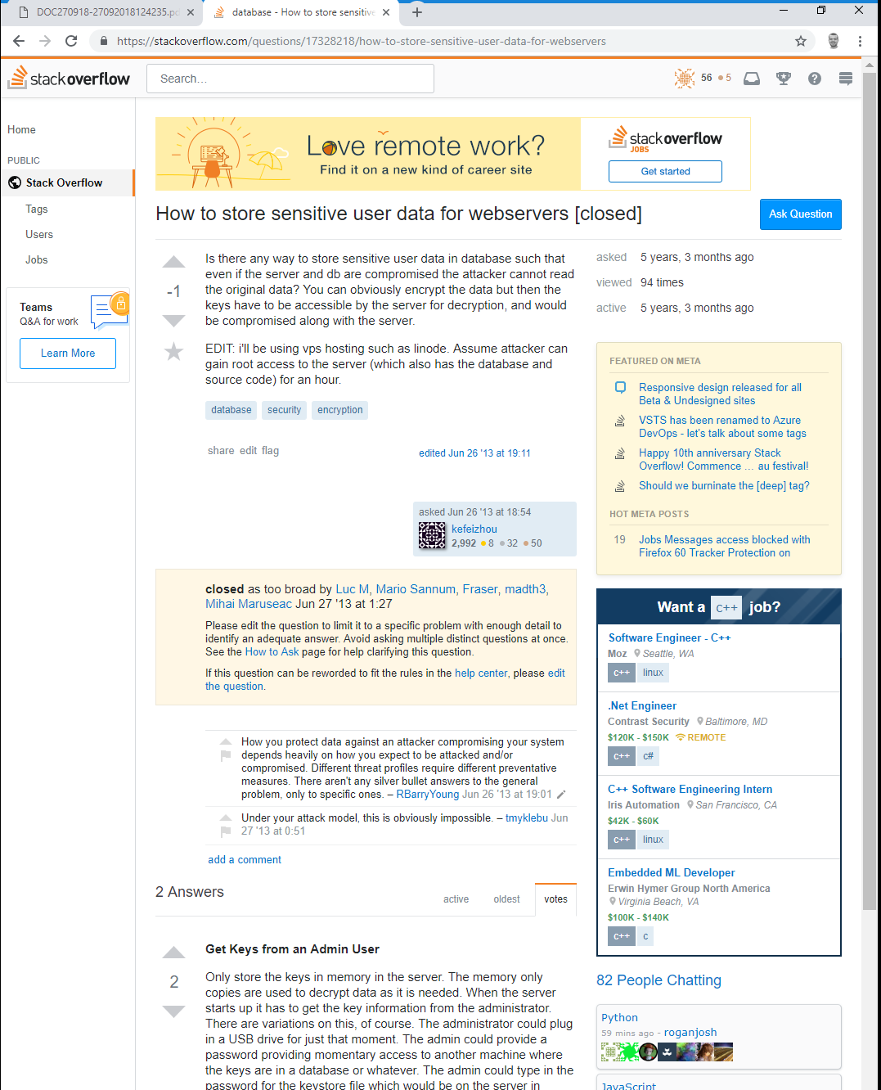

How to store sensitive data?

Slide 3


How to store sensitive data?
Naïve Approach:
Encrypt M and store sk somewhere
Single point of failure
Use secure hardware (HSM)?
Costly
Side-channels
Lacks flexibility
Software only?
Secret Share the key: sk=sk₁+ sk₂ + sk₃
sk₃
C
← ENCRYPT( )
₂
sk
M
,
sk₁

Slide 4
How to store sensitive data?
Naïve Approach:
Encrypt M and store sk somewhere
Single point of failure
Use secure hardware (HSM)?
Costly
Side-channels
Lacks flexibility
Software only?
Secret Share the key: sk=sk₁+ sk₂ + sk₃
Must reconstruct sk to use it…
sk₃
M ← DECRYPT( )
sk
C
sk₂
,
sk₁

Slide 5
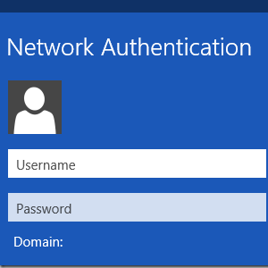
Existing Solutions (w/o Reconstruction)
Threshold Cryptography
Mostly limited to PKI/Signatures [F’89,CG’99,Shoup’00,…,BGGJKRS’18,DKLA’18,…]
Do not meet security/efficiency requirements for symmetric-key
Applications:
Encrypting data & credentials (passwords, tokens, etc.) at rest.
Network authentication/ticket granting (e.g. Kerberos).
Multi-device IoT authentication (e.g. removing trusted hardware on device).

Slide 6
Existing Solutions (w/o Reconstruction)
Threshold Cryptography
Mostly limited to PKI/Signatures [F’89,CG’99,Shoup’00,…,BGGJKRS’18,DKLA’18,…]
Do not meet security/efficiency requirements for symmetric-key
Applications:
Encrypting data & credentials (passwords, tokens, etc.) at rest.
Network authentication/ticket granting (e.g. Kerberos).
Multi-device IoT authentication (e.g. removing trusted hardware on device).
General Purpose MPC
Can compute any function (e.g. encryption/decryption) [DK’10,GRR’16,RSS17,dya].
Strong privacy/correctness.
Large overhead compared to Threshold Cryptography.

Slide 7
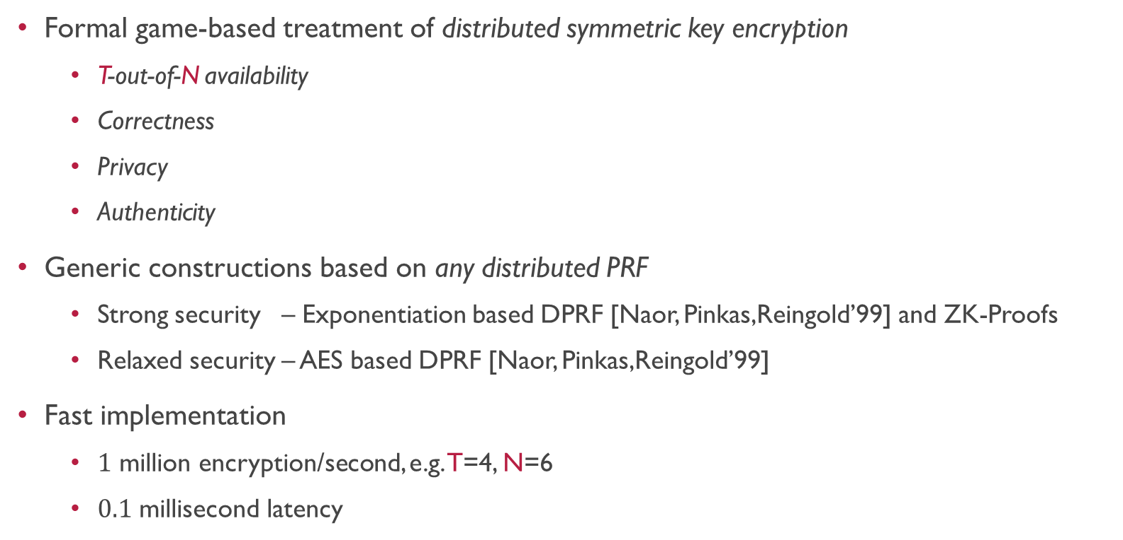
Our Solution
Formal game-based treatment of distributed symmetric key encryption
T-out-of-N availability
Correctness
Privacy
Authenticity
Generic constructions based on any distributed PRF
Strong security – Exponentiation based DPRF [Naor, Pinkas,Reingold’99] and ZK-Proofs
Relaxed security – AES based DPRF [Naor, Pinkas,Reingold’99]
Fast implementation
$1$ million encryption/second, e.g. T=4, N=6
$0.1$ millisecond latency

Slide 8
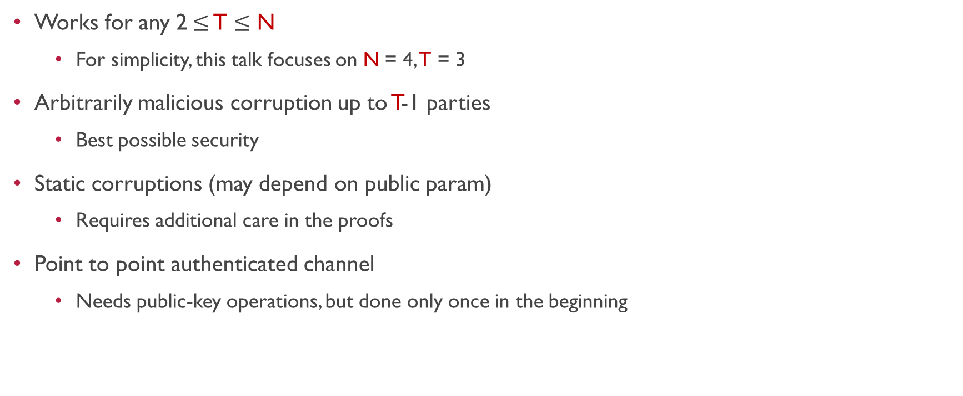
The Setting
Works for any 2$≤$ T $≤$ N
For simplicity, this talk focuses on N = 4, T = 3
Arbitrarily malicious corruption up to T-1 parties
Best possible security
Static corruptions (may depend on public param)
Requires additional care in the proofs
Point to point authenticated channel
Needs public-key operations, but done only once in the beginning
sk₃
M,sk₄
sk₂
sk₁

Slide 9
Definitions
Threshold Symmetric-key Encryption

Slide 10

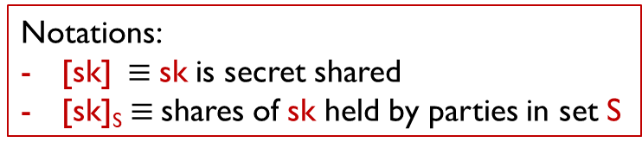
The Framework
Algorithms:
SETUP → [sk]
ENC([sk]_{S},M)→ C
DEC([sk]_{S‘},C)→ M
Consistency: works for any S, S’
S’
sk₃
M,
sk₄
,C
sk₂
S
sk₁
Notations:
[sk]$≡$ sk is secret shared
[sk]_{S} $≡$shares of sk held by parties in set S

Slide 11
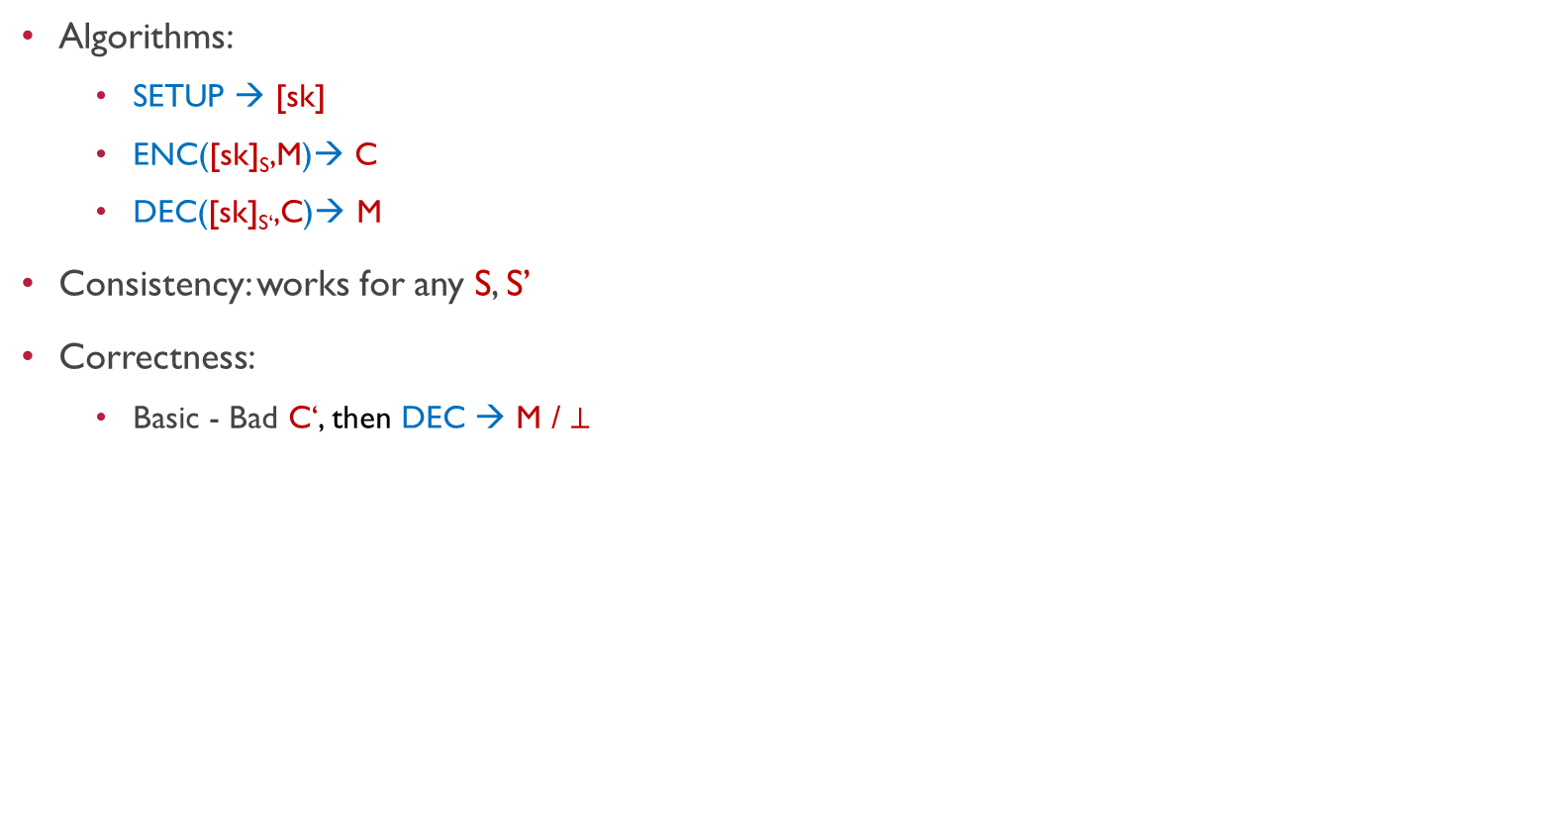

The Framework
Algorithms:
SETUP → [sk]
ENC([sk]_{S},M)→ C
DEC([sk]_{S‘},C)→ M
Consistency: works for any S, S’
Correctness:
Basic - Bad C‘, then DEC → M / $⊥$
ENC([sk]_{S},M)→ C / $\text{C}\text{’}$
sk₃
M,
sk₄
sk₂
sk₁
Notations:
[sk]$≡$ sk is secret shared
[sk]_{S} $≡$shares of sk held by parties in set S

Slide 12


The Framework
Algorithms:
SETUP → [sk]
ENC([sk]_{S},M)→ C
DEC([sk]_{S‘},C)→ M
Consistency: works for any S, S’
Correctness:
Basic - Bad C’, then DEC → M / $⊥$
sk₃
Sk₄,C’
sk₂
DEC([sk]_{S},C’)→ M / $⊥$
sk₁
Notations:
[sk]$≡$ sk is secret shared
[sk]_{S} $≡$shares of sk held by parties in set S

Slide 13


The Framework
Algorithms:
SETUP → [sk]
ENC([sk]_{S},M)→ C
DEC([sk]_{S‘},C)→ M
Consistency: works for any S, S’
Correctness:
Basic - Bad C’, then DEC → M / $⊥$
Strong - Bad C’, then ENC / DEC → $⊥$
ENC([sk]_{S},M)→ C / $⊥$
sk₃
M,
sk₄
sk₂
S
sk₁
Notations:
[sk]$≡$ sk is secret shared
[sk]_{S} $≡$shares of sk held by parties in set S

Slide 14

The Framework
Algorithms:
SETUP → [sk]
ENC([sk]_{S},M)→ C
DEC([sk]_{S‘},C)→ M
Consistency: works for any S, S’
Correctness:
Basic - Bad C’, then DEC → M / $⊥$
Strong - Bad C’, then ENC / DEC → $⊥$
Message Privacy:
ENC / DEC should not reveal M
sk₃
Sk₄
sk₂
M / C
S
sk₁
Notations:
[sk]$≡$ sk is secret shared
[sk]_{S} $≡$shares of sk held by parties in set S

Slide 15

The Framework
Algorithms:
SETUP → [sk]
ENC([sk]_{S},M)→ C
DEC([sk]_{S‘},C)→ M
Consistency: works for any S, S’
Correctness:
Basic - Bad C’, then DEC → M / $⊥$
Strong - Bad C’, then ENC / DEC → $⊥$
Message Privacy:
ENC / DEC should not reveal M
Authenticity:
Adversary can’t “forge” ciphertexts
sk₃
Sk₄
sk₂
sk₁
Notations:
[sk]$≡$ sk is secret shared
[sk]_{S} $≡$shares of sk held by parties in set S

Slide 16




The Framework - Authenticity
Authenticity:
Adversary can’t “forge” ciphertexts
Traditional Authenticity:
Adv. Wins if $c′$ decrypts correctly and $c^{′}∉\{c_{1},c_{2},…\}$
$$m_{1},m_{2},…$$
sk₃
Encryption Oracle
$$c_{1},c_{2},…$$
, M
Sk₄
sk₂
C
$$c^{′}$$
S
sk₁

Slide 17
The Framework - Authenticity
Authenticity:
Adversary can’t “forge” ciphertexts
Adv. initiated ctxt are NOT forgeries
How to define C for malicious Adv.?
Listing these C’s requires extraction...
sk₃
, M
Sk₄
sk₂
C
S
sk₁

Slide 18
The Framework - Authenticity
Authenticity:
Adversary can’t “forge” ciphertexts
Adv. initiated ctxt are NOT forgeries
How to define C for malicious Adv.?
Listing these C’s requires extraction...
Honest initiated ctxt are forgeries
Forgery if Adv can outputs honest parties
sk₃
, M
Sk₄
sk₂
C
S
sk₁

Slide 19
The Framework - Authenticity
Authenticity:
Adversary can’t “forge” ciphertexts
Honest ENC / DEC should not leak C
C would be a forgery
sk₃
, M
Sk₄
sk₂
C
S
sk₁

Slide 20


The Framework - Authenticity
Authenticity:
Adversary can’t “forge” ciphertexts
Adversary can initiate encryptions
C is not a forgery
Idea: Put C on a white list?
C may not be well defined…
Honest ENC / DEC should not leak C
C would be a forgery
Solution:
Let h = number of times the adversary contacts honest parties
Adversary “wins” if they can output more than h ciphertext*
E.g. h = $1$ in the example above
sk₃
Sk₄, M
sk₂
C
S
sk₁
*Assuming: $\text{T}\text{−}\left|𝒜\right|=1$

Slide 21
Construction
DiSE – Distributed Symmetric Encryption

Slide 22



Main Ingredient: Distributed PRF
[Naor-Pinkas-Reingold’99]
Algorithms:
SETUP → [k]
DPRF([k]_{S}, X)→ Y
Public X / private Y
Pseudorandomness: Y is pseudorandom
Two malicious flavors:
Strong – Y is pseudorandom and correct
Weak – Y is pseudorandom
Example protocol:
Shamir Secret Sharing in the exponent
DPRF([k]_{S}, X)$=Xk=X^{λ_{1}k_{1}}⋅X^{λ_{2}k_{2}}⋅X^{λ_{4}k_{4}}$
k₃
X
X
Y₂
k₄
k₂
Y
Y₁
S
k₁
$$=$$
$$Y_{1} ⋅Y_{2} ⋅Y_{4}$$

Slide 23
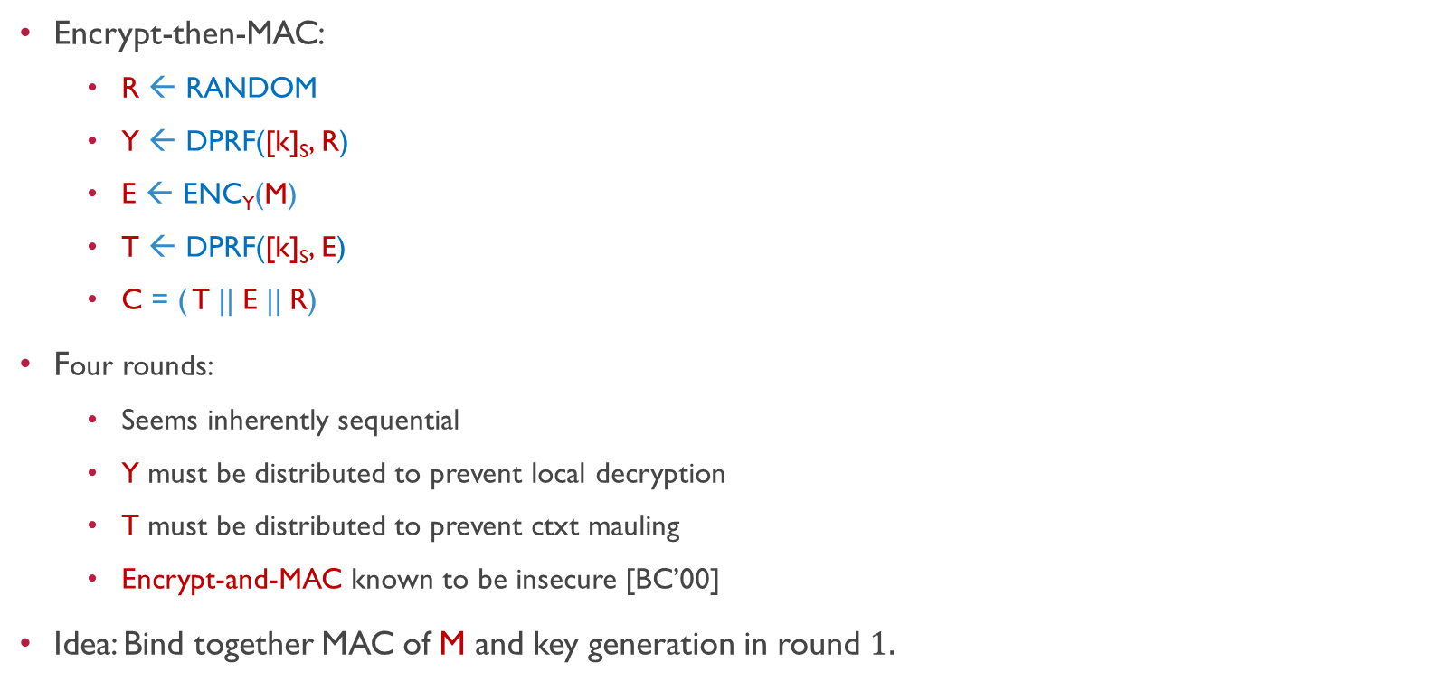
Warmup: 4 Round Protocol
Encrypt-then-MAC:
R ← RANDOM
Y ← DPRF([k]_{S}, R)
E ← ENC_{Y}(M)
T ← DPRF([k]_{S}, E)
C = ( T || E || R)
Four rounds:
Seems inherently sequential
Y must be distributed to prevent local decryption
T must be distributed to prevent ctxt mauling
Encrypt-and-MAC known to be insecure [BC’00]
Idea: Bind together MAC of M and key generation in round $1.$
k₃
R
E
Y₂
T₂
k₄,M
R
k₂
Y
,T
Y₁
E
T₁
k₁

Slide 24

Basic Protocol
Commit-then-Encrypt:
R ← RANDOM
Q ← COMM(M; R)
Y ← DPRF([k]_{S}, Q)
E ← ENC_{Y}(M || R)
C = (Q || E )
Decrypt:
Y ← DPRF([k]_{S}, Q)
(M || R) ← DEC_{Y}(E)
Abort if: Q $≠$COMM(M; R)
k₃
Q
Q
Y₂
k₄,M
k₂
Y
Y₁
k₁

Slide 25
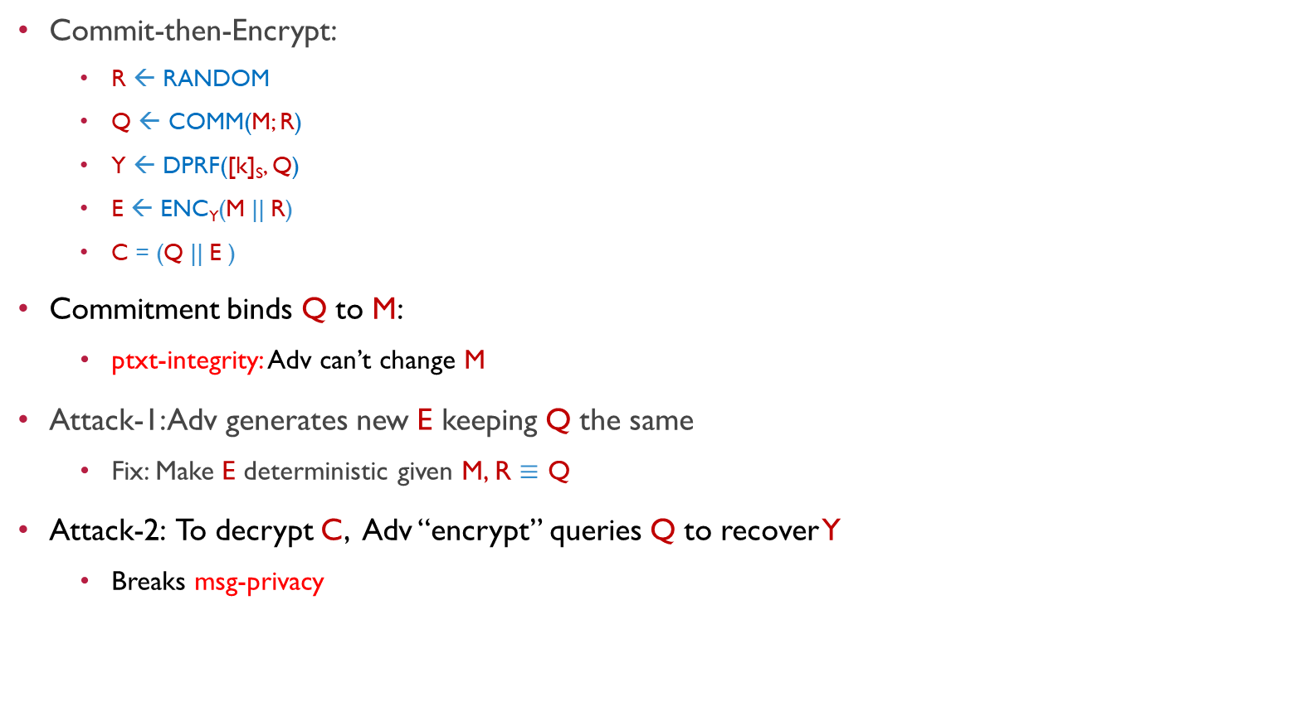
Basic Protocol
Commit-then-Encrypt:
R ← RANDOM
Q ← COMM(M; R)
Y ← DPRF([k]_{S}, Q)
E ← ENC_{Y}(M || R)
C = (Q || E )
Commitment binds Q to M:
ptxt-integrity: Adv can’t change M
Attack-1: Adv generates new E keeping Q the same
Fix: Make E deterministic given M, R $≡$ Q
Attack-2: To decrypt C, Adv “encrypt” queries Q to recover Y
Breaks msg-privacy
k₃
Q
Q
Y₂
k₄,M
k₂
Y
Y₁
k₁

Slide 26
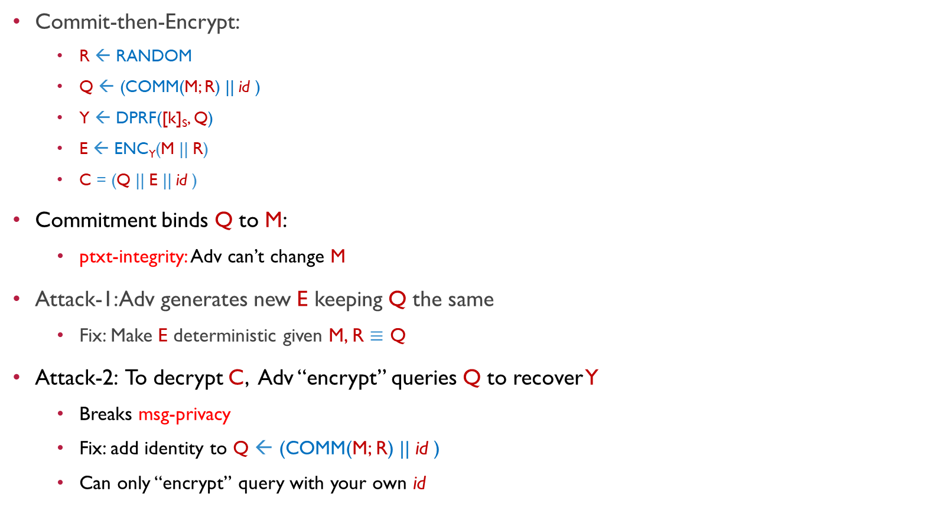
Full Protocol
Commit-then-Encrypt:
R ← RANDOM
Q ← (COMM(M; R) || id )
Y ← DPRF([k]_{S}, Q)
E ← ENC_{Y}(M || R)
C = (Q || E || id )
Commitment binds Q to M:
ptxt-integrity: Adv can’t change M
Attack-1: Adv generates new E keeping Q the same
Fix: Make E deterministic given M, R $≡$ Q
Attack-2: To decrypt C, Adv “encrypt” queries Q to recover Y
Breaks msg-privacy
Fix: add identity to Q ← (COMM(M; R) || id )
Can only “encrypt” query with your own id
k₃
Q
Q
Y₂
k₄,M
k₂
Y
Y₁
k₁

Slide 27
Instantiations
Any DPRF → TSE with Strong Correctness + Privacy + Authenticity
Weak DPRF → TSE with correctness + Privacy + Authenticity
Weak DPRF candidates [NPR’99]:
DP-DDH: based on DDH; Random Oracle; trapdoor commitment
DP-PRF: based on any PRF, works only for small N,T
DPRF candidate (a variant of [NPR’99]):
DP-NIZK: based on DDH; Random Oracle; trapdoor commitment and NIZK
Instantiating we get three TSE protocols:
1. DISE-DDH
2. DISE-PRF
3. DISE-NIZK

Slide 28
Performance
Throughput (Enc/sec)
Parameters:
N = 18;
RO = Blake2;
PRF = AES;
DDH = ECC p256k1;
LAN 10 Gbps, 0.1ms
Threshold (T) | DISE-PRF |  | DISE-DDH |  | DISE-NIZK
 | Enc/sec | Mbps | Enc/sec | Mbps | Enc/sec | Mbps
2 | 1,037,703 | 253 | 553 | 0.14 | 226 | 0.28
6 | 45,434 | 55 | 297 | 0.77 | 64 | 0.40
9 | 10,194 | 20 | 231 | 0.45 | 42 | 0.50
16 | 524,109 | 1919 | 135 | 0.49 | 23 | 0.43
Latency (ms/Enc)
Threshold (T) | DISE-PRF | DISE-DDH | DISE-NIZK
2 | 0.1 | 4.6 | 9.6
6 | 0.6 | 5.4 | 21.5
9 | 1.1 | 8.0 | 31.3
16 | 2.2 | 12.6 | 55.2
- We also implemented for N = 6, 12, 24 and corresponding values of T
- We also implemented over WAN`

Slide 29
Performance (WAN 40 Mbps, 80ms)
Throughput (Enc/sec)
Threshold (T) | DISE-PRF | DISE-DDH | DISE-NIZK
2 | 1,037,703 | 553 | 226
6 | 45,434 | 297 | 64
9 | 10,194 | 231 | 42
16 | 524,109 | 135 | 23
Bandwidth (MBps)
Threshold (T) | DISE-PRF | DISE-DDH | DISE-NIZK
2 | 253 | 0.14 | 0.28
6 | 55 | 0.77 | 0.40
9 | 20 | 0.45 | 0.50
16 | 1919 | 0.49 | 0.43

Slide 30
Summary
We initiate the formal study of Threshold (authenticated) Symmetric Encryption
We propose a generic framework based on any Distributed PRF and many concrete instantiations
Our implementations are extremely fast and scales to a large number of parties
Future directions:
Prevent adversary using decryption queries to encrypt
Dealing with practical features of standard authenticated encryption:
nonce-misuse
multi-user security etc.

Slide 31
Thank you,
let’s DiSE!
Peter Rindal
Shashank Agrawal
Payman Mohassel
Pratyay Mukherjee

