Slide 1

Faster Malicious 2-party Secure Computation with Online/Offline Dual Execution
Peter Rindal
Mike Rosulek

Slide 2










2 Party Computation
Real Protocol
$$x$$
$$y$$
$$f(x,y)$$
$$x$$
Ideal Functionality
$$y$$
$$f$$
$$f(x,y)$$

Slide 3


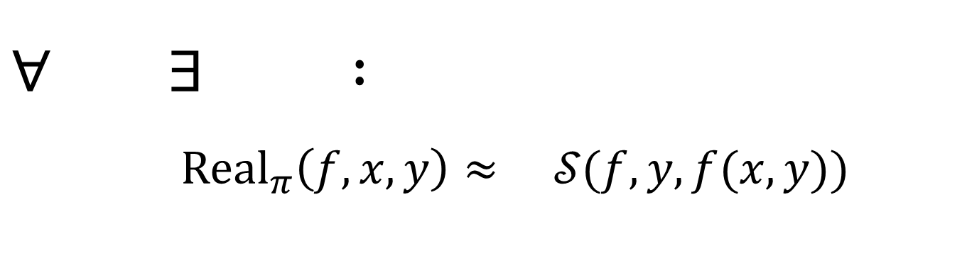
2 Party Computation
Real Protocol
$$x$$
$$y$$
$$f(x,y)$$
Secure against malicious adversaries
Def (simplified):
$∀ ∃ :$ $${Real}_{π}\left(f,x,y\right)≈ 𝒮(f,y, f(x,y))$$
$$𝒮$$
$$𝒮$$
Notes:
We can formalize this notion of security against arbitrarily malicious adv by saying
For all adv. Bob, there should exist a simulator which can generate bob’s view of the protocol. That is, the messages that bob sees and sends.
Crucially, this simulation should only depend on bob's input y and the final result.
In this way, we can formally say that bob can not learn any additional information about Alice's input x…

Slide 4
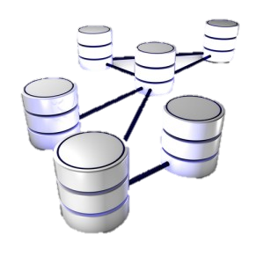


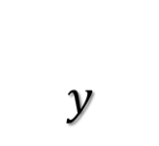
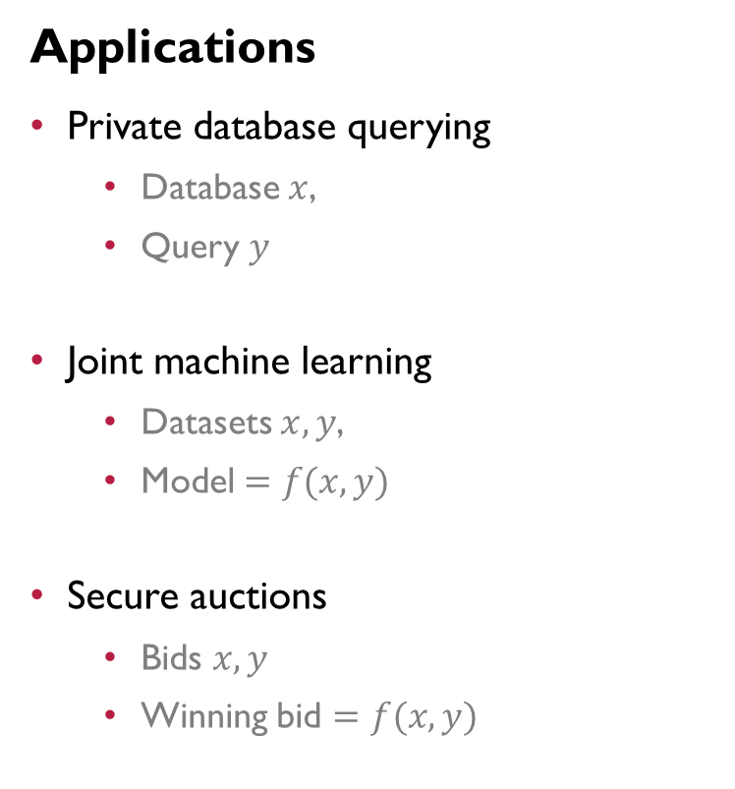



Applications
2-party Secure Computation
Applications
Private database querying
Database $x$,
Query $y$
Joint machine learning
Datasets $x,y$,
Model $=f(x,y)$
Secure auctions
Bids $x,y$
Winning bid $=f(x,y)$
$$x$$
$$y$$
$$f$$
$$f(x,y)$$

Slide 5

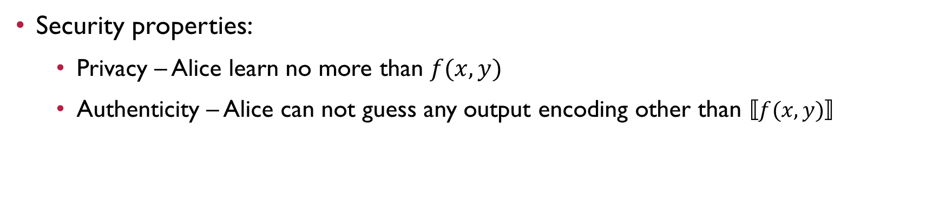





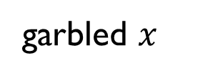


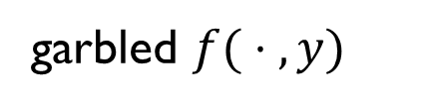
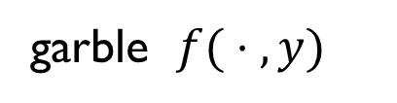

Yao’s Protocol
garble $f( ⋅ ,y)$
$$x$$
$$y$$
$$,$$
$$x$$
$$f\left(⋅,y\right)$$
Yao
OT
garbled $x$
garbled $f( ⋅ ,y)$
def
$$⟦ ⋅ ⟧$$
$$⟦f(x,y)⟧$$
$$=$$
Bob knows
garbled $f\left(x,y\right)$
Security properties:
Privacy – Alice learn no more than $f(x,y)$
Authenticity – Alice can not guess any output encoding other than $⟦f(x,y)⟧$
Notes:
Alice can use this garbled x along with the garbled f to securely evaluate the function and obtain a garbled output encoding of f(x,y).
We will use the notation f(x,y) in the box to denote this garbled output encoding.
Furthermore, because bob generated the garbled f, he knows the full set of output encodings denoted by the dot in the box
There are several important security properties that we get from this protocol, name …
=========================================================
Lets zoom out on this protocol and summarize a little.
Bob provides a function f with his input y hard coded.
Alice provides her input x and receives this authenticated output encoding f(x,y) in the box.
Furthermore, Alice can not forge any other output encoding

Slide 6



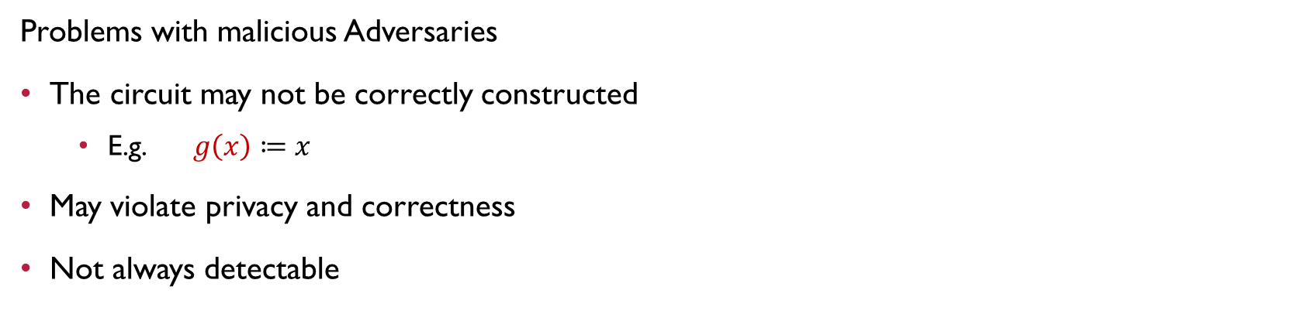
Yao’s Protocol
$$g\left( ⋅ \right)$$
$$x$$
$$y$$
$$x$$
$$g\left( ⋅ \right)$$
Yao
$$⟦g(x)⟧$$
Problems with malicious Adversaries
The circuit may not be correctly constructed
E.g. $g\left(x\right)≔x$
May violate privacy and correctness
Not always detectable
Notes:
One of the major short coming’s of Yao’s protocol is that it is not secure against a malicious Bob who provides the wrong function.
Shown here, Bob inputs the function g which is only a function of alice’s input.
Furthermore, there are only mild restrictions on what g can be.
In fact, Bob can have g simply output alice’s input.
If in the larger context in which the protocol runs ever allows bob to see the output, Alice looses all privacy.
Furthermore, correctness is definitely violated as Alice thought she held an output encoding of f(x,y).
While simply output x may be detectable, in general Bob can be clever and mask how he may be learning addition information.

Slide 7







Dual Execution
[MohasselFranklin06]
$$x$$
$$f( ⋅ ,y)$$
Yao
$$x$$
$$y$$
$${⟦f\left(x,y\right)⟧}_{B}$$
$$⋅ )$$
$$f(x,$$
$$y$$
Yao
$${⟦f\left(x,y\right)⟧}_{A}$$
First Yao secure against Alice.
Second Yao secure against Bob

Slide 8







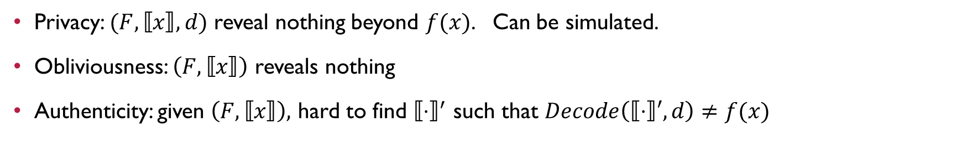



Dual Execution
[MohasselFranklin06]
$$x$$
$$f( ⋅ ,y)$$
Yao
$${⟦ ⋅ ⟧}_{A},$$
$$x$$
$$y$$
$${⟦f\left(x,y\right)⟧}_{B}$$
$$,{⟦ ⋅ ⟧}_{B}$$
$$⋅ )$$
$$f(x,$$
$$y$$
Yao
$${⟦f\left(x,y\right)⟧}_{A}$$
$${⟦f\left(x,y\right) ⟧}_{AB}$$
$${⟦f\left(x,y\right)⟧}_{AB}$$
Eq?
yes / no
Define common encoding:
def
$${⟦z⟧}_{AB} = {⟦z⟧}_{A}⊕{⟦z⟧}_{B}$$

Slide 9




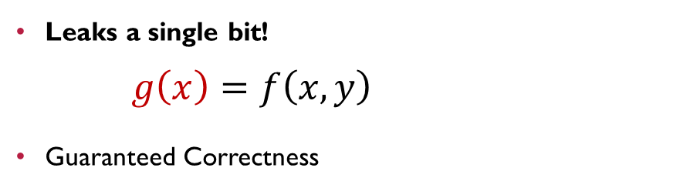



Dual Execution
[MohasselFranklin06]
$$x$$
$$g\left( ⋅ \right)$$
Yao
$$g\left( ⋅ \right)$$
$${⟦ ⋅ ⟧}_{A},$$
$$x$$
$$y$$
$${⟦g\left(x\right)⟧}_{B}$$
$$,{⟦ ⋅ ⟧}_{B}$$
$$⋅ )$$
$$f(x,$$
$$y$$
Yao
$${⟦f\left(x,y\right)⟧}_{A}$$
$${⟦g\left(x\right)⟧}_{AB}$$
$${⟦f\left(x,y\right)⟧}_{AB}$$
Eq?
Define common encoding:
yes / no
Leaks a single bit! $g\left(x\right)=f\left(x,y\right)$
Guaranteed Correctness
$$?$$
def
$${⟦z⟧}_{AB} = {⟦z⟧}_{A}⊕{⟦z⟧}_{B}$$

Slide 10











Improved Dual Execution
[KolesnikovMohasselRivaRosulek15]
$$x$$
$$f$$
$$f$$
$$y$$
$$x$$
$$f$$
$$f$$
$$y$$
$$x$$
$$f$$
$$f$$
$$y$$
$$f$$
$$f$$
$${⟦f(x,y)⟧}_{AB}$$
$${⟦f(x,y)⟧}_{AB}$$
Eq?
Send 𝑠 circuits
Check some for correctness
yes / no

Slide 11









Improved Dual Execution
[KolesnikovMohasselRivaRosulek15]
$$x$$
$$f$$
$$g_{1}$$
$$y$$
$$g\left( ⋅ \right)$$
$$x$$
$$f$$
$$f$$
$$y$$
$$x$$
$$f$$
$$f$$
$$y$$
$$f$$
$$f$$
$${⟦z_{1}⟧}_{AB},$$
$${⟦f(x,y)⟧}_{AB}$$
$${⟦f(x,y)⟧}_{AB}$$
PSI
Eq?
Intersection
Send 𝑠 circuits
Check some for correctness
Use Private Set Intersection (PSI) to reconcile
$$⟦f(x,y)⟧$$
$∀i :$ $g\left(x\right)≠f\left(x,y\right)$
$$Pr\left[leak a bit\right]= 2^{−s}$$
Leakage:

Slide 12



Improved Dual Execution
[KolesnikovMohasselRivaRosulek15]
$$x$$
$$f$$
$$g_{1}$$
$$y$$
$$g\left( ⋅ \right)$$
$$x$$
$$g_{2}$$
$$f$$
$$y$$
$$x$$
$$f$$
$$f$$
$$y$$
$$f$$
$$f$$
$${⟦z_{1}⟧}_{AB},$$
$${⟦z_{2}⟧}_{AB}$$
$${⟦f(x,y)⟧}_{AB}$$
PSI
Eq?
Intersection
Send 𝑠 circuits
Check some for correctness
Use Private Set Intersection (PSI) to reconcile
$⟦f(x,y)⟧$ or $∅$
$∀i :$ $g\left(x\right)≠f\left(x,y\right)$
$$Pr\left[leak a bit\right]= 2^{−s}$$
Leakage:

Slide 13
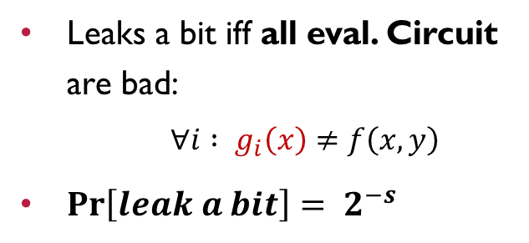
Improved Dual Execution
[KolesnikovMohasselRivaRosulek15]
$$x$$
$$f$$
$$g_{1}$$
$$y$$
$$g\left( ⋅ \right)$$
$$x$$
$$g_{2}$$
$$f$$
$$y$$
$$x$$
$$f$$
$$f$$
$$y$$
$$f$$
$$f$$
$${⟦z_{1}⟧}_{AB},$$
$${⟦z_{2}⟧}_{AB}$$
$${⟦f(x,y)⟧}_{AB}$$
PSI
Eq?
Leaks a bit iff all eval. Circuit are bad:
$∀i :$ $g_{i}\left(x\right)≠f\left(x,y\right)$
$Pr\left[leak a bit\right]= 2^{−s}$
Send 𝑠 circuits
Check some for correctness
Use Private Set Intersection (PSI) to reconcile
$⟦f(x,y)⟧$ or $∅$
$∀i :$ $g\left(x\right)≠f\left(x,y\right)$
$$Pr\left[leak a bit\right]= 2^{−s}$$
Leakage:

Slide 14
















































Online – Offline [LindellRiva14,NeilsenOrlandi08,RRosulek16]
$$f$$
$$f$$
$$f$$
$$f$$
$$f$$
$$f$$
$$f$$
$$f$$
$$f$$
$$f$$
$$f$$
$$f$$
$$f$$
$$f$$
$$f$$
$$f$$
$$f$$
$$f$$
$$f$$
$$f$$
$$f$$
$$f$$
$$f$$
$$f$$
$$f$$
$$f$$
$$f$$
$$f$$
$$f$$
$$f$$
$$f$$
$$f$$
$$f$$
$$f$$
$$f$$
$$f$$
$$f$$
$$f$$
$$f$$
$$f$$
$$f$$
$$f$$
$$f$$
$$f$$
$$f$$
$$f$$
$$f$$
$$f$$
Want to perform $N$ executions of $f$
Construct enough circuits for all $N$ executions

Slide 15

Online – Offline [LindellRiva14,NeilsenOrlandi08,RRosulek16]
$$f$$
$$f$$
$$f$$
$$f$$
$$f$$
$$f$$
$$f$$
$$f$$
$$f$$
$$f$$
$$f$$
$$f$$
$$f$$
$$f$$
$$f$$
$$f$$
$$f$$
$$f$$
$$f$$
$$f$$
$$f$$
$$f$$
$$f$$
$$f$$
$$f$$
$$f$$
$$f$$
$$f$$
$$f$$
$$f$$
$$f$$
$$f$$
$$f$$
$$f$$
$$f$$
$$f$$
$$f$$
$$f$$
$$f$$
$$f$$
$$f$$
$$f$$
$$f$$
$$f$$
$$f$$
$$f$$
$$f$$
$$f$$
Want to perform $N$ executions of $f$
Construct enough circuits for all $N$ executions
Check some for correctness

Slide 16







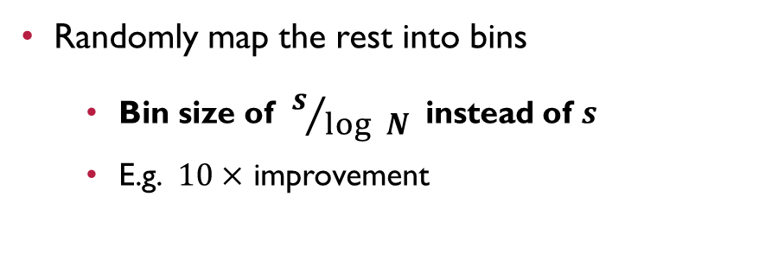

Online – Offline [LindellRiva14,NeilsenOrlandi08,RRosulek16]
$$f$$
$$f$$
$$f$$
$$f$$
$$f$$
$$f$$
$$f$$
$$f$$
$$f$$
$$f$$
$$f$$
$$f$$
$$f$$
$$f$$
$$f$$
$$f$$
$$f$$
$$f$$
$$f$$
$$f$$
$$f$$
$$f$$
$$f$$
$$f$$
$$f$$
$$f$$
$$f$$
$$f$$
$$f$$
$$f$$
$$f$$
$$f$$
$$f$$
$$f$$
$$f$$
$$f$$
$$f$$
$$f$$
$$f$$
$$f$$
$$f$$
$$f$$
$$f$$
$$f$$
$$f$$
$$f$$
$$f$$
$$f$$
$$f$$
$$f$$
$$f$$
$$f$$
$$f$$
$$f$$
$$f$$
$$f$$
Want to perform $N$ executions of $f$
Construct enough circuits for all $N$ executions
Check some for correctness
Randomly map the rest into bins
Bin size of $s/{log N}$ instead of $s$
E.g. $10×$ improvement

Slide 17

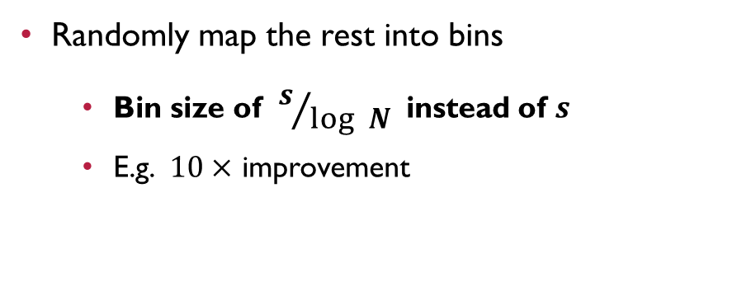







Online – Offline [LindellRiva14,NeilsenOrlandi08,RRosulek16]
$$f$$
$$f$$
$$f$$
$$f$$
$$f$$
$$f$$
$$f$$
$$f$$
$$f$$
$$f$$
$$f$$
$$f$$
$$f$$
$$f$$
$$f$$
$$f$$
$$f$$
$$f$$
$$f$$
$$f$$
$$f$$
$$f$$
$$f$$
$$f$$
$$f$$
$$f$$
$$f$$
$$f$$
$$f$$
$$f$$
$$f$$
$$f$$
$$f$$
$$f$$
$$f$$
$$f$$
$$f$$
$$f$$
$$f$$
$$f$$
$$f$$
$$f$$
$$f$$
$$f$$
$$f$$
$$f$$
$$f$$
$$f$$
$$f$$
$$f$$
$$f$$
$$f$$
$$f$$
$$f$$
$$f$$
$$f$$
$$f$$
$$f$$
$$f$$
$$f$$
$$f$$
$$f$$
$$f$$
$$f$$
Want to perform $N$ executions of $f$
Construct enough circuits for all $N$ executions
Check some for correctness
Randomly map the rest into bins
Bin size of $s/{log N}$ instead of $s$
E.g. $10×$ improvement

Slide 18














Online – Offline [LindellRiva14,NeilsenOrlandi08,RRosulek16]
$$f$$
$$f$$
$$f$$
$$f$$
$$f$$
$$f$$
$$f$$
$$f$$
$$f$$
$$f$$
$$f$$
$$f$$
$$f$$
$$f$$
$$f$$
$$f$$
$$f$$
$$f$$
$$f$$
$$f$$
$$f$$
$$f$$
$$f$$
$$f$$
$$f$$
$$f$$
$$f$$
$$f$$
$$f$$
$$f$$
$$f$$
$$f$$
$$f$$
$$f$$
$$f$$
$$f$$
$$f$$
$$f$$
$$f$$
$$f$$
$$f$$
$$f$$
$$f$$
$$f$$
$$f$$
$$f$$
$$f$$
$$f$$
$$f$$
$$f$$
$$f$$
$$f$$
$$f$$
$$f$$
$$f$$
$$f$$
$$…$$
$$f$$
$$f$$
$$f$$
$$f$$
$$…$$
$$f$$
$$f$$
$$f$$
$$f$$
$$f$$
$$f$$
$$f$$
$$f$$
$$f$$
$$f$$
$$f$$
$$f$$
Want to perform $N$ executions of $f$
Construct enough circuits for all $N$ executions
Check some for correctness
Randomly map the rest into bins
Bin size of $s/{log N}$ instead of $s$
E.g. $10×$ improvement

Slide 19



Online – Offline [LindellRiva14,NeilsenOrlandi08,RRosulek16]
$$f$$
$$f$$
$$f$$
$$f$$
$$f$$
$$f$$
$$f$$
$$f$$
$$f$$
$$f$$
$$f$$
$$f$$
$$f$$
$$f$$
$$f$$
$$f$$
$$f$$
$$f$$
$$f$$
$$f$$
$$f$$
$$f$$
$$f$$
$$f$$
$$f$$
$$f$$
$$f$$
$$f$$
$$f$$
$$f$$
$$f$$
$$f$$
$$f$$
$$f$$
$$f$$
$$f$$
$$f$$
$$f$$
$$f$$
$$f$$
$$f$$
$$f$$
$$f$$
$$f$$
$$f$$
$$f$$
$$f$$
$$f$$
$$f$$
$$f$$
$$f$$
$$f$$
$$f$$
$$f$$
$$…$$
$$f$$
$$f$$
$$…$$
$$f$$
$$f$$
$$f$$
$$f$$
$$f$$
$$f$$
$$f$$
$$f$$
Use one bin per evaluation
$$x$$
$$f$$
$$f$$
PSI
$$f$$
$$f$$
$$y$$
$$f$$
$$f$$
$$f$$
$$f$$
$$⟦f(x,y)⟧$$

Slide 20


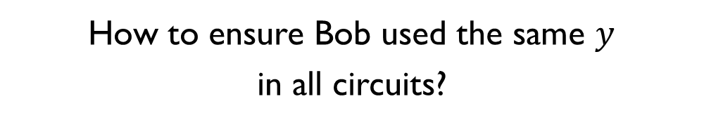









Challenge #$1$: Input Consistency
[RRosulek16]
How to ensure Bob used the same $y$ in all circuits?
$$y$$
$$f$$
$$f$$
PSI
$$f$$
$$f$$
$$f$$
$$f$$
$$f$$
$$f$$

Slide 21
Challenge #$1$: Input Consistency
[RRosulek16]
How to ensure Bob used the same $y$ in all circuits?
Circuit generated by Alice
Bob receives input via OT [easy]
$$y$$
$$f$$
$$f$$
PSI
$$f$$
$$f$$
$$f$$
$$f$$
$$f$$
$$f$$

Slide 22
Challenge #$1$: Input Consistency
[RRosulek16]
How to ensure Bob used the same $y$ in all circuits?
Circuit generated by Alice
Bob receives input via OT [easy]
Circuit generated by Bob [hard]
$$y$$
$$f$$
$$f$$
PSI
$$f$$
$$f$$
$$f$$
$$f$$
$$f$$
$$f$$

Slide 23

Challenge #$1$: Input Consistency
[RRosulek16]
How to ensure Bob used the same $y$ in all circuits?
Circuit generated by Alice
Bob receives input via OT [easy]
Circuit generated by Bob [hard]
In the offline, Bob tells Alice the relationship between the two arrows
Alice check in the cut and choose
$$y$$
$$f$$
$$f$$
PSI
$$f$$
$$f$$
$$f$$
$$f$$
$$f$$
$$f$$

Slide 24
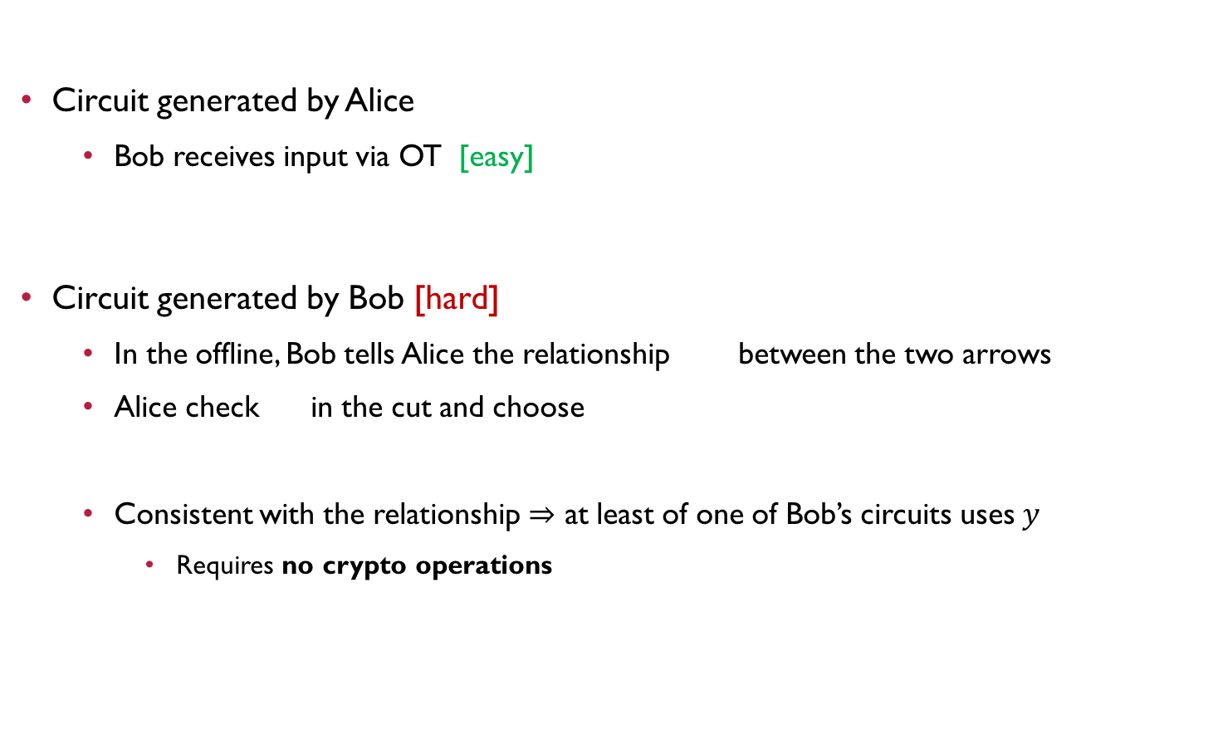
Challenge #$1$: Input Consistency
[RRosulek16]
How to ensure Bob used the same $y$ in all circuits?
Circuit generated by Alice
Bob receives input via OT [easy]
Circuit generated by Bob [hard]
In the offline, Bob tells Alice the relationship between the two arrows
Alice check in the cut and choose
Consistent with the relationship $⇒$ at least of one of Bob’s circuits uses $y$
Requires no crypto operations
$$y$$
$$f$$
$$f$$
PSI
$$f$$
$$f$$
$$f$$
$$f$$
$$f$$
$$f$$

Slide 25



Challenge #$2$: Private Set Intersection (PSI)
[RRosulek16]
Build PSI from Private Equality Test
Fastest PSI protocol
[PinkasSchneiderZohner14]
$$f$$
$$f$$
PSI
$$f$$
$$f$$
$$f$$
$$f$$
$$f$$
$$f$$
$$X$$
$$Y$$

Slide 26
Challenge #$2$: Private Set Intersection (PSI)
[RRosulek16]
Build PSI from Private Equality Test
Fastest PSI protocol
[PinkasSchneiderZohner14]
Issues: Not malicious secure in general
Can not be simulated
$$f$$
$$f$$
PSI
$$f$$
$$f$$
$$f$$
$$f$$
$$f$$
$$f$$
$$X$$
$$Y$$

Slide 27



Challenge #$2$: Private Set Intersection (PSI)
[RRosulek16]
Build PSI from Private Equality Test
Fastest PSI protocol
[PinkasSchneiderZohner14]
Issues: Not malicious secure in general
Can not be simulated
Ex: singleton set
$$f$$
$$f$$
PSI
$$f$$
$$f$$
$$f$$
$$f$$
$$f$$
$$f$$
$$\{$$
$$X= \begin{matrix}a \\ b \\ c\end{matrix}$$
$$a$$

Slide 28

Challenge #$2$: Private Set Intersection (PSI)
[RRosulek16]
Build PSI from Private Equality Test
Fastest PSI protocol
[PinkasSchneiderZohner14]
Issues: Not malicious secure in general
Can not be simulated
Ex: singleton set
$$f$$
$$f$$
PSI
$$f$$
$$f$$
$$f$$
$$f$$
$$f$$
$$f$$
$$\{$$
$$X= \begin{matrix}a \\ b \\ c\end{matrix}$$
$$b$$
$$a$$

Slide 29

Challenge #$2$: Private Set Intersection (PSI)
[RRosulek16]
Build PSI from Private Equality Test
Fastest PSI protocol
[PinkasSchneiderZohner14]
Issues: Not malicious secure in general
Can not be simulated
Ex: singleton set
$$f$$
$$f$$
PSI
$$f$$
$$f$$
$$f$$
$$f$$
$$f$$
$$f$$
$$\{$$
$$X= \begin{matrix}a \\ b \\ c\end{matrix}$$
$$c$$
$$b$$
$$a$$

Slide 30





Challenge #$2$: Private Set Intersection (PSI)
[RRosulek16]
Ideal: Bob only knows one valid PSI input $⟦f(x,y)⟧$
Simulator doesn’t need to extract Bob input!
Just test if it contains $⟦f(x,y)⟧$
Build PSI from Private Equality Test
Fastest PSI protocol
[PinkasSchneiderZohner14]
Issues: Not malicious secure in general
Can not be simulated
Ex: singleton set
$$f$$
$$f$$
PSI
$$f$$
$$f$$
$$f$$
$$f$$
$$f$$
$$f$$
$$⟦z_{1}⟧$$
$$⟦z_{2}⟧$$
$$⟦f(x,y)⟧$$
$$⟦z_{3}⟧$$

Slide 31

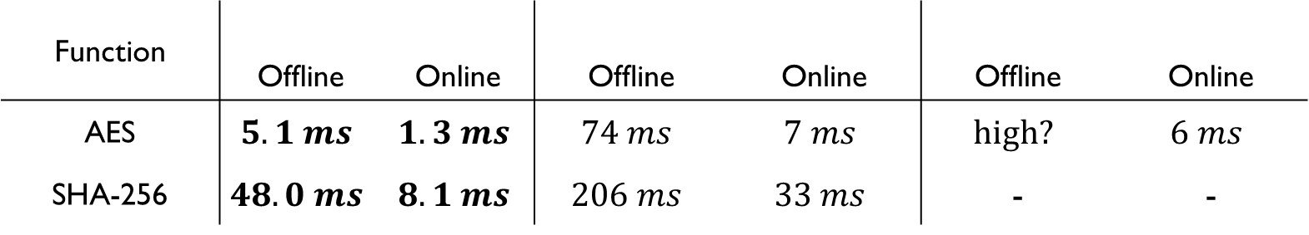
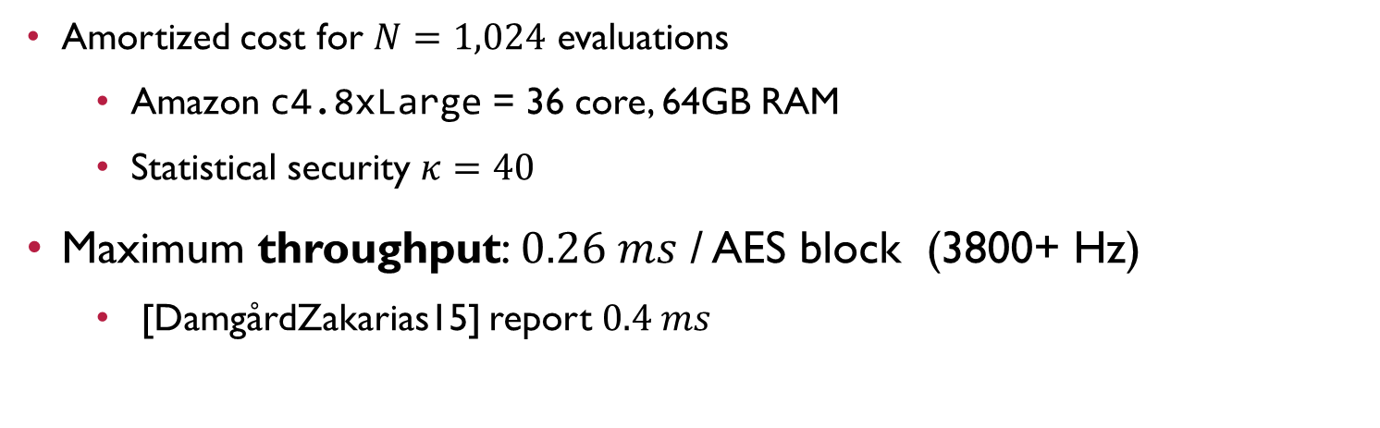
Performance
[RRosulek16]
[DamgårdZakarias15]
Function
 | Offline | Online | Offline | Online | Offline | Online
AES | $$5.1 ms$$ | $$1.3 ms$$ | $$74 ms$$ | $$7 ms$$ | $$high?$$ | $$6 ms$$
SHA-256 | $$48.0 ms$$ | $$8.1 ms$$ | $$206 ms$$ | $$33 ms$$ | - | -
[LindellRiva15]
Amortized cost for $N=1,024$ evaluations
Amazon c4.8xLarge = 36 core, 64GB RAM
Statistical security $κ=40$
Maximum throughput: $0.26 ms$ / AES block (3800+ Hz)
[DamgårdZakarias15] report $0.4 ms$

Slide 32





Total Protocol Times for AES
[PSSW] $$18 min$$
[KSS]
$$3.4 sec$$
[FN] $$0.8 sec$$
[LR15] $$81 ms$$
[RR16] $$6 ms$$

Slide 33
Total Protocol Times for AES
[PSSW] $$18 min$$
[KSS]
$$3.4 sec$$
[FN] $$0.8 sec$$
[LR15] $$81 ms$$
[RR16] $$6 ms$$

Slide 34
Total Protocol Times for AES
[PSSW] $$18 min$$
64-node cluster
Consumer GPU
AWS c4.8xLarge
[KSS]
$$3.4 sec$$
[FN] $$0.8 sec$$
[LR15] $$81 ms$$
[RR16] $$6 ms$$

Slide 35
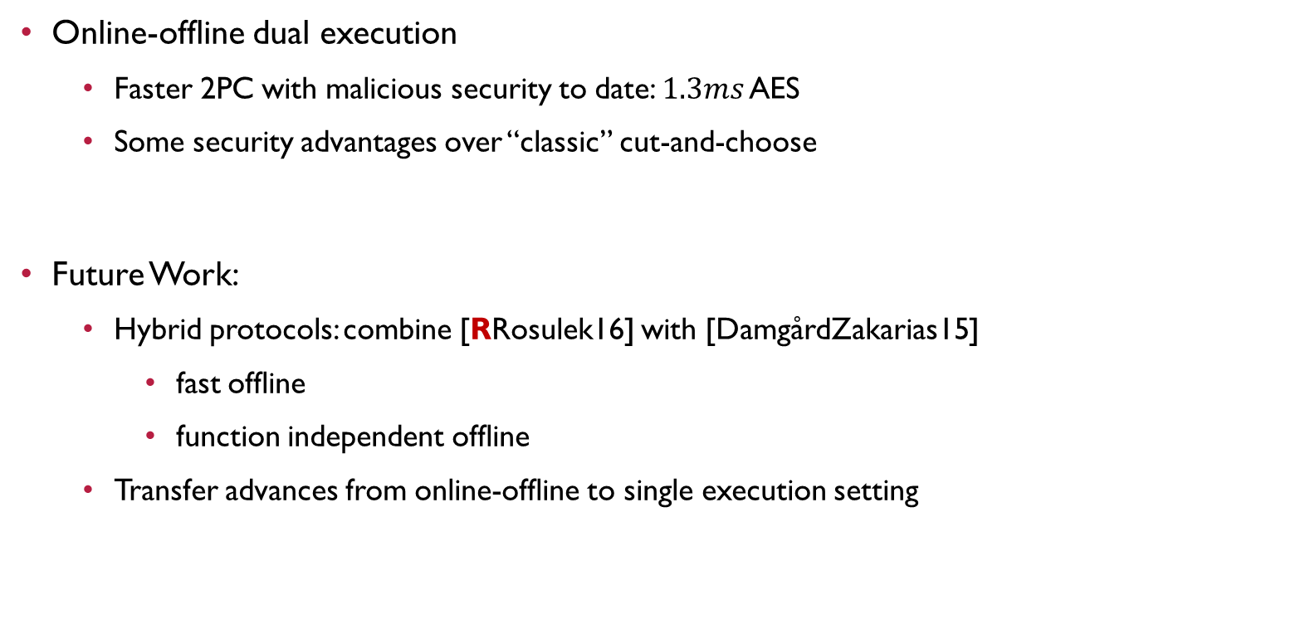
Summary
Online-offline dual execution
Faster 2PC with malicious security to date: $1.3ms$ AES
Some security advantages over “classic” cut-and-choose
Future Work:
Hybrid protocols: combine [RRosulek16] with [DamgårdZakarias15]
fast offline
function independent offline
Transfer advances from online-offline to single execution setting

Slide 36
The End
Thanks
Faster Malicious 2-party Secure Computation with Online/Offline Dual Execution
github.com/osu-crypto/batchDualEx
Peter Rindal
Mike Rosulek

Slide 37
Paper and implementation
To appear in Usenix ’16
ePrint 2016/632
Implementation,
https://github.com/osu-crypto/batchDualEx/
“Faster Malicious 2-party Secure Computation
with Online/Offline Dual Execution”

Slide 38
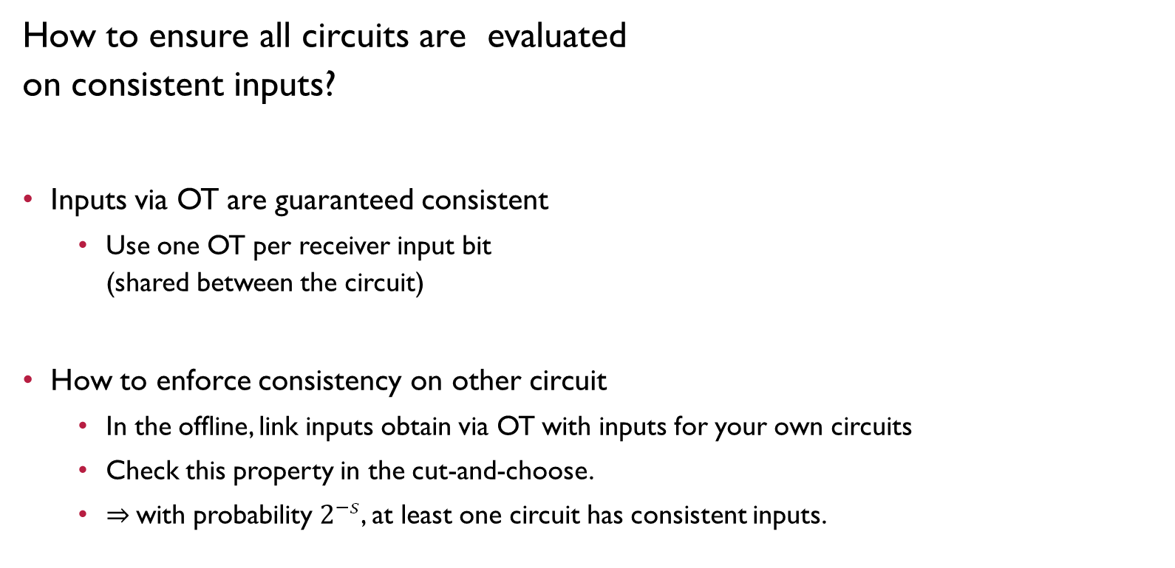
Challenge #$1$: Input Consistency
How to ensure all circuits are evaluated on consistent inputs?
Inputs via OT are guaranteed consistent
Use one OT per receiver input bit (shared between the circuit)
How to enforce consistency on other circuit
In the offline, link inputs obtain via OT with inputs for your own circuits
Check this property in the cut-and-choose.
$⇒$with probability $2^{−s}$, at least one circuit has consistent inputs.
Yao
Yao
Yao
Yao

Slide 39

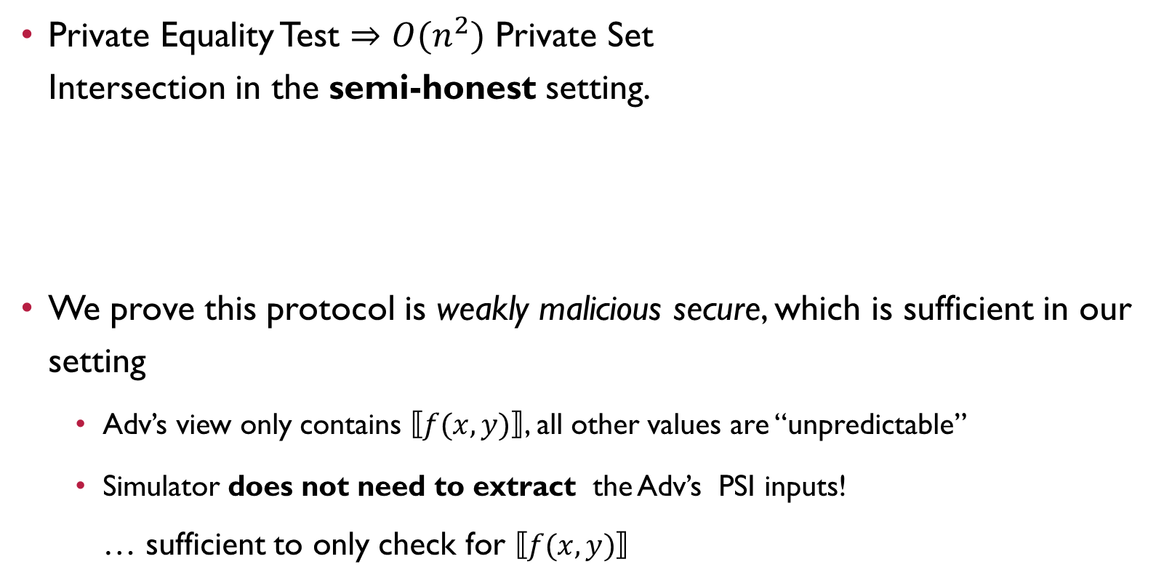

Private Set Intersection
[PinkasSchneiderZohner14, RRosulek16]
Private Equality Test $⇒O(n^{2})$ Private Set Intersection in the semi-honest setting.
We prove this protocol is weakly malicious secure, which is sufficient in our setting
Adv’s view only contains $⟦f(x,y)⟧$, all other values are “unpredictable”
Simulator does not need to extract the Adv’s PSI inputs! … sufficient to only check for $⟦f(x,y)⟧$
$${\left\{⟦z_{i}⟧\right\}}_{i}$$
$$\left\{⟦f\left(x,y\right)⟧\right\}$$

Slide 40






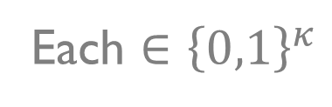





Private Set Intersection Warmup
[PinkasSchneiderZohner14]
$$?$$
Input: Alice has $x$, Bob has $y$ Output: $x=y$
Example: $x=001, y=011$
Each $∈{\left\{0,1\right\}}^{κ}$
0 | 1
0 | 1
0 | 1
$$OT$$
0
 | 1
 | 1
…
$$OT$$
$$?$$
0
$$⊕$$
0
$$⊕$$
1
$$=:$$
$$=$$
0
$$⊕$$
1
$$⊕$$
1

Slide 41



Technical Challenges
Input Consistency
Only online $O\left(n\right)$ decommits
PSI reconciliation
Very light weight malicious PSI
Only weak security required
Yao
Yao
Yao
Yao
$$\left\{{⟦z_{1}⟧}_{B}\right\}$$
$$\{{⟦z_{1}⟧}_{A}\}$$
PSI

Slide 42



























Online – Offline [LindellRiva14,NeilsenOrlandi08,RRosulek16]
$$f$$
$$f$$
$$f$$
$$f$$
$$f$$
$$f$$
$$f$$
$$f$$
$$f$$
$$f$$
$$f$$
$$f$$
$$f$$
$$f$$
$$f$$
$$f$$
$$f$$
$$f$$
$$f$$
$$f$$
$$f$$
$$f$$
$$f$$
$$f$$
$$f$$
$$f$$
$$f$$
$$f$$
$$f$$
$$f$$
$$f$$
$$f$$
$$f$$
$$f$$
$$f$$
$$f$$
$$f$$
$$f$$
$$f$$
$$f$$
$$f$$
$$f$$
$$f$$
$$f$$
$$f$$
$$f$$
$$f$$
$$f$$
$$f$$
$$f$$
$$f$$
$$f$$
$$f$$
$$f$$
$$…$$
$$f$$
$$f$$
$$…$$
$$f$$
$$f$$
$$f$$
$$f$$
$$f$$
$$f$$
$$f$$
$$f$$
$$f$$
$$f$$
PSI
$$f$$
$$f$$
$$f$$
$$f$$
$$f$$
$$f$$
$⟦f(x,y)⟧$ or $∅$

Slide 43



















































Online – Offline [LindellRiva14,NeilsenOrlandi08,RRosulek16]
Want to perform $N$ executions of $f$
Construct enough circuits for all $N$ executions
Check some e.g. $1/5$
Later we get inputs and evaluate
Evaluate a random set of $O\left(\frac{s}{\log{N}}\right)$ circuits, e.g. 3 circuits
Perform a Private set intersection on the output
$$f$$
$$f$$
$$f$$
$$f$$
$$f$$
$$f$$
$$f$$
$$f$$
$$f$$
$$f$$
$$f$$
$$f$$
$$f$$
$$f$$
$$f$$
$$f$$
$$f$$
$$f$$
$$f$$
$$f$$
$$f$$
$$f$$
$$f$$
$$f$$
$$f$$
$$f$$
$$f$$
$$f$$
$$f$$
$$f$$
$$f$$
$$f$$
$$f$$
$$f$$
$$f$$
$$f$$
$$f$$
$$f$$
$$f$$
$$f$$
$$f$$
$$f$$
$$f$$
$$f$$
$$f$$
$$f$$
$$f$$
$$f$$
PSI
$$Pr\left[leak a bit\right]= 2^{−s}$$
$$f\left(x,y\right)$$

Slide 44

Online – Offline [LindellRiva14,NeilsenOrlandi08,RRosulek16]
Want to perform $N$ executions of $f$
Construct enough circuits for all $N$ executions
$$f$$
$$f$$
$$f$$
$$f$$
$$f$$
$$f$$
$$f$$
$$f$$
$$f$$
$$f$$
$$f$$
$$f$$
$$f$$
$$f$$
$$f$$
$$f$$
$$f$$
$$f$$
$$f$$
$$f$$
$$f$$
$$f$$
$$f$$
$$f$$
$$f$$
$$f$$
$$f$$
$$f$$
$$f$$
$$f$$
$$f$$
$$f$$
$$f$$
$$f$$
$$f$$
$$f$$
$$f$$
$$f$$
$$f$$
$$f$$
$$f$$
$$f$$
$$f$$
$$f$$
$$f$$
$$f$$
$$f$$
$$f$$

Slide 45







Dual Execution
[KolesnikovMohasselRivaRosulek15]
$$x$$
$$f$$
$$f$$
$$y$$
$$g\left( ⋅ \right)$$
$$x$$
$$g$$
$$f$$
$$y$$
$$x$$
$$f$$
$$f$$
$$y$$
$$f$$
$$f$$
$${⟦z_{2}⟧}_{B},{⟦z_{3}⟧}_{B}$$
$${⟦z_{2}⟧}_{B}$$
$${⟦z_{2}⟧}_{A},{⟦z_{4}⟧}_{A}$$
PSI
Send 𝑠 circuits in both direction
Check some for correctness
$$⟦z_{∗}⟧$$

Slide 46




Dual Execution
[KolesnikovMohasselRivaRosulek15]
$$x$$
Yao
$$y$$
Yao
Yao
Yao
$$y$$
$$x$$
$$x$$
Yao
$$y$$
Yao
Yao
Yao
$${⟦z_{1}⟧}_{B},{⟦z_{n}⟧}_{B}$$
$${⟦z_{1}⟧}_{A},{⟦z_{n}⟧}_{A}$$
PSI
Send 𝑠 circuits in both direction
Check some for correctness

Slide 47
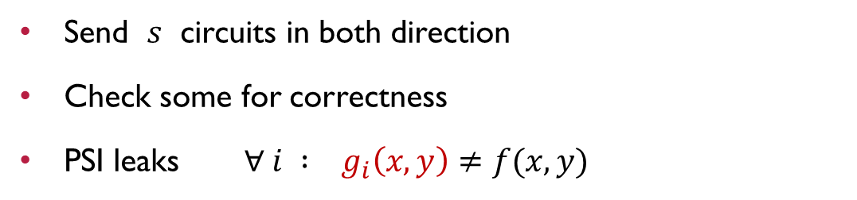



Dual Execution
[KolesnikovMohasselRivaRosulek15]
$$x$$
Yao
$$g( ⋅ )$$
Yao
Yao
Yao
$$y$$
$$x$$
$$x$$
Yao
$$y$$
Yao
Yao
Yao
$${⟦z_{1}⟧}_{B},{⟦z_{n}⟧}_{B}$$
$${⟦z_{1}⟧}_{A},{⟦z_{n}⟧}_{A}$$
PSI
Send 𝑠 circuits in both direction
Check some for correctness
PSI leaks $∀ i : g_{i}\left(x,y\right)≠f(x,y)$
$$Pr\left[leak a bit\right]= 2^{−s}$$

Slide 48
Dual Execution
[KolesnikovMohasselRivaRosulek15]
$$x$$
Yao
$$g( ⋅ )$$
Yao
Yao
Yao
$$y$$
$$x$$
$$x$$
Yao
$$y$$
Yao
Yao
Yao
$${⟦z_{1}⟧}_{B},{⟦z_{n}⟧}_{B}$$
$${⟦z_{1}⟧}_{A},{⟦z_{n}⟧}_{A}$$
PSI
Send 𝑠 circuits in both direction
Check some for correctness
PSI leaks $∀ i : g_{i}\left(x,y\right)≠f(x,y)$
$$Pr\left[leak a bit\right]= 2^{−s}$$

Slide 49
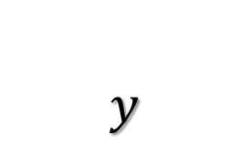


2 Party Computation
Ideal functionality
$$f$$
$$x$$
$$y$$
$$f(x,y)$$

Slide 50
2 Party Computation
Real Protocol
$$x$$
$$y$$
$$f(x,y)$$
Secure against malicious adversaries

Slide 51
2 Party Computation
Ideal functionality
$$f$$
$$x$$
$$y$$
$$f(x,y)$$
Secure against malicious adversaries

Slide 52

Yao’s Protocol
$$x$$
$$y$$
$$x$$
$$f\left(⋅,y\right)$$
Yao
$$f(x,y)$$

