Slide 1


Faster Malicious 2-party Secure Computation with Online/Offline Dual Execution
Peter Rindal
Mike Rosulek

Slide 2





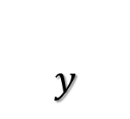



Applications and techniques
Applied Cryptography track @ 4:30
2-party Secure Computation
Applications
Private database querying
Joint machine learning
Secure auctions
$$x$$
$$y$$
$$f$$
$$f(x,y)$$
Notes:
Secure two party computation is a class of interactive protocols that allows Alice and Bob to evaluate a function on their private inputs. That is, Bob should learn f(x,y) and nothing more about Alice’s input.
Secure two party computation has a number of applications ranging from improved privacy for database queries, to machine learning on private data, and many other applications such as auctions.

Slide 3









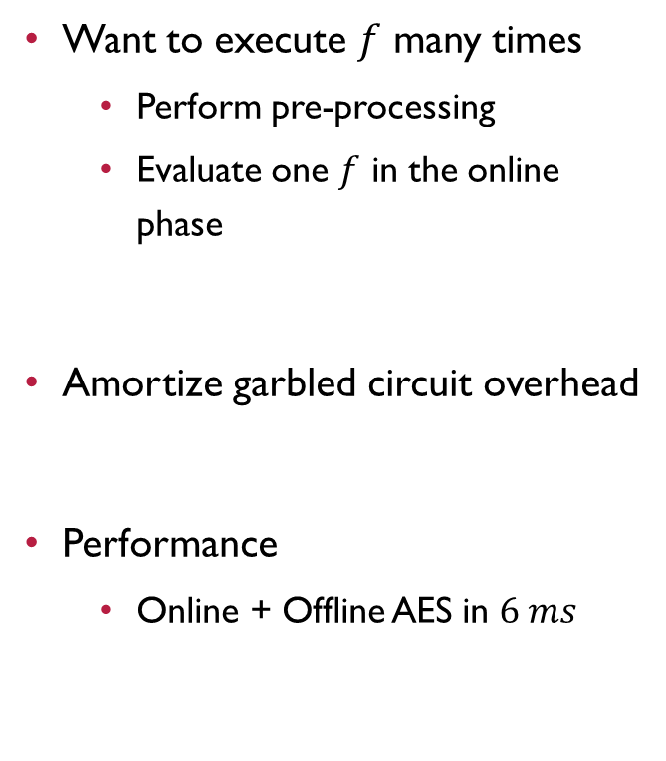











Faster Malicious 2PC with Online/Offline Dual Execution
Want to execute $f$ many times
Perform pre-processing
Evaluate one $f$ in the online phase
Amortize garbled circuit overhead
Performance
Online + Offline AES in $6 ms$
Offline Pre-Processing
Yao
Yao
$$f$$
$$f$$
$$f$$
$$f$$
$$f$$
$$f$$
Yao
Yao
$$f$$
$$f$$
$$f$$
$$f$$
$$f$$
$$f$$
$$f$$
$$f$$
Yao
Yao
$$f$$
$$f$$
Online phase
$$x$$
$$y$$
$$f$$
$$f(x,y)$$
Notes:
In this work we take Yao’s Garbled circuit protocol to the online offline model where much of the work is moved to a preprocessing phase. Later the parties can evaluate the function f many times.
Our methods allows the amortization of the primary overheads and we achieve a running time of just 6ms per AES evaluation.

Slide 4





Total Protocol Times for AES
Applied Cryptography track @ 4:30
$$18 min$$
AWS c4.8xLarge
(amortized)
$$3.4 sec$$
Time
(milliseconds)
$$0.8 sec$$
$$81 ms$$
[RR16] $$6 ms$$

Slide 5
Faster Malicious 2-party Secure Computation with Online/Offline Dual Execution
Applied Cryptography track @ 4:30
Peter Rindal
Mike Rosulek

