Slide 1
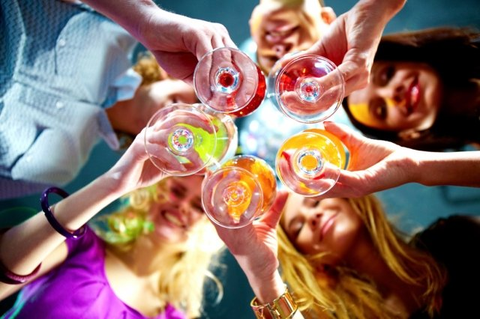
Alcostudents

Slide 2


Dinara Sultan
Islam Duisenbek

Slide 3
TOPIC: Students’ consumption of alcohol.
PURPOSE: To identify the susceptibility of students of SDU to alcoholism.
GOALS: 1. To present as complete and reliable a description of this problem as possible in our university
2. Determine the factors that influence the occurrence of alcoholism among young people
3. Identify methods to combat alcoholism
SUBJECT OF THE STUDY: the study of the causes of addiction to alcohol among young people.
OBJECT OF RESEARCH: students of SDU
For the first we created survey, consisted 25 questions, and share it with students.
Here’s the link to our survey: https://docs.google.com/forms/d/e/1FAIpQLSejkkYbXqMhPP5LfMnORfmZrC-_FKJR8iqS9Rc_vZJWy0aa2w/viewform?edit2=2_ABaOnuciosDy_d6nOF4X5s1VymQwYwByHeDutsPUQzVm-AWkas4x-eJ3XSSNA-d6lH_SanA

Slide 4
HYPOTHESES. 1. Residents of rural areas drink more alcohol
2. Alcohol affects academic performance negatively
3. males drink more alcohol
4. the worse the relationship in the family, the more they drink alcohol
5. parent’s cohabitation status affects
6. Alcohol consumption affects negatively to health

Slide 5
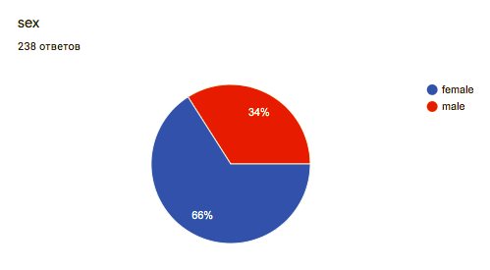
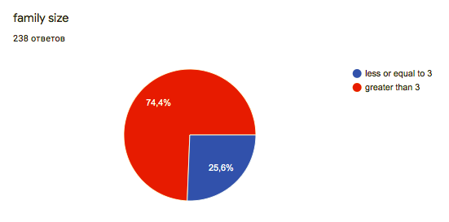
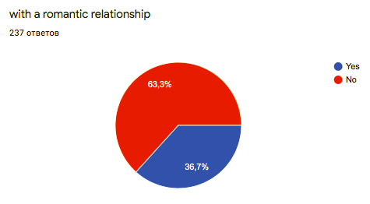
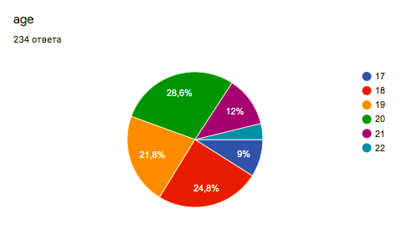
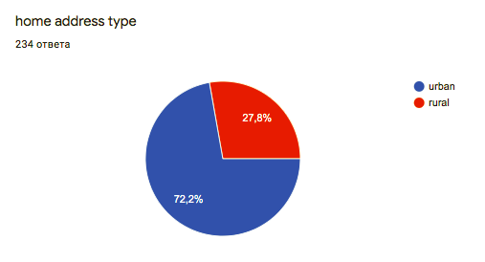
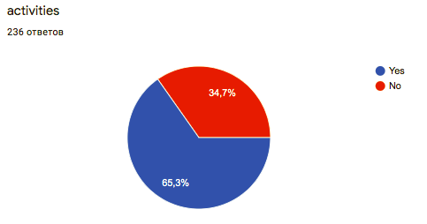
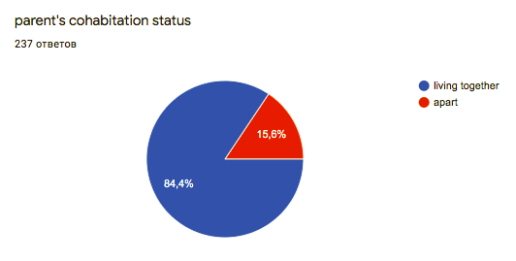
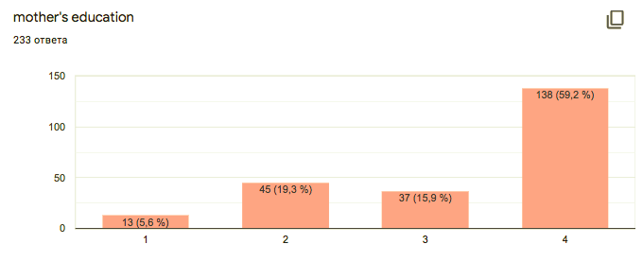
And after that we had results:

Slide 6
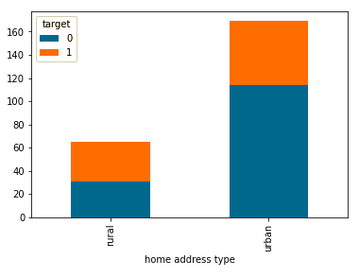
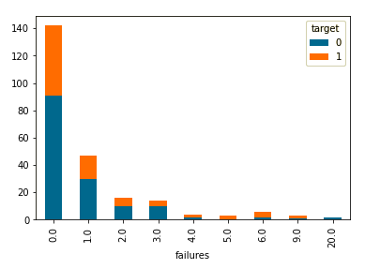
And after we started analyse with python. And got some results:
Residents of rural areas drink more alcohol.
1st Hypothesis is confirmed.
2nd hypothesis is refuted.
alcohol does not affect academic performance.

Slide 7
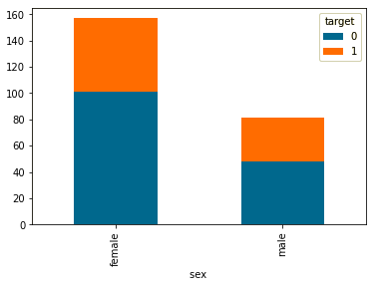
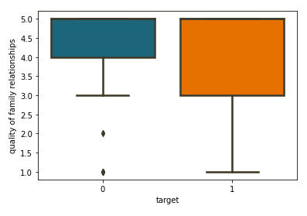
Here we can see that the number of drinking girls is more than boys, but surveyed girls are also more than boys
So, it means that sex is not a criteria for drinking person.
3rd hypothesis is refuted.
The more the quality of relationships the more that the student doesn't drink.
4th hypothesis is confirmed.

Slide 8
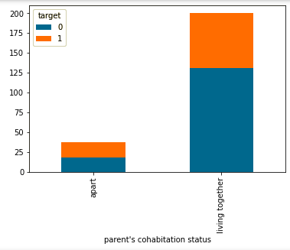
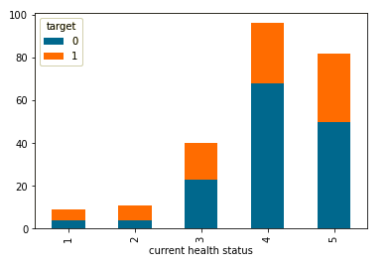
parent’s cohabitation status affects.
if the parents live separately, it is possible that the child will drink alcohol.
5th Hypothesis is confirmed.
6th Hypothesis is refuted.
Alcohol consumption does not affect negatively to health.

Slide 9
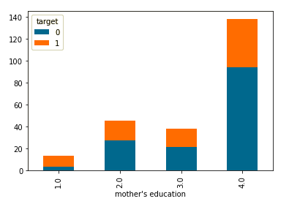
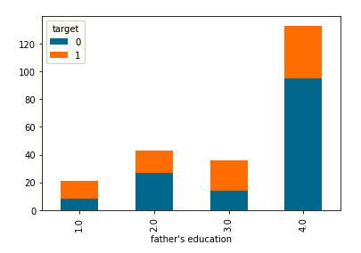
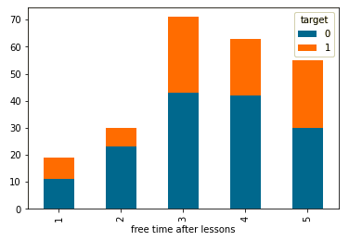
New hypothesis:
Mother's education affects to consumption of alcohol: the lower the level of education, the more their children drink.
Father's education affects to consumption of alcohol: the lower the level of education, the more their children drink.
the more free time, the more drink alcohol.

Slide 10
Before collecting the data, we had several hypotheses, some of which were confirmed during the analysis, and others were refuted.
In addition, we have identified several other patterns, which are shown above.
The purpose of this project was to find out the causes of potential alcoholism among students, if these reasons were found, then try to warn them against these actions.
But during the analysis, it turned out that the majority of users do it in moderation, and do not cross the line.
P.S.: “who drinks, does not know about the harm of wine,
and who does not drink, does not know about its benefits”.
© japanese wisdom

