Slide 1

COMPUTERIZED ACCOUNTING SOFTWARE
Benefits and Core Tasks in Peachtree
Selling • Purchasing • Payroll • Inventory • Reports

Slide 2



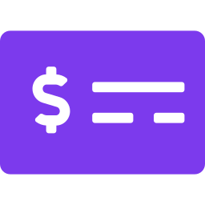
BENEFITS
Why use computerized accounting software?
Timely & Accurate Information
Cash In & Cash Out
Inventory Management
Payroll Made Easy
Accurate financial reports arrive on time, so managers can analyze data, judge performance and decide with confidence.
Track money earned from sales and services, and money spent on goods and needs from vendors.
Know quantities and prices of goods on hand to avoid sudden shortages or needless overstock.
Calculate hours and base pay, deductions, taxes and benefits, and produce related tax documents.
2

Slide 3




BENEFITS
Stronger control, trust and funding
Efficiency & internal control
Daily activities run more effectively. Clear procedures and defined policies protect assets and reduce errors or misappropriation.
BENEFIT / COST RULE
Reliable financial statements
Benefits > Costs
Better-controlled data raises confidence in the statements the business produces.
The benefits gained from the software must exceed the cost of acquiring and implementing it, so it adds real value to the business.
Easier external dealings
Regular, trustworthy statements make it easier to obtain bank loans and financing.
3

Slide 4





CORE TASKS
Five core accounting tasks in the software
1
2
3
4
5
Selling
Purchasing
Payroll
Inventory
Reports
Goods & services
Orders & payments
Wages & deductions
Track stock levels
Decision making
Every task starts from a menu: Tasks, Maintain, or Reports & Forms.
4

Slide 5




CORE TASK 1 | 4 STEPS
Task 1: Selling goods and services
1
2
3
4
Sales Orders
Sales Invoicing
Receive Money
Create Deposit Tickets
Tasks › Quotes & Sales Orders › Sales Orders
Tasks › Sales Invoices
Tasks › Receive Money
Tasks › Select for Deposit
Enter the customer ID, address, date, quantity, item description, unit price, tax and shipping charges.
Invoice from an earlier sales order (Apply to Sales Order) or record a direct sale (Apply to Sales).
Record cash or check receipts, applied to accumulated invoices or directly to revenue.
Group the money received and deposit it into the bank account.
5

Slide 6
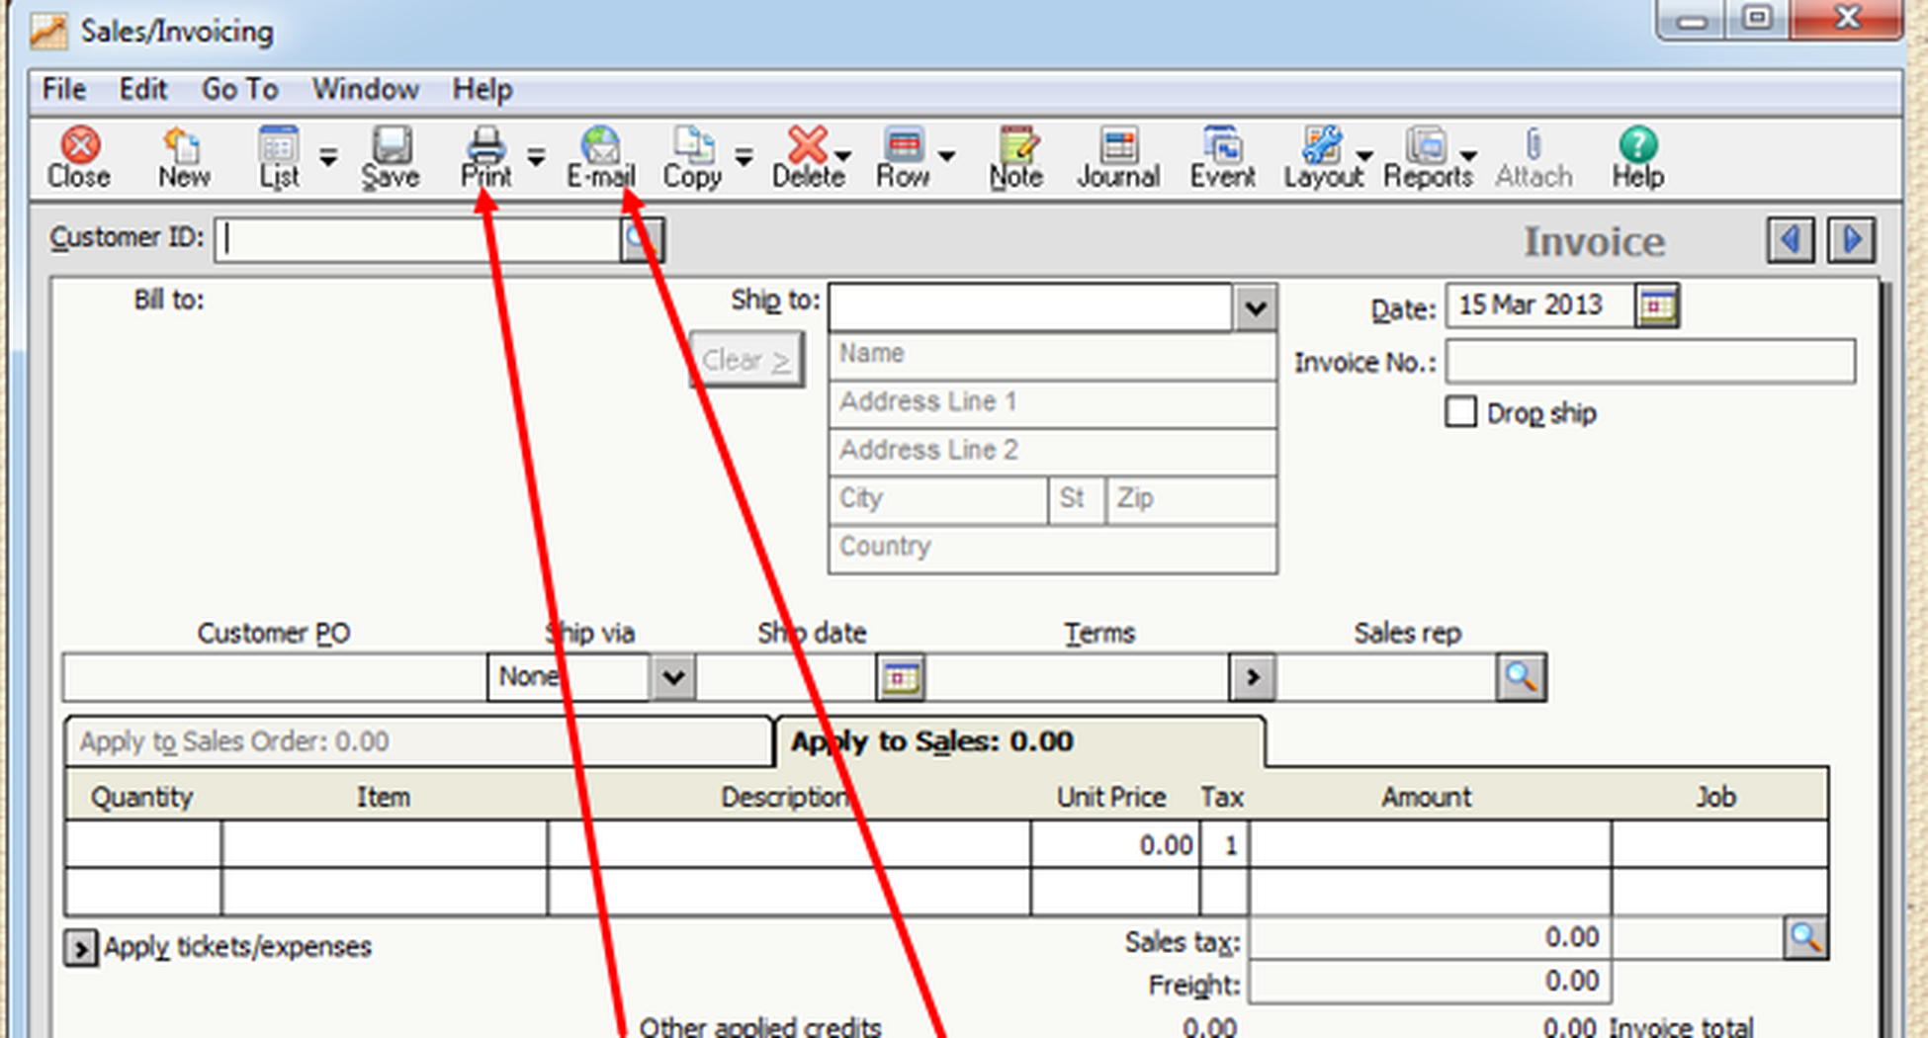
TASK 1 IN ACTION
Inside the software: Sales Invoices
1
Customer details
Pick the Customer ID and the program fills in the name and address.
2
Apply to
Choose Apply to Sales Order for an earlier order, or Apply to Sales for a direct sale.
3
Automatic totals
Subtotal, sales tax and freight roll up into the invoice total.
Screenshot from the program
6

Slide 7



CORE TASK 2 | 3 STEPS
Task 2: Purchasing and payments
1
2
3
Purchase Orders
Receive Inventory / Enter Bills
Pay Vendors
Tasks › Purchase Orders
Tasks › Purchases / Receive Inventory
Tasks › Payments
Identify the vendor and the goods you need to order.
Record the goods received together with the vendor invoice that arrives with them.
Pay one specific invoice or several at once, applied to invoices or expenses.
7

Slide 8
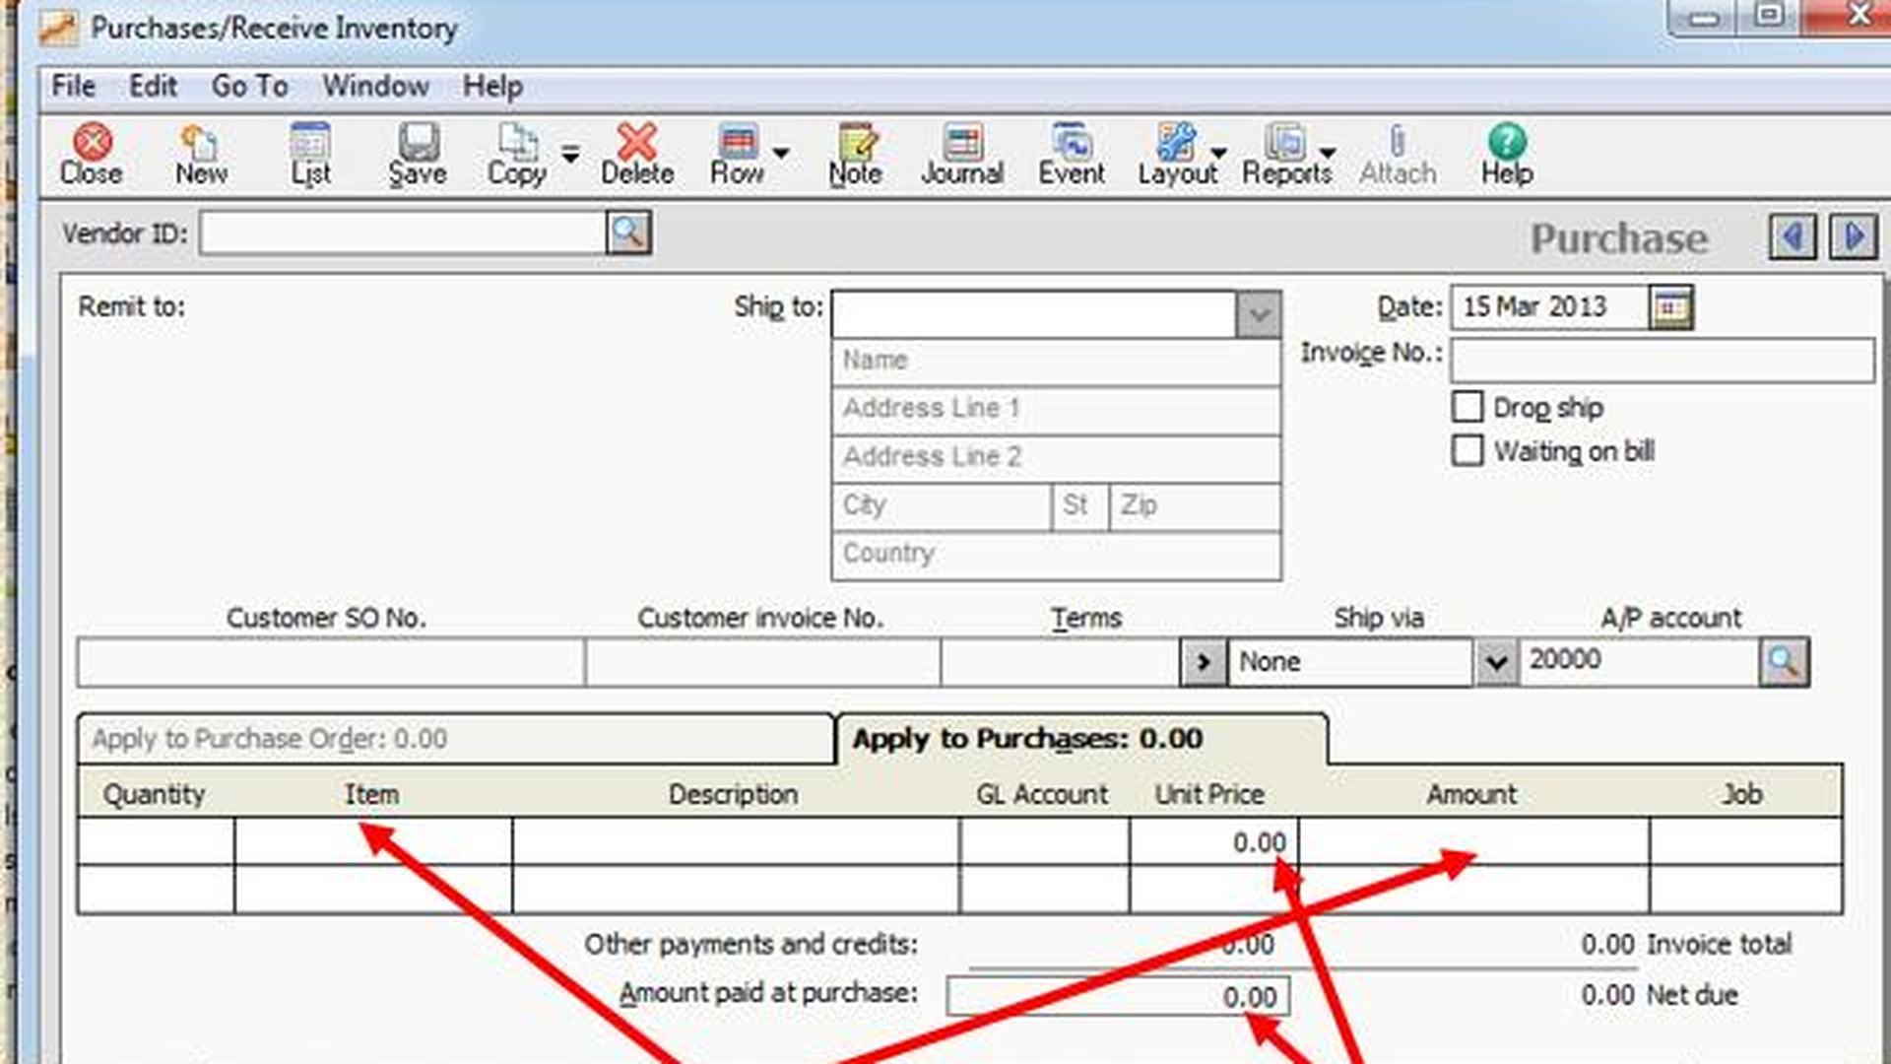
TASK 2 IN ACTION
Inside the software: Receiving a Bill
1
Vendor details
Select the Vendor ID to load the supplier and shipping information.
2
Items received
List each item with its quantity and unit cost; amounts are calculated for you.
3
Net due
The invoice total less payments gives the amount owed to the vendor.
Screenshot from the program
8

Slide 9


CORE TASKS 3 & 4
Tasks 3 and 4: Payroll and inventory
Payroll management
Inventory tracking
Tasks › Payroll Entry
Maintain › Inventory Items
Select the Employee ID
Hours worked and base pay appear automatically
Deductions, taxes and withholdings are calculated
Net pay is reached with flexibility
Monitor quantities on hand
Set the reorder point
Choose a costing method, for example FIFO
Avoid stock-outs and overstock
9

Slide 10
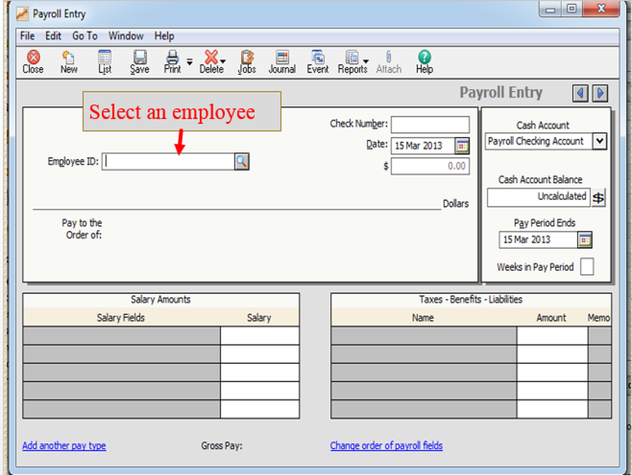
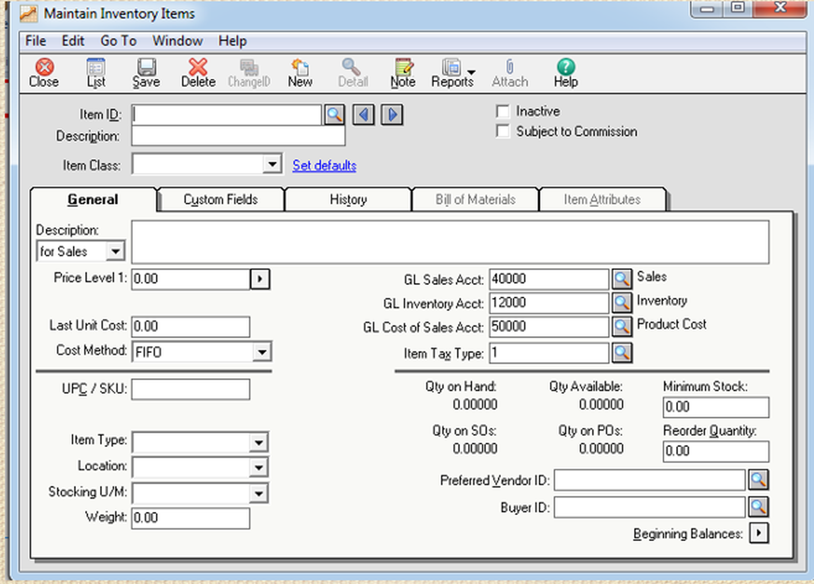
TASKS 3 & 4 IN ACTION
Inside the software: Payroll and Inventory
Payroll Entry
Inventory Items
Hours, pay, deductions and net pay appear once you pick the employee.
Quantity on hand, reorder point and costing method (FIFO) in one place.
10

Slide 11
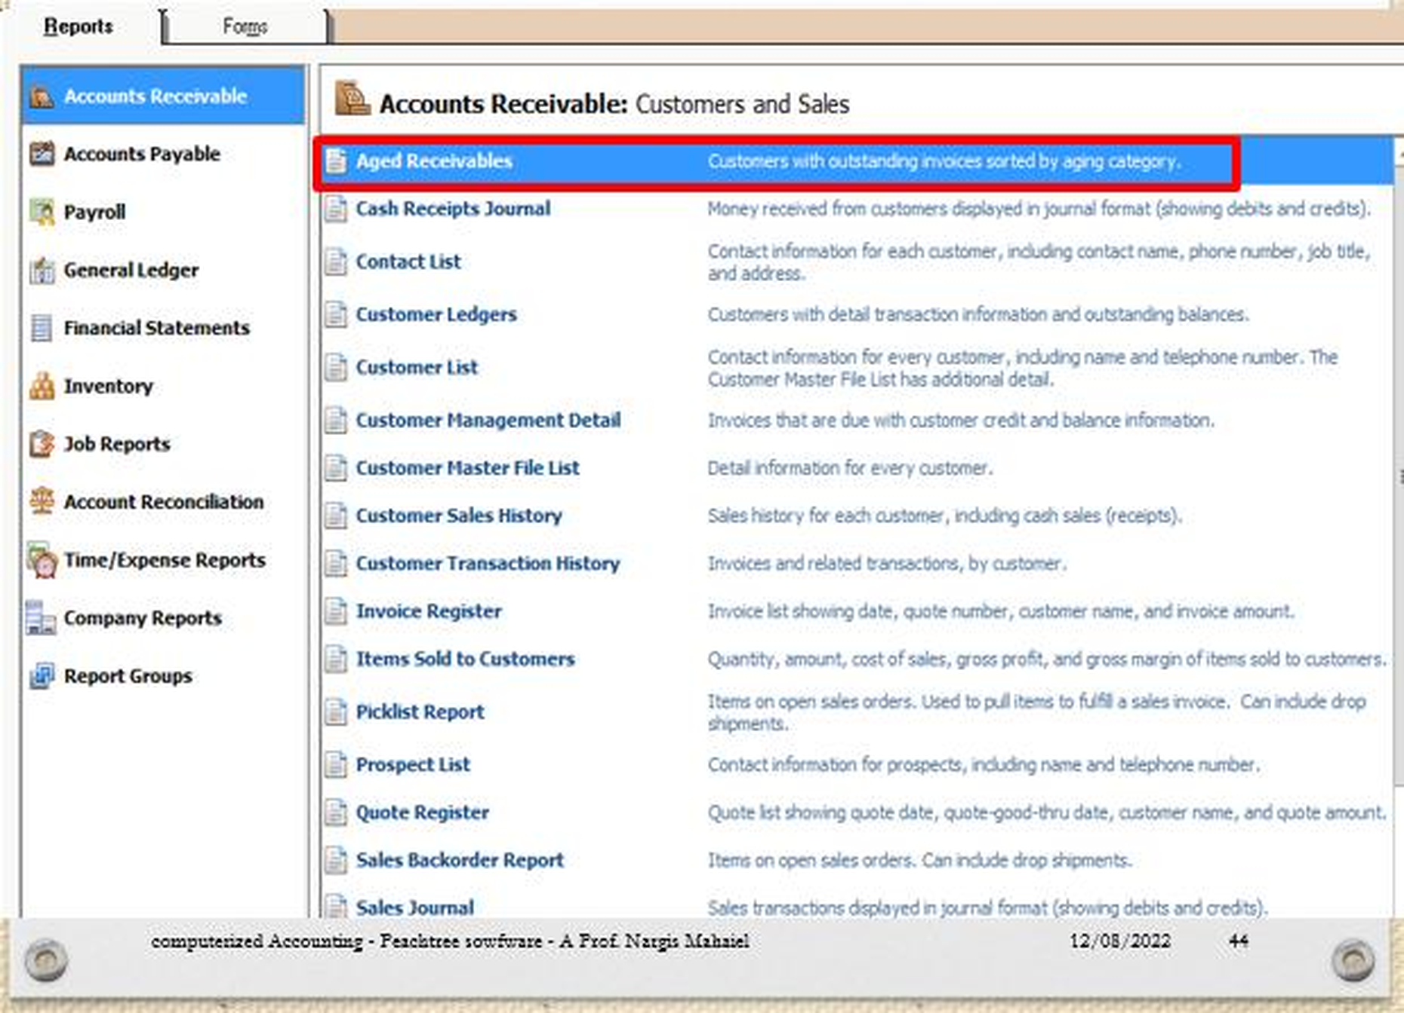


CORE TASK 5
Task 5: Reports for decision making
Decisions it supports
Collect outstanding debts
Reduce a customer's credit limit
Stop dealing with late payers
Aged Receivables report
Reports & Forms › Accounts Receivable › Aged Receivables. Shows overdue invoices, days late and customers who have not paid.
11

Slide 12
KEY TAKEAWAYS
From transaction to decision
01
02
03
04
Accurate & timely
Five core tasks
Controlled & trusted
Benefits > Costs
Reliable information drives sound decisions.
Selling, purchasing, payroll, inventory and reports.
Better control, fewer errors, easier financing.
Adopt the software only when value exceeds cost.
Thank you

Slide 13

PRESENTED BY
Our Team
1
Islam Ashraf
2
Islam Reda
3
Mohamed Abdelwahab
4
Jana Wael
5
Hana Adel
6
Ghadeer Mohamed

