Slide 1


Slide 2
SIGMA

Slide 3
01
02
03
04
05
06
07
08
SIGMA

Slide 4
Problem
Hardware
01
02
03
04
Solution
Front-end

Slide 5
Back-end
Marketing
05
06
07
08
AI
Future Work
SIGMA

Slide 6
SIGMA

Slide 7




SIGMA
Problem
Hardware
Front-end
Back-end
AI
Marketing
Future Work

Slide 8
Problem
SIGMA
Solution
Hardware
Front-end
Back-end
AI
Marketing
Future Work

Slide 9
Problem

Slide 10
Problem
SIGMA
Solution
Hardware
Front-end
Back-end
AI
Marketing
Future Work

Slide 11
Problem
Solution
SIGMA
Hardware
Front-end
Back-end
AI
Marketing
Future Work

Slide 12
Solution

Slide 13

Solution

Slide 14
Solution
SmartBrace

Slide 15
Solution
Application
SmartBrace

Slide 16
Solution
Website
SmartBrace
Application

Slide 17
Solution
SmartBrace
Application
Website

Slide 18
Solution

Slide 19
Solution
SIGMA
Hardware
Front-end
Back-end
AI
Marketing
Future Work

Slide 20
Solution
Hardware
SIGMA
Front-end
Back-end
AI
Marketing
Future Work

Slide 21
Hardware

Slide 22

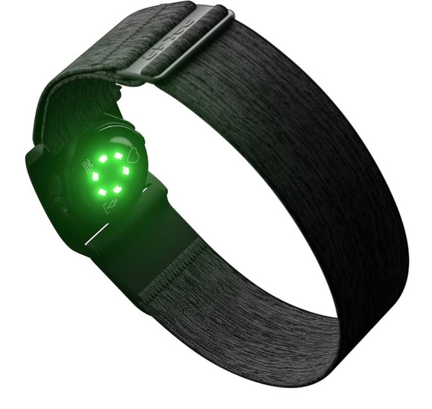
Hardware
Project Idea
Designing a smart wearable bracelet for children to monitor health indicators (heart rate, temperature) and real-time location using IoT technologies.

Slide 23
Hardware
Components

Slide 24
Hardware
Components
01
ESP32
Main microcontroller that connects and processes sensor data

Slide 25
Hardware
Components
01
02
ESP32
MAX30105
Main microcontroller that connects and processes sensor data
Measures heart rate and blood oxygen (SpO2)

Slide 26
Hardware
Components
01
02
03
ESP32
MAX30105
Temp. Sensor TMP 36GZ
Main microcontroller that connects and processes sensor data
Measures heart rate and blood oxygen (SpO2)
Monitors body temperature

Slide 27
Hardware
Components
01
02
03
04
ESP32
MAX30105
Temp. Sensor TMP 36GZ
MPU6050
Main microcontroller that connects and processes sensor data
Measures heart rate and blood oxygen (SpO2)
Monitors body temperature
Gyroscope & Accelemeter to detect abnormal movement or falls

Slide 28
Hardware
System Flow Diagram
Components
01. Sensors continuously collect health and location data
02. ESP32 processes and evaluates the data
03. ESP32 connect to Wi-Fi
04. Data is sent to a mobile server via MQTT
05. Server connected to MQTT and get data in real time
01
02
03
04
05
ESP32
MAX30105
Temp. Sensor TMP 36GZ
MPU6050
NEO-6M GPS Module
Main microcontroller that connects and processes sensor data
Measures heart rate and blood oxygen (SpO2)
Monitors body temperature
Gyroscope & Accelemeter to detect abnormal movement or falls
Provides accurate geolocation

Slide 29
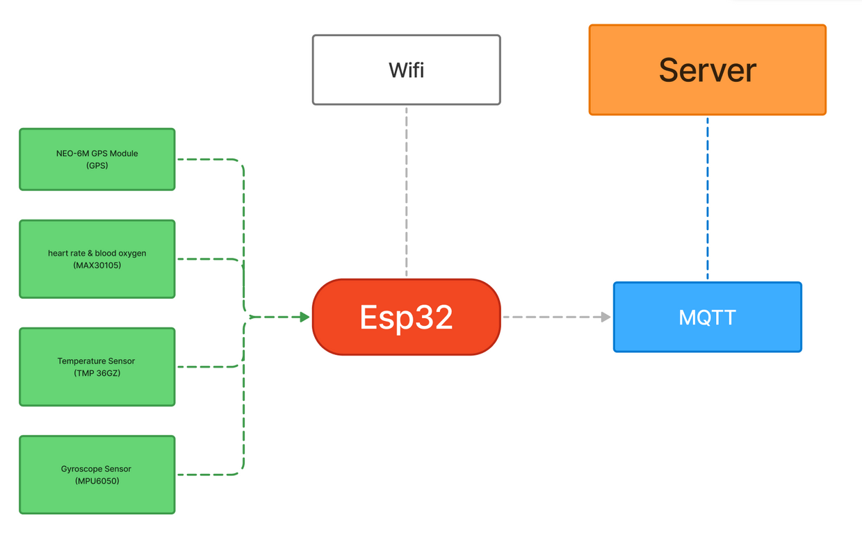
Hardware
System Flow Diagram
01. Sensors continuously collect health and location data
02. ESP32 processes and evaluates the data
03. ESP32 connect to Wi-Fi
04. Data is sent to a mobile server via MQTT
05. Server connected to MQTT and get data in real time

Slide 30
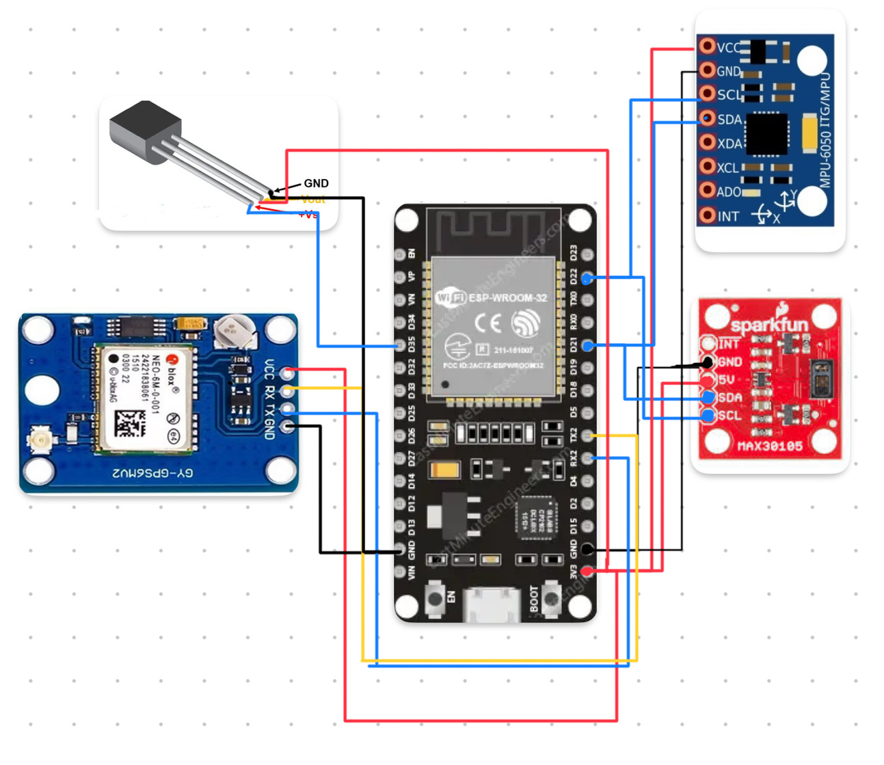
Hardware
Circuit Design

Slide 31
Hardware

Slide 32
Hardware
SIGMA
Front-end
Back-end
AI
Marketing
Future Work

Slide 33
Hardware
Front-end
SIGMA
Back-end
AI
Marketing
Future Work

Slide 34
Front-end

Slide 35

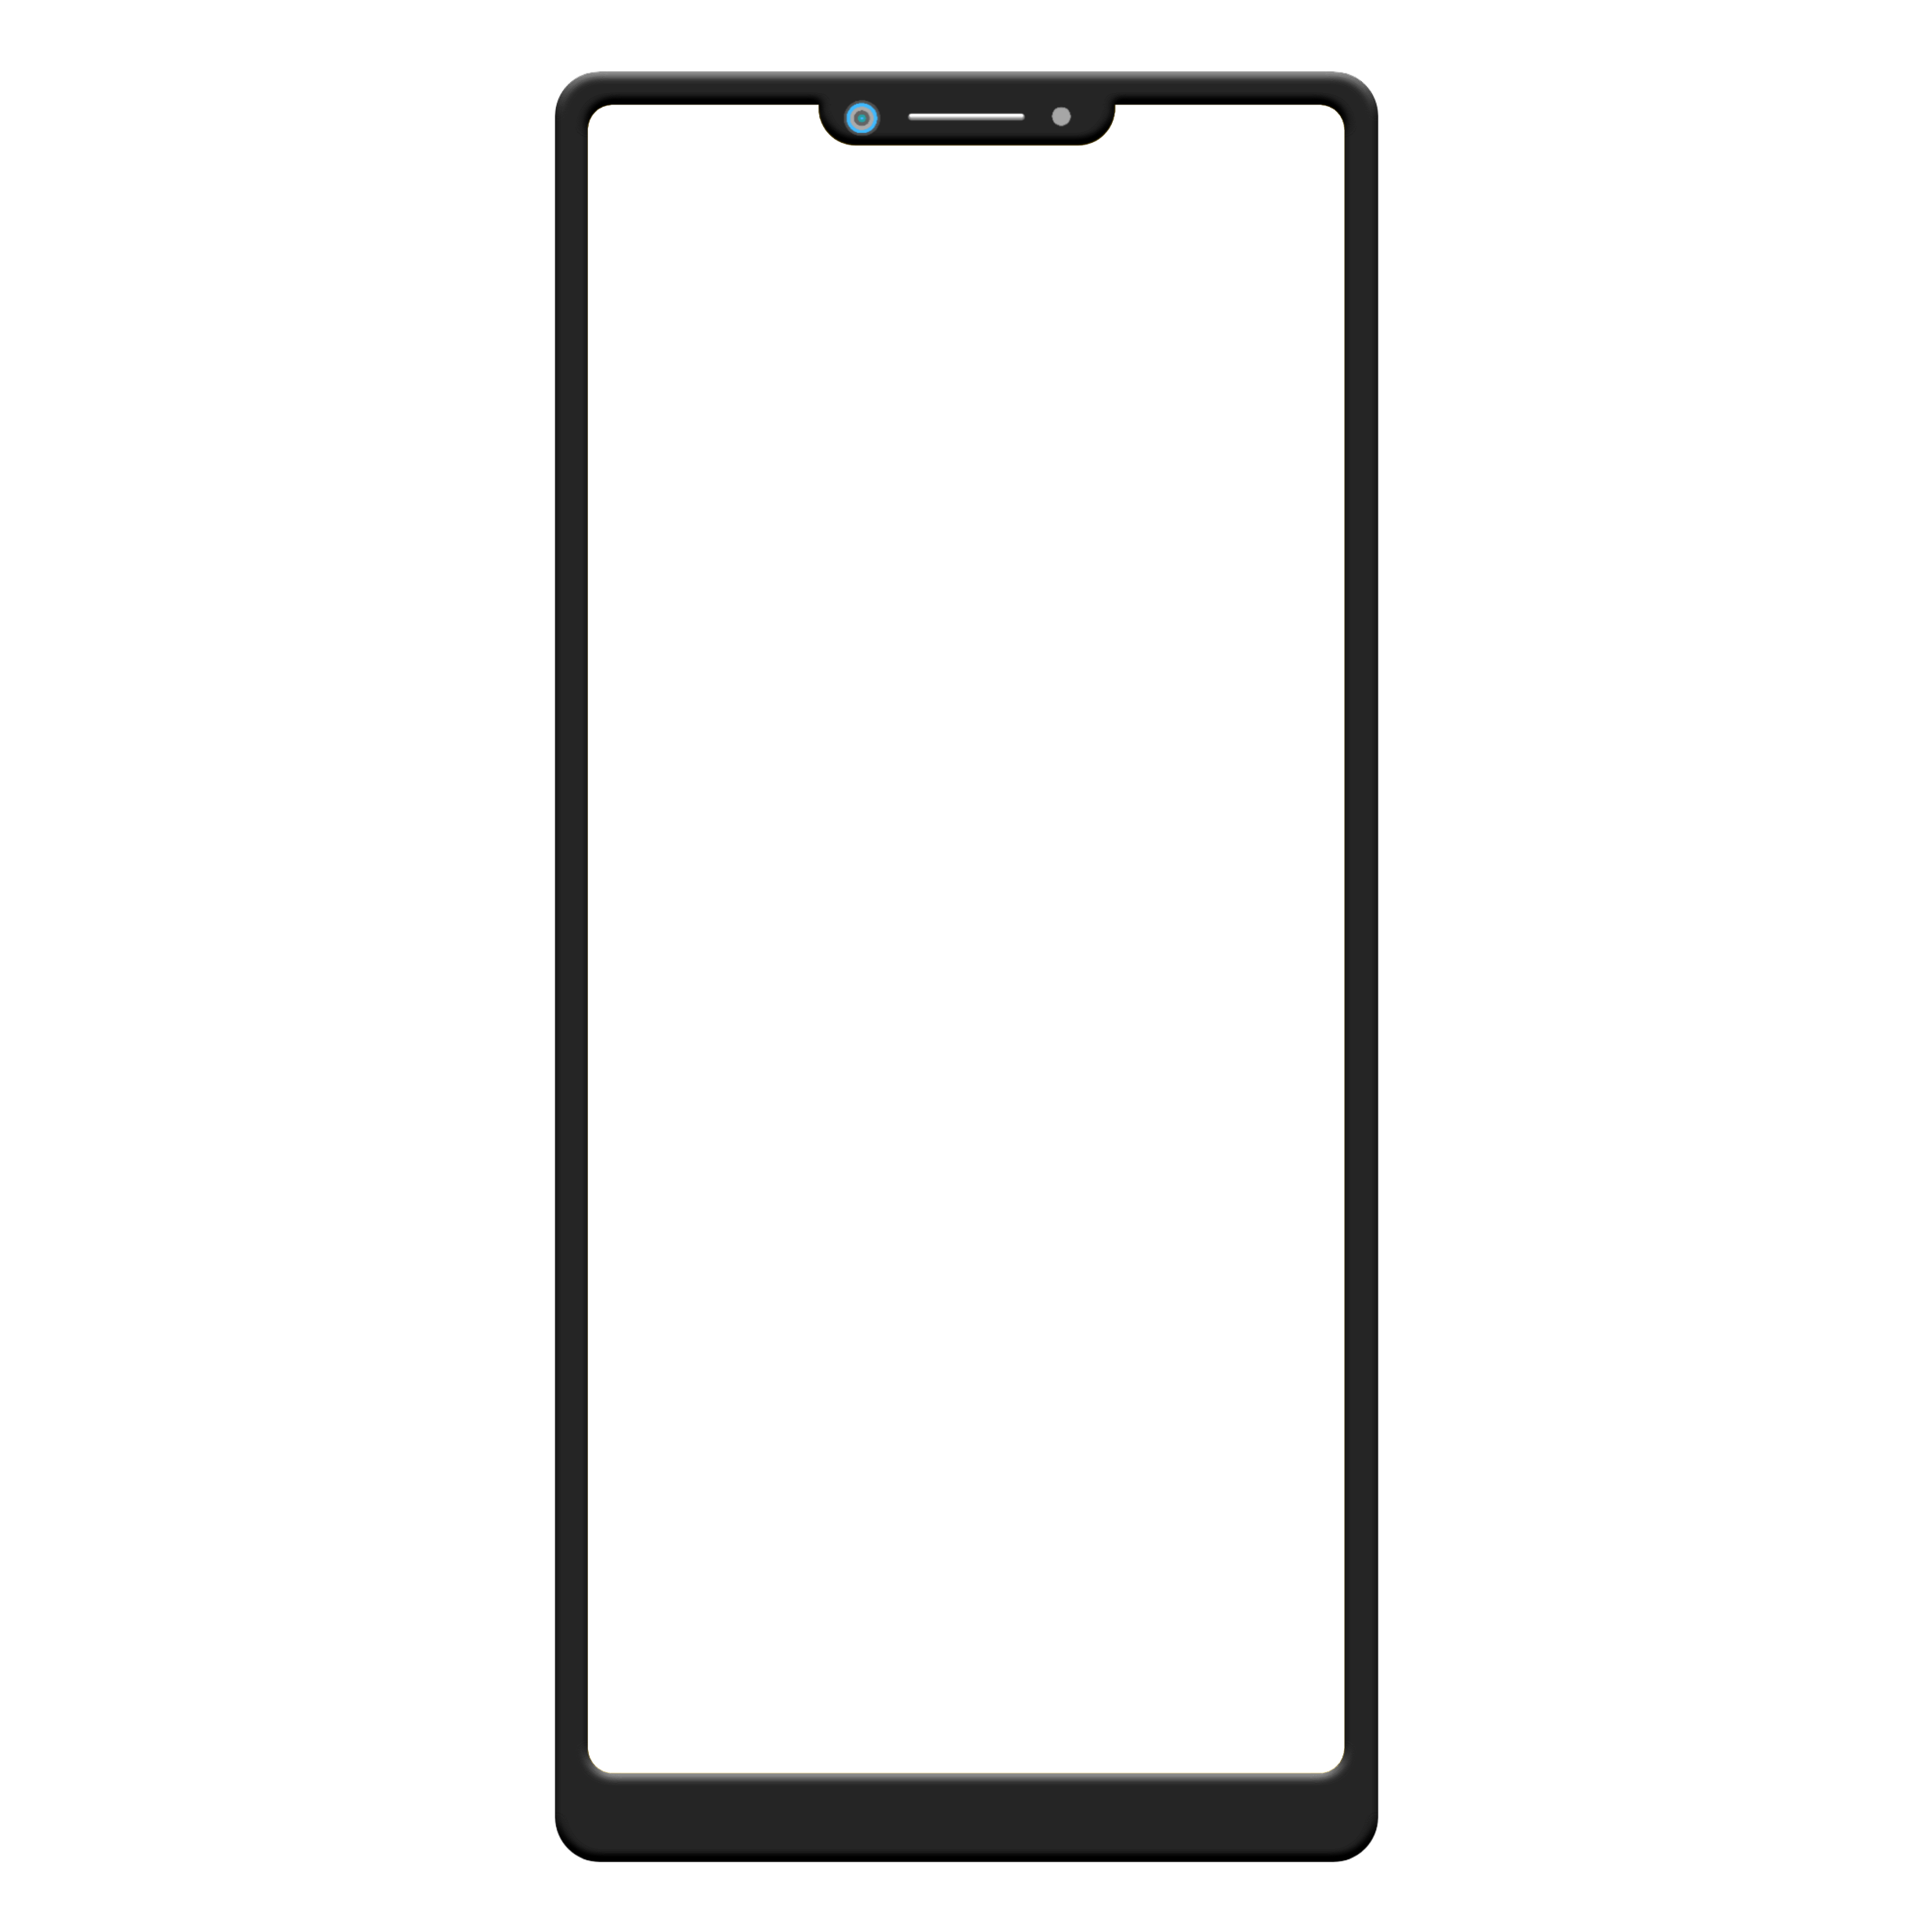

Front-end
Why Flutter?
01
01. Cross Platform Rich Widget
02. Library Hot Reload Strong
03. Community & Google
02
04. Support Open Source
03
04

Slide 36
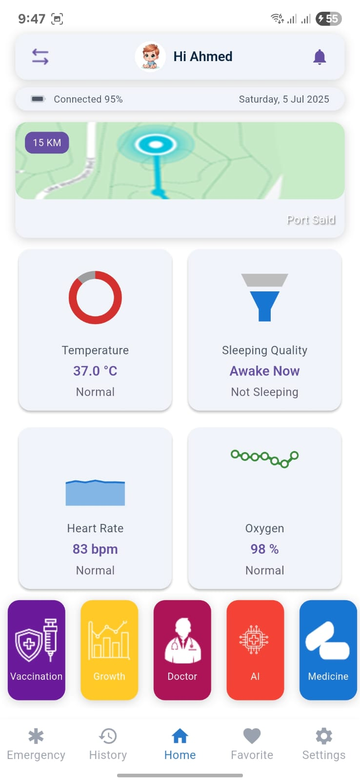
Front-end
01
02
03
04

Slide 37
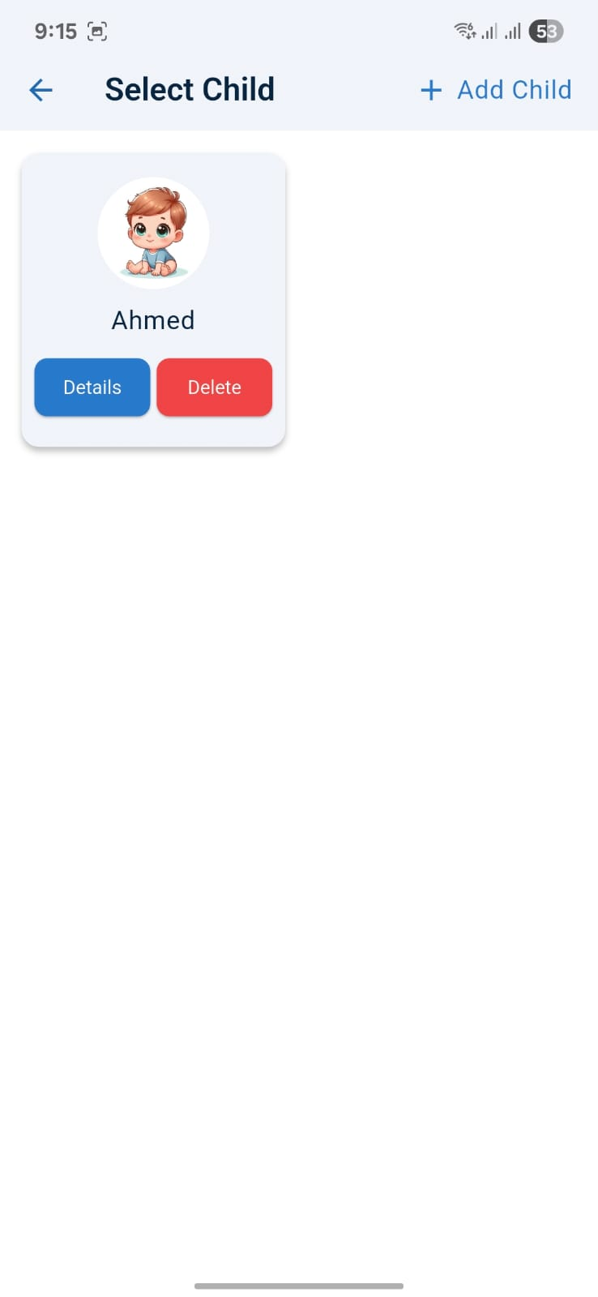
Front-end
01
02
03
04

Slide 38
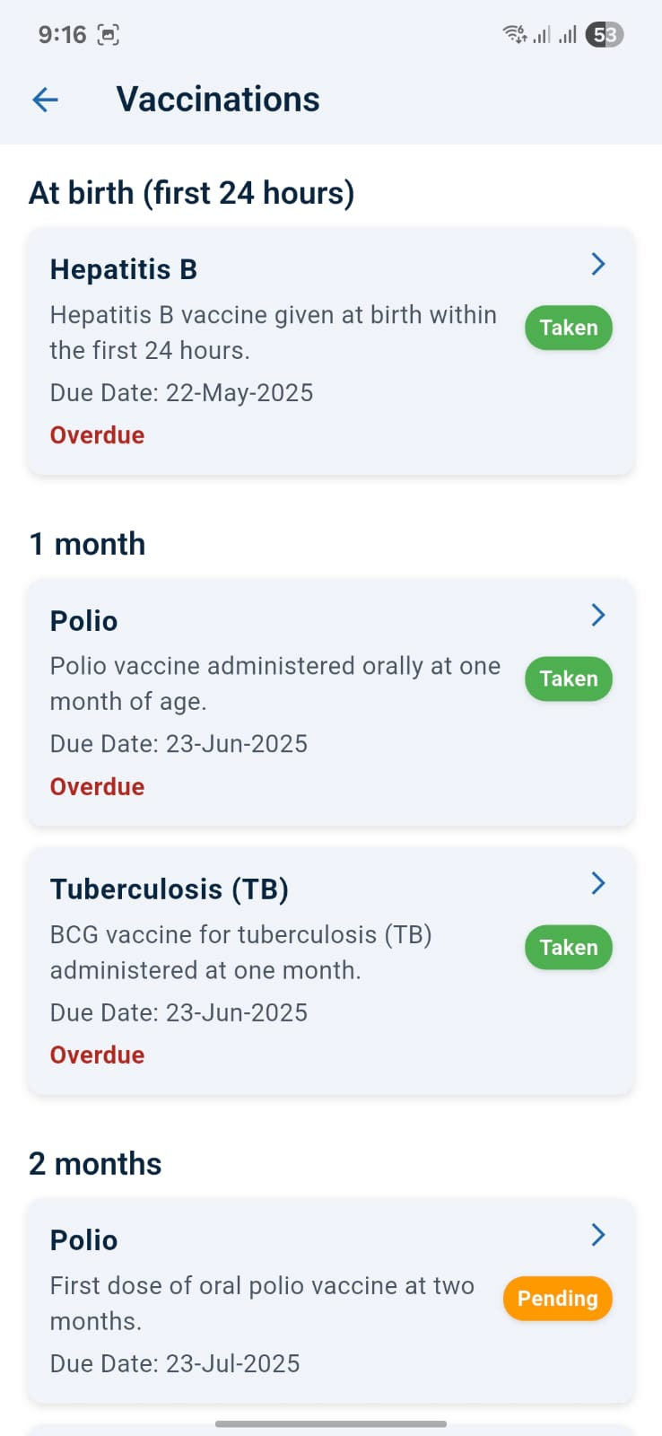
Front-end
01
02
03
04

Slide 39
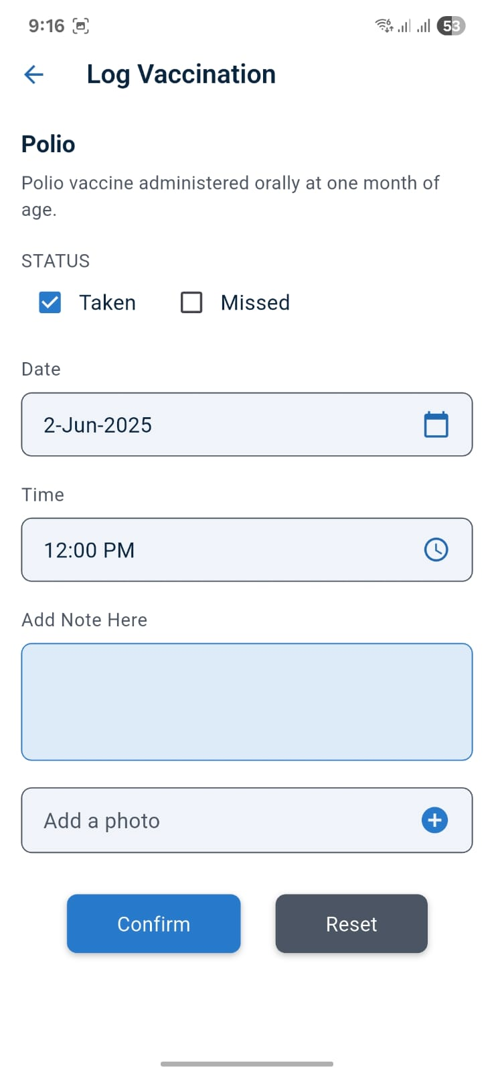
Front-end
01
02
03
04

Slide 40
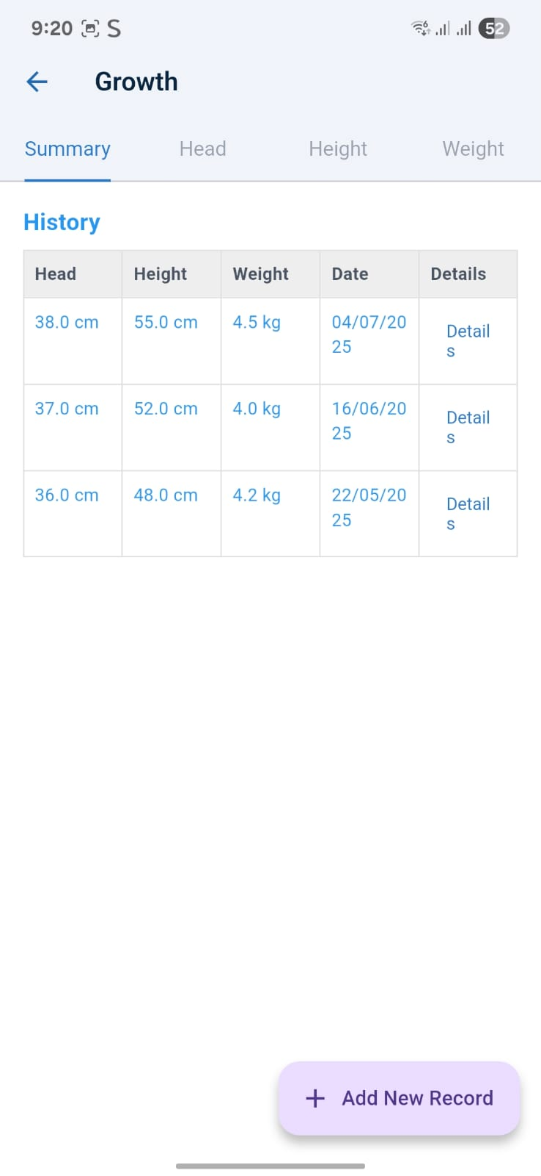
Front-end
01
02
03
04

Slide 41
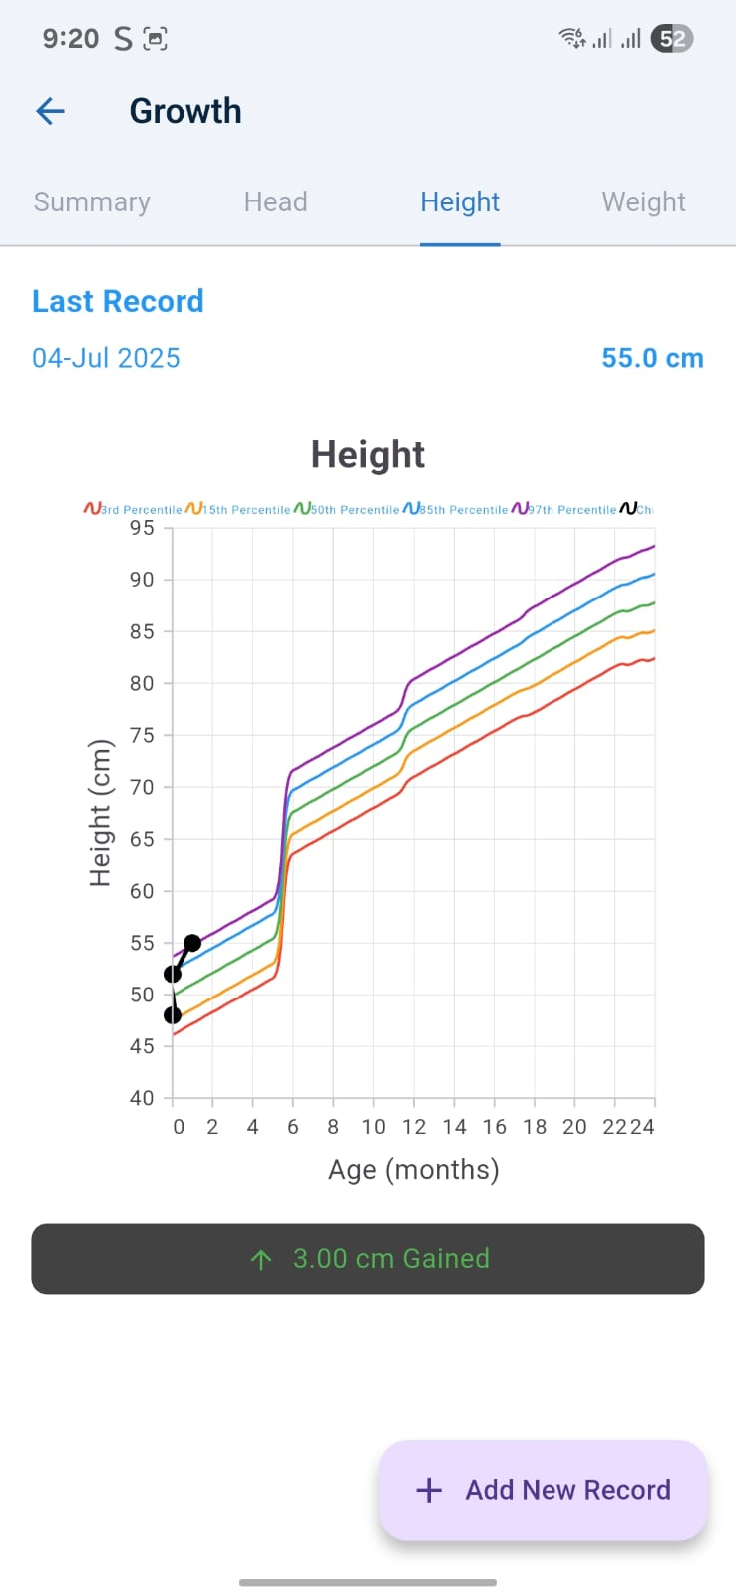
Front-end
01
02
03
04

Slide 42
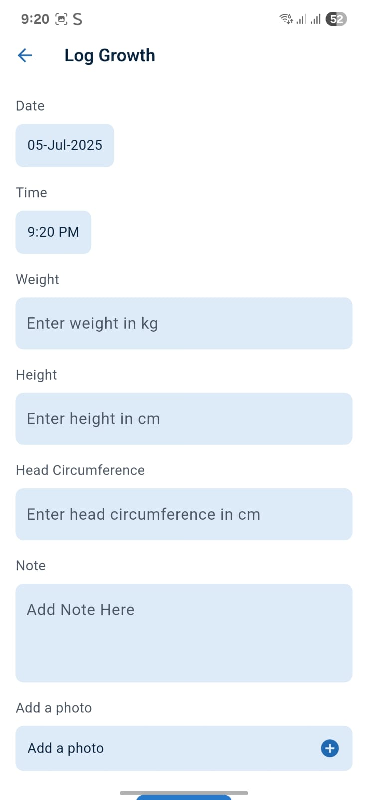
Front-end
01
02
03
04

Slide 43
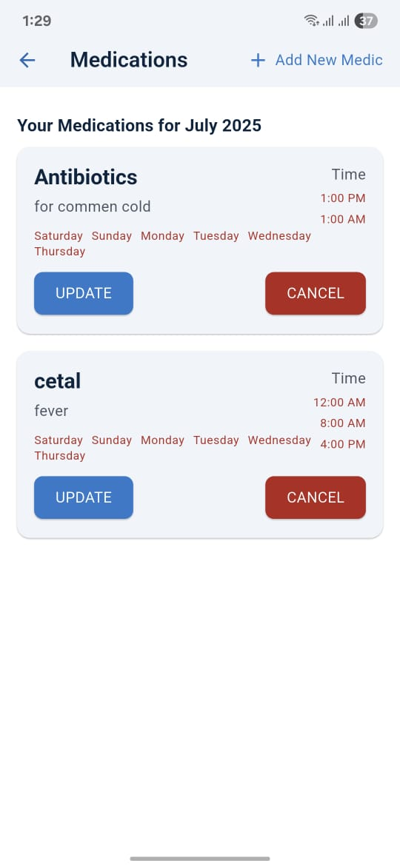
Front-end
01
02
03
04

Slide 44
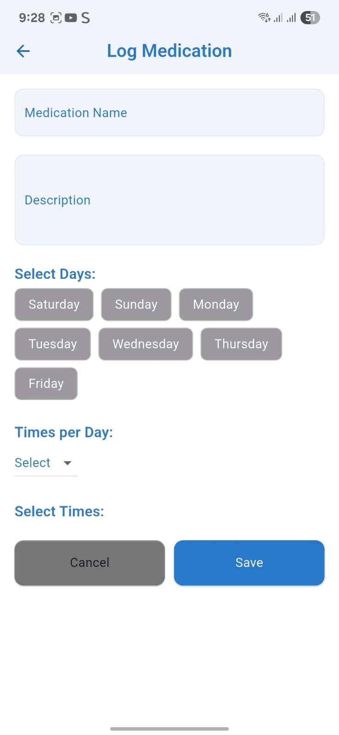
Front-end
05
02
03
04

Slide 45
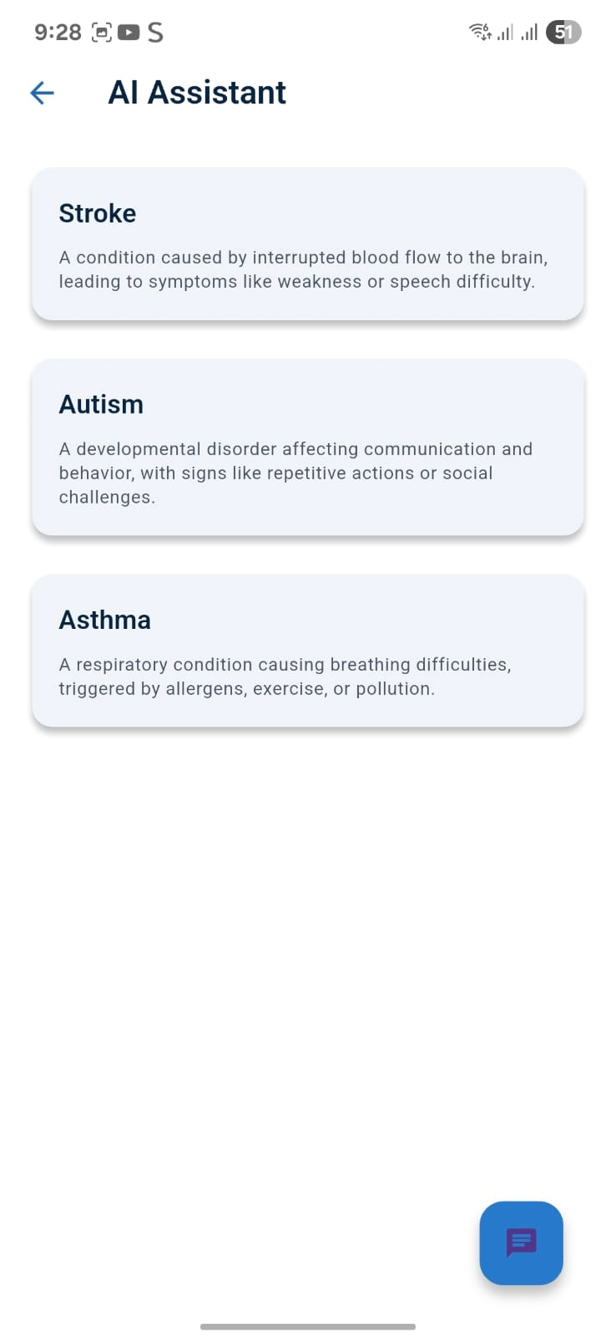
Front-end
05
02
03
04

Slide 46
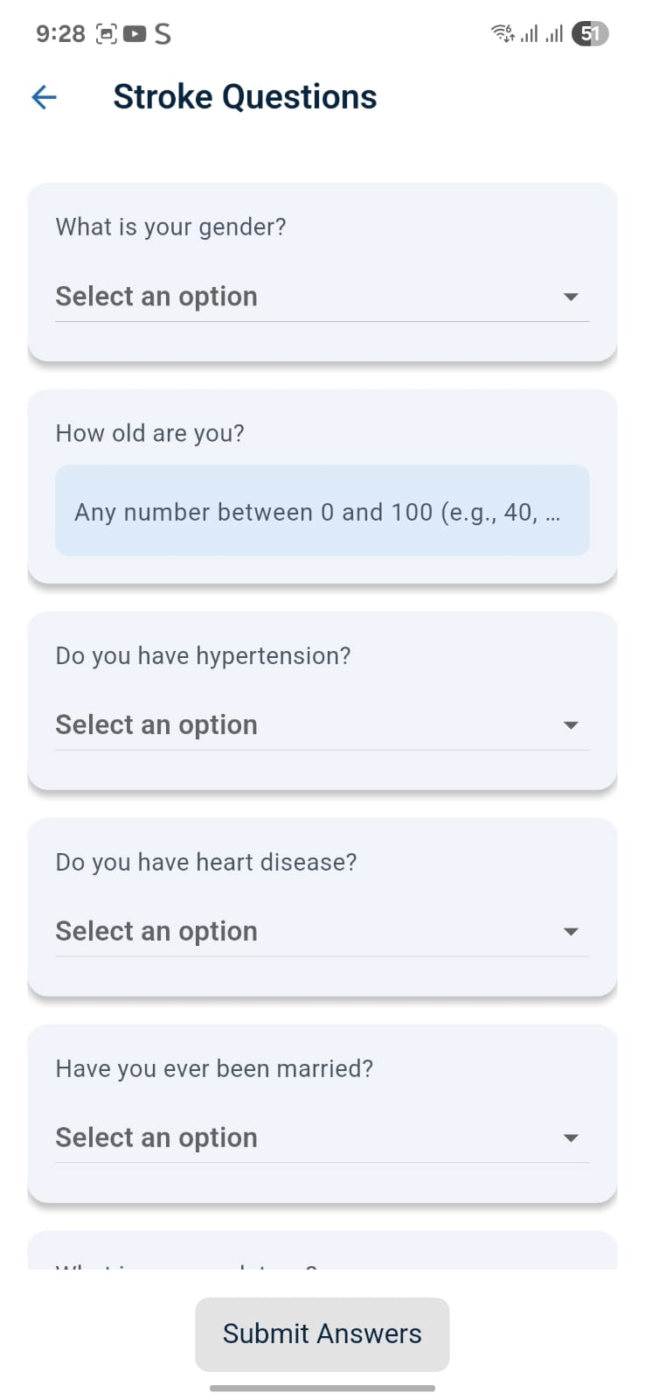
Front-end
05
06
07
08

Slide 47
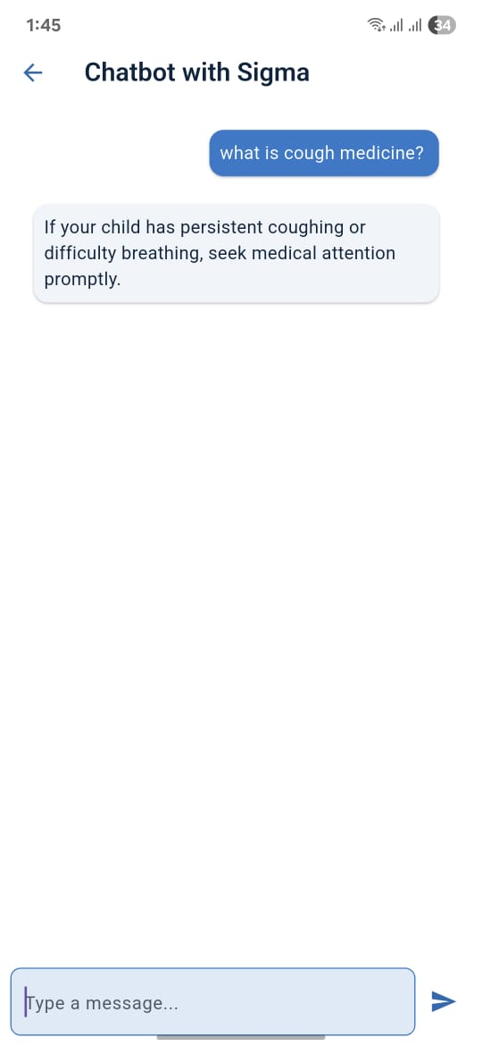
Front-end
05
06
07
08

Slide 48
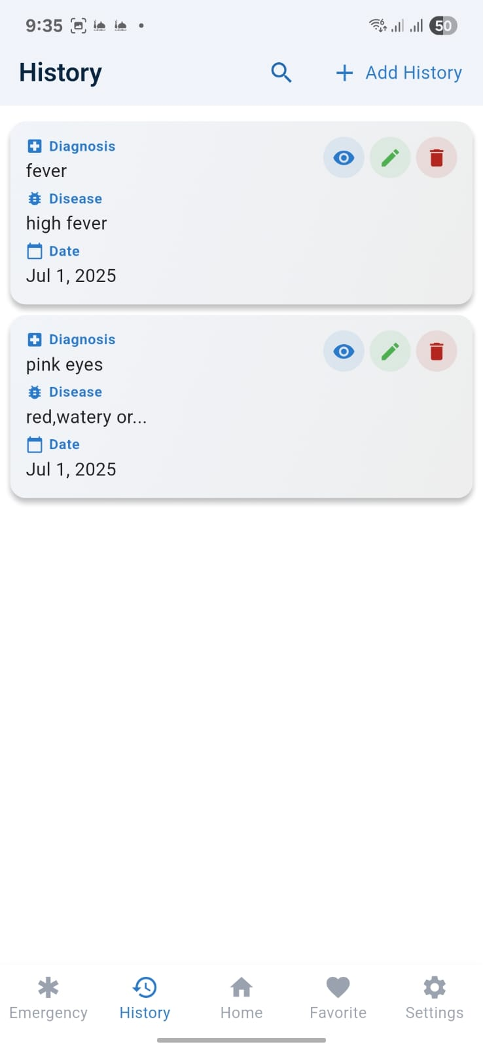
Front-end
05
06
07
08

Slide 49
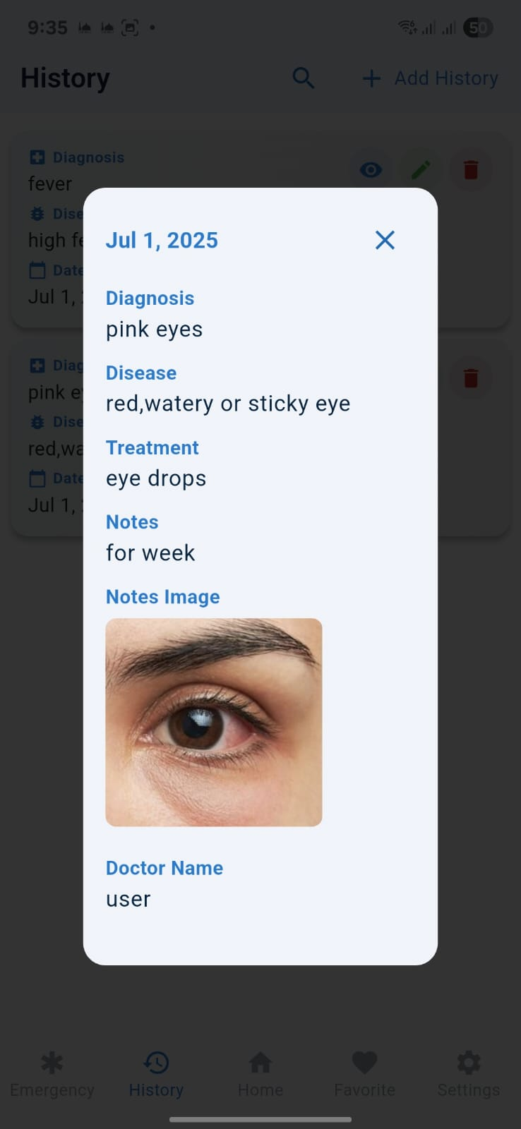
Front-end
05
06
07
08

Slide 50
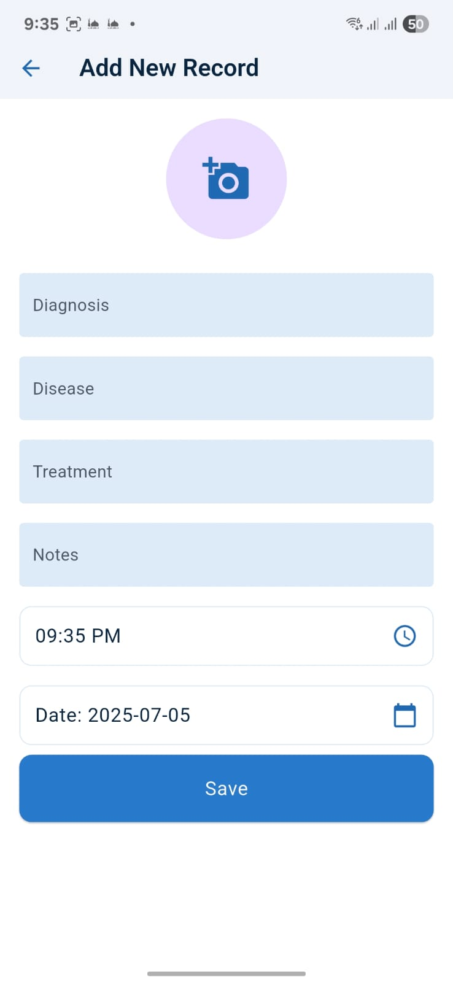
Front-end
05
06
07
08

Slide 51
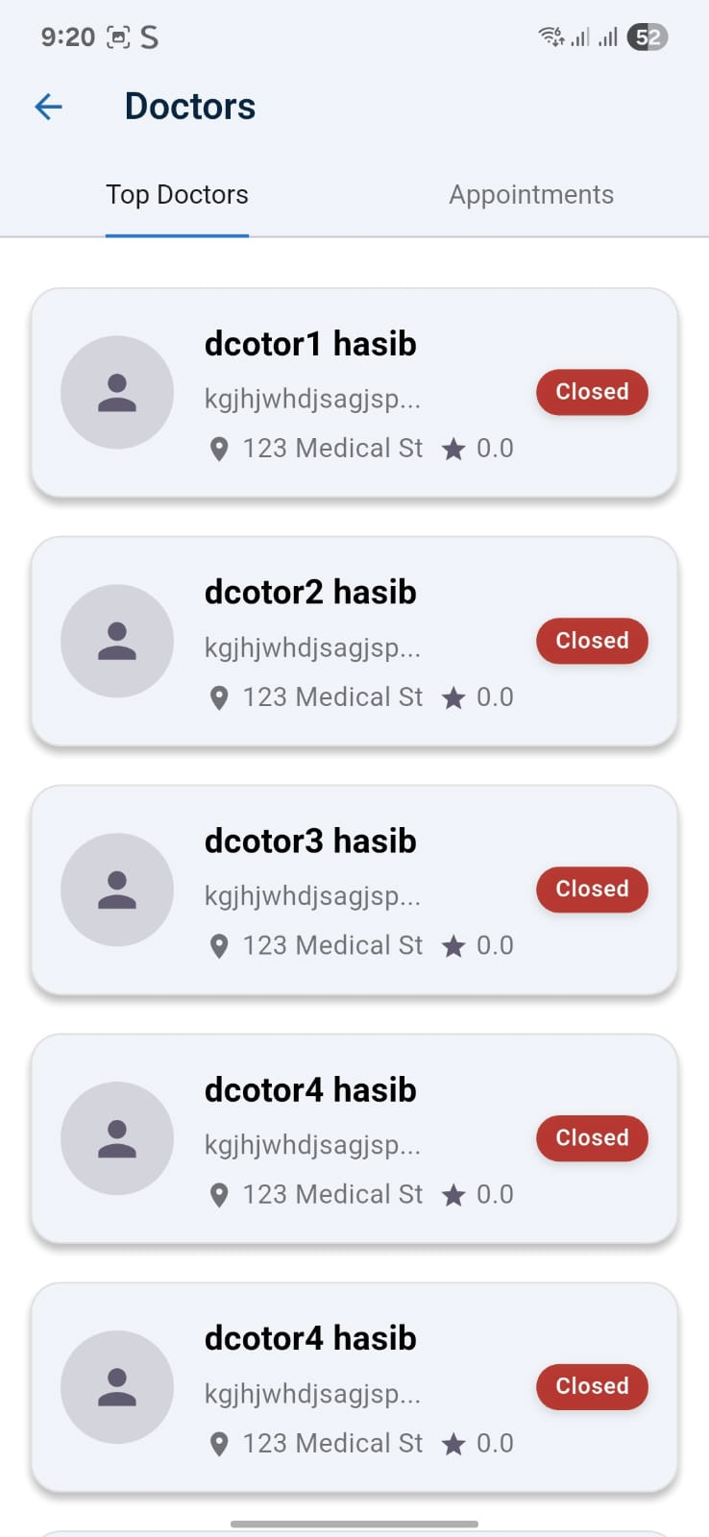
Front-end
05
06
07
08

Slide 52
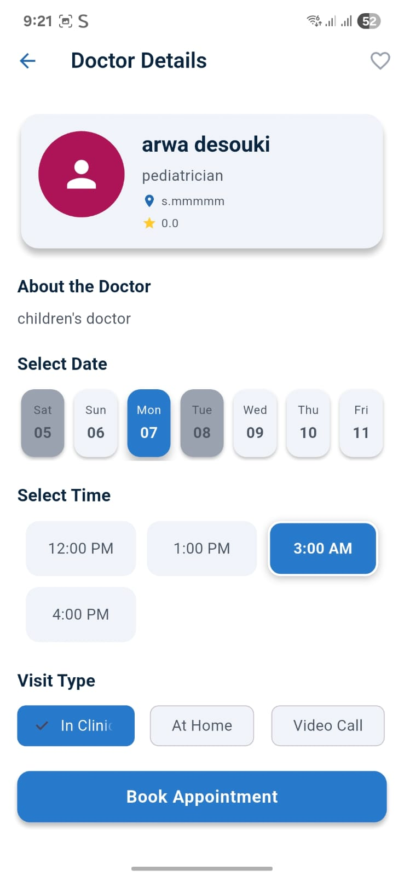
Front-end
05
06
07
08

Slide 53
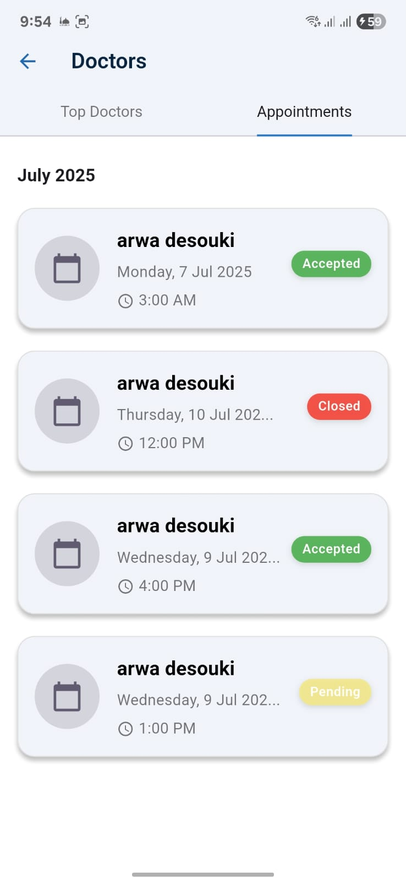
Front-end
05
06
07
08

Slide 54
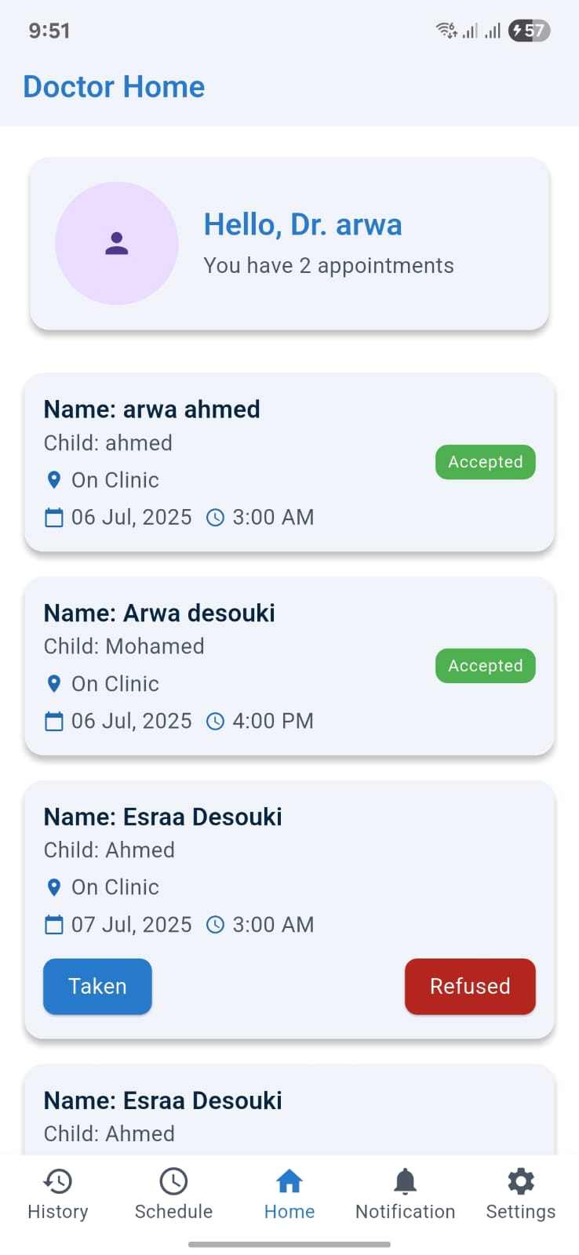
Front-end
05
06
07
08

Slide 55
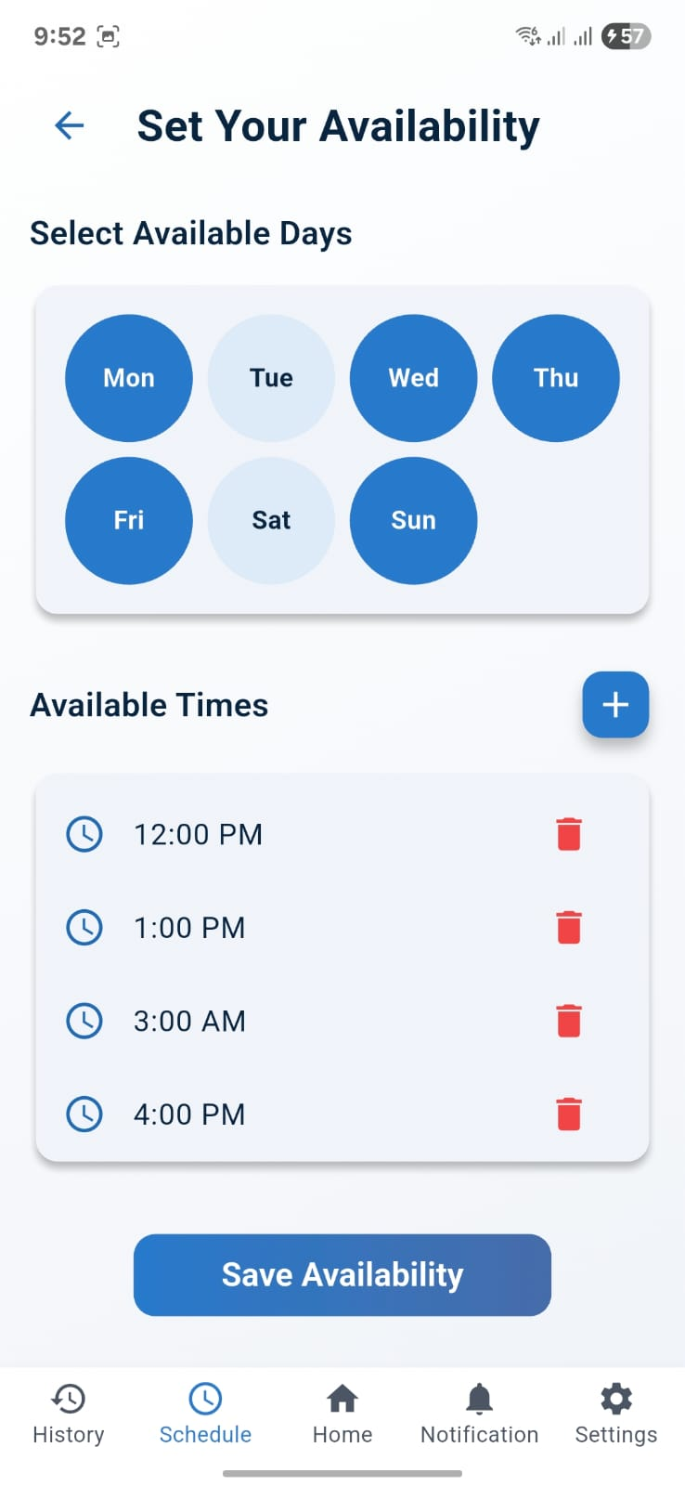
Front-end
09
06
07
08

Slide 56
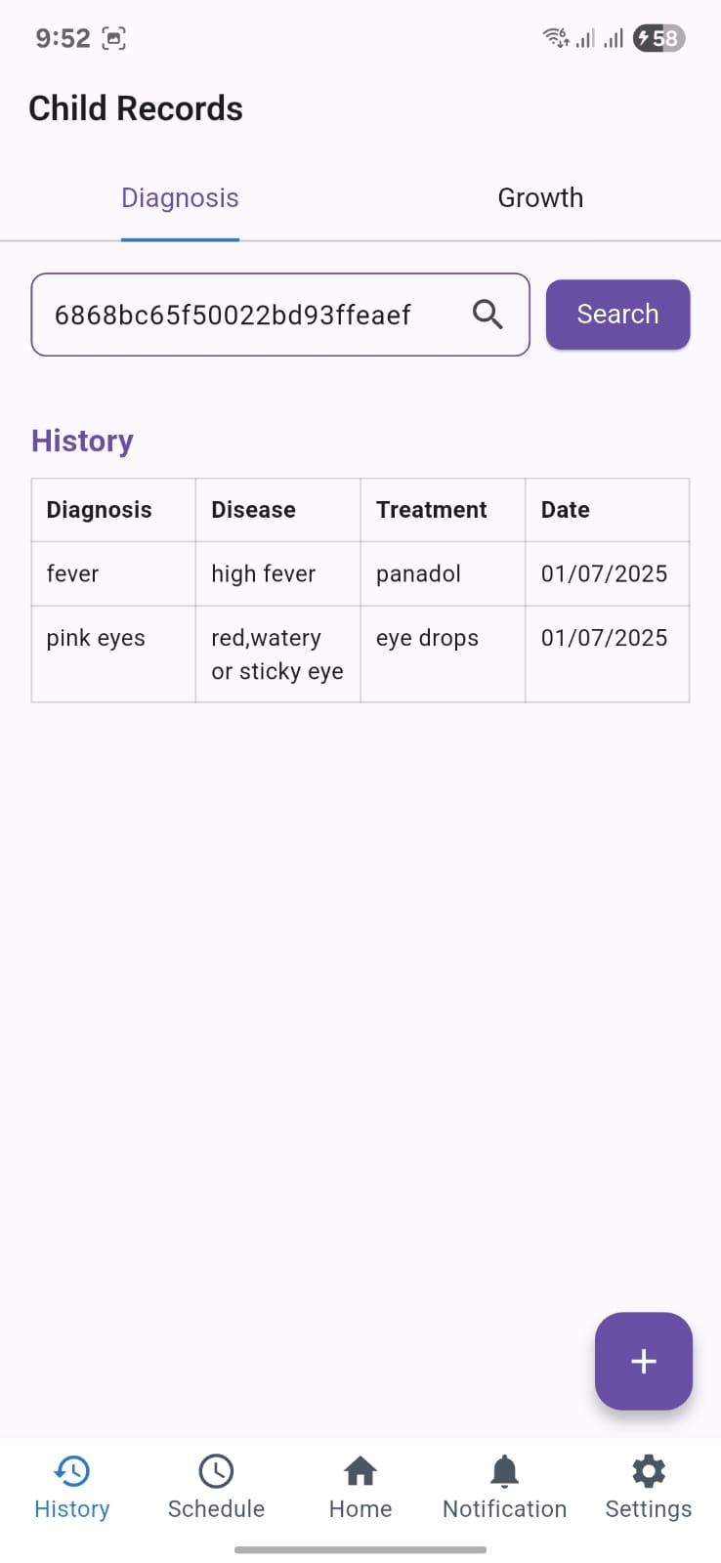
Front-end
09
06
07
08

Slide 57
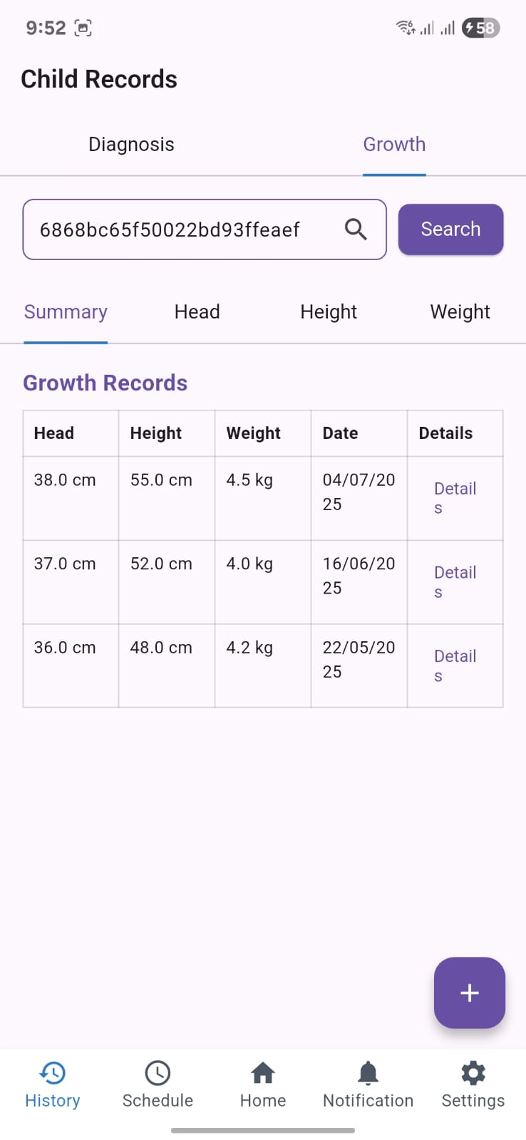
Front-end
09
06
07
08

Slide 58
Front-end
09
06
07
08

Slide 59

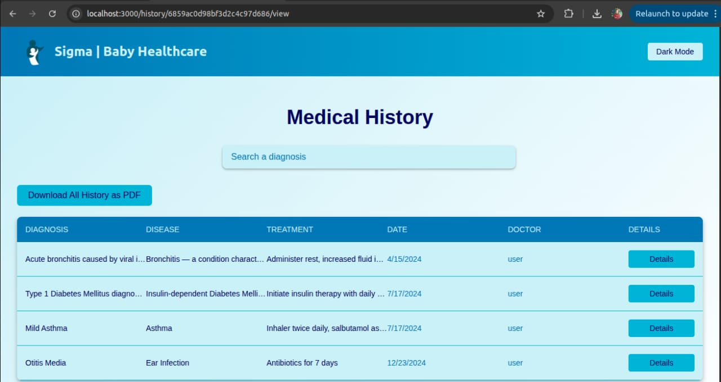
Front-end
09
06
07
08

Slide 60
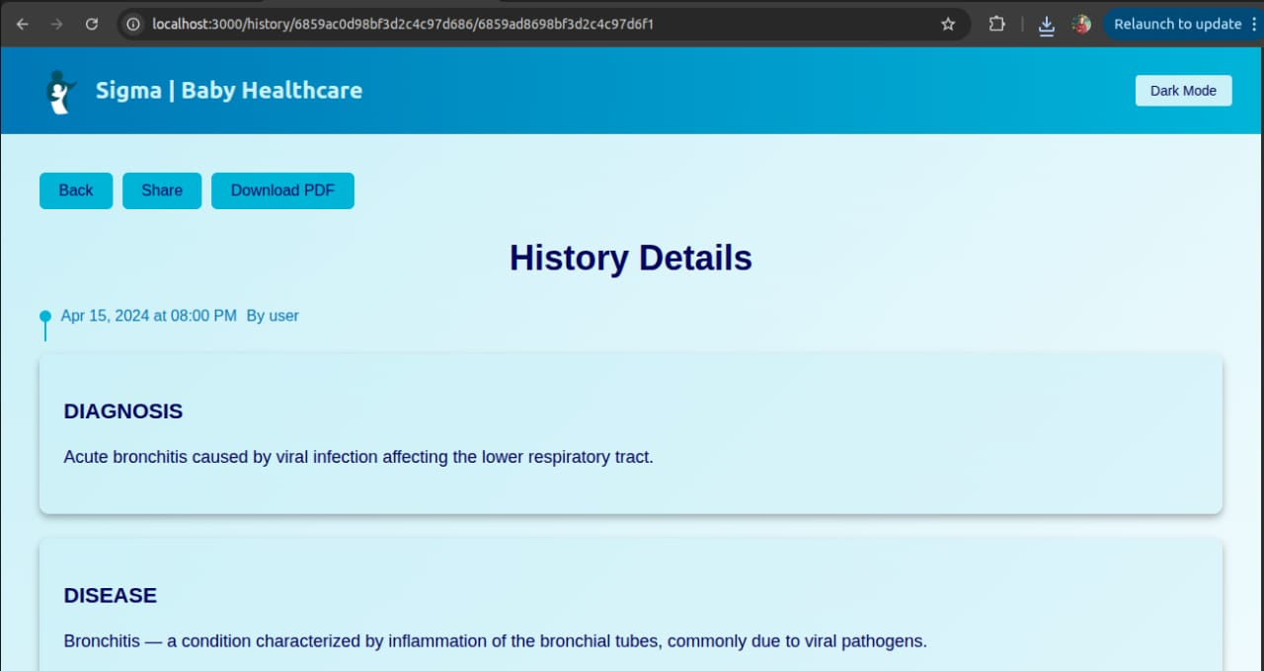
Front-end
09
06
07
08

Slide 61

Front-end
05
06
07
08

Slide 62
Front-end

Slide 63




Front-end
SIGMA
Back-end
AI
Marketing
Future Work

Slide 64
Front-end
Back-end
SIGMA
AI
Marketing
Future Work

Slide 65
Back-end

Slide 66






Back-end
Authentication & Authorization
01. Verifies the identity of a user by common methods: username-password.
02. Determines user access levels after authentication and grants permissions based on the user's role.
03. Ensures users interact only with authorized parts of the application.
04. Tokens are used to authenticate users in the Flutter app.

Slide 67

MongoDB & S3
Back-end
Authentication & Authorization
01. Verifies the identity of a user by common methods: username-password.
02. Determines user access levels after authentication and grants permissions based on the user's role.
03. Ensures users interact only with authorized parts of the application.
04. Tokens are used to authenticate users in the Flutter app.

Slide 68
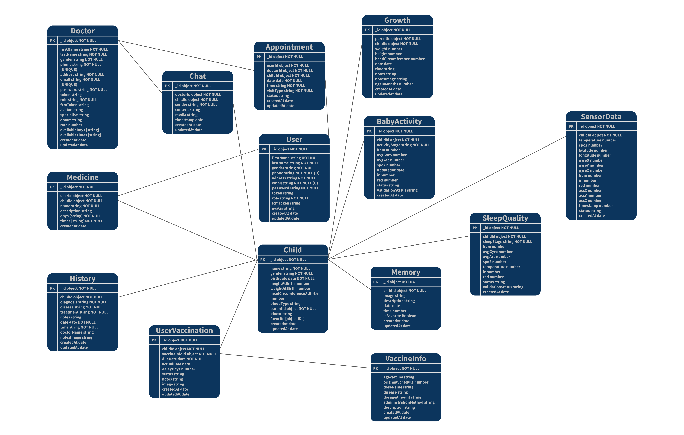

Back-end
MongoDB & S3
MQTT & WebSocket
01. MQTT receives live sensor data from a wearable.
02. Lightweight & ideal for IoT sensors.
03. HiveMQ used as MQTT broker.
04. Node.js subscribes to topics.
05. WebSocket pushes data to user in real-time.
06. Data includes temp, heart rate, oxygen, and location.
07. Data is validated before sending.

Slide 69
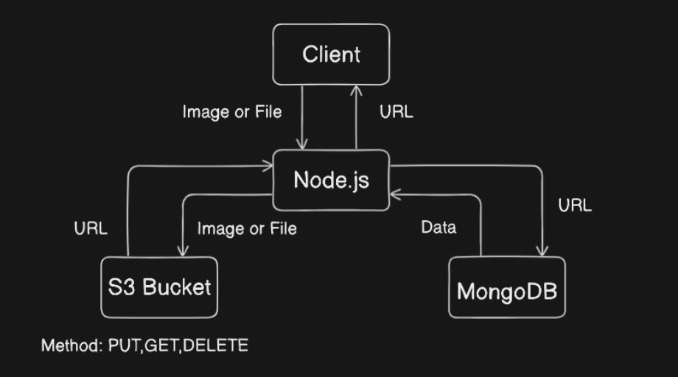
Back-end
MongoDB & S3
MQTT & WebSocket
01. MQTT receives live sensor data from a wearable.
02. Lightweight & ideal for IoT sensors.
03. HiveMQ used as MQTT broker.
04. Node.js subscribes to topics.
05. WebSocket pushes data to user in real-time.
06. Data includes temp, heart rate, oxygen, and location.
07. Data is validated before sending.

Slide 70
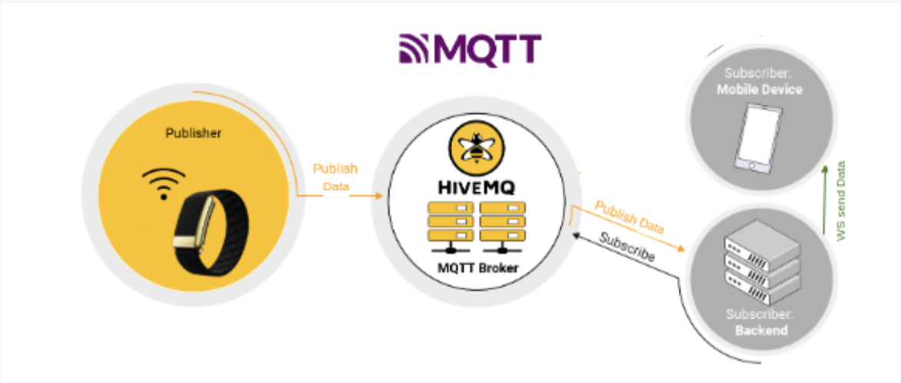

Back-end
EC2 ubuntu & PM2
MQTT & WebSocket
01. The server is hosted on AWS EC2 (Ubuntu instance).
01. MQTT receives live sensor data from a wearable.
02. PM2 is used for Node.js process management.
02. Lightweight & ideal for IoT sensors.
03. Ensures auto-restart on crashes or reboots.
03. HiveMQ used as MQTT broker.
04. The server is always running in the background.
04. Node.js subscribes to topics.
05. WebSocket pushes data to user in real-time.
06. Data includes temp, heart rate, oxygen, and location.
07. Data is validated before sending.

Slide 71

Back-end
FASAPI microservice & Render
EC2 ubuntu & PM2
01. AI services built with FASTAPI (Python).
01. The server is hosted on AWS EC2 (Ubuntu instance).
02. Deployed on Render as a separate microservice.
02. PM2 is used for Node.js process management.
03. Node.js server sends requests to FASTAPI.
03. Ensures auto-restart on crashes or reboots.
04. FASTAPI returns predictions (e.g., asthma, stroke).
04. The server is always running in the background.
05. Clean, modular microservice architecture.

Slide 72

Back-end
FASAPI microservice & Render
01. AI services built with FASTAPI (Python).
02. Deployed on Render as a separate microservice.
03. Node.js server sends requests to FASTAPI.
04. FASTAPI returns predictions (e.g., asthma, stroke).
05. Clean, modular microservice architecture.

Slide 73
Back-end
01. Verifies the identity of a user by common methods: username-password.
02. Determines user access levels after authentication and grants permissions based on the user's role.
03. Ensures users interact only with authorized parts of the application.
04. Tokens are used to authenticate users in the Flutter app.

Slide 74
Back-end

Slide 75
Back-end
SIGMA
AI
Marketing
Future Work

Slide 76
Back-end
AI
SIGMA
Marketing
Future Work

Slide 77
AI

Slide 78

AI
Machine learning
Neural Network
Asthma
Autism
Stroke
Diseases Chatbot

Slide 79
AI
Machine learning pipeline for healthy data analysis
01
02
03
04
05
Data
Collection
Feature Selection
Model
Training
Preprocessing
Evaluation

Slide 80
AI
Machine learning pipeline for healthy data analysis
01
Data
Collection
05
Evaluation
02
04
03
Model
Training
Preprocessing
Feature Selection

Slide 81
AI
Machine learning pipeline for healthy data analysis
01
Data
Collection
02
Preprocessing
05
Evaluation
04
03
Model
Training
Feature Selection

Slide 82
AI
Machine learning pipeline for healthy data analysis
01
Data
Collection
02
03
Preprocessing
Feature Selection
05
Evaluation
04
Model
Training

Slide 83
AI
Machine learning pipeline for healthy data analysis
01
Data
Collection
02
04
03
Model
Training
Preprocessing
Feature Selection
05
Evaluation

Slide 84
AI
Machine learning pipeline for healthy data analysis
01
05
Asthma
Autism
Stroke
Data
Collection
02
04
Evaluation
03
Model
Training
Preprocessing
Feature Selection

Slide 85
AI
Diseases
Stroke
Asthma
Autism

Slide 86
AI
Diseases
Stroke
Stroke is the third leading cause of death in the U.S. and a significant source of long-term disability. Every 40 seconds, someone experiences a stroke, contributing to annual U.S. costs exceeding $56 billion.
Asthma
Autism

Slide 87
AI
Diseases
Stroke
Asthma
Stroke is the third leading cause of death in the U.S. and a significant source of long-term disability. Every 40 seconds, someone experiences a stroke, contributing to annual U.S. costs exceeding $56 billion.
Affects over 25 million people in the U.S., including 1 in 12 children. Causes more than 1.6 million emergency visits each year and contributes significantly to absenteeism and reduced quality of life.
Autism

Slide 88
AI
Diseases
Stroke
Asthma
Autism
Stroke is the third leading cause of death in the U.S. and a significant source of long-term disability. Every 40 seconds, someone experiences a stroke, contributing to annual U.S. costs exceeding $56 billion.
Affects over 25 million people in the U.S., including 1 in 12 children. Causes more than 1.6 million emergency visits each year and contributes significantly to absenteeism and reduced quality of life.
Affects 1 in 36 children in the U.S., with early signs often evident by 18 months. Diagnosis usually occurs after age 4, impacting lifelong development and requiring ongoing support.

Slide 89
AI
Diseases
Asthma
Autism
Stroke
Affects 1 in 36 children in the U.S., with early signs often evident by 18 months. Diagnosis usually occurs after age 4, impacting lifelong development and requiring ongoing support.
Affects over 25 million people in the U.S., including 1 in 12 children. Causes more than 1.6 million emergency visits each year and contributes significantly to absenteeism and reduced quality of life.
Stroke is the third leading cause of death in the U.S. and a significant source of long-term disability. Every 40 seconds, someone experiences a stroke, contributing to annual U.S. costs exceeding $56 billion.

Slide 90
AI
Diseases
Stroke
Optimized Random Forest
Asthma
Accuracy
0.9254
Precision
0.9066
Recall
0.9486
F1
0.9271
ROC AUC
0.9785

Slide 91
AI
Diseases
Asthma
Autism
Accuracy
0.965859
0.879956
0.809471
0.801762
Precision
0.966887
0.867804
0.771760
0.716088
Recall
0.964758
0.896476
0.878855
1.000000
F1
0.965821
0.881907
0.821833
0.834559
Confusion Matrix
[[439, 15], [16, 438]]
[[392, 62], [47, 407]]
[[336, 118], [55, 399]]
[[274, 180], [0, 454]]
ROC AUC
0.992102
0.942479
0.886923
0.941547
Random Forest
Logistic Regression
Support Vector Machine
K-Nearest Neighbors

Slide 92
AI
Diseases
Autism
Optimized GaussianNB
Accuracy
0.971564
Precision (Macro)
0.949153
Recall (Macro)
0.981013
F1 (Macro)
0.963537

Slide 93
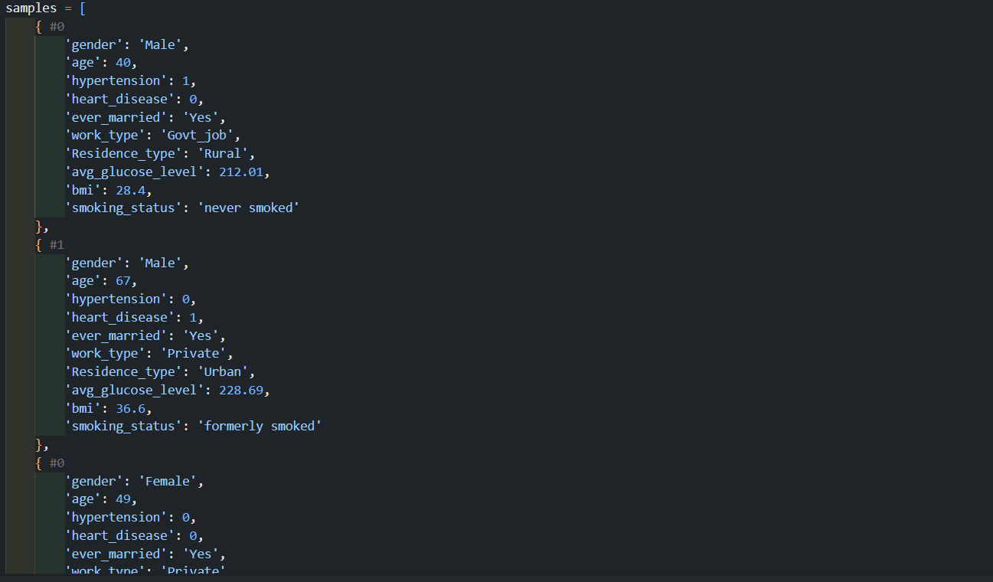
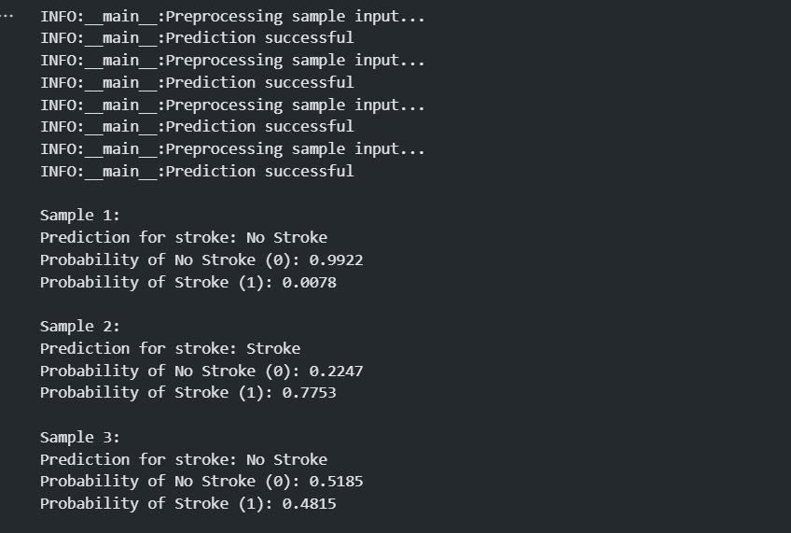
AI
Result Validation
It sounds like you may have asthma. Common symptoms of asthma include shortness of breath, chest tightness or pain, wheezing when exhaling, and coughing or wheezing attacks. It's important to use your prescribed inhaler, avoid known triggers, and consult a healthcare professional if necessary.

Slide 94
AI
Chat Bot
model performance

Slide 95
AI

Slide 96
AI
SIGMA
Marketing
Future Work

Slide 97
AI
Marketing
SIGMA
Future Work

Slide 98
Marketing

Slide 99

Marketing
Problem Statement
A smart bracelet worn by a child has been developed that measures vital signs (such as heart rate, oxygen level, and temperature) and sends the data to an app. This includes real-time GPS location.
01. Nighttime Health Emergencies
02. Children at Risk of Getting Lost
03. Children with Chronic Medical Conditions

Slide 100

Marketing
Problem Statement
01. Nighttime Health Emergencies
02. Children at Risk of Getting Lost
03. Children with Chronic Medical Conditions

Slide 101

Marketing
COMPETITOR
analysis

Slide 102
Marketing
Huawei Kids Watch
Huawei offers smartwatches for kids that combine stylish design with GPS tracking, voice messaging, and water resistance, mainly marketed as a communication and safety tool.
COMPETITOR
analysis

Slide 103
Marketing
Apple Watch
Huawei Kids Watch
The Apple Watch is a premium wearable known for features like heart rate tracking, ECG, fall detection, and emergency SOS, making it popular for fitness and health management among adults and a competitor to our product.
Huawei offers smartwatches for kids that combine stylish design with GPS tracking, voice messaging, and water resistance, mainly marketed as a communication and safety tool.
COMPETITOR
analysis

Slide 104
Marketing
Apple Watch
Huawei Kids Watch
The Apple Watch is a premium wearable known for features like heart rate tracking, ECG, fall detection, and emergency SOS, making it popular for fitness and health management among adults and a competitor to our product.
Huawei offers smartwatches for kids that combine stylish design with GPS tracking, voice messaging, and water resistance, mainly marketed as a communication and safety tool.
COMPETITOR
analysis
Tide Kids Watch
G-Tide offers affordable smartwatches for children with basic functionalities such as GPS tracking and calling, targeting parents who want to stay connected with their kids.

Slide 105
Marketing
Apple Watch
Huawei Kids Watch
The Apple Watch is a premium wearable known for features like heart rate tracking, ECG, fall detection, and emergency SOS, making it popular for fitness and health management among adults and a competitor to our product.
Huawei offers smartwatches for kids that combine stylish design with GPS tracking, voice messaging, and water resistance, mainly marketed as a communication and safety tool.
COMPETITOR
analysis
Tide Kids Watch
Imoo Kids Watch
G-Tide offers affordable smartwatches for children with basic functionalities such as GPS tracking and calling, targeting parents who want to stay connected with their kids.
Imoo is a known smartwatch for kids, providing GPS tracking and communication. It enables parents to locate their children and make voice or video calls via a dedicated app.

Slide 106
Marketing
Opportunity in Egypt
Target Audience
Market
Customer Segments
Egypt has over 15 million children under 14
01. Mothers needing health and safety tracking for their children
02. Parents worried about their kids getting lost
Lack of Suitable Alternatives
03. Schools and nurseries aiming to improve child safety
There is currently no product available in the Egyptian market that combines:
Real health monitoring + GPS tracking + real-time notifications for the mother.
Most available are GPS watches or health apps for adults only.
Customer Needs
child safety and peace of mind for parents.

Slide 107
Marketing
Opportunity in Egypt
Market
Egypt has over 15 million children under 14
Lack of Suitable Alternatives
There is currently no product available in the Egyptian market that combines:
Real health monitoring + GPS tracking + real-time notifications for the mother.
Most available are GPS watches or health apps for adults only.

Slide 108
Marketing

Slide 109
Marketing
SIGMA
Future Work

Slide 110
Marketing
Future Work
SIGMA

Slide 111
Future Work

Slide 112

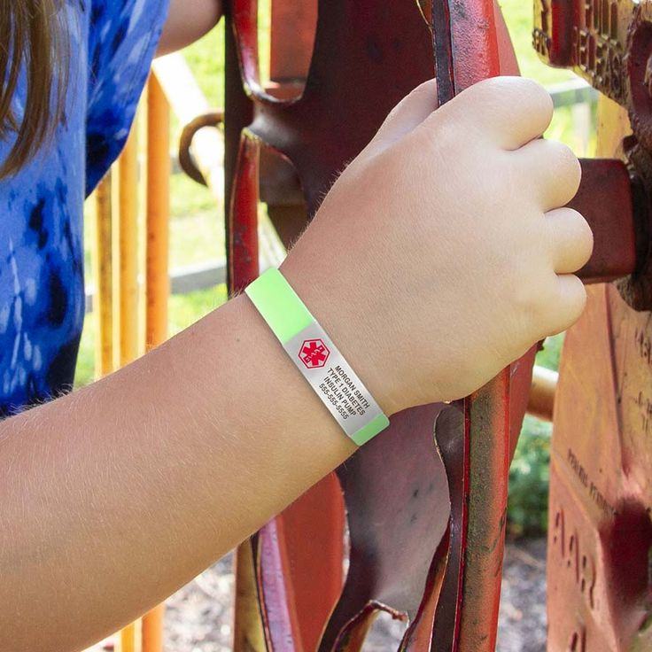
Future Work
AI
CNN-Based Models for Medical Imaging In the future, we aim to develop Convolutional Neural Network (CNN)-based models that utilize medical images as input to accurately diagnose patients. These models will be trained on large datasets of medical imaging to identify patterns and anomalies that support clinical decision-making.

Slide 113
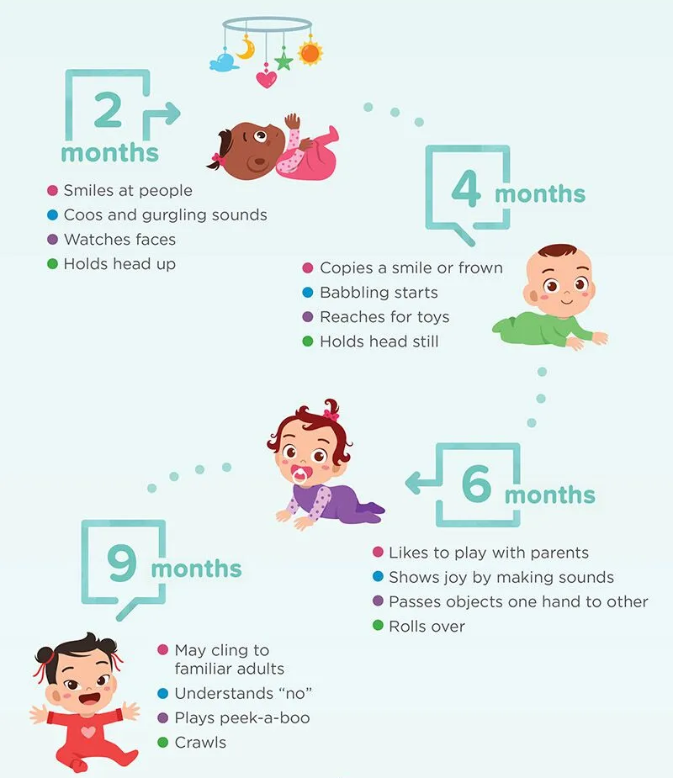
Development
interactive developmental questionnaire based on the CDC’s “Learn the Signs. Act Early” milestones for children aged 2 months to 5 years. By answering simple, age-appropriate questions, parents can receive immediate feedback on whether their child’s behavioral, speech, and motor development aligns with expected norms or if further evaluation is recommended.

Slide 114
Future Work

Slide 115
Future Work
SIGMA

Slide 116
Future Work
SIGMA

Slide 119
Thank You for Being Part of This Journey.
Every slide held a story — thank you for listening. Questions, thoughts, or reflections? Let’s hear them.

