Slide 1



AI-Powered Health Monitoring App & Bracelet & Web Platform
SmartBrace:

Slide 2
Table of contents
01
02
03
04
05
06
The problem and the solution
Hardware
UI/UX
AI Model
Back-End
Next Step

Slide 3


01
Our Problem and the Solution

Slide 4



Our problem
Childcare, especially in critical medical situations like fever or respiratory conditions, demands constant attention from both parents and healthcare providers.
In today's fast-paced world, parents face numerous challenges in monitoring and managing their child's health efficiently. Traditional health tracking methods are often fragmented, inefficient, and prone to human error.

Slide 5


The Solution
Hardware
Application

Slide 6
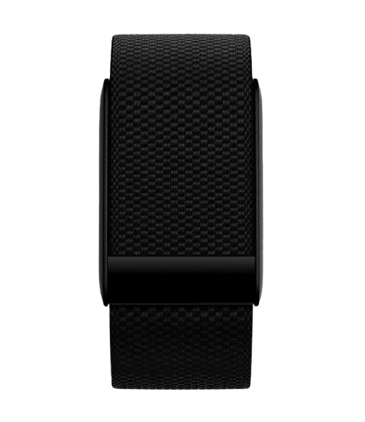
02
Hardware

Slide 7


Sigma
Protection and notifications
No matter the distance

Slide 8



Features

Slide 9
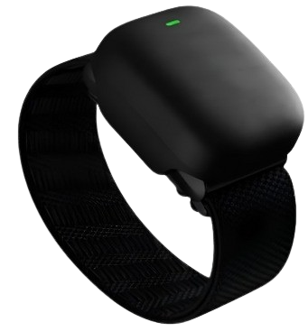
Charging

Slide 10
Sizes
1.01cm
2.79cm

Slide 11

03
UI/UX

Slide 12
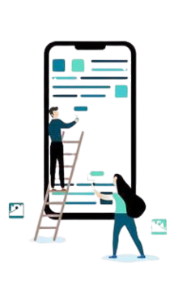
Why FLUTTER?
Single Codebase for Multiple Platforms
Expressive UI
High-performance capabilities

Slide 14
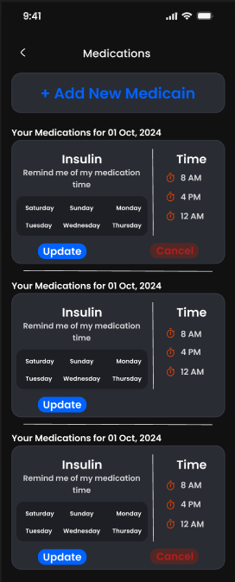
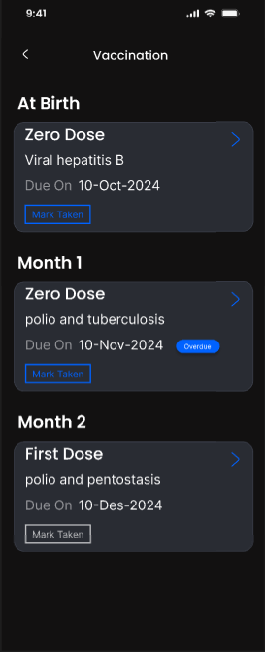
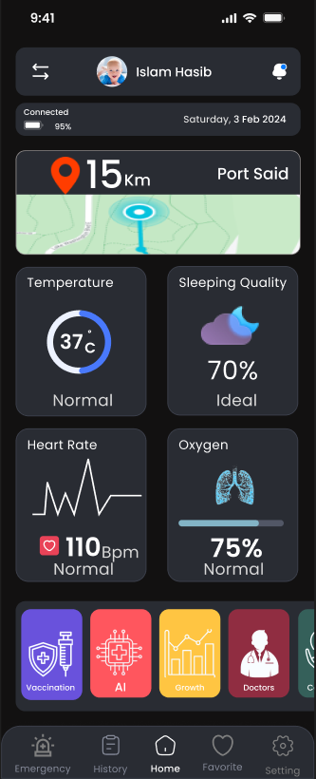
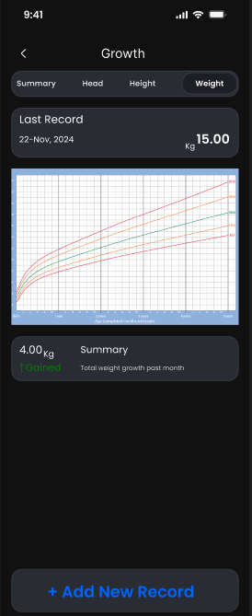
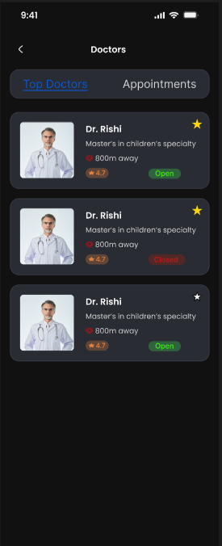



Slide 24

04
AI Model

Slide 25


We have 4 AI models
1. Asthma prediction
2. Diabetes prediction
3. Autism prediction
4. Stroke prediction

Slide 26

WORK WE HAVE COMPLETED
1. Data Validation
2. Data Exploration
3. Data Preparation

Slide 27
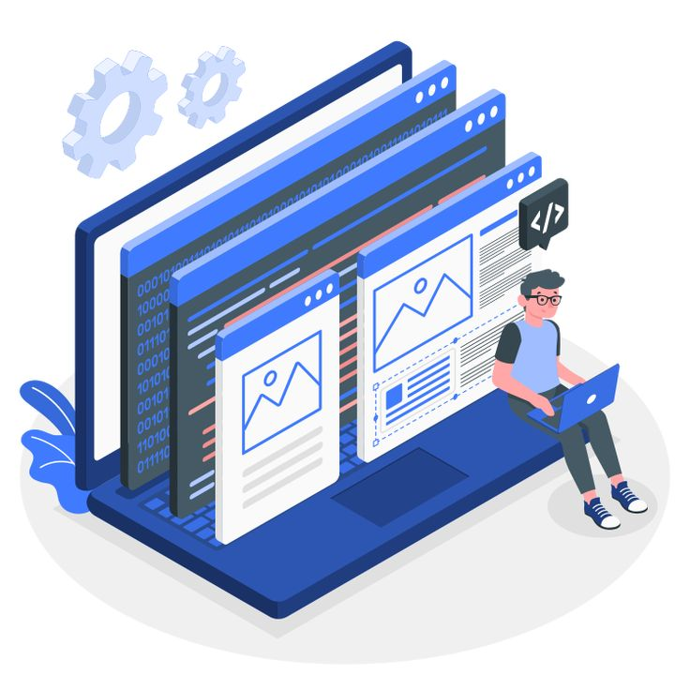
Back-End
05

Slide 28
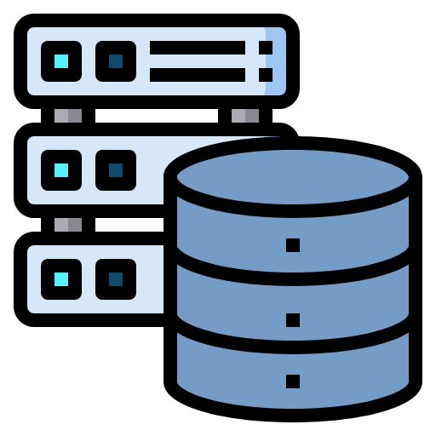
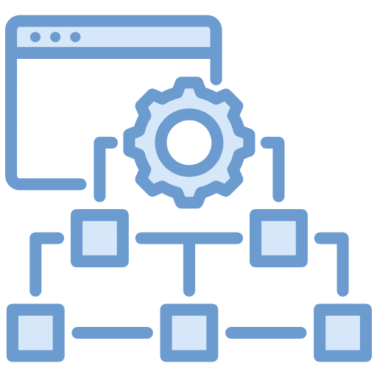





Slide 29

DATABASE
Why Mongodb?

Slide 30
DATABASE
Why Mongodb?

Slide 31
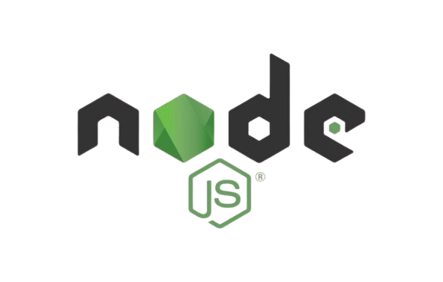
FRAMWORK
Nodejs (express)

Slide 32
FRAMWORK
Nodejs (express)

Slide 33

SREVER
Amazon Web Services

Slide 34
SREVER
Amazon Web Services

Slide 35

Next Step
06

Slide 36
Smart Bracelet Development:
Designing and creating innovative wearable technology tailored for child needs.
Mobile App Development:
Building a user-friendly and interactive application to complement the smart
bracelet’s functionalities
AI Models:
Model Results: Finalize models, extract accuracy, and evaluate performance using
relevant AI statistical measures.
Flutter Integration: Integrate the models with a Flutter application for seamless
mobile app connectivity.

Slide 37
Backend:
Implementing a scalable and secure backend infrastructure to manage data and system
operations efficiently.
Testing and Integration:
Conducting thorough testing and seamless integration to ensure optimal performance
and reliability.

Slide 38
Website

Slide 39

Thanks

