Slide 1


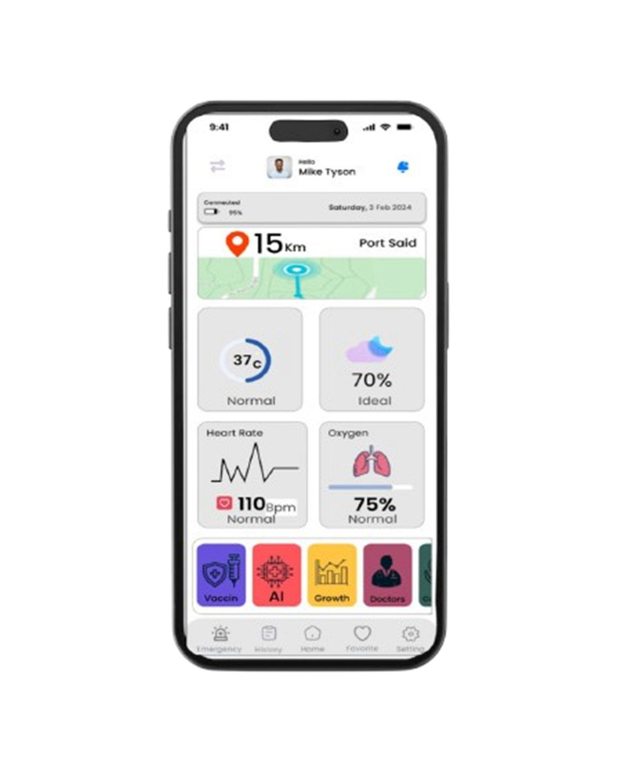

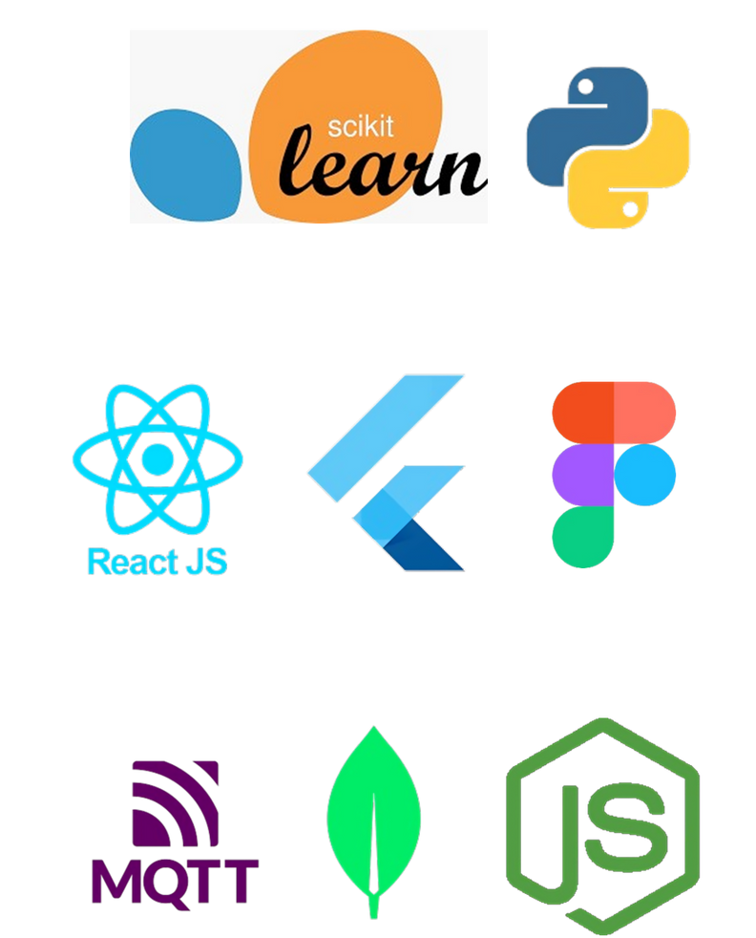


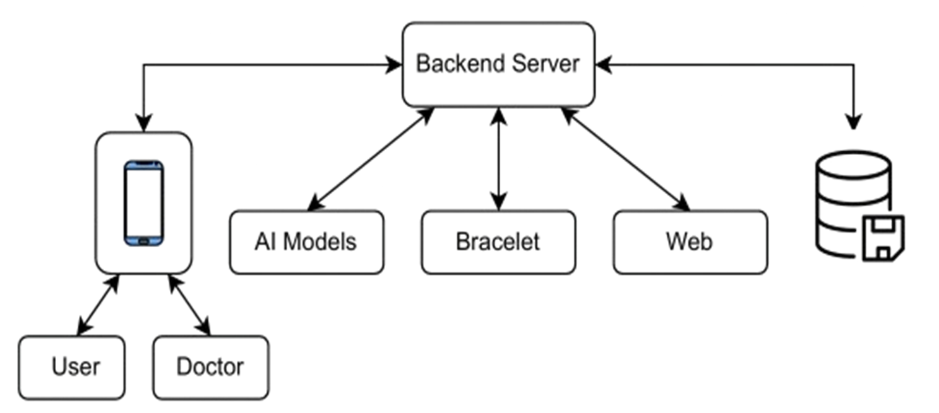
SmartBrace: AI-Powered Health Monitoring App &Bracelet &
Web Platform
INTRODUCTION
1
We offer a smart application to monitor children's health, using a bracelet attached to their wrist to measure vital signs and display them in real-time.
The application helps track the child's vaccinations, growth, and medication schedules, as well as record their medical history in case of any health problems.
It also allows easy booking of doctor appointments to follow up on medical conditions. The project aims to provide an integrated digital solution to support children's healthcare with precision and ease.
4
RESULTS
Home Screen: Main screen showing the child’s health metrics (temperature, sleep, heart rate, oxygen)
Vaccination Screen: Displays the child’s vaccination schedule, tracks progress, and sets reminders.
Growth Screen (AI Growth): Uses AI to show growth metrics (height, weight) in charts for monitoring.
Medicine Screen: Manages the child’s medication schedule with dosage and reminders.
Doctor Screen (Appointments): Lists upcoming doctor appointments and allows booking.
History Screen: Records past health data, vaccinations, and doctor visits.
TECHNOLOGY
Machine Learning
Coded using Python .
Collecting data from Kaggle.
Front-End
Design the app on Figma.
Built the UI using Flutter.
Website made by React.
Back-End
Use Node.js and Express.js.
MongoDB manages data.
Transfer hardware data to server.
Hardware
- Simulated by Protues .
- Coded by Arduino ide .
2
5
CONCLUSION
The application enables parents to monitor their children's vital signs in real time and manage vaccinations, growth tracking, and medication schedules.
It provides a complete medical history for each child, helping doctors offer faster and more accurate care.
Parents can easily book appointments with doctors through the app, ensuring timely medical consultations when needed.
The project aims to create a smarter healthcare system that supports children's health and improves their quality of life.
BLOCK DIGRAM
3
Project Team
Supervisor:Dr.Ahmed Hosny Eid
Arwa Ahmed Desouki
Osama Mohamed Gharib
Islam Hasib Thabet
Obeid Allam
Hassan Hossam
6

