Slide 1
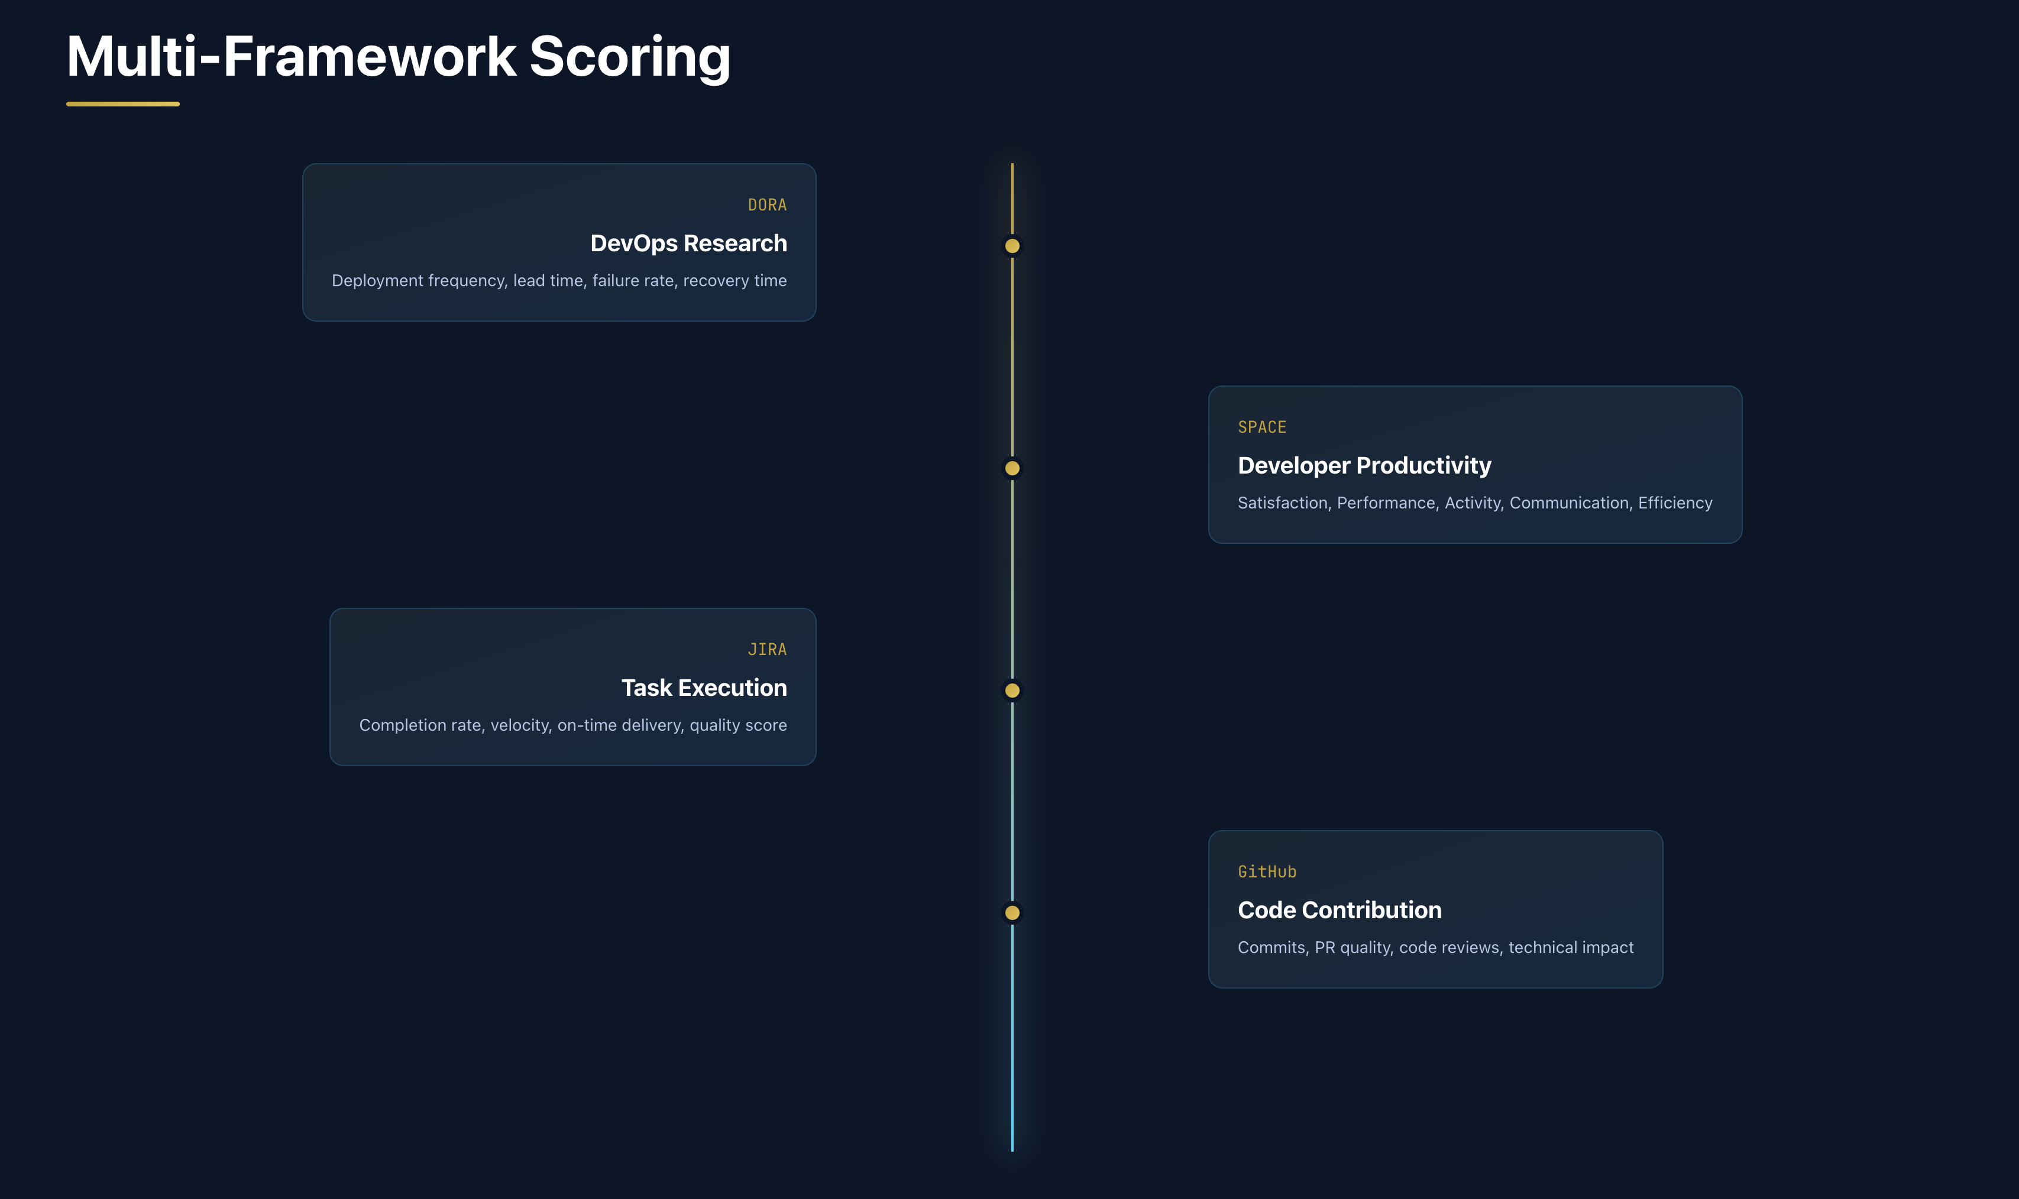
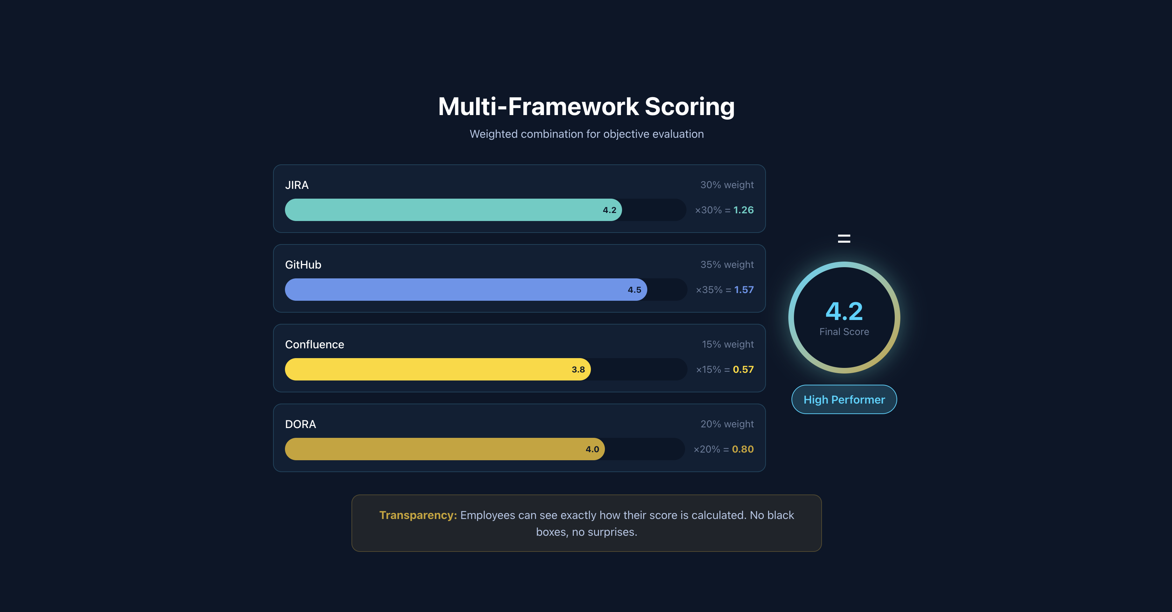
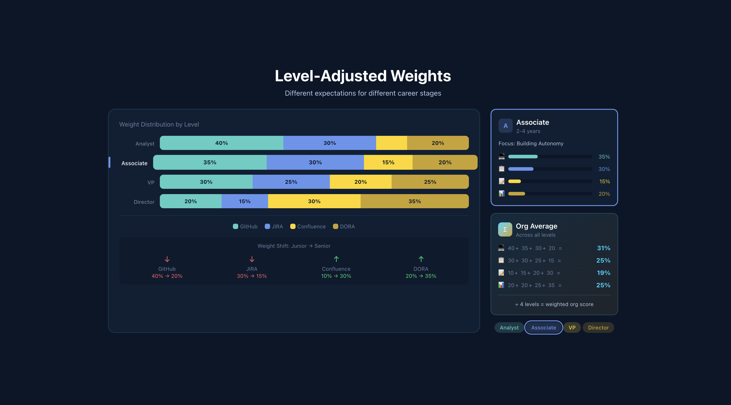
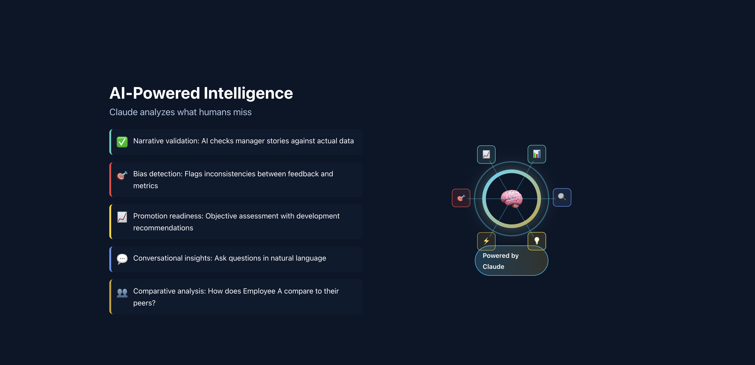
Evalio — Engineering Score
Objective performance measurement powered by data
Key Takeaways
1
Unified scoring from JIRA, GitHub, Confluence data
2
Role-based weights — seniors vs juniors evaluated differently
Multi-Framework Scoring
Score Calculation
3
Team benchmarking removes apples-to-oranges comparisons
4
AI explains the score — no more "How do I justify this rating?"
Level-Adjusted Weights
AI-Powered Intelligence
5
Managers get objective data, engineers get fair evaluations
Objective data. Fair evaluations. No more guesswork.

