Slide 1


An-Nusrah Foundation Web Portal

Slide 2
Project Team & Supervision
Meet the dedicated students and their esteemed faculty mentors driving the development of this Final Year Project.
Development Team
Academic Supervision
Umma Salma Jarin 0272220005101105
Trisna Pual 0272220005101108
Warisul Akter Emon 0272220005101110
Subarna Biswas 0272220005101135
Supervisor:
Md. Al Amin Mridha, Lecturer
Co-Supervisor:
Md. Ajharul Islam Miraj, Lecturer
Department of Computer Science and Engineering
City University

Slide 3
Agenda
Introduction
Problem Statement
System Architecture
Flow Chart
Objective
Key Features
ER Diagram
Future Work
Resource
Website Layout Overview
Payment Integration
Conclusion

Slide 4
Introducing the An-Nusrah Foundation System
The An-Nusrah Foundation System is a web-based platform designed to integrate madrasah education management with Islamic donation processes. This innovative solution addresses the challenges of traditional manual systems in Bangladesh, which often lead to inefficiency and a lack of transparency. The platform streamlines Zakat calculation and donation, inspired by the best practices of the As-Sunah Foundation, to ensure a more organized, efficient, and impactful charitable giving experience.

Slide 5
Literature Review & Existing Systems
Current solutions for educational management and donation administration often operate independently, leading to operational complexities and inefficiencies that require multiple software solutions.
Educational Management System
Donation Management System
Proposed An-Nusrah Portal
Integrates educational management, charity administration, financial reporting, and Islamic digital services into one centralized platform.
Automates student registration, attendance, examinations, fee collection, and academic reporting.
Focuses on online donations, donor records, campaign management, payment tracking, and financial reporting.
The An-Nusrah Foundation Web Portal addresses these gaps by offering an integrated platform that enhances transparency, simplifies operations, and boosts overall efficiency through a unified system.

Slide 6
Problem Statement
Manual Student Record Management
Inefficient Monthly Fee Tracking
Lack of Donation Transparency
No Integrated Digital Platform

Slide 7
Objectives of the Project
To develop a centralized web-based management system
To create a structured and transparent donation management system
To automate student information and fee management processes
To implement a Shariah-compliant Zakat calculation feature

Slide 8

Complete System Features
CORE MANAGEMENT FEATURES
PUBLIC & COMMUNITY SERVICES
PLATFORM FEATURES
Donation Management
Prayer Times
Secure Authentication
Zakat Management
Qibla Compass
Responsive Design
Islamic Library
Mosque Finder
Online Payment (SSLCommerz)

Slide 9



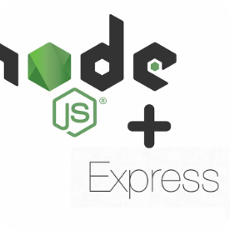





Technology Stack
Our carefully selected technology stack ensures scalability, security, responsiveness, and maintainability.
Frontend
Frontend
Backend
Backend
Database
React.js
Tailwind CSS
Node.js
Express.js
MongoDB
Authentication
Payment Gateway
Development Tools
Version Control GitHub
JWT
SSLCommerz
VS Code

Slide 10
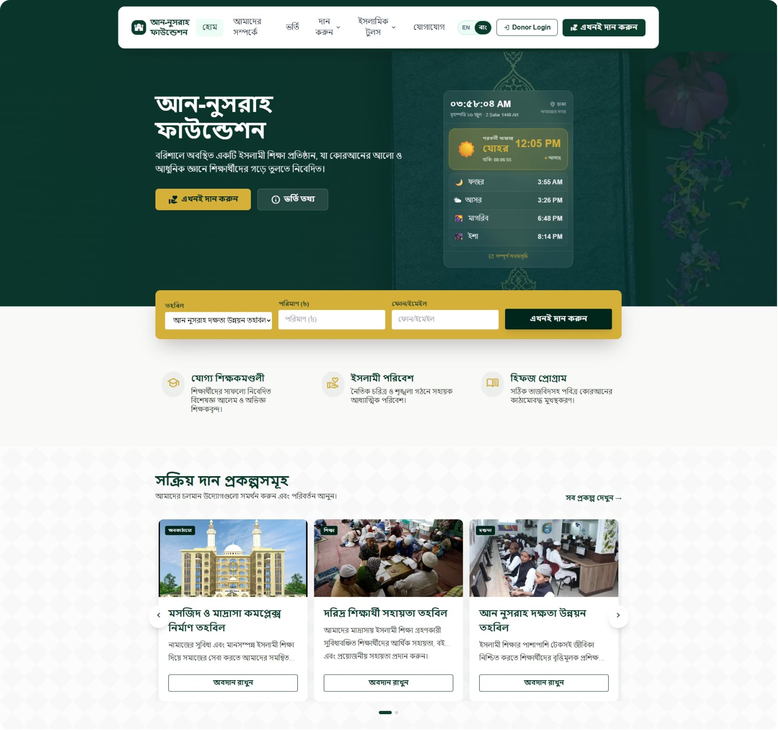
Website Overview - Home Page

Slide 11
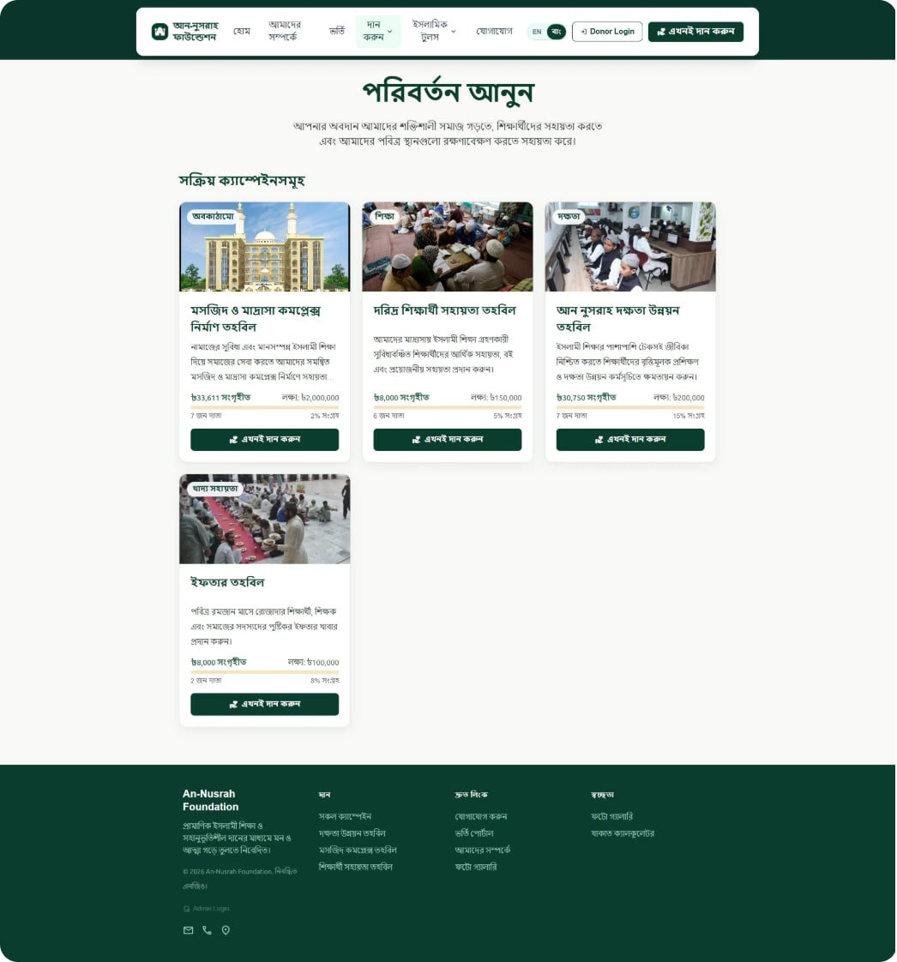
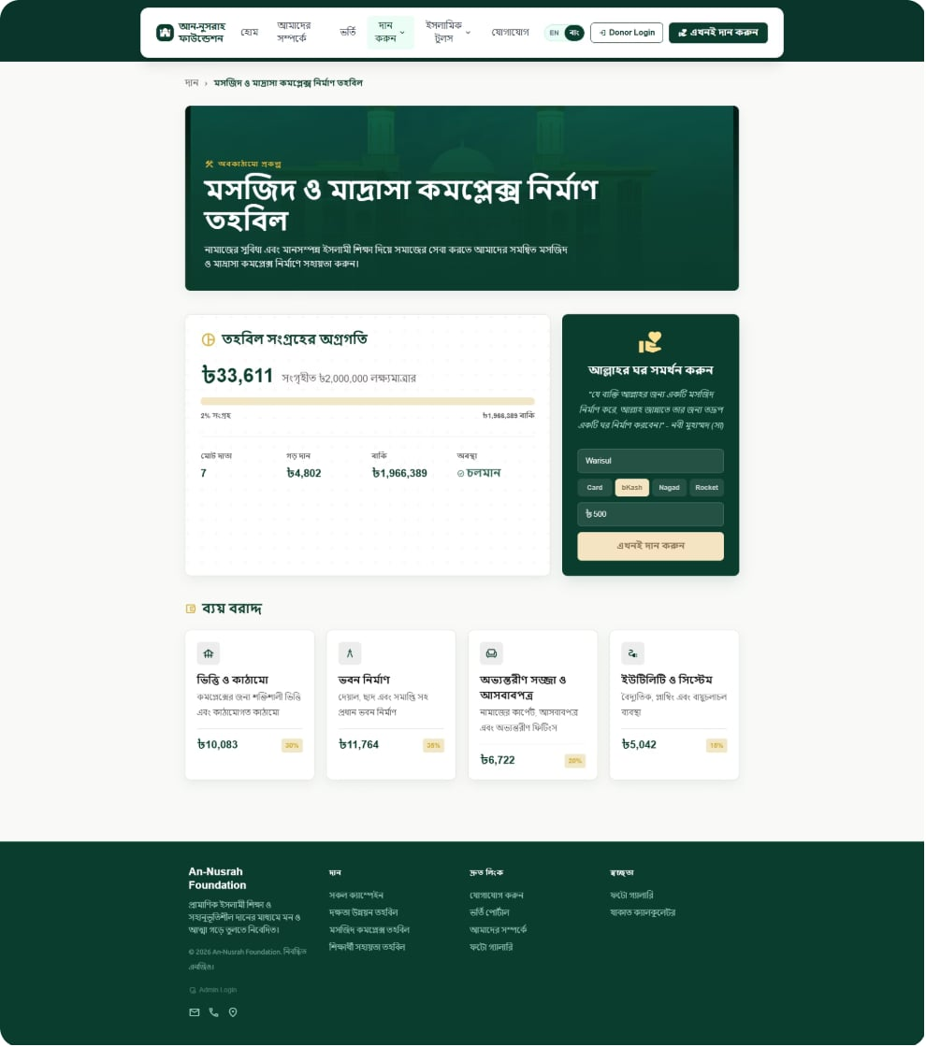
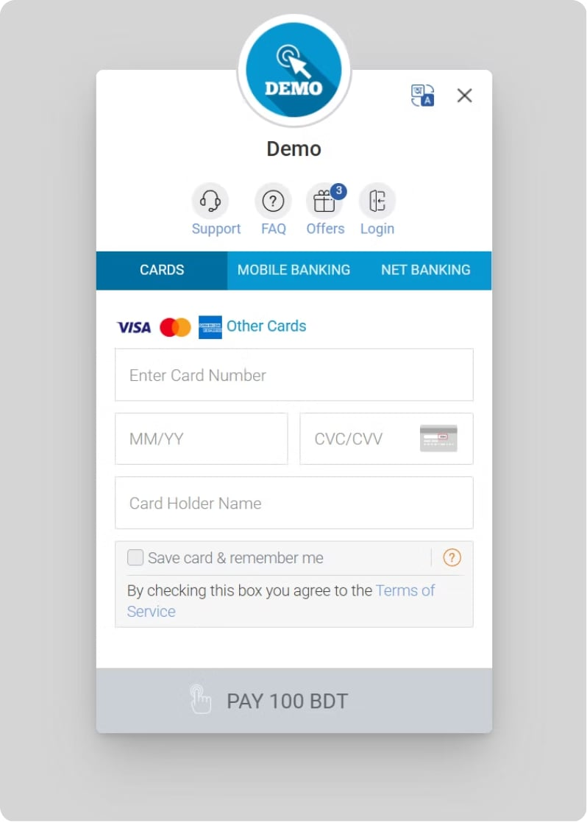
Website Overview - Donation Page

Slide 12
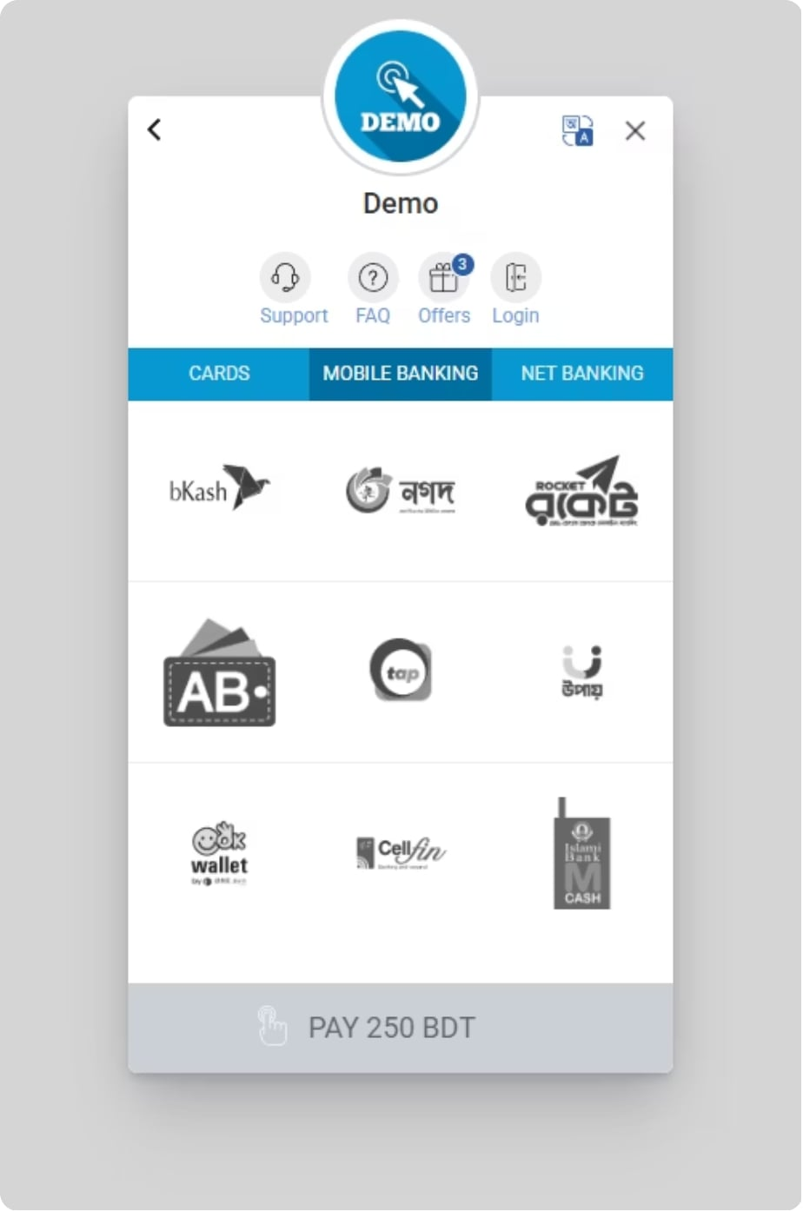
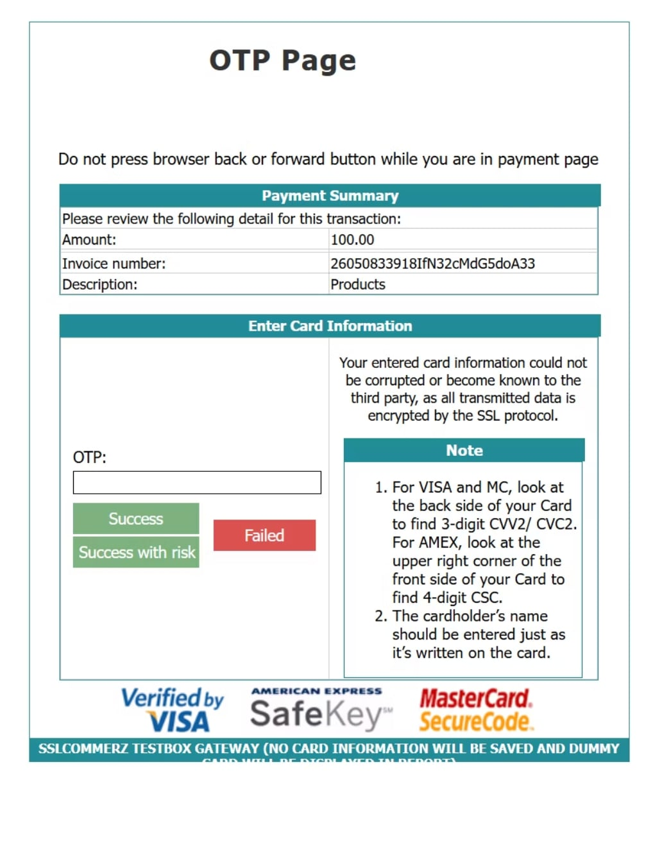
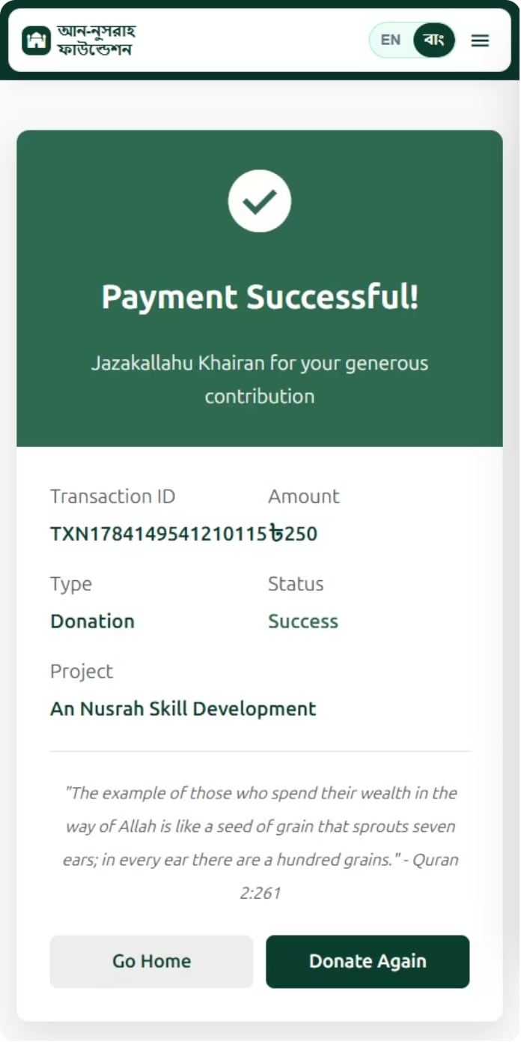
Website Overview - Donation Page

Slide 13
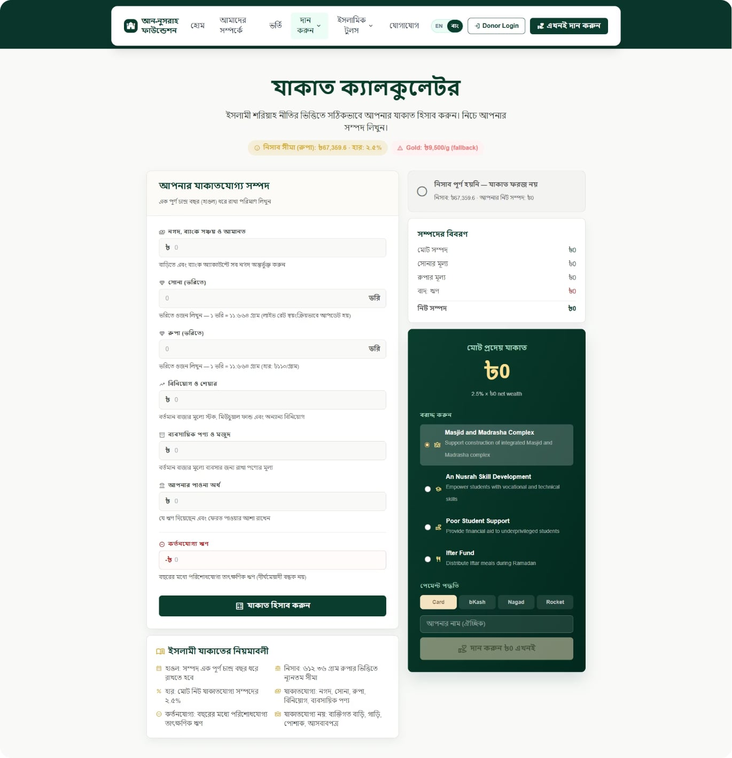
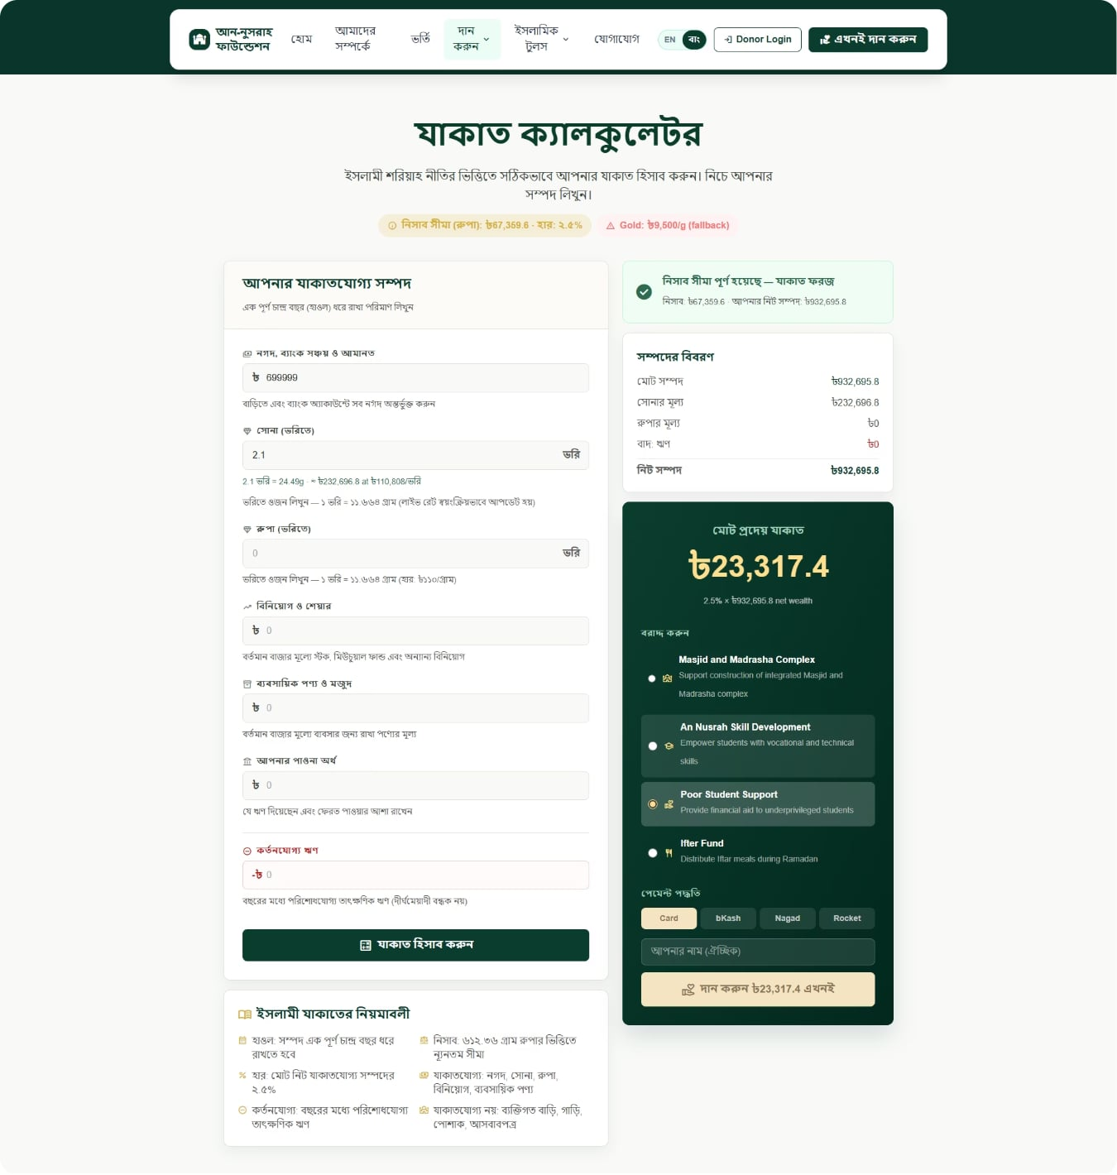
Website Overview - Zakat Page

Slide 14
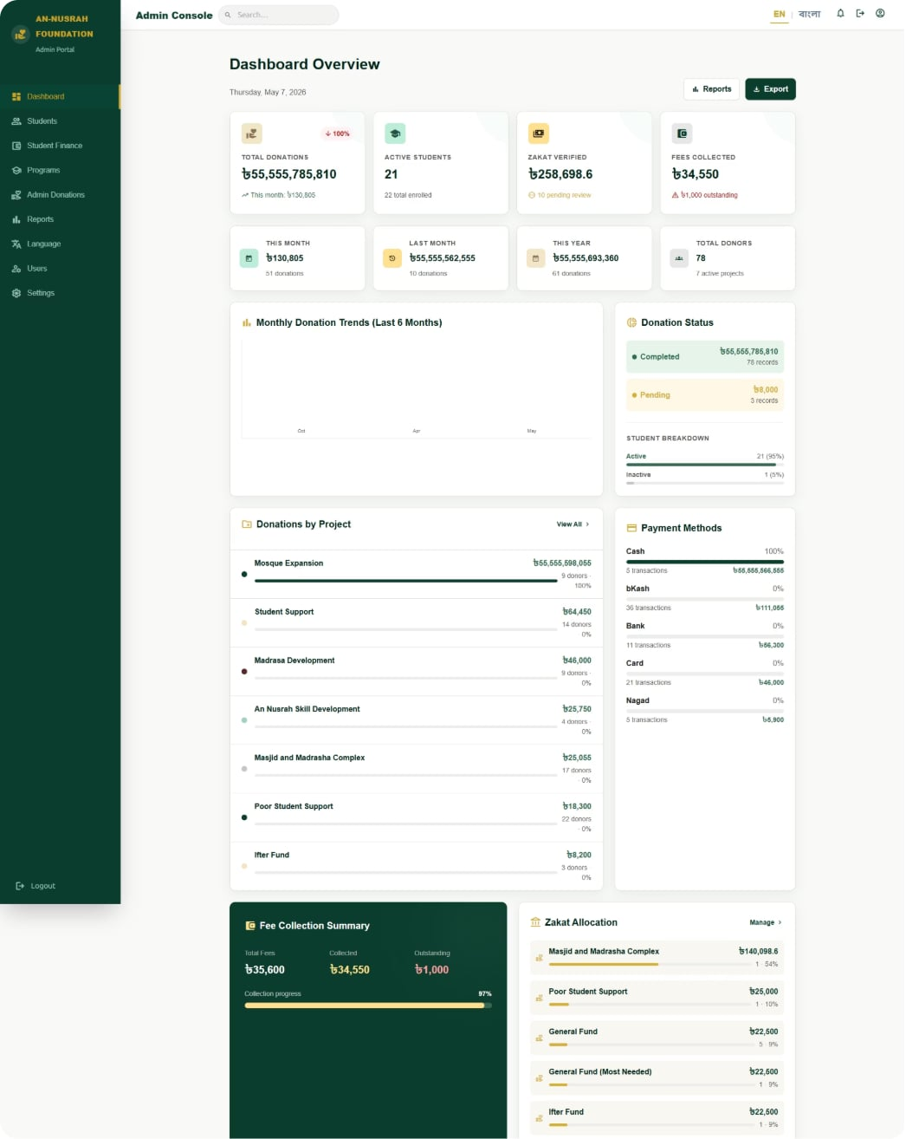
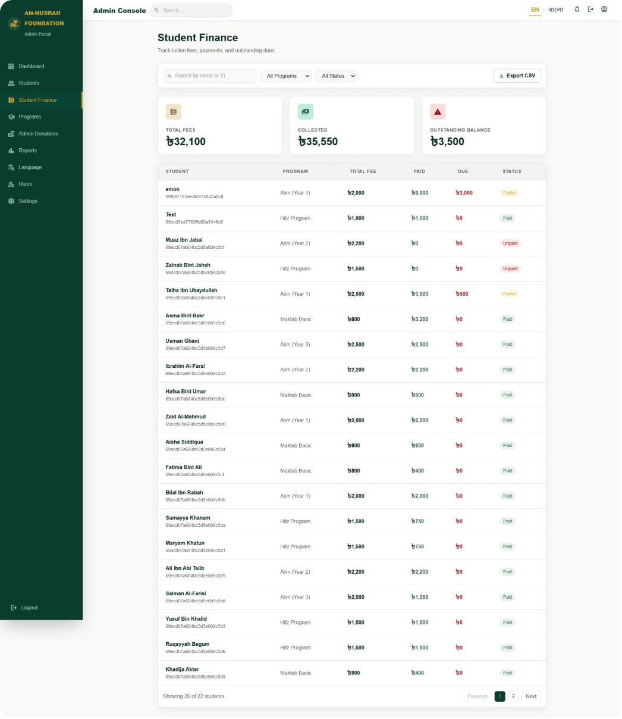
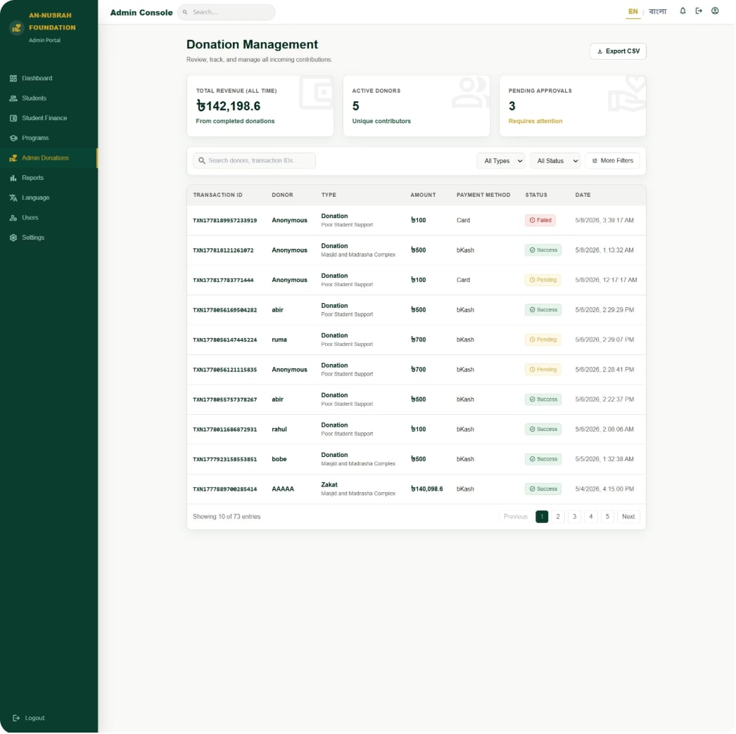
Website Overview - Admin Panel

Slide 15
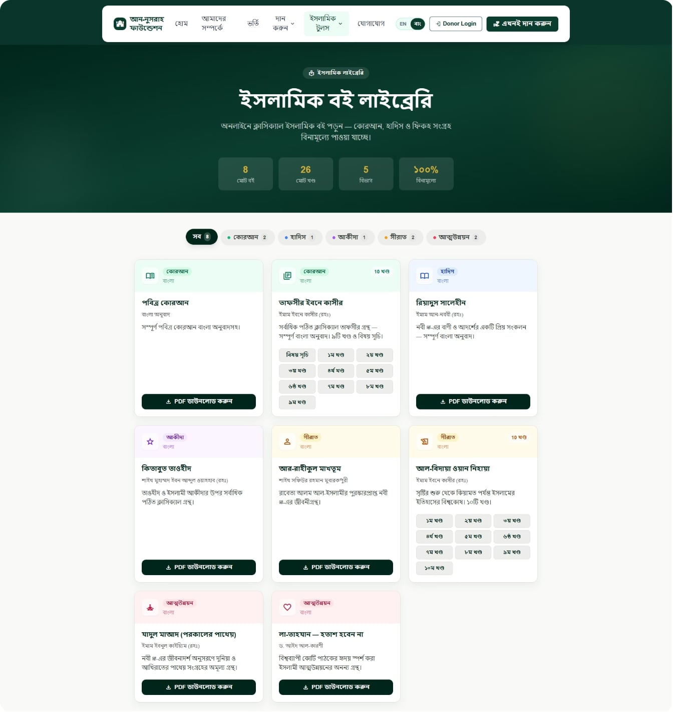
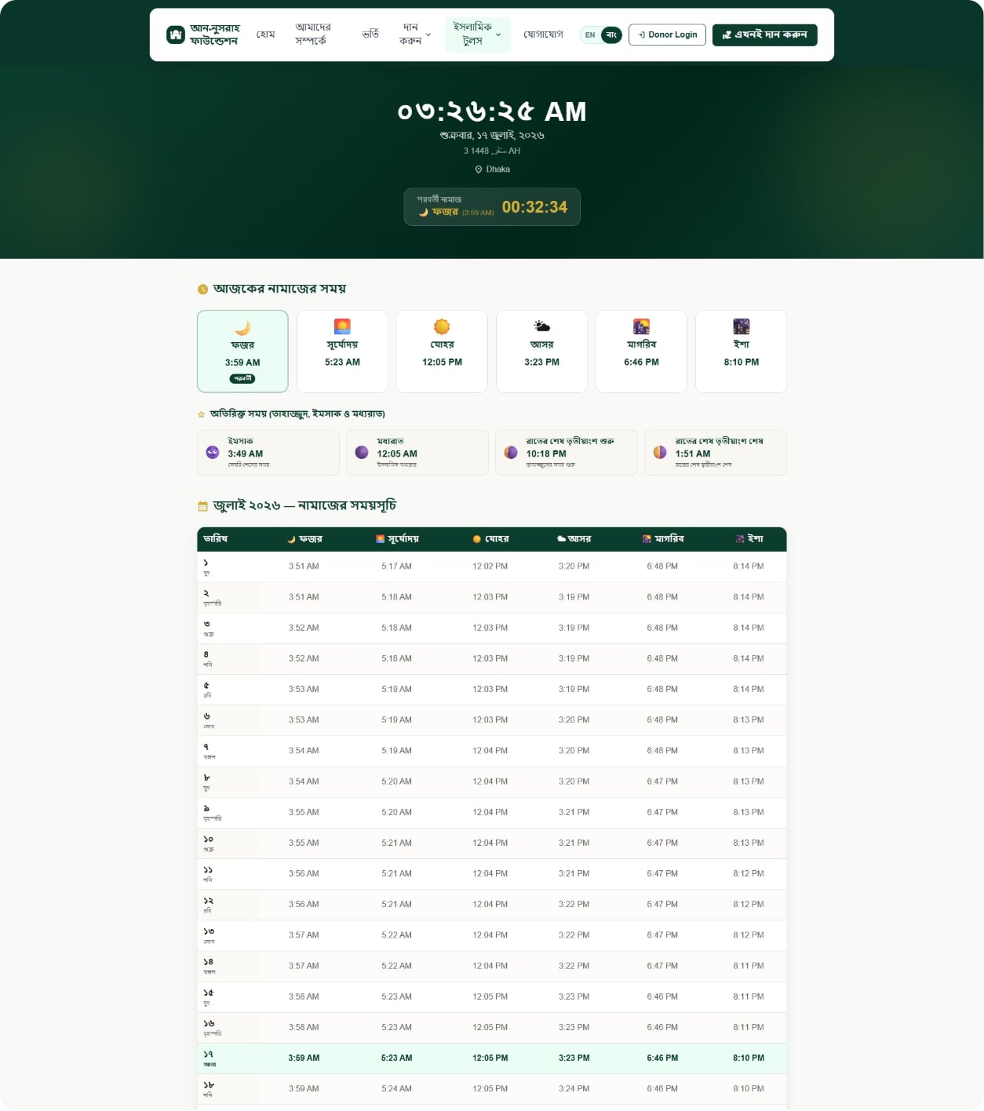
Website Overview - Islamic Tools

Slide 16
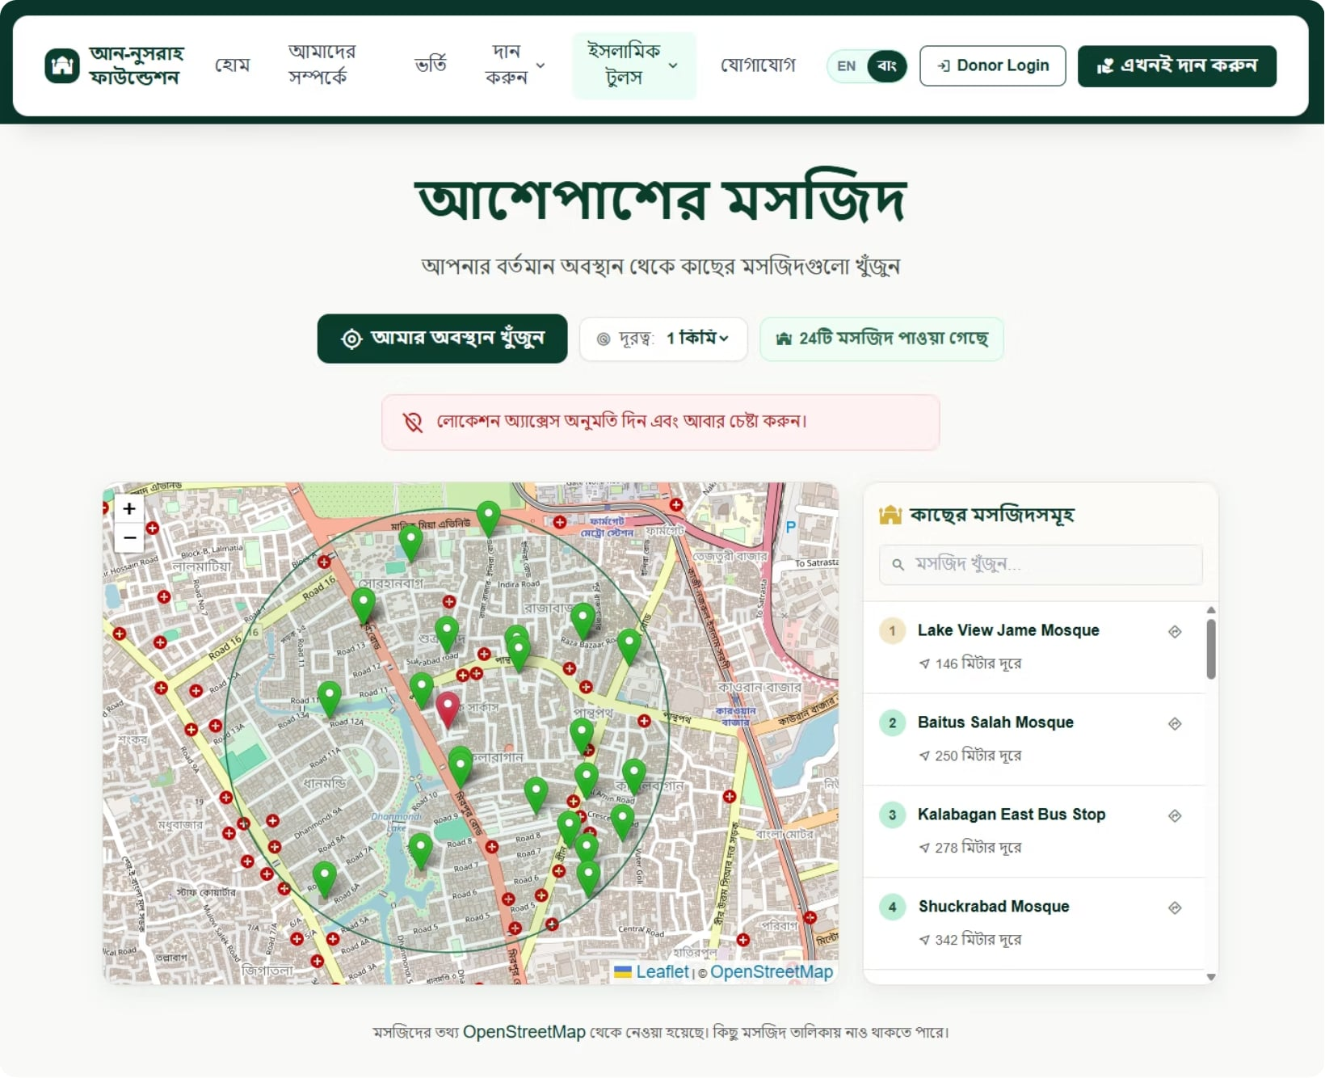
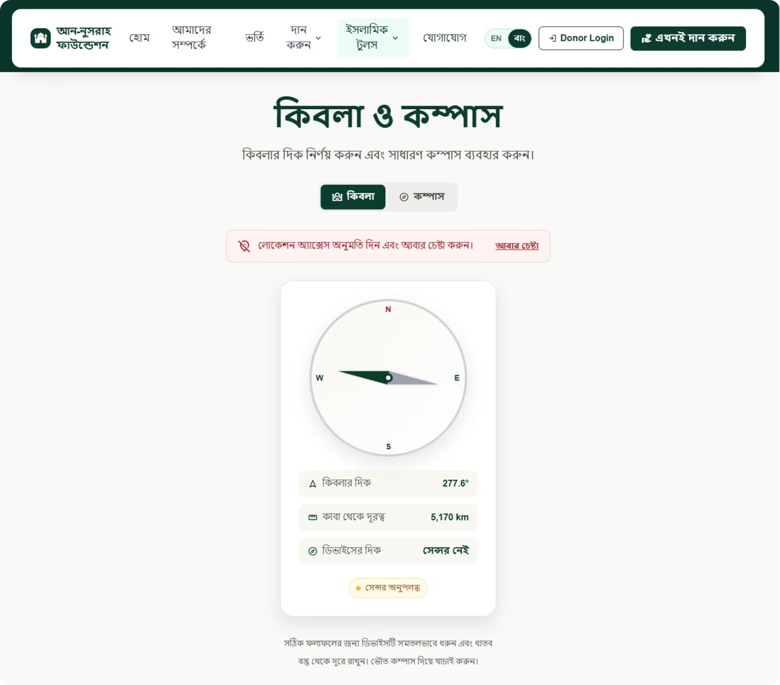
Website Overview - Islamic Tools

Slide 17
System Architecture
USERS LAYER
PRESENTATION LAYER
APPLICATION LAYER (REST API)
MONGODB DATABASE
Administrator
Donor
Visitor
React.js Frontend
Responsive User Interface
Dashboard
Express.js Backend
Authentication (JWT)
Business Logic
Donation Management
Zakat Management
Islamic Digital Services
Users
Students
Donations
Programs
Payments

Slide 18
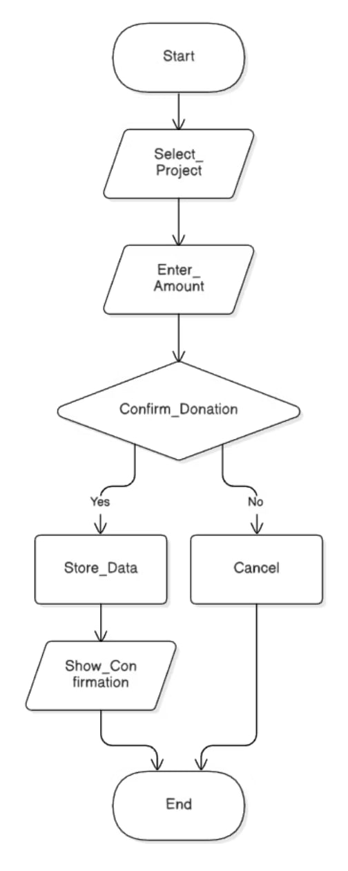
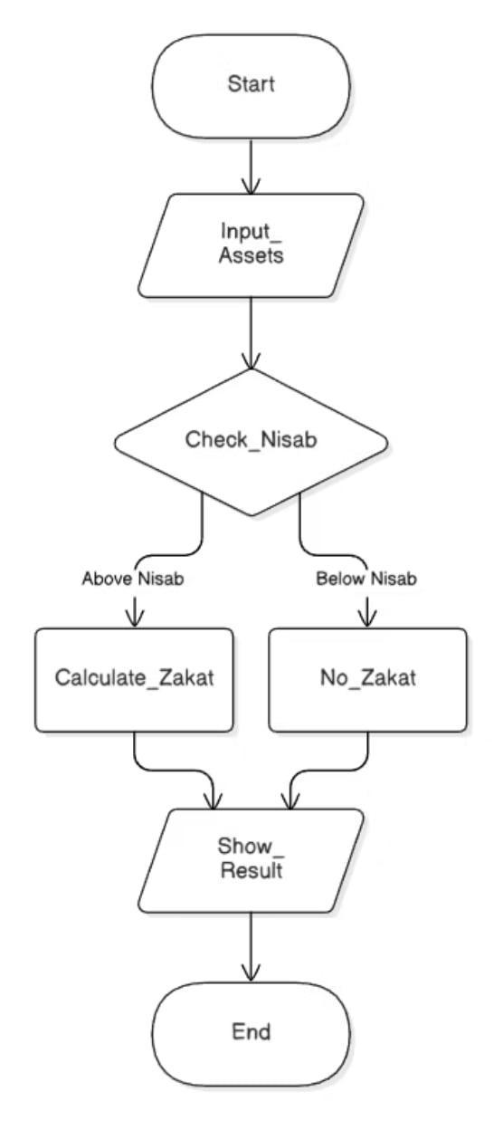
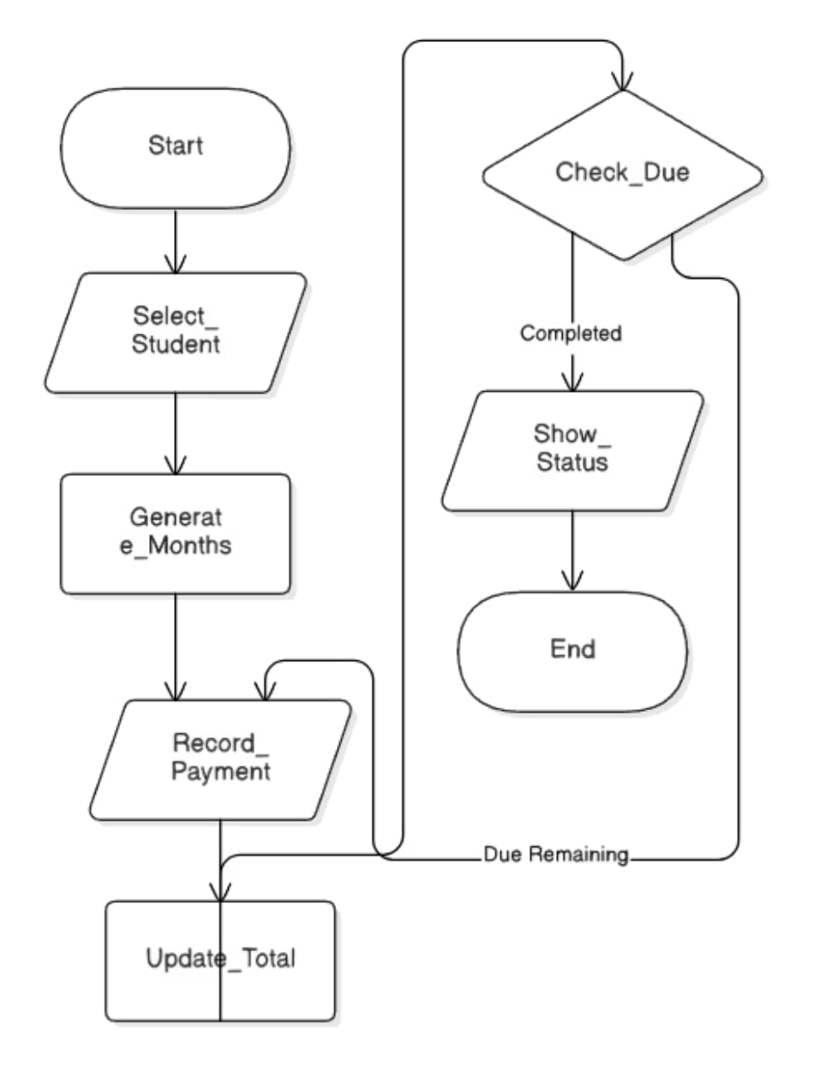
Flow Chart
Donation Process
Zakat Calculation
Fee Management System

Slide 19
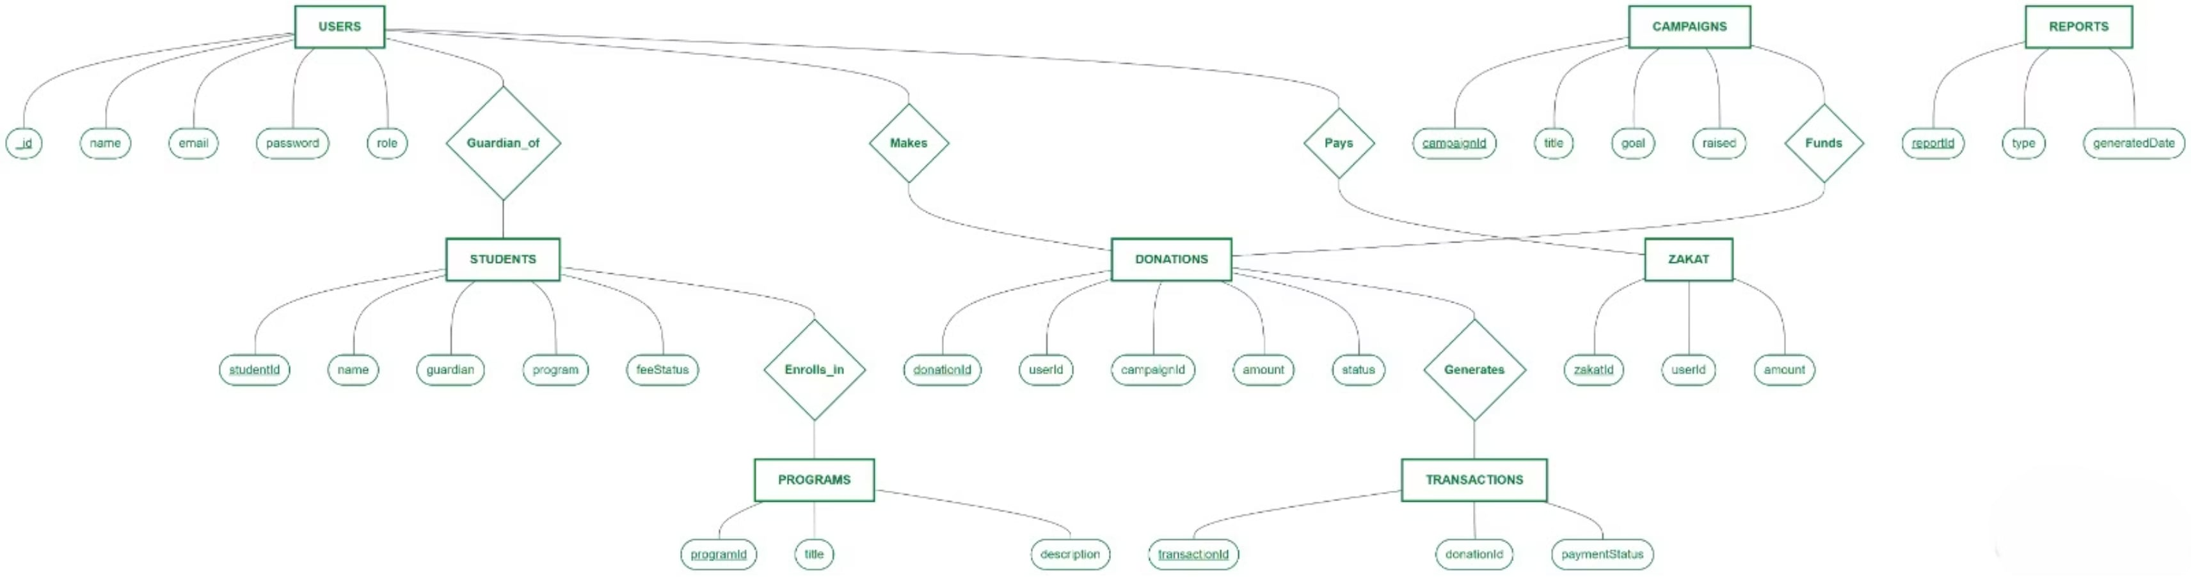
ER-Diagram

Slide 20
Payment Integration
Mobile Financial Services
Integration with bKash, Nagad, and Rocket for Bangladesh donors
Online Banking
Direct bank transfers through commercial banking services
Card Payments
Debit and credit cards for international donors

Slide 21
Future Work & Enhancements
Mobile Apps
Real Time Notification
QR Code Donation

Slide 22
Conclusion
Our system is more than just a digital platform; it is a modern solution designed to ensure speed and transparency. Through this project, we have prioritized time efficiency and accurate data management. Moving forward, the integration of a mobile application and an Emergency QR Code will take our service to the next level. We believe this project will eliminate current complexities and create a lasting, sustainable impact.

Slide 23
Thank You!
Thank You for your Kind Attention.
We would be pleased to answer any questions or receive your feedback.
Questions & Discussion

