Slide 1
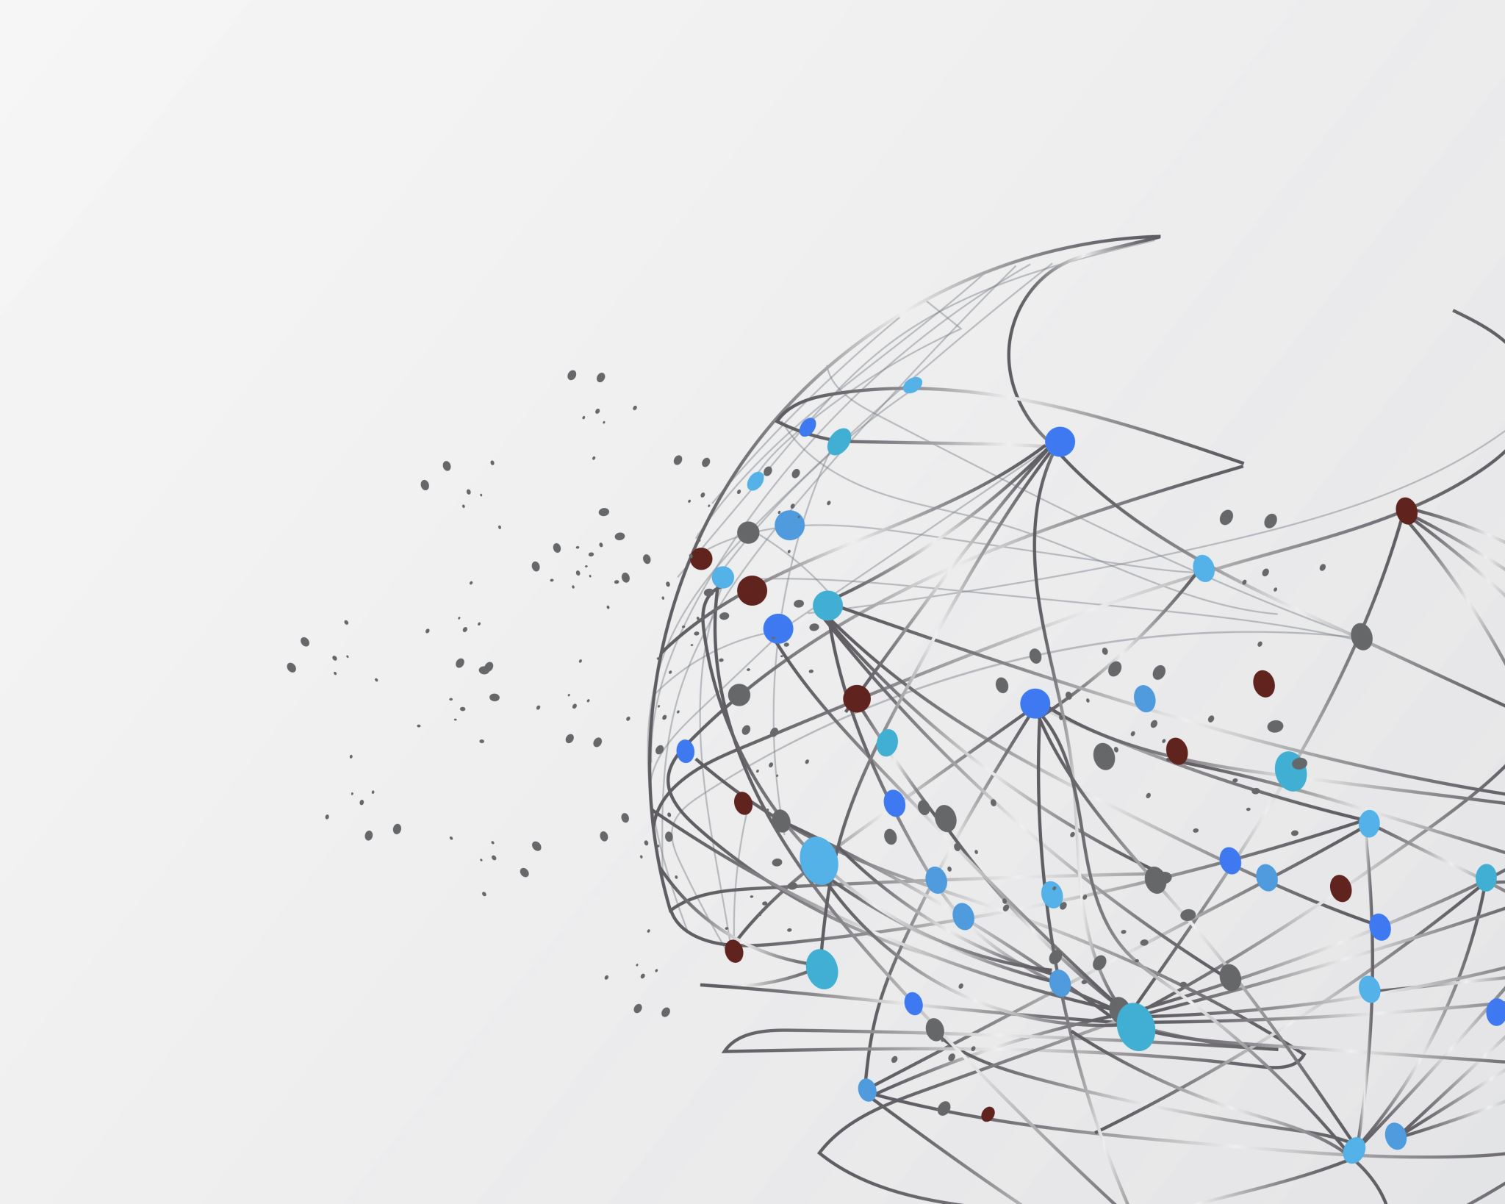
Analysis of Leukemia
Group 2
Alok Madamanchi
Kashika Tyagi
Md Tajrianul Islam
Sandeep Karapa Srivatsav
Spurthi Patnam
Sweta Mankala

Slide 2
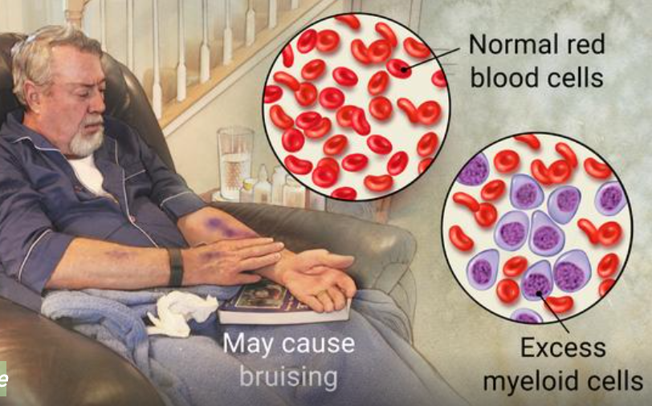
Leukemia
Leukemia is a cancer of the body's blood-forming tissues, including the bone marrow and the lymphatic system. It usually involves white blood cells.
Symptoms
Fever or chills
Persistent fatigue, weakness
Frequent or severe infections
Losing weight without trying
Swollen lymph nodes, enlarged liver or spleen
Easy bleeding or bruising
Recurrent nosebleeds
Tiny red spots in your skin (petechiae)
Excessive sweating, especially at night
Bone pain or tenderness

Slide 3
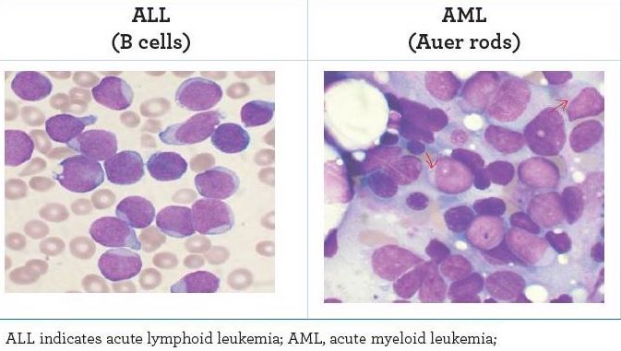
Leukemia, Myeloid, Acute
Leukemia is diagnosed 10 times more often in adults than children
60,300 people are expected to be diagnosed with leukemia this year
Over 382,000 people are living with leukemia, or are in remission
Every day 170 Americans are diagnosed with leukemia and 67 lose the fight

Slide 4

Dataset Overview
For our analysis, we extracted the data from ChEMBL database:
Filtered the data based on "Leukemia" and "Leukemia, Myeloid, Acute" Indication.
Browsed and extracted the data on Mechanism level.
The final dataset consists of 410 rows and 25 variables or columns
The data type of all the 25 variables is "object".

Slide 5
Variable Definitions
Column Name​ | Data Type​ | Description​
CHEMBL_ID​ | VARCHAR​ | ChEMBLidentifier​
Target_Name​ | VARCHAR​ | Target Name​
Action Type​ | VARCHAR​ | Type of action of the drug​
Target Type​ | VARCHAR​ | Type of the target​
Target Organism​ | VARCHAR​ | Source organism of molecular target or tissue​
Mechanism of Action​ | VARCHAR​ | Description of the mechanism of action​
First Approval​ | NUMBER​ | The FDA approval date for the product​
Max Phase​ | NUMBER​ | Maximum phase of development reached for thecompound​
Parent Molecule Name​ | VARCHAR​ | Name of the Parent Molecule​
Parent MoleculeType​ | VARCHAR​ | Type of the Parent Molecule​

Slide 6
Target Type Distribution
It is evident from the Target Type distribution graph that "Single Protein" target has the highest distribution which is clearly our focus area.

Slide 7
Target Type Distribution in Homo Sapiens
In ‘Homo Sapiens’ where the parent molecule type is small molecule, we observe that the ‘Single Protein’ target type is the predominant one and it will be considered for further analysis.

Slide 8
Target Type Distribution by Maximum Phase of development
From the chart we infer that the target type ‘Single Protein’ is the one which has highest targets in Phase 3 & Phase 4 for target organism Homo Sapiens.

Slide 9
Target Type Distribution by Maximum Phase of development and unique ChEMBL IDs
The Target Type ‘Single Protein’ has the highest targets in phase 4 when distinct ChEMBL IDs are considered.

Slide 10
Maximum Phase of Indication by Action Type
‘Inhibitor’ is the leading Action Type which has highest targets in maximum Phase 4 of developing a compound in small molecules.

Slide 11
Maximum Phase of Indication by Action Type in Single Protein Targets
‘Inhibitor’ action type has the highest number of targets in maximum phase 4 of developing a compound in Single Protein Targets as well.

Slide 12
Target Distribution by top ten highest Parent Molecules
This chart represents the top ten highest Parent Molecules targets by small molecules and single protein targets.

Slide 13
Maximum Phase of Indication of Targets by Parent Molecules
This chart represents the maximum phase of top ten parent molecules with ‘REGORAFENIB’ having the highest targets in maximum phase of indication 4.

Slide 14
Target Distribution by top ten highest Mechanism of Action
This chart represents the top ten highest mechanism of action in small molecules and single protein target type.

Slide 15
Target Distribution by top ten highest Mechanism of Action of top ten parent molecule targets
This chart represents the highest mechanism of action in small molecules and single protein target type of top ten parent molecule targets.

Slide 16
Targets by top ten Parent Molecules and Mechanism of Action
This chart represents the top seven targets chosen by single protein target type, small molecules and highest mechanism of action.

Slide 17
Maximum phase of Targets by top ten Parent Molecules and Mechanism of Action
This charts represents the maximum phase of indication for the chosen Targets.

Slide 18
Final Target Names for Target Centric Analysis
These five targets are the chosen Target names for further target centric analysis for the disease Leukemia narrowed down by filtering the targets by highest mechanism of action, top parent molecule names of small molecules and single protein types.

Slide 19

Thank you

